Slide 1
PROJECT 3 - Cloud DevOps Engineer
Duy nguyen anh

Slide 2
URLS
Github: https://github.com/nganhduy/cdond-c3-projectstarter
S3 URL: http://udapeople-b8a075b.s3.amazonaws.com/index.html#/employees

Slide 3
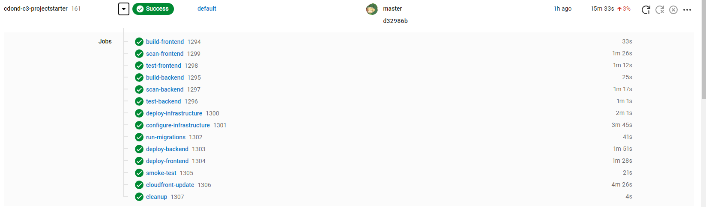
CircleCI Pipeline
CircleCI builds successfully

Slide 4
AWS Console
3 CloudFormation stacks were created.
1 S3 Bucket was created.
2 EC2 instances were created
1 RDS database was created.

Slide 5
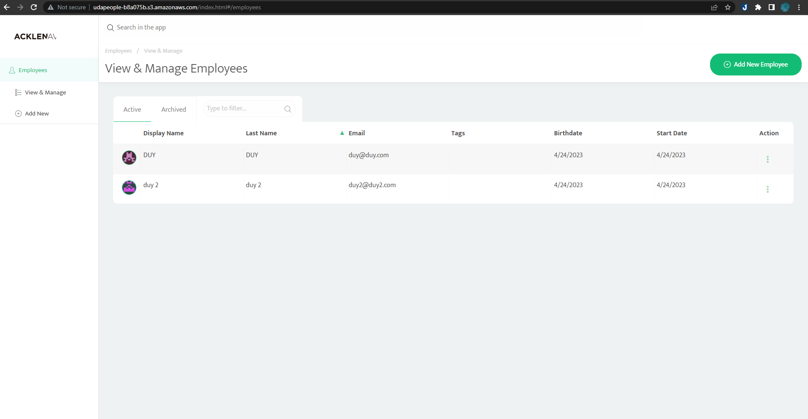
Website UI:

Slide 6
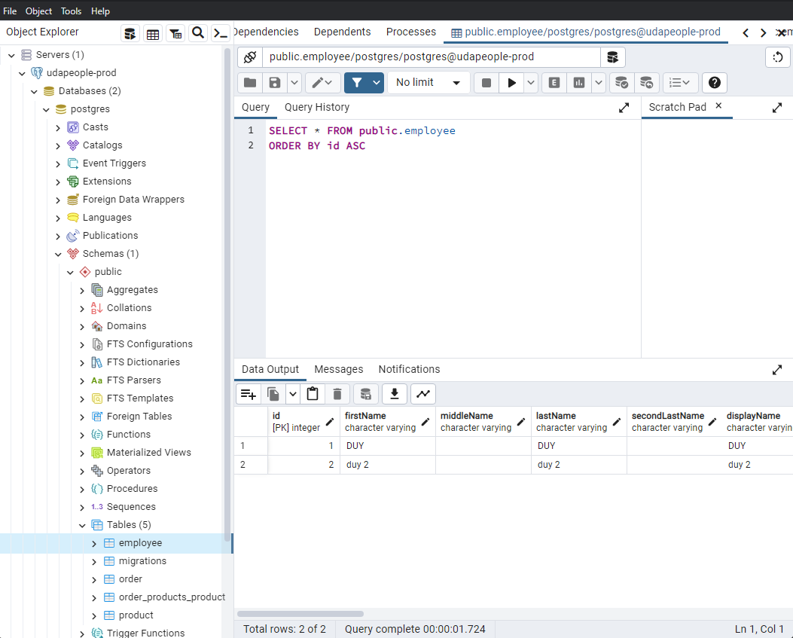
Database

