Slide 1
PROJECT 3 - Cloud DevOps Engineer
Duy nguyen anh

Slide 2
URLS
Github: https://github.com/nganhduy/cdond-c3-projectstarter
S3 URL: http://udapeople-b8a075b.s3.amazonaws.com/index.html#/employees

Slide 3
WHAT IS CI/CD?

Slide 4
CI/CD
Continuous integration (CI) is a software development process where teams integrate code early and often into a central repository where they can run frequent tests and validate changes.
CI reduces the amount of time spent on bug fixes and regression testing and ensures that everyone has a deep understanding of what’s happening inside the codebase and what features they’re developing for end-users.
Continuous Delivery (CD) is the practice of getting all updates, fixes, features, and configuration changes either into production or into the hands of end-users as quickly (and safely) as possible.
CD aims to ensure that the code is always in a deployable state, even with developers making continuous updates to the codebase by bringing integration and testing together.

Slide 5
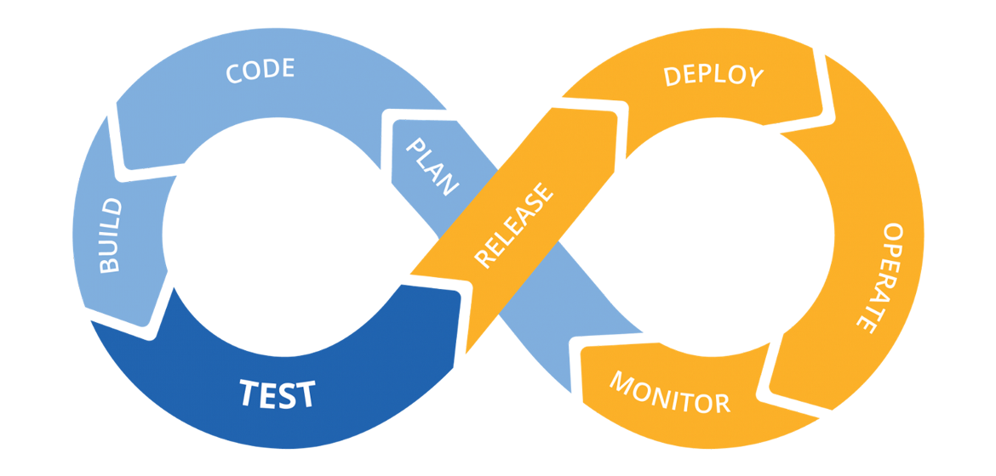
CI/CD Phases
The CI/CD pipeline typically breaks down into the following stages:
Build
Test
Release
Deploy
Validate

Slide 6
What are the benefits of CI/CD?
Bring Products to Market Faster
Allows Developers to Deliver Products Consumers Want Now.
CI/CD enables organizations to respond to consumer needs as they evolve.
CI/CD plays a crucial role in shortening time to value.
CI/CD supports customer outcomes from a technical standpoint.
CI/CD pipelines enable a much shorter time to market for new product features, creating happier customers and lowering strain on development.
The great increase in overall speed of delivery enabled by CI/CD pipelines improves an organization’s competitive edge.
Automation frees team members to focus on what they do best, yielding the best end products.
Organizations with a successful CI/CD pipeline can attract great talent. By moving away from traditional waterfall methods, engineers and developers are no longer bogged down with repetitive activities that are often highly dependent on the completion of other tasks.

Slide 7
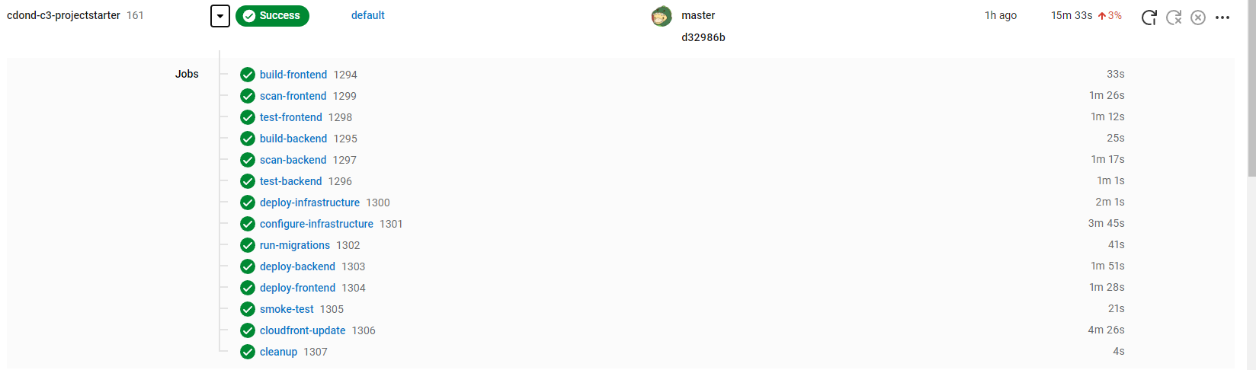
CircleCI Pipeline
CircleCI builds successfully

Slide 8
AWS Console
3 CloudFormation stacks were created.
1 S3 Bucket was created.
2 EC2 instances were created
1 RDS database was created.

Slide 9
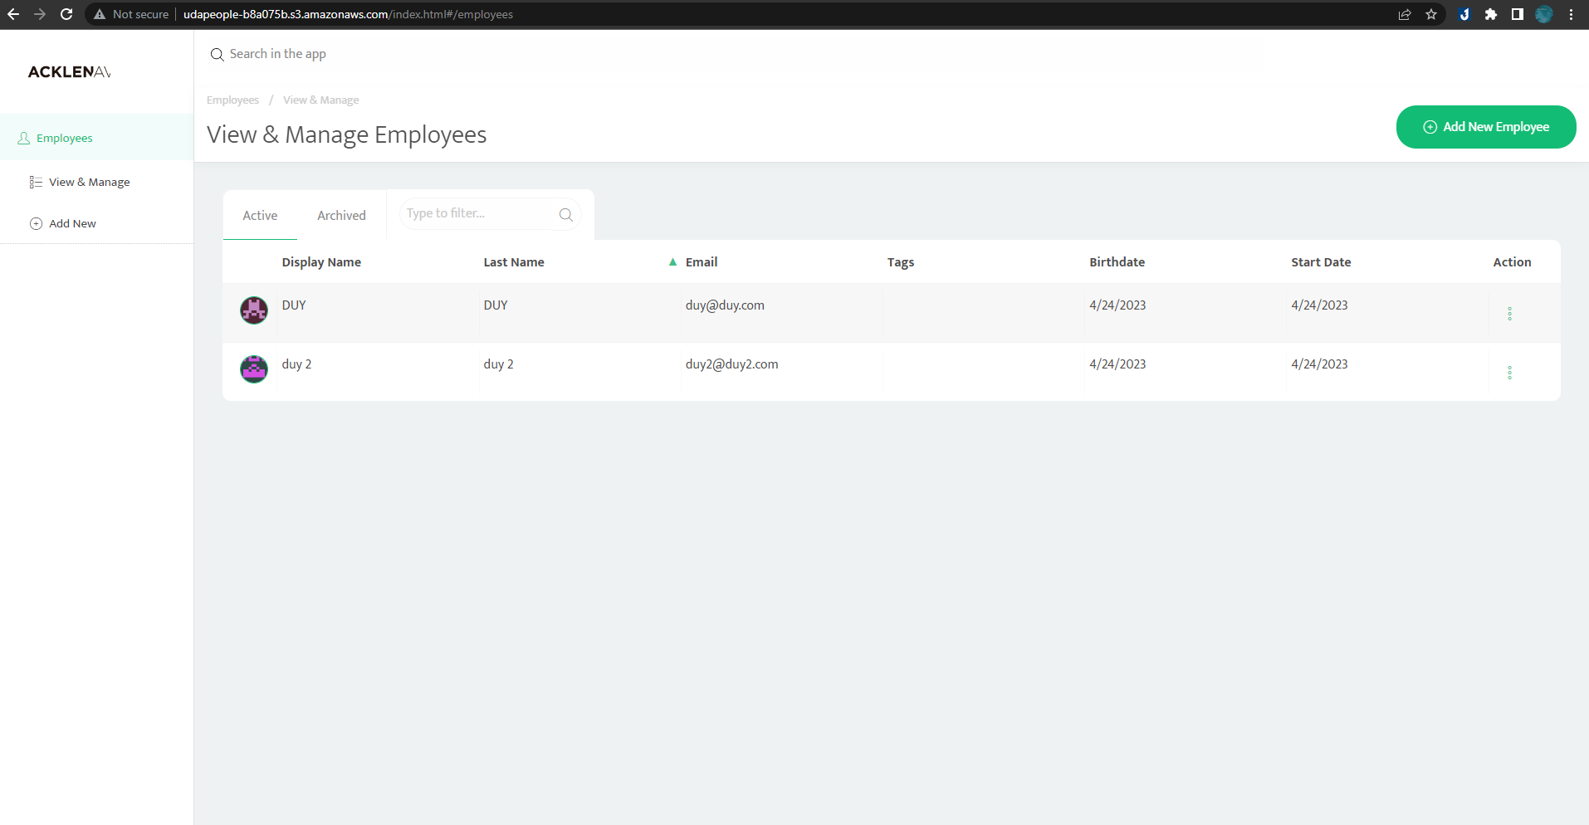
Website UI:

Slide 10
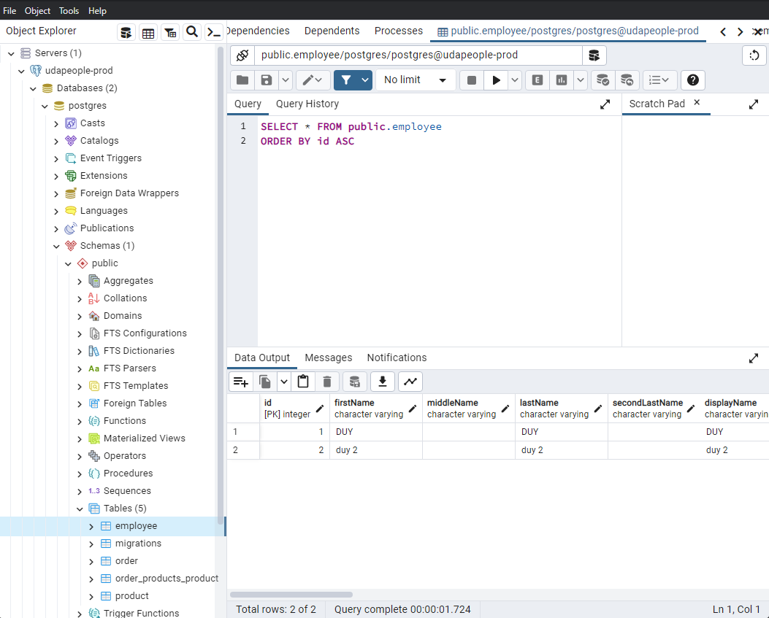
Database

