Slide 1
PROJECT 3 - Cloud DevOps Engineer
Duy nguyen anh

Slide 2
URLS
Github: https://github.com/nganhduy/cdond-c3-projectstarter
S3 URL: http://udapeople-b8a075b.s3.amazonaws.com/index.html#/employees

Slide 3
WHAT IS CI/CD?

Slide 4
CI/CD
Continuous integration (CI) is a software development process where teams integrate code early and often into a central repository where they can run frequent tests and validate changes.
CI reduces the amount of time spent on bug fixes and regression testing and ensures that everyone has a deep understanding of what’s happening inside the codebase and what features they’re developing for end-users.
Continuous Delivery (CD) is the practice of getting all updates, fixes, features, and configuration changes either into production or into the hands of end-users as quickly (and safely) as possible.
CD aims to ensure that the code is always in a deployable state, even with developers making continuous updates to the codebase by bringing integration and testing together.

Slide 5
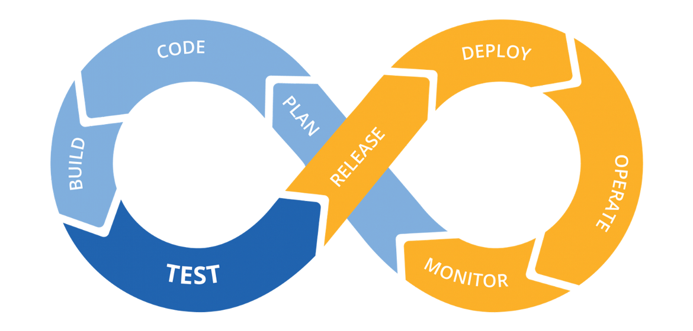
CI/CD Phases
The CI/CD pipeline typically breaks down into the following stages:
Build
Test
Release
Deploy
Validate

Slide 6
What are the benefits of CI/CD?
Bring Products to Market Faster
Allows Developers to Deliver Products Consumers Want Now.
CI/CD enables organizations to respond to consumer needs as they evolve.
CI/CD plays a crucial role in shortening time to value.
CI/CD supports customer outcomes from a technical standpoint.
Boosts DevOps efficiency
CI/CD Improves App Quality
Supports Cloud-Based App Development
Reduce Costs and Boost Profits
Gain Real-Time Visibility of the Development Process

Slide 7
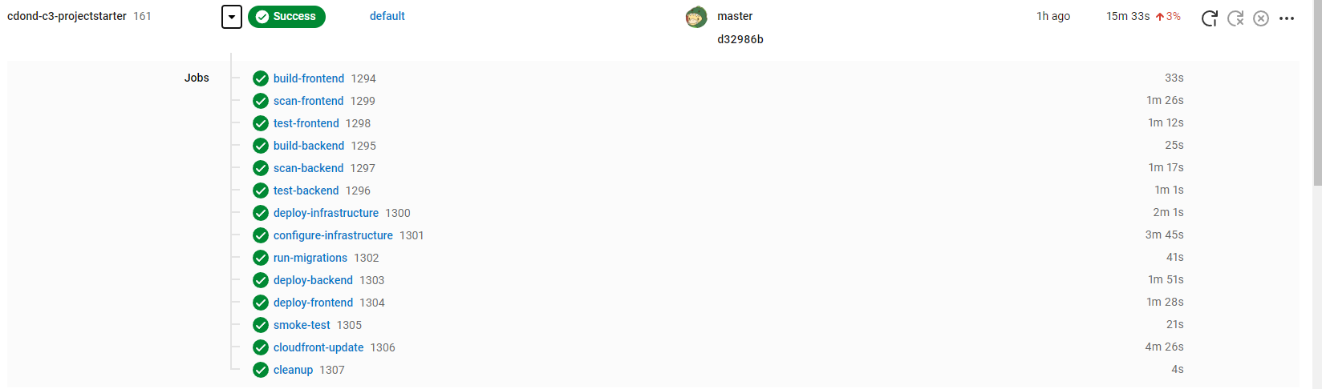
CircleCI Pipeline
CircleCI builds successfully

Slide 8
AWS Console
3 CloudFormation stacks were created.
1 S3 Bucket was created.
2 EC2 instances were created
1 RDS database was created.

Slide 9
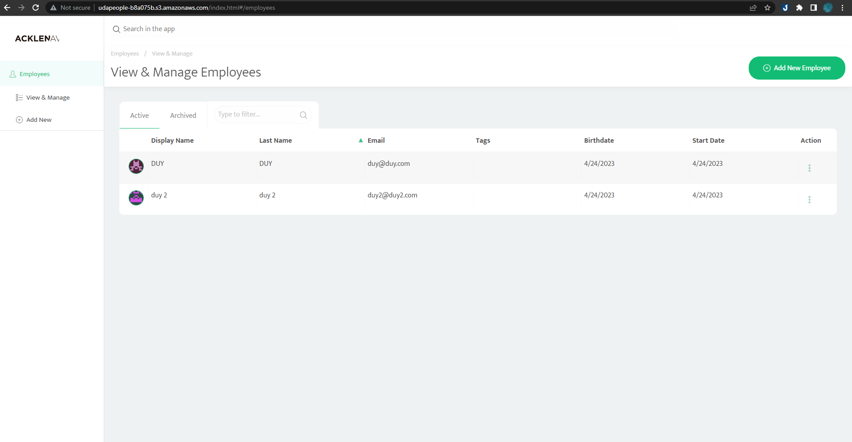
Website UI:

Slide 10
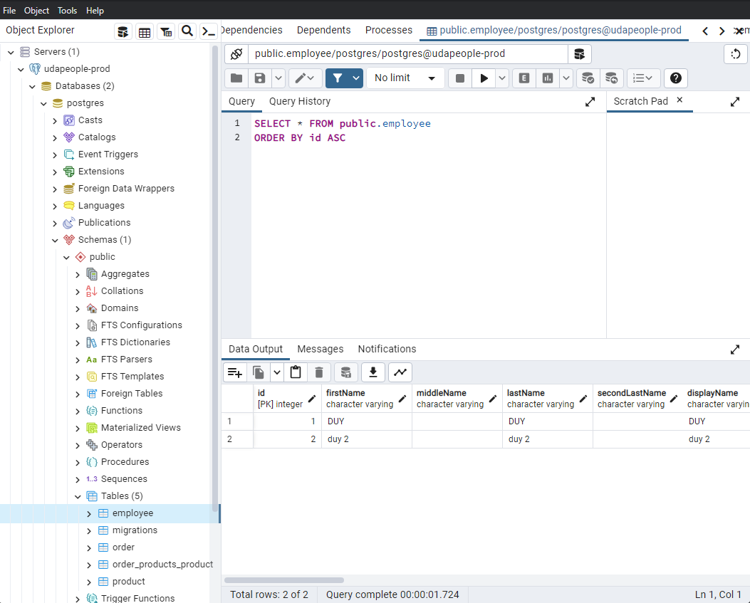
Database

