Slide 1

R
redis
cognee
AI-MEMORY HACKATHON · SAN FRANCISCO
Build the LLM Wiki Your Agents Actually Remember
"Instead of just retrieving from raw documents at query time, the LLM incrementally builds and maintains a persistent wiki" — Karpathy
Technology Partner: redis.io · github.com/redis-developer/redis-ai-resources

Slide 2
R
Redis 101
The world's fastest in-memory data platform, built for AI.
<1ms
62%
10+
1
typical read/write latency
faster than the #2 vector DB
data types (strings, hashes, vectors & more)
pip install away
What Redis does for your AI stack:
Vector Search
Semantic Caching
Agent Memory
Session State
Semantic Router
Full-Text Search
Redis is NOT just a cache. It's a full-featured database: run vector similarity search, full-text search, pub/sub, streams, geospatial, time series — all in one.
Redis

Slide 3
Search in Redis
powered by RedisVL — the Python vector library for Redis
pip install redisvl
Vector Search
Hybrid Search
Dedicated Python client for Redis as a vector DB
KNN & range queries over dense embeddings
Combine vector + full-text (BM25) in one query
Built-in support for HNSW & FLAT index algorithms
Automatic embedding generation
Semantic caching to cut LLM costs
Semantic Cache
Semantic Router
Reranking, hybrid search, and routing out-of-the-box
Skip re-calling the LLM for similar prompts
Route user intent to correct tool/agent
Fully async — non-blocking in agent pipelines
github.com/redis-developer/redis-ai-resources — dozens of code examples
Redis

Slide 4
Vector Search in 10 Lines
RedisVL — index creation, embedding + search
from redisvl.index import SearchIndex
from redisvl.query import VectorQuery
from redisvl.utils.vectorize import OpenAITextVectorizer
# 1. Define your schema
schema = {
"index": {"name": "docs", "prefix": "doc"},
"fields": [
{"name": "content", "type": "text"},
{"name": "embedding", "type": "vector",
"attrs": {"dims": 1536, "algorithm": "hnsw",
"distance_metric": "cosine"}}
]
}
# 2. Create index & load data
index = SearchIndex.from_dict(schema)
index.connect("redis://localhost:6379")
index.create(overwrite=True)
# 3. Vectorize & search
vectorizer = OpenAITextVectorizer()
query_vec = vectorizer.embed("What is Redis?")
results = index.query(
VectorQuery(query_vec, "embedding", num_results=5)
)
What you get
HNSW indexing
Sub-millisecond ANN at hundreds of millions of vectors
Hybrid queries
Mix vector KNN with full-text or numeric filters
Async native
Non-blocking in FastAPI / async agents
Auto-sync
Index updates on write — no reindex needed
Redis

Slide 5
Cognee + Redis
Plug Redis in as Cognee's vector memory backend — one import away
User Input
Cognee Agent
Redis Vector Store
LLM / Response
store / retrieve memories
import cognee
from cognee.infrastructure.databases.vector \
import get_vectordb_config
# Point Cognee at Redis as vector backend
config = get_vectordb_config()
config.vector_db_provider = "redis"
config.vector_db_url = "redis://localhost:6379"
# Now use Cognee normally — Redis handles the memory
await cognee.add(documents)
await cognee.cognify() # builds the knowledge graph
results = await cognee.search("What did we discuss?")
Why Redis for Cognee memory?
Persistent memory across agent runs
Sub-ms similarity search at scale
Semantic deduplication built-in
Works with any embedding model
Free cloud tier — no infra setup
Redis

Slide 6
IRIS
by Redis
Something big is coming.
Redis Iris — an intelligent layer that brings native AI reasoning to your Redis data. Launching this Monday.
Stay tuned — Monday launch
Redis

Slide 7




Scale your startup faster
Free Redis for qualifying startups
Access to Redis support
Build your brand and go to market
Angel, Pre-seed, and Seed stage startups can take advantage of exclusive benefits to help your business build fast apps and scale earlier.
$25k Redis Cloud credit for 6 months— usage limits apply
Early access to new Redis features and products
This program offers everything growing businesses need to build fast apps fast.
To qualify, you must be a venture-backed, seed or below startup.
Partner with our experts, mentors, and fellow startups to design apps that succeed at scale, perform seamlessly, and more.
Dedicated customer support, including monthly office hours and a basic support plan
Learn from our industry-leading applied AI team
Use our network of customers, partners, and industry connections to grow your go-to-market strategy.
Access co-marketing opportunities and lead generation programs
Meet potential investors and customers
Redis Startup Program
For more information: redis.io/startups

Slide 8
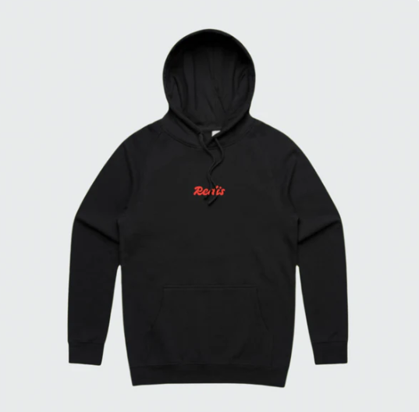
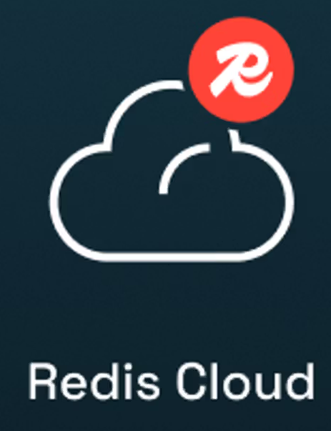
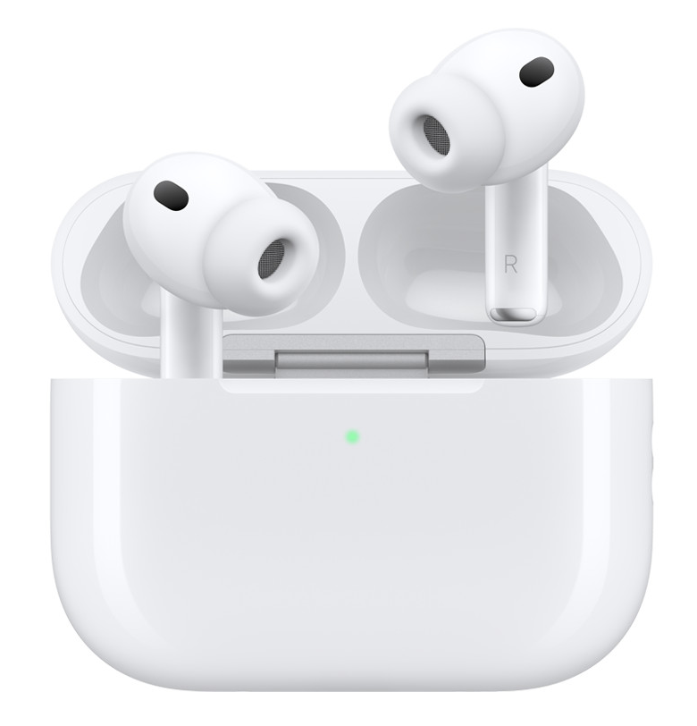
Win the Best Use of Redis Prize
Use Redis Cloud, RedisVL, or the Cognee Redis Adapter in your hack
AirPods Pro
Redis Hoodies
10K Redis Cloud Credits
(one per team member)
(one per team member)
(for the team)
To qualify:
Use Redis Cloud, RedisVL, or the Cognee Redis Vector Adapter (demonstrated in demo + GitHub)
Build something new today — no plagiarism
Strong preference for interesting Redis use beyond basic caching
redis.io/login → Free cloud DB · github.com/redis-developer/redis-ai-resources · redis.io/agent-skills · cognee Redis Vector Adapter docs

Slide 9




AI Resources
Redis VL
Redis Cognee Adapter
Redis Agent Skill Repo

