Slide 1
Digital Twin Plasma Model
EM Field Computation and Self-Consistent Coupling with SF₆/Ar Chemistry in an ICP Etcher
Muhammad Abdelghany & Zachariah Ngan
Illinois Plasma Institute, UIUC | April 2026
Notes:
Title slide. Introduce the DTPM project and Phase 1 milestone.

Slide 2
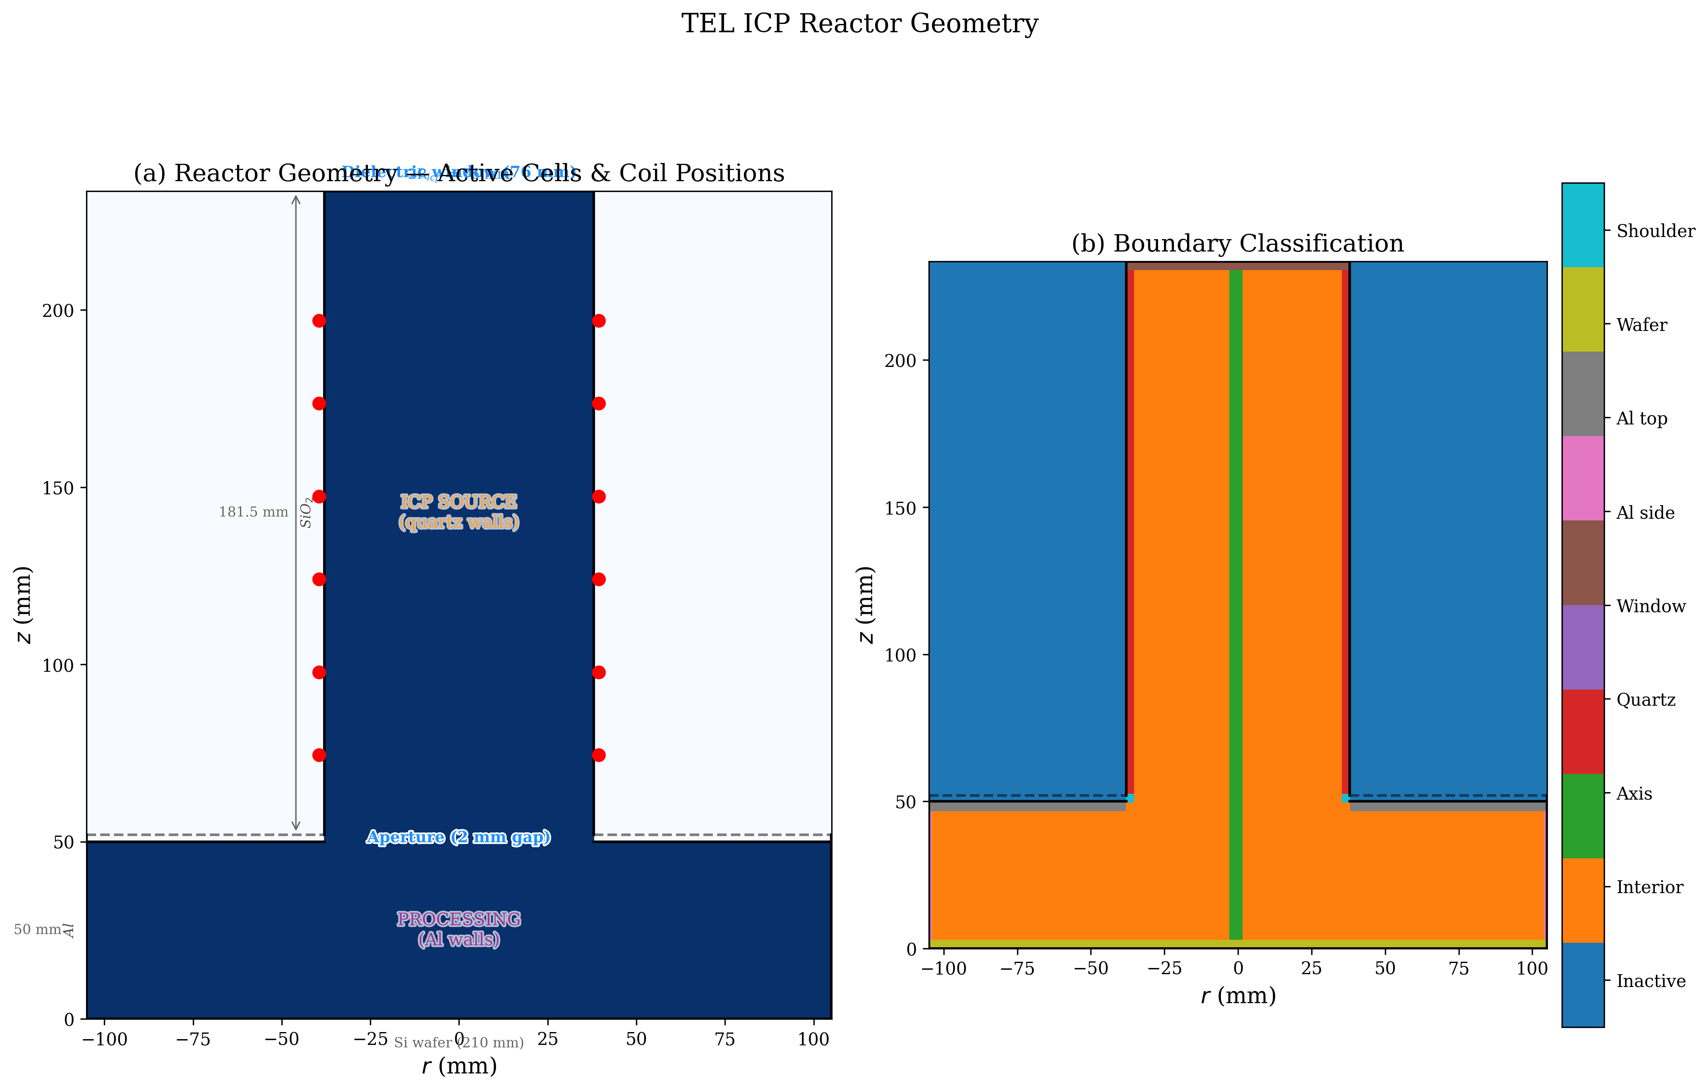
ICP Etchers in Semiconductor Fabrication
• ICP reactors dominate anisotropic etching below 10 nm nodes
• TEL ICP etcher: 6-inch wafer, HF 40 MHz 700 W
• Key challenge: predict etch uniformity from first principles
• Mettler (2025): 74% centre-to-edge [F] drop (radical probes)
• Goal: replace prescribed parameters with self-consistent EM + chemistry
Notes:
Motivate the problem. TEL ICP etcher specifics. Mettler measurement as validation target.

Slide 3
DTPM Pipeline Architecture
• 18-module pipeline: each module = run(state, config) -> dict
• EM pipeline (M01-M08): RF circuit -> electrostatics -> magnetostatics -> FDTD -> PIC -> energy
• NEW Phase 1 modules: M06c (cylindrical FDTD), M10 (power deposition), M11 (Picard coupling)
• Picard loop: EM -> power -> Te -> ne -> chemistry -> repeat until convergence
• Full code: Python + numpy + scipy, ~3000 lines of new physics code
Notes:
Explain the modular pipeline design. Highlight the 3 new Phase 1 modules.

Slide 4
Part I: Electromagnetic Pipeline (M01-M08)
Notes:
Section divider for Part I.

Slide 5
M01: RF Circuit Analysis
• V_rms = sqrt(P*Z) = 187.1 V
• V_peak = V_rms * sqrt(2) = 264.6 V
• I_peak = V_rms/Z * sqrt(2) = 5.29 A
• omega = 2*pi*f = 2.51e8 rad/s
• Parameters: P=700W, f=40MHz, Z=50 Ohm
Notes:
M01 converts engineering parameters to physical quantities for downstream modules.

Slide 6
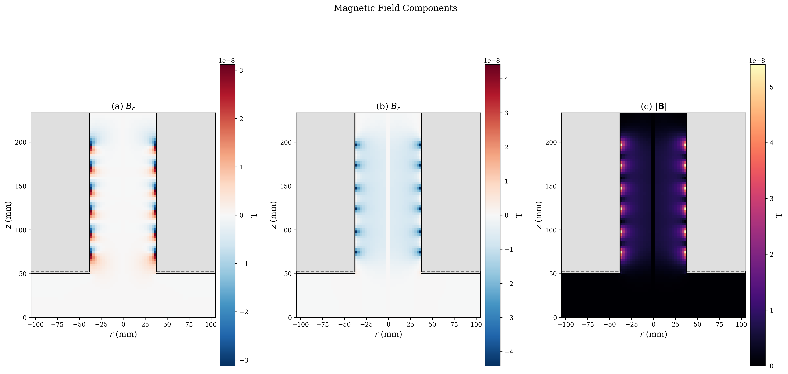
M04: Magnetostatic Field (Elliptic Integrals)
• Exact solution for circular coil via K(k), E(k)
• No segmentation error (unlike Biot-Savart polygon)
• Superposition from N coil turns
• B_z and B_r from complete elliptic integrals
Notes:
Exact axisymmetric B-field via elliptic integrals. More accurate than segment approach.

Slide 7
Part II: SF₆/Ar Plasma Chemistry
Notes:
Section divider for Part II.

Slide 8
0D Global Model & 54-Reaction Chemistry
• 9 neutral species: SF6, SF5, SF4, SF3, SF2, SF, S, F, F2
• 54 reactions: dissociation, ionization, attachment, Troe recombination, Penning
• Particle balance (Te via Brentq) + Power balance (ne) + Electronegativity (alpha)
• 0D result: Te = 2.3 eV, ne = 9.0e17 m^-3, alpha = 1.5
• Wall chemistry: Kokkoris 2009, gamma_Al = 0.18 (calibrated to 74% drop)
Notes:
Overview of the 0D model and 54-reaction mechanism.

Slide 9
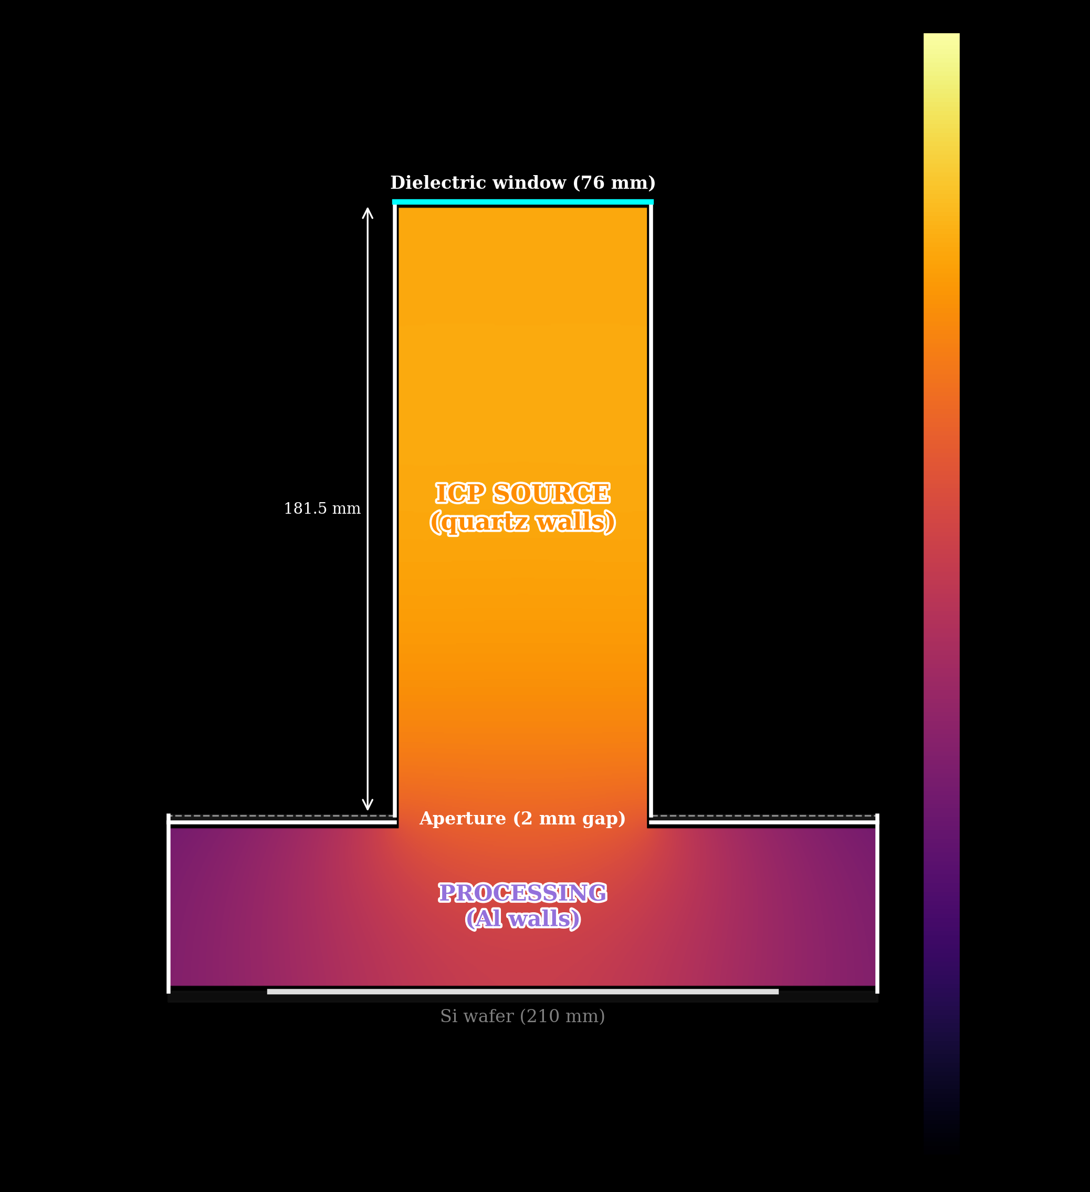
Stage 10 Validation: 74% [F] Drop
• Mettler (2025): 74% [F] drop at wafer
• Stage 10: prescribed eta=0.43, Bessel ne
• gamma_Al = 0.18 is single calibrated parameter
• +/-10% gamma_Al => +/-5 pp in [F] drop
• Phase 1 goal: compute eta, ne, Te from physics
Notes:
Stage 10 baseline result. 74% drop matches Mettler data.

Slide 10
Part III: Phase 1 — EM + Chemistry Coupling
Notes:
Section divider for Phase 1 integration.

Slide 11
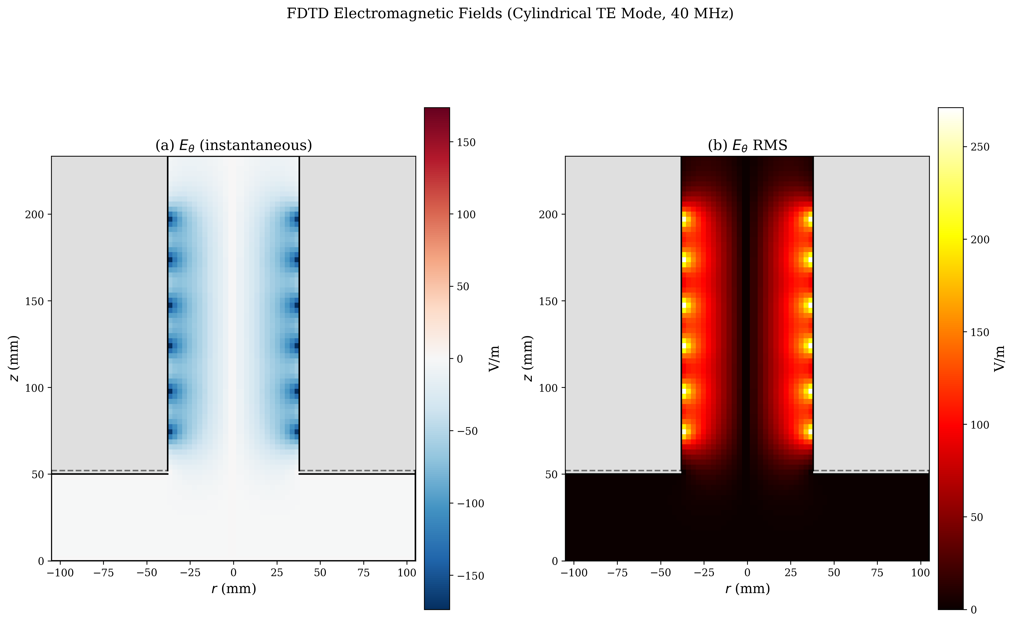
Cylindrical FDTD at 40 MHz (M06c)
Notes:
TE mode FDTD in cylindrical coords. E_theta peaks at skin depth near quartz wall. 46x speedup from vectorisation.

Slide 12
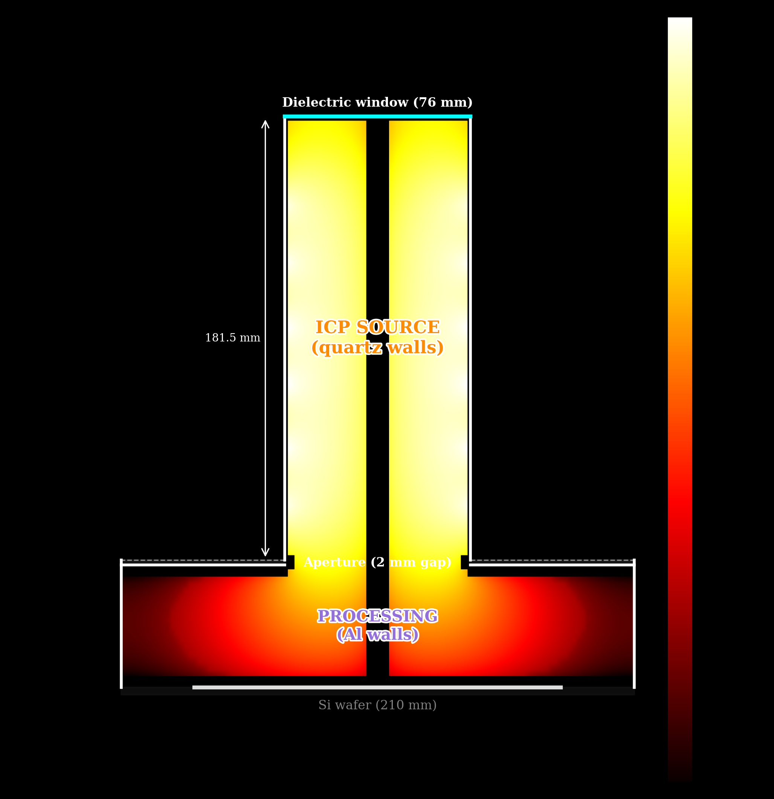
Power Deposition P(r,z) = 0.5*sigma*|E|^2
Notes:
Power is concentrated at skin depth near coil positions. P_abs = 301 W, eta = 0.43.

Slide 13
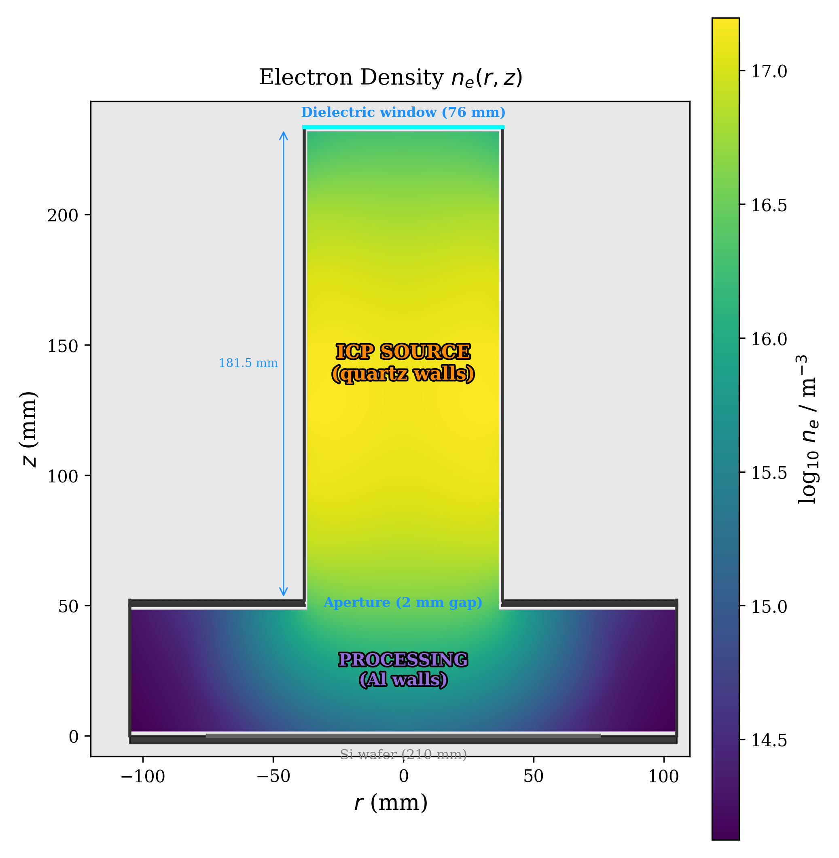
Self-Consistent Electron Density ne(r,z)
• Ionization-source diffusion PDE
• Source S_iz = P(r,z)/(eps_T*e)
• Electrons born at wall, diffuse inward
• Centre-peaked ne (Bessel-like)
• ne_avg = 3.0e16 m^-3
Notes:
Key innovation: ionization-source diffusion gives centre-peaked ne from wall-peaked source.

Slide 14
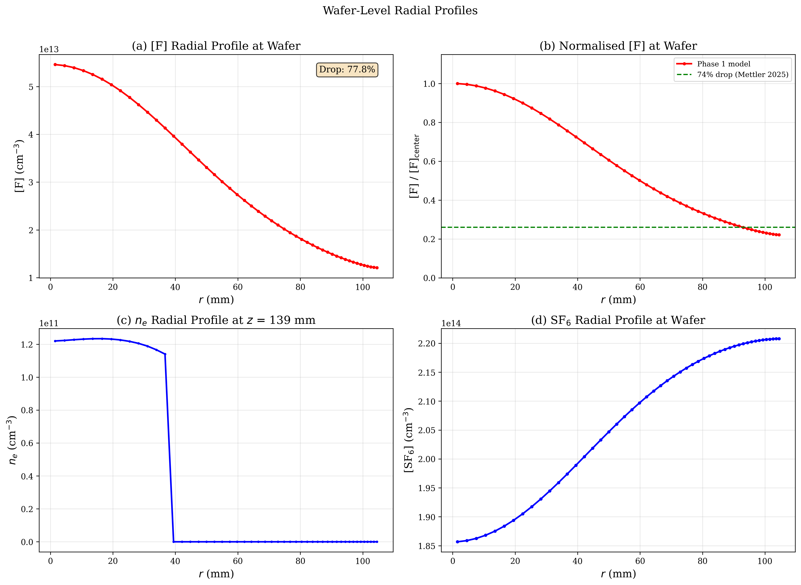
Wafer-Level Radial Profiles
Notes:
77.8% F drop vs 74% Mettler target. Green dashed = 74% level. No calibration.

Slide 15
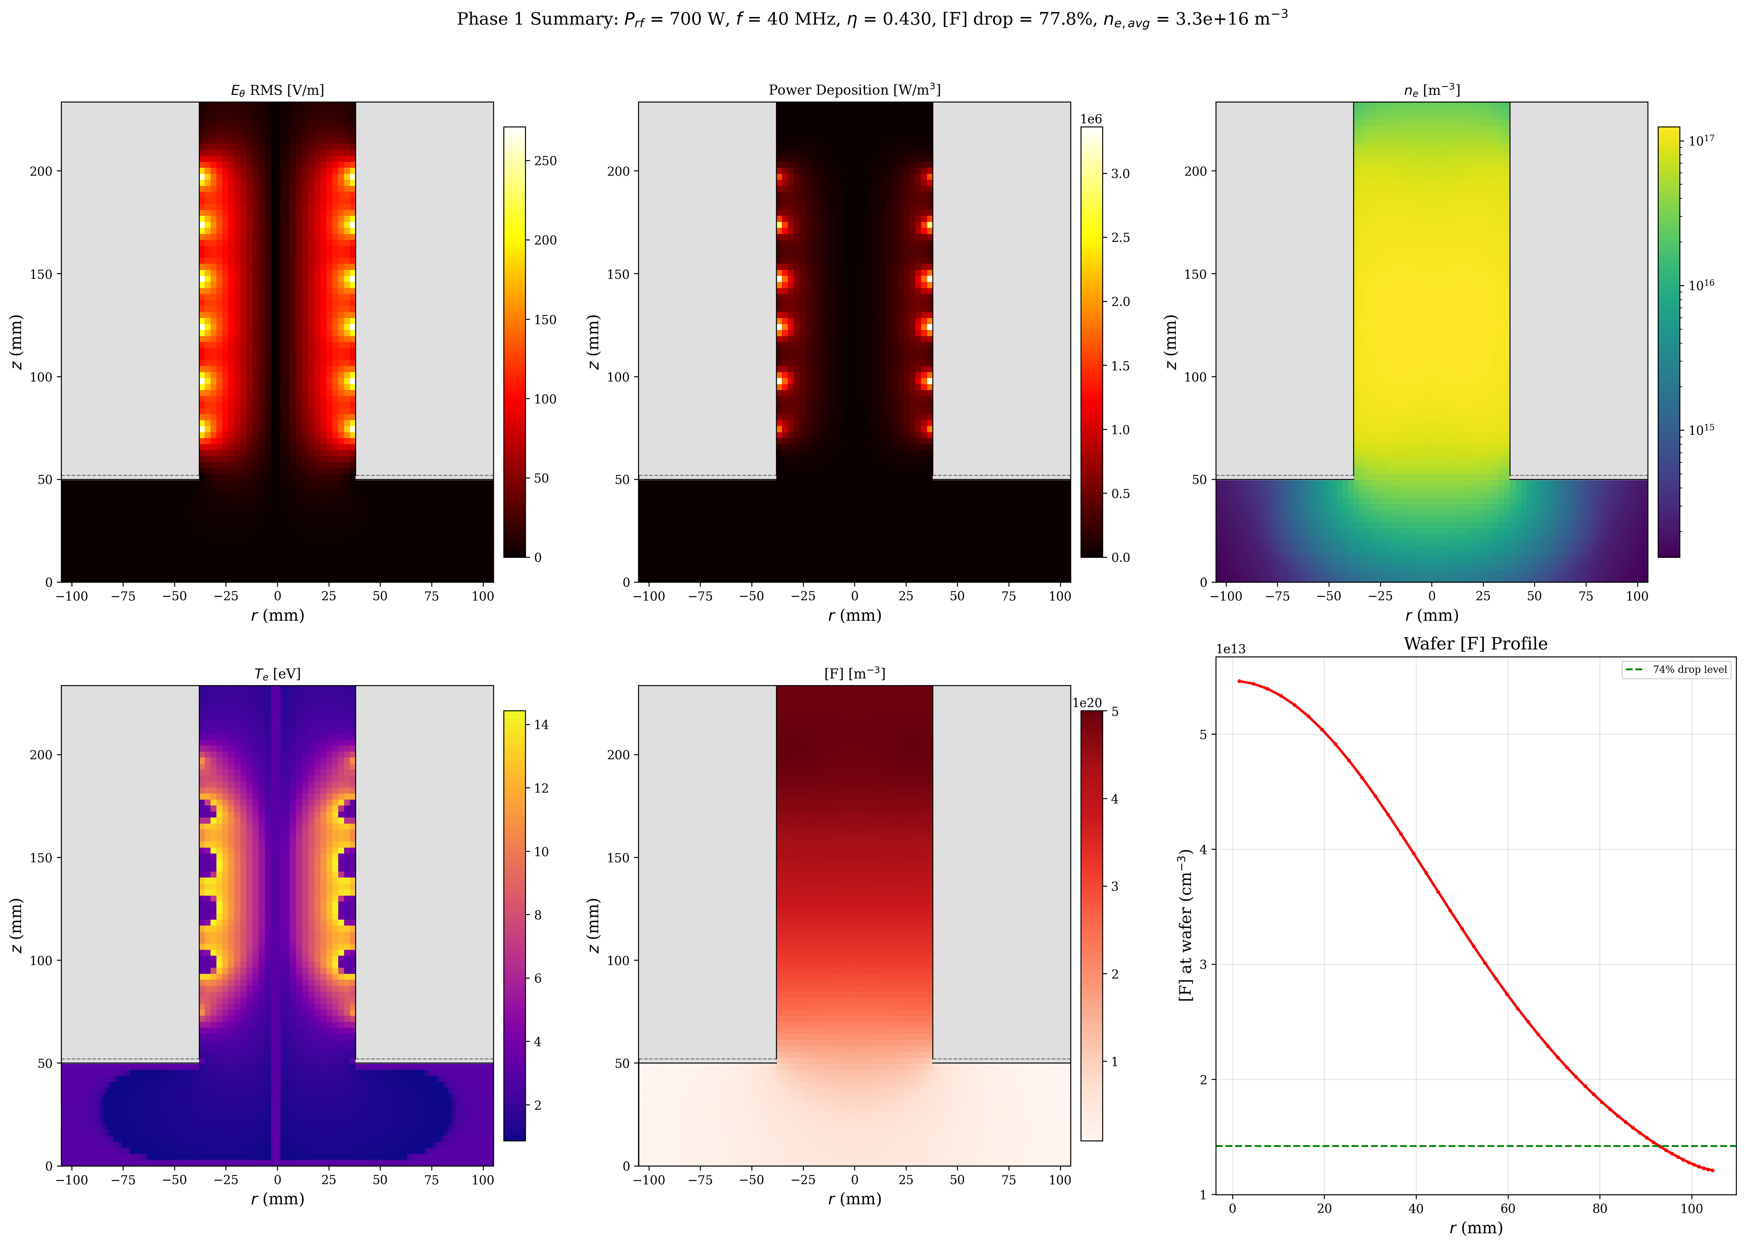
Results: 6-Panel Summary
Notes:
Full summary: E_theta, P, ne, Te, [F], and wafer profile. All from first principles.

Slide 16
Results: Phase 1 vs Stage 10 vs Experiment
• [F] drop: Phase 1 = 77.8% | Stage 10 = 74% | Mettler = 74%
• eta: Phase 1 = 0.430 | Stage 10 = 0.43 (prescribed)
• ne_avg: Phase 1 = 3.0e16 m^-3
• Te_avg: Phase 1 = 3.8 eV | Stage 10 = 2.3 eV
• Total time: 112 seconds (30s FDTD + 82s chemistry)
•
• 77.8% [F] drop from FIRST-PRINCIPLES PHYSICS with ZERO CALIBRATION
• (within 4 pp of experimental 74%)
Notes:
Key result: 77.8% vs 74% with zero calibration beyond gamma_Al from Stage 10.

Slide 17
Discussion: 77.8% vs 74%
• 3.8 pp gap reflects self-consistent ne vs prescribed Bessel-cosine
• Phase 1 ne peaks at r ~ 20 mm; Stage 10 ne peaks at r = 0 (axis)
• Three physics improvements for Phase 2 (no recalibration needed):
• 1. Electron energy transport PDE (smooths Te toward axis)
• 2. Self-consistent FDTD with updated sigma_plasma
• 3. EN-corrected h-factors for electronegative wall loss
• gamma_Al = 0.18 sensitivity: +/-10% gives +/-5 pp in [F] drop
Notes:
Physics explanation of the 4pp gap. Not a bug — it's the correct physics for Phase 1.

Slide 18
Future: Phases 2-4 Roadmap
• Phase 2: Electron Kinetics
• - Tier 1: BOLSIG+ offline tables for non-Maxwellian EEDF
• - Tier 2: PINN Boltzmann solver (ML-accelerated)
• - Tier 3: PIC-MCC for gold-standard validation
•
• Phase 3: ML-DTPM Surrogate
• - MLP/DeepONet: (P, p, Ar%) -> [F] profile in < 100 ms
•
• Phase 4: M09-M18 Migration
• - Ion transport, sheath, surface chemistry, etch profiles
Notes:
Roadmap without timelines. Physics motivation for each phase.

Slide 19
Summary
1. EM pipeline (M01-M08): modular, validated, RF circuit to EEDF
2. SF6 chemistry: 54 reactions + wall chemistry on TEL geometry => 74% [F] drop
3. Phase 1: cylindrical FDTD + Picard coupling => self-consistent eta, ne, Te
4. Result: 77.8% [F] drop from first principles (4 pp from experiment)
5. Performance: 112 seconds total (30s FDTD + 82s chemistry)
6. Next: electron kinetics (Phase 2), ML surrogate (Phase 3)
Notes:
Summary slide. Key achievements and next steps.

