Slide 1

E-Project
Web Designing

Slide 2

HCM City, 13th JANUARY 2020
FUN ZONE
Authors: | Aptech – C1903L - Group 4
Student1179217 | NGUYEN HOANG KHOI
Student1200756 | NGA NGUYEN TUYET
Student1155845 | HUY NGUYEN QUOC
Student1200836 | KHOA HUYNH NHAT
Centre Name: | Aprotrain Aptech
Date: | 13^{h} ,JANUARY 2020
Semester: | 1
Instructor:

Slide 3
Introduce the topic:
The ‘FUN ZONE’ Most Entertaining Theme Park, is one of the best ideas executed in the amusement & entertainment industry. It caters to everyone, be it a child who seeks entertainment or an adult who wishes for a pleasant evening. This initiative is aimed towards providing its visitors with ample elements to spend a quality day.
It promises fun and frolic packed with adventurous and elegant ambience. We design this website to introduce to our visitors recreational services and activities.

Slide 4
Sitemap:
The website includes two parts:
Visitor Site
Administrator Site

Slide 5
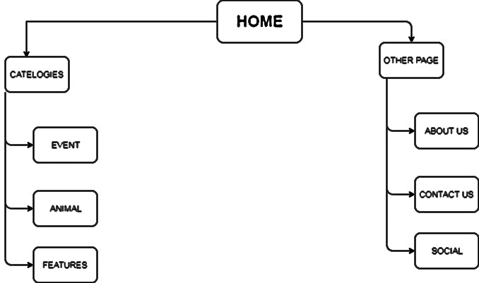
Sitemap for Customer Site

Slide 6
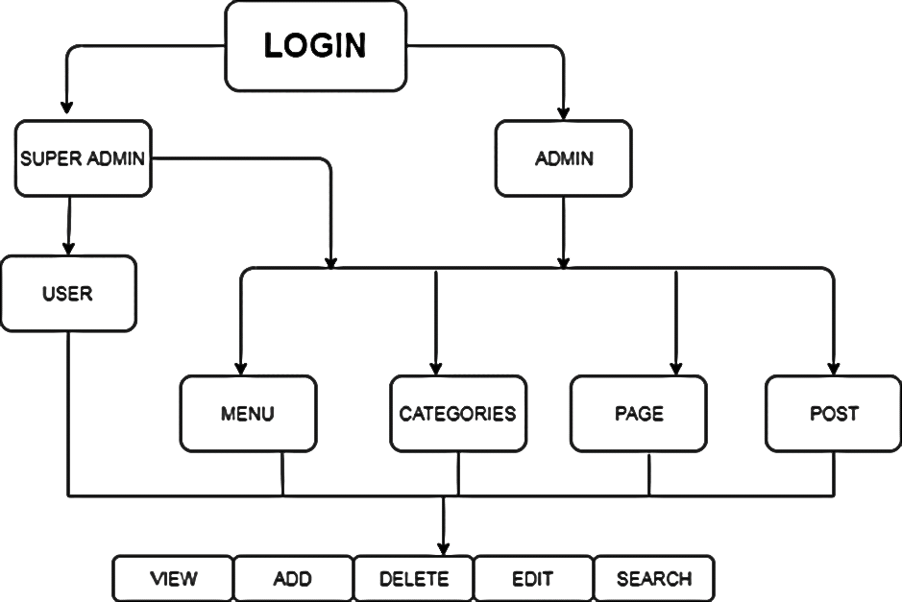
Sitemap for Admin Site

Slide 7
Purpose of website:
Website showcase entertaining information and easy to navigate and frequently updated in order to keep users coming back for more information for visitors. It can be made more engaging by using dynamic content, such as videos, podcasts, slideshows, etc.

