Slide 1
SME Credit Scorecard Development
SR&T Senior Consultant, Regulatory & Financial Risk: Risk Modelling
Lê Thị Kim Ngân | Candidate Technical Presentation
March 2026

Slide 2
Table of Contents
SME Credit Scorecard Development | Candidate Technical Presentation
I
Background & Data Overview
II
Exploratory Data Analysis (EDA)
III
Recommendation on Risk Component Weights
IV
Review of Formulated Scorecard
V
Scorecard Model Development
VI
Model Validation

Slide 3
Background & Data Overview
SME portfolio scorecard — expert-weighted system under review
Context
Feature Summary
Dataset
557 SME borrowers, 8 features, 9.0% default rate
Code
Feature
Type
IV
Expert Wt
Target
Default Flag (1 = default, 0 = performing)
C1
Debt Restructuring History
Cat
1.17
12.5%
Scorecard
Expert-weighted, C + F components, score per bin
C2
Debt Rescheduling History
Cat
0.57
12.5%
C Component
50% weight
C3
Worst CB Delinquency 2yr
Cat
5.43
25.0%
F Component
50% weight: F1–F5 financial ratios equally at 10% each
F1
Net Fixed Asset
Num
2.60
10.0%
Missing Data
C2: 282 NaN (51%), Net Fixed Asset: 26 (5%)
F2
Net Profit Margin (%)
Num
1.28
10.0%
F3
Sale Growth (%)
Num
0.04
10.0%
Sentinels
99999998/99999999
F4
Debt-to-Equity Ratio
Num
1.46
10.0%
Objective
Assess expert weights using quantitative analysis ; develop LR-based PD model
F5
Debt Service Coverage Ratio
Num
1.58
10.0%

Slide 4
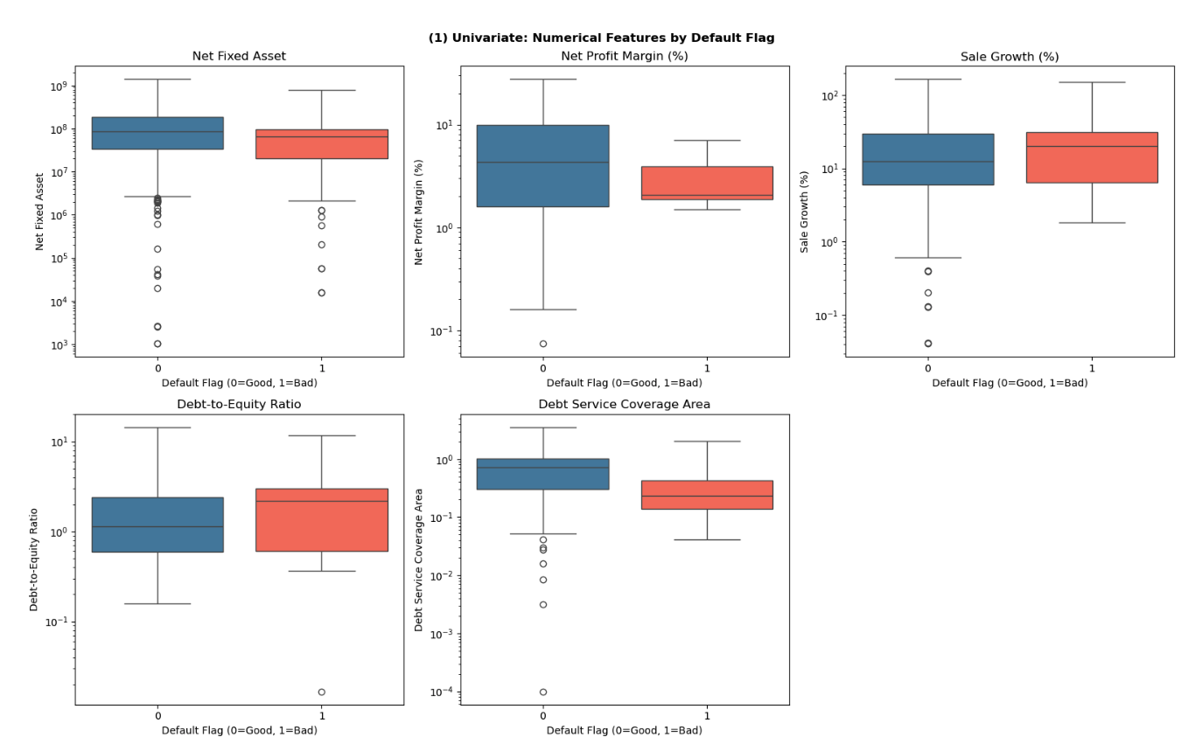
EDA: Univariate Analysis
Distribution and default rates across categorical and numerical features
Key Observations
▸ F1 - Net Fix Asset
Data have high variance and outliers. Fix asset of firms that not defaults have higher mean
▸ F4 - DSCR
Defaulters concentrated at lower DSCR; non-defaulters spread across positive values
▸ F2 - Net Profit Margin
Heavy left-skew, median near -8%; most SMEs unprofitable
▸ F3 - Sale Growth
Quantile 1 and 3 of defaulter and non defaulter are approximately the same, many zero-growth observations

Slide 5
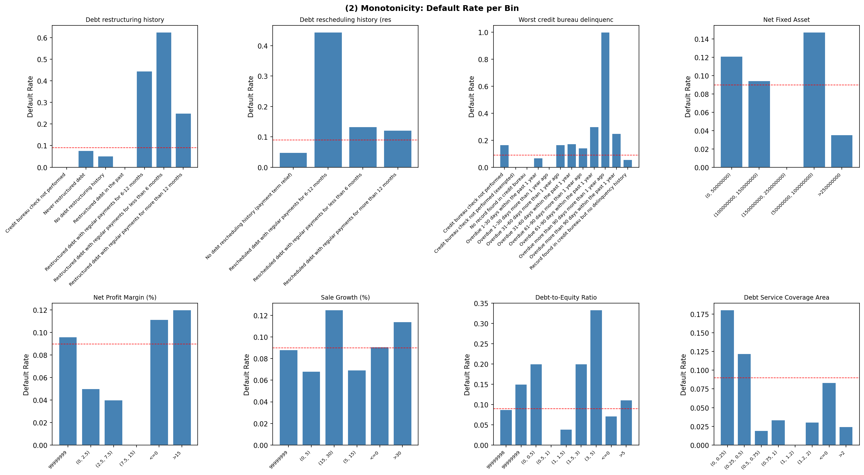
EDA: Monotonicity Analysis
Monotonicity Findings:
▸ C1 Restructuring:
▸ C3 CB Delinquency:
▸ F4 D/E Ratio:
Non-monotone: "Never restructured" has lower WoE than "No history" - bins should be merged
Broadly monotone: longer overdue → higher WoE
Partially monotone; (0.5,1) bin has zero defaults

Slide 6
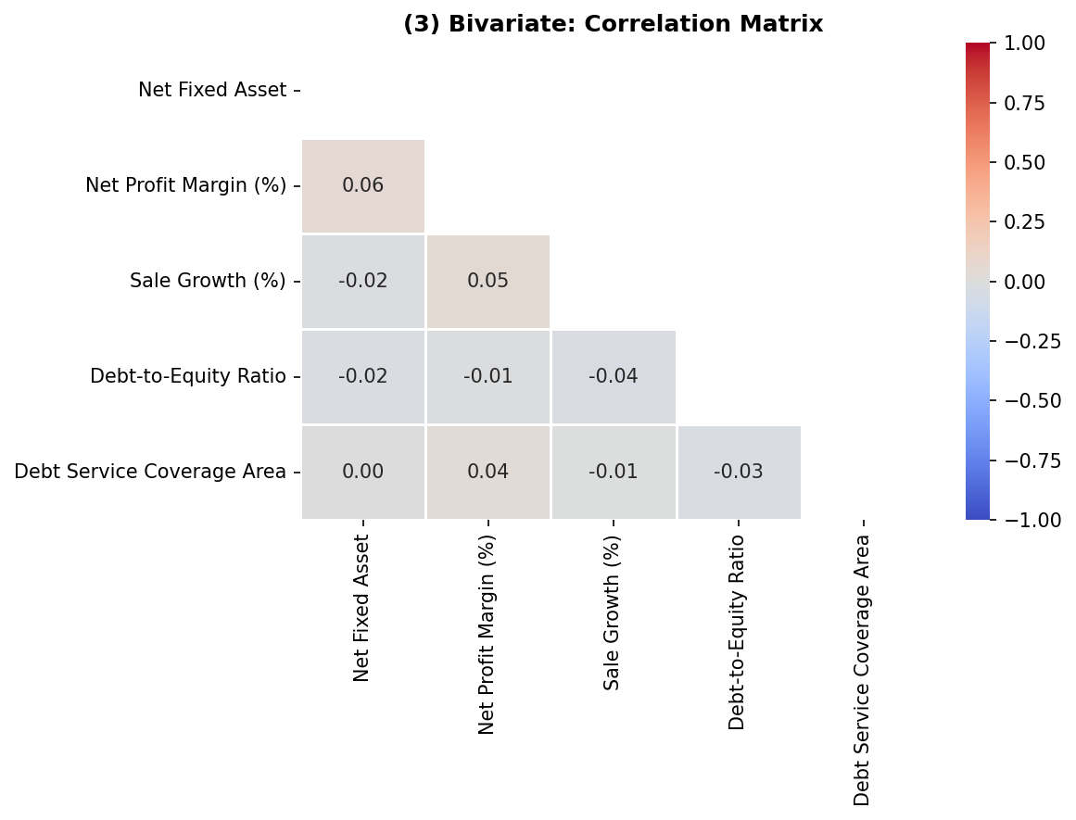
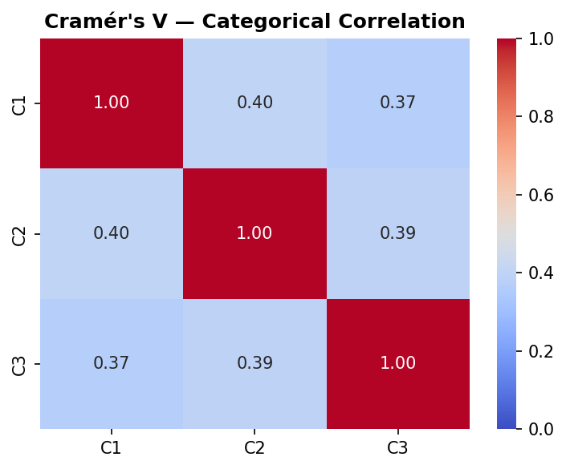
EDA: Correlation & Multicollinearity
Pearson correlation for numerical features; Cramér's V for categorical pairs
Multicollinearity Findings
• Cramér's V: moderate correlation among credit history features
• Net Profit Margin and Net FIx Asset show weak correlation
• No severe multicollinearity

Slide 7
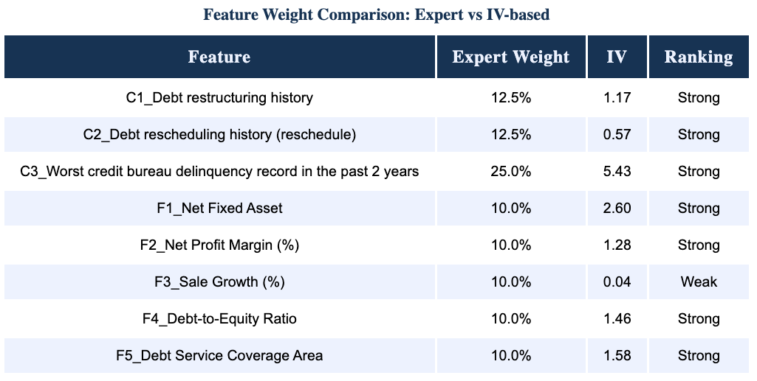
Q1: Feature Weight Assessment
Apprach 1: Information Value (IV) as objective measure vs expert-assigned weights
(*) IV calculation and ranking from book Intelligent credit scoring - Naeem Siddiqi
Recommendation: Proposed Weight Rebalancing
Using IV to assess predictive power:
- Sale Growth (IV=0.04) shows negligible signal and should be removed.
- F1_Net Fixed Asset outperform F2_Net Profit Margin and F4_Dept-to-Equity Ratio
- C1_Dept restructuring history have more predictive power than C2_Dept rescheduling history (reschedule)

Slide 8
√
Q1: Feature Weight Assessment
Approach 2: Calculating weights using linear regression model
LR Coefficients & Normalised Importance
Feature
Coef
LR Wt%
Expert
C3 Worst CB Delinquency
0.897
26.60%
25%
F4 Debt-to-Equity Ratio
0.745
22.17%
10%
F5 DSCR
0.545
16.22%
10%
C2 Debt Rescheduling
0.469
13.96%
12.5%
F1 Net Fixed Asset
0.282
8.43%
10%
C1 Debt Restructuring
0.238
7.09%
12.5%
F2 Net Profit Margin
0.182
5.52%
10%
Recommendation: Proposed Weight Rebalancing
Increase weights on highest-impact leverage
(1) Debt-to-Equity Ratio - second strongest predictive feature (currently underweighted by ~12 %)
(2) Debt Service Coverage Ratio (DSCR) - underweighted by ~ 6%
Decrease weights on features
(1) Debt Restructuring History
(2) Net Profit Margin

Slide 9
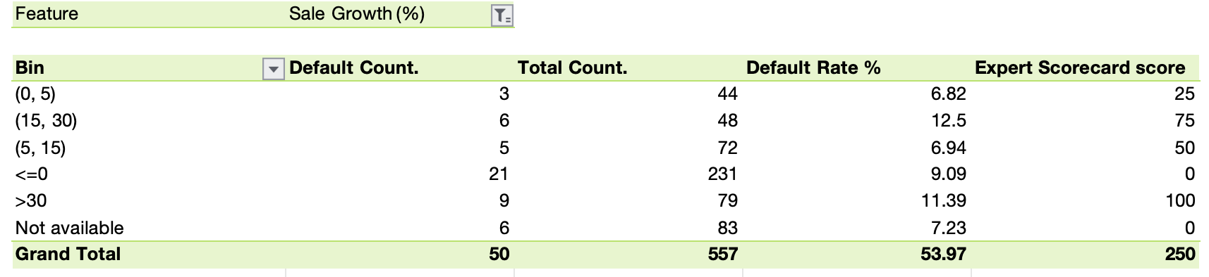
√
Q2: Scorecard Enhancement Suggestions
Approach : Validate monotonicity - default rate must strictly increase band-by-band
Recommendation: F3 Sale Growths - cap binning the score
Current scorecard score contradict default rate trend
Higher sales growth is associated with greater default risk
> Suggesting that aggressive growth may signal financial distress rather than stability.

Slide 10
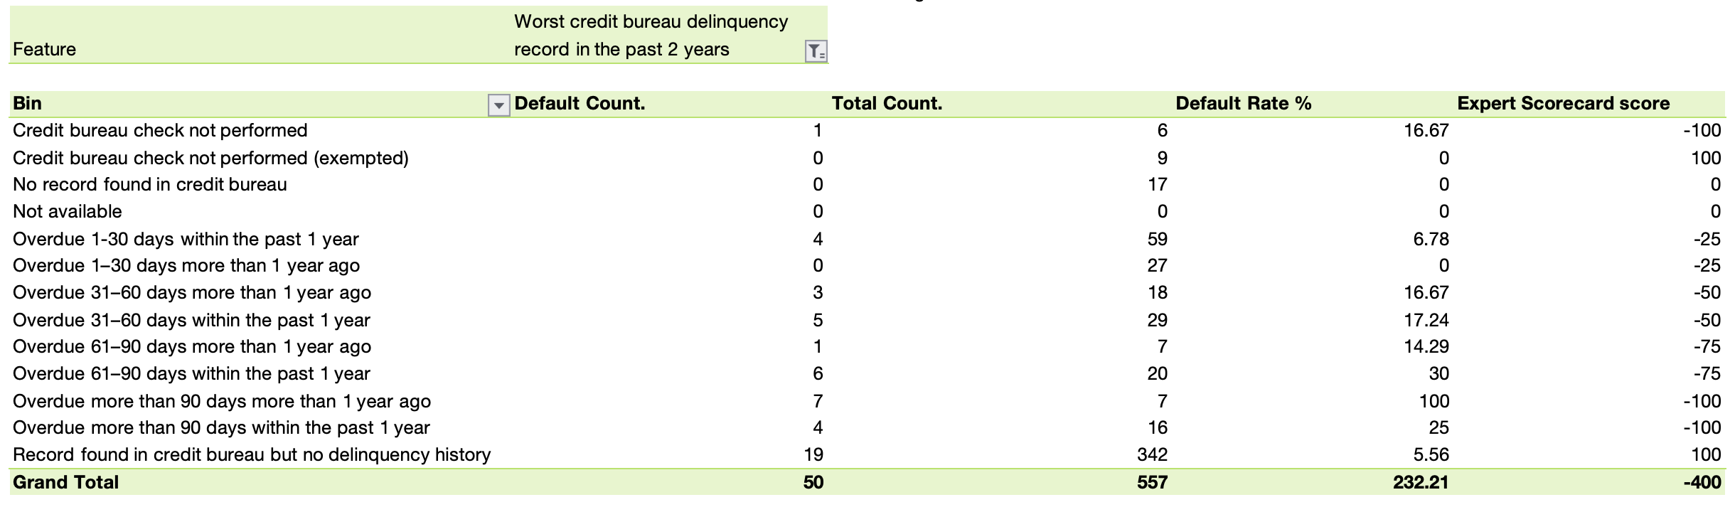
√
Q2: Scorecard Enhancement Suggestions
Approach : Validate monotonicity - default rate must strictly increase band-by-band
Recommendation: F3 Sale Growths - change scores for 3 bins to ensure consistency
Credit score not consistent
Among Credit bureau check not performed, No record found in credit bureau, and Not Available.
While Credit bureau check not performed get penalised for -100 points, the two other get neutral of 0 point
> Suggesting inconsistency

Slide 11
Q3: EDA Methodology for Credit Risk Datasets
Structured five-step framework for borrower, financial and macroeconomic data
Step 1 Data Quality
Step 2 Univariate
Step 3 Bivariate
Step 4 IV/WoE
Step 5 Macroeconomic
• Missing value audit & sentinel detection
• Categorical: frequency, default rate per bin, concentration check
• Numerical vs Target: KS test, Pearson correlation
• Quantify predictive power per bin
• Usually affect the whole portforlio or segment
• Skewness check, IQR-based outlier treatment
• Numerical: histogram, boxplot, describe()
• Categorical vs Target: Chi-square, Cramér's V
• Shoud be consider as a adverse or favorable variable
• Duplicate and data type validation
• Flag features with >50% single-bin concentration
• Should be monitor in at least 1 business cycle
• Two-stage model: micro scorecard + macro adjustment

Slide 12


Q4: PD Model Development — Logistic Regression
Theory, assumptions and implementation steps
Model Theory
Implementation Steps
▸ General formulation
1
1. Data Preparation
WoE encoding linearises the log-odds relationship
$$f(x) =θ(w^{T}x)$$
▸ MLE estimation
2
2. WoE Encoding
Parameters estimated by minimizing negative log-likelihood function
Compute WoE per bin
$$J(w) = −\sum_{i=1}^{N}{(yᵢ logzᵢ +(1−yᵢ )log(1−zᵢ)}$$
3
3. Train/Test Split
▸ Have no close form soluion
Approximate close solution by iterating
80/20 stratified split; EPV check (need ≥10 defaults per feature)
w=w+η(yi​−zi​)xi​
4
4. Model Training
Assumption
Set stopping condition when loss funcion small enough or by iteration
▸ Binary or Ordinal Dependent Variable
5
5. Validation
▸ Independence of Observations
6
5. Score Mapping
▸ Absence of Multicollinearity
Score_i = Offset + Factor×β₀ + Σ[−Factor×βᵢ×WoEᵢ]
▸ Linearity of Independent Variables with the Log-Odds
7
6. PDO Calibration
▸ No extreme outliers
Allocating rating classes to entities to ensure the calibration power of the division created is as high as possible

Slide 13
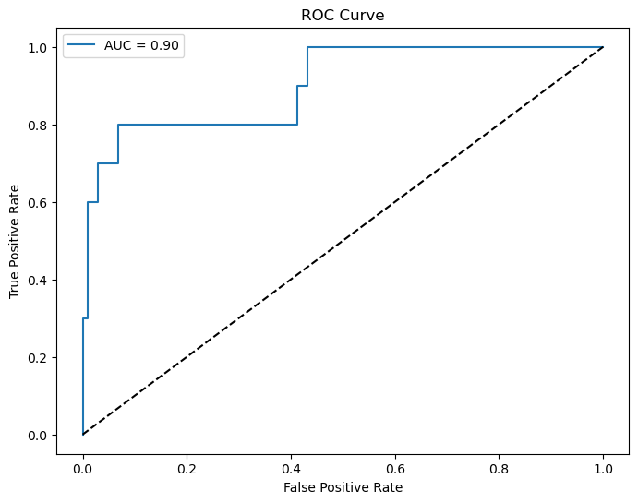
Q5: Model Evaluation Framework
Three pillars: goodness-of-fit, discriminatory power, calibration
Pillar 1 Goodness-of-Fit
Pillar 2 Discriminatory Power
Pillar 3 Forecasting Accuracy
Hosmer-Lemeshow Test
AUC-ROC = 0.90
PSI — Population Stability
Groups: 10
Hosmer-Lemeshow Statistic: 4.8454
Degrees of Freedom: 8
P-value: 0.7740
Good fit — fail to reject H0
Model ranks 90% of default/non-default pairs correctly Excellent - robust even with extreme WoE values Gini Coefficient = 2×AUC−1 = 0.80
precision recall f1-score support
0 0.96 0.99 0.98 102
1 0.86 0.60 0.71 10
accuracy 0.96 112
macro avg 0.91 0.80 0.84 112
weighted avg 0.95 0.96 0.95 112
Binomial Test
Observed Defaults: 50
Total Borrowers: 557
Expected PD (avg): 0.0952
Expected Defaults: 53.0
p-value: 0.7182
Fail to reject H0 — predicted default rate matches observed

Slide 14
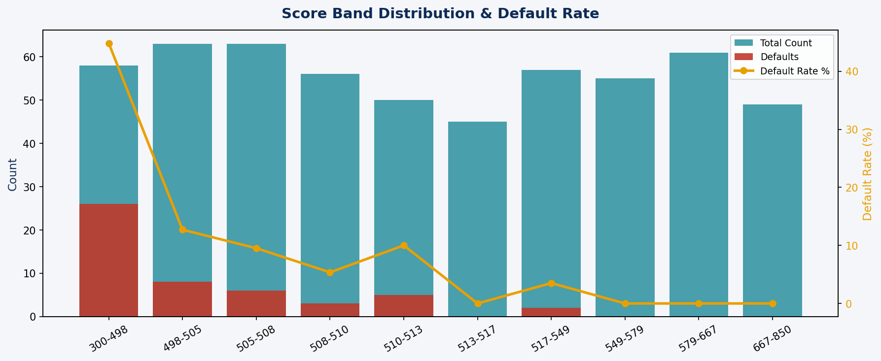
Score Distribution Analysis
PDO-calibrated scores mapped to 300–850 range with band-level default rates
PDO Calibration
PDO
20 (score doubles odds per 20 pts)
Base Score
600 at odds 50:1
Factor
PDO/ln(2) = 28.85
Offset
Base − Factor×ln(Base_Odds) = 487.1
Intercept
Factor × β₀ = 10.55
Score Range
300–850 (min-max scaled)
Score Band Findings
• 300–498: 44.8% default rate → High Risk
• 498–513: 5–13% default rate → Medium Risk
• 513+: 0–3.5% default rate → Low Risk
• Clear separation validates model discrimination
⚠ Calibration Issue: Predicted avg PD = 34.97% vs Actual 9.0% — due to class_weight="balanced" distorting probabilities. Apply Platt scaling before using PD values for provisioning or pricing.
• Bands 513–850: 0 defaults in top 5 bands

Slide 15
Conclusion
Based on quantitative analysis, three actions are recommended to strengthen the scorecard:
01
Reassess the Weights of Risk Components
02
Adjust Bins and the Formulated Scorecard
03
Combine Quantitative Model with Expert Model
• C3 (Worst CB Delinquency) is the strongest predictor with IV = 5.43 — its 25% weight is justified and may warrant an increase to 30%
• Merge non-monotone bins where WoE direction breaks the expected risk ordering (e.g. C1 Restructuring)
• Use LR-implied coefficients to cross-validate expert weights — flag features where the gap exceeds 5 percentage points
• F3 Sale Growth has IV = 0.04, below the acceptable threshold — it should be removed or replaced with a more predictive variable
• Cap extreme values at 5th–95th percentile before binning to reduce sensitivity to outliers in skewed features
• Adopt a hybrid approach: data-driven weights as the baseline, with expert overlay for features with limited historical data
• D/E Ratio and DSCR are underweighted relative to their data-implied importance — consider increasing both to 15%
• Validate monotonicity after each bin adjustment — default rate must strictly increase from best to worst bin
• Incorporate macroeconomic variables (GDP growth, interest rates) in a two-stage model: micro scorecard × macro scalar
• Use IV as the primary basis for weight assignment rather than expert judgement alone
Model achieves AUC = 0.90 — strong discrimination — but requires calibration and structural fixes before production deployment.

