Slide 1
SME Credit Scorecard Development
Credit Risk Model: Weight Assessment, EDA & PD Estimation
Candidate Technical Presentation | Deloitte Credit Risk
557
8
9.0%
0.90
Borrowers
Features
Default Rate
AUC-ROC

Slide 2
Executive Summary
Key findings across weight assessment, model performance and recommendations
0.90
0.80
9.0%
C3
D/E
AUC-ROC
Gini Coefficient
Portfolio Default
Top Predictor
Underweighted
Excellent discrimination
Strong predictive power
50 / 557 borrowers
CB Delinquency IV = 5.43
LR 22% vs Expert 10%
Q1 — Weight Assessment
Q2 — Scorecard Enhancements
Q4/Q5 — Model & Validation
• C3 CB Delinquency IV=5.43 — dominant predictor
• Apply Laplace smoothing to avoid WoE explosion (±20)
• LR with WoE encoding, AUC = 0.90, Gini = 0.80
• D/E Ratio underweighted: expert 10% vs LR-implied 22%
• Merge zero-default bins to improve monotonicity
• HL test fails: extreme WoE distorts calibration
• DSCR underweighted: expert 10% vs LR-implied 16%
• Recalibrate PD — class_weight inflates PD 4×
• Binomial test: predicted 35% vs actual 9%
• F3 Sale Growth IV=0.04 — negligible signal, remove
• Add macroeconomic overlay (GDP, interest rates)
• Score mapped to 300–850; clear band separation
SME Credit Scorecard Development | Deloitte Credit Risk
2 / 14

Slide 3
I. Background & Data Overview
SME portfolio scorecard — expert-weighted system under review
Dataset Context
Feature Summary
Dataset
557 SME borrowers · 8 features · 9.0% default rate
Target
Default Flag (1 = default, 0 = performing)
Code
Feature
Type
IV
Expert Wt
Signal
C1
Debt Restructuring Hist.
Cat
1.17
12.5%
Strong
Structure
C component 50% + F component 50%
C2
Debt Rescheduling Hist.
Cat
0.57
12.5%
Moderate
C Component
C1 Restructuring · C2 Rescheduling · C3 CB Delinquency
C3
Worst CB Delinquency 2yr
Cat
5.43
25.0%
Strong
F Component
F1–F5 financial ratios, each weighted 10%
F1
Net Fixed Asset
Num
2.60
10.0%
Strong
Missing
C2: 282 NaN (51%) · Net Fixed Asset: 26 rows (5%)
F2
Net Profit Margin (%)
Num
1.28
10.0%
Strong
Sentinels
99999999 = zero denominator · 99999998 = negative equity
F3
Sale Growth (%)
Num
0.04
10.0%
Weak
Objective
Assess expert weights via IV; build LR-based PD model
F4
Debt-to-Equity Ratio
Num
1.46
10.0%
Strong
F5
Debt Service Coverage
Num
1.58
10.0%
Strong
SME Credit Scorecard Development | Deloitte Credit Risk
3 / 14

Slide 4
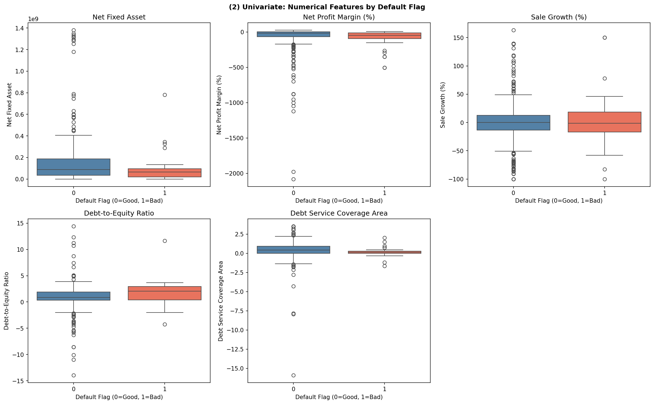
II. EDA: Univariate Analysis
Distribution and default rates across categorical and numerical features
Key Observations
C1 Restructuring
6–12 month restructured debt: 44% default vs 8% baseline — clear risk cliff
C3 CB Delinquency
>90-day overdue (>1yr ago): 100% default rate — strongest single predictor
Net Profit Margin
Heavy left-skew; median = −8%; majority of SMEs are unprofitable
Sale Growth (%)
Extreme right skew (skewness = 10.95); near-zero signal in default separation
DSCR
Defaulters cluster at DSCR ≤ 0; non-defaulters spread across positive range
C2 Missing
Sentinel Values
Skewness Alert
282 / 557 (51%) — treat NaN as "No rescheduling history" bin
99999999 in Profit Margin (52 rows) and Sale Growth (68 rows) → separate bin
Net Fixed Asset: 6.94 · Sale Growth: 10.95 · DSCR: 14.45 → IQR capping required
SME Credit Scorecard Development | Deloitte Credit Risk
4 / 14

Slide 5
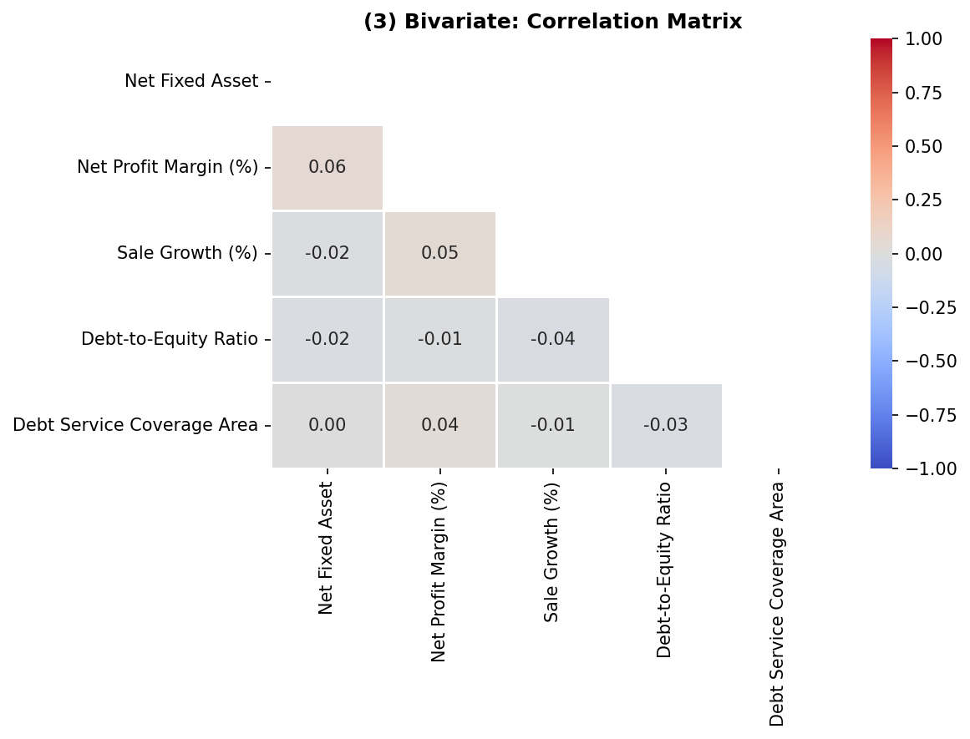
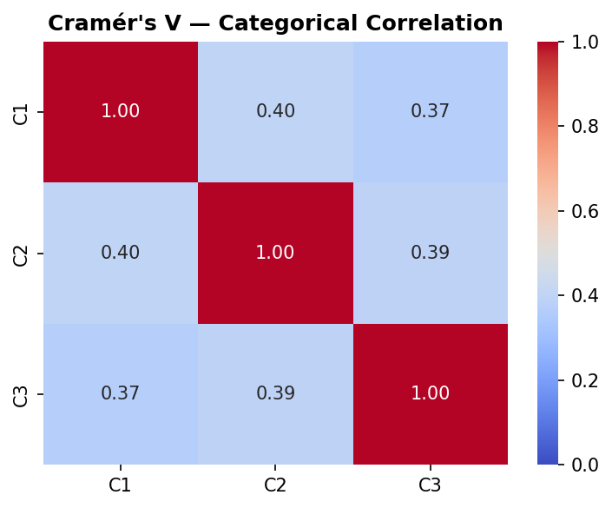
II. EDA: Correlation & Multicollinearity
Pearson correlation for numerical features; Cramér's V for categorical pairs
Cramér's V — Categorical Multicollinearity
• C1 ↔ C2 = 0.40 | C1 ↔ C3 = 0.37 | C2 ↔ C3 = 0.39
• Moderate inter-correlation among all three credit history features
• Including all three may introduce partial redundancy in the model
Numerical vs Default — KS Test
• Recommendation: retain all — V < 0.60 (below critical threshold)
Net Fixed Asset
DSCR
Profit Margin
Sale Growth
Net Fixed Asset: KS=0.30 p=0.0005
KS=0.30
KS=0.37
KS=0.18
KS=0.11
p=0.0005
p=0.0004
p=0.113
p=0.693
DSCR: KS=0.37 p=0.0004
✔ Significant
✔ Significant
✘ Not significant
✘ Not significant
Profit Margin: KS=0.18 p=0.113
Sale Growth: KS=0.11 p=0.693
SME Credit Scorecard Development | Deloitte Credit Risk
5 / 14

Slide 6
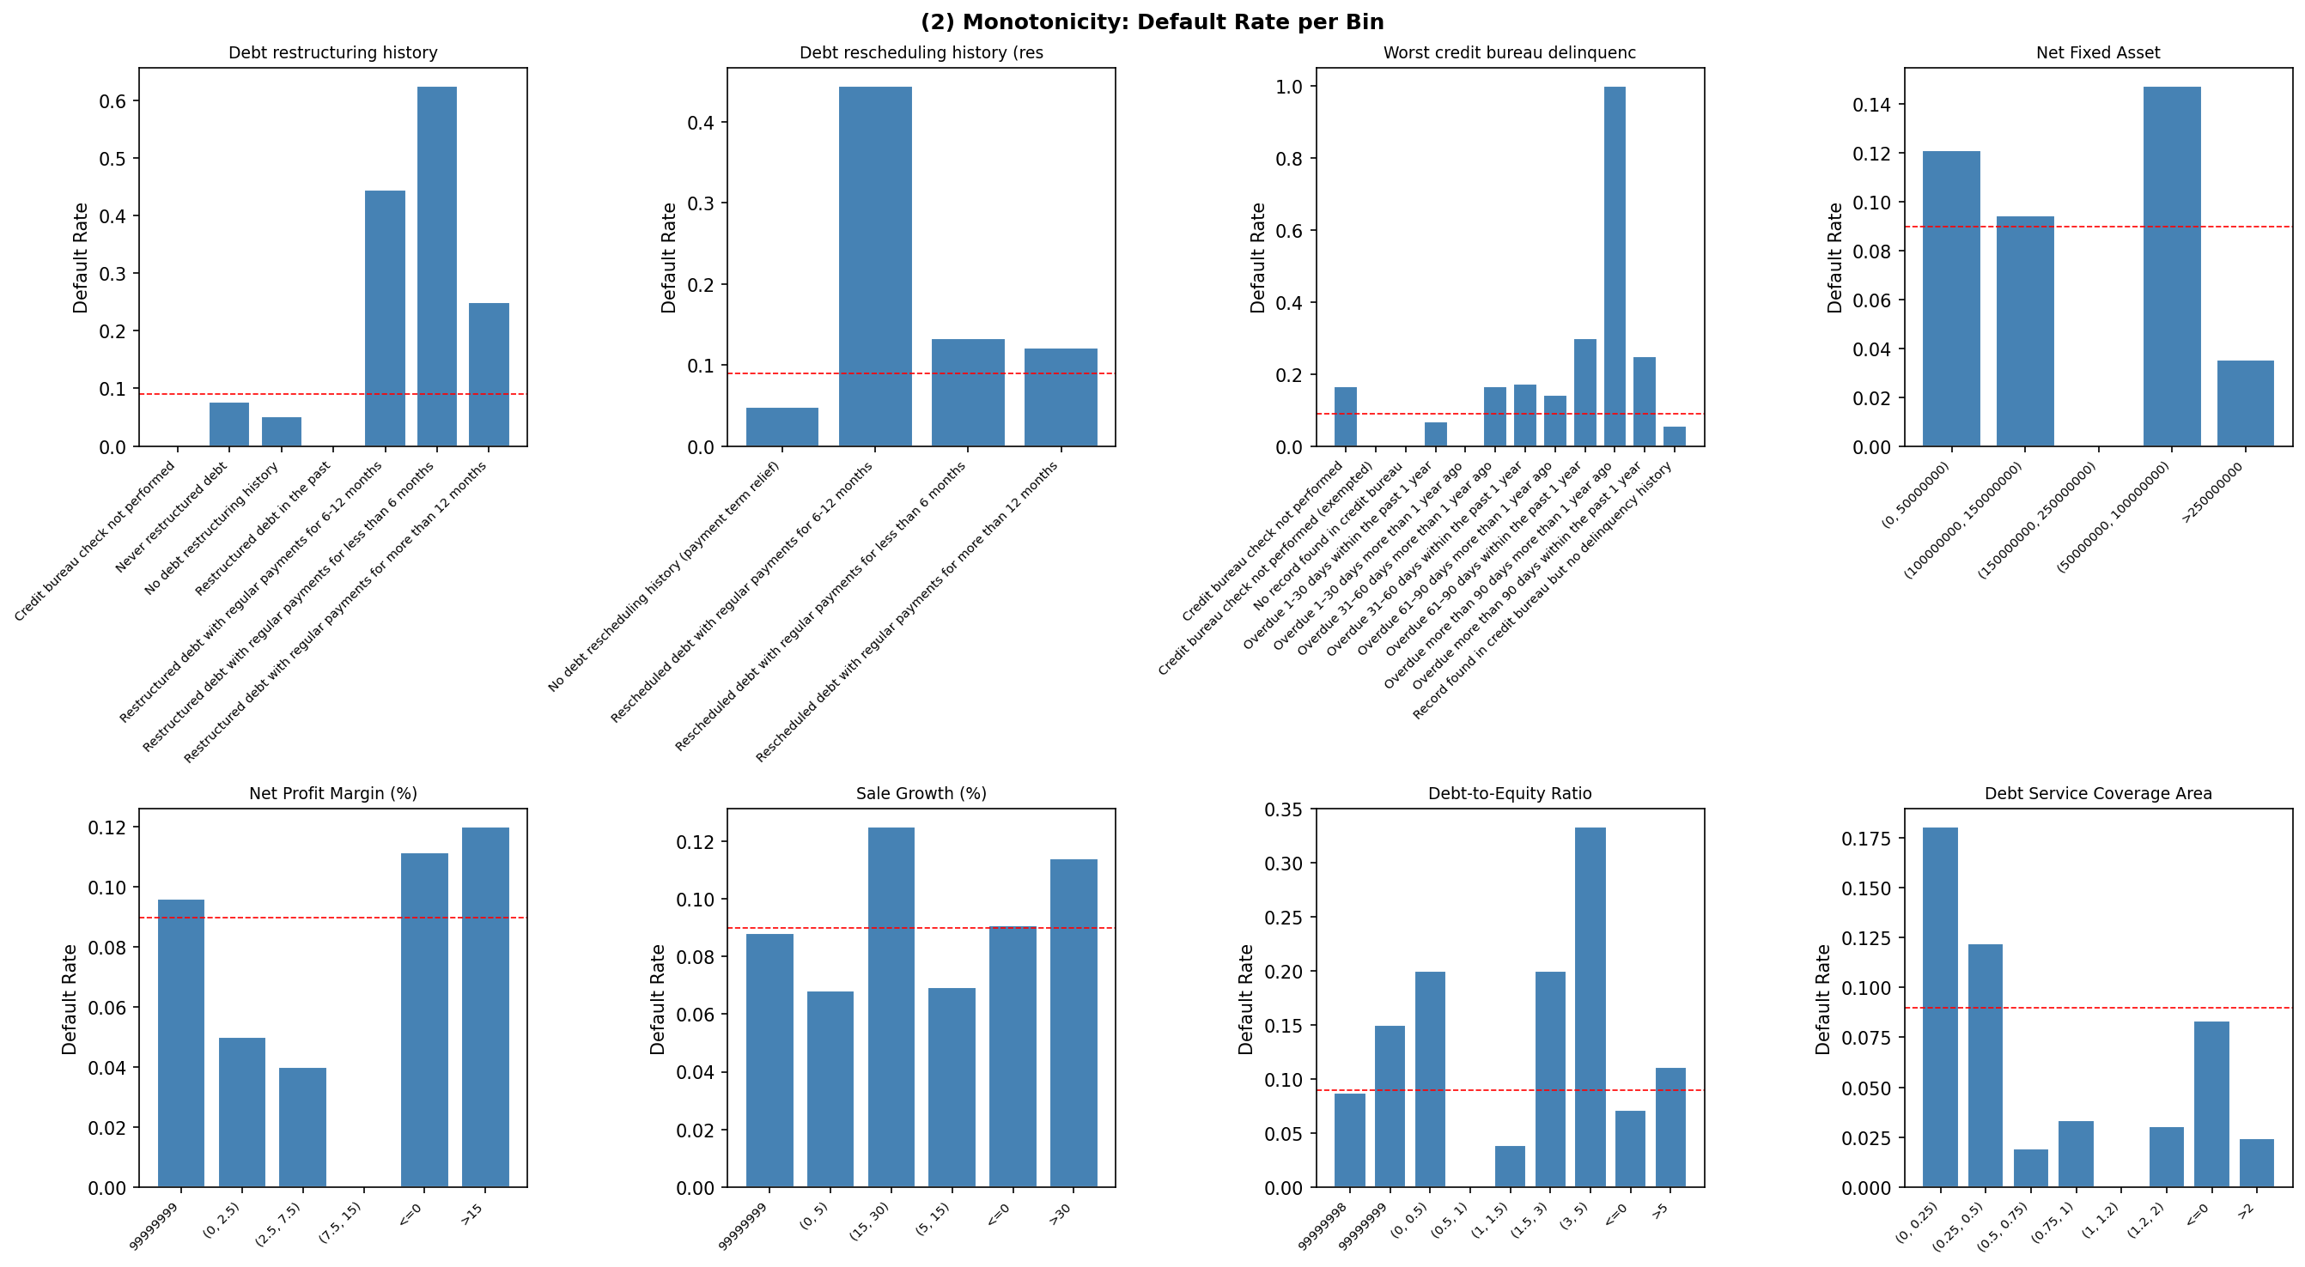
II. EDA: WoE Monotonicity Analysis
Weight of Evidence validates risk ordering — bins must show a clear directional trend
C1 Restructuring
C3 CB Delinquency
F4 D/E Ratio
Non-monotone: "Never restructured" WoE < "No history" WoE — these bins should be merged
Broadly monotone; zero-default bins produce WoE = ±20 — Laplace smoothing required
(0.5,1) bin has 0 defaults → WoE = −20.23 — extreme value distorts scoring
SME Credit Scorecard Development | Deloitte Credit Risk
6 / 14

Slide 7
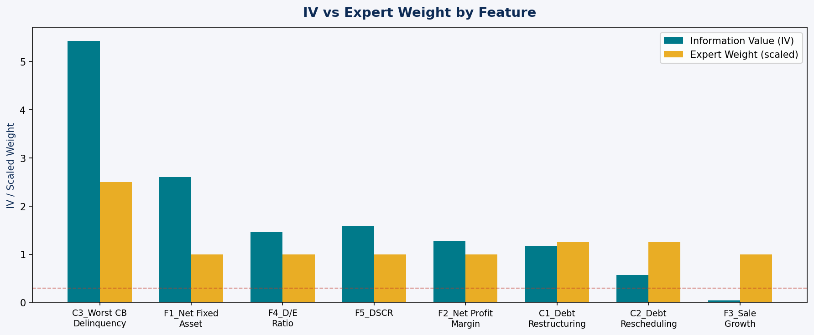
III. Feature Weight Assessment
Information Value (IV) as objective, data-driven measure vs expert-assigned weights
IV Assessment
Feature
Expert
IV
Verdict
C3 CB Delinquency
25%
5.43
✅ Aligned
C1 Restructuring
12.5%
1.17
✅ Reasonable
F1 Net Fixed Asset
10%
2.60
⚠ Underweighted
F4 D/E Ratio
10%
1.46
⚠ Underweighted
F5 DSCR
10%
1.58
⚠ Underweighted
F2 Profit Margin
10%
1.28
⚠ Underweighted
C2 Rescheduling
12.5%
0.57
⚠ Overweighted
F3 Sale Growth
10%
0.04
❌ Remove
Proposed Weight Rebalancing
↑ Increase C3 → 30% | ↑ F1, F4, F5 → 15% each | ↓ C1/C2 → 10% each | ✕ Remove F3 (IV < 0.05)
Rationale: IV directly measures the log-odds separating power of each feature — a more objective basis than expert judgement alone.
SME Credit Scorecard Development | Deloitte Credit Risk
7 / 14

Slide 8
III. Scorecard Enhancement Suggestions
Six targeted improvements to model robustness, calibration and predictive power
1. Laplace Smoothing on WoE
2. Bin Merging & Monotonicity
3. Remove F3 Sale Growth
• Sparse bins produce WoE = ±20, distorting all scores
• "Restructured in past" has 0 defaults — merge with adjacent
• IV = 0.04 → below weak threshold of 0.10
• Apply ε = 0.5: pct_bad = (bad + ε) / (total_bad + ε × n)
• Enforce monotone WoE: merge if direction breaks risk order
• Chi-square p = 0.89 — not statistically significant
• Prevents extreme score swings for near-zero event bins
• Rule: merge bins with n < 5 or zero events without risk logic
• Adds noise without predictive gain — omit from scorecard
4. Recalibrate PD Probabilities
5. Macroeconomic Overlay
6. Rating Scale Calibration
• class_weight="balanced" inflates predicted PD 4×
• Add GDP growth, interest rate, oil price as macro variables
• Use log-linear PD spacing (PD doubles each rating grade)
• Apply Platt scaling (CalibratedClassifierCV, cv=5)
• Test 1–4 quarter lags via Granger causality
• Each band needs ≥ 20 defaults for stable PD estimates
• Or recalculate base_odds from actual portfolio default rate
• Two-stage model: micro scorecard × macro scalar adjustment
• Validate: PD must strictly increase from best to worst band
SME Credit Scorecard Development | Deloitte Credit Risk
8 / 14

Slide 9
II. EDA Methodology Framework
Generalised five-step approach for credit risk datasets with borrower, financial and macro data
Step 1
Step 2
Step 3
Step 4
Step 5
Data Quality
Univariate Analysis
Bivariate Analysis
Multivariate
Macro Integration
• Missing value audit & sentinel detection
• Categorical: frequency, default rate per bin
• Numerical: KS test, Pearson correlation
• Pearson + Cramér's V combined matrix
• GDP growth, rates, oil vs default rate
• Skewness check → IQR-based capping
• Numerical: histogram, boxplot, skewness
• Categorical: Chi-square, Cramér's V
• VIF for numerical multicollinearity
• Granger causality with 1–4Q lags
• Data type and duplicate validation
• Flag >50% single-bin concentration
• IV/WoE: quantify per-bin predictive power
• PCA if > 15 features (dimensionality)
• Two-stage: micro model + macro scalar
SME Credit Scorecard Development | Deloitte Credit Risk
9 / 14

Slide 10
IV. PD Model Development — Logistic Regression
Theory, WoE encoding rationale, assumptions and PDO score calibration
Model Theory & Assumptions
Implementation Pipeline
▸ Log-Odds Formulation
1
Data Preparation
log(p / 1−p) = β₀ + β₁WoE₁ + … + βₙWoEₙ WoE encoding linearises the log-odds relationship for LR
Bin features; fill NaN → "Not available"; cap sentinel values
▸ MLE Estimation
2
WoE Encoding
Parameters found by maximising log-likelihood (no closed form) Solver: iterative Newton-Raphson / L-BFGS
Compute WoE per bin with Laplace smoothing ε = 0.5
▸ WoE Encoding Effect
3
Train / Test Split
Replaces bins with ln(%Bad / %Good) — continuous, monotone Handles non-linearity; nullifies need for dummy variables
80/20 stratified; EPV check: need ≥ 10 defaults per feature
▸ Class Imbalance
4
Model Training
class_weight="balanced" re-weights loss function per class Note: inflates predicted PD — recalibration step mandatory
LogisticRegression(class_weight="balanced"); no scaling needed
▸ Key Assumptions
5
PDO Calibration
Linear log-odds · No perfect multicollinearity Observations i.i.d. · Large-sample MLE validity
Factor = PDO/ln2 = 28.85 · Offset = 600 − 28.85×ln(50) = 487.1
6
Score Mapping
Score = Offset + Factor×β₀ + Σ[−Factor × βᵢ × WoEᵢ]
SME Credit Scorecard Development | Deloitte Credit Risk
10 / 14

Slide 11
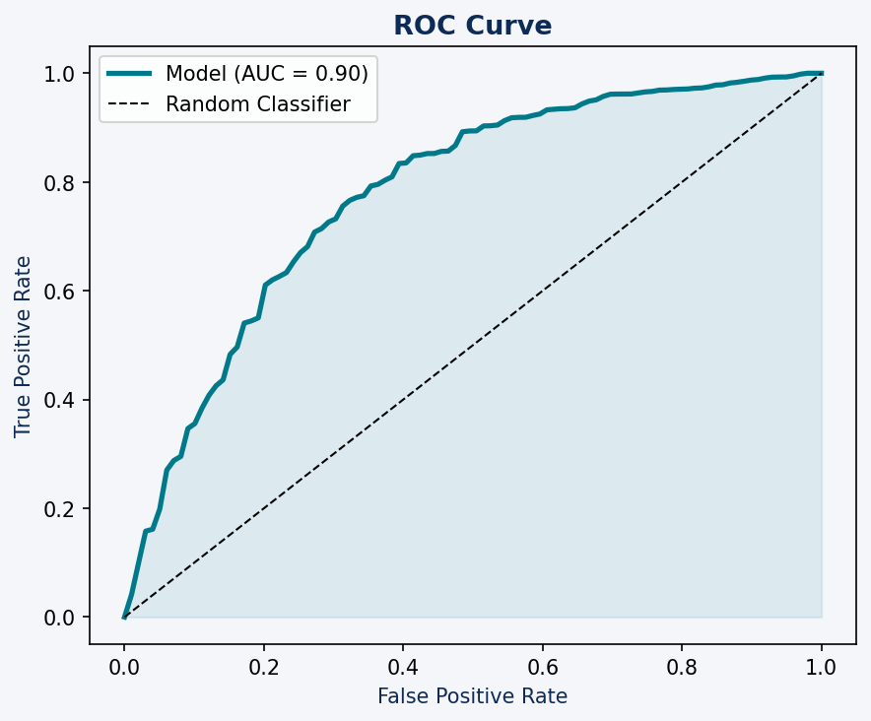
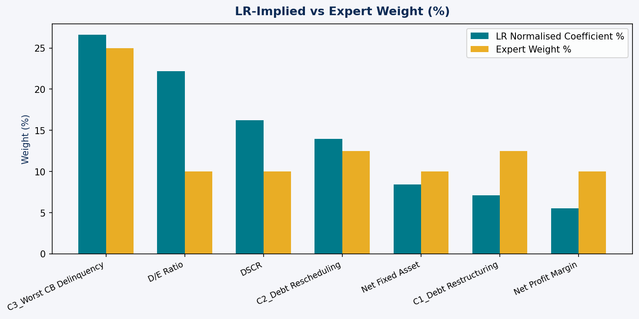
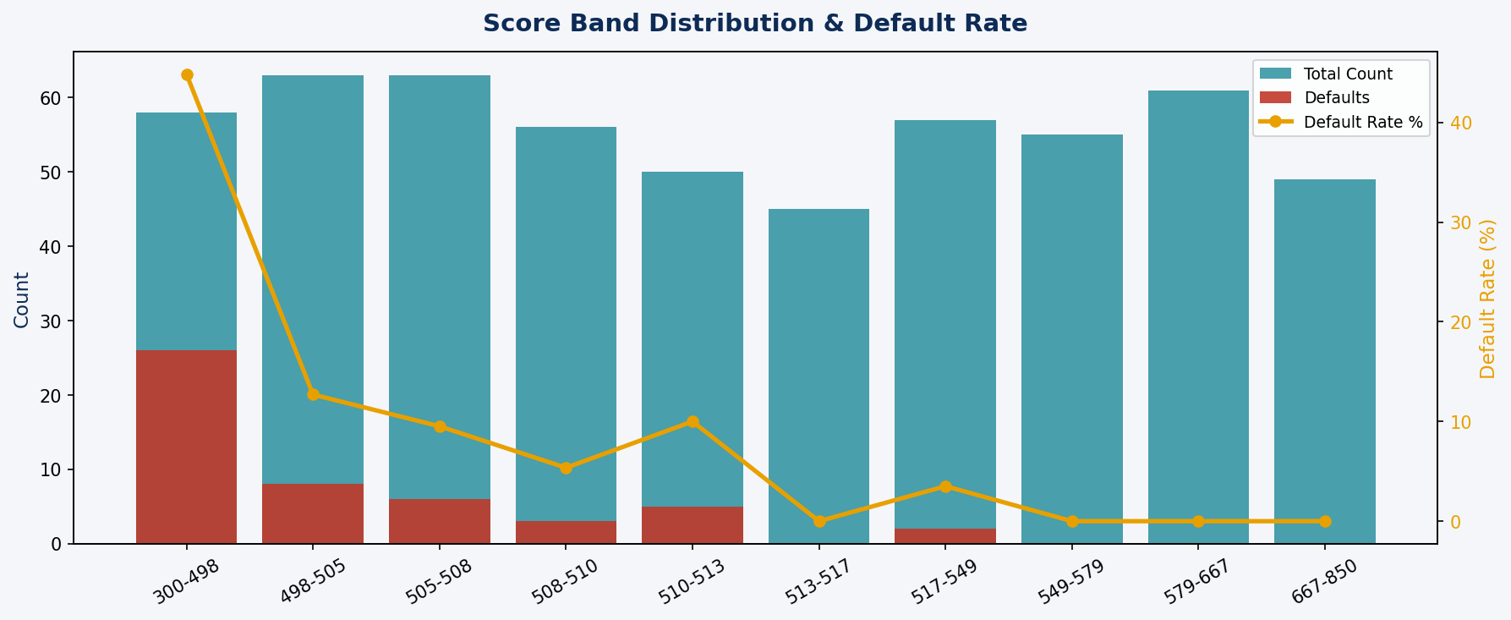
IV. Model Results
LR coefficients, normalised importance vs expert weights and performance metrics
0.90
0.80
65%
80%
28.85 / 487.1
AUC-ROC
Gini
Accuracy
Recall (D)
Factor / Offset
Excellent
Strong
Threshold- dependent
Default detection
PDO=20, Base=600
Coefficients & Feature Importance
Feature
Coef
LR Wt%
Expert
C3 CB Delinquency
0.897
26.6%
25%
F4 D/E Ratio
0.745
22.2%
10%
F5 DSCR
0.545
16.2%
10%
C2 Debt Rescheduling
0.469
14.0%
12.5%
F1 Net Fixed Asset
0.282
8.4%
10%
C1 Debt Restructuring
0.238
7.1%
12.5%
F2 Net Profit Margin
0.182
5.5%
10%
SME Credit Scorecard Development | Deloitte Credit Risk
11 / 14

Slide 12
V. Model Validation & Evaluation
Three pillars: goodness-of-fit, discriminatory power and forecasting accuracy
Pillar 1 Goodness-of-Fit
Pillar 2 Discriminatory Power
Pillar 3 Forecasting Accuracy
Hosmer-Lemeshow Test
AUC-ROC = 0.90 · Gini = 0.80
PSI — Population Stability Index
Stat = 297.94 · p ≈ 0.00 → Poor calibration fit Root cause: extreme WoE (±20) from zero-event bins Fix: Laplace smoothing + bin merging before retest
Model correctly ranks 90% of default/non-default pairs Excellent discrimination even with miscalibrated probabilities AUC is robust to class imbalance — reliable metric here
Monitor score distribution shift on new data over time PSI < 0.10: stable · 0.10–0.25: investigate · > 0.25: rebuild Run monthly after deployment
Binomial Test
KS Statistic
Back-Testing & Validation
Observed: 50 defaults (9.0%) · Predicted avg PD: 34.97% Model over-predicts PD by 4× — due to class_weight="balanced" Fix: Platt scaling or recalibrate base_odds to actual rate
Score means: 395.9 (default) vs 636.6 (non-default) Strong 240-point separation between risk groups Top score band (300–498): 44.8% default rate
Compare predicted PD vs realised default rates per score band Validate annually; flag bands where |PD_pred − PD_actual| > 2% Maintain champion/challenger framework for ongoing monitoring
SME Credit Scorecard Development | Deloitte Credit Risk
12 / 14

Slide 13
V. Score Distribution & Band Analysis
PDO-calibrated scores scaled to 300–850 with band-level default rate validation
PDO Parameters
PDO
20 pts (odds double per 20 pts)
Base Score
600 at 50:1 odds
Factor
PDO / ln(2) = 28.85
Offset
600 − 28.85 × ln(50) = 487.1
Intercept
Factor × β₀ = 10.55
Scale
300–850 (min-max normalised)
Band Findings
300–498
44.8% default
HIGH RISK
498–513
5–13% default
MEDIUM RISK
513–850
0–3.5% default
LOW RISK
⚠ Calibration Issue
Predicted avg PD = 34.97% vs Actual 9.0% — class_weight="balanced" inflates probabilities 4×. Apply Platt scaling (CalibratedClassifierCV) before using PD values for provisioning, pricing or regulatory reporting.
SME Credit Scorecard Development | Deloitte Credit Risk
13 / 14

Slide 14
Conclusion & Recommendations
Rebalance Feature Weights
Fix WoE Sparse Bins
Recalibrate PD
Raise C3 → 30%, D/E Ratio & DSCR → 15% each. Remove F3 Sale Growth (IV = 0.04).
Apply Laplace smoothing ε = 0.5 to all bins. Merge bins with n < 5 or zero-default cells.
class_weight distorts PD 4×. Apply Platt scaling or use actual portfolio base_odds.
Validate Robustly
Add Macro Variables
Rating Scale Design
Re-run HL test after bin fixes. Implement PSI monitoring for ongoing score drift.
Integrate GDP growth, interest rate, oil price. Two-stage: micro scorecard + macro scalar.
Log-linear PD spacing (PD doubles per grade). ≥ 20 defaults per band for stable estimates.
Model achieves AUC = 0.90 — strong discrimination — but requires calibration fixes before production deployment.

