Slide 1
VID2020
DATA ANALYST APPLICATION

Slide 2
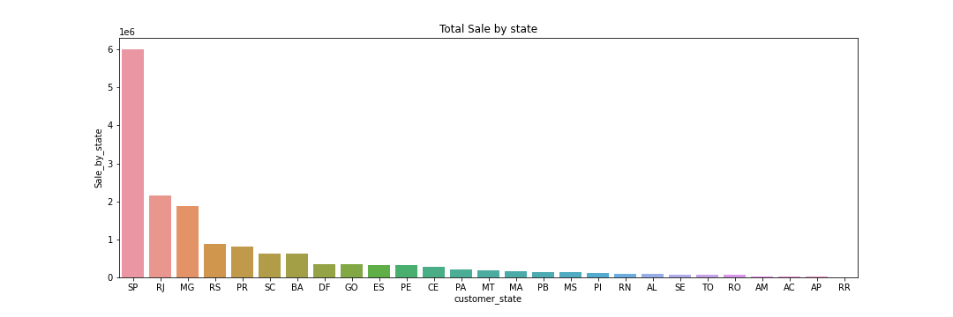
I. Revenue overview
Focus on 1 biggest market with revenue being 3 time bigger than the second biggest city
oogf
Notes:
SP >> biggest n richest city, it comes as no surprise that sale come most from this region
Total sale 16,008,872 brazil real ~~ 3,1 triệu đô

Slide 3
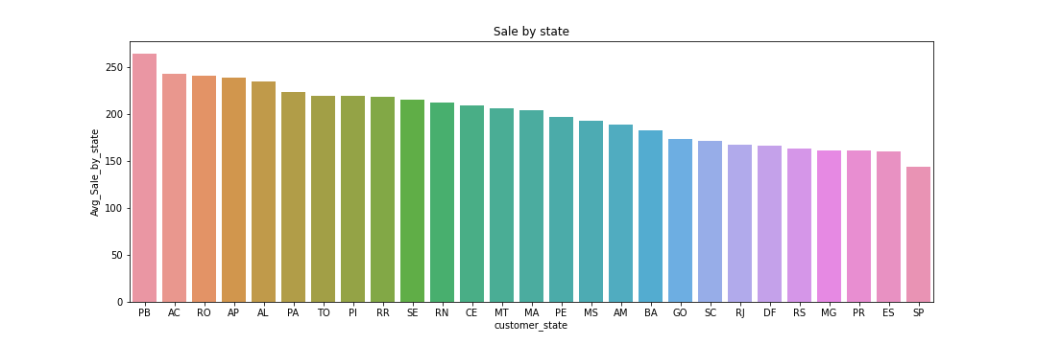
I. Revenue overview
SP has the highest revenue but lowest in term of average order value
PB - a city with much lower income rate and living standards - has the highest average order value
Notes:
joao pessoa being the city with highest amount per order
With standard of living and income per head is lower than Sp, it may suggest that this is a profitable business

Slide 4
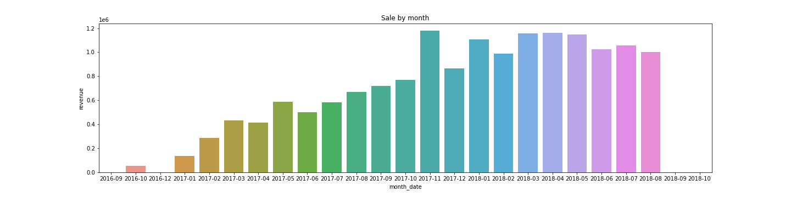
I. Revenue overview
Peak month is 11-2017 with abnormal high revenue
The last quarter of the report see a good performance when revenue was stably high

Slide 5
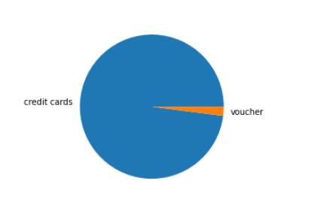
II. Business Analysis
Overcharge
Distribution of overcharge by payment method
>> Indicate problem in credit card control

Slide 6
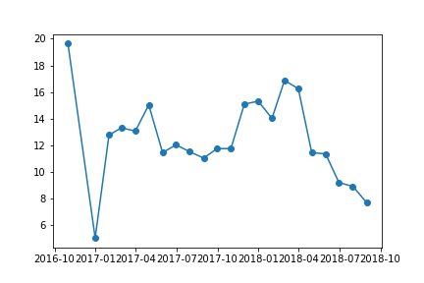
II. Business Analysis
2. Delivery day
Steep drop in Jan 2017 is abnormal and outliner
Generally, it takes 12-17 days for Ecom to deliver.

Slide 7
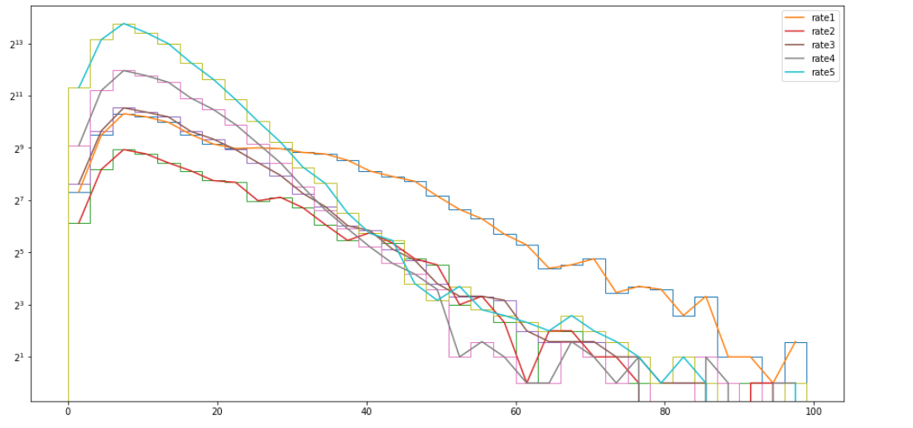
II. Business Analysis
2. Delivery day
Higher the rate, the more package delivery in the shorter period of time indicates the correlation between delivery date and customer satisfaction

Slide 8
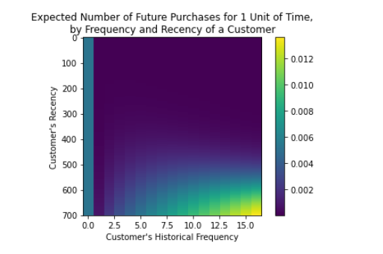
III. Forcasting
The graph illustrates the possibility of repurchase of a customer given their past behaviour
Using Gamma model, the average future value of customer is 147.78 Real

