Slide 1
DB Management Systems Graph: Arango
Joel Klein – jdk514@gwmail.gwu.edu

Slide 2
Introduction to Arango
Notes:
Introduce myself – education, work experiences, etc.

Slide 3
Arango
Arango is a Graph based Database
Graph Databases primarily store information about relationships between nodes/entities
These nodes/entities may be represented as flat information or a dictionary of information
The key design behind Arango (Graph Databases) is to enable people to query data based on its relationships, rather than its underlying information

Slide 4
Terminology
Database: A group of collections
Vertex Collection: Collection of documents defining graph nodes
Think mongo documents
Edge Collection: Collection of node pairings
Similar to Join logic used in SQL
Graph: Joint representation of vertex and edge collections
Node (think document): Data element, containing a number of properties and labels
Primary Key: Document attribute that identifies the node
AQL: Query language for Arango
Notes:
Go a little in depth on the shard key

Slide 5
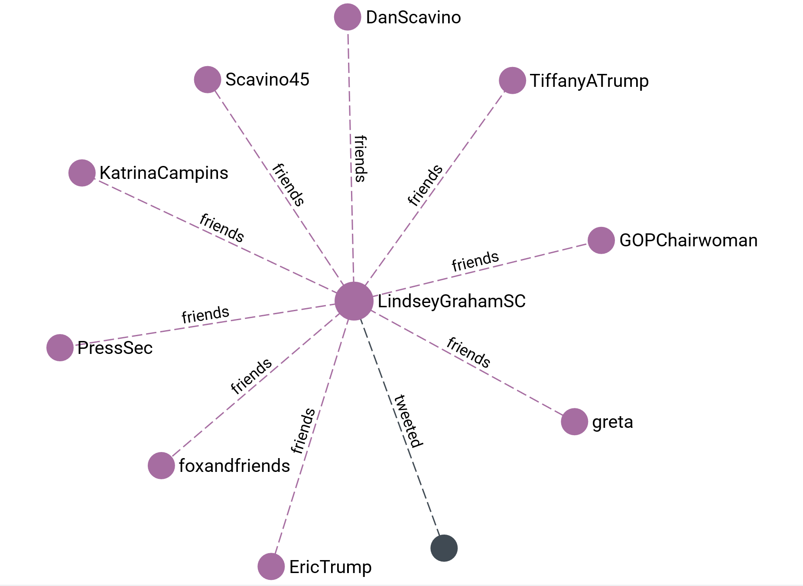
Arango Graph Layout
When we visualize a graph, we see how different vertices (nodes) are connected via their edges (relationships)
As mentioned earlier, each vertex in Arango is comprised of labels and properties
In addition to vertices, Arango also has edges. These are on a similar level as vertices, as they can house data too.
Both vertices and edges store data in JSON-like documents
Notes:
'users/432895323' – depth 2

Slide 6
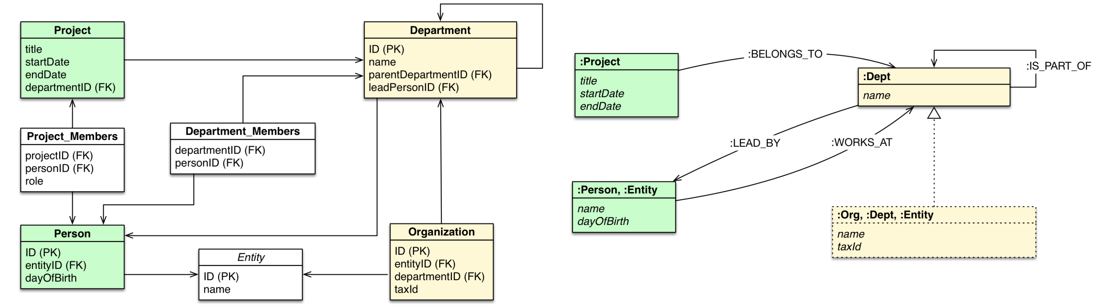
Relational vs Graph

Slide 7
Acceptable Arango Data Types
Basic Types:
Boolean
Numerical
String
Null
Compound Types:
Array
Object/Document
Graph Structure Types
Node
Relationship
Path

Slide 8
Querying Arango - Browser

Slide 9
Arango Browser
We can query information from Arango directly from a browser
This allows us to both query and visualize information
You simply need to navigate to http://18.219.151.47:8529 to access the browser based GUI
I’ll provide the username and password in class

Slide 10
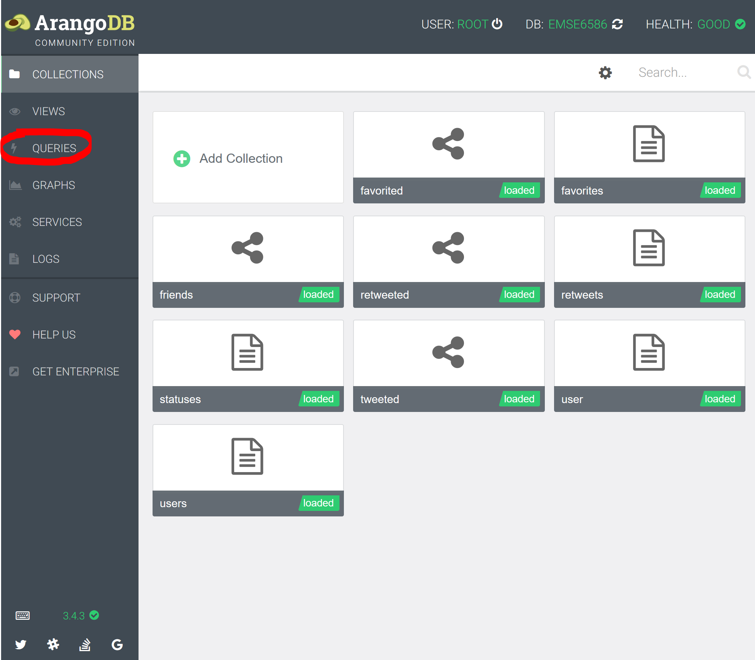
Arango Browser Cont. 1
Once logged in, the page shown on the right should appear
From here you can view the collections of data, but more importantly we can run queries from the QUERIES tab

Slide 11
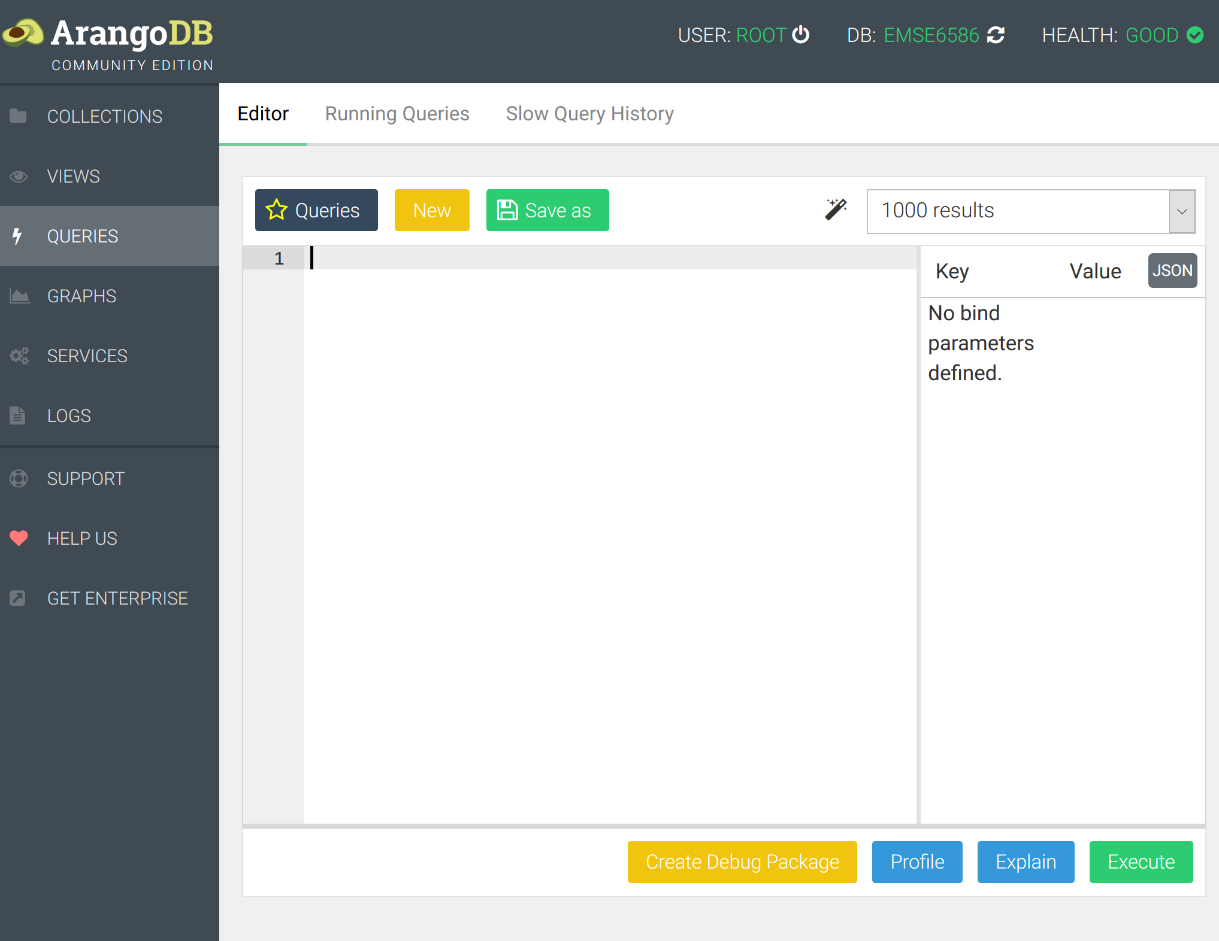
Arango Browser Cont. 2
From here we have an editor to write and view our queries
Certain queries will even return a graph-based visualization along with the data

Slide 12
ArangoDB Query Language

Slide 13
AQL
AQL is very different than any of the previous languages we have worked with
It is focused on telling Arango what to return, not necessarily how.
It also is unique in that it works by defining the filter/relationships, and then defining what should be returned from the resulting set
It is also unique in the fact that it currently there is not a default or dominant graph query language (Gremlin API may be a front runner)

Slide 14
Before Querying
Before writing anything in AQL, it is good to understand the structure of the nodes and relationships in the graph. This requires understanding the vertex and edge collections

Slide 15
Vertex Collections
Users – information about users in our data
screen_name, location, etc.
Statuses – information about the tweets made by our users
created_date, user_id, text, hashtags, etc.
Retweets – information about what status a user retweeted
created_date, retweeted_status, text, etc.

Slide 16
Edge Collections
Friends – details whether two users are friends
Tweeted – what statuses where tweeted by what users
Favorited – what statuses where favorited by what users
Retweeted – what statuses are retweets of what statuses

Slide 17
Reading Documents
Reading documents from a collection is similar to working with an iterable in python
FOR variableName IN collectionName RETURN variableName
Example:
FOR user IN users RETURN user

Slide 18
Formatting the Return
The Return statement in an AQL query can be formatted in several different manners. For FOR user IN users RETURN we can return the following:
user – this returns each document that exists in the users table
user.{attr} – This returns the attribute for each user in the users table
{attr_name_1: user.attr_1, attr_name_2: user.attr_2, …} – This returns a new document based on the provided attributes and names
In Class:
Write a query to get all the screen_name’s and their created_date in the users collection

Slide 19
Filtering
When asking for documents (or other values) to be RETURNED, we can filter the results using the FILTER keyword.
FOR {var} IN {collection} FILTER {var}.{attr_name} == {cond} RETURN user
Example:
FOR user IN users FILTER user.statuses_count > 50000 RETURN user

Slide 20
Filtering Cont.
We can Filter on a number of different aspects/attr:
Equality: ==
Range: >, <, >=, <=
Logical Operators: AND, OR, &&, ||
Other: LIKE, IN, NOT IN, REGEX
Note: If logical operators aren't used to join Filters, then they follow a linear order of operation
Example in notes
In Class:
Write a query that returns the status_id, favorites_count, and retweet_count for statuses that contain the word "AI"
Notes:
FOR user IN USERS
FILTER user.statuses_count > 50000
SORT users.statuses_count ASC
LIMIT 10
RETURN user

Slide 21
Limit
Like Mongo and SQL, we can LIMIT the number of results returned
FOR {var} IN {coll} LIMIT {num} RETURN {var}
Example:
FOR user IN users LIMIT 5 RETURN user
The location of the LIMIT statement can drastically affect the query, as it will limit the current resultset wherever it is placed

Slide 22
Sort
Just like LIMIT, AQL also provides a means to SORT resultsets based on certain parameters
FOR {var} IN {coll} SORT {var}.{attr_name} [ASC|DESC] RETURN {var}
Example:
FOR stat IN statuses SORT stat.favorites_count DESC RETURN stat
Note: SORT defaults to ASC ordering

Slide 23
Sort Cont.
Similar to SQL, we can SORT on multiple attributes. This will sort on the first attribute, and resolve any equivalencies using the second attribute
FOR {var} IN {coll} SORT {var}.{attr_name_1}, {var}.{attr_name_2} [ASC|DESC] RETURN {var}

Slide 24
Graph Traversals

Slide 25
Traversals
When "merging" data between collections in arango, we don't join or concat information, rather we traverse our graph.
With a traversal we define an origin point (document) and the nature/depth of the edges we wish to traverse
FOR v, e, p [min_depth]..[max_depth] IN [ANY|OUTBOUND|INBOUND] {start_node} {edge_coll} RETURN {var}
Example:
FOR v, e, p IN 1..1 OUTBOUND "users/44196397" tweeted LIMIT 25 RETURN p

Slide 26
Traversals Edge Relations
The edge relationship [ANY|OUTBOUND|INBOUND] dictates how we traverse relationships
ANY – Follow any edge in the graph
OUTBOUND – Only follow edges where the starting node is the FROM node
INBOUND – The inverse of OUTBOUND

Slide 27
Traversals Depth
The numeric values in our query dictate the depth of the search that we perform.
Example – 1..1
In this situation the first number is dictating the starting depth, while the second number dictates how deep we are willing to traverse
1..1 -> only go one level deep
2..3 -> go two-three levels deep into the graph

Slide 28
Traversals Options
When running traversal based queries, we can define the options for traversing the relationships
Options:
uniqueVertices: [path|global|none]
Should we terminate at a previously seen vertex
uniqueEdges: [path|none]
Should we terminate at a previously seen edge
bfs: [true|false]
This dictates if we want to use bfs or dfs

Slide 29
Filtering Traversals
We can filter our traversals based on vertex, edge, or path values.
FOR v, e, p IN 1..1 ANY {start_node} GRAPH {graph_name}
FILTER v.nodes[{index}].{attribute} == {value}
RETURN v
This essentially enables us to focus our traversal to nodes/edges/paths of interest

Slide 30
6 Degrees of Kevin Bacon
6 Degrees of Kevin Bacon is a game trying to link Kevin Bacon to another actor using a maximum of 6 co-stars
We can implement this same concept in Arango with the following:
FOR v, e, p IN 1..6 OUTBOUND "users/44196397" friends
OPTIONS {bfs: True, uniqueEdges : 'path', uniqueVertices : 'path'}
RETURN DISTINCT v.user_id
In Class:
Implement the same logic for either Mongo or MySQL

Slide 31
Tracking Retweet Groups
Graph traversals like this also enable us to explore how subsets of our data aggregate together.
Find all groups of retweet users:
For status IN statuses
FILTER status.user_id == "44196397"
FOR v, e, p IN 1..2 ANY status retweeted, tweeted
FILTER p.vertices[1].user_id != "44196397"
Return p

Slide 32
Advanced Features

Slide 33
Grouping Results
Given that we can RETURN any formatted JSON, Arango provides a COLLECT keyword to define lists of returned elements
FOR var1 IN coll COLLECT x = var1.attr INTO var2 RETURN var2
Example:
FOR tweet IN statuses
LIMIT 100
COLLECT favs = tweet.favorites_count INTO sid = tweet.status_id
RETURN {fav_count: favs, text: sid}
Notes:
FOR tweet IN statuses
LIMIT 100
COLLECT favs = tweet.favorites_count INTO tweetsByFavs
RETURN {fav_count: favs, text: tweetsByFavs[*].tweet.status_id}

Slide 34
Counting Records
Counting documents in Arango actually requires the use of a number of different special functions
FOR var IN coll
COLLECT WITH COUNT INTO len
RETURN len
Note: Recall that all functions occur sequentially, so filtering the results prior to the COLLECT enables us to count filtered subsets

Slide 35
End Slide EMSE 6992 – DBMS for Data Analytics

