Slide 1
Software for the Course
Joel Klein

Slide 2
Setting up Python

Slide 3
Python Distributions
Using a distribution simplifies the process of setting up your python environment, includes necessary data packages, and integrate useful tools (IDE’s, notebooks, etc.)
In class we will be using the Anaconda Distribution which is based on the conda package manager
It provides integration with Jupyter, Virtual Envs, etc.

Slide 4
Anaconda

Slide 5
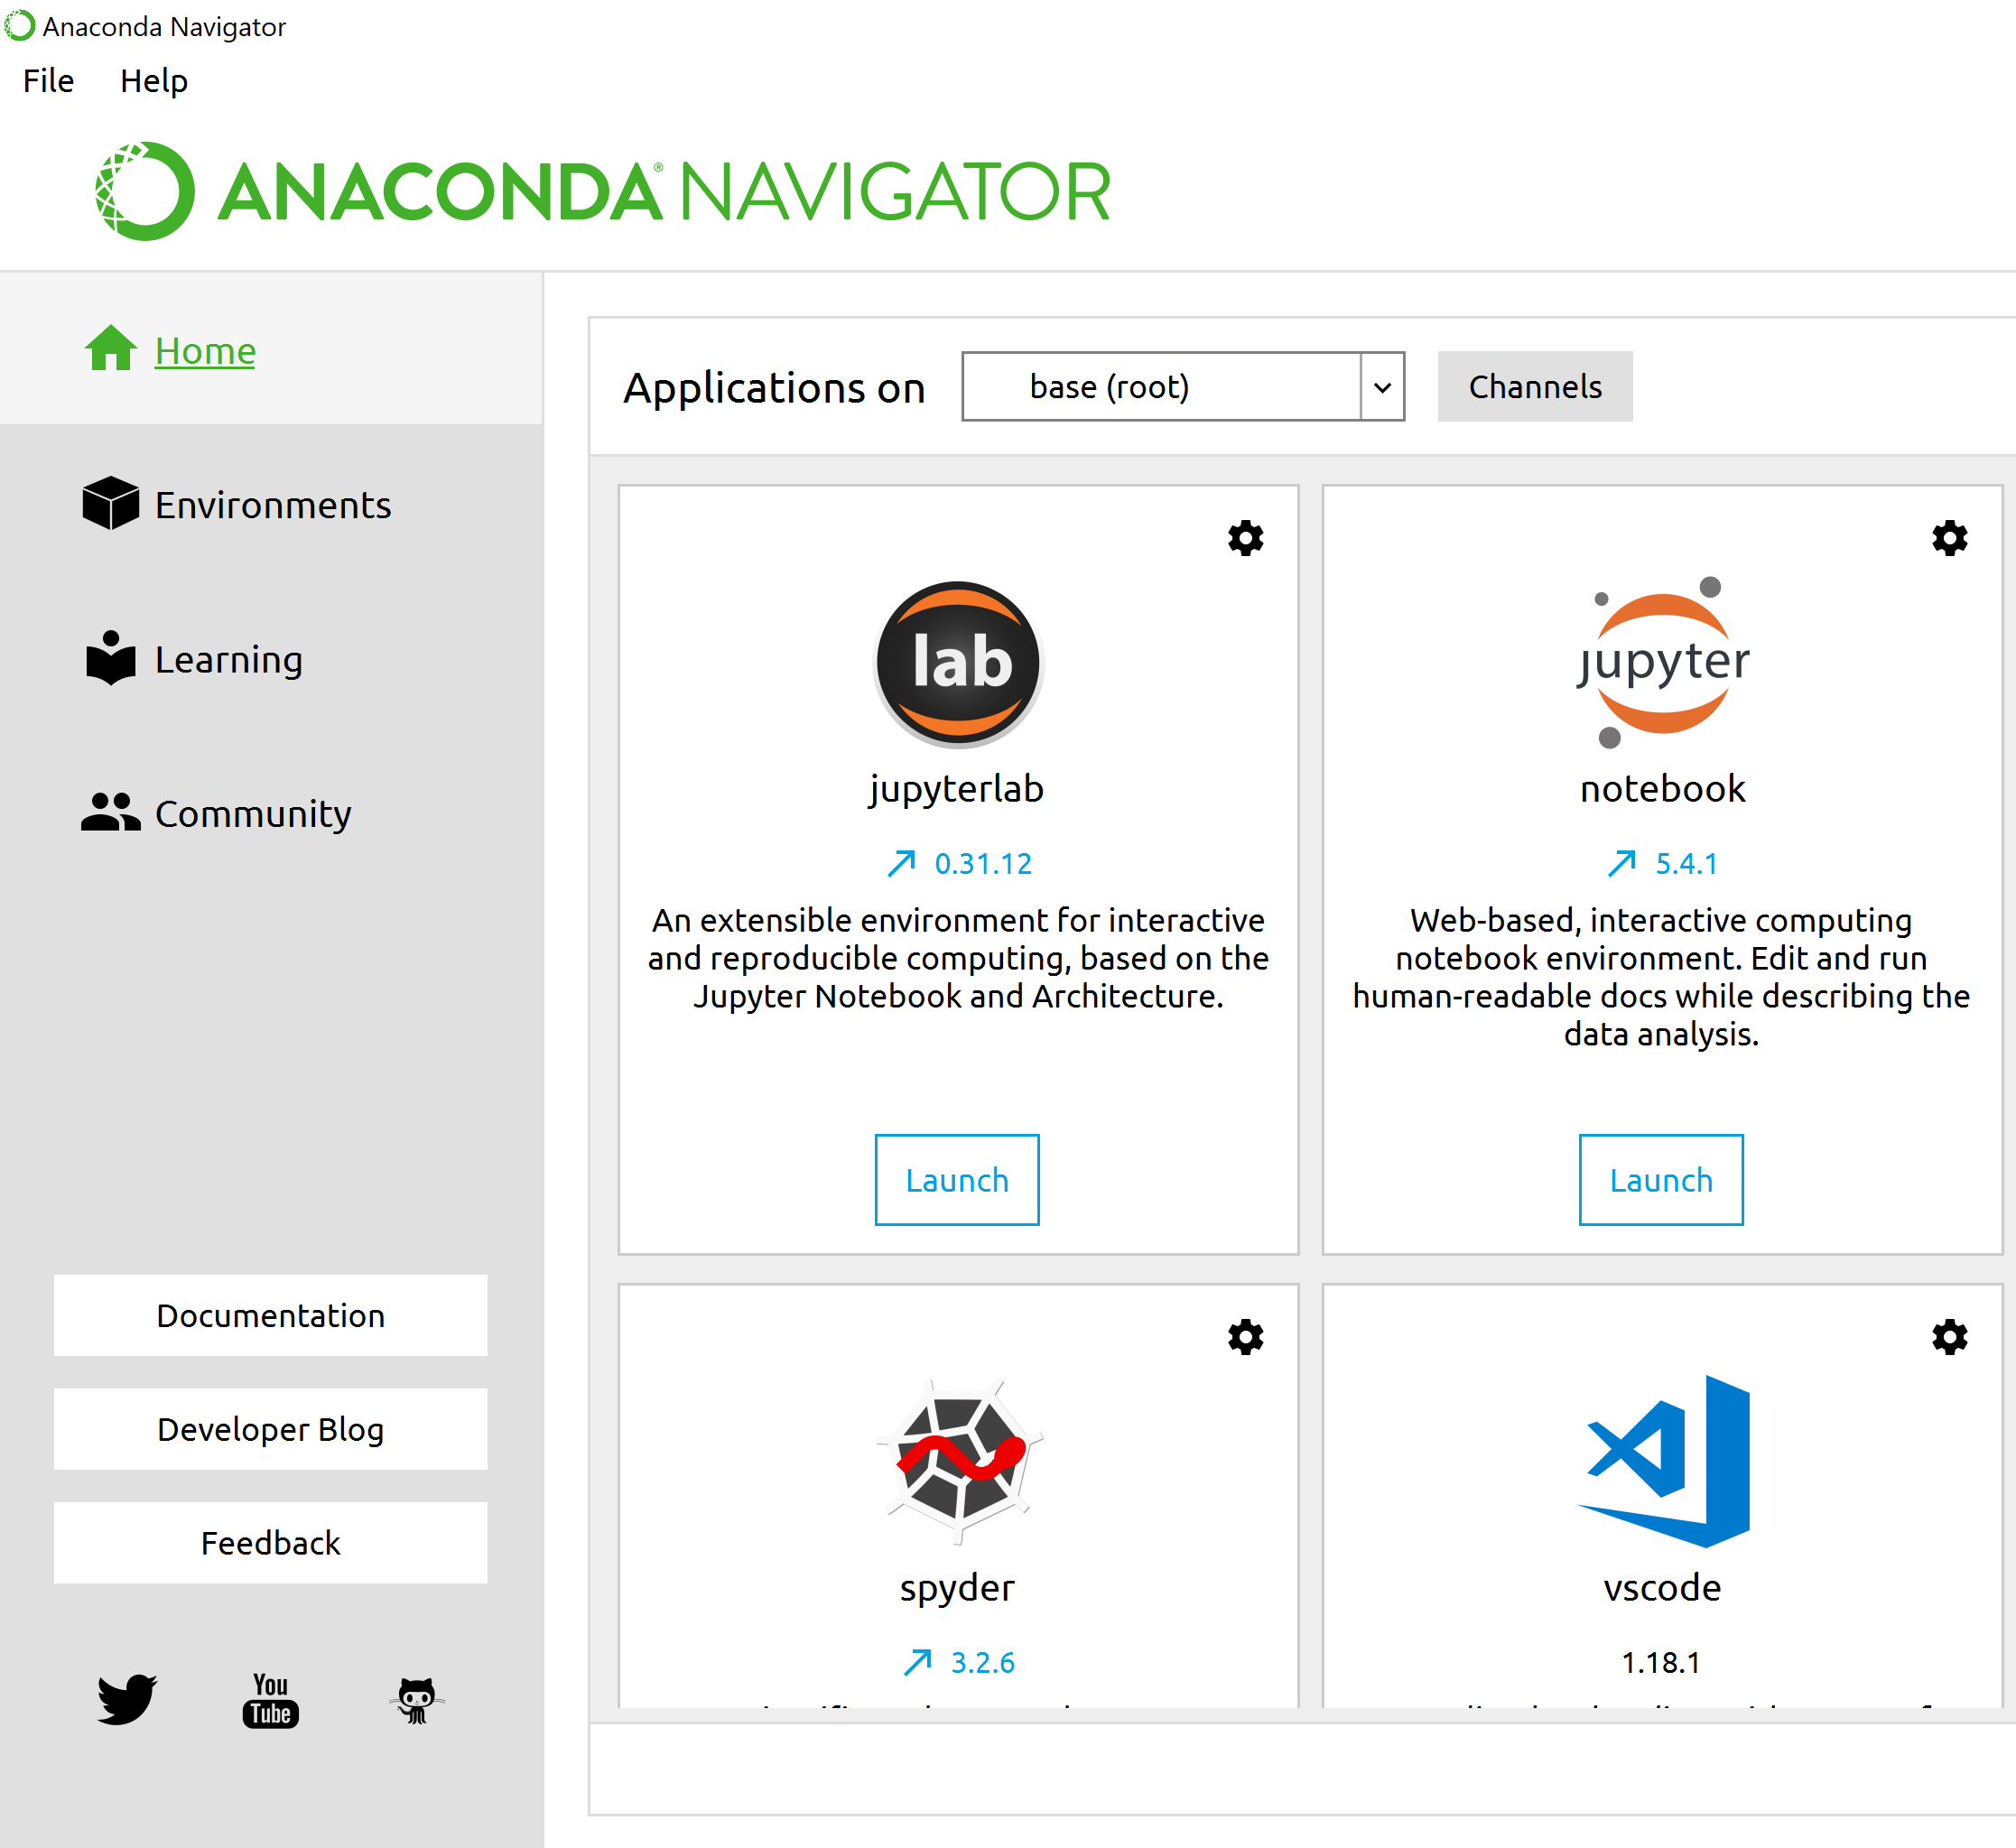
Anaconda Navigator
The Navigator is a main landing page for working with your python environment.
Here we can launch editors (spyder, jupyter notebook, etc.) to write and develop python code
In addition we can manage (install packages, etc.) our python environment
Notes:
Anaconda makes installing certain types of packages a lot easier (numpy, sklearn, tensorflow, etc.)
Anaconda ensures that all of these different tools run on the same version of python packages
Packages are so important because they enable us to use tested and pre-built functionality in python (ml algorithms/stats/etc.)

Slide 6
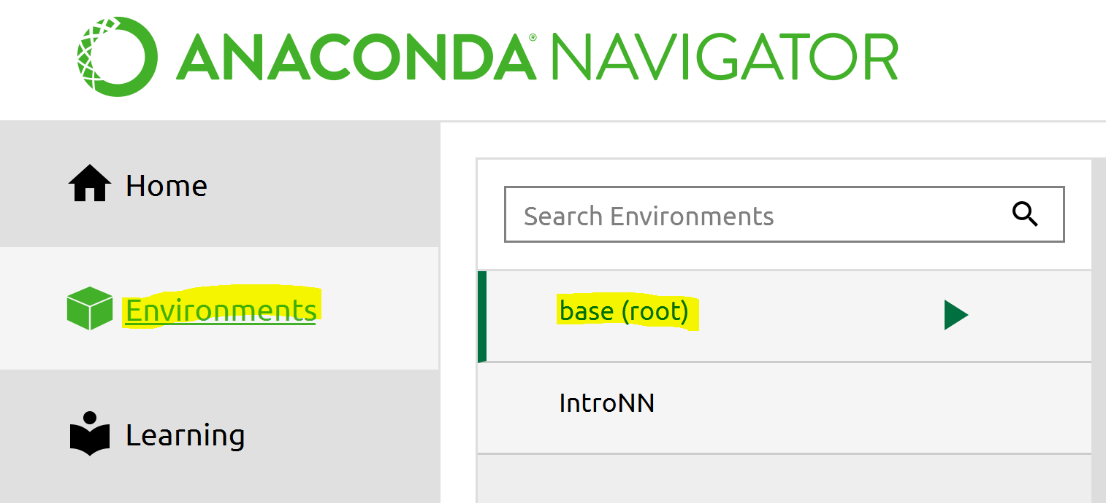
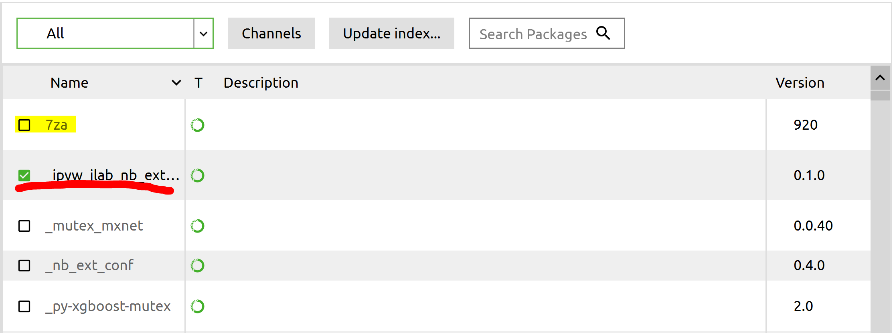
Anaconda Environments
Clicking on the “Environment” tab will show us what environments are available in Anaconda
In the simplest terms, an anaconda “environment” is a self-contained collection of python packages.
From the “Environment” tab we can see which packages are installed and which packages are available for installation.
If you click on a package for installation, you’ll be prompted to Apply your changes

Slide 7
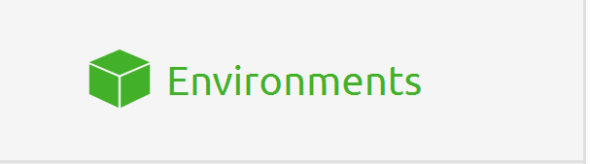
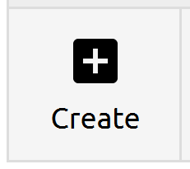
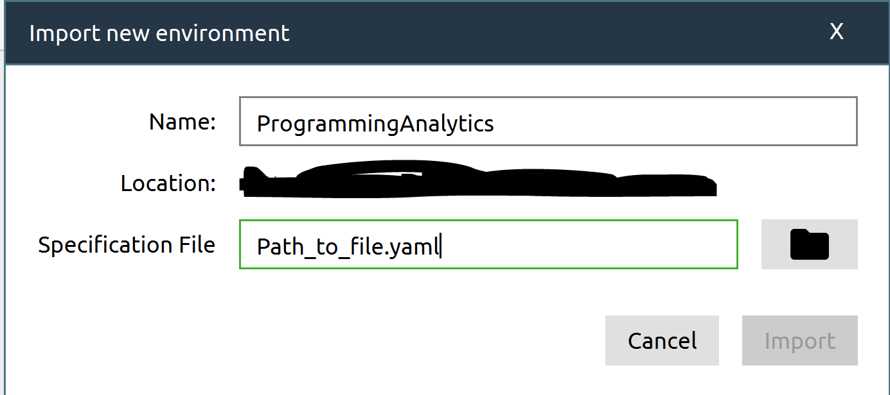
Setting Up Class Environment
For this class I’ve provided an environment file (and a package list) on blackboard. This environment should include all of the packages necessary for the class and can be installed as follows:
Navigate to the “Environment” tab in Anaconda.
Click on the “Create” button
Next fill in the specification file by navigating to the provided .yaml file
Import

Slide 8
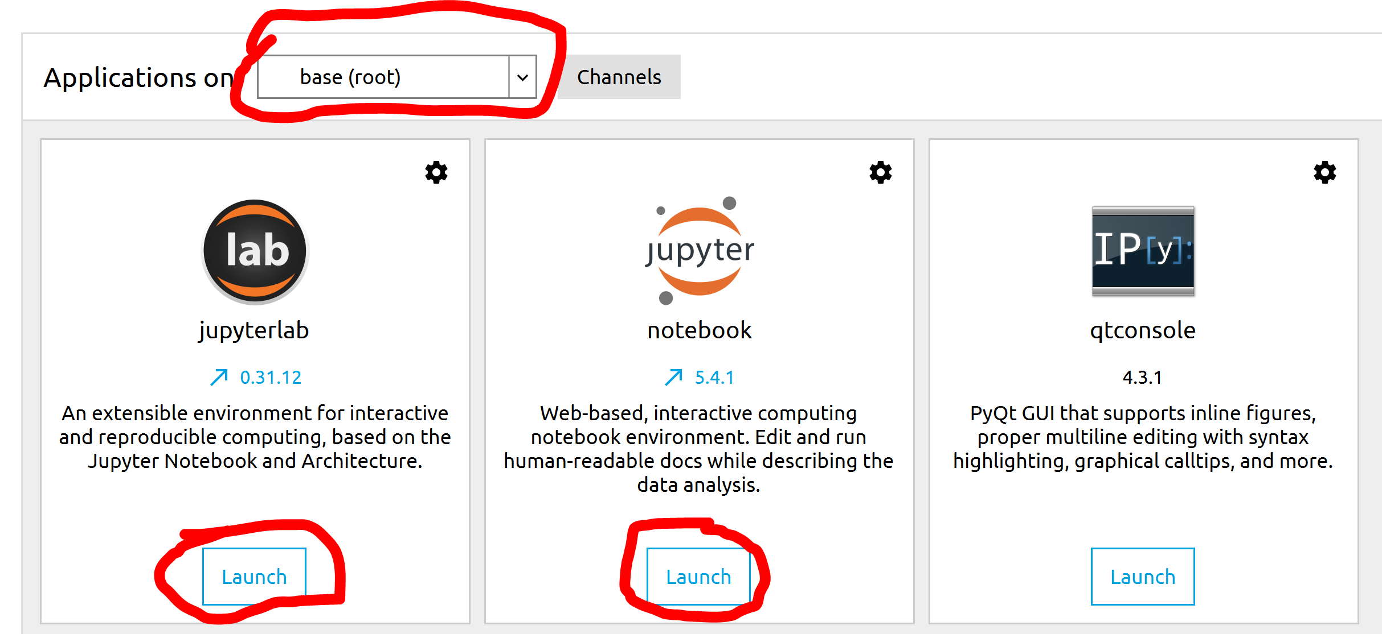
Anaconda Applications
On the home page we can choose which environment (base(root) in the image) we want to launch applications from.
Clicking the “Launch” button on any of these applications will launch a separate window.

Slide 9
Jupyterlab

Slide 10
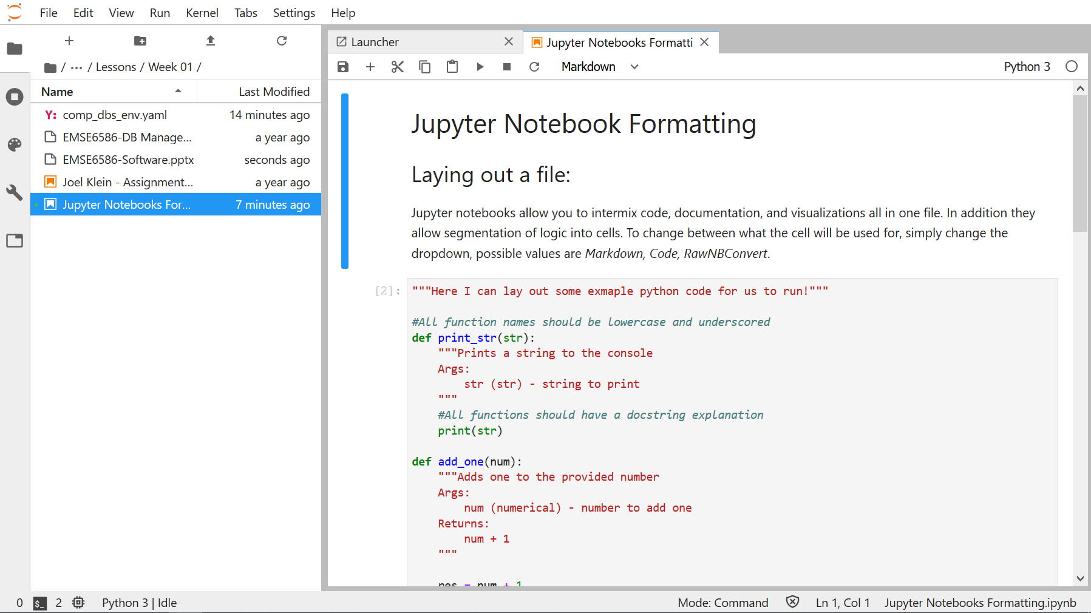
JupyterLab
Jupyter Notebooks and Jupyterlab are the IDEs we will use for this course.
Jupyter Notebooks are used heavily throughout this course, as they provide a means to intermix text, code, and graphics.

Slide 11
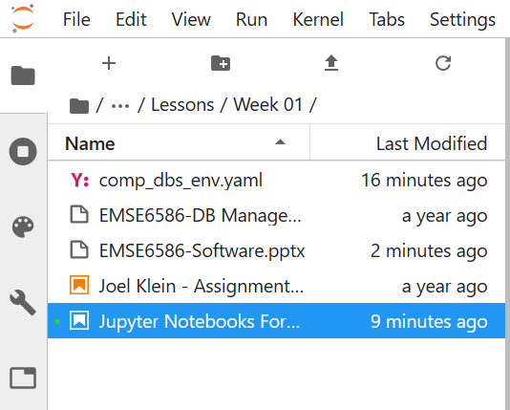
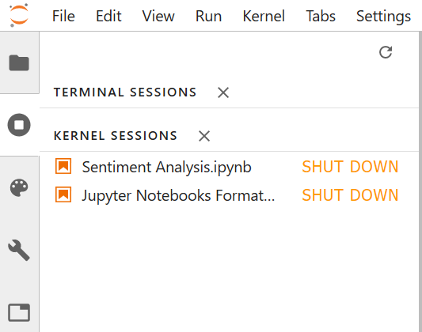
File Navigation and Kernels
We can navigate the file system using the left hand panel
In addition we can monitor the running kernels within that same panel

Slide 12
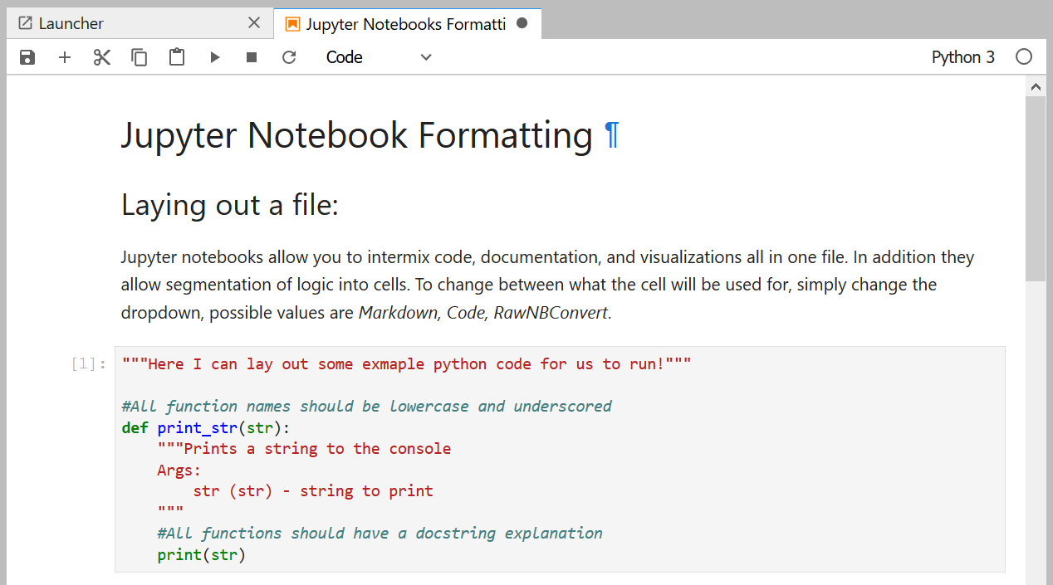
Working with Notebooks
Notebooks let us mark up (using markdown) our code to provide context and information.
The primary function is to provide cells of execution for our code/logic

Slide 13
The Databases

Slide 14
MySQL Type – SQL | Environment – AWS RDS
We will be interacting with an AWS RDS instance running MySQL to learn about SQL query languages
RDS supports several different SQL types
For non-programmatic access we will be utilizing MySQL Workbench (https://www.mysql.com/products/workbench/)
For programmatic access we will be using the pymysql package for python
This can be downloaded through anaconda or through pip

Slide 15
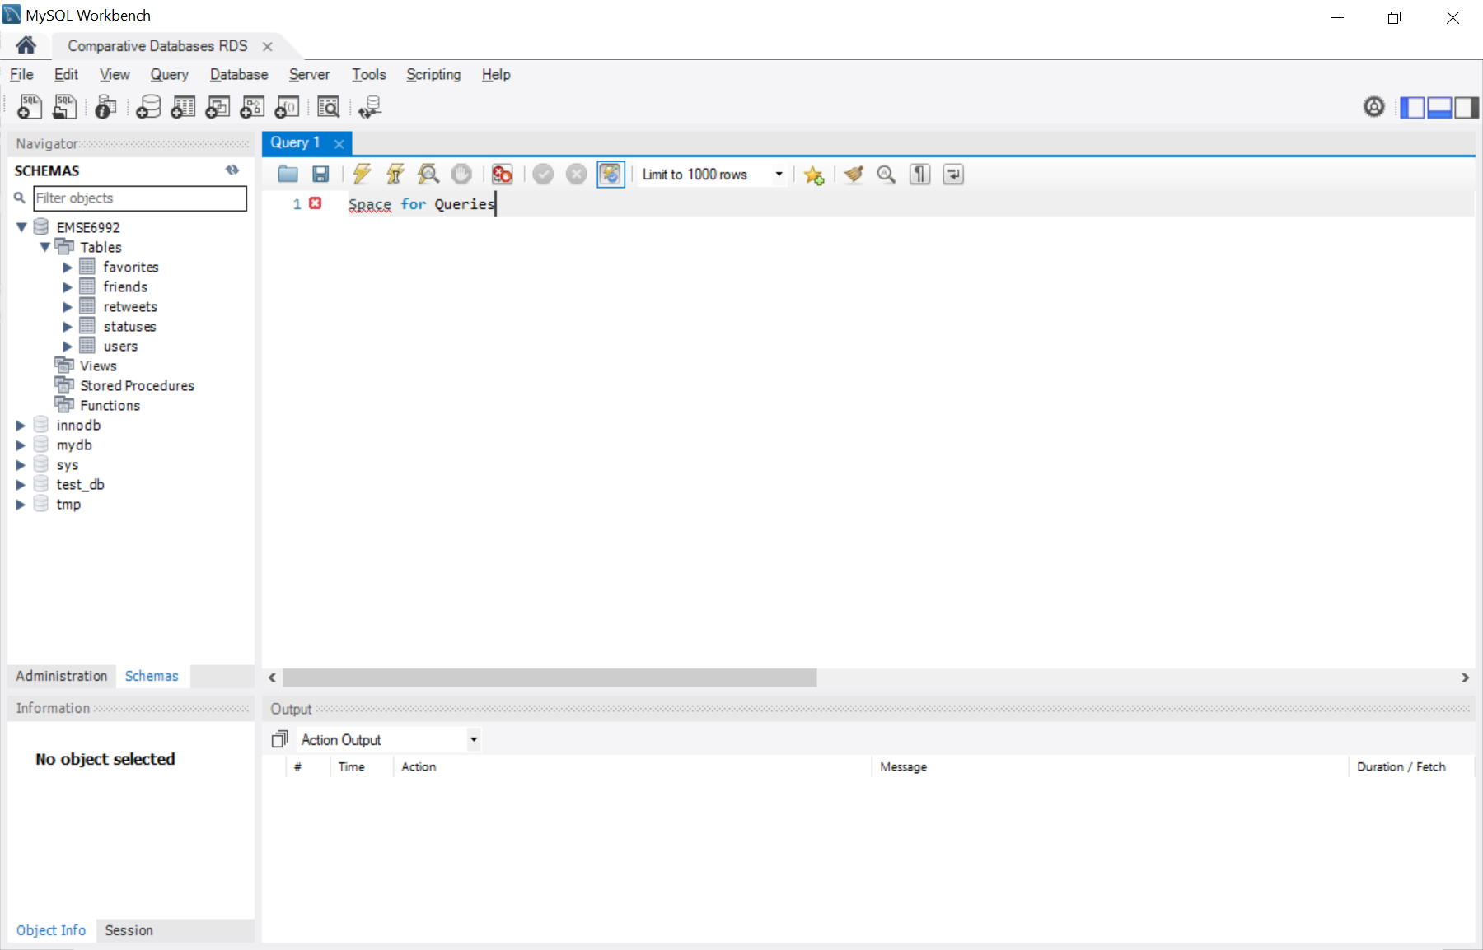
MySQL Workbench This is a free tool for managing MySQL instances and running queries and working with database schemas You can download it for free at: https://www.mysql.com/products/workbench/

Slide 16
Mongo DB: Type – Document | Environment – EC2 Instance
For this course we will be using an instance of Mongo DB running on an AWS EC2 instance
Alternatively, there is Azure Cosmos and AWS DocumentDB which both support the Mongo API in managed environments
For non-programmatic access we will be using Robo3T
For programmatic access we will be using python and the pymongo package

Slide 17
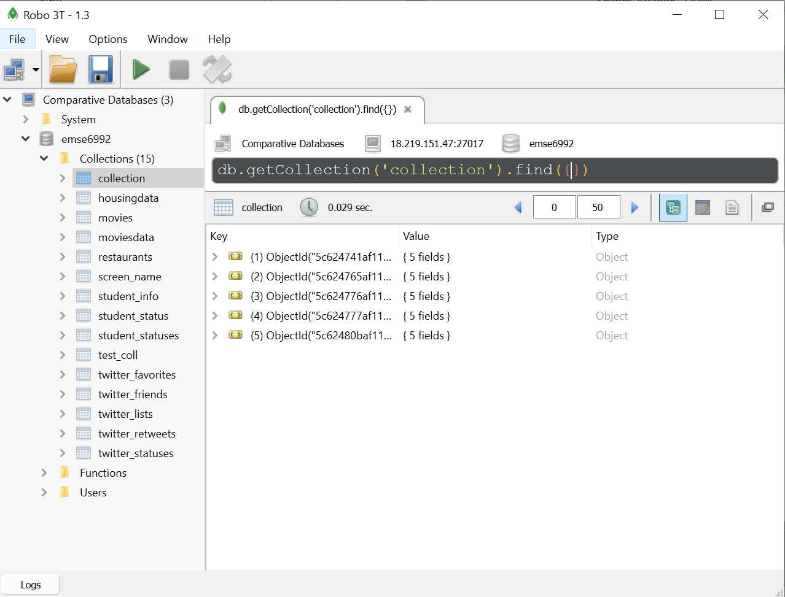
Robo3T This is a free tool for querying databases that support the mongo API and provides some minimal management options You can download it for free at: https://robomongo.org/download

Slide 18
Arango: Type – Graph | Environment – EC2 Instance
For this course we will be using an instance of Arango running on an AWS EC2 instance
Alternatives are Azure Cosmos and AWS Neptune for managed solutions
For non-programmatic access we will be using a web browser (http://18.219.151.47:8529)
For programmatic access we will be using python and python-arango package

Slide 19
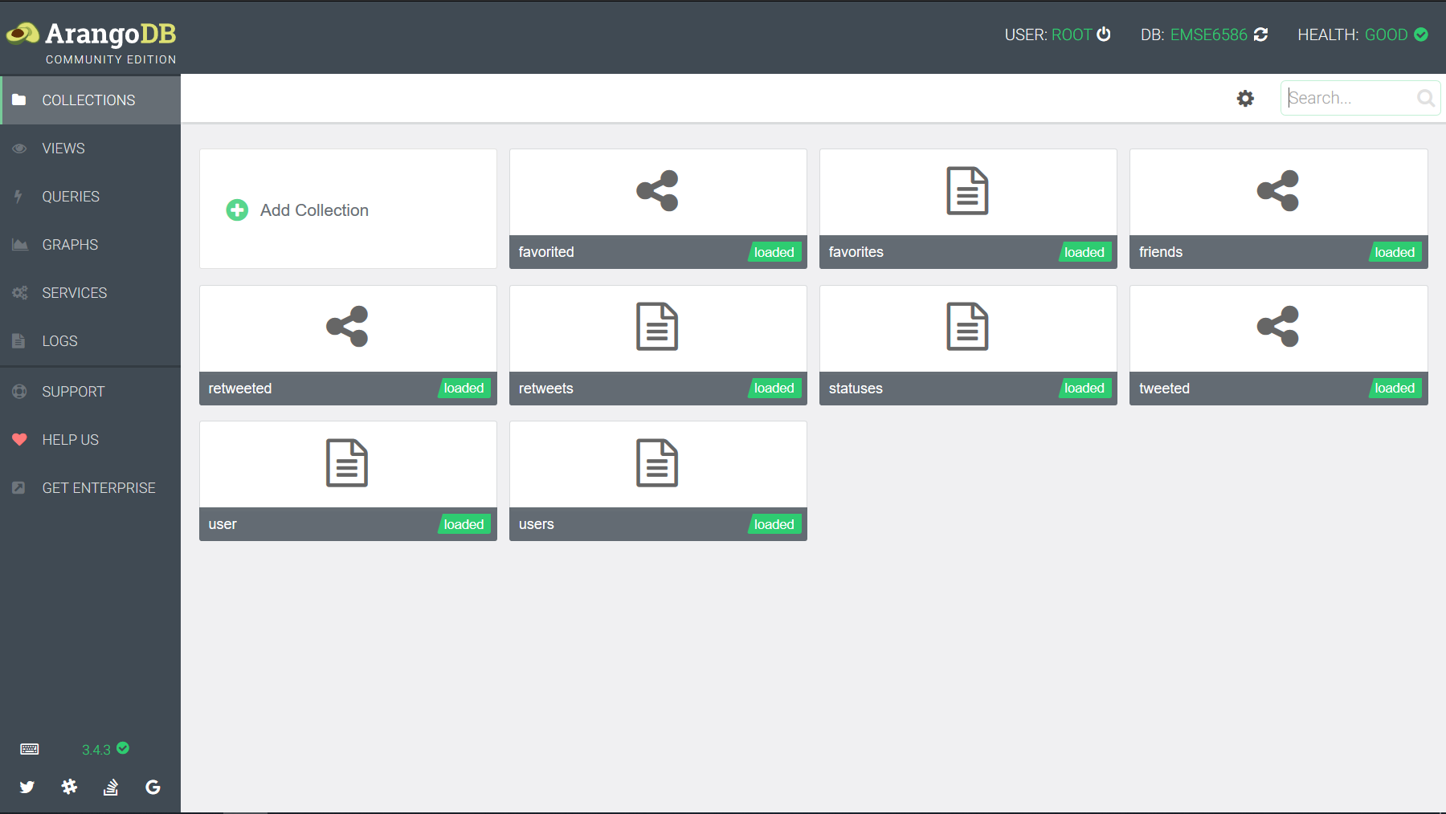
Arango Web-GUI Arango natively supports a web GUI for managing the database, running queries, and visualizing graphs You can download it for free at: http://18.219.151.47:8529

Slide 20
Cloud Database Solutions

Slide 21
Cloud Databases
While the means in which I host our database resources leverage cloud infrastructure, they are all open-source solutions not dependent on cloud infrastructure
The following database solutions are approaches to handling data that are more unconventional and rely more heavily on services.

Slide 22
Azure Cosmos
Azure Cosmos is a multi-model database provided by Microsoft on their Azure cloud.
Multi-Model means that the database supports multiple models of interacting with the data
The benefits of Cosmos is that it provides the following:
Managed Solution
“Infinitely” scalable
Multi-Model
Etc.

Slide 23
AWS Athena
AWS Athena is Amazon’s approach to SQL-like access to static files.
Essentially Athena is focused on providing queryable access to files stored in S3
The benefits of Athena are:
Quick and Flexible access to existing data
A Serverless approach to SQL-like interfaces

Slide 24
Hadoop and Spark

Slide 25
Hadoop/Spark Infrastructure
Time permitting we will also dive into the Hadoop and Spark architecture
Hadoop is a pseudo database architecture that has evolved into a ecosystem of tools and services for processing large volumes of data

Slide 26
End Slide EMSE 6586 – DBMS for Data Analytics

Slide 27
Environment Problems?

Slide 28
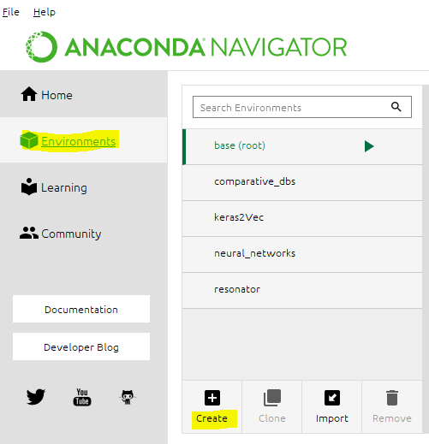


Pip Install to Environment
If Anaconda gives you some problems with environment yaml file, then pip is your next best option.
To install via pip, you’ll want to create a new environment manually.
Click on on the left-hand side
Click on at the bottom

Slide 29
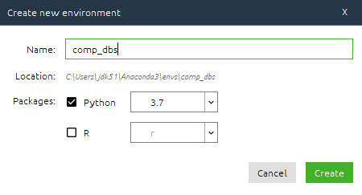
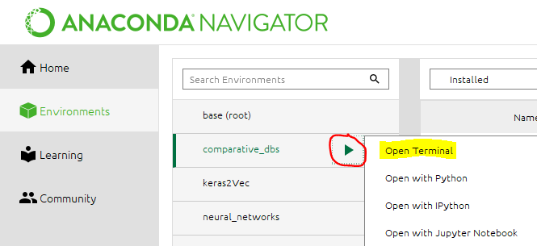
Creating a New Environment
In the resulting pop-up
Provide a name for the environment
Select “Python 3.7”
Once the environment is created, you’ll need to open a terminal.
Click on your environment
Hit that appears
Click on “Open Terminal”

Slide 30
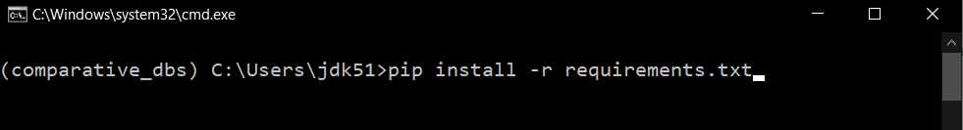
Finally Pip Install
In the resulting window you’ll be able to install the requirements for the environment.
Simply run “pip install –r requirements.txt”
Note: Make sure that you provide the correct pathing to the requirements.txt file

