Slide 1
DB Management Systems Distributed: Hadoop
Joel Klein – jdk514@gwmail.gwu.edu

Slide 2
Hadoop Architecture

Slide 3
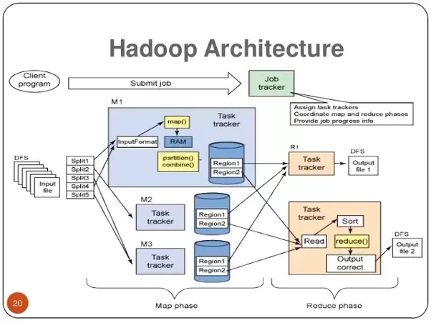

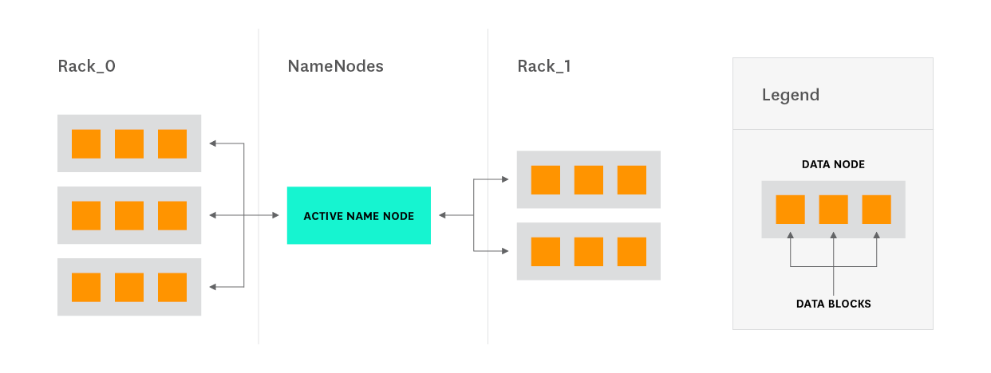
Hadoop Architectural Diagram
Complex
Simple
Notes:
Sources: https://www.datadoghq.com/blog/hadoop-architecture-overview/, http://hadoop.apache.org/docs/current/hadoop-project-dist/hadoop-hdfs/HdfsDesign.html, https://drive.google.com/file/d/0B-zw6KHOtbT4MmRkZWJjYzEtYjI3Ni00NTFjLWE0OGItYTU5OGMxYjc0N2M1/view

Slide 4
NameNode
Think of this as the master node.
It is the node a user actually interfaces with to input commands/configuration
It doesn’t need to necessarily be a powerful machine (specs wise) as it doesn’t do any of the heavy lifting

Slide 5
DataNode
DataNode’s represent the true brute force behind the Hadoop framework.
They are the nodes that both store and process the data used by Hadoop’s MapReduce processes
DataNodes typically consume/store data through HDFS, but there are other options:
S3, FTP, local filesystem, Azure, Swift(??)
These machines are usually beefier than the NameNode, as they need to be able to process large amounts of data quickly

Slide 6
MapReduce
MapReduce isn’t really a “component” of Hadoop, but rather the algorithm that makes Hadoop work.
MapReduce works under two basic principles
Map a function across data on the datanodes
Reduce the results to create a composite answer that can be returned
This is critical to distributed computing, as it removes the dependency on locality of the data being processed.

Slide 7
Uploading Data

Slide 8
S3 (Simple Storage Service)
For us to explore anything within the Hadoop framework, we'll need some data to work with.
In Blackboard there is a ratebeer.zip archive with the files we'll be uploading
S3 is effectively a cloud-based file directory. It allows us to store and access files for use within a range of AWS services.
To create the correct environment, we'll need to setup a directory for use.

Slide 9
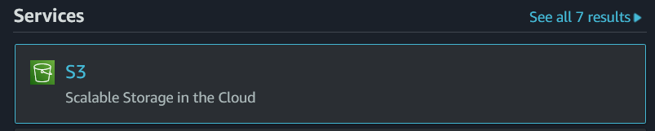




Initializing Our Bucket
Navigate to the S3 service's landing page
Click
Provide a Bucket Name
Note: Bucket names must be AWS unique
Click at the bottom of the page
Click on your bucket –
Click
Drag and drop your files

Slide 10
Hadoop on AWS

Slide 11
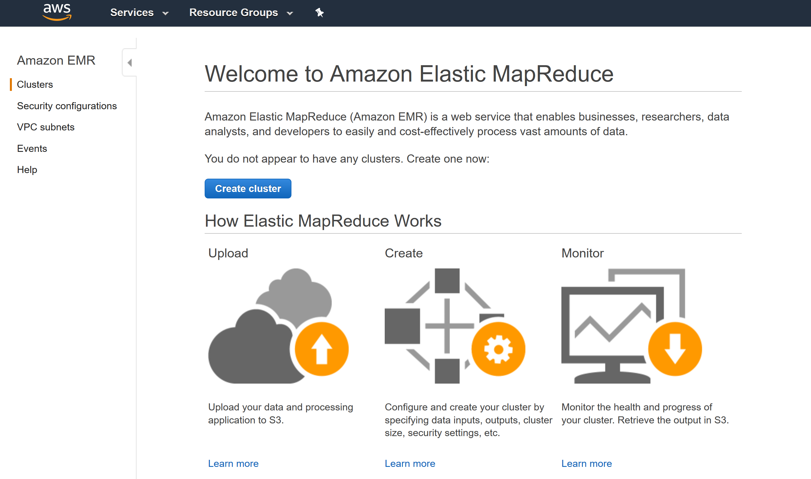
EMR (Elastic Map Reduce)

Slide 12
EMR cont.
EMR is amazon’s answer to easily scalable and demandable Hadoop clusters
Since Hadoop clusters can easily leverage AWS S3 storage, they focus on providing bursts of massive processing rather than more permanent infrastructure
Thus, EMR relies heavily on creation scripts and automatic processing of clusters to make demand when needed and remove it when it is not.

Slide 13
Security for EMR

Slide 14
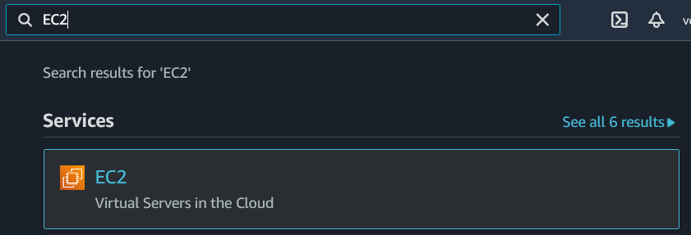
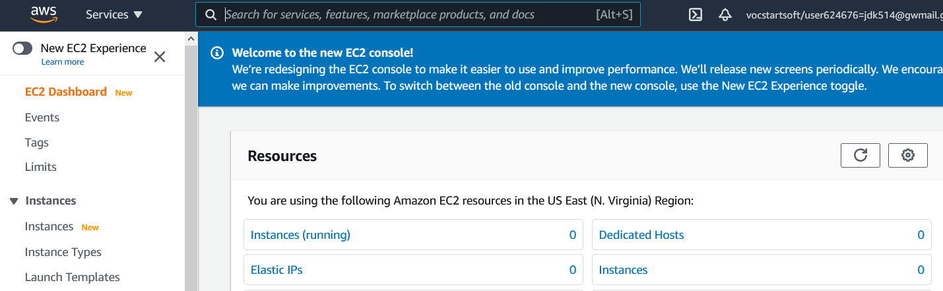
Key-Pair
To connect and work with our EMR cluster we’ll need to SSH into the namenode
To accomplish this, we’ll need to create a key-pair to authenticate our connection
To start, we'll need to navigate to the EC2 service within our AWS console (accessed through the AWS Educate classroom).

Slide 15
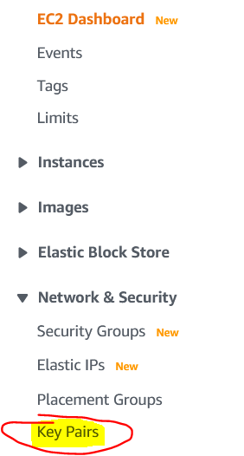
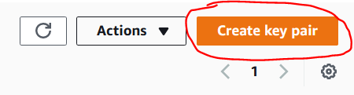
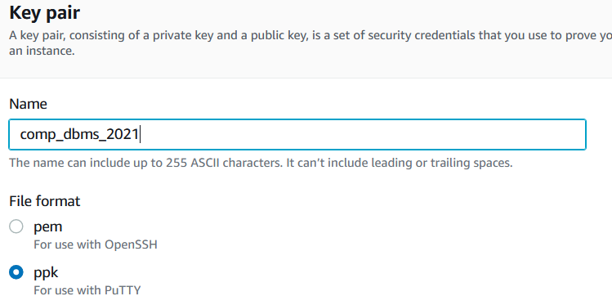
Creating Our Key-Pair
On the EC2 page, there is an option for Key Pairs on the left-hand side
Within the Key Pair page, click Create key pair
Give the key pair a name
Select your format (ppk for windows, pem for Mac/Linux)

Slide 16
Creating Our EMR Cluster

Slide 17
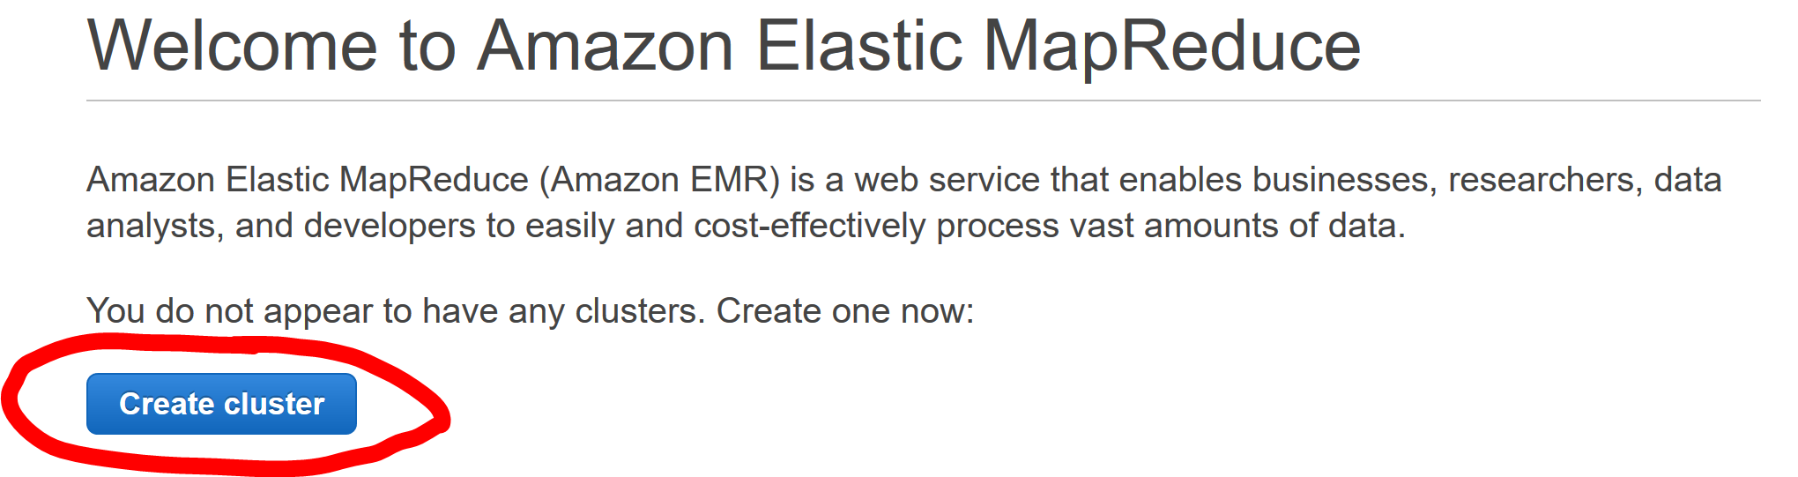
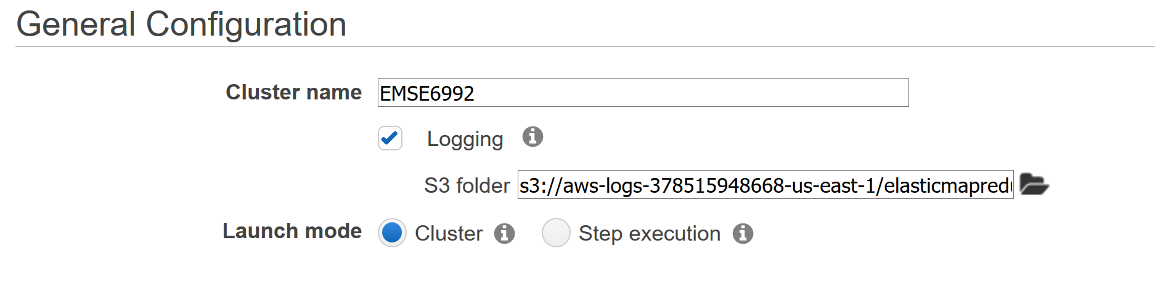
Creating an EMR Cluster
Start creating a cluster:
Define Cluster:
NOTE: “Launch mode” defines how we initialize our cluster. “Step execution” enables us to define certain configuration or setup processes to run while creating our cluster (not necessary for our purposes).

Slide 18
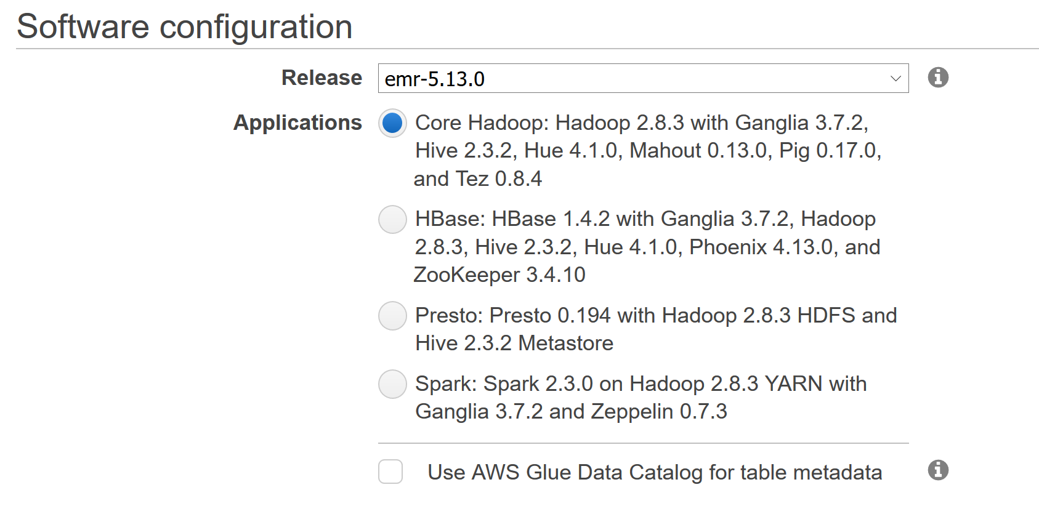
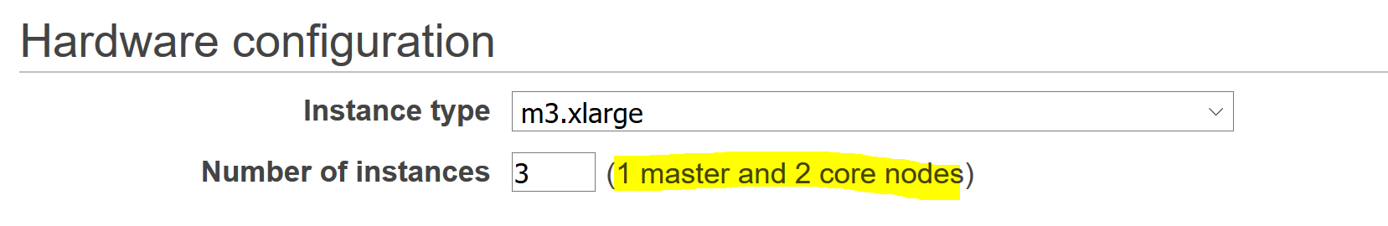
Creating an EMR Cluster cont.
Defining Software:
Defining the Nodes:

Slide 19
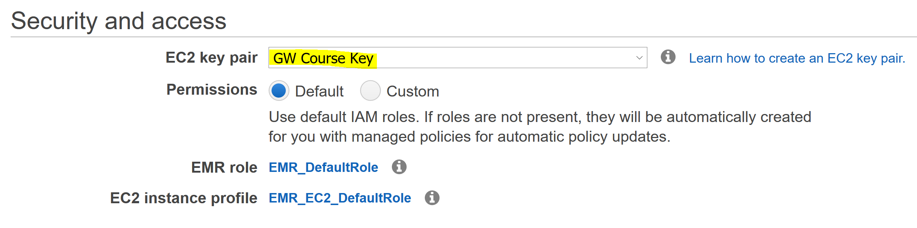
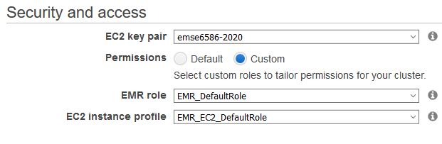
Creating an EMR Cluster cont.
Defining Security:
This defines the credentials to access the cluster
Defining Roles:
Select Custom permissions and provide the roles we created earlier

Slide 20
Accessing Our EMR

Slide 21
Access Through Shell/SSH
AWS launches an EC2 (Virtual Machine) instance for each node, but we typically only connect to the namenode.
We connect to the namenode, as this is where commands are executed
The EC2 instance does not have a graphical interface and thus we connect via SSH (directly into the terminal)
The endpoint and security keys are designated during the creation of the cluster and the EC2 pair key

Slide 22
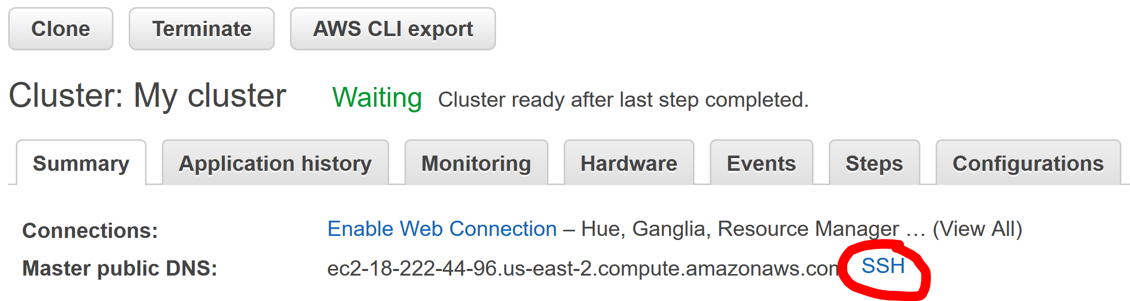
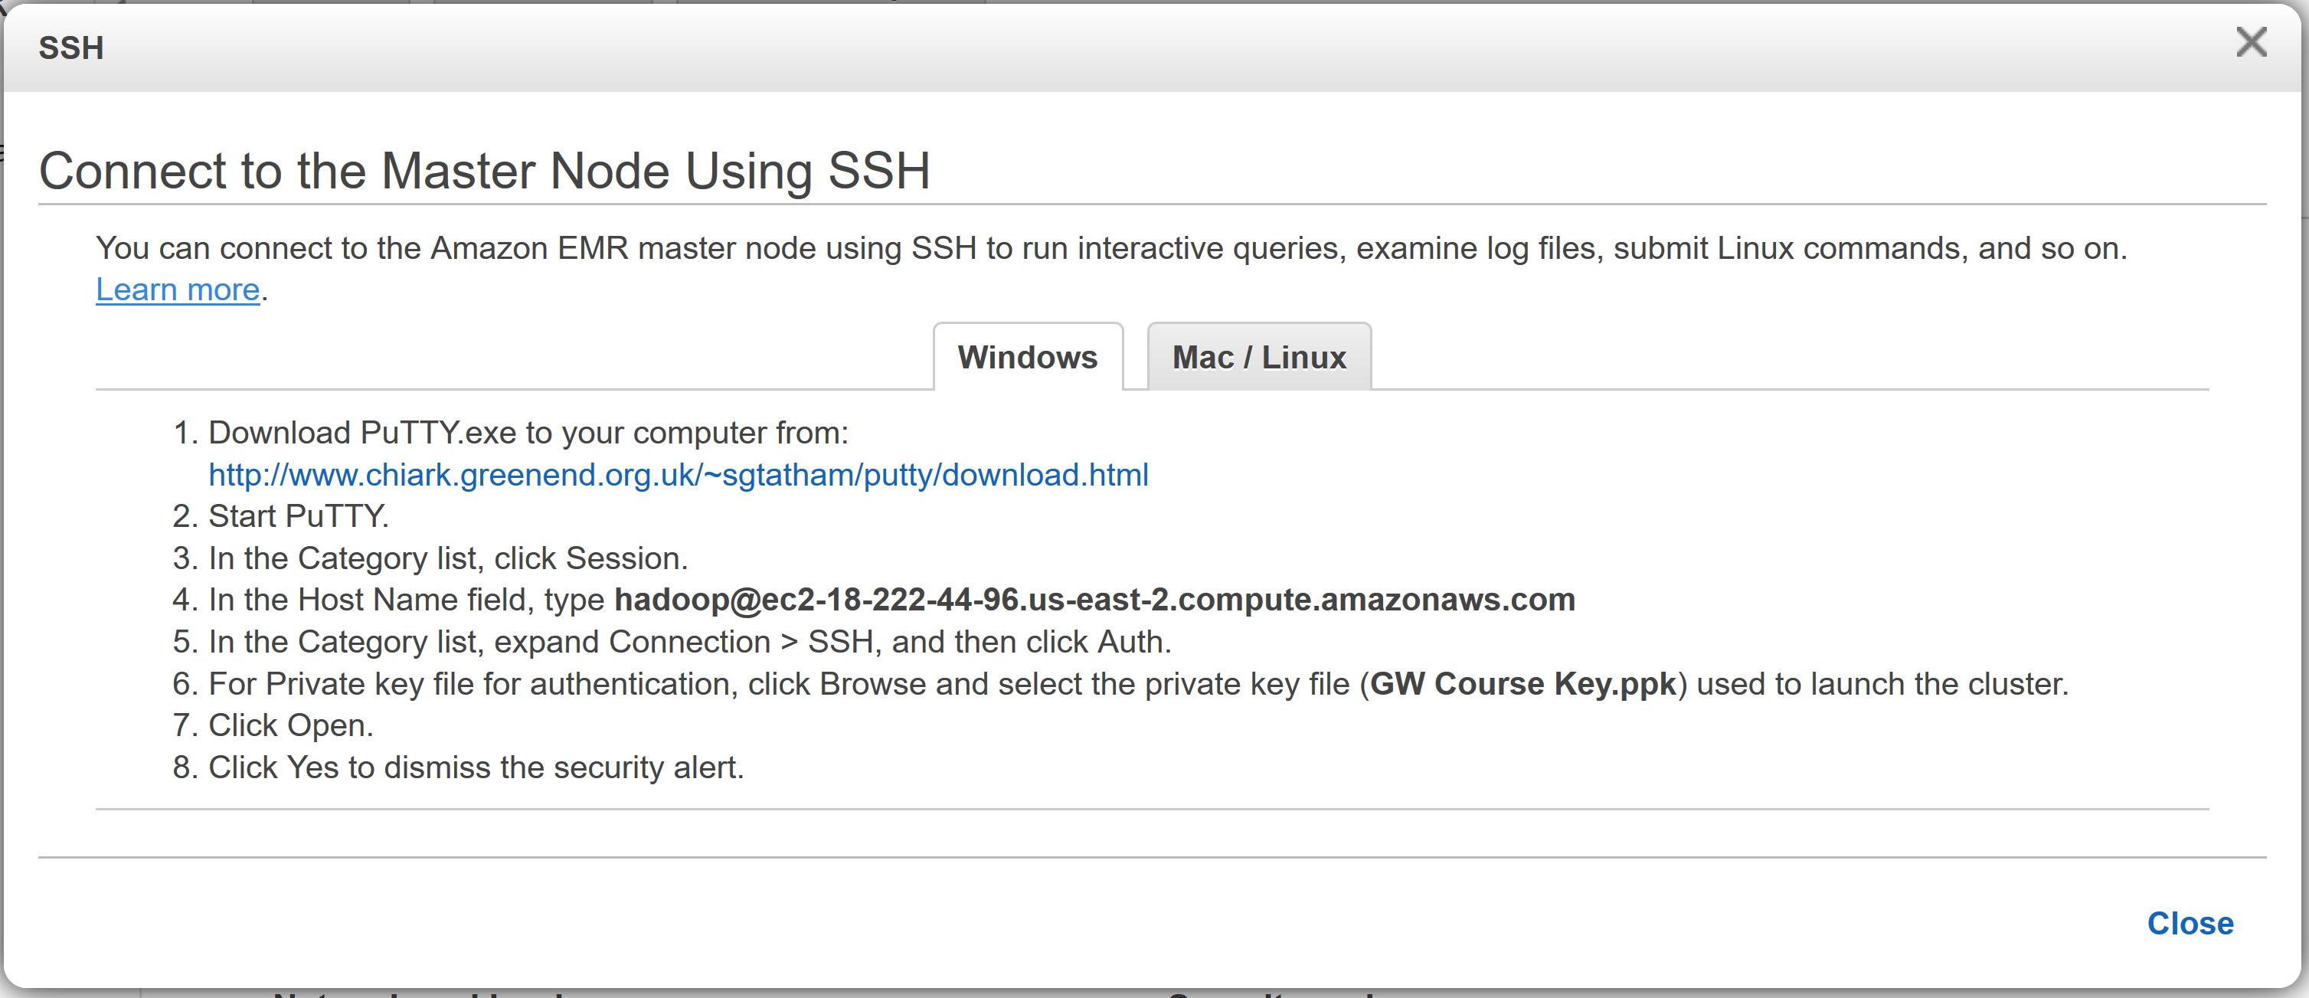
SSH Endpoint
Finding our endpoint:

Slide 23
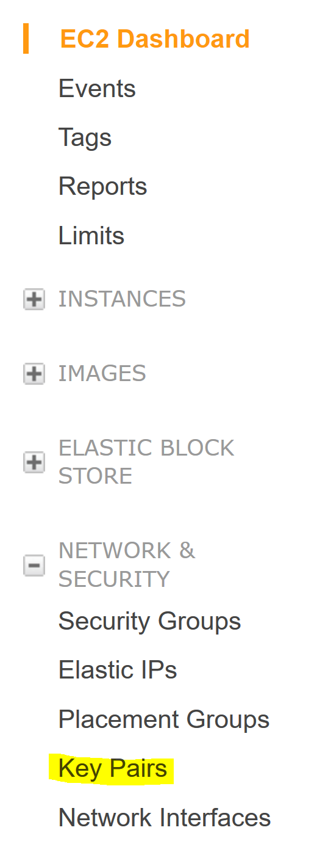
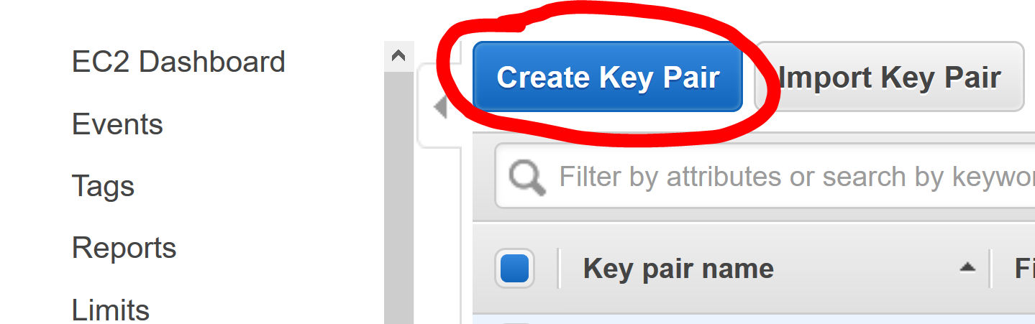
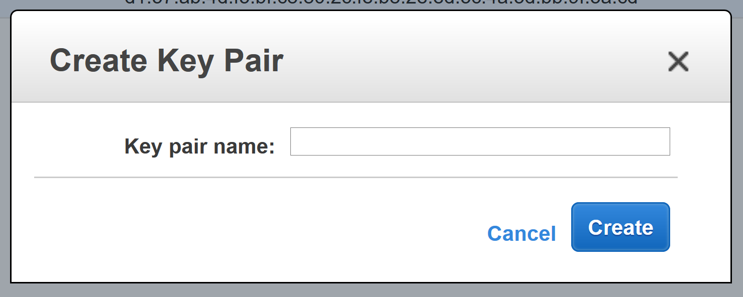
SSH Security Key
Finding our security key:
Note:
The EC2 key pair is something defined at the EC2 level. It defines an RSA key that can be used as credentials for connecting to EC2 instances.

Slide 24
Using the Endpoint and Security Key to SSH
Ultimately the “how” on the SSH side is platform dependent
Macs and Linux machines have SSH built-in
Windows typically use Putty
When connecting via SSH there are a couple key important steps
IP Address: hadoop@{endpoint}
Port: 22 (unless defined otherwise)
Key: EC2 key-pair (if defined during cluster creation)

Slide 25
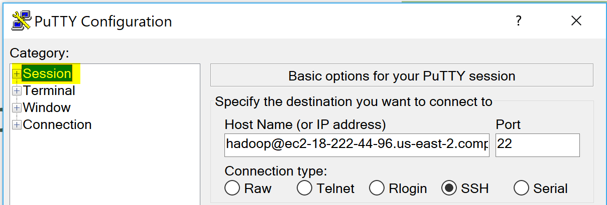
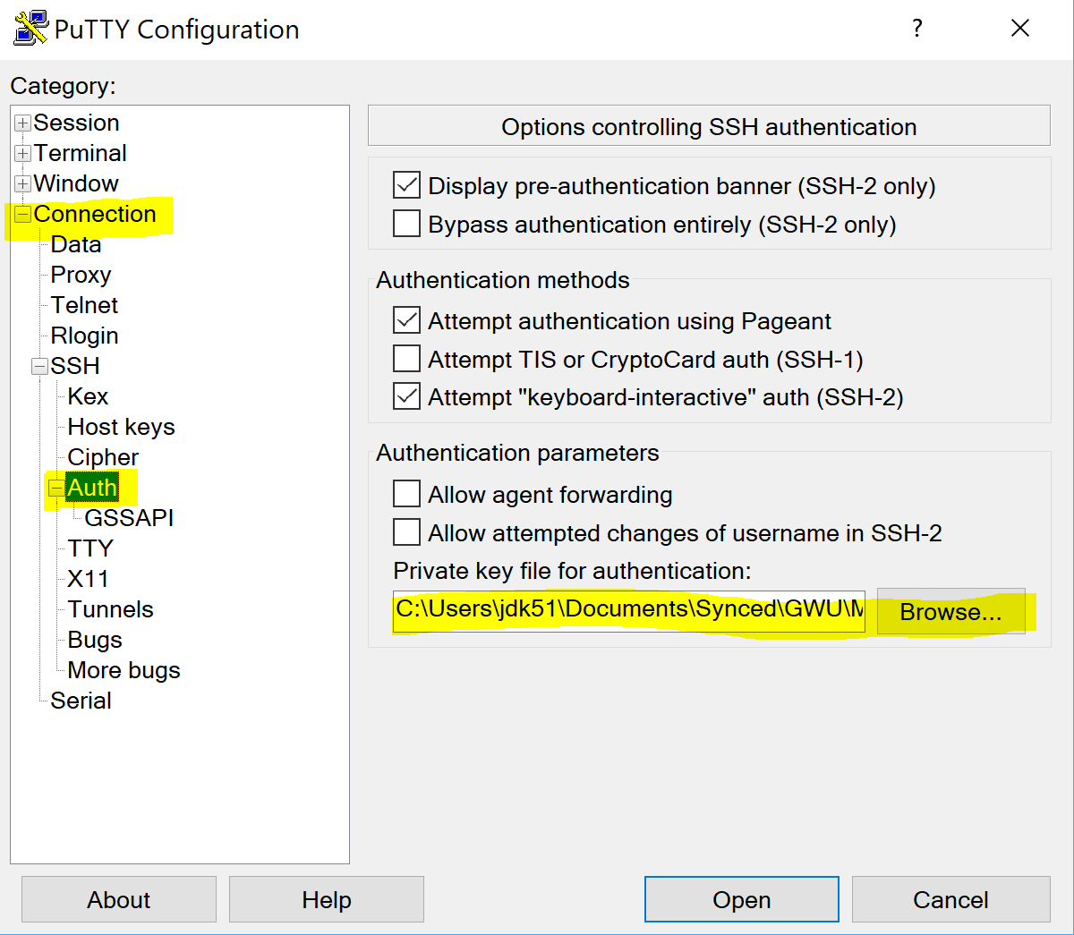
Putty Example
IP and Port:
EC2 Key-Pair:

Slide 26
Mac/Linux Example
ssh –i /path/to/key-pair.pem hadoop@namenode_address
Here we see another example of a flag in a command
The –i flag states the identifier file used to authenticate

Slide 27
Hadoop Terminal

Slide 28
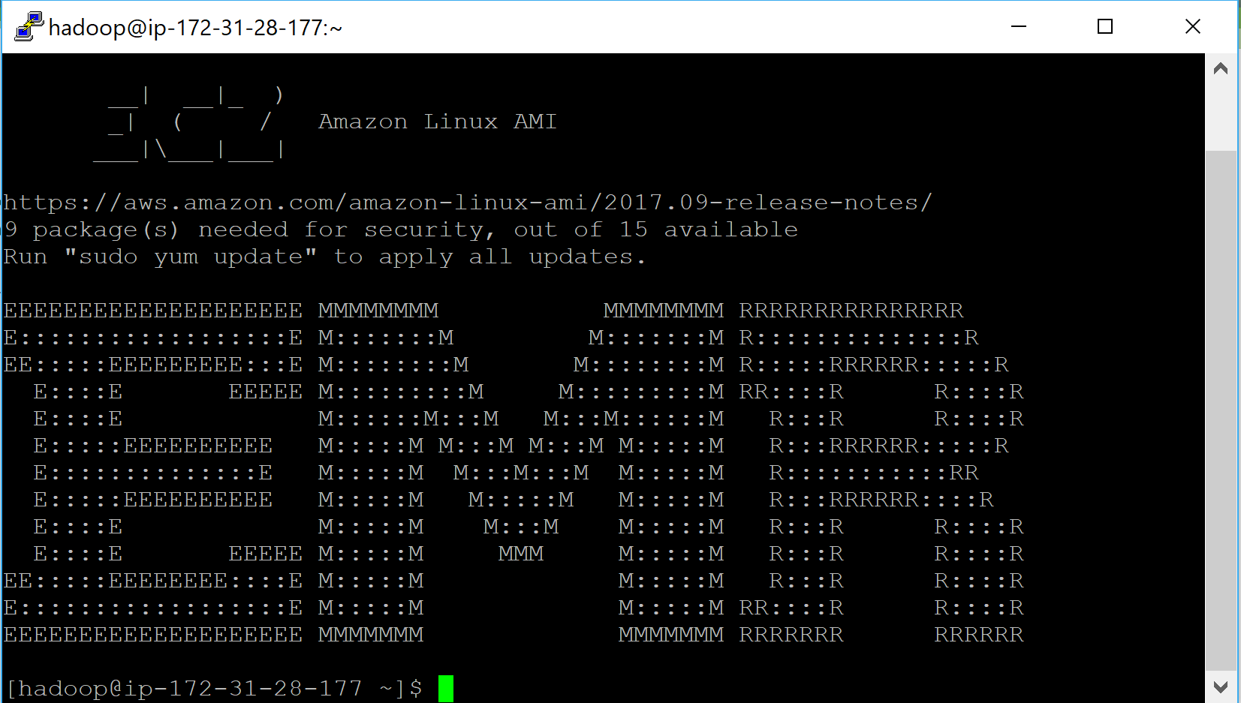
Once Connected Via SSH
If everything was done correctly, we should be met with the following:

Slide 29
Hive
Sadly, the terminal isn't very useful to us
Instead to leverage Hadoop/our cluster, we need to leverage the installed software.
Our focus today will be on Hive
Hive is essentially a SQL interface for working with data stored in Hadoop

Slide 30
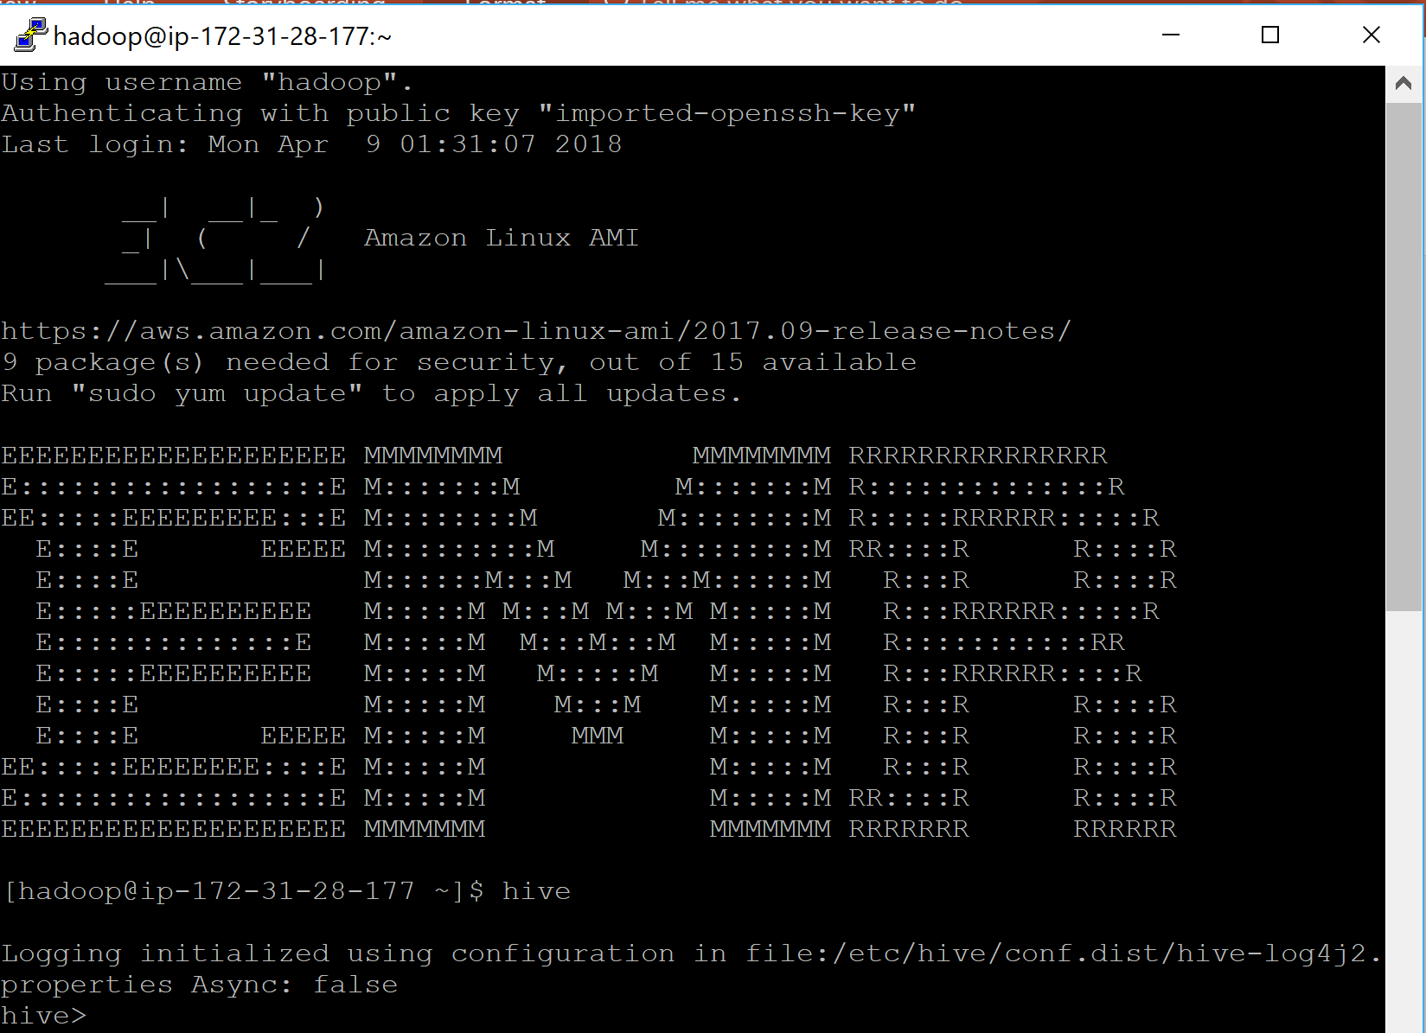
Connecting to Hive
From the terminal, we are can easily connect to hive
We simply run: $ hive
This should produce the hive interface: hive >

Slide 31
Hive

Slide 32
What is Hive?
As mentioned earlier, Hive is essentially a SQL interface for working with Hadoop.
This may raise the question of why?
Why Hive is so useful is that it allows us to create a SQL-like representation of our data in Hadoop.
Remember that Hadoop is for storing/processing terabytes of data per node (in the more extreme cases).
Thus, Hive enables us to run standard queries against data that cannot fit in a normal relational database (MySQL, SQL Server, SQLite, etc)

Slide 33
SQL Interface?
When I say SQL interface, it means that Hive doesn’t actually run SQL
Hive only enforces schema on read
This means that Hive doesn’t load all the data in Hadoop into tables for querying. Instead, it reads the data and parses it as if it was in the table structure
This means that Hive can be pointed at any data source that we can coerce into a table-like structure

Slide 34
Creating a Hive Table

Slide 35
Defining a Hive Table
When defining a Hive table we need to know a couple of things:
Data Source (S3, HDFS, Azure, etc)
Format of the Data (CSV, JSON, TXT, etc)
This includes data types (string, int, double, etc)
External vs Internal (Does Hive own the data?)
With the answers to these questions we can now run:
CREATE {External/Internal} Table {Table Name} (
{col name} {col type},
) LOCATION {url to data};
Notes:
Hive tables can be created as EXTERNAL or INTERNAL. This is a choice that affects how data is loaded, controlled, and managed.
Use EXTERNAL tables when:
The data is also used outside of Hive. For example, the data files are read and processed by an existing program that doesn't lock the files.
Data needs to remain in the underlying location even after a DROP TABLE. This can apply if you are pointing multiple schemas (tables or views) at a single data set or if you are iterating through various possible schemas.
You want to use a custom location such as ASV.
Hive should not own data and control settings, dirs, etc., you have another program or process that will do those things.
You are not creating table based on existing table (AS SELECT).
Use INTERNAL tables when:
The data is temporary.
You want Hive to completely manage the lifecycle of the table and data.

Slide 36
Beer Data
I’ve loaded a number of records into S3 based on beer ratings
These ratings are in JSON format
Using this data, I can create an External Hive Table with the following:
CREATE EXTERNAL TABLE beer (`beer/beerId` string, `beer/brewerId` string, `beer/ABV` double) ROW FORMAT SERDE 'org.apache.hive.hcatalog.data.JsonSerDe' LOCATION 's3n://compdbms-spring-2021-jk/ratebeer/';
Note: {ROW FORMAT SERDE 'org.apache.hive.hcatalog.data.JsonSerDe’} is stating that I will be using the apache hive Json serializer/deserializer for processing the files
Notes:
set hive.cli.print.header=true;
CREATE EXTERNAL TABLE beer (
`beer/name` string,
`beer/beerId` string,
`beer/brewerId` string,
`beer/ABV` string,
`review/appearance` string,
`review/aroma` string,
`review/palate` string,
`review/taste` string,
`review/overall` string,
`review/time` string,
`review/profileName` string,
`review/text` string) ROW FORMAT SERDE 'org.apache.hive.hcatalog.data.JsonSerDe' LOCATION 's3n://hadoop-data-emse6992/ratebeer_small_json/';

Slide 37
Querying Hive

Slide 38
Querying in Hive
One of the primary benefits of Hive is that it imitates SQL.
This means everything we know about SQL is fairly applicable to Hive
The main reason for the imitation is the fact that SQL is still used very extensively for data processing and analysis, thus integrating with SQL makes Hadoop integratable with other processes

Slide 39
Proof of Parity
Lets run a quick example:
“SELECT * FROM beer LIMIT 10;
For an outside perspective:
https://hortonworks.com/blog/hive-cheat-sheet-for-sql-users/

Slide 40
Some Queries to Run
Select sum(cast(`beer/beerid` as int)) From beer;
Select sum(distinct(cast(`beer/beerid` as int))) From beer;
Select avg(split(`review/overall`, '/')[0]) From beer;
SELECT avg(length(`review/text`)) as avg_len, std(length(`review/text`)) as std_len From beer;
SELECT `review/text` as rev, length(`review/text`) as len from beer where length(`review/text`) > (218.16 + 343.28) limit 2;

Slide 41
DELETE YOUR EMR CLUSTER!!!
EMR clusters are running multiple expensive EC2 clusters – so we don’t want to leave it running or you’ll have no money left ☹

Slide 42
End Slide EMSE 6992 – DBMS for Data Analytics

