Slide 1
DB Management Systems Document: Mongo
Joel Klein – jdk514@gwmail.gwu.edu

Slide 2
Dealing with JSON Data

Slide 3
What We Don't Know
All the twitter data we pulled down looks somewhat complex
There are nested objects, lists, variable types, etc.
This won't work well with a structured database (SQL) due to the complexity of the data structures (semi-structed)
Essentially, if we couldn't fit it in a collection of CSV or Excel documents, we can't use a traditional SQL database
So, what are we going to do?

Slide 4
Introduction to MongoDB
Our Document DB
Notes:
Introduce myself – education, work experiences, etc.

Slide 5
Document Databases
To solve our semi-structured data problem, we'll leverage something called a Document Database (MongoDB in this instance)
Document databases are databases designed for storing semi-structured data – so it's perfect!
We are going to use MongoDB as our document DB for a variety of reasons:
It is one of the most popular Document DBs
It is designed to work with BSON (a special kind of JSON)
It has a very developed query language to ask questions of our data
Its API is so dominant, both Azure and AWS provide compatibility

Slide 6
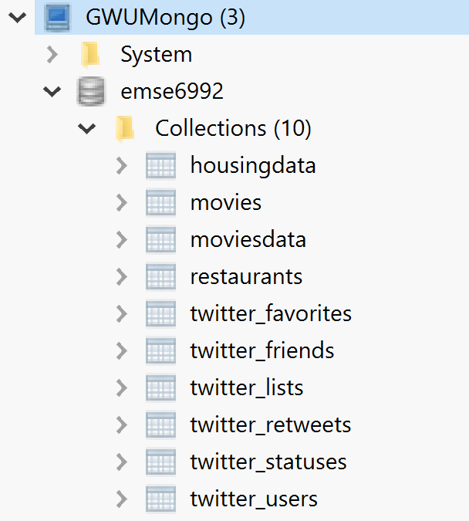
Uploading Our Data
Due to these qualities, MongoDB can actually handle the twitter data we've pulled down without any modifications
We'll talk about this view later

Slide 7
Mongo Specifics

Slide 8
Terminology
Database: Group of Collections
Collection: A group of documents
Document: JSON-like object
Field: Key-value of a document
Primary Key: Key that uniquely identifies a document
Shard Key: Key indicating a field that determines the distribution of data
Index: Optimization feature for improving queries
Query: A command to extract information from a Database
Notes:
Go a little in depth on the shard key

Slide 9
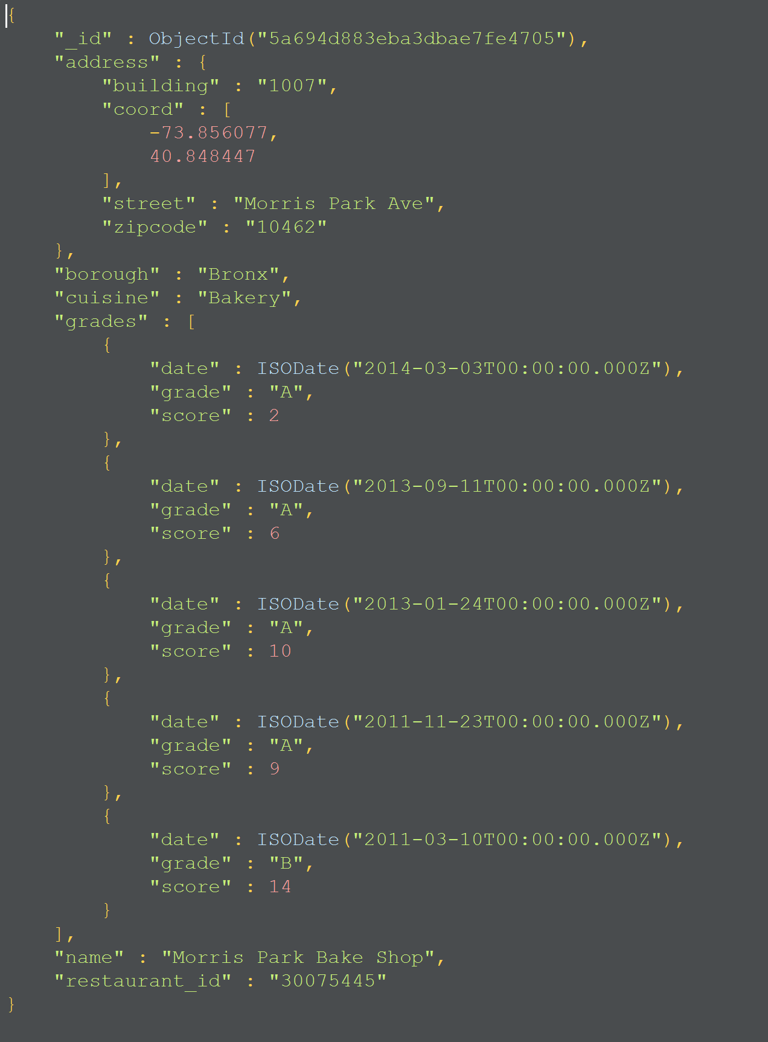
Mongo Document Layout
As mentioned earlier, each document in Mongo is comprised of a Primary Key and one or more fields (key: value)
Keys are flexible (can be any type) and are always identified by '_id'
The '_id' doesn't even have to be a consistent type
The remaining fields simply just conform to the 'key: value' paradigm (or JSON notation)

Slide 10
Acceptable Mongo Data Types Note: This is primarily how BSON and JSON differ
Double – Double and Decimal
String
Object – For embedded documents
Array – key: [value1, value2, …]
BinaryData
ObjectId – used simply for Primary Keys, although not required
This is specific datatype to MongoDB
Boolean
Date – Date and Timestamp
Null
Regex – Regular Expressions
Integer

Slide 11
Querying Mongo - Shell

Slide 12
Mongo Shell
We can query information in Mongo directly from a command shell
Although that is not ideal for most situations
We can also utilize 3rd party GUI's to visually interact with Mongo
We'll be using this methodology along with Robo3T (https://robomongo.org/download)

Slide 13
Robo3T
Robo3T is a very useful application that provides a GUI interface for interacting with Mongo
While there are limited administrative aspects to Robo3T, it does provide the following:
Query window to run and view queries
Database viewer to see collections and databases under the connection
Ability to view indexes
Etc.

Slide 14
Studio3T and Compass
Studio3T and Compass are both additional tools to inspect and work with MongoDB.
Studio3T is made by the same company that makes Robo3T and provides more administrative functionality
Compass is provided via Mongo
It is a very useful tool for running queries, but has a limited interface
We can't run freeform queries or modify the data via quereies

Slide 15
Mongo Query Language

Slide 16
Query Structure
In Mongo, when querying from the shell, we always need to first start with selecting our collection
db.getCollection('collection_name')
db.collection_name
Once we have this setup, we can start requesting information from our collection

Slide 17
Finding Elements

Slide 18
Mongo Find()
In Mongo we find the data we are looking for
db.getCollection('coll_name').find({})
The find command will return all records for a given collection
By providing additional criteria to the find() command, we can further sub-select data from the collection.

Slide 19
Finding specific elements
With find({}), we are also able to pass criteria for what we want returned
db.getCollection('coll_name').find({'attribute_name': value})
db.getCollection('twitter_retweets').find({"_id": ObjectId("60064b18e991a9c37653a9c6")})
IN CLASS:
Find all friends of elonmusk within the twitter_friends collection

Slide 20
Finding/Querying Sub-Elements
When working with mongo documents, we aren't only dealing with the highest layer of the document's hierarchy (like key-pair databases)
Many times, we need to query based on a nested element (document within a document)
Dictionaries: Append the keys together with periods
e.g. retweeted_status.retweet_count
Lists: Append the index or field with a period
e.g. hashtags.1 (finds tweets based on the second hashtag)
e.g. hashtags.text (finds tweets based the sub-elements of a list)
In Class:
Find all favorited tweets (twitter_favorites) that mention elonmusk

Slide 21
Count Elements
We can always determine the number of resulting documents using the count() operator
db.getCollection('coll_name').operation.count()
This is a good means to measure the amount of data that might need to be processed if the query is going to be utilized for follow-up processes
It can also play a role in verifying the results of a query we've run.
How can we use the counts to verify a results?

Slide 22
Sort Elements
We can sort our resultset in alphanumeric order by a given attribute
However, this process can get complicated if there isn’t consistent typing
db.collection_name.find({filter}).sort({attr: 1/-1})
1 for ascending
-1 for descending
Multiple attributes will be sorted in left-right ordering
This means that elements will be sorted by attribute_1 then any duplicates are sorted by attribute_2 and so on.
Notes:
Resultsets – the results that come back from a query

Slide 23
Comparators

Slide 24
What about comparators?
While direct matches can lead to some insights, more advanced queries will require more robust logic.
Mongo has special comparator functions to handle that $gte, $lte, $gt, $lt, etc.
db.getCollection('coll_name').find({attribute: {$gte: value}})
db.getCollection('twitter_statuses').find({"retweet_count": {$gt: 1000}})
In Class:
Why are these two results different
db.getCollection('twitter_statuses').find({"coordinates.coordinates.0": {$gt: 0}}).count()
db.getCollection('twitter_statuses').find({"coordinates.coordinates.1": {$gt: 0}}).count()

Slide 25
Checking equivalency in lists
Sometimes we are not concerned about relative values, but are interested in specific value comparisons
For these operations we can utilize the $in [$nin] command to check for existence in a list of values
db.getCollection('coll_name').find({'attribute': {$in: [val1, val2, …]}})
db.getCollection('twitter_statuses').find({"hashtags.text": {$in: ["tesla", "spacex", "openAI"]}})
Notes:
$nin is dangerous if you don't know the full set of values that the element can take

Slide 26
Logical Operators

Slide 27
$and / $or
Unlike in most programming languages Mongo logical operations ($and/$or/etc.) wrap the expressions
db.getCollection('coll_name').find({$and: [{expression_1}, {expression_2}, ..]})
Our previous $in statement, but converted to use $and:
db.getCollection('twitter_statuses').find({$or: [{"user.screen_name": "elonmusk"}, {"user.screen_name": "grimezsz"}]})
In Class:
Write a query to find every retweeted tweet (twitter_retweets) of arxivblog that has a retweet_count greater than 15

Slide 28
Regular Expressions
Does everyone know what regexes are?

Slide 29
Mongo Regular Expressions
For generalized text searches, mongo enables regular expressions. This way we can look for patterns in text fields.
db.getCollection('coll_name').find({'attr': { $regex: 'pattern', $options: 'options'}})
Using this we can, for example, find all trump accounts statuses:
db.getCollection('twitter_statuses').find({'text': {$regex: 'machine learning', $options: 'i'}})
The <$options: 'i'> is to enable case insensitivity

Slide 30
Element Operators

Slide 31
$Exists
When working with structured data we always know that an attribute exists, the only ambiguity is whether there is a value or if the attribute is NULL
Since Mongo documents are semi-structured, the attribute may not exist in all documents, therefore we need to check if it $exists
db.getCollection('twitter_statuses').find({'coordinates': {$exists: false}})
Think dict.get() in python!
IN CLASS:
Determine which favorites (twitter_favorites) have at least 5 user_mentions

Slide 32
$type
Similar to how we may not know if the attribute exists, there are also no guarantees about the type of the attribute’s value
We can use $type to check/return only elements that meet a given expectation
db.getCollection('coll_name').find({'attribute': {$type: 'type_name'}})
Why is this dangerous that the type can be variable?
Think programmatically
Notes:
Demonstrate that, due to lack of enforcement, zipcode could end up as an integer rather than a string
db.getCollection('moviesdata').find({"year": {$type: "string"}})
db.getCollection('moviesdata').find({"year": {$type: "int"}})

Slide 33
Array Operators

Slide 34
$elemMatch
We've seen previously that we can index into a list when querying for information (look back at the slides on comparators)
But what if we want to look at all elements of a list?
$elemMatch gives us the ability to match an attribute in a list
Db.getCollection('coll_name').find('list_path' : {$elemMatch: {'expression_1', 'expression_2'}})
NOTE:
$elemMatch and the dot notation (<array field name>.<embedded document field>) are essentially interchangeable.

Slide 35
$size
$size allows us to filter objects based on the number of elements in an array (not a dictionary, but a list)
Note: $size will only work with set numbers, cannot use logical operators like $gt
db.getCollection('coll_name').find({'array_attribute' : {$size: size}})
IN CLASS:
Find all statuses that have 5 hashtags
Notes:
For operations where you want to be able to use $gt, etc. we would want to create a field in the document for querying against.

Slide 36
Inserting and Updating

Slide 37
Inserting Documents
Inserting in mongo is not very difficult. You simply need to identify the collection you want to insert a document and insert() it.
db.getCollection('coll_name').insert(document)
All documents need to have an _id field
If one is not provided, then Mongo will automatically add an ObjectId to the document (this is actually the recommended behavior)

Slide 38
Updating and Replacing
You can easily replace a document with the following
db.getCollection('coll_name').replaceOne(<filter>, <document>)
You can update a document using updateOne().
db.getCollection('coll_name').updateOne(<filter>, <update>)
The methodology for updating is, however, somewhat complicated
You essentially need to $set, $unset, and $rename each element of a document
Depending on the use case and overhead it’s possible that simply replacing is a safer option

Slide 39
Delete a Document

Slide 40
deleteOne(<filter>)
Similar to insert/replace we have the ability to deleteOne() record
db.getCollection('coll_name').deleteOne(<filter>)
deleteMany(<filter>)
This enables us to remove all records that match our filter
Passing the empty filter {} will remove all documents (obviously dangerous)

Slide 41
Misc Functions

Slide 42
Distinct
Distinct enables us to find the unique values that may exist for a given attribute
db.getCollection('coll_name').distinct(<attribute>)
Distinct is very handy when understanding the landscape of a given value
IN CLASS
Calculate the number of users in the retweet collection (twitter_retweets)

Slide 43
Subsetting Returned Documents
We don’t always need to return all the data elements. In Mongo we can subset the resulting objects
db.getCollection('coll_name').find({expression}, {'attr': 1})
In the above query, the second {filter} determines which attributes are returned
So finding just the user.names of people with popular tweets:
db.getCollection('twitter_statuses').find({"retweet_count": {$gt: 5000}}, {"user.name": 1})
In Class:
Why can this be critical for enterprise applications?

Slide 44
Geospatial Operators

Slide 45
Geospatial Data
In mongo we can define geospatial data (luckily, the twitter API provides this directly) by specifying certain fields within our objects
For our case we are using the following structure:
“coordinates”: {
“type”: “Point”,
“coordinates”: [lon, lat]
}
With this we are able to run geospatial queries against our data

Slide 46
Geospatial Indexes/Types
To query geospatial data we need to define geospatial indexes. These are essentially lookup tables for Mongo to leverage when asked geospatial questions/queries.
2dsphere
This datatype is for projecting datapoints onto an earth-like sphere
2d
This datatype is for datapoints on a 2-dimensional plane

Slide 47
$near and $nearsphere
$near(Sphere) will determine what geospatial datapoints are within proximity of a given point
$near(Sphere) will sort the results, nearest to farthest
{<location field>: { $near(Sphere): {
$geometry: {
type: "Point" ,
coordinates: [ <longitude> , <latitude> ]
},
$maxDistance: <distance in meters>,
$minDistance: <distance in meters>
}}}
Notes:
db.twitter_statuses.find({"coordinates":
{$near:
{$geometry:
{type: "Point",
coordinates: [-77.036484, 38.897470]
},
$maxDistance: 500,
$minDistance:0
}
}
})

Slide 48
$geoIntersects and $geoWithin
$geoIntersects and $geoWithin leverages geometries to determine whether data points/geometries intersect or lie within a given geometry
{<location field>: { $geoWithin: {
$geometry: {
type: <"Polygon" or "MultiPolygon"> ,
coordinates: [ <coordinates> ]
}
}}}

Slide 49
End Slide EMSE 6586 – DBMS for Data Analytics

