Slide 1
DB Management Systems: SQL - MySQL
Joel Klein – jdk514@gwmail.gwu.edu

Slide 2
Introduction to MySQL
Notes:
Introduce myself – education, work experiences, etc.

Slide 3
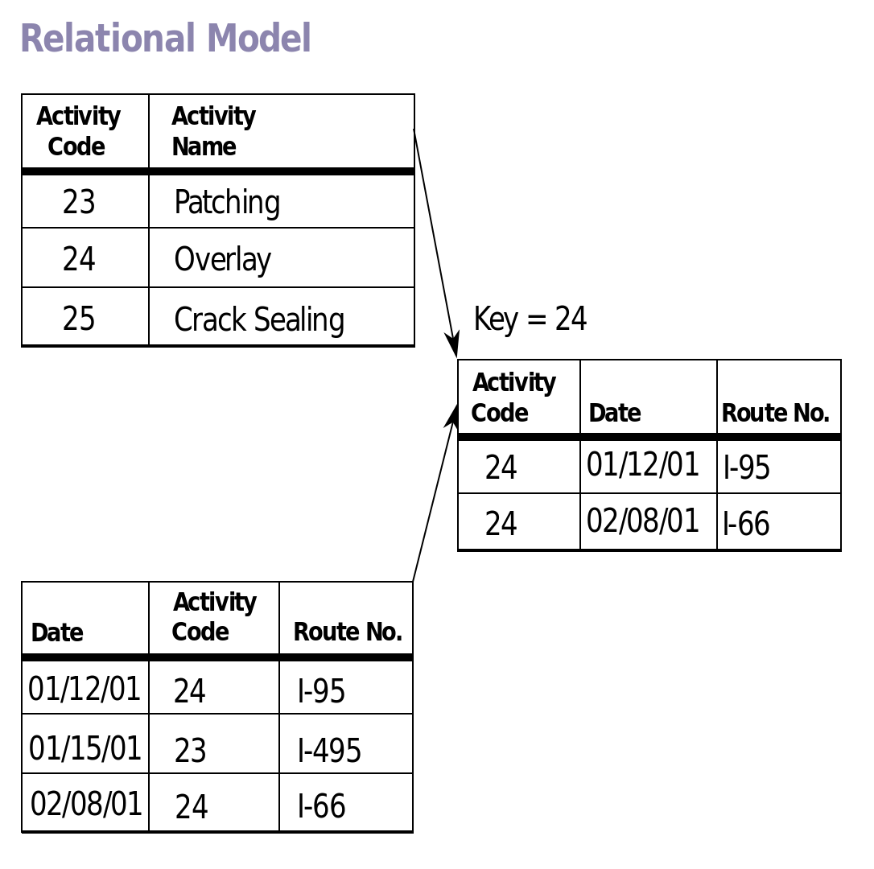
MySQL
MySQL is a RDBMS (Relational Database Management System)
Database means that it is designed for the storage of information
Relational means that it conforms to the relational model
The key design being that we are working with tabular data with interconnecting relationships
Think PANDAS DataFrame!
Source: https://en.wikipedia.org/wiki/File:Relational_Model.svg

Slide 4
Terminology
Instance: Installation or running application of the RDBMS
Database: Collection of Tables, there can be multiple Databases on a single Instance
Table: Matrix of data, there can be multiple Tables in a single Database
Column: Features/data-types found within a Table
Row (record/tuple): Group of Column-values that define a datapoint
Primary Key: Column(s) that define a unique record in a Table
Foreign Key: Column whose set of possible values is defined by a column within another Table
Index: Column(s) in a Table that will be optimized for Queries
Query: A command to extract information from a Database

Slide 5
Standard SQL Data Types
Numeric
INT – Integer ranging from -2147483648 to 2147483647
BIGINT – Integer ranging from -9223372036854775808 to 9223372036854775807
FLOAT(M,D) – Floating point number (M: Display Length, D: # of Decimals)
DOUBLE(M,D) – Double precision floating point
Datetimes
DATE – YYYY-MM-DD
DATETIME – YYYY-MM-DD HH:MM:SS (TIMESTAMP is same w/out symbols)
TIME – HH:MM:SS
String
CHAR(M) – Fixed-length string of size M
VARCHAR(M) – Variable sized string of max-size M
BLOB/TEXT – Manner to store large objects (BLOB is for Binary objects, TEXT for text)
NOTE: Additional types are supported (JSON), but they may differ between databases and/or have different functionality.
Notes:
Float good to 7 decimals, while double is 14
Decimal is for storing exact numbers

Slide 6
MySQL Instance
Primary Key
Column
Account ID | Account Type | Date Created | Balance
123213 | Checking | 01/03/1986 | 1,003.23
124312 | Savings | 11/13/1999 | 5,452.32
312343 | Investment | 01/07/2003 | 12,321.01
142323 | Checking | 01/23/1996 | 42.34
432423 | Checking | 05/05/2016 | 243.00
Database
Record
Table
Table
Table
INT
VARCHAR
DATE
DOUBLE
Notes:
Mention that a Record must be unique in RDBMS

Slide 7
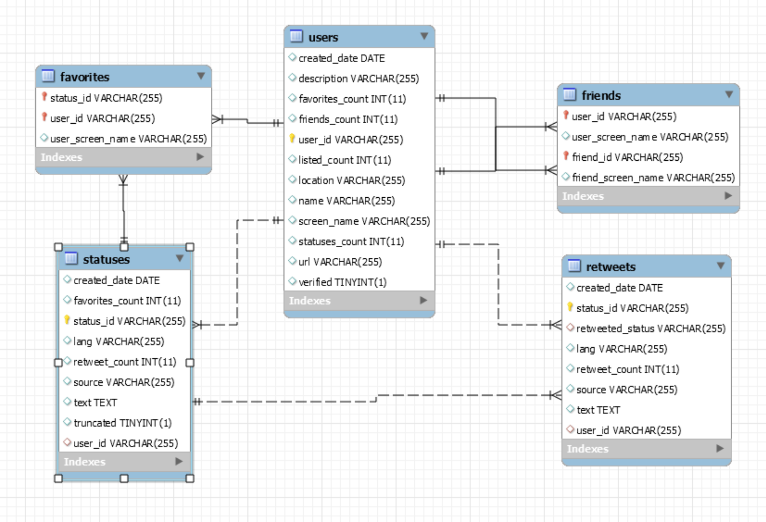
Our Entity-Relationship Model
Notes:
In class:
What are the yellow keys? What are the red keys? What is the significance of the lines in-between our tables/relations?
Ask if class wants to know how to generate this model

Slide 8
Types of relationships
One-to-One (1-1):
This means that each entity in one table is linked to one entity in another table
One-to-Many (1-m):
This means that each entity in one table is linked to one or more entities in another table
Many-to-Many (m-m):
This means that one or more entities are linked to one or more entities in another table
In Class:
Identify each type of relationship in our ERM Model (previous slide)
Notes:
1-1: Course and its title/CRN
1-m: Course and its sections
M-M: Students and courses (normalization!)

Slide 9
SQL

Slide 10
So How Do We Access Our Data?
SQL (Structured Query Language): A Database specific language designed for managing data in RDBMS
While SQL has a overall generic structure, it does change from Database to Database (MySQL vs MSSQL vs Oracle vs etc.)
We can run SQL commands directly off the database (command-line), from a GUI (MySQL workbench), or programmatically (python, java, etc.)

Slide 11
SQL - SELECT

Slide 12
Selecting Information
To get information out of our database we need to select the data
“SELECT col1, col2, etc. FROM table”
Ex. “SELECT text FROM statuses;”
Ex. “SELECT text FROM EMSE6992.statuses”
We can also select all columns using the “*” symbol
Ex. “SELECT * FROM statuses”
Lets run this in the workbench!
Notes:
Talk about the difference between catalog and EMSE6992.catalog
Talk about how we can comma separate values in SQL to ask for a combination

Slide 13
SQL - WHERE

Slide 14
Filtering the Information
Obviously there will be times where we want to subselect data (we may be looking for something specific).
“SELECT * FROM statuses WHERE [NOT] condition1”
Conditions are usually focused around column values
Ex. “SELECT * FROM statuses WHERE location='Washington, DC'”
We can combine conditions using logical statements AND/OR
Ex. “SELECT * FROM users
WHERE location='Washington, DC' AND verified=1”

Slide 15
WHERE – Data Types
WHERE conditional comparators/operators are type dependent
String: =, !=, or LIKE (talk about shortly)
Numeric: =, !=, >, <, >=, or <=
Datetime: =, !=, >, <, >=, or <=
For DATETIME’s we can simply provide a DATE
DATE looks like DATE(“YYYY-MM-DD”)
In Class:
Write a query to find all of the statuses made on the January 1st, 2019
Notes:
1,3,6

Slide 16
WHERE - LIKE
The LIKE clause is a special comparator in SQL that enables partial string matching
Using the LIKE clause with a string containing a ‘%’, the ‘%’ is treated as a wild character
This means ‘%{word}%’ is effectively the REGEX ‘.*{word}.*’
This means that we can find columns where only a certain key phrase exists
Ex.
“SELECT * FROM statuses WHERE text LIKE '%AI%';”
In Class:
Find all retweets that contain an @ symbol
Notes:
Note: Some SQL Databases support regex’s!

Slide 17
WHERE - NULL
Like many programming languages, SQL databases also have a means to indicate that no information is stored (versus an attentionally blank value) – NULL
This is necessary as every record must have a value for every column
Likewise, sometimes we need to evaluate if there are/are not any NULL’s in a column
“SELECT cols FROM tbl WHERE col IS [NOT] NULL”

Slide 18
SELECT cont.
Run the following query in MySQL Workbench:
“SELECT text, name, description FROM statuses, users;”
In Class:
What is this query returning?
Why can this be dangerous?
How could we fix this?

Slide 19
SQL - JOINS

Slide 20
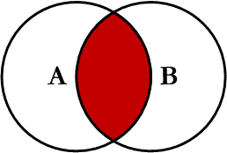
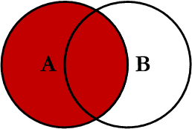
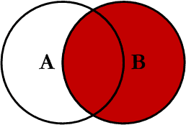
Joining Tables
What we achieved in the previous slide is called a table join
This is the process where we join together data in our database to get a more comprehensive view of our data
Joins come in a number of different forms:
Inner Join
Right Join
Left Join
Inner Join
Right Join
Left Join
Source: https://www.codeproject.com/Articles/33052/Visual-Representation-of-SQL-Joins
Notes:
Inner Join: Returns all elements that exist in both tables
Right/Left Join: Returns all elements only in the Right/Left table
Left/Right excluding Join: Returns all elements only in the Right/Left table

Slide 21
Proper Table Join
The first example of a Join that we did is not advised
It is not supported in all SQL databases
It can lead to confusion and ambiguity in larger queries
Correct table join:
“SELECT [cols] FROM tbl1 LEFT JOIN tbl2 ON condition;”
In Class:
Rewrite our initial join in the correct format:
“SELECT text, name, description FROM statuses, users;”

Slide 22
Multiple Joins
Just like everything else (column selection, conditions) we can join together multiple tables
However, this works slightly different than previous chains.
Ex:
"SELECT * FROM friends
JOIN users ON friends.friend_id = users.user_id
JOIN statuses ON statuses.user_id = users.user_id;"
Notes:
When we join tables, we effectively create a new merged table. Thus each new join looks similar to the first.
Having run the first, what do you think the second query will return?

Slide 23
SQL - ORDER

Slide 24
Sorting Values
Many times while working with data, we want to order them on some column(s)
This is where the ORDER clause comes into play
“SELECT col(s) FROM tb1 ORDER BY col1, [col2, etc.]”
When providing multiple columns, it sorts the values in column order
Ex.
“SELECT * FROM statuses ORDER BY created_date”
Notes:
NOTE: Simply add DESC after ORDER BY col to reverse the order

Slide 25
Selecting Top Results
In MySQL we can get the first x results using the LIMIT clause
“SELECT * FROM tb1 LIMIT [x];”
Ex.
“SELECT * FROM users LIMIT 5;”
This can be used in conjunction with ORDER BY to get the top/bottom X results for a table
Notes:
Mention sometimes TOP others LIMIT, etc.

Slide 26
SQL - FUNCTIONS

Slide 27
Selecting the Minimum or Maximum
We can get the MIN() or MAX() of columns, using their respective clauses
“SELECT MIN(col) FROM tbl WHERE cond;”
Ex
“SELECT MAX(favorites_count) FROM statuses;”
NOTE: MAX and MIN functions limit the number of records returned

Slide 28
SUM, AVG, COUNT
SUM, AVG, and COUNT functions aggregate values across a table
“SELECT SUM(col) FROM tbl;”
In Class:
Determine the average favorites_count for tweets that @ someone (include the @ symbol in the tweet’s text)

Slide 29
SQL - AGGREGATION

Slide 30
Grouping Elements
Sometimes when selecting fields we want to group elements across a key identifier
We can accomplish this goal using the GROUP BY clause. It states that we want to group our results by a given set of columns
“SELECT colX FROM tbl GROUP BY colY;”
In Class:
Group the ‘statuses’ table by ‘user_id’
Notes:
Why does the GROUP BY simply seem to truncate our result?

Slide 31
GROUP BY cont.
When grouping elements we typically need to provide an aggregation function (AVG, SUM, COUNT, MIN, MAX, etc.), otherwise the group will pull top result for the given column
In Class:
Modify our previous exercise to look for the AVG favorites_count and retweet_count per user
Notes:
NOTE: Not entirely sure it will always be the top result

Slide 32
Conditional Grouping
When grouping elements in tables we usually want to have certain conditions applied to our groups
We can thus us the HAVING clause to further filter our groups
“SELECT colX FROM tbl GROUP BY colY HAVING cond;”
NOTE: The HAVING clause can only be applied on GROUP BY columns or on aggregate functions
In Class:
Find the average retweet_count for verified users

Slide 33
SQL – Special Functionality

Slide 34
Selecting Distinct Elements
When selecting columns we can ask for distinct results, to ensure that there are no duplicates in the resulting data
“SELECT DISTINCT(col) FROM tbl;”
Exercise:
How many dates are stored in the statuses collection?

Slide 35
IN Clause
The IN clause allows us to check if a value exists in a list
“SELECT * FROM tbl WHERE col in (value1, value2, . . .);”

Slide 36
Aliasing
Many times it is easier or necessary to provide an alias for a column or table
An alias is simply an alternative representation for that element
“SELECT user_id AS id FROM users;”
How do you think we alias a table? Why would we do this?
Notes:
NOTE: This actually changes the column name for the result
Also don’t actually need AS for table alias (I would recommend)

Slide 37
Nested Queries
Nested queries allow us to query the results of other queries to form complex requests
Nested queries can appear in a:
SELECT clause
FROM clause
WHERE clause
Notes:
Note: I typically use and see them as FROM and WHERE statements

Slide 38
Nested Queries cont.
FROM
Select avg(retweet_count), user_id FROM
(SELECT retweet_count, user_id FROM statuses
WHERE favorites_count > 500) as tmp_tbl
Group By user_id;
WHERE
SELECT * FROM statuses
WHERE user_id IN (SELECT user_id FROM users WHERE verified=1);

Slide 39
Inserting Information

Slide 40
Adding New Information
Frequently we will want to store new or generated information, we can achieve this by inserting the data
INSERT INTO tbl (field1, field2, …) VALUES (value1, value2, ….);
NOTE: You do not need to insert values for all fields
NOTE: You do not need to provide a field list if you provide values for all fields in order
INSERT INTO users(user_id, screen_name) VALUES ('001', 'Joel Klein');
INSERT INTO Friends VALUES ('001', 'Joel Klein', '001', 'Joel Klein');
Notes:
Note: Primary and Foreign keys can prevent an insertion. If your Primary key is not included or conflicts with another record the insertion will fail. If you add a foreign key that doesn’t exist in the originating table it will fail.

Slide 41
Updating Information
Sometimes we don’t want to insert new information, but rather update an existing record
UPDATE tbl SET col1=value1, col2=value2, … WHERE cond1[, cond2, …];
NOTE: The conditions are typically to align to the primary keys of a specific record
UPDATE users SET favorites_count=78 WHERE user_id='001';

Slide 42
Delete, Alter, Indexes
Notes:
Go over the sql for creating a table, etc.

Slide 43
Deleting Records
Works very similar to a SELECT clause, but we just replace SELECT with DELETE
DELETE FROM tbl WHERE cond1, etc…;
DELETE FROM users WHERE user_id='001'

Slide 44
Alter Table
Altering a table gives us the ability to add/remove/modify a tables columns.
We can do other things, but these are the most common
ALTER TABLE tbl (Drop, Add, Modify) col (datatype);

Slide 45
Indexes
Indexes are like phonebooks for your table. They store a quick lookup for all values in a table.
Indexes can be for indexing or fulltext (for optimized text queries)
Indexes can be multi-column
In these situations queries are indexed on the first column, and then the second column (e.g. think “group by” statements)
Indexes can be applied to any number of columns any number of times

Slide 46
End Slide EMSE 6992 – DBMS for Data Analytics

Slide 47
BACKUP SLIDES

Slide 48
Selecting Distinct Elements
When selecting columns we can ask for distinct results, to ensure that there are no duplicates in the resulting data
“SELECT DISTINCT(col) FROM tbl;”
Exercise:
How many dates are stored in the statuses collection?

Slide 49
Aliasing
Many times it is easier or necessary to provide an alias for a column or table
An alias is simply an alternative representation for that element
“SELECT user_id AS id FROM users;”
How do you think we alias a table?
Notes:
NOTE: This actually changes the column name for the result
Also don’t actually need AS for table alias (I would recommend)

Slide 50
IN Clause
The IN clause allows us to check if a value exists in a list
“SELECT * FROM tbl WHERE col in (value1, value2, . . .);”

Slide 51
Nested Queries
Nested queries allow us to query the results of other queries to form complex requests
Nested queries can appear in a:
SELECT clause
FROM clause
WHERE clause
Notes:
Note: I typically use and see them as FROM and WHERE statements

Slide 52
Nested Queries cont.
FROM
Select avg(retweet_count), user_id FROM
(SELECT retweet_count, user_id FROM statuses
WHERE favorites_count > 500) as tmp_tbl
Group By user_id;
WHERE
SELECT * FROM statuses
WHERE user_id IN (SELECT user_id FROM users WHERE verified=1);

