Slide 1
DB Management Systems Distributed: Spark
Joel Klein – jdk514@gwmail.gwu.edu

Slide 2
Spark Architecture

Slide 3
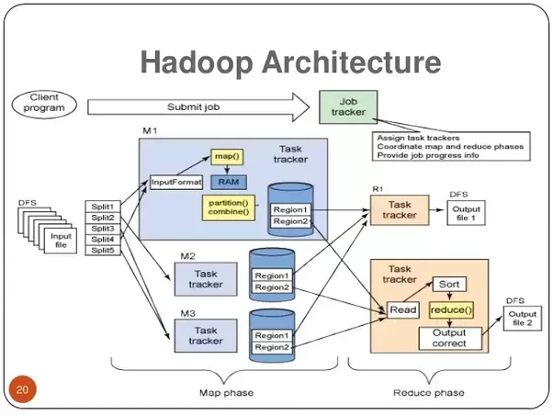

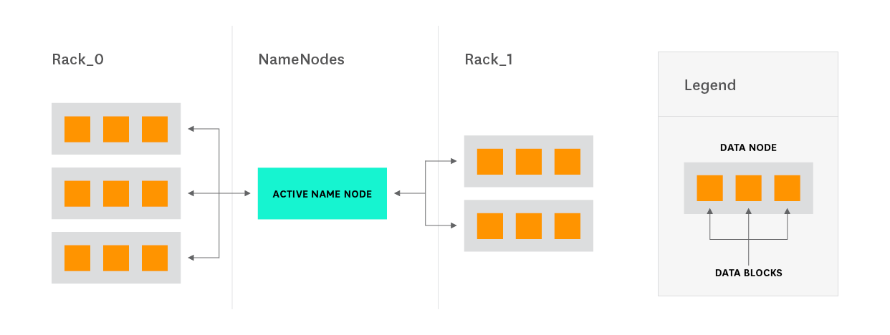
Spark? Architectural Diagram
Complex
Simple
Notes:
Sources: https://www.datadoghq.com/blog/hadoop-architecture-overview/, http://hadoop.apache.org/docs/current/hadoop-project-dist/hadoop-hdfs/HdfsDesign.html, https://drive.google.com/file/d/0B-zw6KHOtbT4MmRkZWJjYzEtYjI3Ni00NTFjLWE0OGItYTU5OGMxYjc0N2M1/view

Slide 4
NameNode (Spark Driver)
Think of this as the master node.
It is the node a user actually interfaces with to input commands/configuration
It doesn’t need to necessarily be a crazy machine (specs wise) as it doesn’t do any of the heavy lifting

Slide 5
DataNode (Worker/Executor)
DataNode’s represent the true brute force behind Spark.
They are the nodes that both store and process (in memory) the data used by Sparks acyclic graph transformations
Executors can load data through a number of different sources
S3, FTP, local filesystem, Azure, Swift(??)
Executors load the data into memory, rather than locally on disk
These machines are usually beefier than the NameNode, as they need to be able to process large amounts of data quickly
These machines typically need more RAM since spark operates entirely in memory

Slide 6
Resilient Distributed Dataset
RDD’s are essentially like Series in Spark, designed for parallelized and distributed operations.
They are a collection of objects storing data
Some key traits are:
Immutability – once created they can not be changed
Partitioned – the dataframes are split amongst a number of executors
Typed – each record is statically typed (RDD[Long], RDD[String, Int, etc.])
RDD’s can only be manipulated via transformations
map, flatmap, filter, reduceByKey, join, cogroup

Slide 7
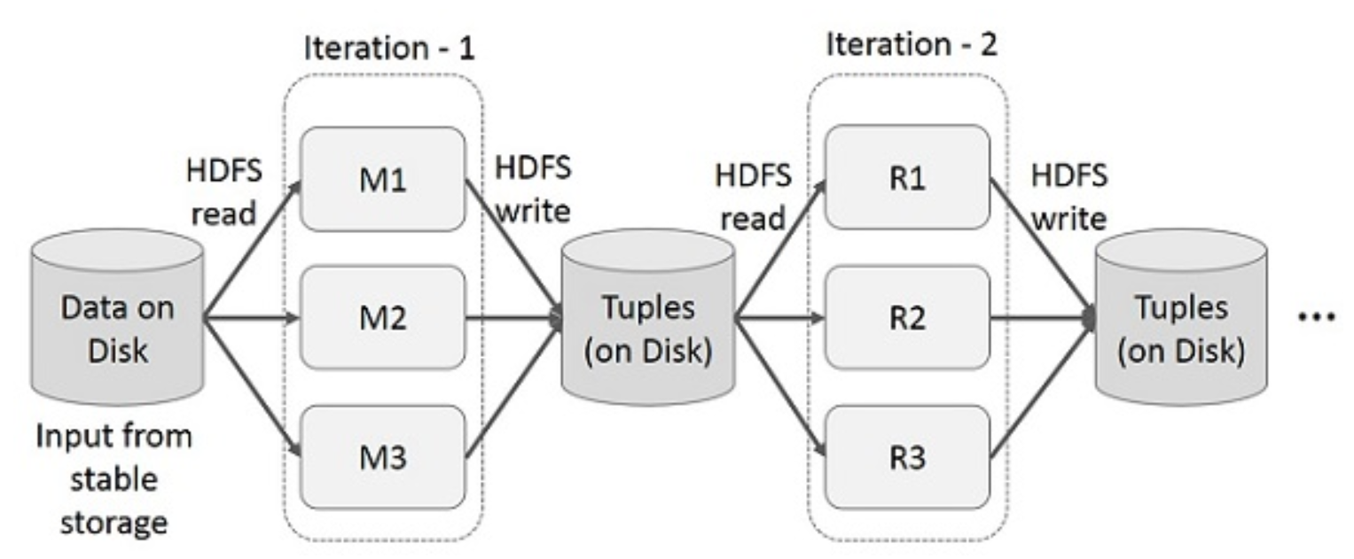
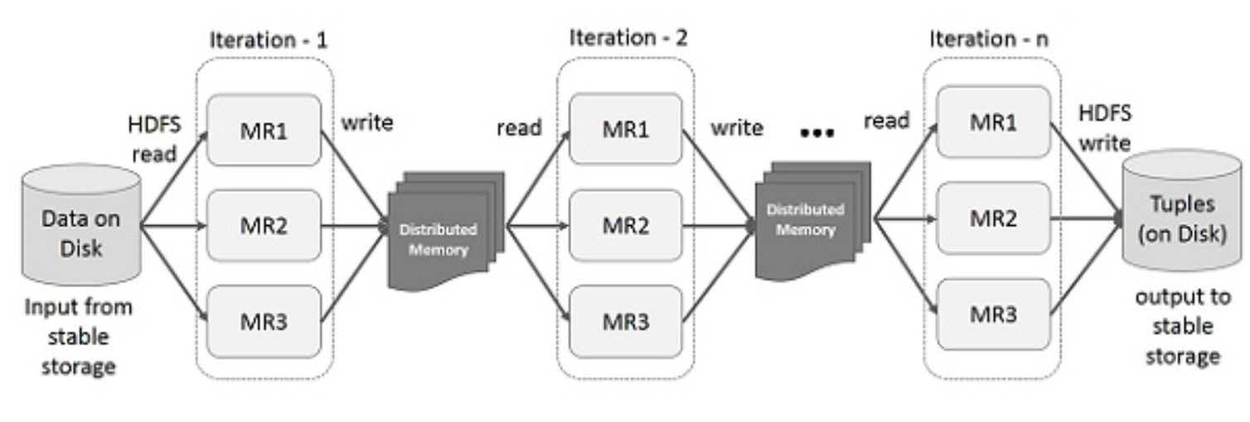
Directed Acyclic Graph (DAG)
DAG is Sparks version of MapReduce. It is essentially a more verbose implementation.
Essentially it is the process of altering an RDD through a series of transformations (as mentioned earlier)
Hadoop MapReduce
Spark DAG

Slide 8
MapReduce
DAG
Always two operations in order
Map
Reduce
Information is read from disk and saved out to disk during each intermediary step
Great for batch processing
Can perform any combination of transformations between RDD states
MapReduce can be one of these transformation processes
Initial data is read from disk, but all further transformations take place solely in-memory
Great for real-time processing and fast iterative processes (training ML algorithms)

Slide 9
Programming in Spark
One of the main reasons for the recent surge in Spark is due to its ease of use through flexible API’s
These API’s have SDKs for the following programming languages (there may be more):
Scala
Java
Python
SQL
R

Slide 10
Spark on AWS

Slide 11
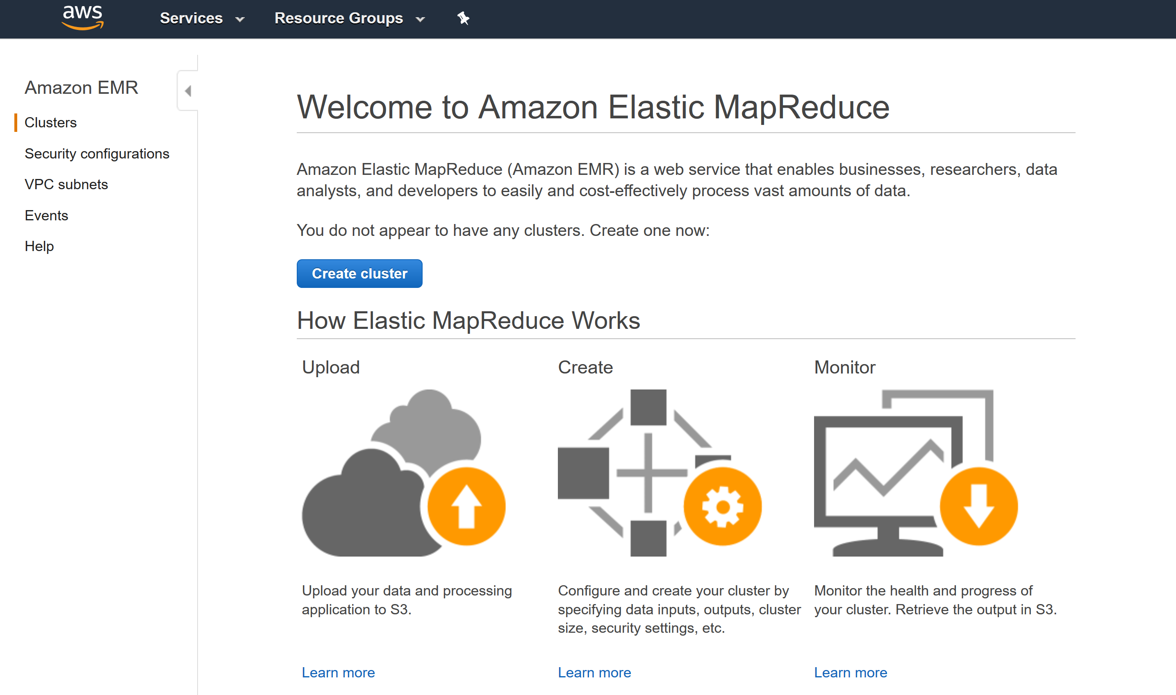
EMR (Elastic Map Reduce)

Slide 12
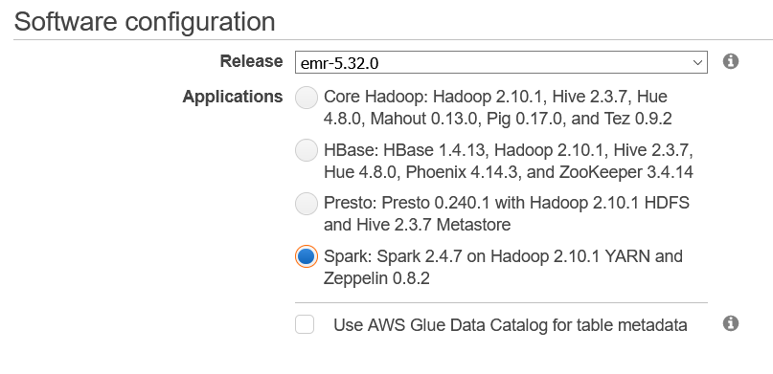
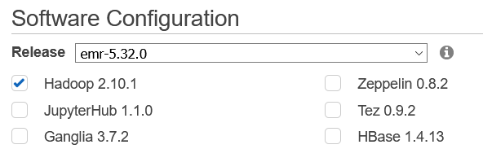
Enabling EMR Notebooks
Normally we could simply instantiate the spark cluster using a default software configuration
However, to make things easier for us, we're going to setup Spark so it can connect to an AWS hosted Jupyter notebook or EMR Notebook

Slide 13
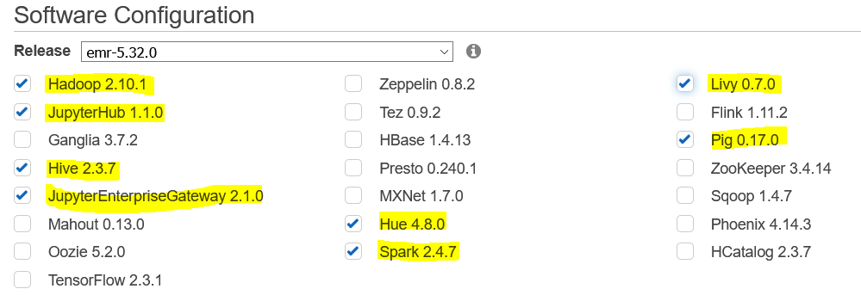
Custom Configuration Software
For EMR Notebooks to work we need to configure a custom selection of software for things to work.
We can also enable Hive so we can take a second look at it's use cases

Slide 14
Reason for Custom Configuration
There are a couple of reasons why we need to modify the configuration
Adding JupyterHub and JupyterEnterpriseGateway enable us to connect via JupyterNotebooks
JupyterHub is a webserver-based version of Jupyter
JupyterEnterpriseGateway enables JupyterHub to spin up notebooks on a cluster of machines
Adding Livy provides a REST driven API for spark that makes handling concurrent asynchronous requests easier (basically makes the notebook interactions work from the EMR perspective)

Slide 15
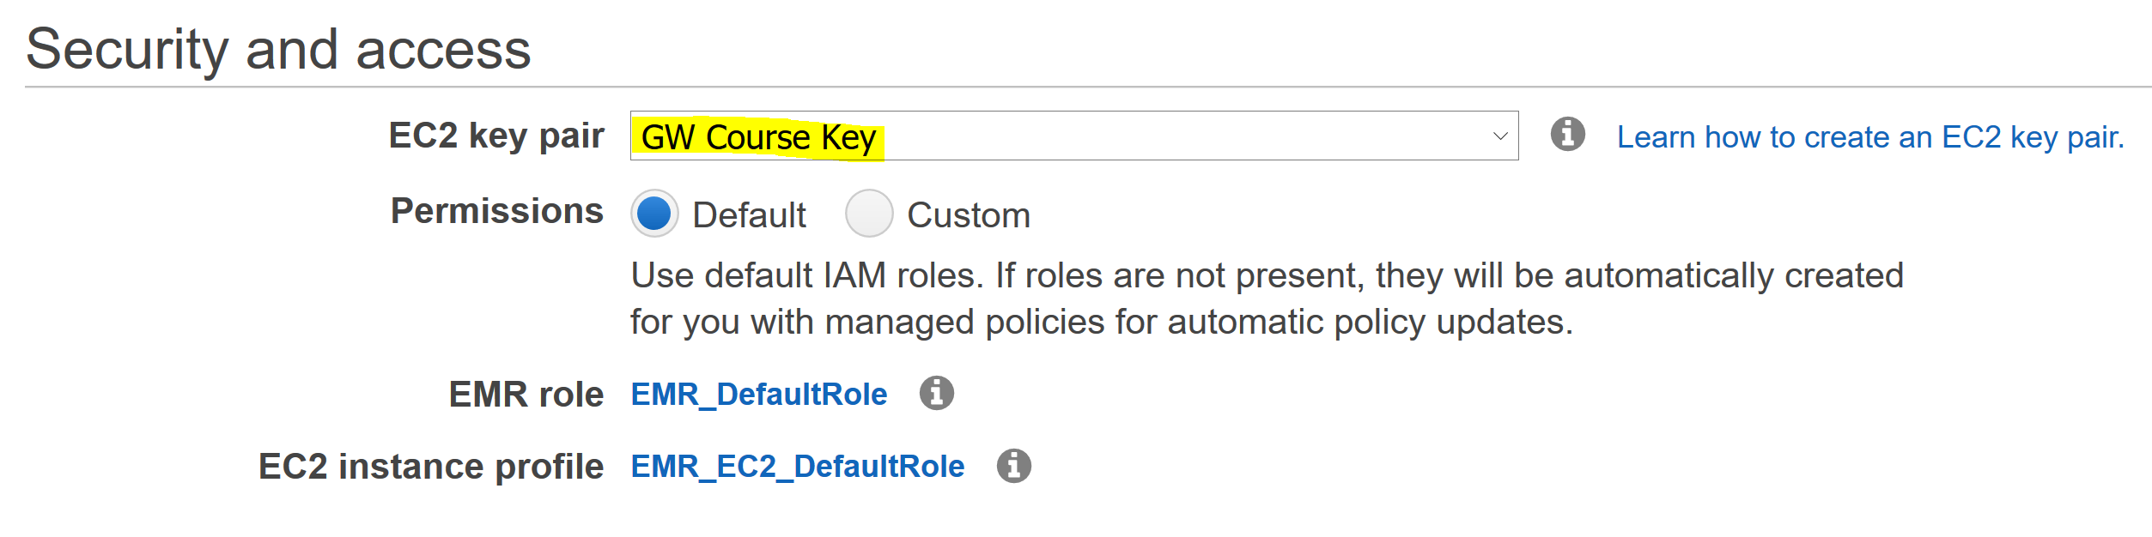
Creating an EMR Cluster cont.
Defining Security:
We'll still setup the EC2 key pair, so we can connect directly to the master node
Waiting:
This shouldn't take any longer than last time, but we still do need to wait

Slide 16
Accessing Our EMR

Slide 17
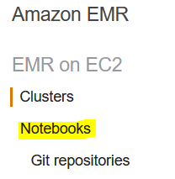

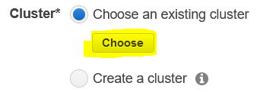
EMR Notebooks
From the EMR service page, there is an option to setup an EMR Notebook, we'll be using that to connect to our cluster
From here we can
The only thing we need to define (beyond providing a name), is the existing cluster for the notebook to connect

Slide 18
PySpark

Slide 19
PySpark
PySpark is the name of the python specific interface for python programming in Spark
One of its main benefits is ability to seamlessly leverage python for distributed programming
PySpark also heavily utilizes Dataframes an abstraction of RDD’s
PySpark Dataframes work a lot like pandas dataframes, but have some unique interfaces

Slide 20
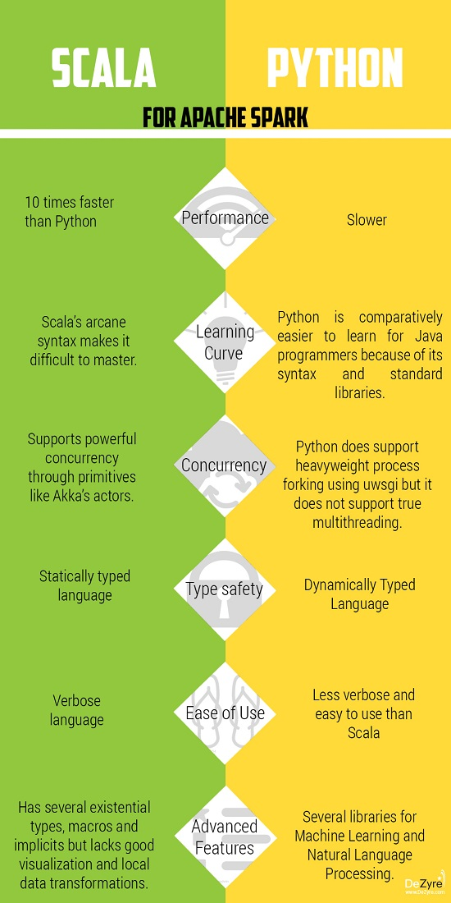
Python vs Scala

Slide 21
Working with PySpark

Slide 22
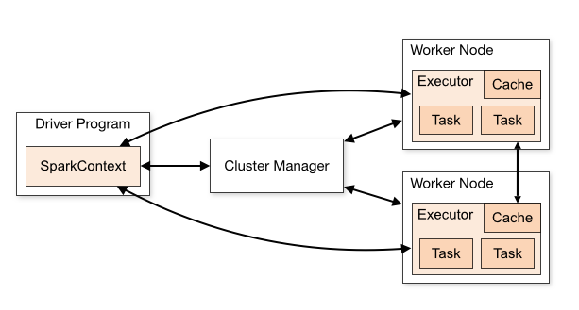
Spark Session
The spark session is the primary interface for working with Spark's API
This means that we need an active spark session to do anything within spark
Creating the EMR Notebooks provides us an easy mechanism to hook into the spark session
Source: hadoopsters.com/2020/10/26/spark-starter-guide-4-2-how-to-create-a-spark-session/

Slide 23
Working with a Spark Session
Normally we need to build a spark session (which can require some complex networking for custom environments)
spark = SparkSession.builder.appName("Python Spark SQL basic example").config("spark.some.config.option", "some-value").getOrCreate()
With the EMR Notebook we can simply call spark directly

Slide 24
Creating a spark Dataframe
To create a spark Dataframe we need to tell spark to read in data from a data source. This can be accomplished through several different commands, like Hadoop:
For our case, we’ll read in the same data from s3 from last class:
spark.read.json("s3a://{s3_bucket}/ratebeer/*.json")
Most datawarehousing applications use file types like parquet and avro

Slide 25
Alternative File Formats - Parquet and Avro
Parquet and Avro are file types that emulate many of the compression techniques provided by databases and archiving (think .zip or .targz)
This means that unlike json and csv, these file types are focused around data optimization
Parquet is a columnar storage format, meaning that it focuses on storing columns of data (compared to csv which is row focused)
Avro is essentially a serialized version of JSON and has similarities to protobuf
Field names are abstracted away and data is stored in binary formatting

Slide 26
PySpark Lazy Evaluation
RDD’s, and thus Dataframes, are lazily evaluated. This means that transformations on the dataframe won’t be evaluated until actually requested.
This also means that only necessary transformations actually occur (to an extent). This is part of the advantage to columnar data, as the entire file/dataset may not need to be processed, but only a single column.

Slide 27
PySpark Streaming and SQL API

Slide 28
SQL in PySpark
In addition to working with data loaded straight into a dataframe, we can also query our data leveraging SQL through Spark's SQL API
To accomplish this we need to simply create a temporary view of our data the we can query against
df.createOrReplaceTempView("beer_table")
Now all we need to do is create a new Dataframe by querying our existing information
sql_table = spark.sql("SELECT * from beer_table LIMIT 10")

Slide 29
End Slide EMSE 6992 – DBMS for Data Analytics

Slide 30
PySpark Terminal (If Using SSH)

Slide 31
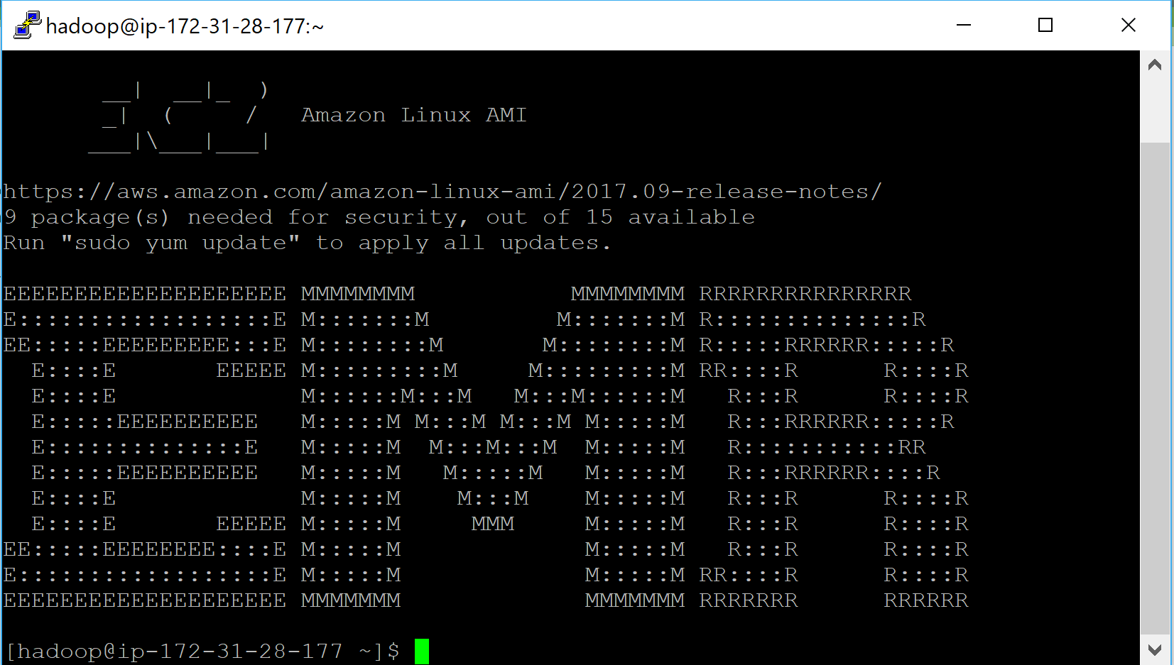
Once Connected Via SSH
If everything was done correctly, we should be met with the following:

Slide 32
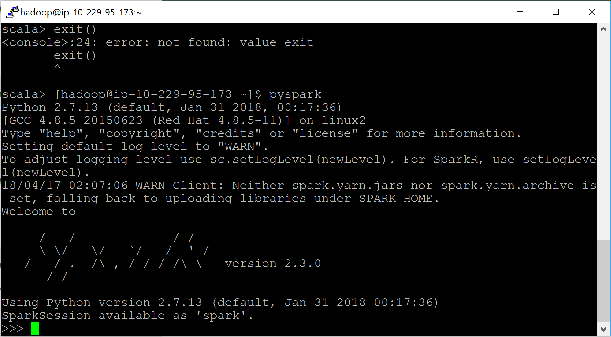
Connecting to PySpark
From the terminal, we are actually very easily able to connect to hive
We simply run: $ pyspark
This should produce the hive interface: >>>

Slide 33
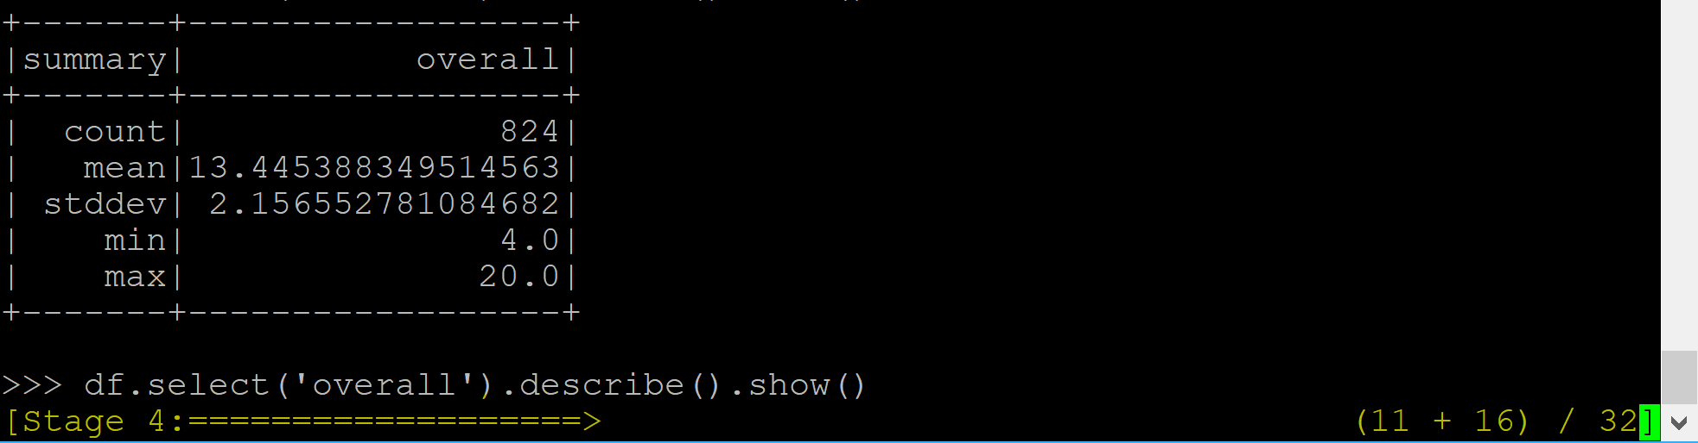
Spark REPL
REPL stands for Read-Eval-Print-Loop
The pyspark repl is effectively a python console
This means that all generic python will run in the pyspark repl
The key difference between pyspark repl and a generic python console is the ability to leverage DAG operations to process RDD’s
You can see when spark is being leveraged when you see the following in the console:

