Slide 1
Lending Club case study
Naga Gayathri
Balaji Pandian

Slide 2
AGENDA
Lending Case study analysis will help the company to make a decision for loan approval based on the applicant’s profile, which controls loss of business and avoid financial loss for the company.

Slide 3
PRIMARY GOALS
Data Understanding and Sourcing.
Cleaning the data which are not essential.
Check for Data Quality issues and Binning.
Check for Data Imbalance and Univariate, Segmented Univariate and Bivariate analysis.
Recommendations and Risks.

Slide 4
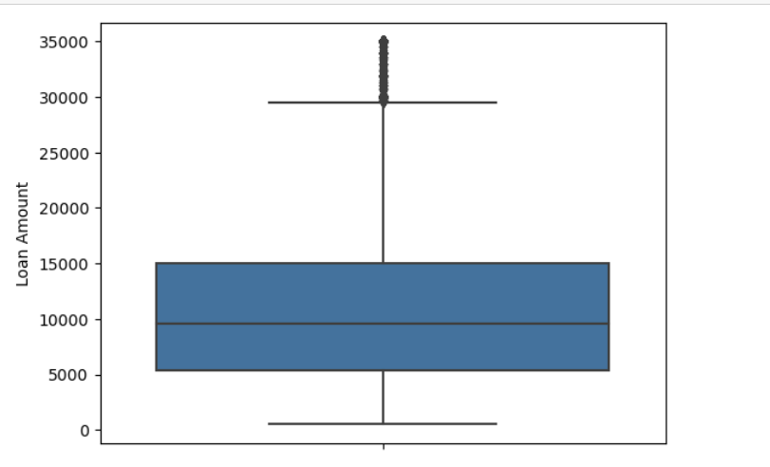
Univariate analysis
Most of the loan Amount taken is around 10000

Slide 5
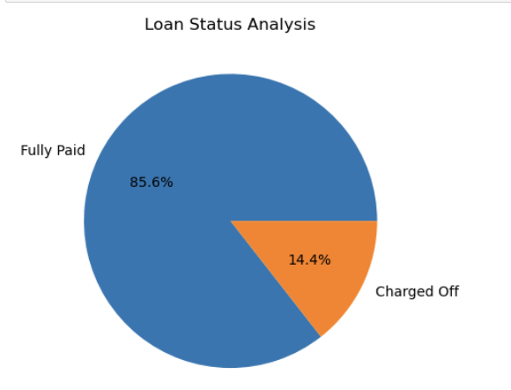
Univariate analysis
Loan Fully Paid Percentage is 85.6%

Slide 6
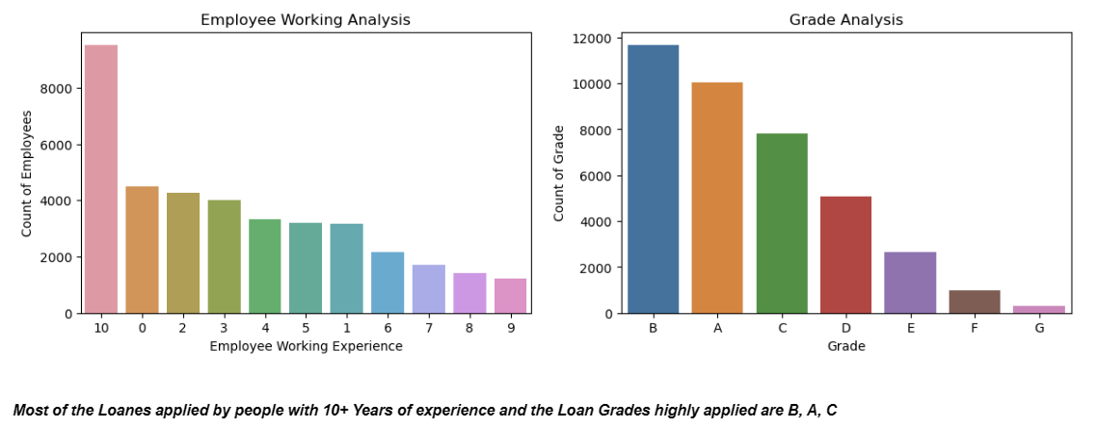
Univariate analysis
Most of the Loans applied by people with 10+ years of experience and the Loan Grades highly applied are B, A,C

Slide 7
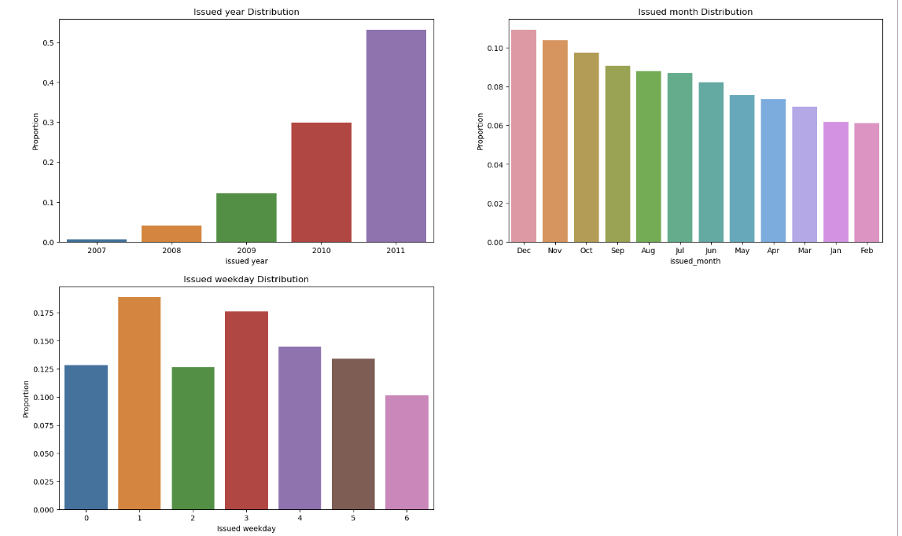
Univariate analysis
The Number of loan applications increases every year.
More Loans are issues in the last three months of the year.

Slide 8
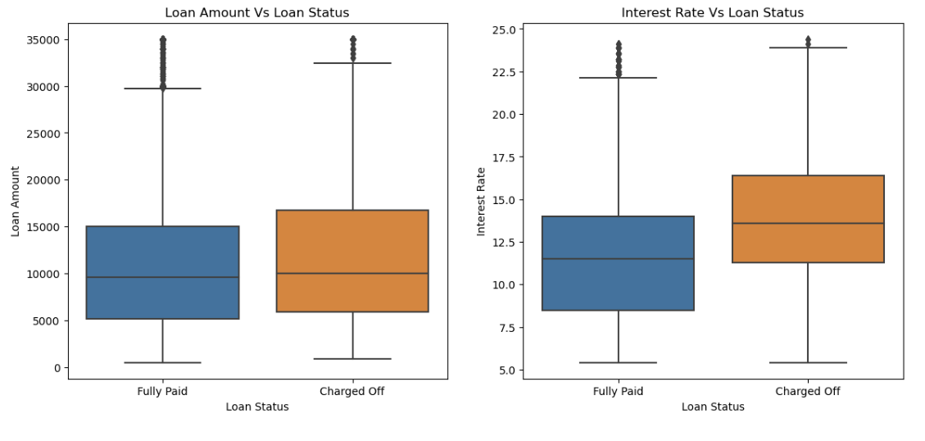
Bivariate analysis
Loan Amount Vs Loan Status shows slight variation in the median range between fully paid and Charged Off
Interest Rate Vs Loan Status shows significant variation explaining that higher the interest rate higher the charge Off

Slide 9
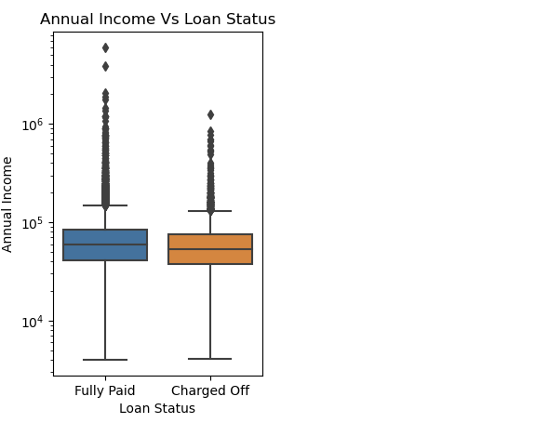
Bivariate analysis
Annual Income Vs Loan Status shows Slight variation explaining that the annual income for the Charge Off status is lower

Slide 10
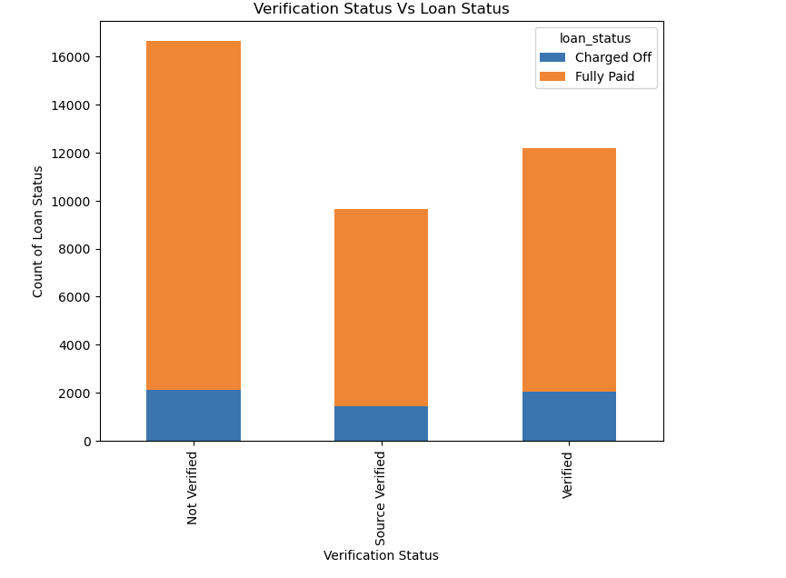
Bivariate analysis
There is only a slight variation in the charge Off between Verified and Non verified profiles

Slide 11
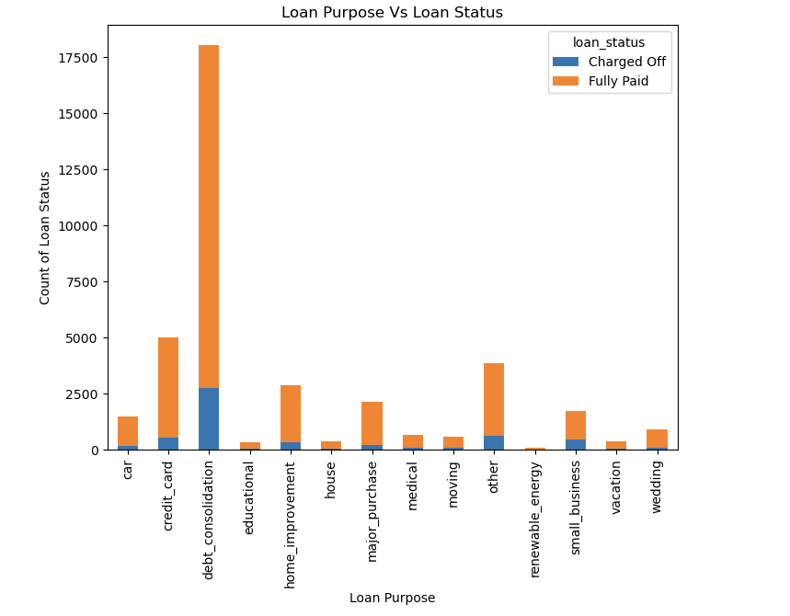
Bivariate analysis
More number of Charge off Profiles have taken loan under Debt Consolidation.

Slide 12
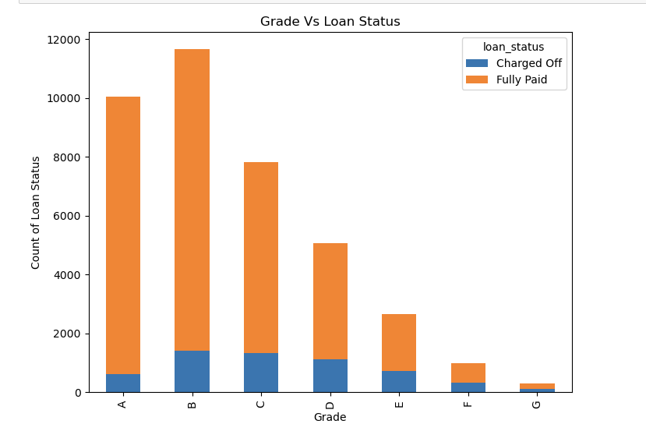
Bivariate analysis
More Loan area under the Grades B, C, A.

Slide 13
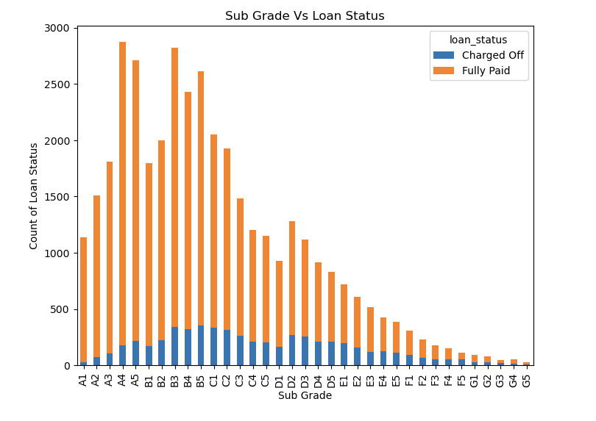
Bivariate analysis
The Subgrade distribution is left skewed.

Slide 14
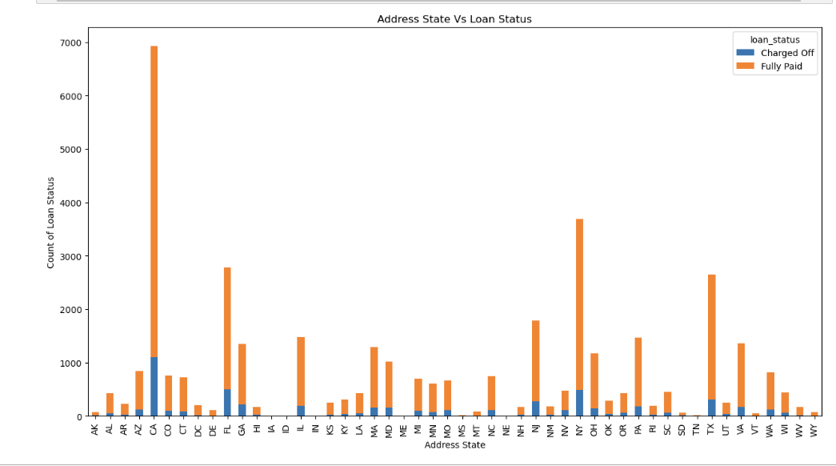
Bivariate analysis
Loans are the region of CA, NY and FL have more charge off.

Slide 15
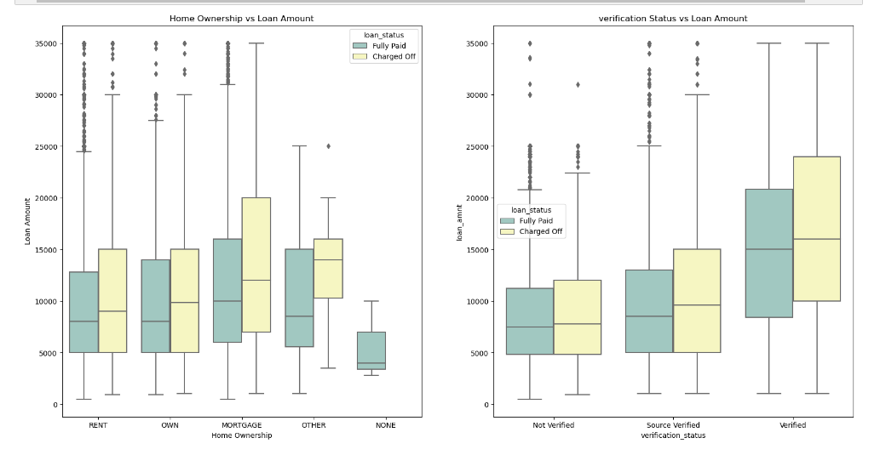
Multivariate analysis
Profiles with home ownership under Mortgage and applied for a loan more than 10,000 are more likely to default

Slide 16
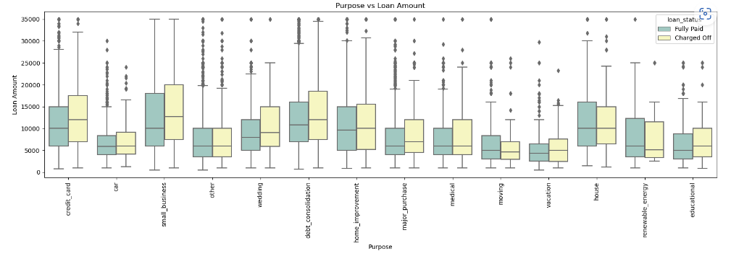
Multivariate analysis
The Purpose of Small Business applied for loan above 10,000 are likely to default
The purpose of Credit Card, Debt Consolidation and home improvement also need to be verified

Slide 17
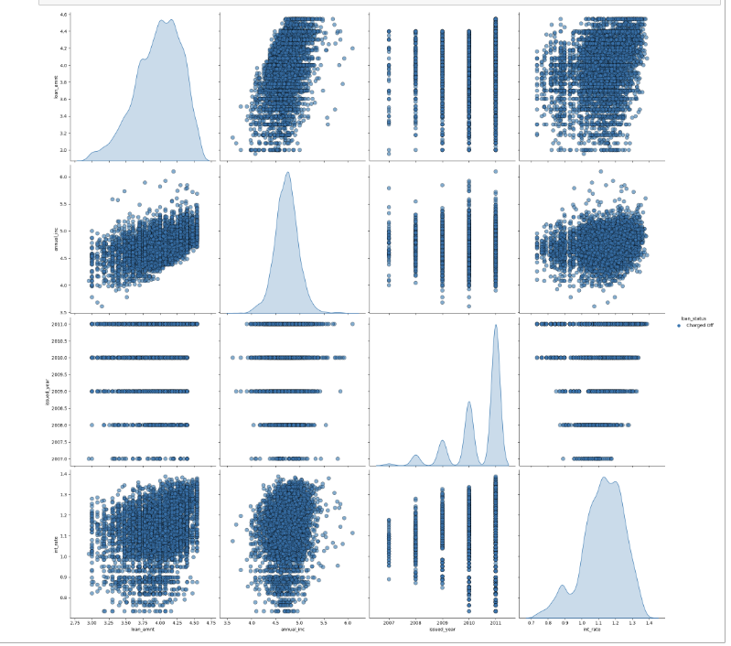
Multivariate analysis
Profiles with home ownership under Mortgage and applied for a loan more than 10,000 are more likely to default

Slide 18
THANK YOU
Naga Gayathri P
Balaji Pandian

