Slide 1
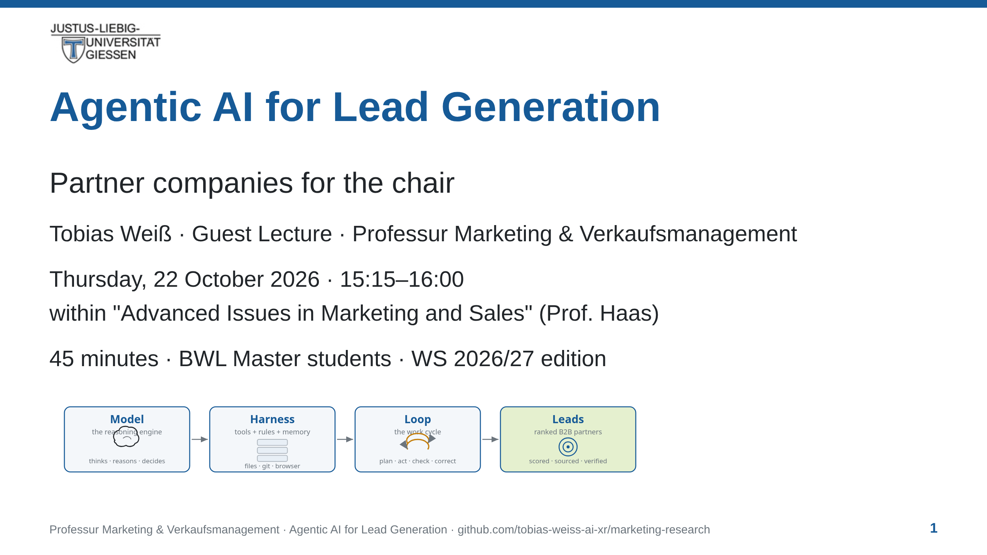
Notes:
notes:
⏱ ~45 s · READ ALOUD
Good afternoon — thank you for having me. This session is about
agentic AI: what it is, and how to run it so its work is
trustworthy. Everything today maps onto one real task — helping
this chair find and qualify B2B partner companies. The shortlist
the agent produces is evidence for our Bachelor course Sales
Strategy and Execution next summer. Nothing here is an exercise.
It is the start of a deliverable. Let's begin.

Slide 2
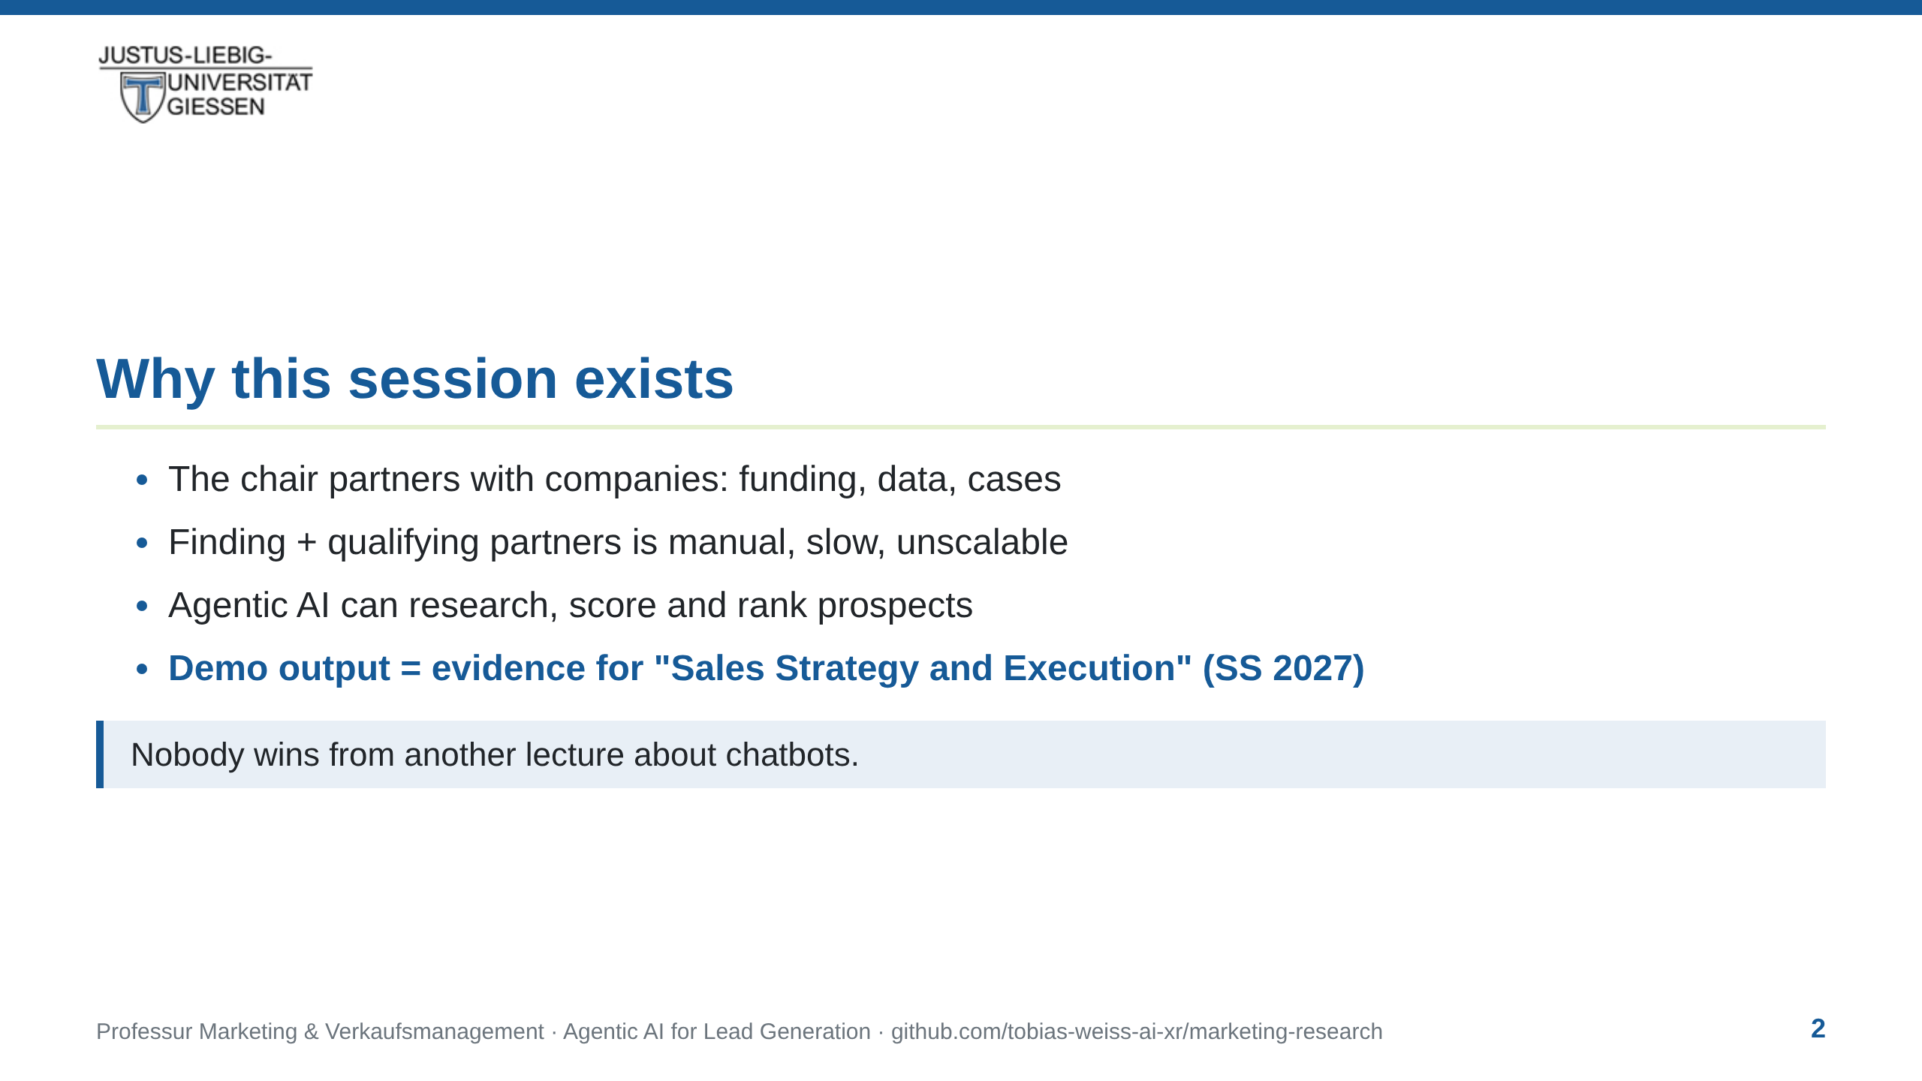
Notes:
notes:
⏱ ~45 s · READ ALOUD
[If preceding talker, bridge first:] You just heard about modern
marketing and sales in a digital world — agentic AI is the tooling
that puts exactly that into practice.
The chair partners with companies — for funding, for data, for
teaching cases. Finding and qualifying those partners is manual
work: slow, and it doesn't scale. Agentic AI can research
companies, score them, and rank them. And be clear: nobody needs
another lecture about chatbots. What you need is to recognise —
and judge — an agentic workflow, and to read the contract that
drives it. The demo produces a ranked list of partners, every claim
with a source. That list is the dataset the Bachelor course builds
on next year.
[jot: the "ranked list" is the handoff artefact — the
"output as input" promise. Protect it; it returns on slides 20/21.]

Slide 3
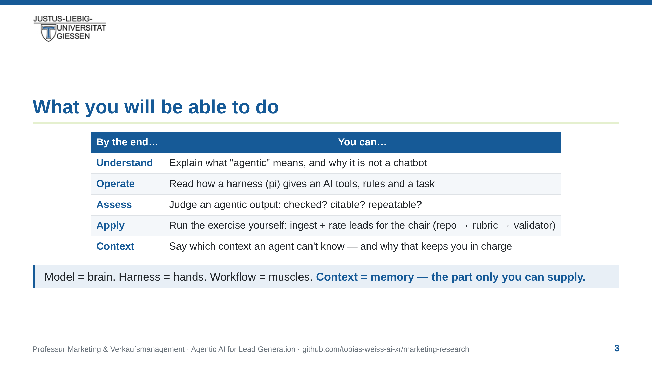
Notes:
notes:
⏱ ~30 s · READ ALOUD
Here's the promise of the next forty-five minutes, in four rows.
You'll be able to explain what agentic means — and why it is not
a clever chatbot. You'll be able to read how a harness gives an AI
tools, rules, and a task. You'll be able to judge an agentic output
— checked? citable? repeatable? And you'll run the loop yourself: repo, rubric, validator —
you'll ingest and rate leads for the chair before the course ends. One headline before we
start: model is the brain, harness is the hands, workflow is the
muscles — and context is the memory. That part is yours.
[Not read — colour:] Row 5 is the thread of the whole talk:
intelligence is distributed — generation (model), execution
(harness), context (you).

Slide 4
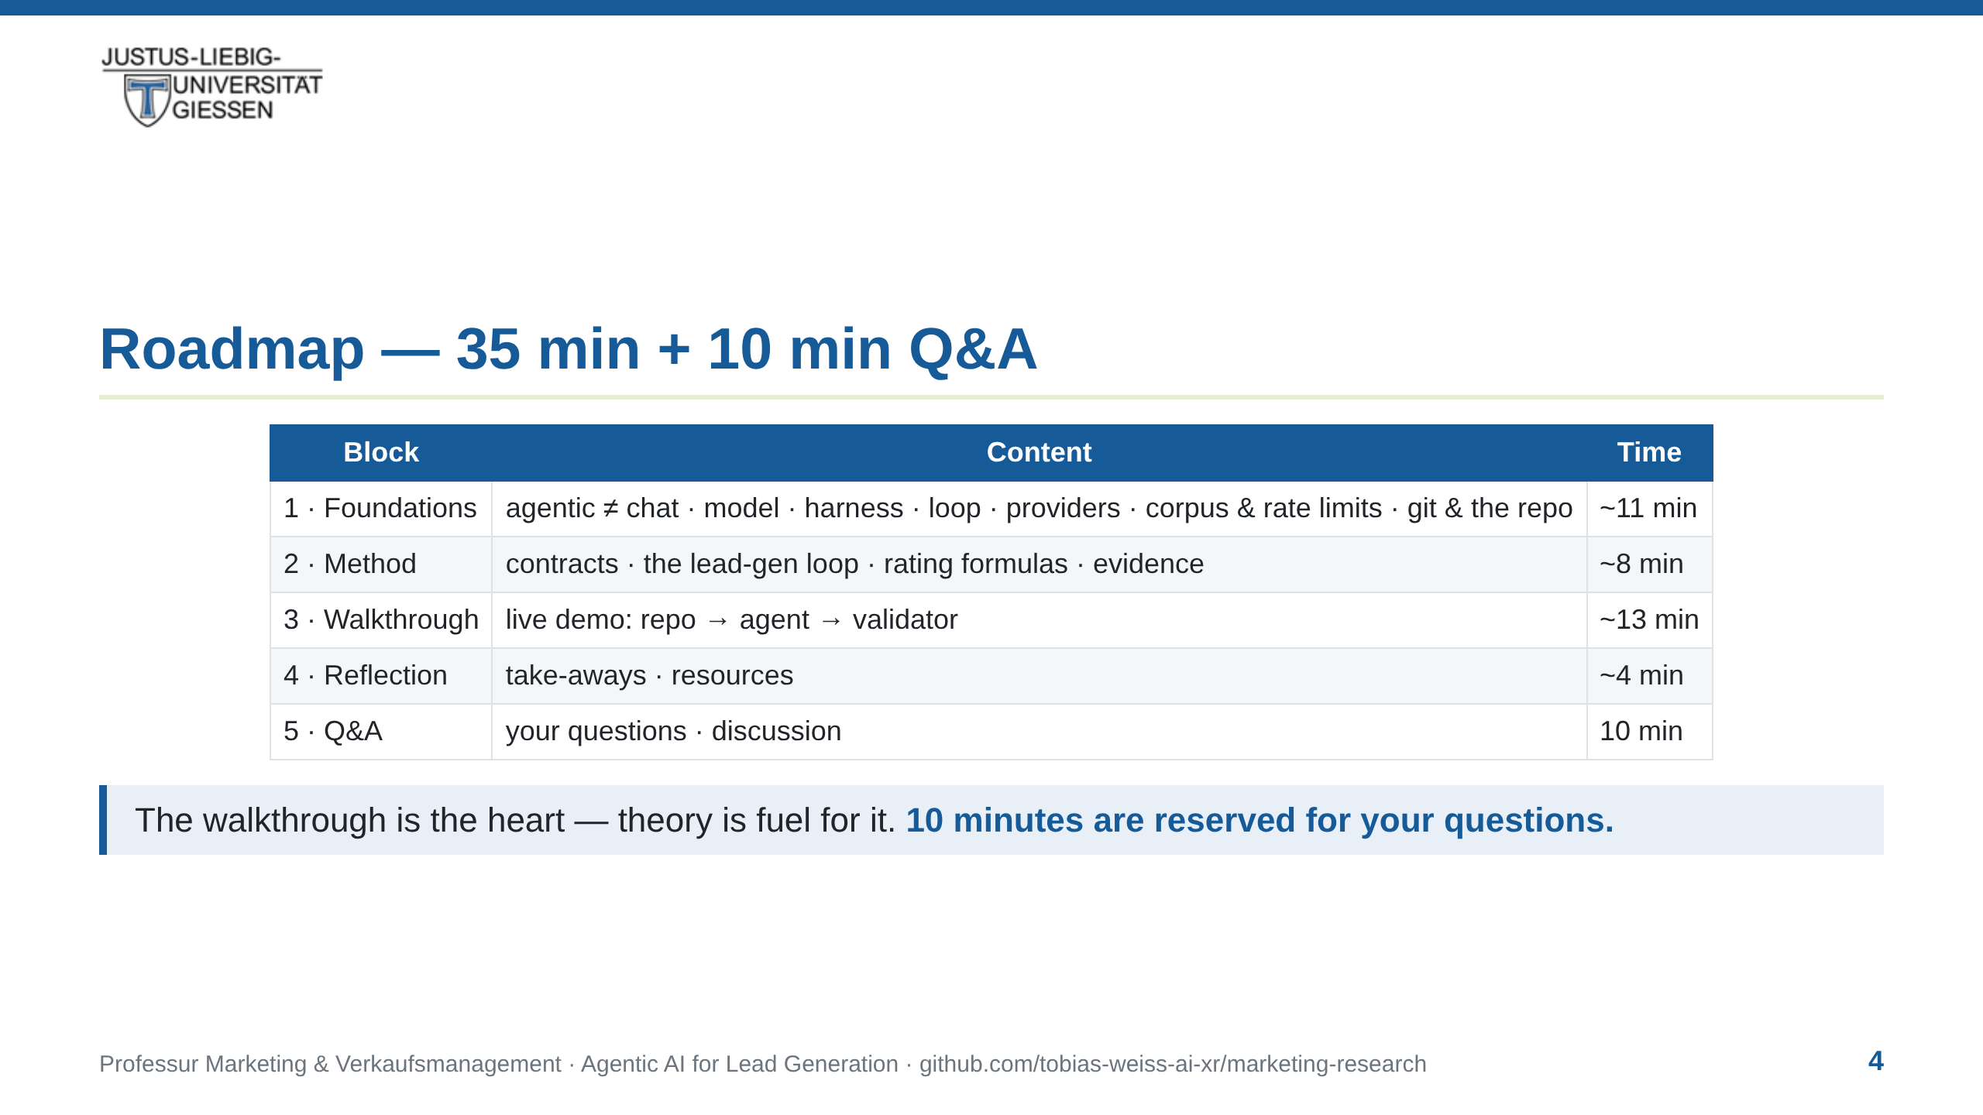
Notes:
notes:
⏱ ~15 s · READ ALOUD
The map for the next thirty-five minutes: foundations first, then
the method, then the live walkthrough — the heart — and a short
reflection at the end. Ten minutes are reserved for your questions.
If one comes to you mid-talk, write it down — we'll get to it.
[Not read:] The notes sum to ~38 min — slightly over the 35 budget.
The flex is Step 2: its ~8 min estimate is padded; in the T1 run the
agent finished well inside it. If running behind: trim Define-the-
hunt (45 s), compress Providers and the corpus slide to the HRZ line, skip the DNS aside
unless it bites. Q&A is fixed at 10 min — bank questions with
"hold that for Q&A". The BrowserMCP intermezzo inside Step 2 (~45 s:
why a real browser — LinkedIn, consent walls, logins) folds into
the walkthrough buffer.

Slide 5
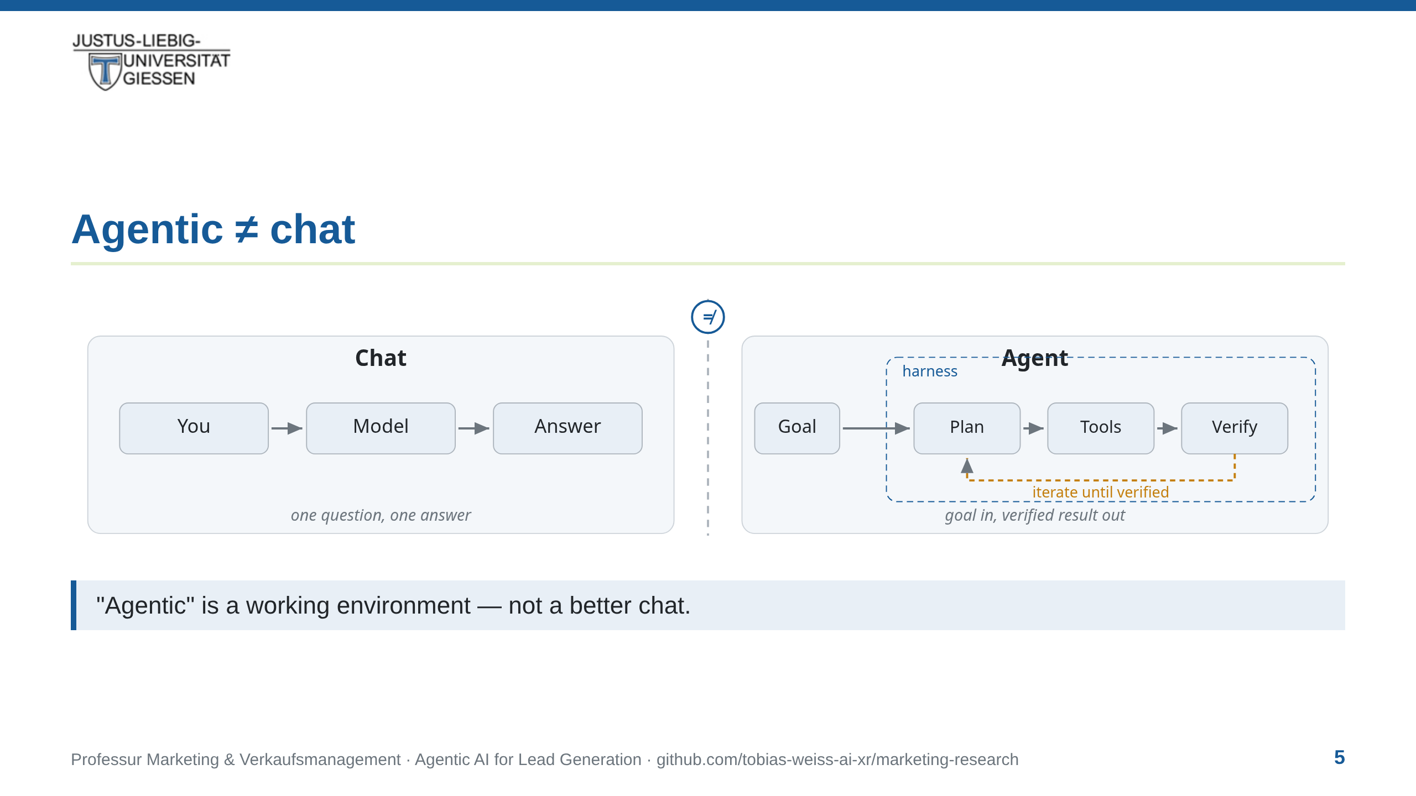
Notes:
notes:
⏱ ~2.5 min · READ ALOUD
Let's clear up the most common confusion first. On the left: chat.
Question in, answer out. No tools, no files, no actions — a
conversation. On the right: an agent — a goal, a plan, tools,
verification, running inside a harness that grants it access to the
world: a browser, files, APIs. The amber loop in the middle is
where the work happens. The key point: agentic is not a smarter
ChatGPT. It is a difference in kind, not in size. The model can
touch the world, and it can check its own work. Keep this image —
it's the whole lecture in one picture.

Slide 6
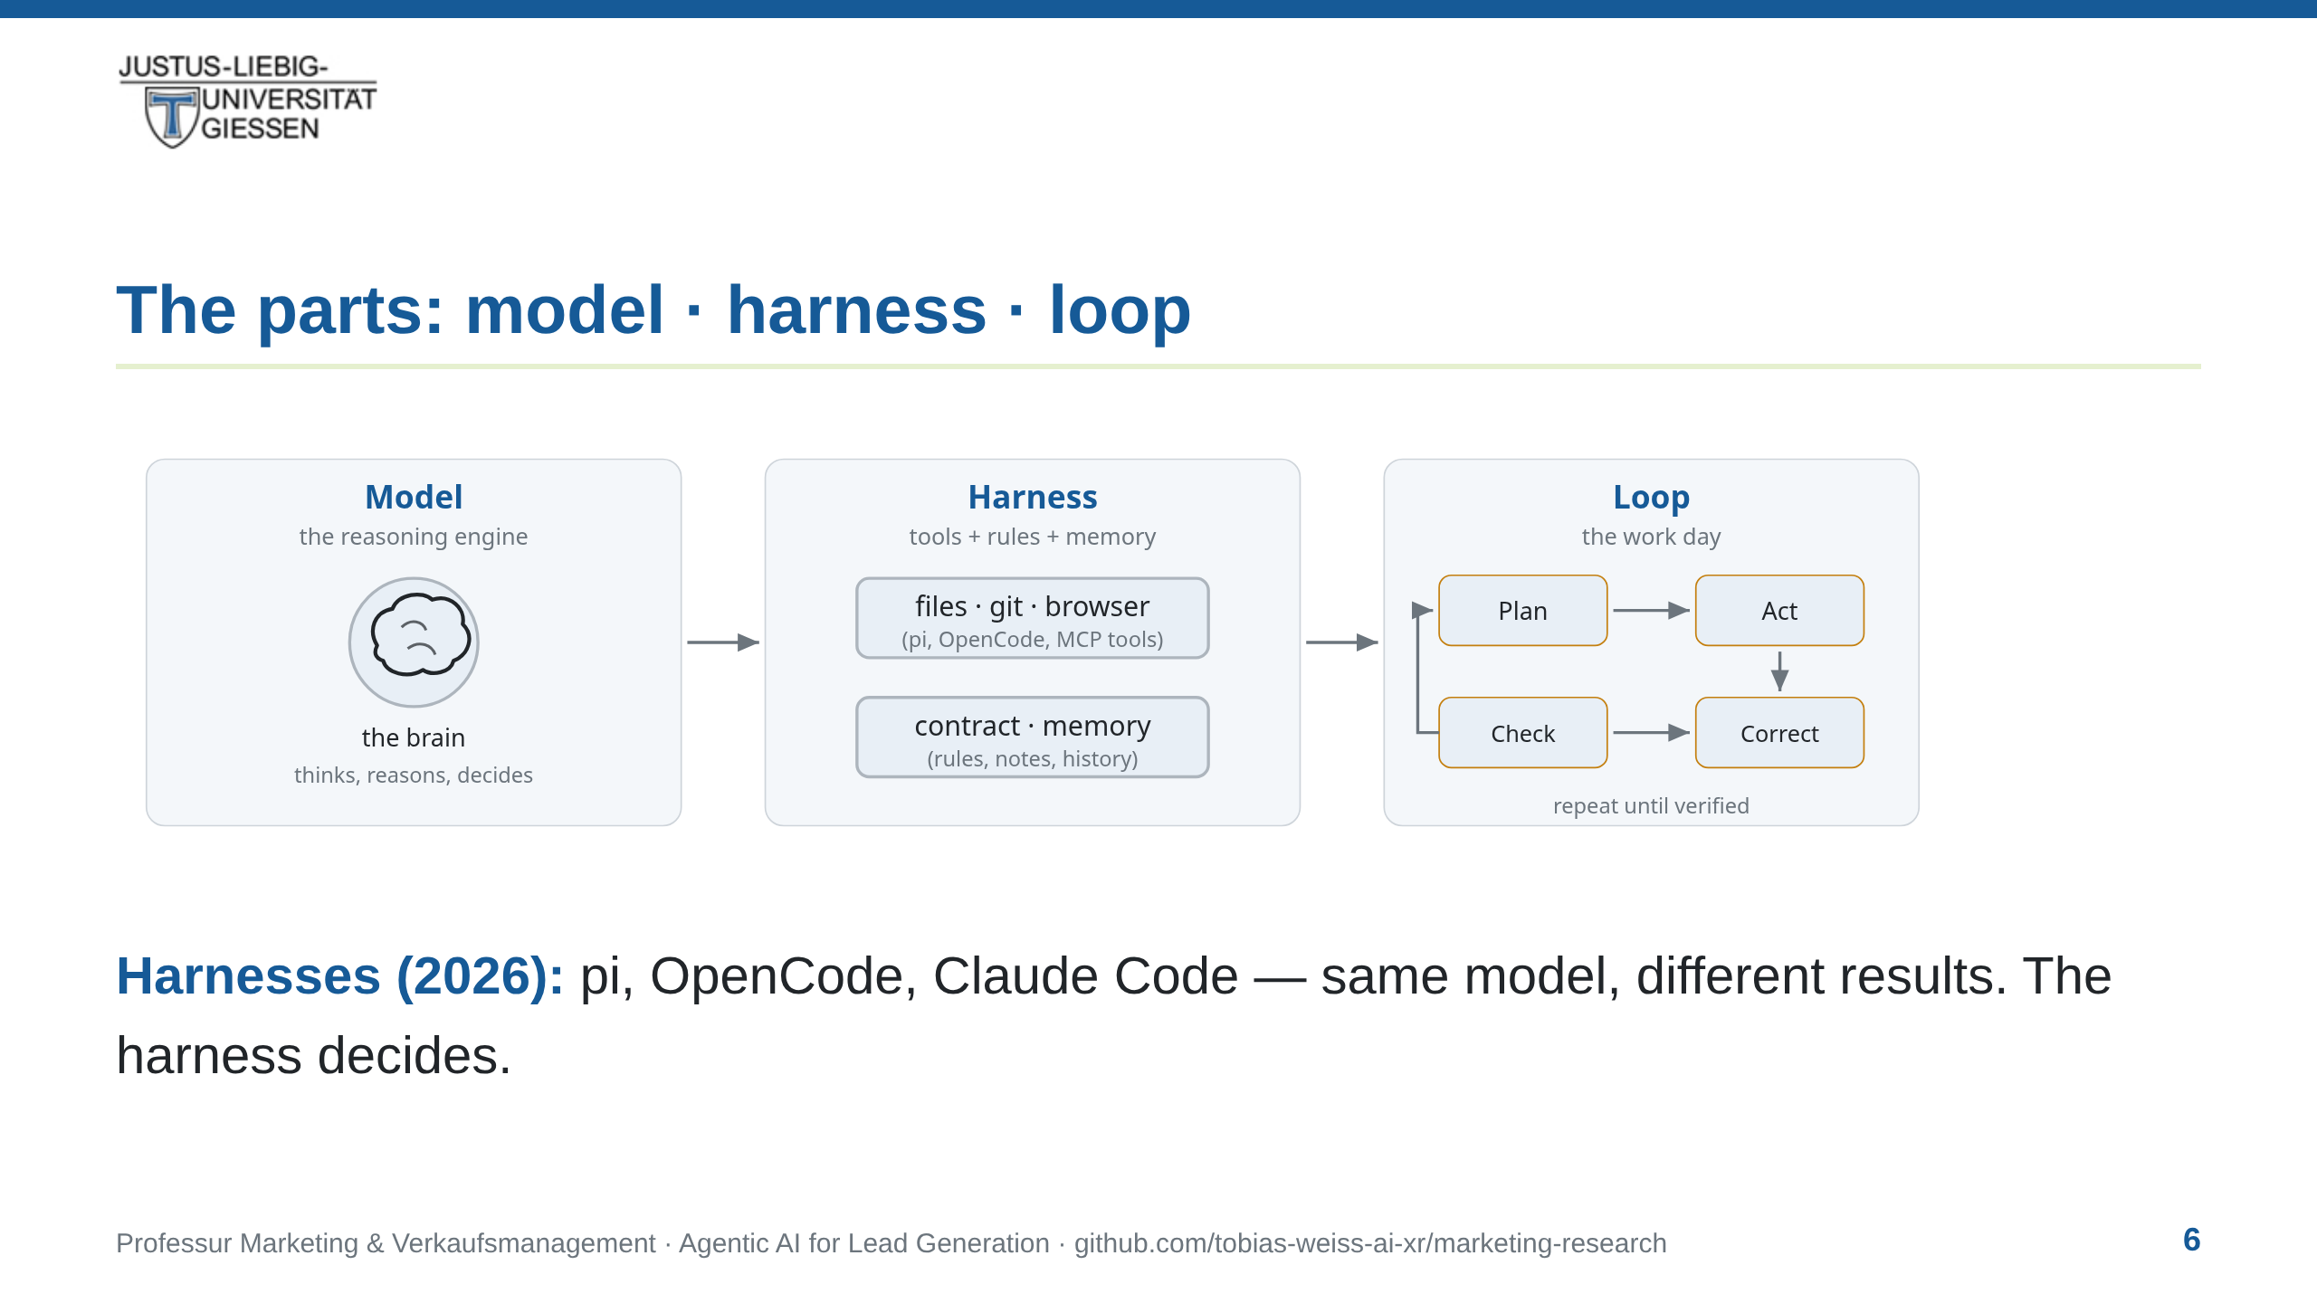
Notes:
notes:
⏱ ~2.5 min · READ ALOUD
Three parts. The model — the brain. The harness — the piece this
lecture adds: an executable environment, permissions, memory — the
hands and the workspace. And the loop — what makes it agentic: it
plans, acts, checks, corrects itself. Two asides. First: a fourth
ingredient is deliberately not on this diagram — context, the
criteria and judgement the loop cannot invent for itself. That's
yours, and it comes back in two slides. Second: pi is the harness
you see in the demo. I use it mainly for its small memory footprint.
OpenCode and Claude Code are solid alternatives. Same model,
different results — the harness decides.
[Not read:] If asked why pi — small memory footprint; OpenCode and
Claude Code are solid alternatives.

Slide 7
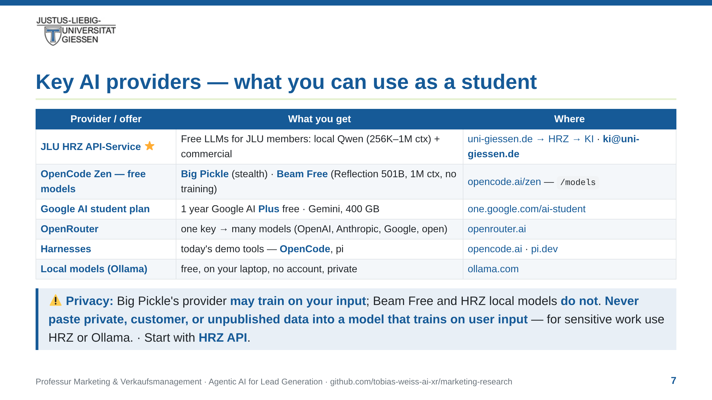
Notes:
notes:
⏱ ~1.25 min · READ ALOUD
What can you use as a student, starting tomorrow? Best option
first: the JLU HRZ API-Service. Free LLMs for every university
member — locally hosted Qwen models with up to a million tokens of
context, plus commercial models. Access by emailing
ki@uni-giessen.de; works with OpenCode out of the box. Second,
OpenCode Zen lists free models — Big Pickle (a stealth model, free
for now) and Beam Free (Reflection's open-weight 501-billion model,
also free, with a one-million-token context). One privacy caveat:
Big Pickle's provider may train on your input; Beam Free and the
HRZ local models do not. So never paste private, customer, or
unpublished research data into a model that trains on user input —
for sensitive work, use HRZ or run Ollama on your own laptop.
Google gives students a year of Google AI Plus free — verify with
your university email by the end of December. OpenRouter: one key,
many models, free tiers included. And the harnesses — OpenCode and
pi — are the tools behind today's live demo. If you take one thing
from this slide: start with HRZ.
One practical note on the network: if the campus Wi-Fi cannot
resolve opencode.ai, the fix — a public resolver or a hosts entry —
is in the HRZ one-pager. Thirty seconds of setup, then move on.
[Not read — DNS fix if opencode.ai does not resolve (hall Wi-Fi):]
Diagnose: `nslookup opencode.ai` fails while other pages load.
Fix A — resolver: set DNS on the Wi-Fi adapter to 1.1.1.1 +
8.8.8.8 (Windows: adapter → IPv4 → DNS; macOS: Network → Details →
DNS; Linux: NetworkManager → IPv4 → DNS); reconnect, retry.
Fix B — hosts entry (admin): resolve fresh via
`dig +short opencode.ai @1.1.1.1`, then append `<IP> opencode.ai`
to /etc/hosts (Linux/macOS) or C:\Windows\System32\drivers\etc\hosts
(Windows). Verified 19 Oct 2026: 172.65.90.20 (Cloudflare anycast,
.20–.23 all work) — re-verify at prep time, IPs can change.
Still failing → it is the firewall, not DNS → phone hotspot for
the demo machine; do not fight a deliberate campus block.
[Not read — for questions:] Google deal redeem by Dec 31 2026,
SheerID verification; OpenCode via LiteLLM provider block
(baseURL api.hrz.uni-giessen.de) or Claude Code via
ANTHROPIC_BASE_URL.

Slide 8
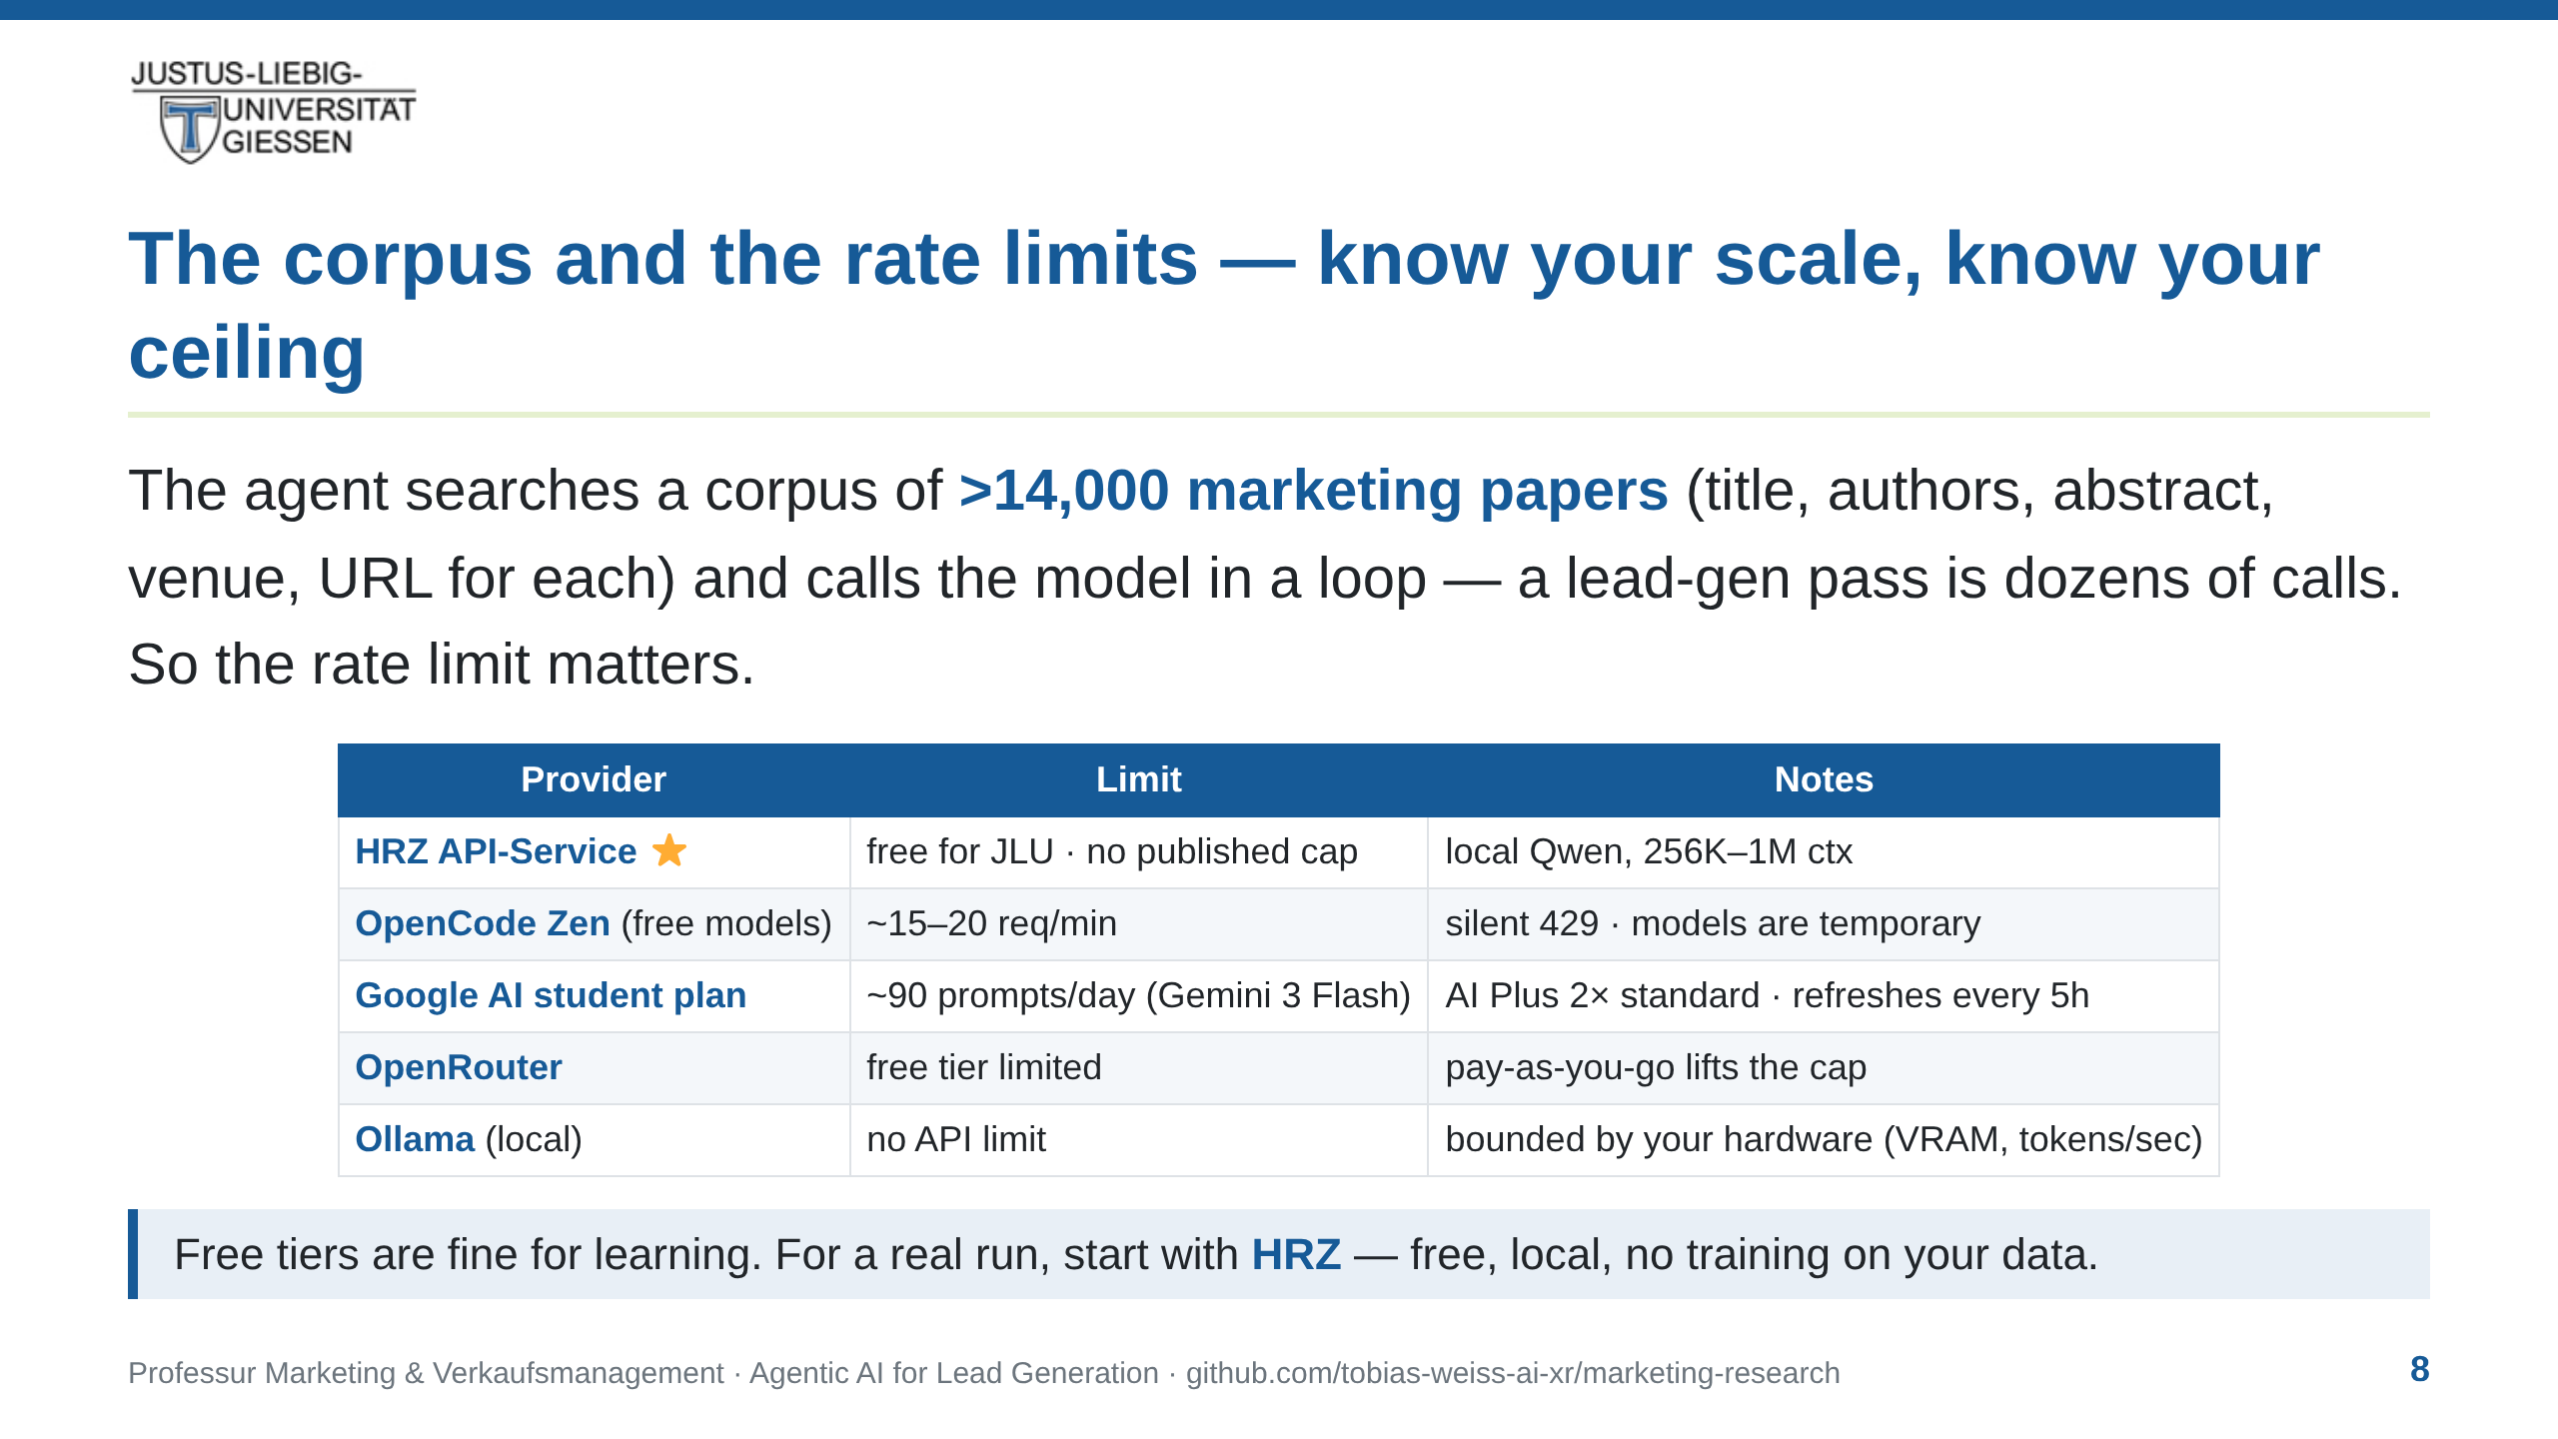
Notes:
notes:
⏱ ~1 min · READ ALOUD
Two things to know about your tools. First, the corpus: the agent
searches more than fourteen thousand marketing papers — title,
authors, abstract, venue, URL for each. A single lead-generation
pass is dozens of model calls, so the rate limit matters. Second,
the limits. HRZ is free for JLU members with no published cap —
start there. OpenCode Zen's free models run about fifteen to
twenty requests per minute, and the four-twenty-nine is silent —
no retry-after header, so the agent just waits and retries.
Google's student plan gives you roughly ninety prompts a day with
Gemini 3 Flash on the AI Plus tier, refreshing every five hours.
OpenRouter's free tier is limited; pay-as-you-go lifts the cap.
And Ollama running locally has no API limit — you are bounded by
your own hardware. For learning, any free tier is fine. For a real
run, start with HRZ.
[Not read — honesty note if probed:] Corpus numbers are lower
bounds (>14,000, >150 commits since Aug 2026, >90 last month);
exact snapshot 20 Oct 2026 in the workspace slide. Rate limits
verified 21 Oct 2026: OpenCode Zen ~15–20 RPM (GitHub
lidge-jun/opencodex#1145, freetokens.fyi); Google AI Plus ~90
prompts/day Gemini 3 Flash (9to5Google, Jan 2026); HRZ has no
published rate limit on the model hub page
(api.hrz.uni-giessen.de/ui/model_hub_table). Ollama is local —
bounded by VRAM and tokens/sec.

Slide 9
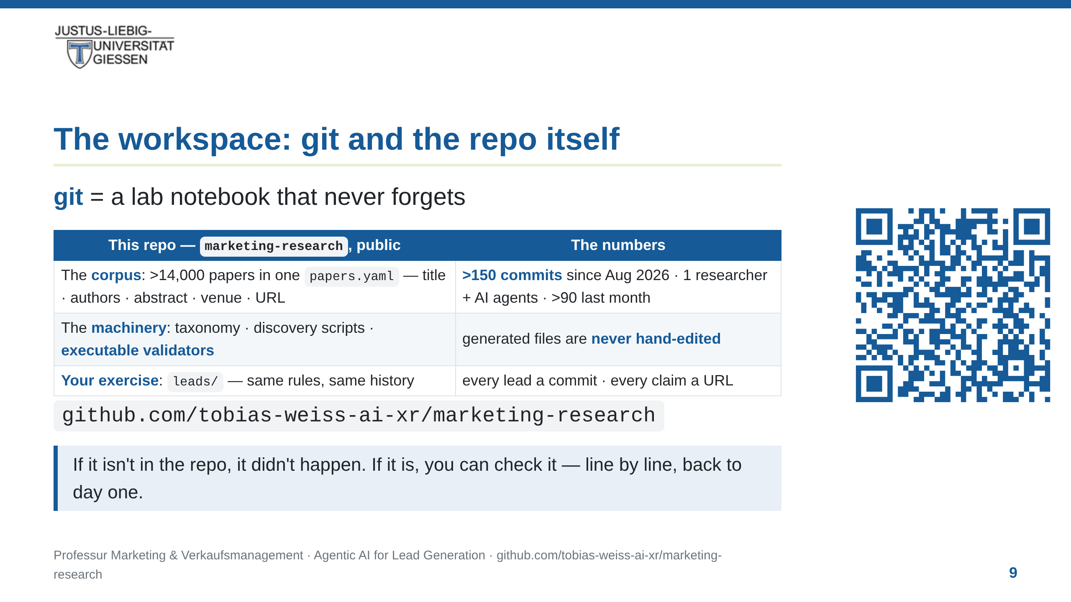
Notes:
notes:
⏱ ~2 min · READ ALOUD
Before we go further: the workspace. Git is a lab notebook that
never forgets. Every change is a commit — who changed what, when,
down to the line. GitHub is the public copy; anyone can audit it —
including you. This lecture lives in one: the chair's
marketing-research repository. Inside: the corpus — more than
fourteen thousand marketing papers in a single file, over three
hundred thousand lines, each with title, authors, abstract, venue,
and a link. The history: more than one hundred fifty commits since
August — one researcher and the AI agents beside them, every commit
attributed — more than ninety in the last month alone. One rule
makes it trustworthy: generated files are never hand-edited, and a
validator runs before anything is committed. Your exercise lives in
the same repo, in the leads folder — same rules, same history. The
QR code on the right goes straight to the repository — scan it now
or after the session. One sentence to keep: if it isn't in the
repo, it didn't happen. If it is, you can check it.
[Not read:] BWL students may never have used git — the lab-notebook
framing is the point; hands-on comes in the leads exercise
(fork, commit, pull request). Numbers are thresholds, not snapshots:
on 20 Oct 2026 the true counts were 163 commits / 97 in the last
month / 14,067 papers / 301,847 lines. ">X" stays true as counts
grow; only the rolling "last month" figure can decay. If probed,
re-read exact counts from `git rev-list` and `wc -l papers.yaml`.

Slide 10
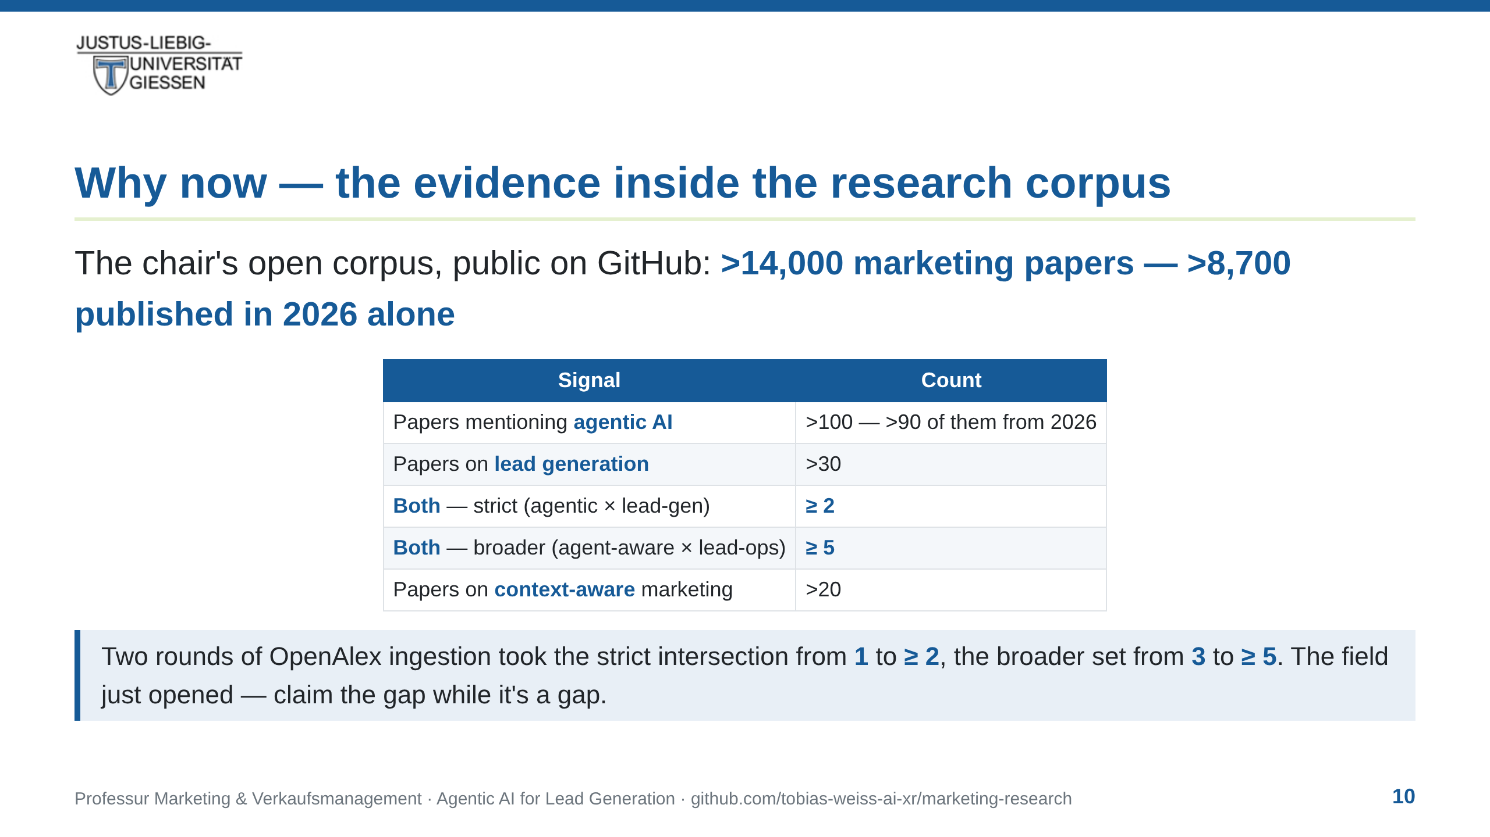
Notes:
notes:
⏱ ~1.5 min · READ ALOUD
Why now? The evidence — from this chair's own open corpus, public
on GitHub. More than fourteen thousand marketing papers — more
than eight thousand seven hundred published in 2026 alone. More
than a hundred papers mention agentic AI — more than ninety of
them from this year. More than thirty are about lead generation.
Now the intersection — papers that do both? Until a few weeks
ago: zero. Two rounds of targeted ingestion later, the strict
intersection is at least two — the Journal of Business Research,
then a second. Count the agent-aware field more broadly and it is
at least five. The field just opened, and the first position in it
is still free.
[Not read — honesty note if probed:] Slide shows lower bounds so
they stay true as the corpus grows. Exact snapshot 20 Oct 2026,
keyword search over title/abstract of our own corpus
(docs/papers.json, 14,067 papers, regenerated today): agentic 112
(100 in 2026), lead-gen 36, strict intersection 2, broader 5,
context-aware 22. Definitions: strict = substring 'agentic' AND
'lead generation'; broader = (agentic | ai agents | ai agent |
multi-agent | autonomous agents) AND (lead generation | lead
scoring | lead qualification | prospecting). Strict 2: the JBR
paper 'AI agents, agentic AI, and the future of sales' (2026) and
'The Augmented Rep' (IRJAEM, 2026). Broader adds GTM-Bench,
Governing Machines (SSRN), The Transformative Role of AI Agents in
Marketing (TechRxiv). Context-aware = 'context-aware' or
'contextual intelligence'. Corpus grew 14,065 → 14,067 this round
(TechRxiv Transformative Role; GENIE CRM, ISJEM) on top of 13 from
the prior round. All URLs resolve; all DOIs verified;
lower-evidence candidates excluded rather than inflating the count;
validation passes.

Slide 11
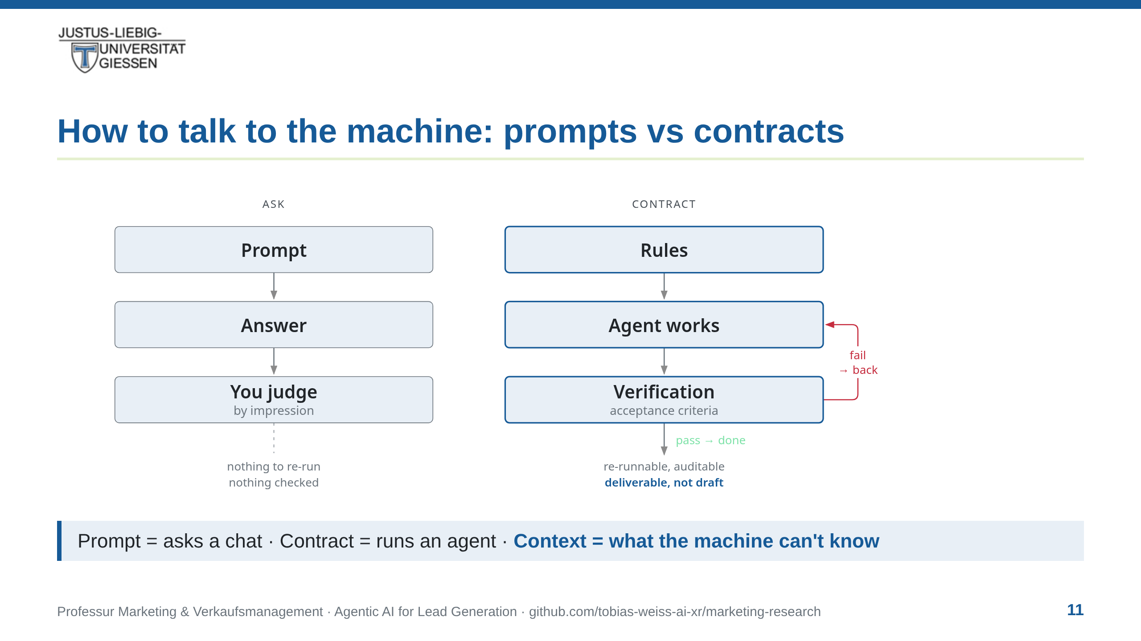
Notes:
notes:
⏱ ~2 min · READ ALOUD
This is the central mental model of the lecture. A prompt is how
you ask a chat: a question, in one go. A contract is how you run an
agent: it lives in the repository, it's versioned, it says what
'done' means. And the third piece: context. The contract is a
container for context — the chair's criteria, the sources we trust,
our judgement, the history of partnerships. Without it, the agent
is a brilliant generalist with no idea what 'good' means here. A
prompt turns an idea-generator into a conversation. A contract
turns it into a reproducible research pipeline. And in this
project the contract is not a document the agent might ignore — it
is the repository itself: schema, rubric, executable validator.
You'll see it in action in the walkthrough.

Slide 12
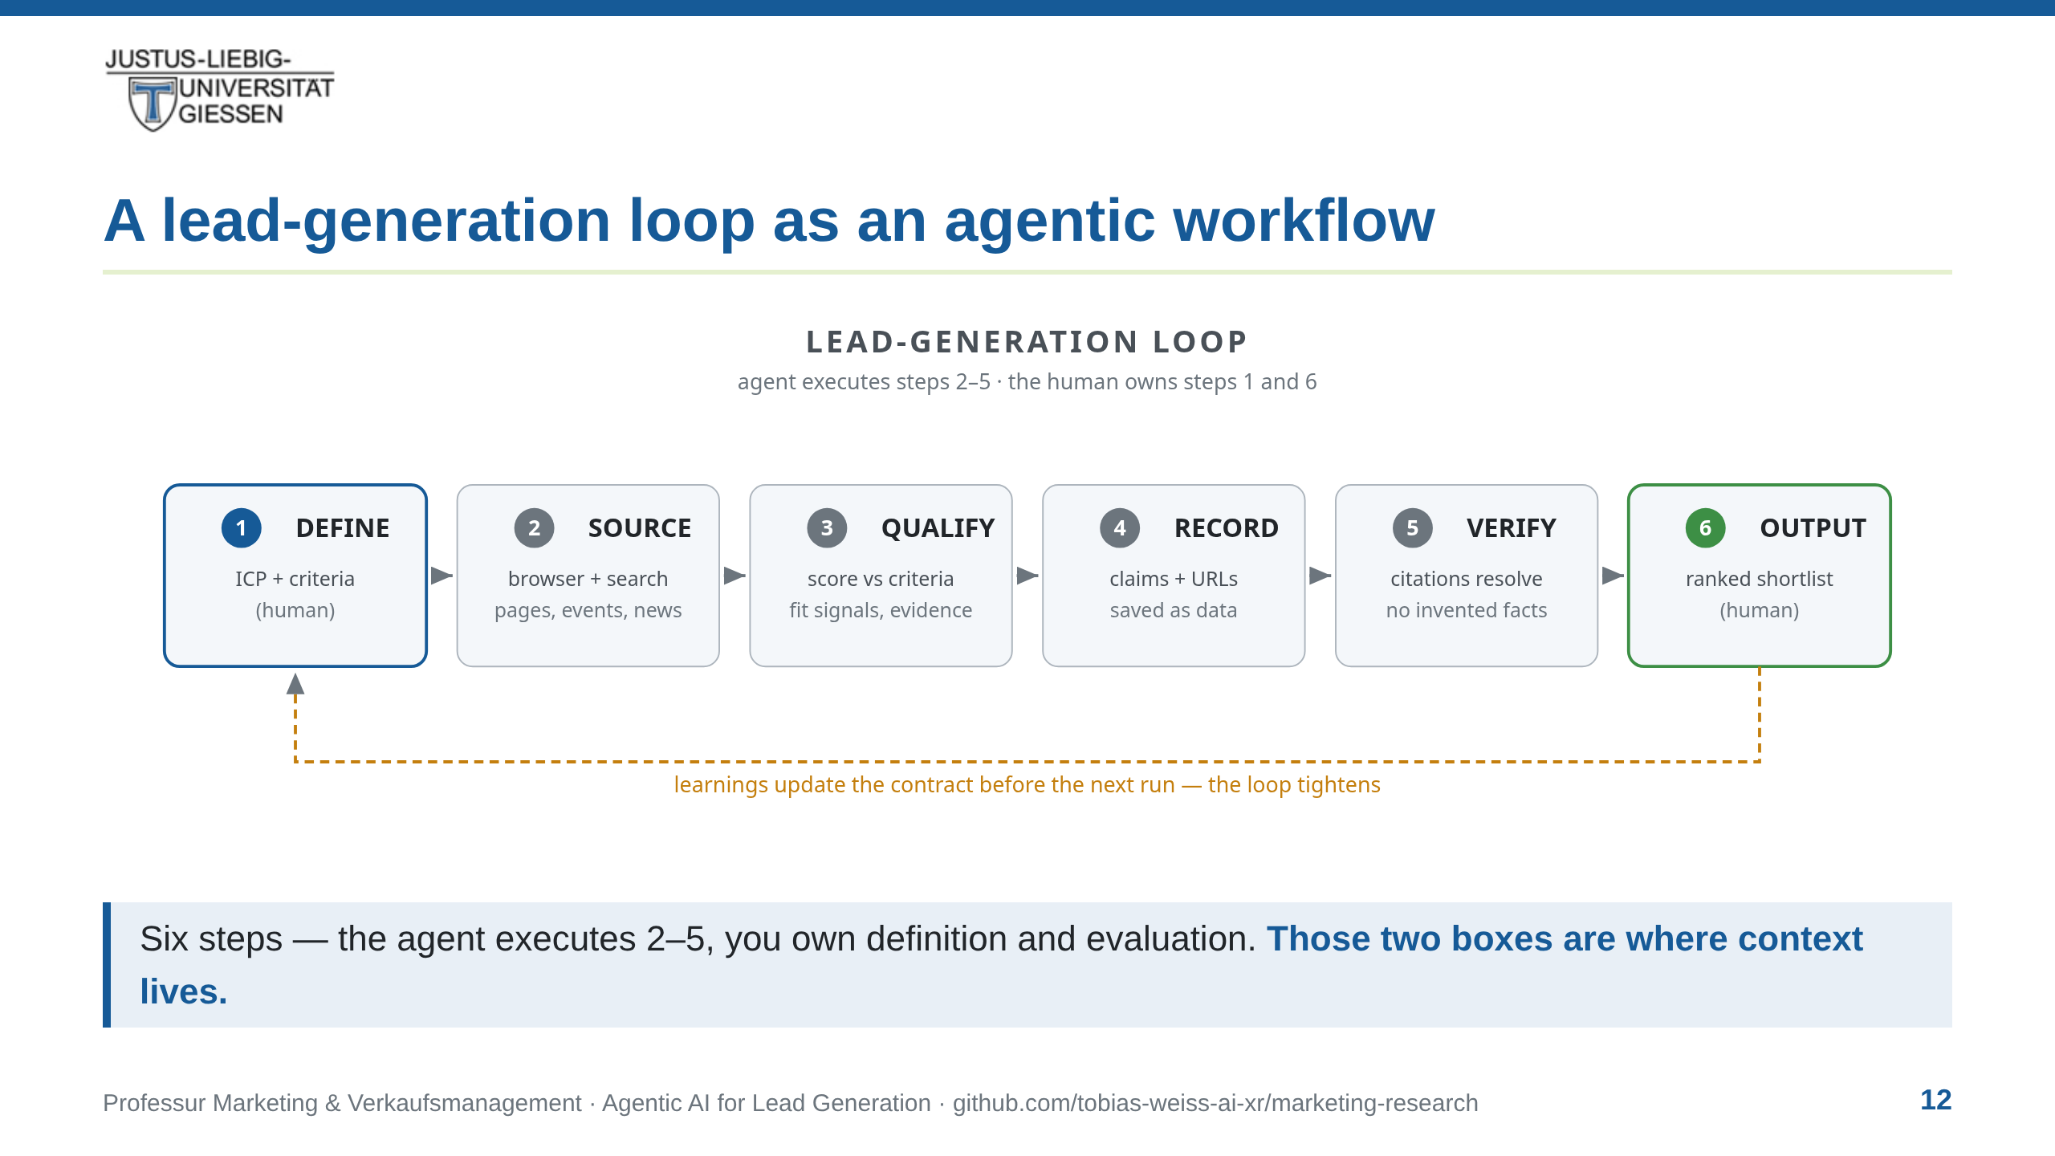
Notes:
notes:
⏱ ~3 min · READ ALOUD
Let's make it concrete — a lead-generation loop as an agentic
workflow. Read it left to right. [point to each box as you say it]
DEFINE — you: the blue box. What does a good partner look like for
this chair? SOURCE — where do we hunt? QUALIFY — does this company
fit? RECORD — capture every claim with its source. VERIFY — check
those sources say what we think they say. OUTPUT — a ranked list,
judged by a human. The agent runs the middle four steps. You own
the first and the last — and you know why from the slide before:
those two boxes are where the context lives. The amber line along
the bottom: what you learn on a run feeds back to tighten the
contract for the next run. The agent stays inside the loop. The
human stays in charge.
[Not read:] DEFINE injects context (criteria, sector, guard rails);
EVALUATE judges with context (the three questions). Next slide makes
DEFINE concrete — the sector choice, still human work.

Slide 13
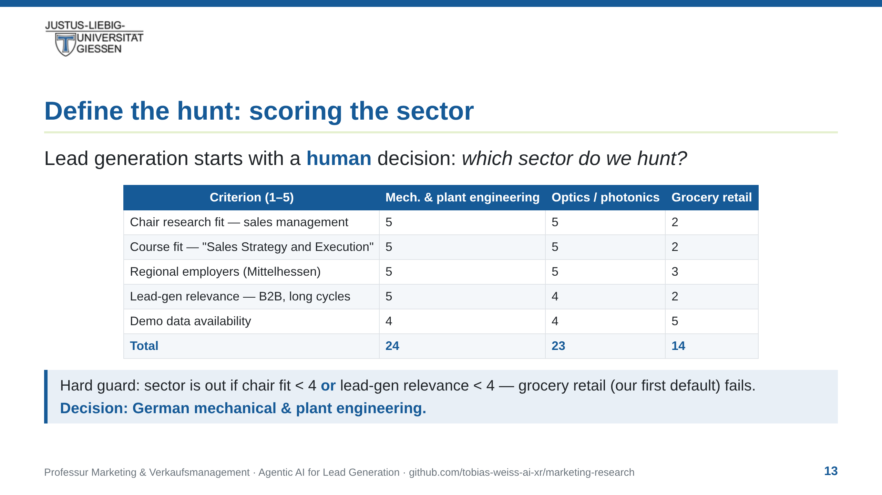
Notes:
notes:
⏱ ~45 s · READ ALOUD
Before the agent does anything, a human decides where to hunt.
Look at the table: five criteria, scored one to five, plus one hard
guard. Our first default — grocery retail — fails the guard: lead
generation there is a consumer, demand-gen game, not a
sales-strategy one. Optics came close. Mechanical and plant
engineering wins on every axis. That's the sector you'll see in the
demo. And notice what just happened: the AI did not choose the
sector. We did. Choosing target segments is a core sales-strategy
decision — one we can teach in the Bachelor course.
[Not read:] This is the DEFINE box made concrete; guards the claim
the walkthrough is human-steered, not agent-chosen.

Slide 14
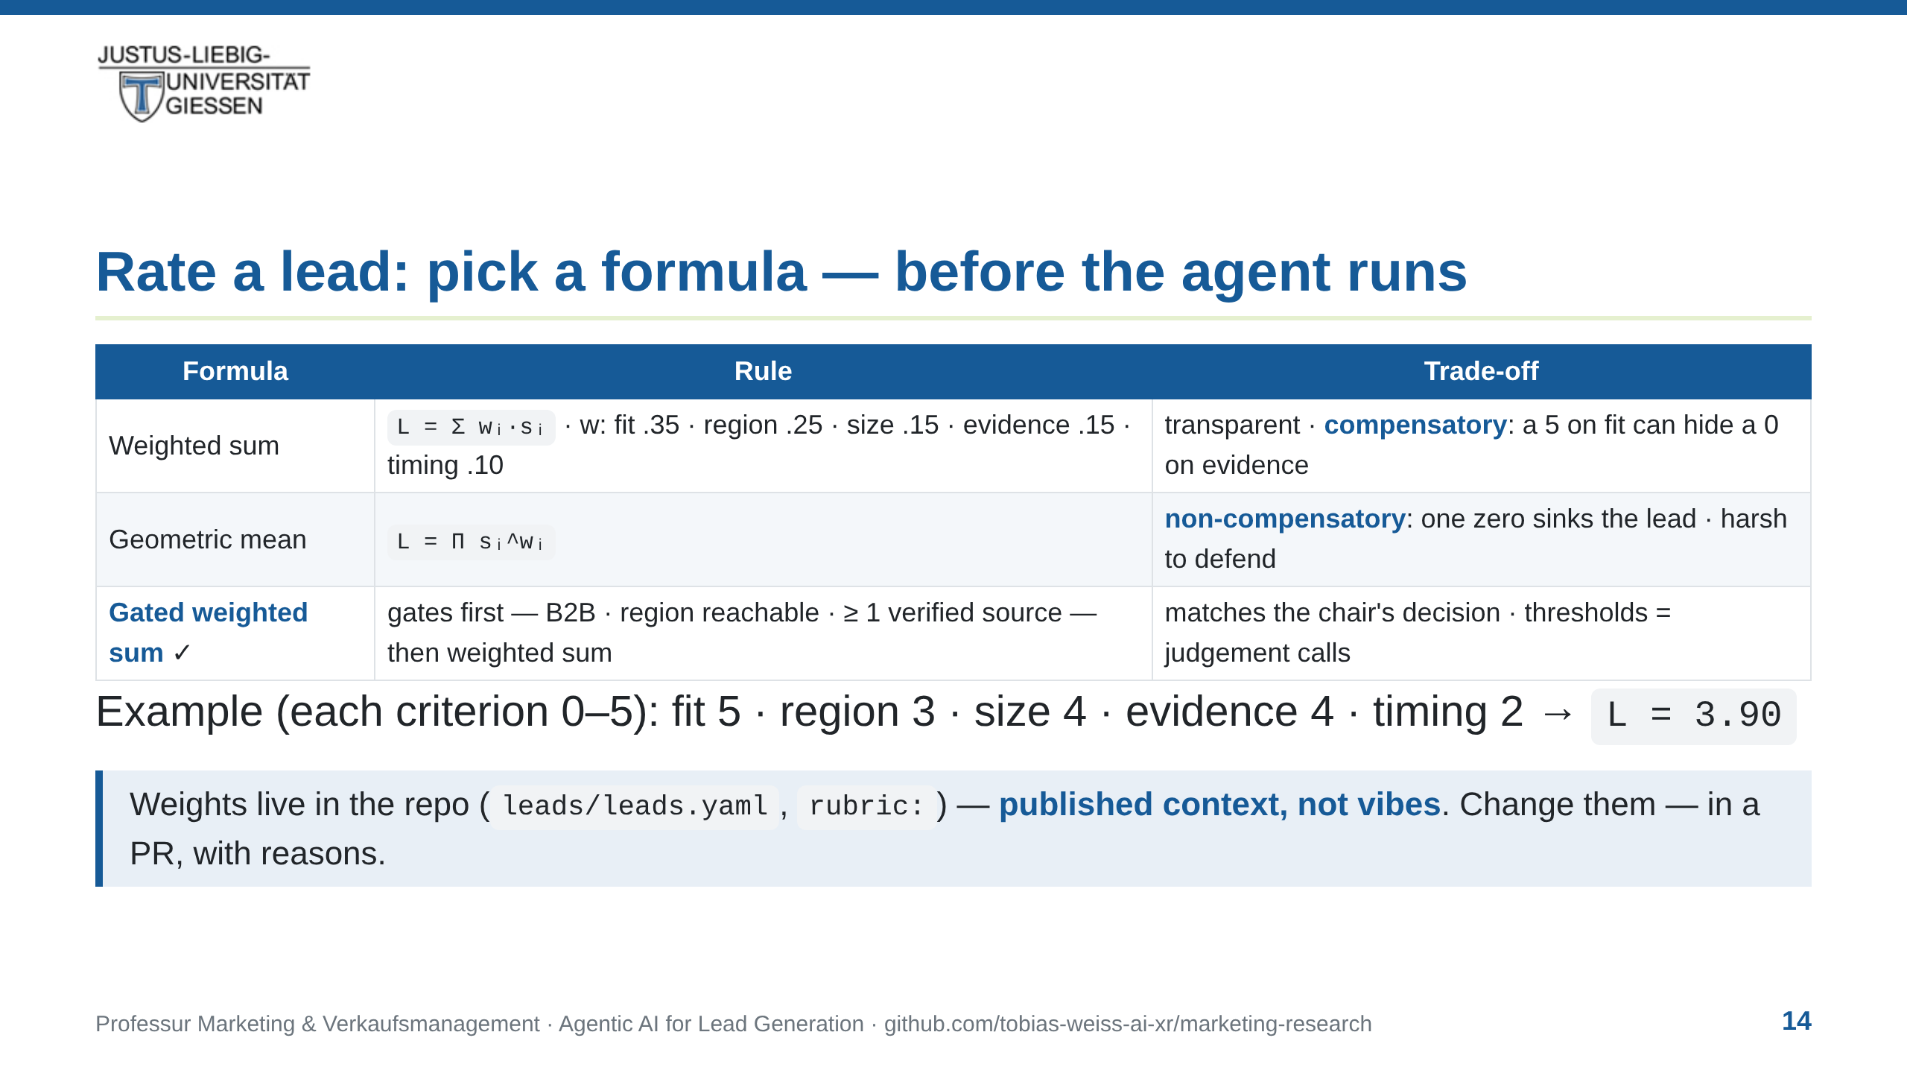
Notes:
notes:
⏱ ~2 min · READ ALOUD
Before the agent scores anything, we decide how scoring works.
Five criteria, each nought to five: fit — chair research fit;
region — Mittelhessen reachability; size — at least a thousand
employees; evidence — independent sources; timing — live signals
like expansion or sales hiring. Three candidate formulas. The
weighted sum: transparent — but compensatory. A five on fit can
hide a zero on evidence. The geometric mean: one zero sinks the
whole lead — harsh, and hard to explain to a dean. Our choice:
gates first — B2B, region reachable, at least one verified source
— then the weighted sum on the survivors. Exactly like the sector
guard two slides ago. Worked example: three point nine. And the
weights are not vibes — they are published in the repository, in
the same file you will edit. Disagree? Change them — in a pull
request, with reasons. That is what published context means.

Slide 15
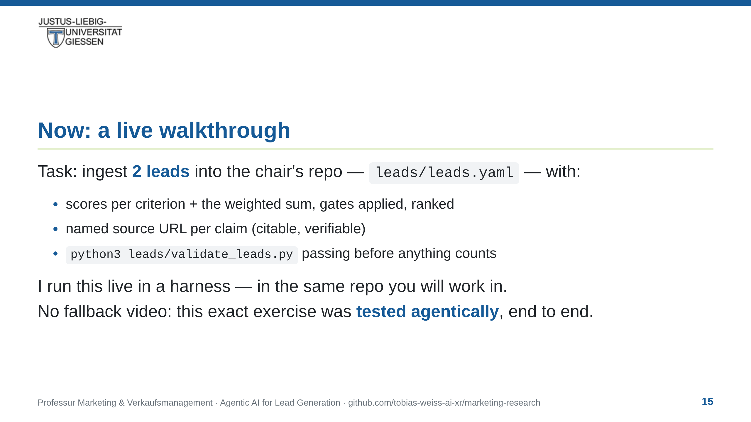
Notes:
notes:
⏱ ~30 s · READ ALOUD
The live walkthrough. Task: ingest two leads into the chair's
repository — the same file, schema and validator you will use
yourself. Every claim with a source URL, scores per criterion,
gates first, then the weighted sum. And no fallback video: if
something breaks, I fix it live — that is the loop working. The
approach is trustworthy because it was tested agentically
beforehand — same task, same prompt, several timed runs. Let's go.

Slide 16
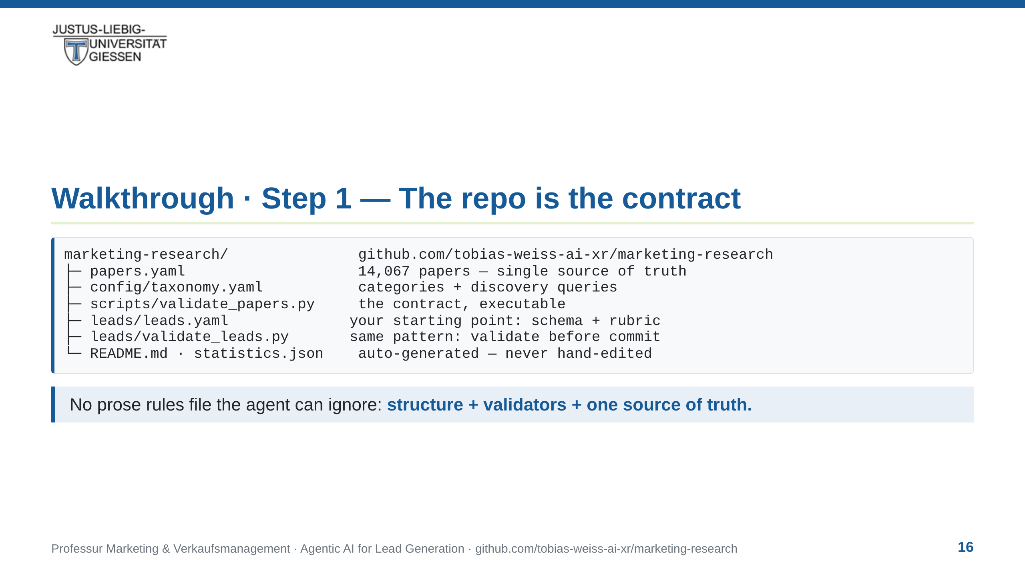
Notes:
notes:
⏱ ~2 min · READ ALOUD
Step one: the contract. Earlier I said contracts beat prompts —
here is what that means in practice. It is not a document the agent
reads at start and may ignore. It is the repository itself. One
source of truth: papers.yaml, fourteen thousand and sixty-seven
papers. Everything downstream is generated, never hand-edited.
Every change passes an executable validator before it is committed.
And your exercise lives in the same pattern: leads/leads.yaml —
schema, rubric, weights — and its own validator. Done does not mean
"looks finished". Done means the validator passes. One
critical-literacy point before we go on: every source in this repo
is self-reported by companies. A URL proves a claim exists; it does
not prove the claim is true. So the standing question today: whose
evidence is this?
[Not read:] The earlier approach — an AGENTS.md rules file — kept
getting ignored and drifting; structure plus executable validation
is what survived contact with real runs.

Slide 17
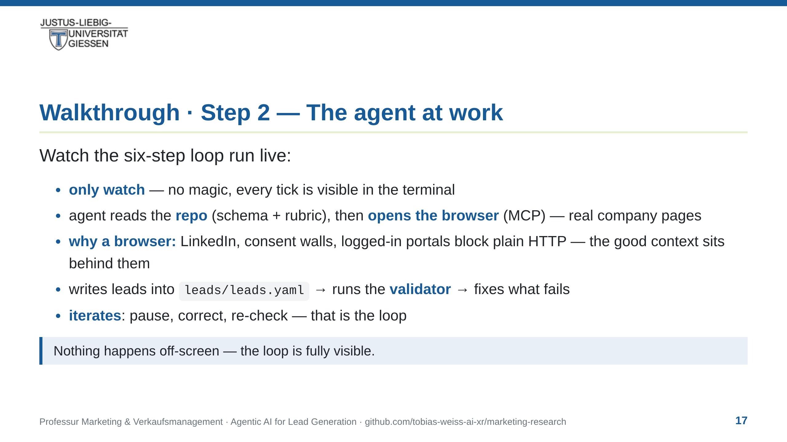
Notes:
notes:
⏱ ~8 min live action — spoken play-by-play, in this order:
[agent starts] "I'm introducing the agent the way I'd introduce a
new colleague: here's the repo — schema, rubric, validator.
Here's the task. Show me your plan first."
[it plans] "Watch the plan — it maps one-to-one onto the six boxes
from the pipeline slide."
[it opens the browser] "There it is — it can touch the world; that's
what agentic means. It's reading the companies' own pages. Right
now it is absorbing our context — the criteria it could not invent
for itself."
[same beat — THE INTERMEZZO, pause & explain:] "Why a real browser
and not just an API call? Because the richest lead sources are
protected. LinkedIn hides contacts behind a login. Half the
companies gate their site behind a cookie banner or an anti-bot
wall, and vendor pages sit in logged-in portals. A plain HTTP
request or a search API gets a '403' — or a consent wall it can't
click through. So the agent drives a real browser — log in, accept
the consent, scroll the page — a tool purpose-built for exactly the
sites where the good context lives. That's the MCP part: a browser
as one more tool the model can pick up."
[quick show — one protected page it just logged into:] "Watch it
open that profile. It didn't scrape a summary; it read the real
page — the context behind the wall is what we're after."
[Not read — honesty if probed:] The agent is rate-limited and
touches only public or already-authenticated pages; we never paste
private or customer data. If the wall blocks it, we name it and
move on — a fixed failure is the lesson.
[it scores] "It scores each lead against the rubric — fit signal,
one sentence, source alongside."
[on a mistake — pause, then:] "Hold on. It over-claimed. Stop.
Which URL says that?" [let it correct itself] "That
pause-and-correct is the loop in action."
[it runs the validator] "It re-checks its own citations and the
score math — the validator checks both. That's step five: verify."
[final table] "There's the shortlist — ranked, cited, validated.
Let's judge it with the three questions."
[Not read:] Steps: (1) open browser via MCP, search prospects;
(2) read real pages, extract fit signals; (3) score vs rubric;
(4) write leads/leads.yaml entries with URLs; (5) run
validate_leads.py, fix failures; (6) ranked table. Speed beats
completeness — cut lead two if running long. Demo runs on real
public data via cloud API — never paste private/customer data.
Tested beforehand: ≥2 timed agentic runs of this exact exercise
(demo/test-protocol.md). If it breaks live: debug on screen and
name it — a fixed failure is the lesson. No recording, no
fallback video.

Slide 18
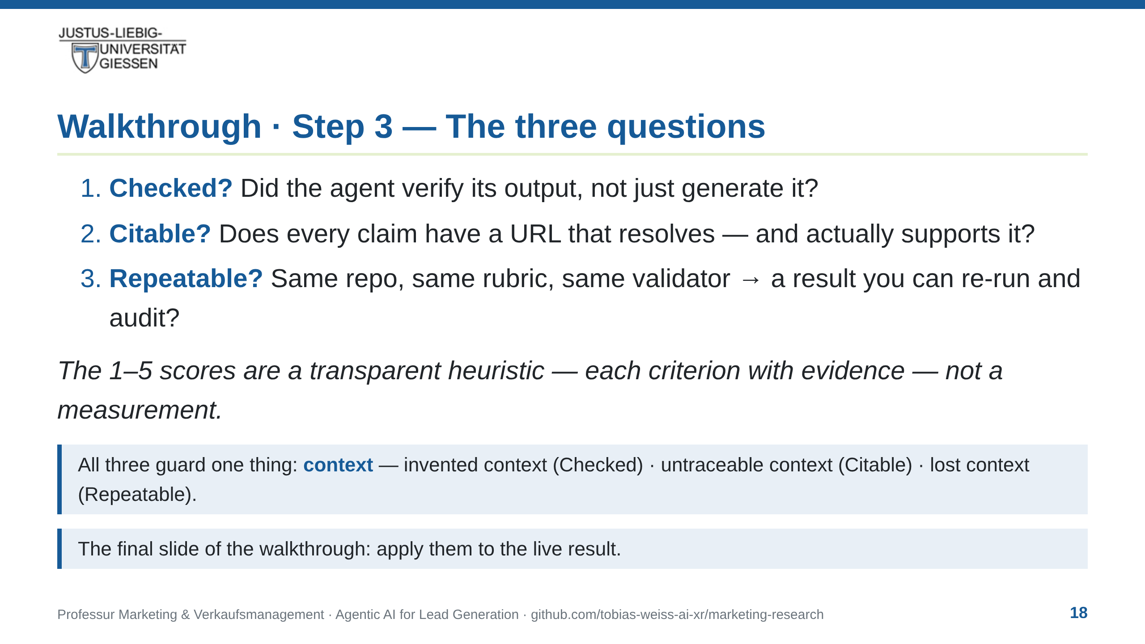
Notes:
notes:
⏱ ~2 min · READ ALOUD
The last step of the walkthrough: judge the output with three
questions. Checked — did the agent verify its output, or just
generate it? Citable — does every claim carry a URL that resolves
and supports the sentence? Repeatable — re-run the same repo, the
same rubric, the same validator: a result you can audit. All three
guard context.
Checked guards against invented context. Citable guards against
untraceable context. Repeatable guards against lost context. If the
output passes, it's a deliverable. If not, it's a draft. Same
discipline as verifying a prospect's claims before you sign.
Verify before you trust.
[Not read:] Repeatability is process-level, not byte-identical
output — models are stochastic, the method is re-runnable. Sales
connection: you verify a prospect's claims before signing.

Slide 19
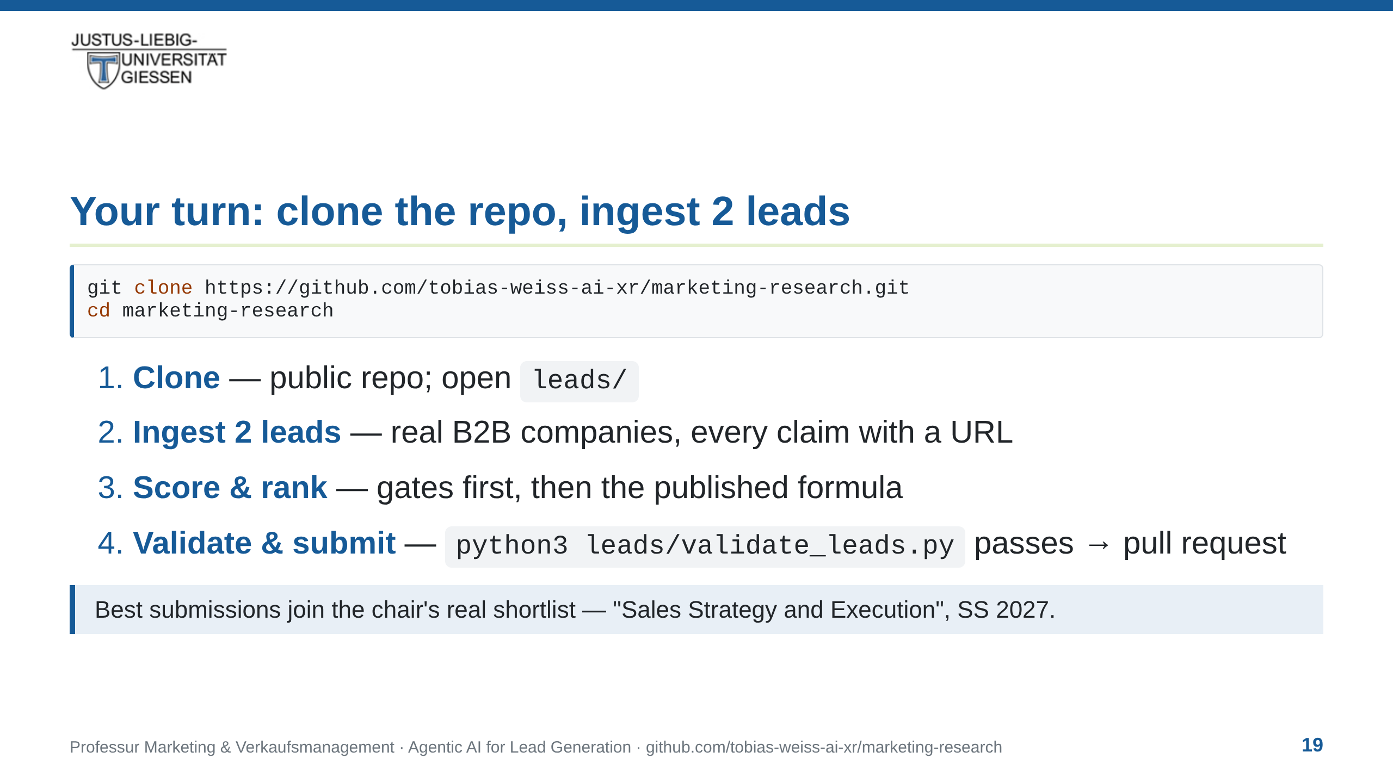
Notes:
notes:
⏱ ~1.5 min · READ ALOUD
Now it's your turn. The repo is public — clone it, cd in, open
the leads folder. The command is on the slide. The brief, the
schema, the rubric, the validator: all there. Your task: in your
own clone, ingest two leads — real companies that could partner
with this chair. Score them with the published formula: gates
first, then the weighted sum. Run the validator; if it passes,
open a pull request. The chair reviews submissions like papers.
And the best ones join the real shortlist for the Bachelor course
next summer. Everything you saw today, you now run yourself.
[Not read:] To submit a PR: fork on GitHub first, then clone your
fork (same command, your username). The slide shows the upstream
URL for reference.

Slide 20
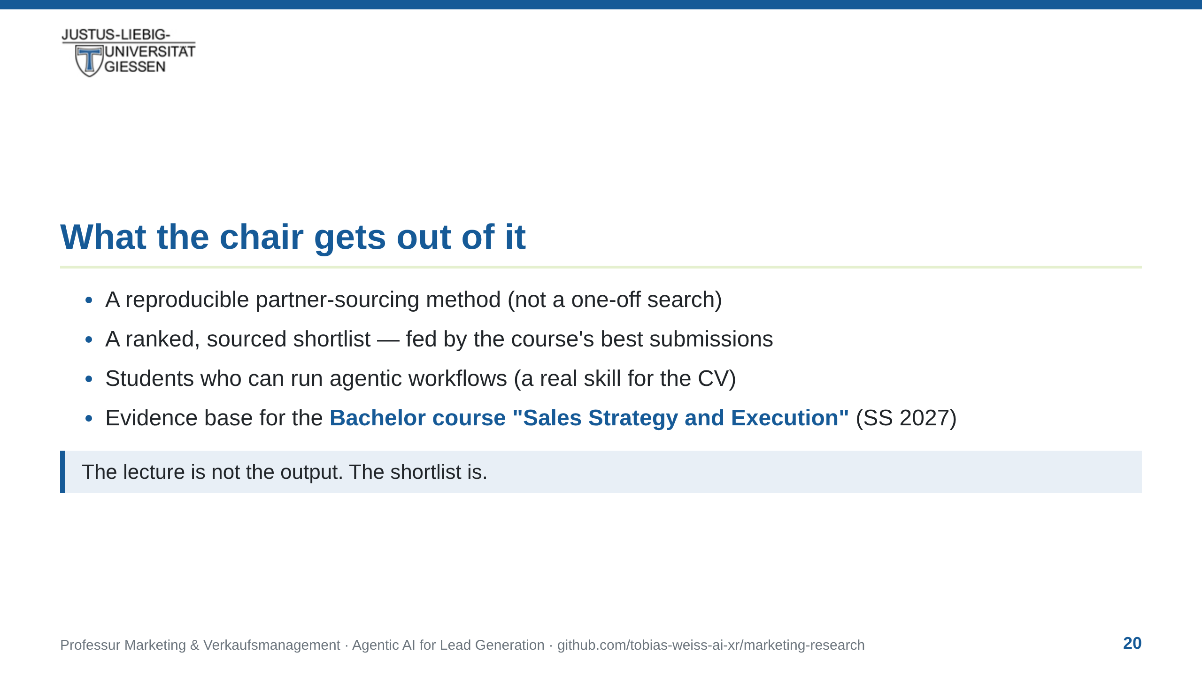
Notes:
notes:
⏱ ~1.5 min · READ ALOUD
What does the chair get out of this? Four things. A reproducible
partner-sourcing method — not a one-off search. A ranked, sourced
shortlist — and it grows with every student submission. Students who can run agentic
workflows — a real CV skill; that's what companies hire for now.
And an evidence base for the Bachelor course Sales Strategy and
Execution next summer. One note: everything here is open and
reusable — you can take this method into internships and theses.
The lecture is not the output. The shortlist is.

Slide 21
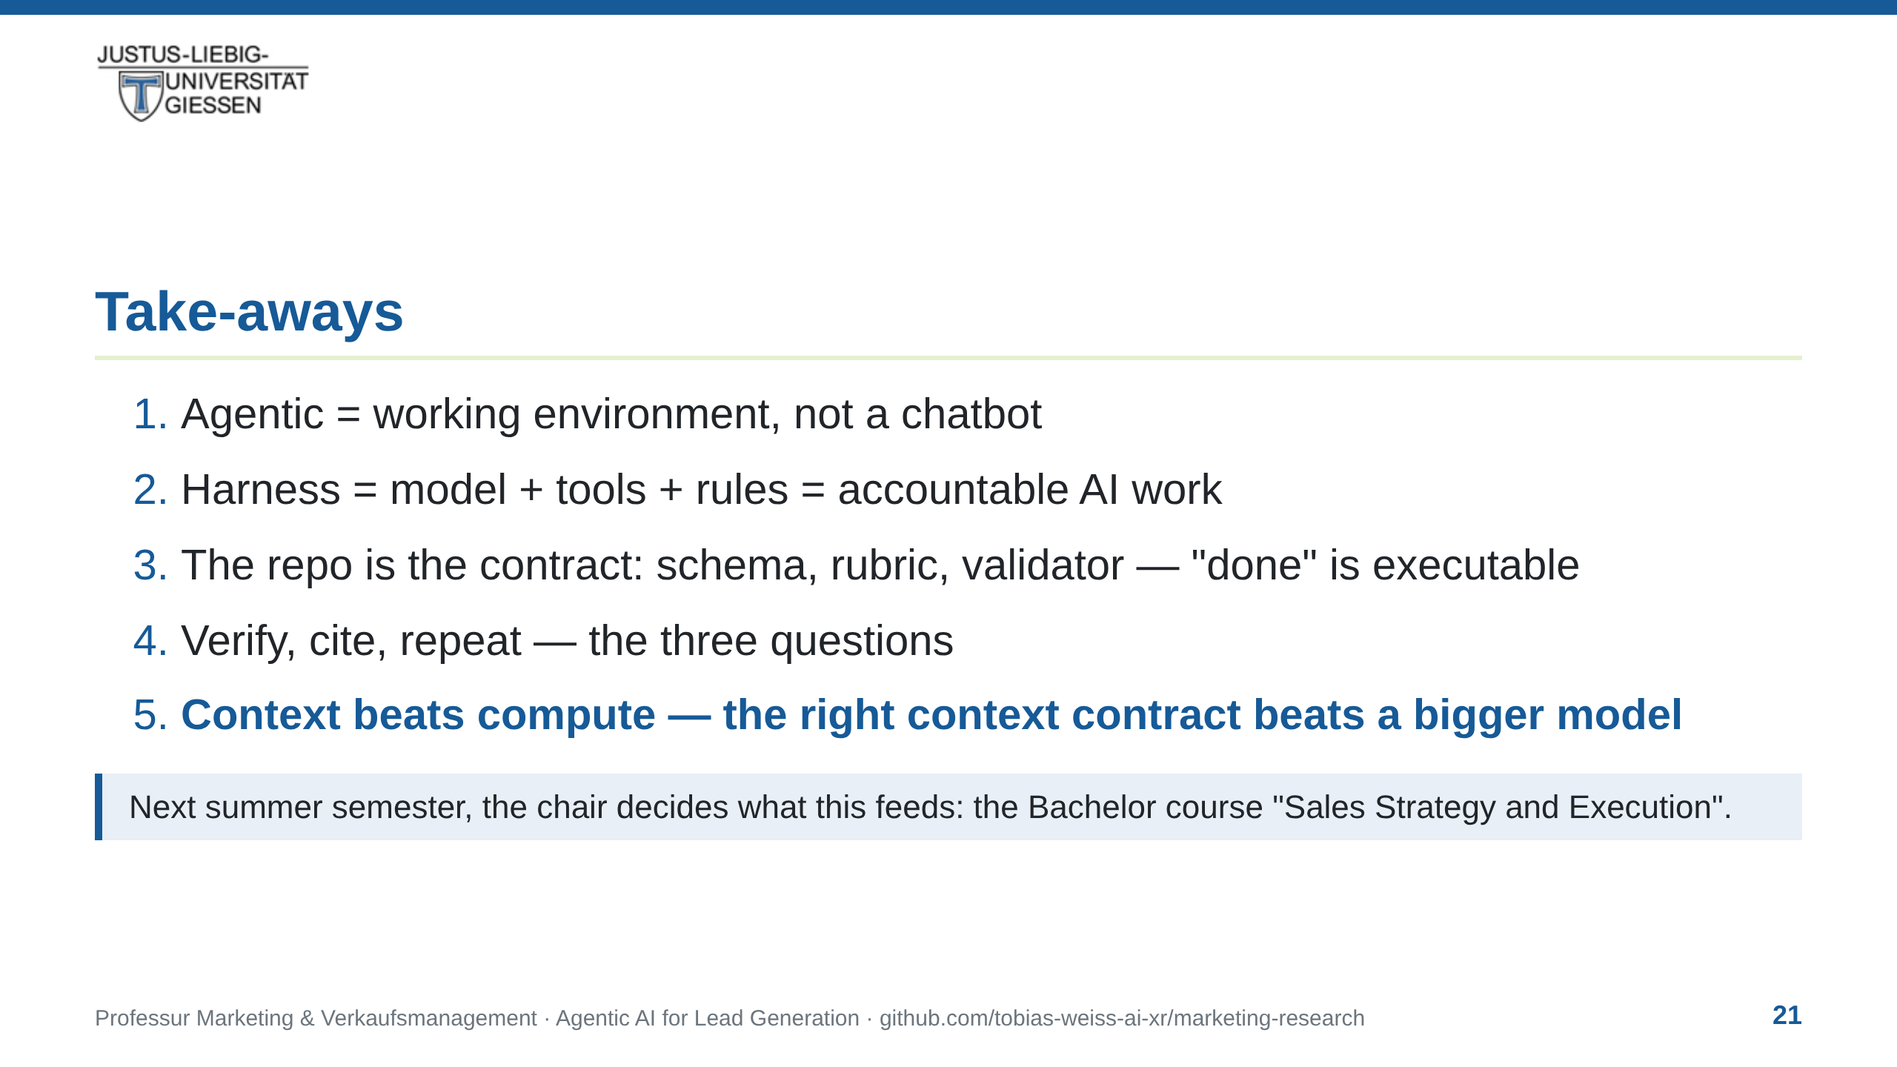
Notes:
notes:
⏱ ~1 min · READ ALOUD
Five lines to take home. Agentic is a working environment, not a
chatbot. A harness is a model plus tools plus rules — that's what
makes AI work accountable. The repo is the contract — schema,
rubric, validator. Done is not 'looks finished'; done is the
validator passing. Verify, cite, repeat — the three questions. And the one
to remember: context beats compute. A small model with your
context beats a big model with none. Next summer, this shortlist
becomes the Bachelor course's input — the chair decides what it
feeds.
[Not read:] Take-away 5 is the portable one-liner; it reframes the
lecture beyond today's demo.

Slide 22
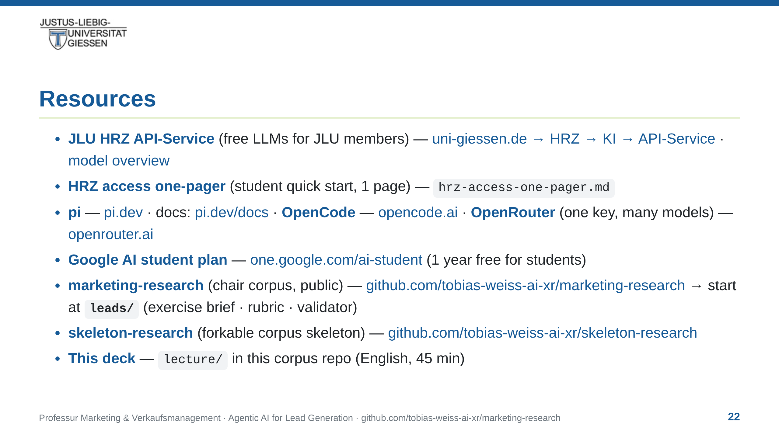
Notes:
notes:
⏱ ~30 s · OPTIONAL read — the list stays up on screen either way.
"Everything on this slide is public and reusable — the links are in
the deck. Two are worth starting with: the HRZ API-Service, and the
research corpus that today's evidence came from. Fork it — it's a
skeleton you can grow into your own corpus."
[If you only say one sentence:] "All links are in the deck — the
corpus and the one-pager are where I'd start."
[Not read:] Lead with HRZ API-Service (free, university-provided).
Google link repeats the providers slide so it survives sharing.
marketing-research = evidence base of the "why now" slides;
skeleton-research = forkable starter for a student's own curated
corpus; hrz-access-one-pager.md = student quick start.

Slide 23
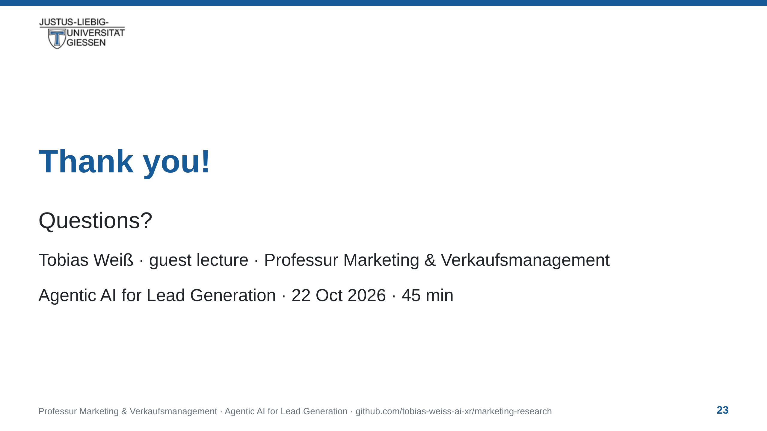
Notes:
notes:
⏱ 10 min Q&A — closing words first, then moderation.
[Closing, ~15 s · READ ALOUD:] "Thank you for listening — and for
the questions you've banked. Let's hear them, one at a time."
[Each answer — keep it short, one idea, then ask the next person.]
Prepared answers you're likely to reach for:
- Model choice — the demo runs on **big pickle**; the harness is
model-agnostic — pi switches model with Ctrl+L. Cost is why we
pick cheap models with tight contracts, not size.
- "Is this just a fancy search engine?" — search returns matches;
this returns judgements, because the contract carries the chair's
context and every judgement is source-traceable. Context is the
difference — and it's yours, not the model's.
- "Is the output reproducible?" — same contract, same method:
auditable, re-runnable; never promised byte-identical, models are
stochastic.
- Data privacy — local models (Ollama, HRZ Qwen) if it matters;
today's demo is public data only.
- "What is git?" — version control: every change is a commit with
author, timestamp, exact diff; the repo's history is public — that
is what makes the work auditable.
- "What does qualified mean?" — defined in the rubric
(`leads/leads.yaml`): fit, region, size, evidence, timing, each
0–5; gates first, then the published weighted sum.
- "What if the demo breaks?" — we debug it live; the approach was
tested agentically beforehand (timed runs of the exact exercise).
- Trying it themselves — resources slide; start with HRZ API and the
`leads/` folder in the repo.
[Hard stop at 16:00 — the course's Übung starts in this room right
after; the ten minutes belong to the students, never overrun.]

