Slide 1
Week 8: Linear Image Processing and Filtering
Nhóm ĐT: Mạnh, Quyên, Phương

Slide 2
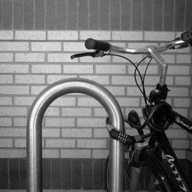
1. Box filter
1.1 Test với ảnh thường
Original Image

Slide 3

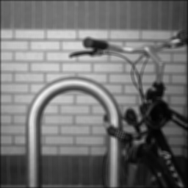
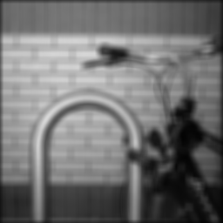
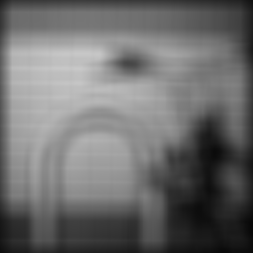








3x3
5x5
9x9
25x25
DIY
Matlab
Integral

Slide 4
Nhận xét
Thời gian thực hiện với 1000 vòng lặp:
Integral
3, i = 1000, t = 44.879 s
5, i =1000, t = 47.380 s
9, i = 1000, t = 46.944 s
25, i = 1000, t = 48.844 s
Naive
3, i = 1000, t = 206.810 s
5, i =1000, t = 217.012 s
9, i = 1000, t = 232.715 s
25, i =1000, t = 376.553 s

Slide 5






1. Box filter
Origin
Box filter 3x3
Box filter 9x9
1.2 Test với ảnh nhiễu Gauss
Sigma = 10
Sigma = 50

Slide 6

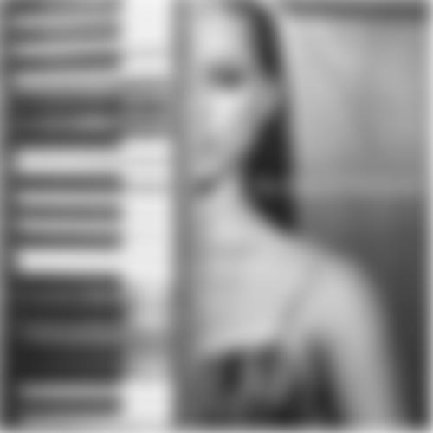
2. Box filter vs Gauss filter
Original Image
Gauss filter, sigma = 10

Slide 7



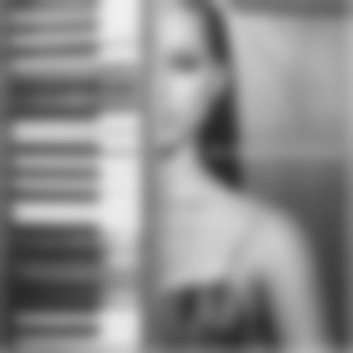
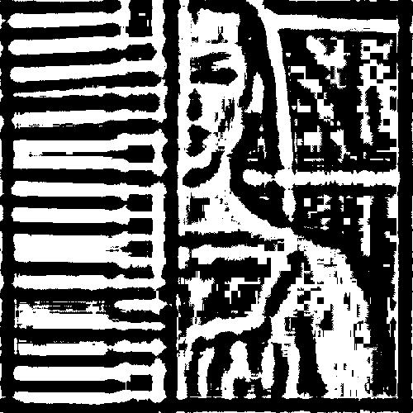
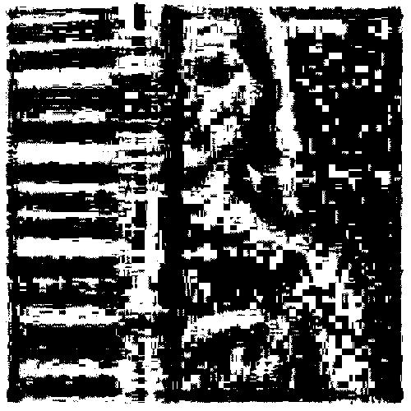
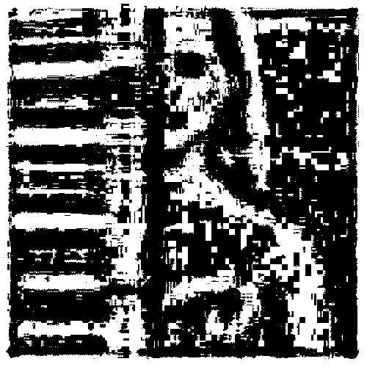
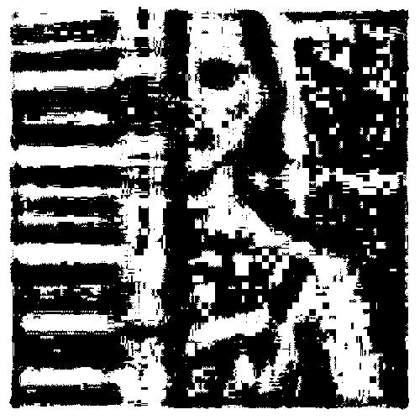
N = 1
N = 3
N = 5
N = 10
Box filter
So sánh với Gauss filter
Tỉ lệ pixel lỗi
0.426872
0.358988
0.391192
0.435408

Slide 8
3. Subsampling
Original Image

Slide 9

Subsampling 1:4 dùng nearest neighboor
1 0 0
0 0 0
0 0 0
0 0 0
0 1 0
0 0 0
0 0 0
0 0 0
0 0 1
0 0 0
0 0 0
0 0 0
Ma trận Hx = Hy

Slide 10

Subsampling 1:4 dùng trung bình pixels
0.250000000000000 0 0
0.250000000000000 0 0
0.250000000000000 0 0
0.250000000000000 0 0
0 0.250000000000000 0
0 0.250000000000000 0
0 0.250000000000000 0
0 0.250000000000000 0
0 0 0.250000000000000
0 0 0.250000000000000
0 0 0.250000000000000
0 0 0.250000000000000
Ma trận Hx = Hy

Slide 11
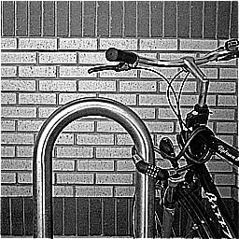

4. Sharpening filter
-1 -1 -1
-1 9 -1
-1 -1 -1
H =
Matlab
Naive DIY
Integral DIY

Slide 12
Nhận xét: 1000 vòng lặp
Integral: 10.530 s
Naive: 212.455 s

