Slide 1
Convolutional Neural Network
SimpleCNNNet (PyTorch): 3 × (Conv2d + ReLU) → MaxPool → Flatten → Linear · input 3×112×112 → 7 classes
No | Layer type | Layer name | Input | Kernel | Filters | Stride | Padding | Output
1 | Input | Input | 3×112×112 | – | – | – | – | 3×112×112
2 | Conv2d + ReLU | Conv-1 | 3×112×112 | 3×3 | 3 | 1 | 1 | 3×112×112
3 | Conv2d + ReLU | Conv-2 | 3×112×112 | 3×3 | 6 | 2 | 1 | 6×56×56
4 | Conv2d + ReLU | Conv-3 | 6×56×56 | 3×3 | 12 | 2 | 0 | 12×27×27
5 | MaxPool2d | Pool-1 | 12×27×27 | 3×3 | – | 4 | 0 | 12×7×7
6 | Flatten | Flatten | 12×7×7 | – | – | – | – | 1×588
7 | Linear | Dense-1 | 1×588 | – | – | – | – | 1×7
LOSS FUNCTION
OPTIMIZER
BATCH SIZE / EPOCHS
WEIGHT INIT
TRAINABLE PARAMS
Cross-Entropy
SGD (lr 0.003)
8 / 50
Xavier uniform
5,035
CARS CLASSIFICATION · WEEK 2
MISA INTERNSHIP

Slide 2
Results
Trained for 50 epochs; the checkpoint with the best validation accuracy was tested on 616 test images
Validation accuracy over 50 epochs
Confusion matrix on the test set (best epoch)
Actual ↓ Predicted → | 0 | 1 | 2 | 3 | 4 | 5 | 6 | Accuracy
Class 0 | 39 | 8 | 8 | 11 | 14 | 18 | 2 | 39%
Class 1 | 6 | 37 | 1 | 2 | 13 | 5 | 3 | 55%
Class 2 | 7 | 4 | 31 | 11 | 9 | 4 | 9 | 41%
Class 3 | 17 | 5 | 9 | 21 | 7 | 9 | 6 | 28%
Class 4 | 2 | 4 | 3 | 5 | 68 | 7 | 11 | 68%
Class 5 | 11 | 3 | 3 | 4 | 8 | 67 | 4 | 67%
Class 6 | 12 | 12 | 9 | 3 | 17 | 7 | 40 | 40%
BEST VALIDATION ACCURACY
TEST ACCURACY
Classes 4 and 5 are recognised best (68% and 67%); class 3 is weakest (28%) and is often confused with class 0.
Validation ≈ 90% but test only 49.2% → the model overfits; next steps: data augmentation, dropout, a deeper network.
≈ 90%
49.2%
at epoch 48 of 50
303 of 616 test images correct
CARS CLASSIFICATION · WEEK 2
MISA INTERNSHIP

Slide 3
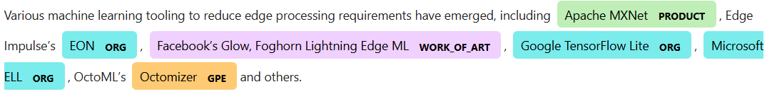
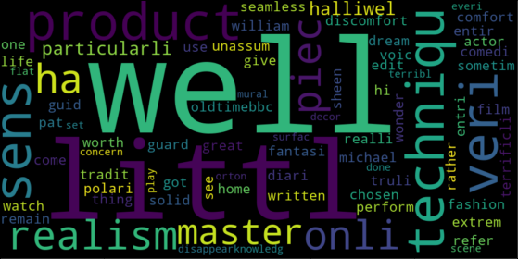
Natural Language Processing
Hands-on coding: word types & NER with spaCy, and review sentiment with TF-IDF + classic ML
01
Word types & Named Entity Recognition
02
Review sentiment with TF-IDF + classic ML
Built and trained a Sequential neural network to classify words into different types
Loaded spaCy's pretrained pipeline as a Named Entity Recognizer to show those types in real text
Cleaned long reviews (stop-word removal, stemming) and turned them into TF-IDF vectors
Compared three supervised classifiers on the same vectors; word cloud of the positive reviews
nlp = spacy.load('en_core_web_sm')
displacy.render(nlp(text), style='ent')
WC = WordCloud(width=1000, height=500,
max_words=500, min_font_size=5)
Word cloud of the positive reviews after stemming: 'well', 'littl', 'product', 'master' and 'realism' dominate.
displaCy output of en_core_web_sm on a tech-news sentence. The small model still slips: 'Optimizer' is tagged GPE.
PRODUCT
products, software
ORG
companies, groups
WORK_OF_ART
titles of works
GPE
countries, cities
Logistic Regression
Support Vector Machine
Multinomial Naive Bayes
NLP PROJECTS
MISA INTERNSHIP

