Slide 1


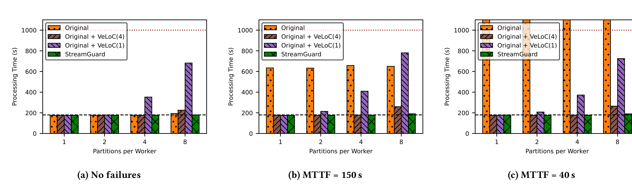
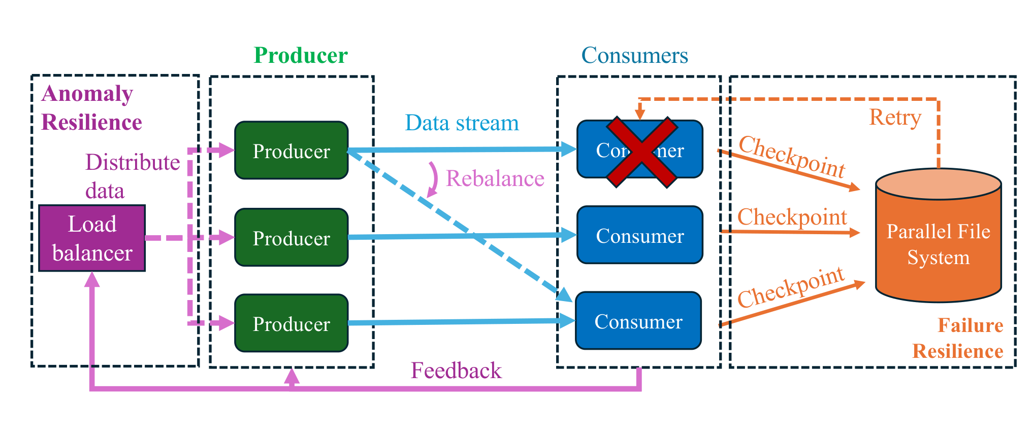
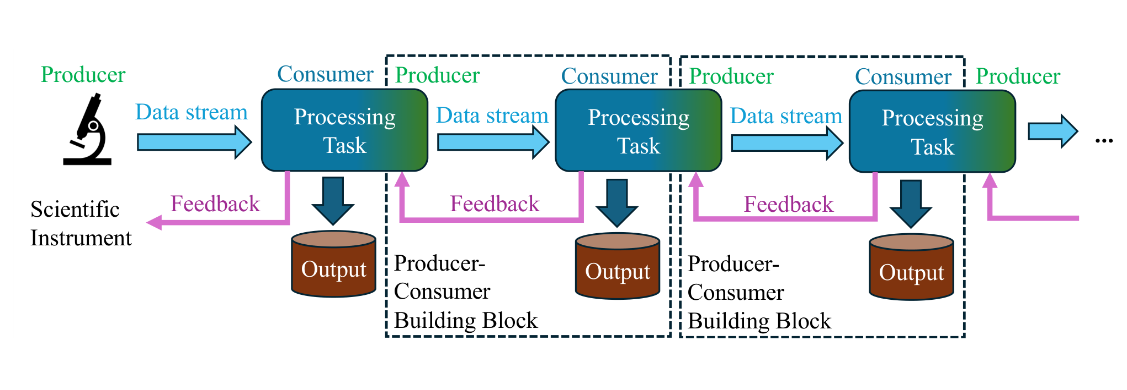
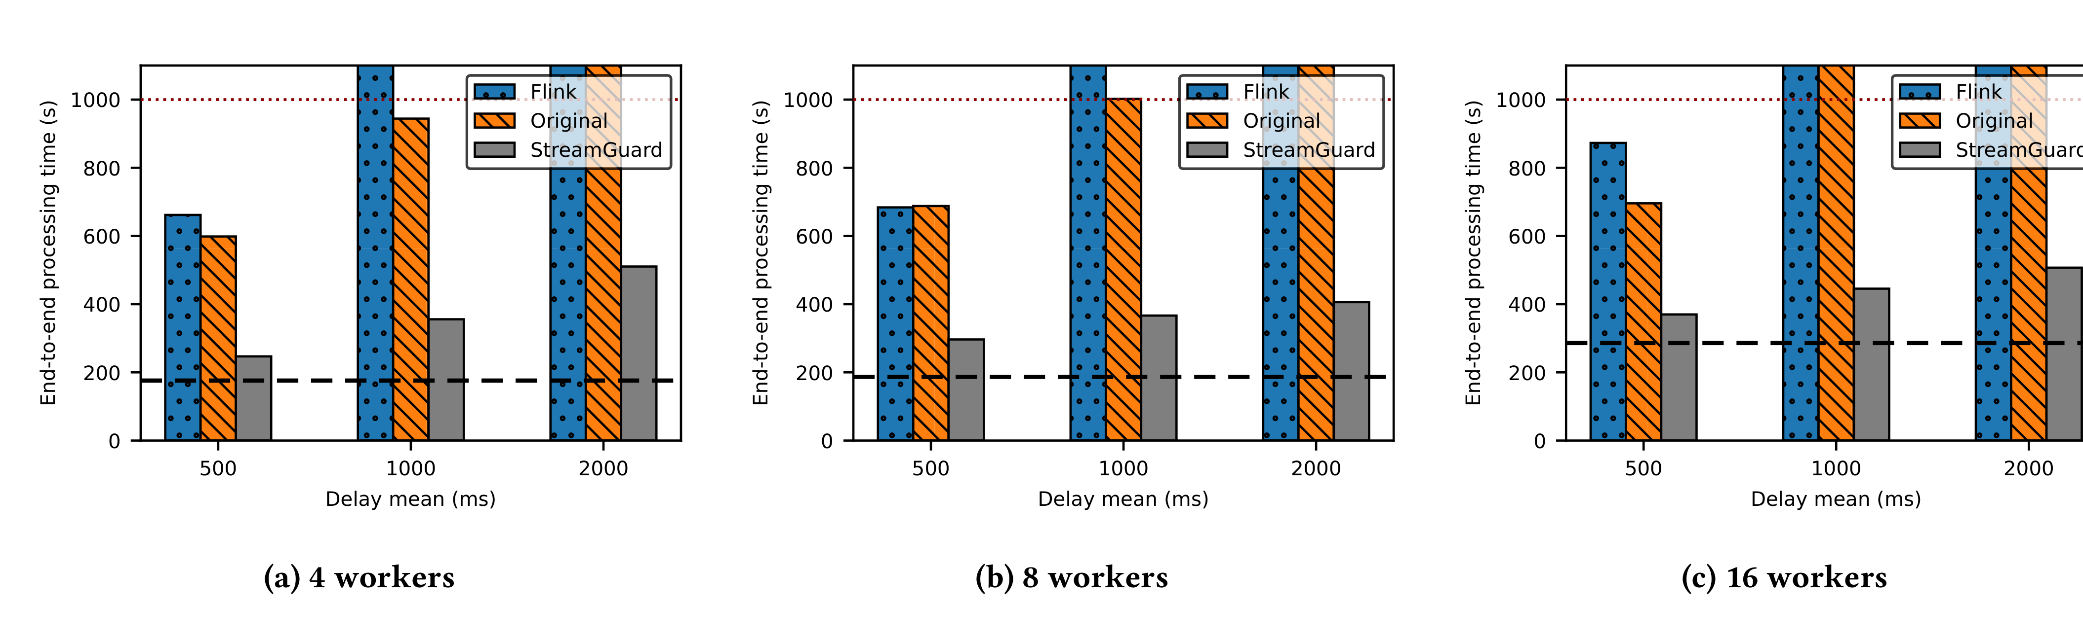
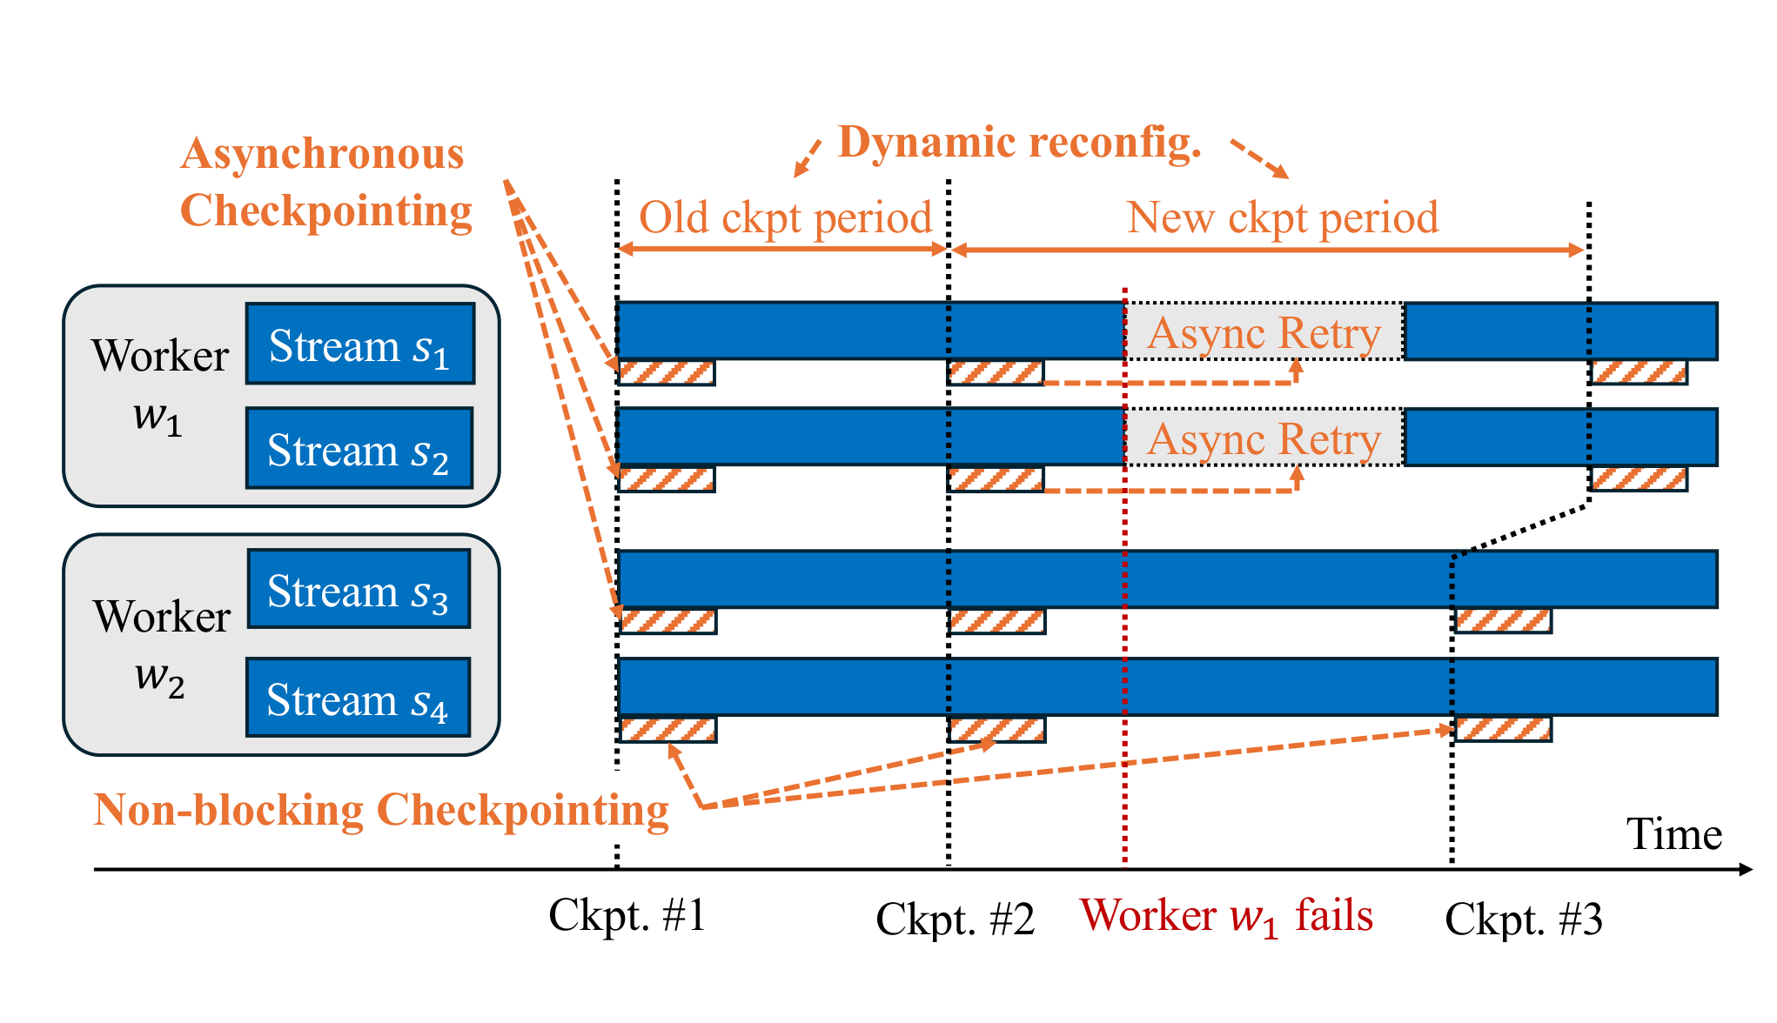
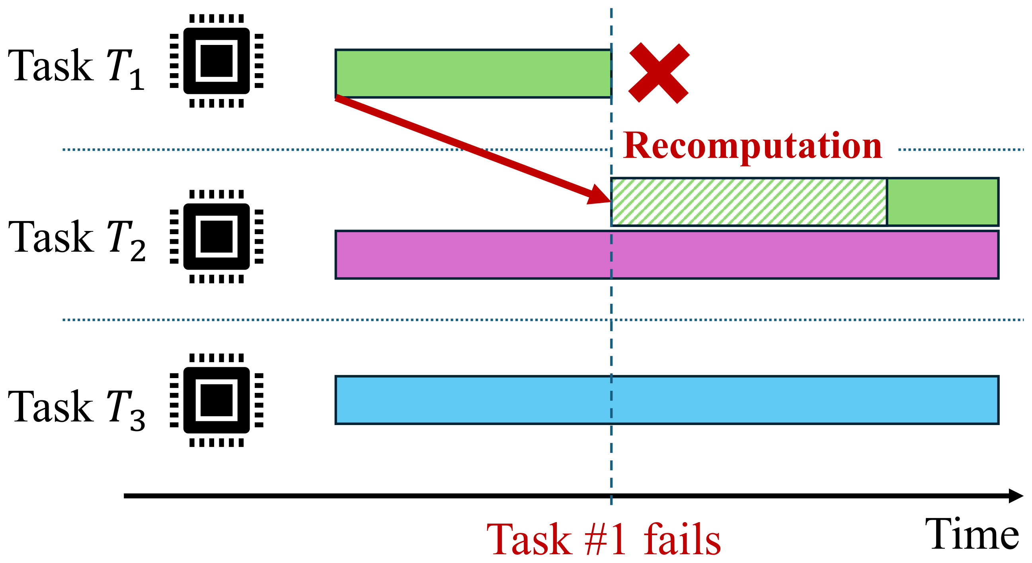
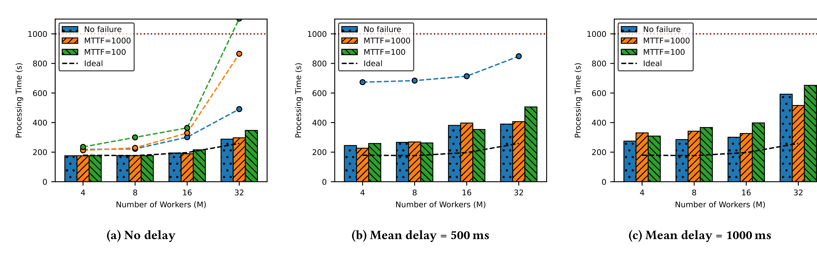
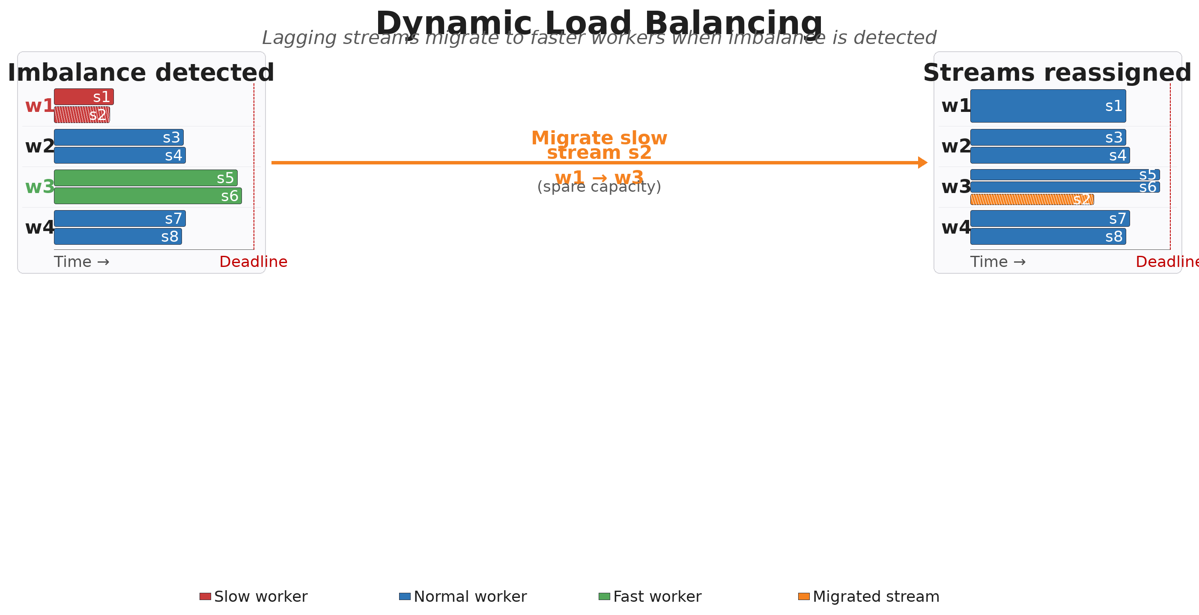
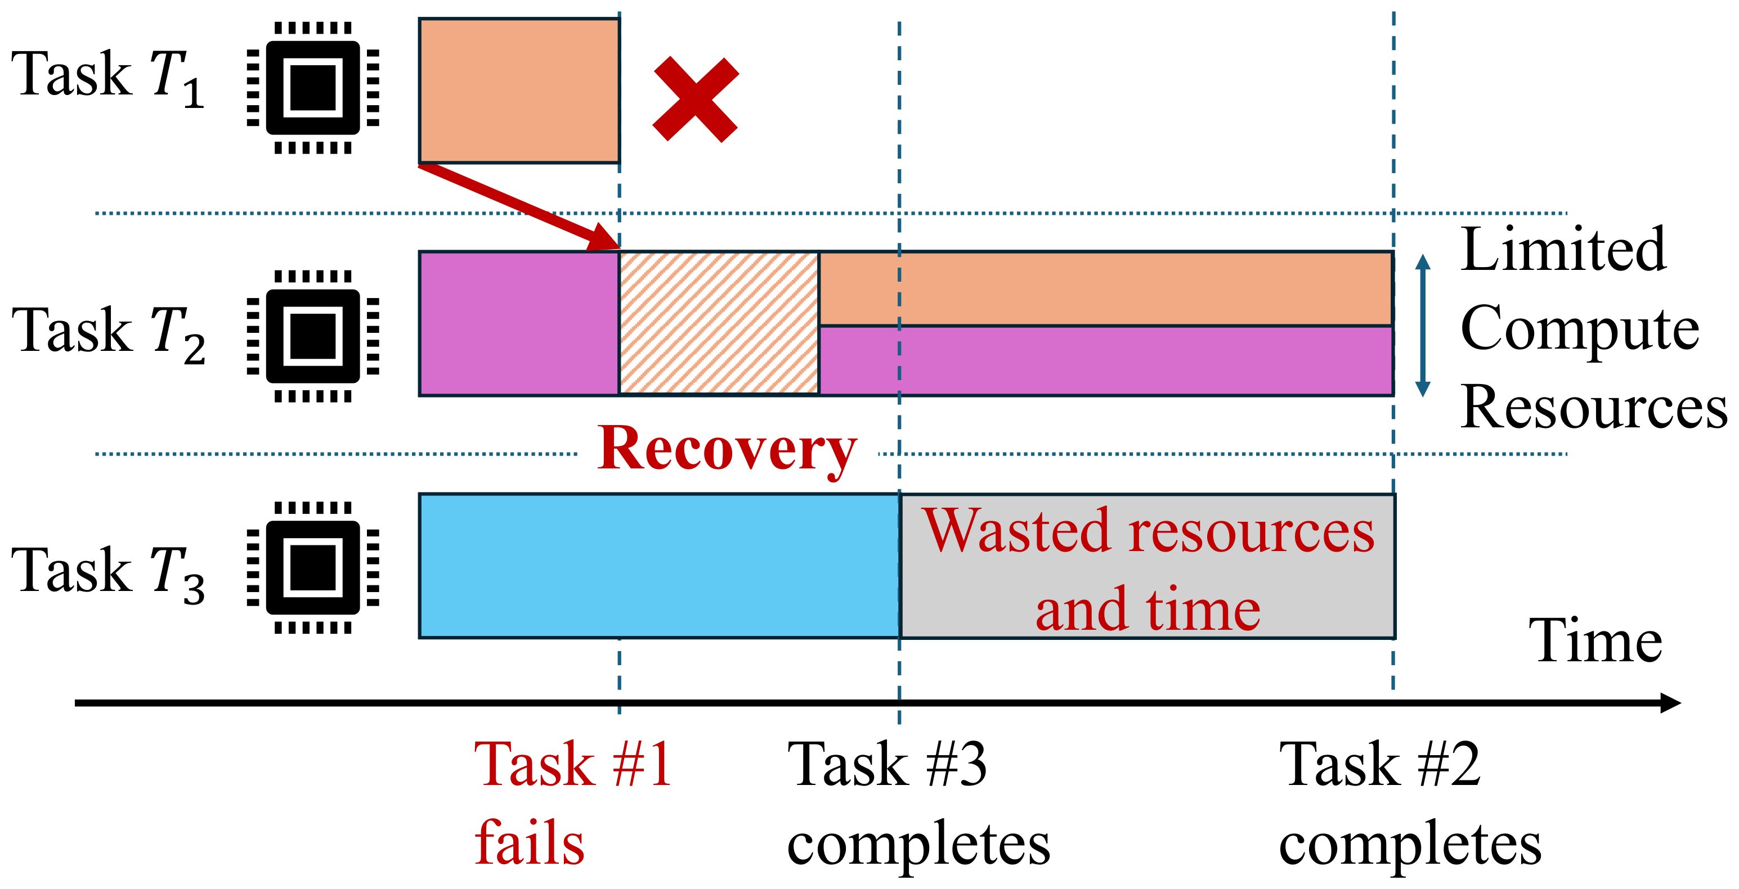
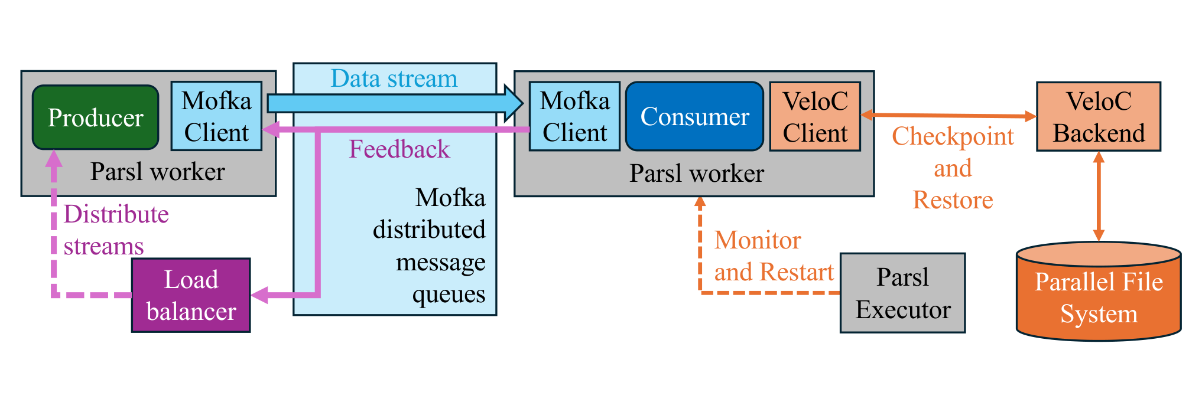
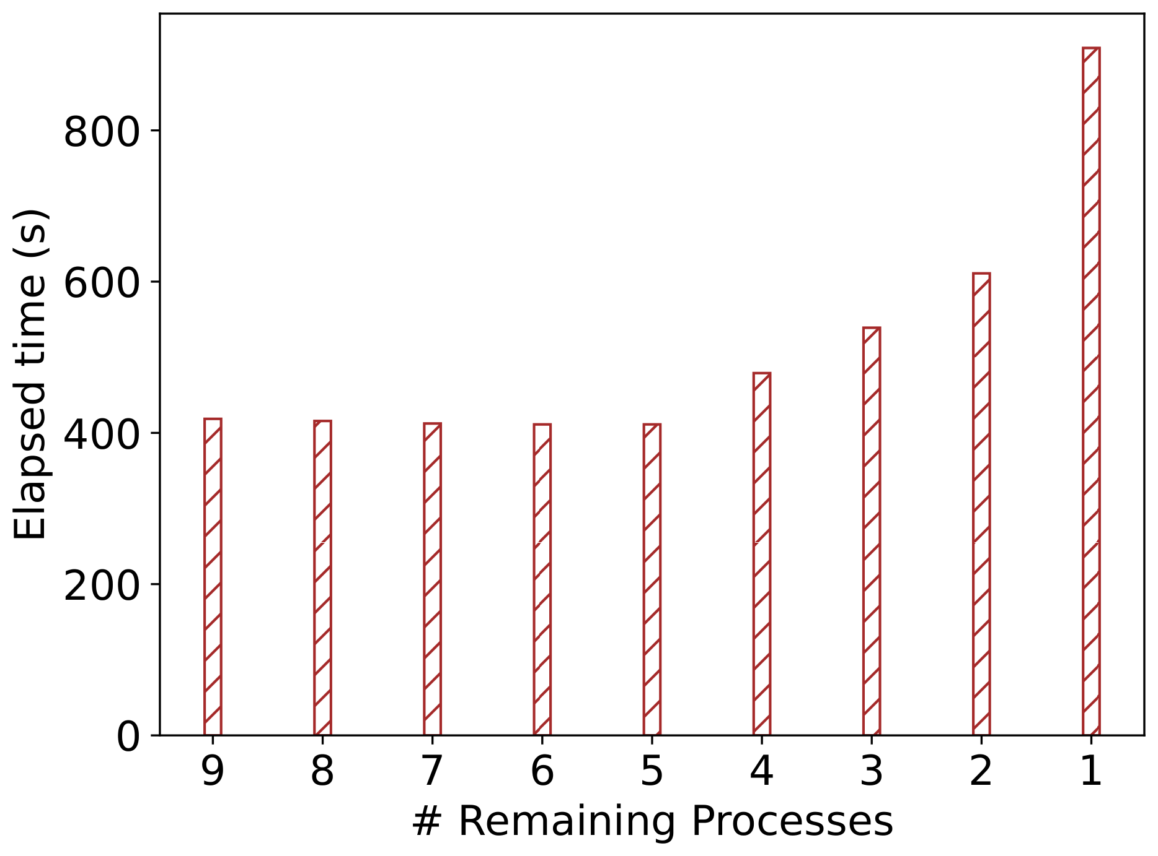
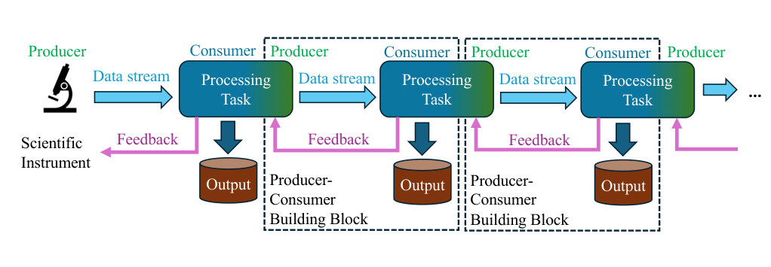


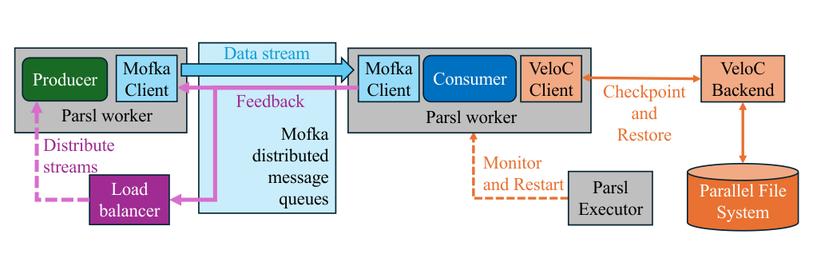
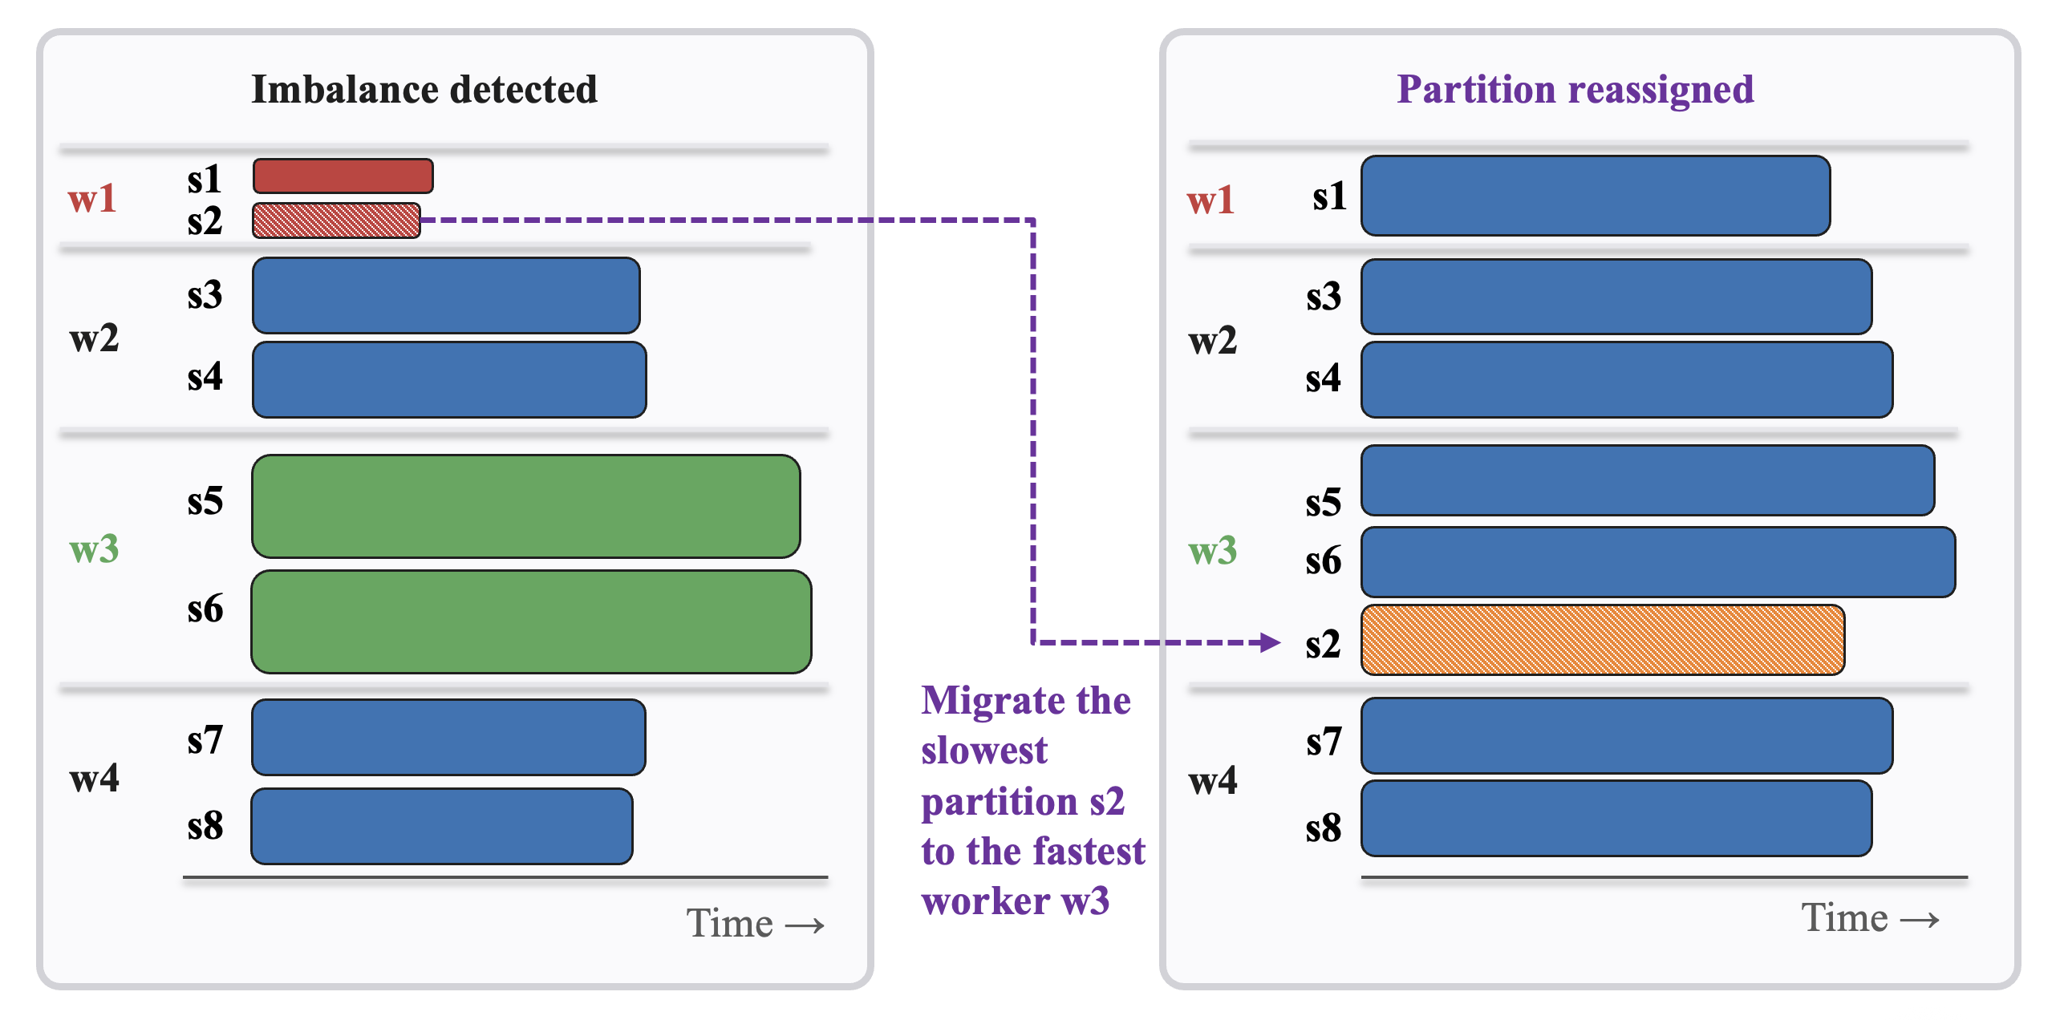
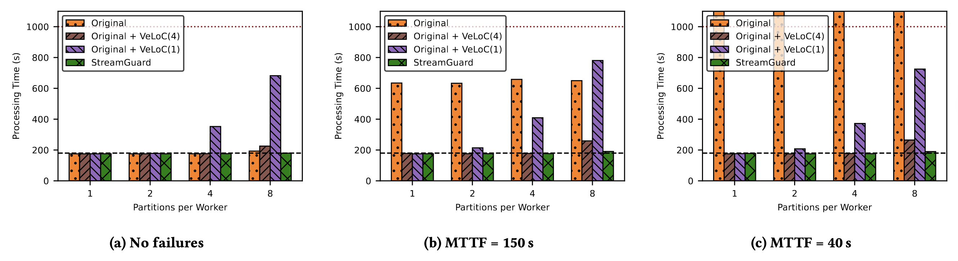
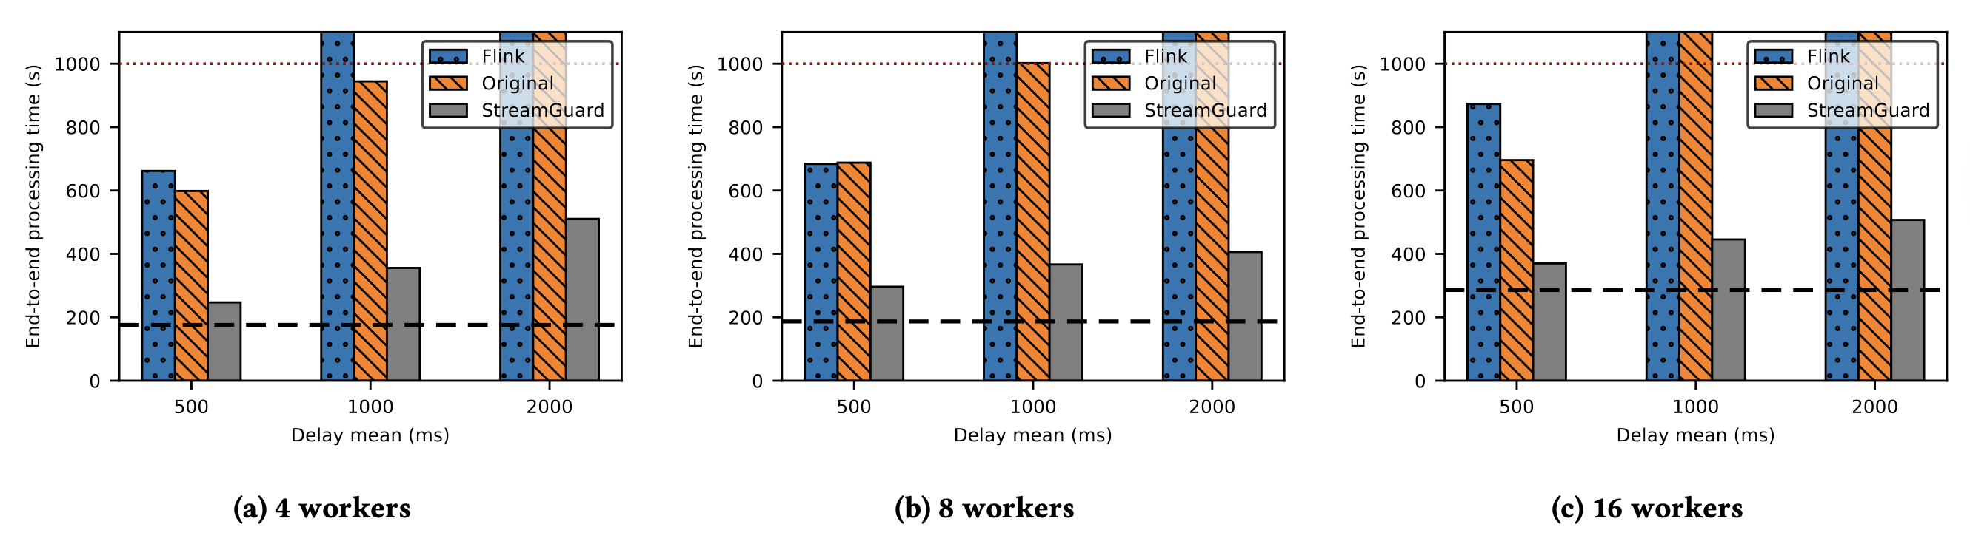
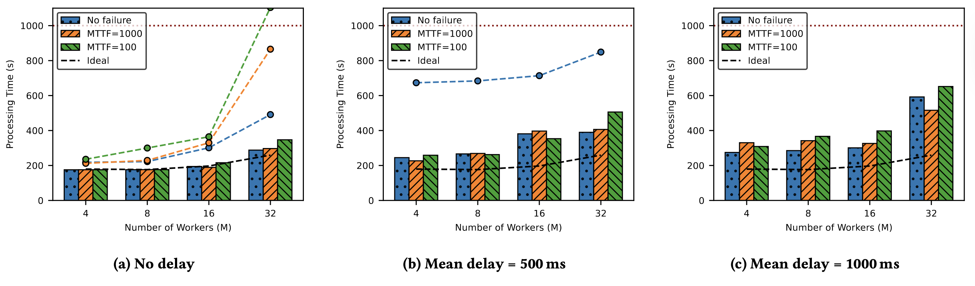
StreamGuard: Low-Overhead Resilience for
Real-time HPC Data Streams
Hai Duc Nguyen, Bogdan Nicolae, Tekin Bicer, Amal Gueroudji, Matthieu Dorier, Kyle Chard, and Ian Foster Argonne National Laboratory and University of Chicago
Motivation
StreamGuard: Resilient HPC Streaming
Results
Modern scientific instruments stream data continuously and require near-real-time analysis to steer ongoing experiments.
Workflows are chains of producer → consumer stages running on HPC, each with many parallel workers.
Every stage must deliver useful output within a real-time deadline (Quality of Service).
StreamGuard delivers resilience through two design principles:
Modular. Resilience is decoupled from the execution framework — applied only to the components that need it.
Lightweight. Operates at each producer–consumer pair to avoid costly workflow-wide coordination.
Failure resilience. Non-blocking, asynchronous checkpoint-restart adds < 1% overhead and meets real-time deadlines, even under extreme failure rates where static or synchronized checkpointing breaks down.
Anomaly resilience. Progress-aware load balancing keeps the workflow on time despite per-worker slowdowns, across scales and heterogeneous execution conditions.
Challenges
Failure resilience
Decoupled, Lightweight Checkpoint-Restart
Asynchronous. Workers checkpoint and restart independently — no inter-worker coordination.
Non-blocking. Checkpoint I/O overlaps computation — overhead removed from the critical path.
Adaptive. Checkpoint frequency tunes itself at runtime to observed I/O cost and failure rate.
Stop-fail events
Workers crash unexpectedly — out of memory, segfaults, node loss.
Failures grow frequent at scale — failure probability rises exponentially with system size.
Naive recovery restarts work from scratch — costly recomputation misses the deadline.
End-to-end robustness. Failure and anomaly resilience operate independently — combining them avoids compounding overhead, holding deadlines across all tested failure rates, slowdown intensities, and scales.
Anomaly resilience
Progress-Aware Load Balancing
Progress-driven. Tracks per-stream progress and keeps all partitions advancing at similar rates.
Capacity-aware. When imbalance is detected, slow partitions are migrated to faster workers with spare capacity.
Slowdown anomalies
Implementation
Resilience SDK
Even healthy workers run unevenly due to noisy hardware and shared resources.
A few slow workers drag down the whole pipeline — the slowest one sets the end-to-end deadline.
Static load assignment cannot adapt as conditions change.
Publications
Acknowledgement
Nguyen HD, et. al. (2025) Resilient execution of distributed X-ray image analysis workflows. Front. High Perform. Comput. 3:1550855.
Dorier M, et. al. (2025) Toward a persistent event-streaming system for high-performance computing applications. Front. High Perform. Comput. 3:1638203.
Nguyen HD, et. al. (2026) StreamGuard: Low-Overhead Resilience for Real-time HPC Data Streams. Proceeding of the ACM International Conference on Supercomputing 2026
This work was supported in part by the U.S. Department of Energy under Contract DE-AC02-06CH11357, as well as the National Science Foundation (NSF), Office of Advanced Cyberinfrastructure, under grants CSSI-2411386 and CSSI-2514056.
Parsl. Manages workers and automatically restarts failed ones.
Mofka. HPC-native message queue for reliable producer–consumer delivery.
Customized VeloC. Per-partition asynchronous checkpoints with adaptive period.
Load balancer. Checkpoints and migrates lagging streams to faster workers.

Slide 2
Imbalance detected
Partition reassigned
s1
s1
w1
s2
w1
w2
s3
w2
s3
s4
s4
s5
s5
w3
s6
w3
s6
s7
Migrate the slowest partition s2 to the fastest worker w3
s2
w4
s8
w4
s7
Time →
s8
Time →

