Slide 1

Performance
What to do when the results are too slow

Slide 2

What can be too slow?
Area | How often?
Batch process: Mediation | High
API call | Medium
Page rendering | Low
Batch process: Billing | Low

Slide 3
Where is the time going?
Database access
Memory leaks
Slow code

Slide 4
Database access: facts
Most of the performance issues are related to accessing the DB: 90%
Always start your performance debugging looking at the DB access
Either an index is missing, or too much data is being requested
This can affect all layers:
  A page loads slowly, because it is requesting data that it does not need (otherwise, how much data can you show in one page)
  A batch process spends too much time getting the data its needs, instead of doing business logic
  An API call always needs to access the DB. If this is slow, the call will be slow

Slide 5
Database access: useful techniques
It all boils down to finding the one query that is non performing
Enable Hibernate logging: simply take a look to log4j configuration (uncomment the configuration)
Enable Postgres logging: Find postgresql.conf (example location: /etc/postgresql/8.4/main/). Then set and restart postgres:
  log_statement= ‘all’
  log_duration = on
  log_destination = 'stderr’
  logging_collector = on
  log_directory = '/tmp’
  log_filename = 'postgresql-%Y-%m-%d_%H%M%S.log'

Slide 6
Database access: example
The customer view pane loads very slow
This install had a lot of orders per customer (not common)
The customer view pane show a link to the latest order
For this, the page was loading all the orders sorted, then showing the last one in the array
Instead, we can ask the DB to just retrieve the latest order for a customer: let the sorting happen in the DB, rather than in the GSP page.

Slide 7
Database access: example
Before:
Use the GSP to find the last order:
<g:set var="order"
value="${selected.orders ? selected.orders.asList().sort{ it.createDate }.last() : null}"/>
After:
From the controller, retrieve just last order:
def latestOrder = webServicesSession.getLatestOrder(user.userId)

Slide 8
Database access: slow DB
If the application is only getting the data that it needs, the DB itself can be the source of the poor performance
In most cases, this means an index is missing

Slide 9
Slow DB: debug
It all boils down to finding the one query that is non performing
The postgres log files are very useful, because they log the time spend on each query.
The ‘EXPLAIN’ postgres command is also a good friend:
jbilling_test=# explain select * from base_user where id = 1;
QUERY PLAN
----------------------------------------------------------------------------------
Index Scan using base_user_pkey on base_user (cost=0.00..8.27 rows=1 width=116)
Index Cond: (id = 1)
jbilling_test=# explain select * from base_user where password = 'xxx';
QUERY PLAN
------------------------------------------------------------
Seq Scan on base_user (cost=0.00..30.95 rows=1 width=116)
Filter: ((password)::text = 'xxx'::text)

Slide 10
Database access: avoiding issues
Unlike other code, when writing code to access the database you need to be aware of the performance implications.
The penalty for careless code is always poor performance!

Slide 11
Memory leaks
Strictly speaking, a memory leak is a bug, not a performance issue
Yet, sometimes when the system is very slow, it is not because of code being slow, but because the JVM is doing too many full Garbage Collection processes too often
A symptom of a leak, is a progressive degradation of performance.
It is important then to rule out a memory leak before going crazy on a witch hunt.

Slide 12
Memory leaks: diagnose
To diagnose a memory leak, enable GC logging from the JVM. You pass the JVM argument through grails.
Use the system variable GRAILS_OPTS to pass the logging request:
export GRAILS_OPTS=” -Xloggc:/tmp/gc.log -XX:+PrintGCDetails”
Use a GC viewer to make a graph out of the log entries:
https://github.com/chewiebug/GCViewer/zipball/master

Slide 13
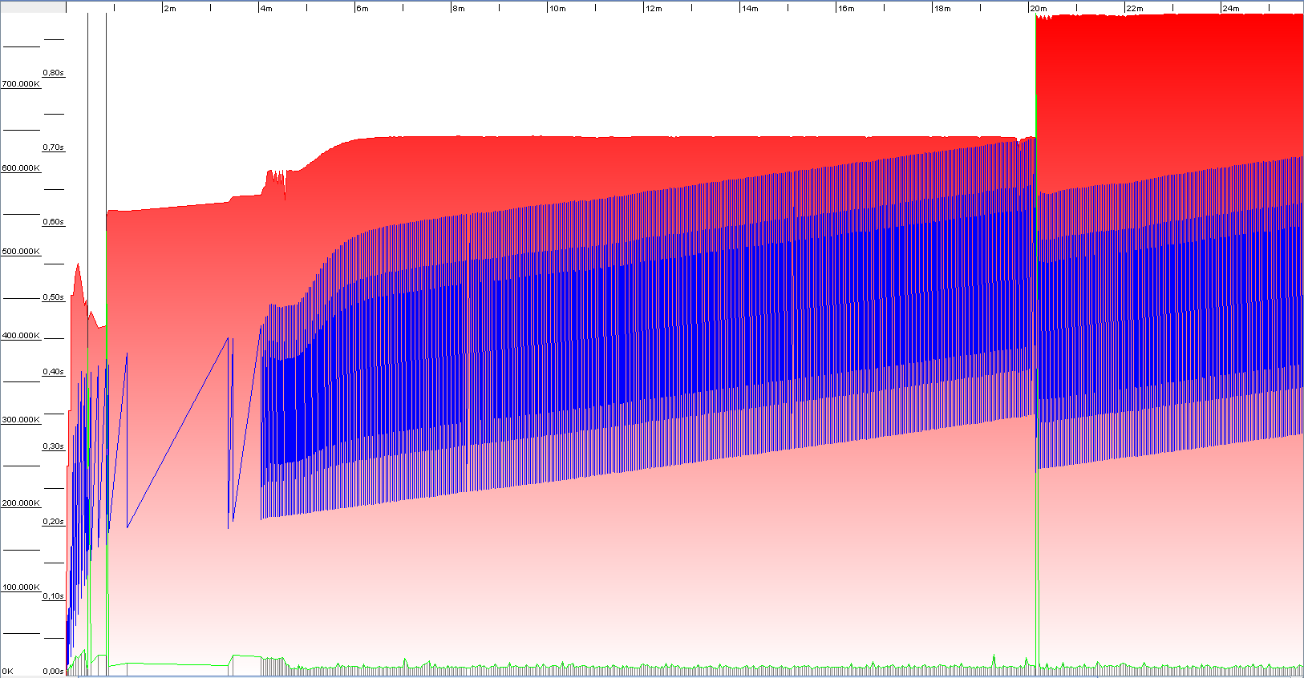
Memory leaks: diagnose
We are looking for a constant increase in the memory base (floor) after a full GC

Slide 14
Memory leaks: origins
Memory leaks typically happen on a batch run: mediation process or billing process are good candidates.
Look for collections that are keeping unnecessary references in a loop.
The lifetime of the memory leak is the duration of the batch process. When it is done, even the offending objects get garbage collected
A memory leak is worst when it is slow, then it can really look like a performance issue
Eventually, a memory leak will results in an ‘out of memory’ exception.

Slide 15
Code: facts
It is rare that pure Java code runs too slow and needs to be optimized.
Yet, there are a few areas of the Java programming language that are notoriously slow
Flexible, well designed code is not meant to be fast

Slide 16
Code: example
redmine #2075
The billing process is not meeting the customer performance needs.
After a LOG.debug and StopWatch rampage, it is determined that the time goes mostly on instantiating Order Filter plug-in objects. It was taking 28 milliseconds per order.
There is one instantiation for each order, and because plug-ins are dynamically instantiated using reflexion, this was very slow.
By hardcoding the type (instead of getting it from the DB), the performance improved to 5 milliseconds per order.

Slide 17
Code: example
Before
OrderFilterTask task = (OrderFilterTask) taskManager.getNextClass();
After
OrderFilterTask task = new BasicOrderFileterTask();
Result
From 28 to 5 milliseconds.

Slide 18
Code: avoiding issues
Don’t! Unlike database access code, simple Java code should be written for clarity and extensibility, not performance.
If you wrote Java code that is too slow, you did something right.
High performance in code, always comes at a high price (example, hard coding).

Slide 19
Performance: tools
There is only one tool that you really need: LOGGING:
Database: Hibernate and Postgres logging
Memory leaks: JVM garbage collection logging
Code and all of the above: StopWatch
Don’t let fancy tools be an obstacle to the real solution of a performance problem: thinking.

Slide 20
Performance: tools
Grails profiler
Installation (BuildConfig.groovy):
plugins {
compile ":profiler:0.4"
}
Logging (Config.groovy):
log4j = {
info additivity: false, jbilling: "com.linkedin.grails"
}
Usage:
http://localhost:8080/jbilling/customer/index?profiler=1
Result(jbilling.log)
- Controller execution time
- View execution time

Slide 21
Performance: step by step
Check the time other systems are taking: tax engines, payment gateways…
Check that there isn’t too much data coming from the DB to the application.
Check that the DB is retrieving the data efficiently
Make sure there isn’t a memory leak
Improve code performance

