Slide 1

ARCHITECTURE OVERVIEW
Volunteer Engagement Platform
Multi-tenant SaaS · SMS-first volunteer operations · AI-assisted
Executive briefing · June 2026

Slide 2
THE PLATFORM
What we built
Your outreach team, on autopilot.
A multi-tenant SaaS that automates the full operational lifecycle of volunteer events — from recruiting and booking, through day-of check-in and check-out, to post-event review and recognition.
Multi-tenant
SMS-first
AI as a tool
Each tenant has its own data, credentials, prompts, and brand voice. Row-level isolation across every table.
Volunteers interact entirely by text. Admins use a web panel plus an SMS command channel for day-of operations.
AI is used where it adds value. The dominant operations run on deterministic code that costs nothing per message.
Architecture Brief · Volunteer Engagement Platform
2 / 13

Slide 3
WHAT WE OPTIMIZED FOR
Three guiding principles
1
Strict tenant isolation
No tenant ever sees another tenant's data. Tenant scoping is applied at the data layer, not bolted onto controllers.
2
Cheapest path handles the dominant case
The fastest, most reliable, lowest-cost code path serves the majority of traffic. AI is reserved for moments where it adds real value.
3
Auditable by default
Every routing decision and AI invocation is logged. We can explain after the fact what the system did and why.
Architecture Brief · Volunteer Engagement Platform
3 / 13

Slide 4
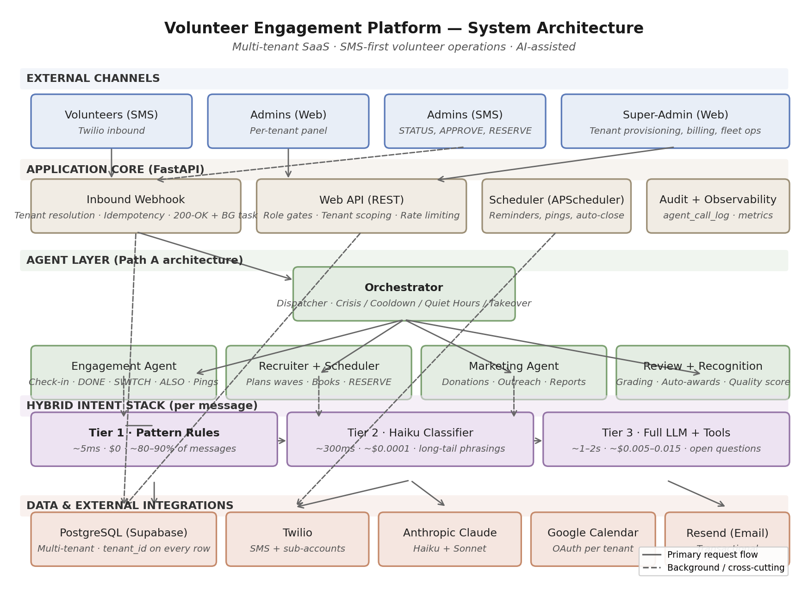
THE BIG PICTURE
System architecture, end to end
Five layers — channels, application core, agents, the hybrid intent stack, data + integrations. Solid arrows = primary request flow; dashed = background work.
Architecture Brief · Volunteer Engagement Platform
4 / 13

Slide 5
READING THE DIAGRAM
The five layers, in one sentence each
EXTERNAL CHANNELS
Volunteers via SMS, admins via web + SMS, super-admins via web.
APPLICATION CORE
Web API, inbound webhook, scheduler, and observability — the FastAPI services that own the request loop.
AGENT LAYER
The Orchestrator routes to specialized agents: Engagement, Recruiter + Scheduler, Marketing, Review + Recognition.
HYBRID INTENT STACK
Pattern rules → small AI classifier → full AI. Cross-cuts every inbound message.
DATA & INTEGRATIONS
PostgreSQL with row-level tenant isolation; Twilio, Anthropic, Google, Resend wrapped behind soft-fail boundaries.
Architecture Brief · Volunteer Engagement Platform
5 / 13

Slide 6
PATTERN 1
Multi-tenant row-level isolation
WHAT IT IS
Every record carries the tenant it belongs to. Every database query automatically scopes to that tenant. No shared data, no shared credentials, no shared prompts.
WHY WE CHOSE IT
The strongest tenant boundary at the lowest operating cost. Faster onboarding, schema changes deploy once, cloud bill stays flat as tenants grow. Tenant scoping is enforced at the base-query layer so no developer can accidentally leak.
BUSINESS BENEFIT
Minutes-to-onboard new tenants. Per-tenant credentials, prompts, and feature flags. Marginal cost per tenant dominated by usage, not infrastructure.
Architecture Brief · Volunteer Engagement Platform
6 / 13

Slide 7
PATTERN 2
Path-A agent architecture
WHAT IT IS
The AI-driven parts of the system are organized into four specialized agents — Orchestrator, Engagement, Recruiter + Scheduler, Marketing — each following the same internal shape.
WHY WE CHOSE IT
Without this structure, AI features sprawl into a single overgrown handler that is hard to test, debug, or modify. The agent shape separates deciding what to do from doing it from explaining what was done. New agents drop into the same slot.
BUSINESS BENEFIT
Faster feature delivery, lower regression risk, easier engineer onboarding. The agent boundary is also where we attribute AI cost and observability.
Architecture Brief · Volunteer Engagement Platform
7 / 13

Slide 8
THE DIFFERENTIATOR
Hybrid intent stack
Every inbound message passes through up to three tiers. Each tier only fires when the previous one cannot answer confidently.
TIER 1
Canonical phrases — HERE, DONE, switch to kitchen.
⏱ ~5 ms 💲 $0
Pattern rules
~80–90% of messages
TIER 2
Long-tail phrasings — "im finally here lol", "leaving now".
⏱ ~300 ms 💲 ~$0.0001
Small AI classifier (Haiku)
~5–10% of messages
TIER 3
Open questions and multi-turn conversations.
⏱ ~1–2 sec 💲 ~$0.005–0.015
Full AI with tools
Long tail
Average AI cost is dominated by Tier 1 (free). Check-in and check-out are 100% deterministic.
Architecture Brief · Volunteer Engagement Platform
8 / 13

Slide 9
OPERATIONAL RELIABILITY
Patterns for trust and uptime
Webhook buffer
Graceful degradation
Optimistic concurrency
Graph-shaped audit
Acknowledge inbound SMS in ~30 ms; process in the background. Carrier-side timeouts no longer become duplicate check-ins or lost messages.
Every external dependency — Twilio, Anthropic, Google, Resend — wrapped in a soft-fail boundary. A vendor outage degrades one capability, not the whole product.
Hot rows like pending service-change approvals use version numbers. Admins and volunteers can act in parallel; collisions resolve with a clean retry.
Every routing decision, AI invocation, and tool call is logged with its relationships. We can answer 'why did the system do that?' for any message.
Architecture Brief · Volunteer Engagement Platform
9 / 13

Slide 10
VELOCITY & CUSTOMIZATION
Patterns for shipping and tuning
Domain-driven folders
Per-tenant configuration
Two-sided LLM personas
Backend and frontend organized by business domain (bookings, recruitment, recognition, etc.). A feature change is a self-contained, reviewable unit.
Prompts, feature flags, credentials, recognition definitions all live in a tenant-scoped config surface. Tenants self-customize without engineering.
Separate AI personas for volunteers and admins, with different tools and prompts. Customers never see admin operations and vice versa — smaller attack surface, clearer tool semantics.
Architecture Brief · Volunteer Engagement Platform
10 / 13

Slide 11
WHY THIS ARCHITECTURE MATTERS
Cost-tiered AI: the headline economic point
Operating cost grows with message complexity, not with message volume. This decouples our AI spend from raw tenant growth.
If we had gone AI-only
What we built instead
• Every check-in, ping, and reminder spends AI tokens.
• Cost scales with raw message volume — gross margin shrinks as tenants grow.
• Latency of 1–2 sec per message at peak times.
• Behavior shifts when the AI vendor changes models.
• 80–90% of messages handled deterministically — $0.
• Tenant growth does not pull AI cost with it.
• Sub-second response on the dominant case.
• Mission-critical actions are stable across model upgrades.
Architecture Brief · Volunteer Engagement Platform
11 / 13

Slide 12
WHY IT MATTERS AT THE BOARD LEVEL
Strategic concerns the architecture addresses
Margin protection at scale
Operational trust
Optionality
Cost grows with message complexity, not raw volume. The more successful a tenant becomes, the more our deterministic tier carries — not our AI budget.
Volunteers and admins rely on the system at high-stakes moments. The architecture is tilted toward reliability — soft-fail dependencies, deterministic critical paths, full audit trail.
Adding a new agent, swapping an AI vendor, or supporting a new SMS provider is a contained refactor — not a platform rewrite. Future product bets stay cheap.
Architecture Brief · Volunteer Engagement Platform
12 / 13

Slide 13
ROADMAP
What this architecture sets us up to do next
Each item below is a contained extension — not a rewrite. The agent layer, configuration surface, and soft-fail dependencies make future changes cheap.
Donations & Marketing Agent
Semantic search
Public donation page + pluggable payment processors.
pgvector + Voyage AI embeddings for conversation recall and similar-past-event suggestions.
Pluggable contact data
AI agent surface (MCP)
External CRM, HRIS, or identity provider as source of truth for volunteer profiles.
External AI tools can integrate with the platform via the Model Context Protocol.
Twilio sub-accounts
Issue reporting pipeline
Per-tenant SMS isolation, billing attribution, 10DLC registration.
Classifies user-reported problems to the right inbox — tenant admin or platform.
Architecture Brief · Volunteer Engagement Platform
13 / 13

Slide 14
BOTTOM LINE
AI as a tool, not as a magic wand.
We built a platform where the cheapest, fastest, most reliable tier handles the largest share of traffic, and AI is reserved for moments where it adds real value.
That's what lets us scale tenants without scaling cost, defend gross margin in an AI-priced market, and ship new product surfaces without rewriting what already works.
Questions?

