Slide 1
PITCH DECK
mustr
An autonomous agent that runs your volunteer program — by SMS today, by voice next.
Series Seed · Confidential · June 2026

Slide 2
THE PROBLEM
Volunteer coordinators are drowning.
The work is repetitive. The tools are passive. The volunteers slip away.
60–80%
33%
28%
$0
of a coordinator's time goes to scheduling, reminders, and chasing no-shows — not to running their mission.
drop in active US volunteers vs. pre-2020 (BLS). Coordinators must recruit harder for the same headcount.
average no-show rate at recurring events. Every no-show is a phone call, a panicked back-fill, or a missed shift.
spent by competitors on reaching out. Their tools wait for volunteers to act. Volunteers stop acting.
mustr · Volunteer ops on autopilot
2 / 14

Slide 3
THE STATUS QUO
What 2026 volunteer software still looks like
All of today's tools are admin dashboards. None of them reach out to volunteers on their own.
Web sign-up forms
Volunteer must visit, log in, click a slot. No outreach.
SignUpGenius, VolunteerLocal
CRM-style platforms
Volunteer profile + event schedule. Admin still works the phones.
Bloomerang Volunteer, Better Impact, Galaxy Digital
Group chat sprawl
WhatsApp, GroupMe, Discord. No structure, no compliance, no reporting.
Ad-hoc adoption everywhere
Spreadsheets + email blasts
Free, manual, brittle. Default fallback for under-resourced orgs.
Google Sheets + Mailchimp
Call-center stacks
Built for enterprise CX teams. $100K+ implementations.
Five9, Twilio Flex, Genesys
mustr · Volunteer ops on autopilot
3 / 14

Slide 4
THE SOLUTION
An autonomous agent that runs your volunteer program.
Volunteers interact entirely by text (and soon voice). Coordinators move from doing the work to supervising it.
Recruits
Schedules
Reminds
Picks the right volunteers per event and reaches out in waves.
Books, confirms, handles reschedules, sends calendar invites.
Personalized nudges before each event — no spam, no opt-out churn.
Checks in & out
Recognizes
Reports
Volunteers text 'HERE' / 'DONE'. Admin sees live roster in real time.
Tracks hours, grants milestones and badges, surfaces top performers.
Daily SMS update to the admin — what's filled, what's at risk, what to act on.
mustr · Volunteer ops on autopilot
4 / 14

Slide 5
TOMORROW
Voice arrives next — same agent, new channel.
SMS reaches the volunteers who text. Voice reaches everyone else — and unlocks higher-fidelity moments that text can't.
SMS Agent — shipping today
Voice Agent — Q1 2027
• Inbound + outbound text on tenant Twilio number.
• Free-form NLU: "im running 5 min late" works.
• Per-tenant prompts, brand voice, opt-out compliance.
• Reaches younger and screen-fluent volunteers.
• Outbound confirmation calls — TCPA-compliant.
• Reaches older volunteers who don't reliably text.
• Real-time wellness checks for senior-volunteer programs.
• Inbound IVR replaced by natural conversation.
• Same agent brain — only the channel changes.
mustr · Volunteer ops on autopilot
5 / 14

Slide 6
WHY NOW
Four tailwinds converging at the same moment.
AI cost has fallen 100× in 18 months
Post-COVID volunteer recovery is stalling
Haiku-class models make a per-message AI tier economically viable for nonprofit budgets. Voice models (Whisper, ElevenLabs, Deepgram) cleared the latency bar in late 2025.
Active volunteer counts are still ~33% below 2019. Coordinators feel the gap. Demand for 'more leverage per coordinator' is structurally higher than it was 3 years ago.
SMS compliance has stabilized
Voice AI just crossed the conversational bar
10DLC registration, opt-in / opt-out standards, and Twilio sub-account economics are now mature enough that a purpose-built SMS product can ship cleanly.
Sub-300ms end-to-end response with natural prosody is finally real. Conversational TCPA-compliant outbound is a 2026 product, not a 2028 product.
mustr · Volunteer ops on autopilot
6 / 14

Slide 7
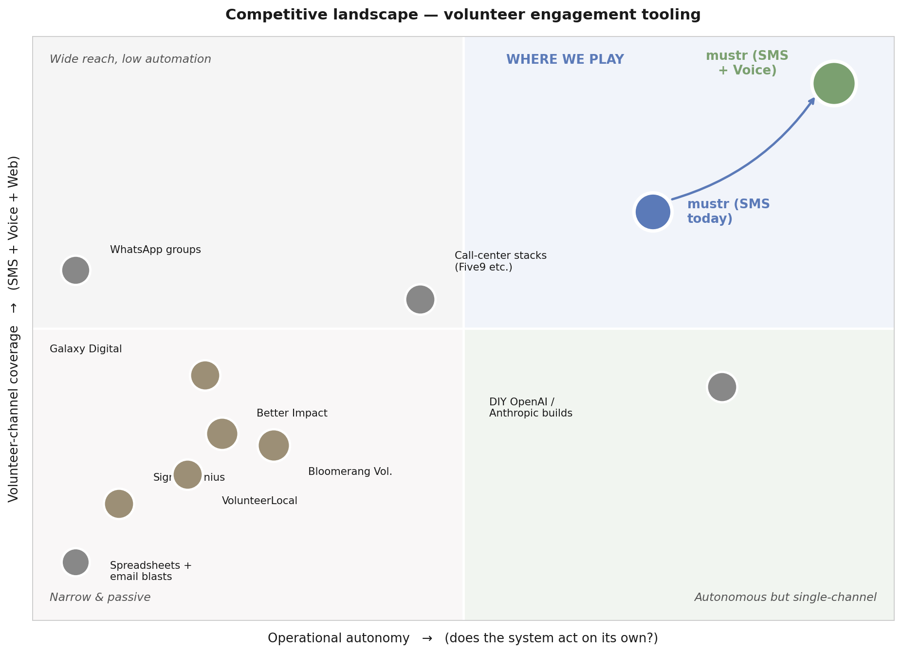
COMPETITIVE LANDSCAPE
Nobody is doing autonomous, multi-channel volunteer ops.
THE GAP
Everyone else built admin software.
We built a volunteer-facing agent that admins supervise. The market has no incumbent that's both autonomous AND multi-channel — that's the quadrant we own.
WHY THEY HAVEN'T
• Legacy code · CRM mindset.
• AI cost only became viable in 2025.
• Voice agents only got good in 2026.
mustr · Volunteer ops on autopilot
7 / 14

Slide 8
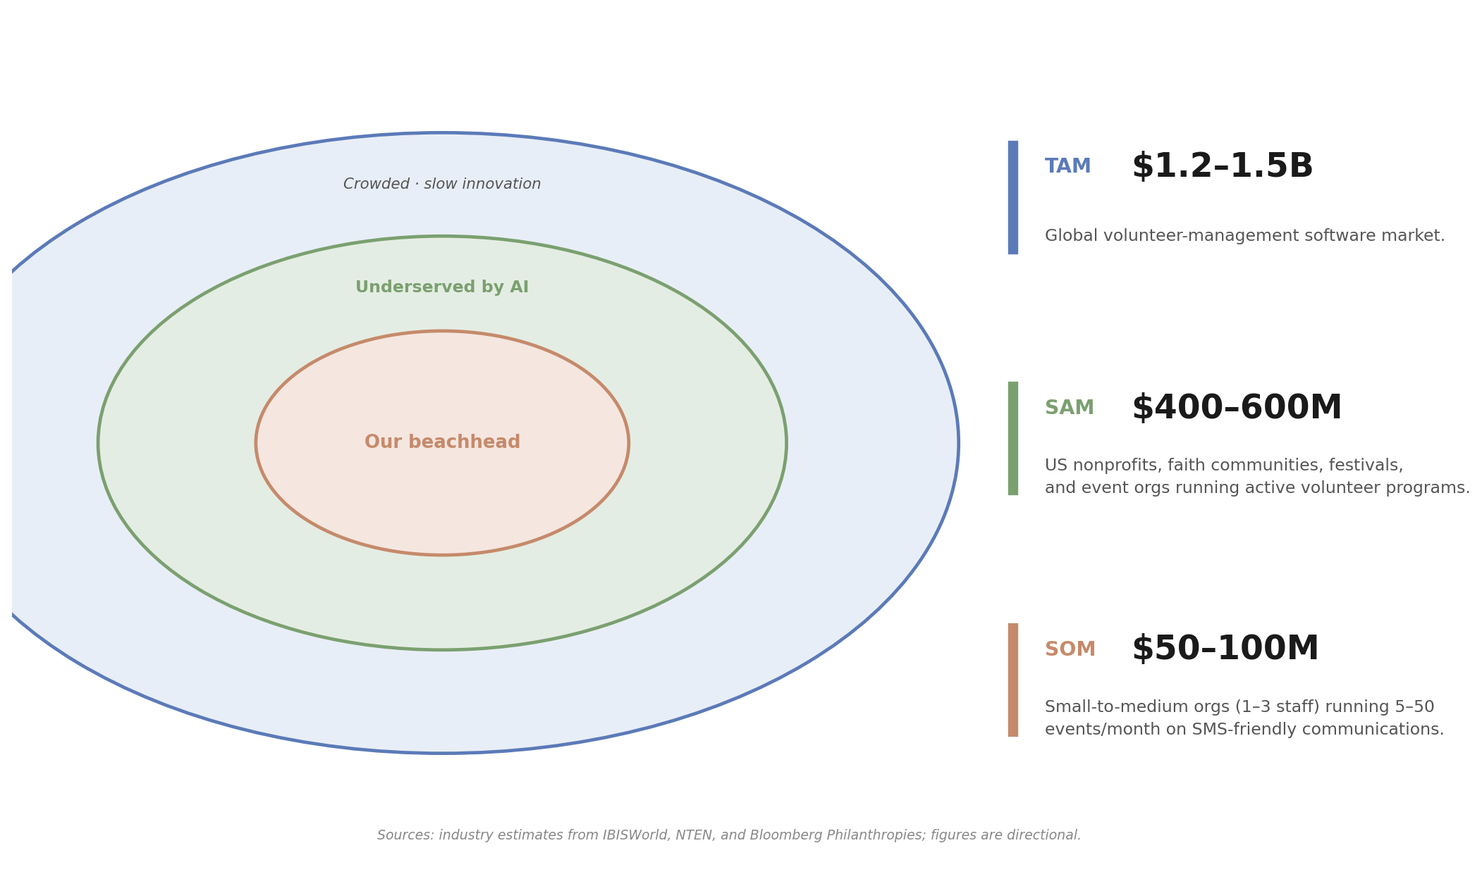
TAM / SAM / SOM
Market size
Volunteer-mgmt software is small but underserved by AI. Adjacent expansions (donations, event ops) extend the addressable spend per tenant by ~3×.
mustr · Volunteer ops on autopilot
8 / 14

Slide 9
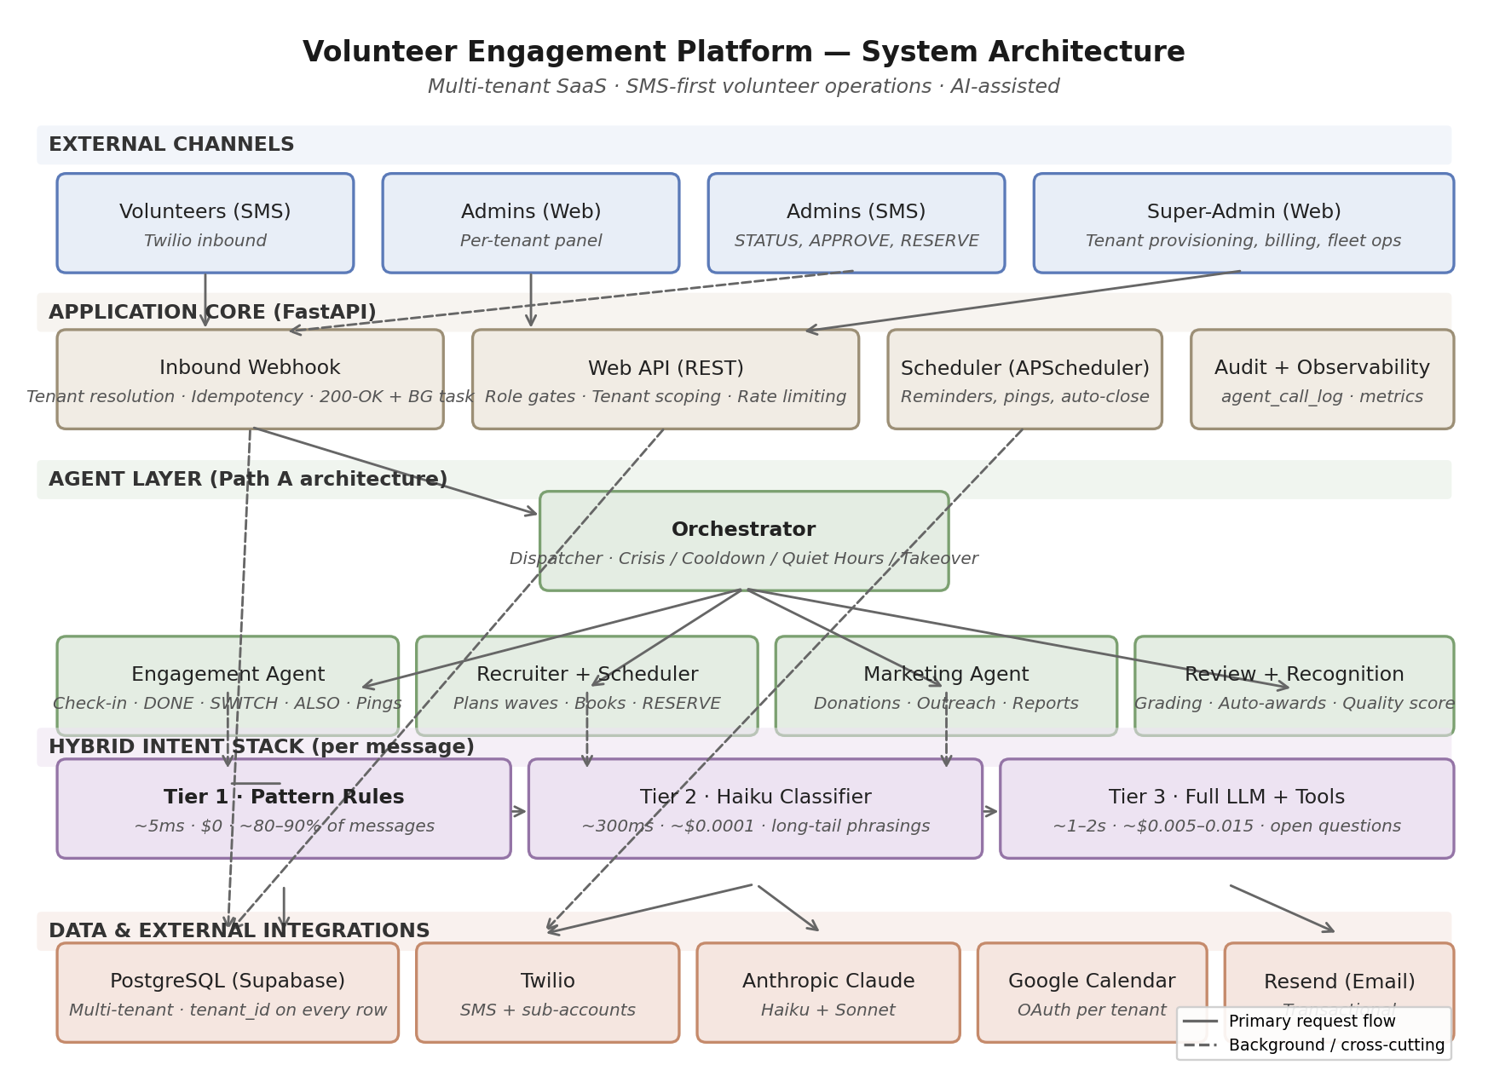
ARCHITECTURE MOAT
Why a generic AI assistant won't catch us.
We built a layered system that makes AI cheap, reliable, and auditable — not just plausible.
OUR MOAT
• Hybrid intent stack: rules → small AI → full AI. 80–90% of messages cost $0.
• Multi-tenant from day one — onboarding in minutes, schema migrations apply once.
• Agent architecture: Engagement, Recruiter+Scheduler, Marketing — independently evolvable.
• Audit-by-default: every routing decision logged. Compliance-ready posture.
• Soft-fail external dependencies — Twilio / Anthropic / Google outages degrade, don't break.
Full system architecture — see companion brief.
mustr · Volunteer ops on autopilot
9 / 14

Slide 10
BUSINESS MODEL
Tiered pricing — designed for nonprofit budgets.
Free tier seeds adoption. Paid tiers scale with active volunteers and unlock the agent + the channels that drive ROI.
STARTER
GROWTH
PRO
ENTERPRISE
Free
$99 / mo
$299 / mo
from $999
<50 active vols
Up to 250 vols
Up to 1,000 vols
Unlimited vols
• Inbound SMS
• Basic scheduling
• mustr branding on SMS
• Community support
• Full SMS Agent (engagement)
• Reminders & follow-up
• Recognition (basic)
• Email support
• Recruiter Agent (autonomous fill)
• Multi-event + roster sharing
• Full recognition + analytics
• 200 Voice minutes / mo *
• Priority support
• Full Voice Agent (with overage)
• SSO + custom integrations
• Pluggable CRM/HRIS adapters
• Dedicated CSM + SLA
• 10DLC sub-account
LEAD-GEN TIER
MOST SMB NONPROFITS
GROWING NONPROFITS + FEDERATIONS
DENOMINATIONS · STAFFING CO'S
* Voice ships Q1 2027 (Beta) / Q2 2027 (GA). Overage: $0.07/min. SMS pass-through included up to tier cap; overages billed at $0.012 / message.
mustr · Volunteer ops on autopilot
10 / 14

Slide 11
UNIT ECONOMICS
$99 / month works — here's the math.
A typical Growth-tier tenant: 250 active volunteers, ~10 events / month, ~2,000 SMS / month.
USAGE PER TENANT / MONTH
WHAT IT COSTS US / MONTH
Active volunteers
≤ 250
SMS pass-through (Twilio)
$16
Events / month
~10
AI inference (hybrid stack)
$1
SMS messages (in + out)
~2,000
Infrastructure (DB + compute)
$5
Tier 1 (regex)
~85% of inbound → $0
Support (batched, AI-assisted)
$10
Tier 2 (Haiku classifier)
~10% → ~$0.0001 each
$32
Tier 3 (full LLM)
~5% → ~$0.036 each
TOTAL COGS
GROSS MARGIN AT $99 / MO
AI-ONLY ARCHITECTURE
$67 / mo · 68%
Healthy SaaS-class margin while keeping the price where SMB nonprofits can buy without procurement.
$67 COGS → 32% margin
Hybrid stack saves ~$35 / tenant / mo. At 1,000 paying tenants, that's ~$420K / yr in gross profit recovered by the architecture.
Assumes US 10DLC SMS at ~$0.008 / msg, Sonnet at $3 / MTok in + $15 / MTok out for Tier 3 (~$0.036 avg / call), Haiku at ~$0.0001 / call for Tier 2. Pro tier ($299) holds ~50% margin at 4× usage including 200 voice minutes.
mustr · Volunteer ops on autopilot
11 / 14

Slide 12
GO-TO-MARKET
Three motions, one funnel.
Self-serve at the bottom, sales-assisted in the middle, partner-led at the top.
Bottoms-up (PLG)
Sales-assisted
Partner-led
Starter and Growth tiers, self-serve.
Pro tier, light-touch outbound.
Enterprise tier, multi-tenant deals.
• Inbound from community forums (NTEN, VolunteerMatch, faith ops Facebook groups).
• Free tier with mustr branding drives word-of-mouth from the volunteers themselves.
• Donation feature unlocks as the conversion hook.
• SDR cohort targeting mid-size nonprofits and event-staffing agencies.
• Case-study driven: published 'we ran X's food drive' wins.
• Demo flow: 7-day pilot to first booked event.
• Denominational HQs (10–500 churches each).
• Nonprofit federations (United Way, Catholic Charities).
• Event-staffing networks: one sale → many tenants.
Goal: 1,000 free tenants by Q4 2026 → ~10% conversion to paid.
Goal: 200 Pro tenants by Q4 2026, ARR $700K.
Goal: 10 partner deals by mid-2027, ~250 tenants captured.
mustr · Volunteer ops on autopilot
12 / 14

Slide 13
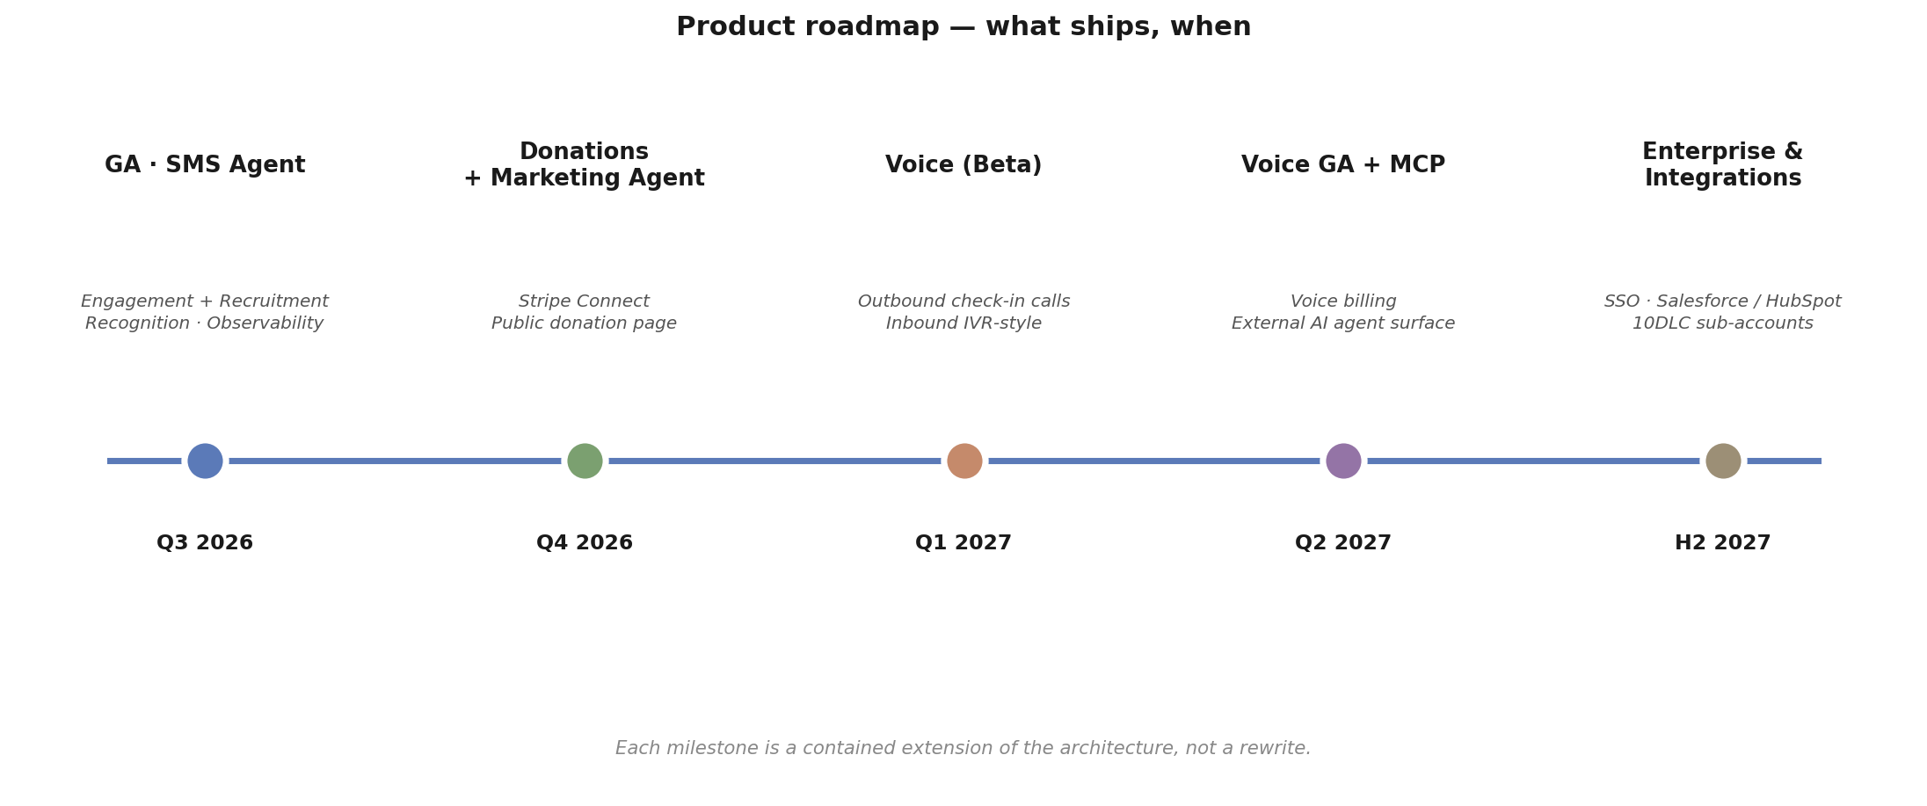
ROADMAP
What ships, when.
Voice is the inflection. SMS gets us into the building; Voice triples our addressable channel reach and unlocks demographics SMS-only tools can't serve (older volunteers, wellness-check programs, low-literacy contexts).
mustr · Volunteer ops on autopilot
13 / 14

Slide 14
TRACTION & ASK
Where we are and what we need.
Where we are
What we need
• Platform shipped: 5-phase event lifecycle (check-in, check-out, mid-event SWITCH, post-event review, recognition).
• Multi-tenant architecture in production with row-level isolation and per-tenant credentials.
• Hybrid intent stack (regex → Haiku → full LLM) live.
• Pilot tenants: 3 active, ~600 volunteers under management.
• Token cost / message: trending below $0.001.
Series Seed — $2.5M
18-month runway to Voice GA + 500 paid tenants.
• Voice engineering (~$700K, 4 hires).
• Sales + partnerships (~$900K, 3 hires).
• Compliance: 10DLC, TCPA, SOC 2 prep (~$300K).
• Working capital, infra, AI spend (~$600K).
mustr · Volunteer ops on autopilot
14 / 14

Slide 15
THE BOTTOM LINE
An autopilot for volunteer ops.
SMS today, voice next, one agent across both.
We're filling a quadrant the incumbents can't reach: autonomous, multi-channel volunteer ops at a price nonprofits can afford. The architecture is built for the next decade of AI-priced software — cheap where it can be, reliable where it must be, auditable everywhere.
Let's run your next event together.
Contact: founders@mustr.app · mustr.app

