Slide 1
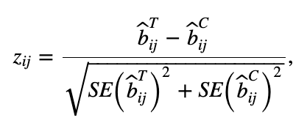
Prior-guided gene expression network using KiMONo¹
Prior network
Prior-guided expression network
Approach DiffGRN²: differential gene interactions using a z-test
Control
Where and are estimated regression coefficients of gene i and gene j within control and treatment group
Differential network
Treatment
¹Ogris et al., Sci Rep, 2021
²Kim Y et al., Int J Data Min Bioinform, 2018
Notes:
Main idea behind differential network analysis:
Are the differentially expressed genes between baseline and treatment samples also those that are differentially co-expressed? Do we get similar results from this analysis or additional information?
Which information do we get from differential gene interactions?
Approach for differential network analysis:
Calculate prior-guided gene expression networks using KiMONo for control and treatment samples separately
Get differential gene interactions:
Take beta values and SE of beta values of control and treatment group for one pair of genes (i and j) and calculate z score
Calculate p values for all z scores
Generate differential network from those interactions with a significant p-value

