Slide 1
Retail Power BI Case Study
Retailer • Product • Store • Perfect Outlet Analysis
Management summary and presentation narrative

Slide 2
Growth of 6.6% in Value Hides a 2.0% Volume Decline
Executive summary
Pick n Pay: value +13.5% and volume +8.7%.
Makro: value +11.9% but volume -3.0%; growth is heavily price-led.
Shoprite: value -9.9%, volume -12.8%, with 36 of 37 declining stores.
Beverages contributed about R266k, roughly half of total value growth.
Decision focus
Shoprite gaps • Makro pricing • Beverages

Slide 3
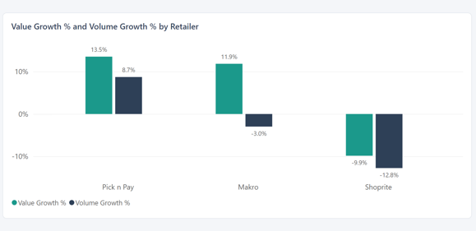
Retailer Performance Tells Three Different Stories
Value, volume, price and mix
Makro's price effect is approximately +R486k against a total gain of about R407k.
Pick n Pay's volume effect is approximately +R208k and carries most of its growth.
Shoprite's lost units created about R265k of negative volume effect; price increases softened the value decline.

Slide 4
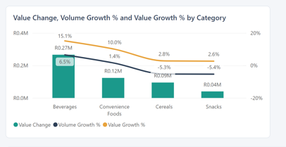
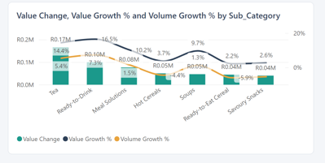
Beverages Delivered Half The Growth
Product and category performance
Tea grew +14.4% in value; Ready-to-Drink grew +16.5%.
Shoprite Beverages grew only 0.9%, versus 21.5% at Makro and 18.5% at Pick n Pay.
CraveCraft Chutney Maize Bites was the only SKU in value decline (-1.1%; volume -8.6%).
Shoprite Cereals lost R146k, the largest single hole in the dataset.

Slide 5
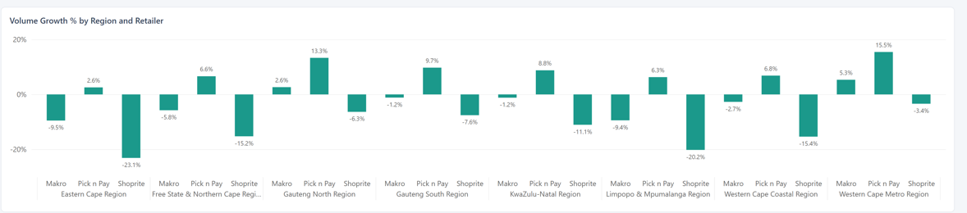
Store exceptions concentrate the risk
Store and regional prioritisation
Tier 1 definition: value decline worse than R8k and at least 5 recorded gaps.
Eight stores fall into Tier 1: Gqeberha, East London, Polokwane, Middelburg, Bethlehem, Mthatha, Mossel Bay and Richards Bay.
36 of the 37 declining stores are Shoprite; the remaining one is Makro Polokwane.
Eastern Cape is the only declining region (-1.2% value; -9.5% volume).
Western Cape Metro is the strongest region at +14.6% value growth.

Slide 6
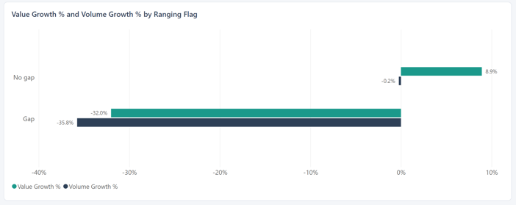
Gap lines are shrinking while no-gap lines grow
Perfect outlet drivers
Without gaps, ranging and availability lines grew about +8.9% to +9.0%.
Within every retailer, SKUs with availability gaps perform worse than those without them.
Shoprite has the largest gap exposure: availability 18% and ranging 11%.
Estimated gap opportunity is about R342k.

Slide 7
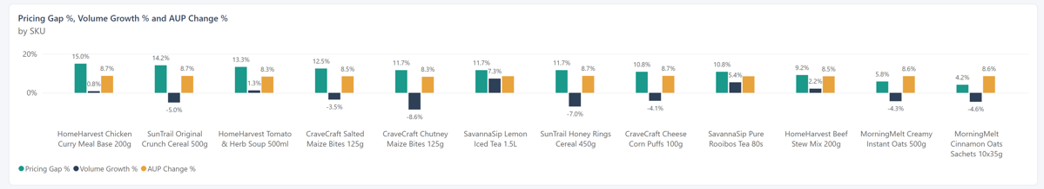
Makro's Price Headroom Is Costing Units
Pricing effectiveness
157 rows (10.9%) are more than 5% above RSP and carry 11.8% of 2026 value.
100 flagged rows are in Makro, representing 21% of Makro's lines.
Makro flagged lines: value +2.9%, volume -10.7%; unflagged lines: value +14.1%, volume -0.9%.
One year of data is insufficient to prove price elasticity.

Slide 8
30 / 60 / 90 Day Action Plan
Proposed actions :targets should be agreed with the business
30 DAYS
Fix availability and ranging in the 8 Tier 1 Shoprite stores; refresh barcode/gap data.
60 DAYS
Extend the Shoprite gap programme, prioritising Eastern Cape and Limpopo & Mpumalanga.
Review Makro lines more than 5% above RSP, starting with the highest premiums.
Launch a Shoprite Beverages plan focused on Tea and Ready-to-Drink.
90 DAYS
Embed Tier 1/Tier 2 exceptions into routine reporting with named owners.
Review Cereals and Snacks volume plans.
Overall proposed goal
Recover a meaningful share of the estimated R342k opportunity, move Shoprite towards flat and stop Makro volume falling further.

Slide 9
Methodology, assumptions and data quality
What the analysis can and cannot tell us
Scope: Oct to Aug FY2026 vs the same period last year; 3 retailers, 4 divisions, 8 regions, 120 stores, 12 SKUs, 5 brands and 4 categories.
Product master barcodes were corrupted into scientific notation; SKU description was used for matching and all 12 SKUs matched.
Used SQL to combine all tables:
AUP/RSP comma-decimal values were converted; no duplicate store/barcode keys, zero/negative sales or unmatched stores/products were identified.
Pricing_Gap matches the rule of AUP more than 5% above RSP on all 157 flagged rows.
Limitations: one period; no margin, promotion, cost or competitor data; gap flags are a snapshot; associations are not causation.

