Slide 1



Tiger_Brands_Sales_Gap_Report
View in Power BI
Last data refresh:
10/1/2026 7:10:21 PM UTC
Downloaded at:
10/1/2026 7:14:48 PM UTC

Slide 2
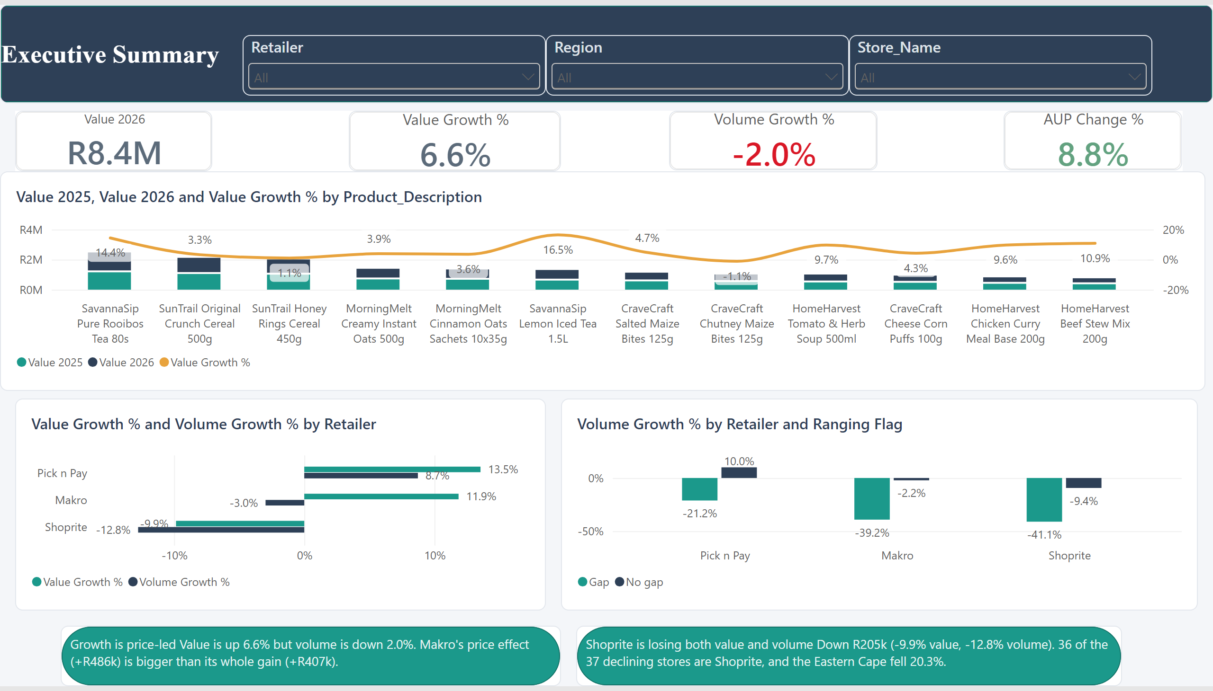
Executive_Summary

Slide 3
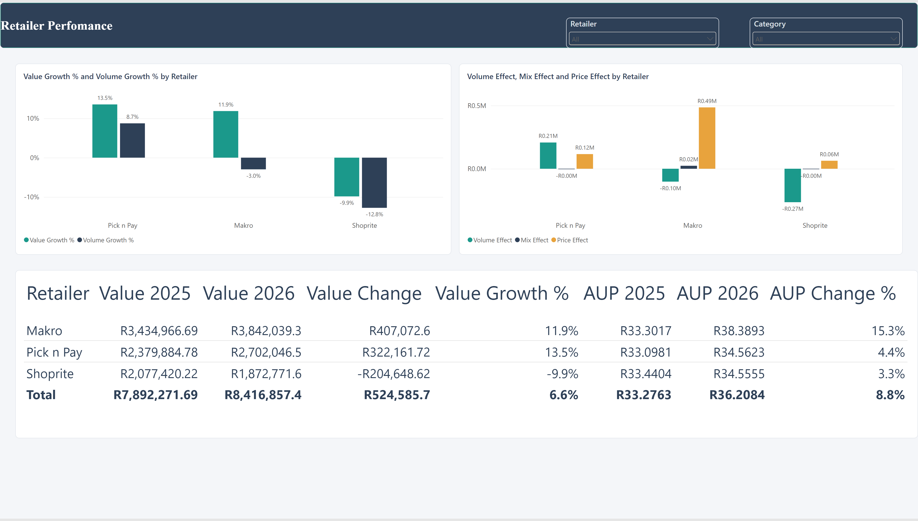
Retailer_Performance
Notes:
tableEx
No alt text provided
slicer
No alt text provided
clusteredColumnChart
No alt text provided
slicer
No alt text provided
shape
No alt text provided
clusteredColumnChart
No alt text provided

Slide 4
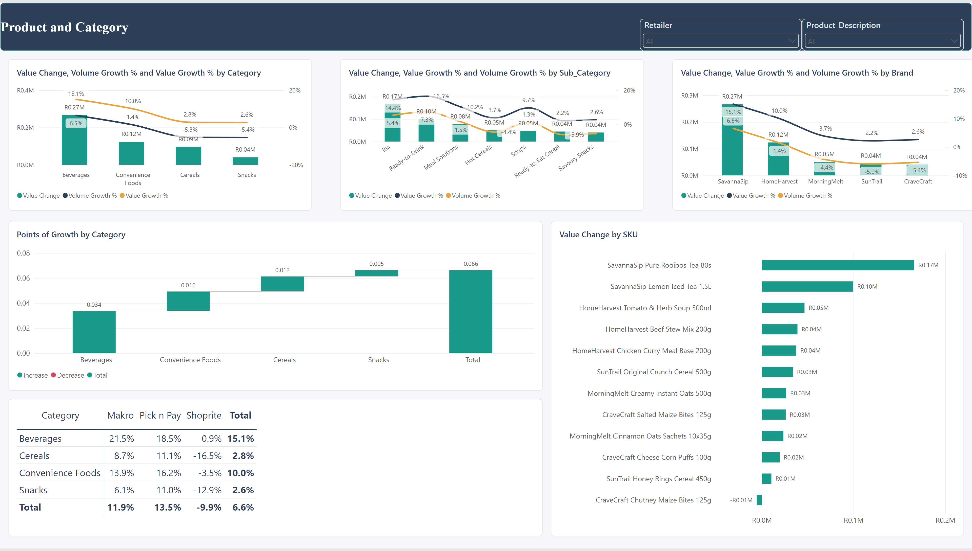
Product_And_Category
Notes:
lineStackedColumnComboChart
No alt text provided
slicer
No alt text provided
shape
No alt text provided
slicer
No alt text provided
barChart
No alt text provided
pivotTable
No alt text provided
waterfallChart
No alt text provided
lineStackedColumnComboChart
No alt text provided
lineStackedColumnComboChart
No alt text provided

Slide 5
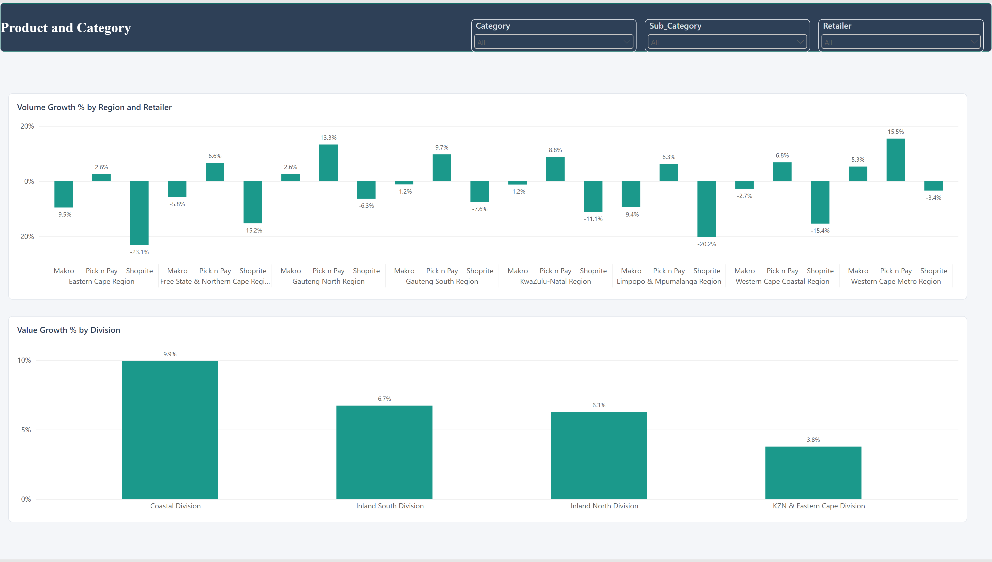
Store_Region_Exceptions
Notes:
slicer
No alt text provided
slicer
No alt text provided
clusteredColumnChart
No alt text provided
slicer
No alt text provided
shape
No alt text provided
clusteredColumnChart
No alt text provided

Slide 6
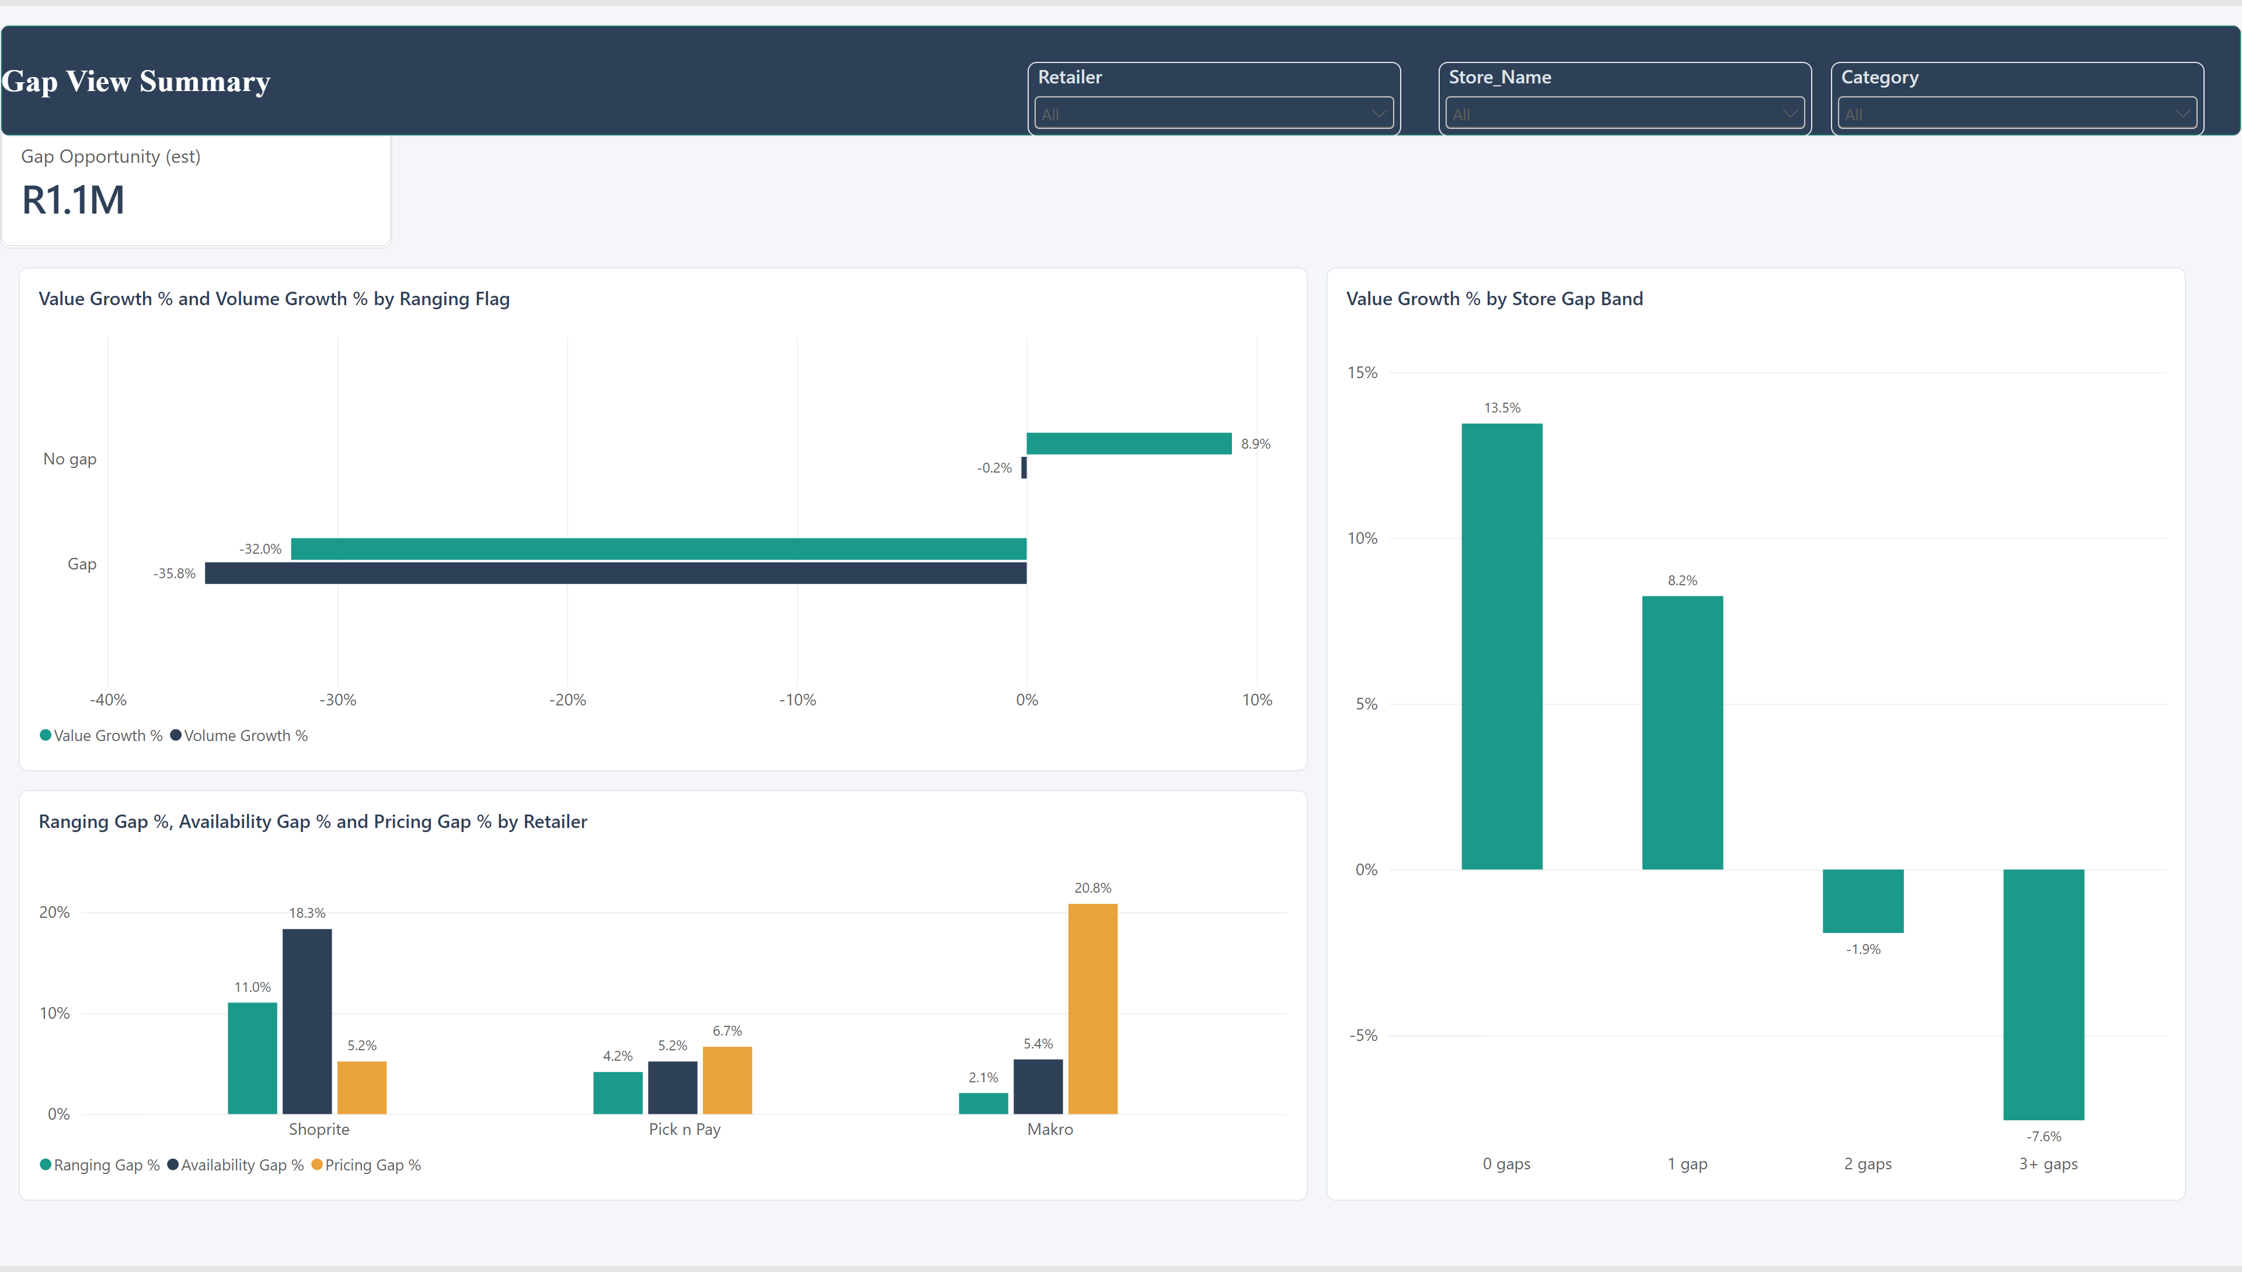
Outlet_Drivers
Notes:
clusteredBarChart
No alt text provided
slicer
No alt text provided
columnChart
No alt text provided
clusteredColumnChart
No alt text provided
cardVisual
No alt text provided
slicer
No alt text provided
slicer
No alt text provided
shape
No alt text provided

Slide 7
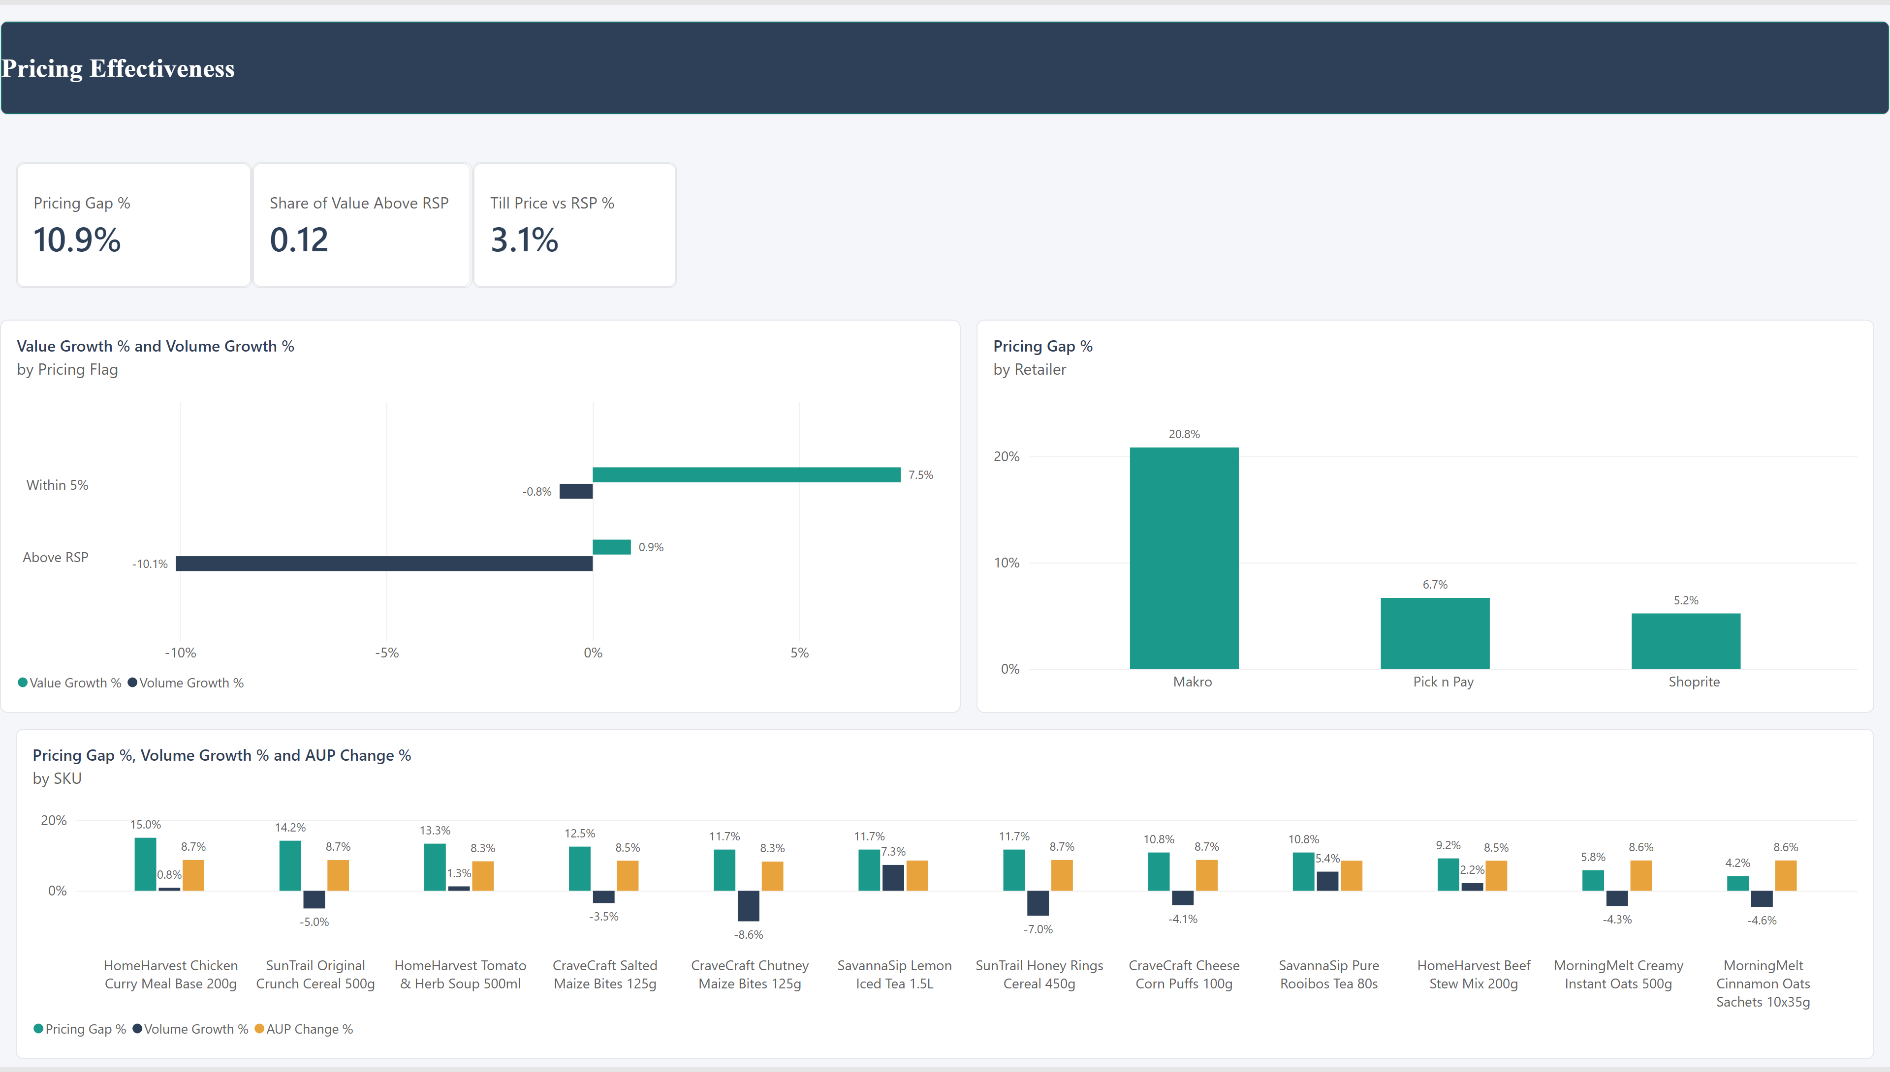
Pricing_Effectiveness
Notes:
cardVisual
No alt text provided
cardVisual
No alt text provided
cardVisual
No alt text provided
clusteredColumnChart
No alt text provided
shape
No alt text provided
clusteredBarChart
No alt text provided
columnChart
No alt text provided

