Slide 1
“But in the current, digitized world, trivial information is accumulating every second, preserved in all its triteness. Never fading, always accessible... All of this junk data preserved in an unfiltered state, growing at an alarming rate.”
“It takes more than premium ingredients and a clever recipe to satisfy the palate. The palate seeks one thing… chemical additives.”

Slide 2
!

Slide 3

Trivia

Slide 4
How to Play
Answer questions about Metal Gear Solid!
  “WOOOOOOOOO!” - Me
  “How the hell do I do that? I don’t know anything about this stupid game!” - Nearly everyone else

Slide 5
How to Play
To help, I’ve prepared a crash course packet
Split up into teams
  Each team should have at least one person who knows what Snake sounds like
    Only prerequisite knowledge your team needs
  If you are familiar with the series, you should be on your own team

Slide 6
Format
Three rounds
  Rounds 1 and 2: Two trivia questions and one bonus
  Round 3: Three trivia questions and a final bonus
Bonus
  Place a wager
  After reveal, select a team member to compete

Slide 7
Notes
Spoilers (in case you care)
  Major spoilers for MGS1, MGS2
  Minor spoilers for MGS3, MGS4
Certain parts of the cheat sheet are not true
  Everything you are supposed to know up through MGS2 is stated as true, even though some of those things are later revealed to be false as part of the story
  If you can’t tell which parts are not true, it won’t affect this game
  If you can tell, you should be on your own team
Every question can be answered with what I give you
  Don’t look things up online!

Slide 8
Question 1

Slide 9
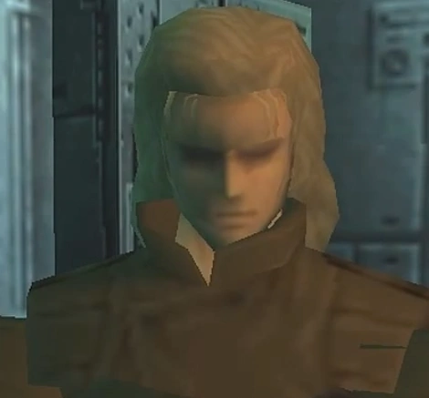


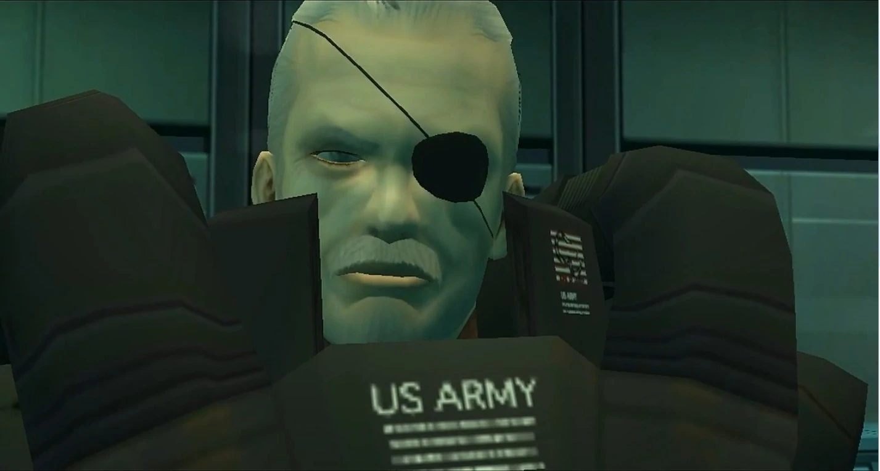
Question 1
Match each character to their name:
Big Boss
Liquid Snake
Solid Snake
Solidus Snake

Slide 10
Question 2

Slide 11
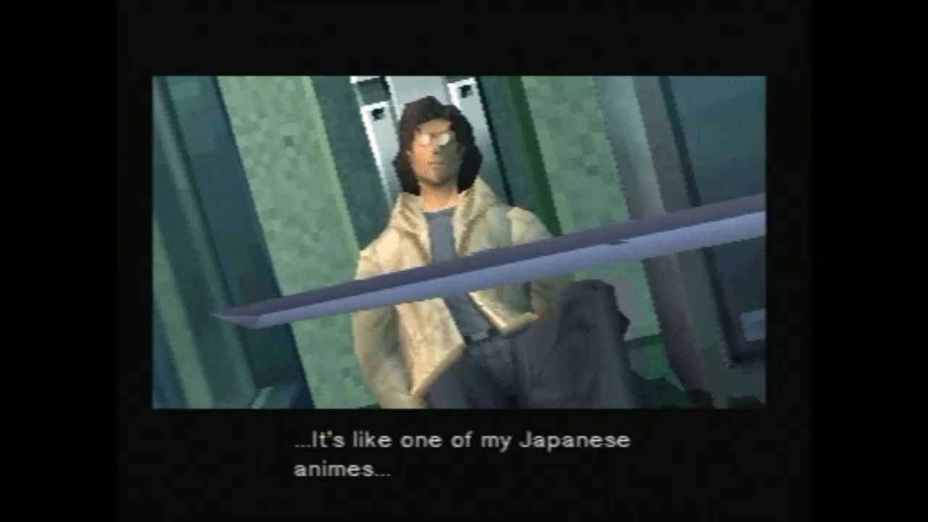
Question 2
Who are Otacon and Solid Snake named after?
  Be specific

Slide 12
Bonus 1

Slide 13
Bonus 1
Each team has received a monologue from Snake
Select one teammate to recite this monologue
Points awarded based on impersonation quality

Slide 14
Bonus 1: Life

Slide 15
Bonus 1: War

Slide 16
Question 3

Slide 17
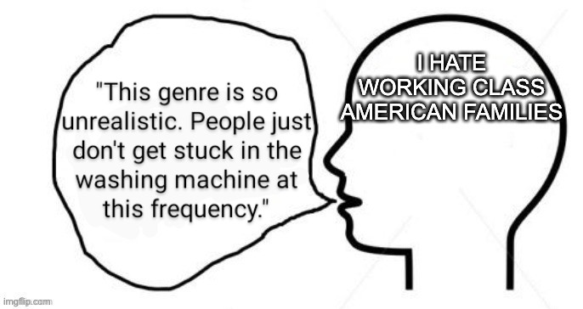
Question 3
What character slept with his stepmom?

Slide 18
Question 4

Slide 19

Question 4
What do Deepthroat and Mr. X have in common?

Slide 20
Bonus 2

Slide 21
Bonus 2
I said you didn’t need any knowledge other than what Snake sounded like
  I lied (kind of)
To do this bonus well, you need additional knowledge not given in the cheat sheet

Slide 23
Question 5

Slide 24
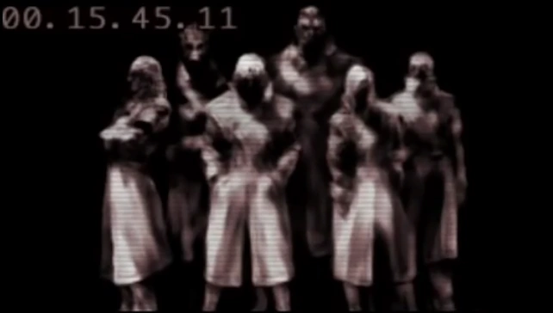
Question 5
Two different impersonations occur during the Shadow Moses Incident. For both, name:
  the impersonator, and
  who they impersonated

Slide 25
Question 6

Slide 26
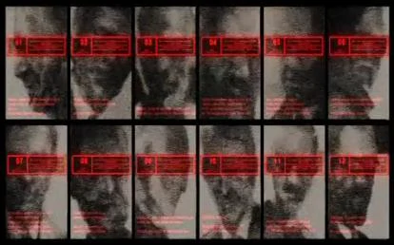
Question 6
What does the S3 Plan stand for?

Slide 27
Question 7

Slide 28
Question 7
Match each character to their “quirk”:
A: Little Gray
B: Johnny Sasaki
C: Fortune
D: The End
E: Psycho Mantis
F: Fatman
1. Bullets always miss them
2. Photosynthetic sniper
3. Roller skater
4. IBS
5. Soda addict
6. Telekinetic powers

Slide 29
Final Bonus

Slide 30
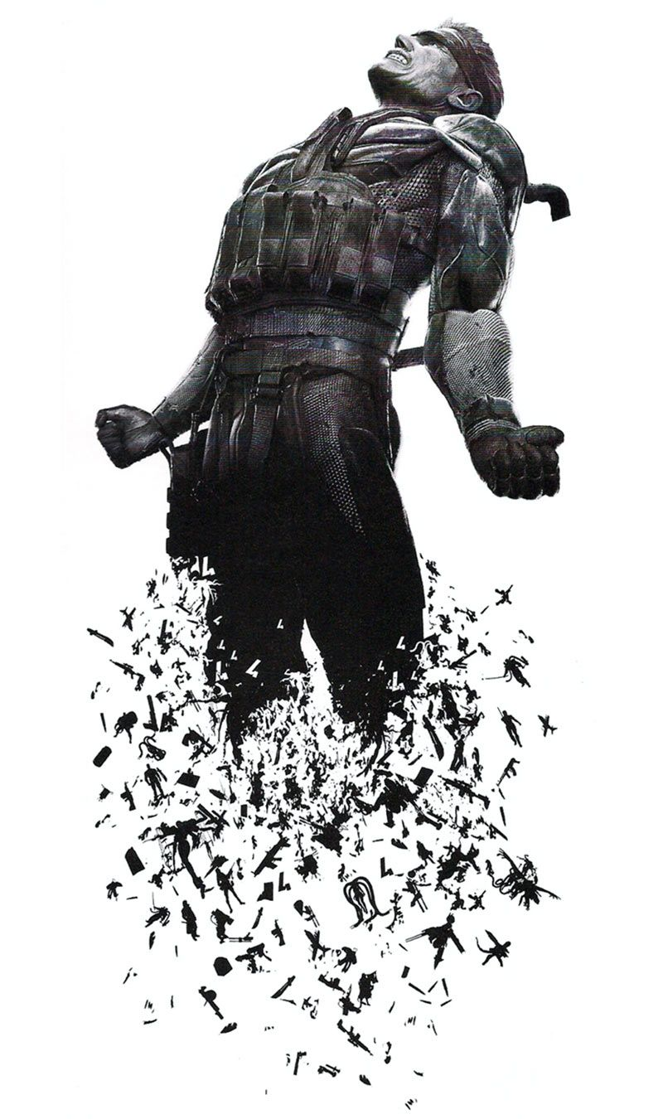
Final Bonus
Place the following in chronological order:
A: Raiden becomes a cyborg ninja
B: Liquid Snake dies
C: Les Enfants Terribles
D: The Boss defects
E: Big Boss is killed in Zanzibarland
F: Big Boss loses his eye
G: Solidus Snake loses his eye
H: Solid Snake is infected with FOXDIE

