Slide 1
COMPUTER STORE MANAGEMENT SYSTEM
GROUP 4
Nguyễn Hoàng Hải - 20200193
Nguyễn Tuấn Hiệp - 20205151
Nguyễn Minh Huy - 20205158

Slide 2
01
Overview
In today's technological era, computer stores play a vital role in providing customers with the latest technology products and services and offering expert advice and support. We decided to design a database system that assists in managing information related to common business activites in a computer store.
The computer store that we are working on sells computers and various accessories. Customers can purchase online or in-store. The store has many branch stores in different places, in each branch store there are many employees with different roles and responsibilities.

Slide 3
Here are the roles that involves in this system:
Customer:
View all product information.
Search for a specific product.
Add items to cart.
Make online orders.
Issue warranty.
View his/her order history and details of the order.
Inventory Clerk
Manage imports and exports of a branch.
Cashier
Process payments for orders.
Check sales and revenue.
Shop Assistant
Insert new product information / update existing product information.
Make offline orders.
Update orders and warranty issues status.
Manager
Manages the business activities in a branch store.
Manages the employees in a branch, update salary.
Admin
Have full control of database system.
Update accounts for employees.

Slide 4
02
ERD Diagram

Slide 5
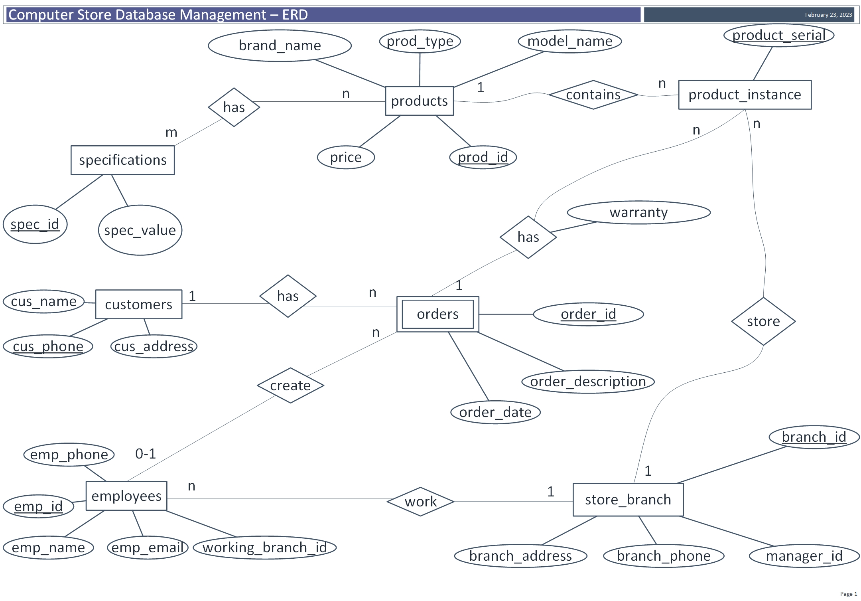

Slide 6
03
Relation Schema

Slide 7
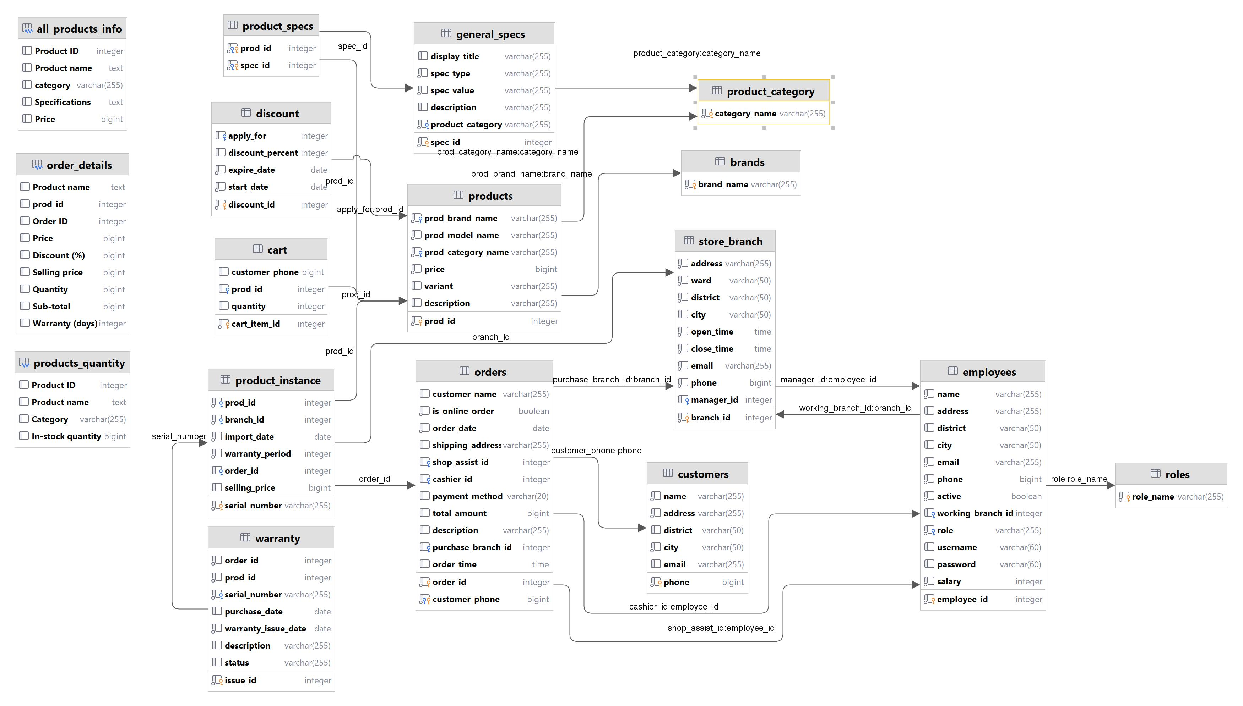
02
ERD Diagram

