Slide 1
VisionIP Viewer Know How
Created By VisionIP (17 Mar 23)

Slide 2
AGENDA
Overview
How to use
User cases

Slide 3
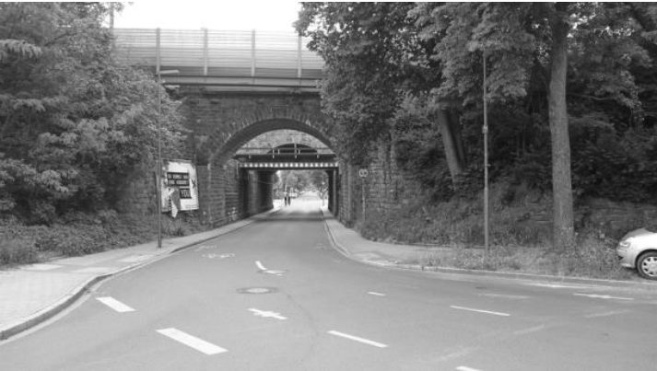
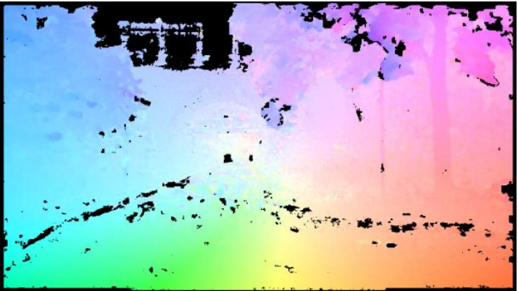
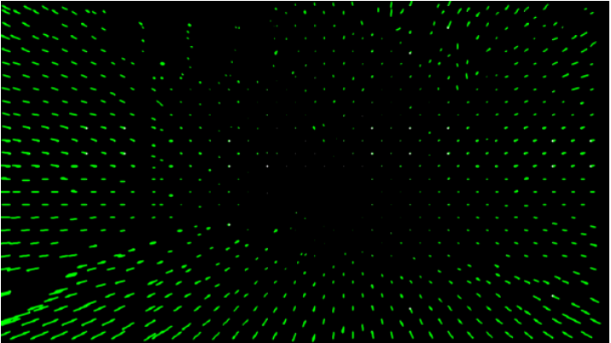
1. Overview
The basic utility to view flow output generated by the R-Car ADAS System.
Specifically dense flow and sparse flow.
scenery image
dense flow field
sparse flow field

Slide 4
2. How to use - Prerequisite (1\4)
This guideline assumes that you have installed all related tools and set PATH correctly:
Install PyQt5 5.15.9 or latest version
Install PyQt5Designer 5.14.1 or latest version
pip install pyqt5
pip install PyQt5Designer

Slide 5
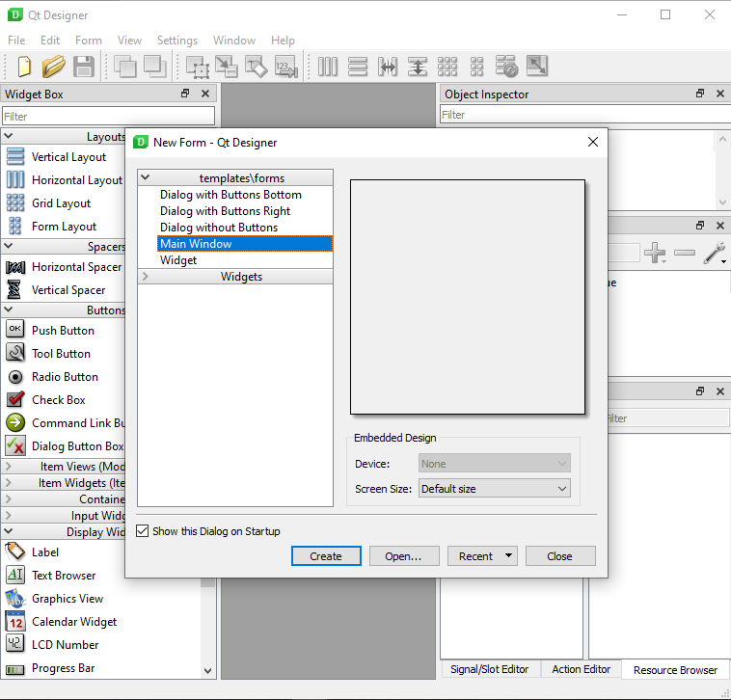
2. How to use – Generate UI design (2\4)
The following screencast shows how we can use Qt Designer to open custom dialogs:
<yourpath>\vip-viewer\sw\MainWindow.ui

Slide 6
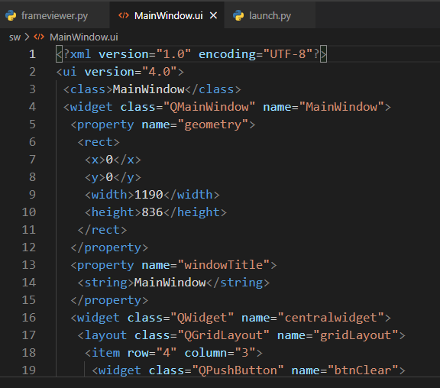
2. How to use – Generate UI design (3\4)
Use the command of above to generate expected design build files:
1. Cd <yourpath>\ vip-viewer\sw\
2. pyuic5 -x .\MainWindow.ui -o .\UI_MainWindow.py

Slide 7
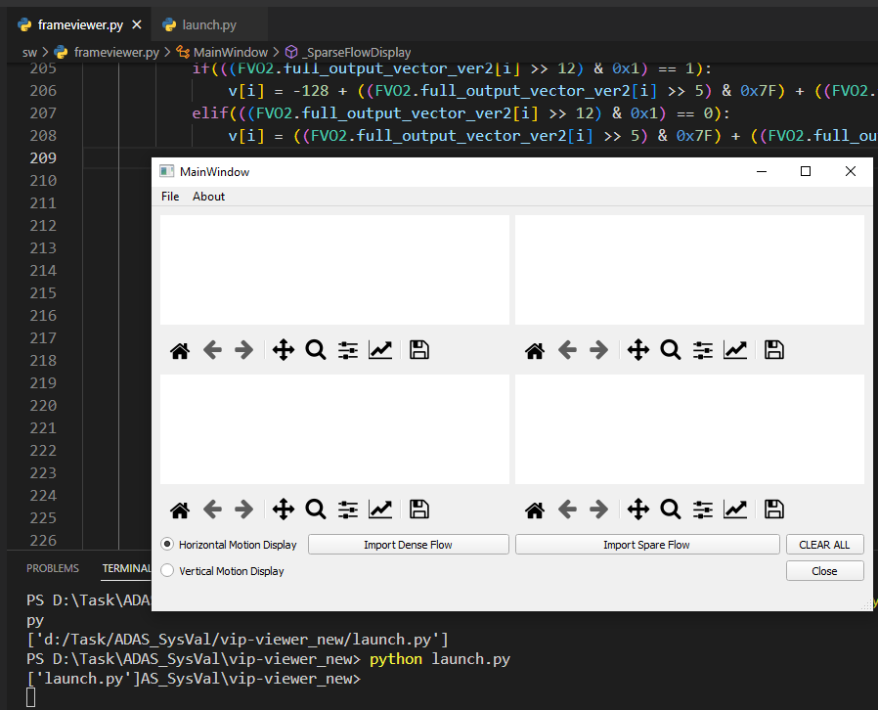
2. How to use - Build (4\4)
Before running Build commands you must execute 1. Generate UI design first
Then, use the command of above to generate expected build files:
1. Cd <yourpath>\vip-viewer\
2. python launch.py

Slide 8
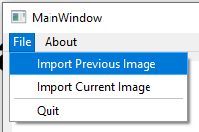
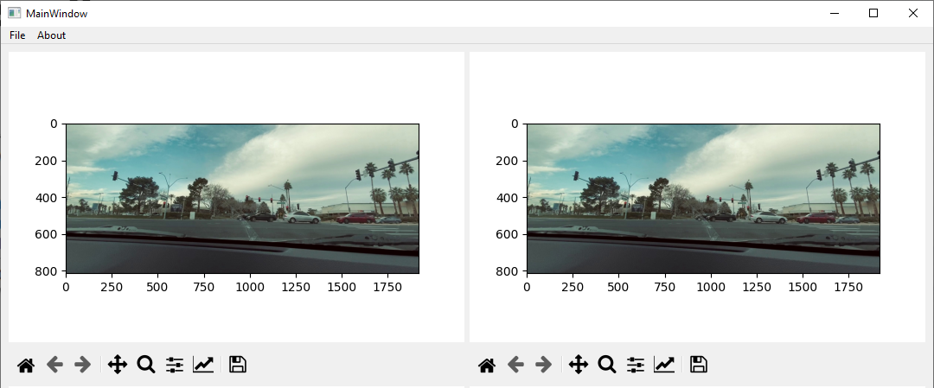
3. User Cases (1\3)
Importing current image and previous image:
Cd <yourpath>\vip-viewer_new\sw\include\imges\<sample imges>

Slide 9
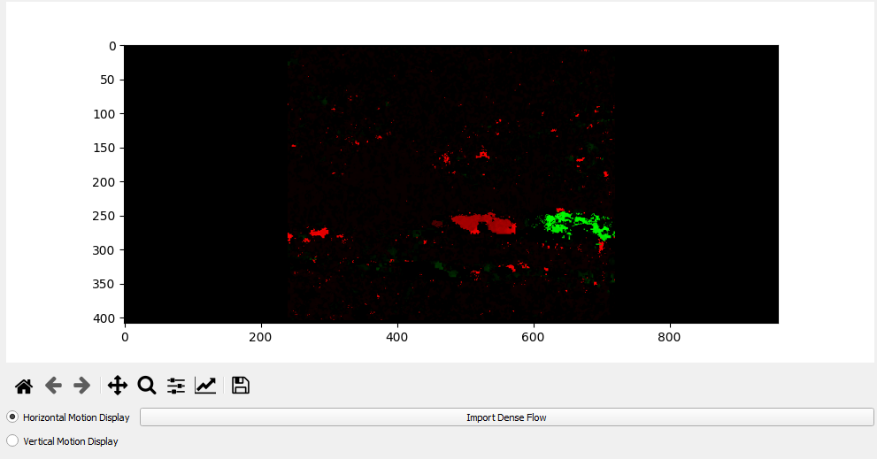
3. User Cases (2\3)
Importing dense flow:
Dense flow
Cd <yourpath>\vip-viewer\sw\include\flows\<sample flow>
2. Select radio buttons the view flow
1. Pushing the “Import Dense Flow” to import flow

Slide 10
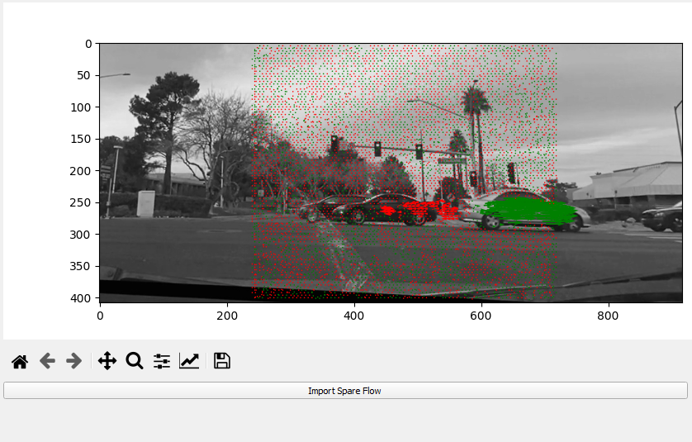
3. User Cases (3\3)
Sparse flow
Importing sparse flow:
Cd <yourpath>\vip-viewer\sw\include\flows\<sample flow>
scenery image
2. Pushing the “Import Sparse Flow” to import flow

Slide 11
Thank You!!

