Slide 1
Extracting Visual Features for Classifying artwork Styles images using CNN and SVM
By Herve Ngomseu Fotsing - 217092052
Big Data Analytics Project Demo – Honours

Slide 2
Outline
Introduction (Analyzing artwork)
Problem Background
Model Pipelines
Specifications of the Implemented solution

Slide 3
Introduction to Artworks
Visual arts provide significant importance to the history and origin of human beings.
Visual artwork is not only valuable in terms of its cultural worth, but also due to the heritage and history provided behind its content and style.
The main difference between visual art and nature
image is shown: the contents of (a) visual art and (b) nature
image is almost the same, but (a) contains the style that
formed by Vincent van Gogh

Slide 4
Problem background
With the massive accumulation of artistic pictures, it becomes challenging for art experts to identify, analyze, and index these artistic visuals. In order to index art-works, it is necessary to have descriptions of visual styles and details about the key features in the artistic pictures

Slide 5
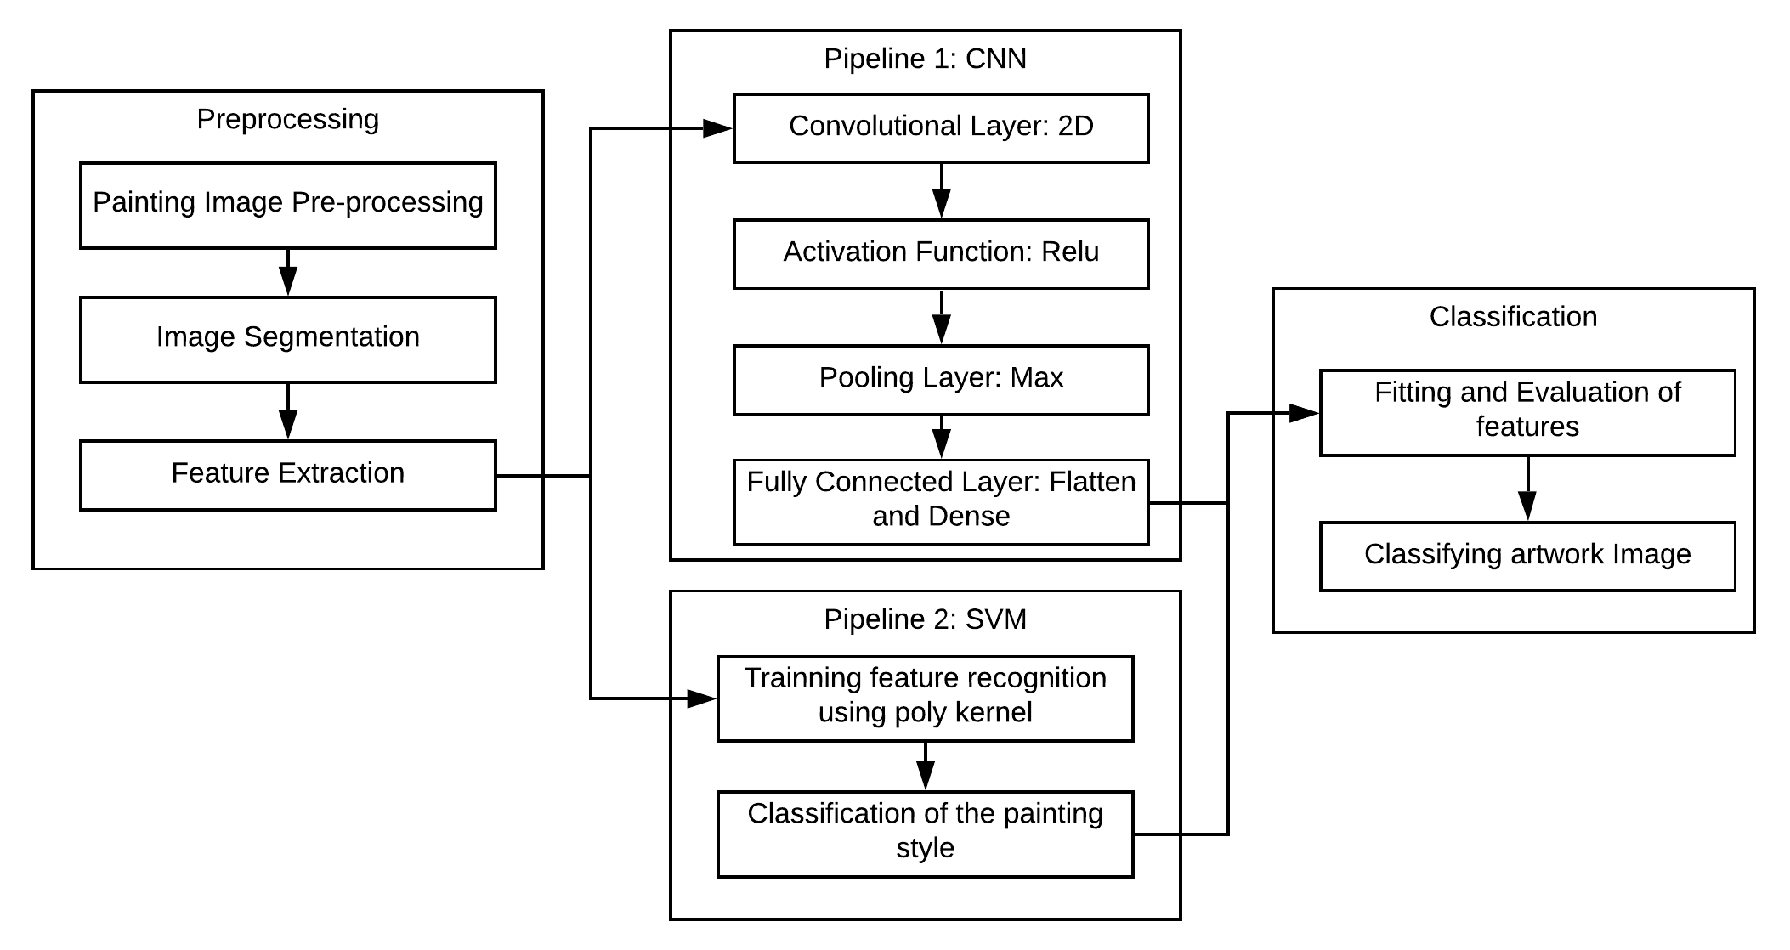
Proposed Solution and Model Pipelines

Slide 6

Specifications of the implemented Solution
The project is implemented in Python 7 using Google Collab Notebook. We train CNN and SVM model and compared with pretrained libraries such as VGG19 for classifying the painting styles.
Essential libraries like TensorFlow, Keras, NumPy, etc.. were used during the training and classification process.
The images dataset was collected from Kaggle, a data science subsidiary of Google LLC.
A total of 8185 training and 1106 testing images were used.
The model classifies five categories of artwork styles namely painting, engraving, iconography, drawing, and sculpture.

Slide 7
Demo time
Thank you!!
“The sky is the limit”

