Slide 1
Hospital Resource Allocator and Finder
By Herve Ngomseu Fotsing - 217092052
CSC3A Mini Project

Slide 2
Outline
Introduction
UN Sustainability Goal
Problem
Solution
Value
Conclusion

Slide 3
Introduction
This mini project focuses on demonstrating the use of Graph ADT to provide a reference for Allocating hospitals, creating partnership between them and determining the shortest path to reach a particular hospital

Slide 4
UN Sustainability Goal
Goal 3: GOOD HEALTH AND WELL-BEING
Hospital Allocator and Finder:
Hospitals create partnership among themselves in other to share resources
Users may find the closest hospital to thier current locations, and know the exact path to reach the particular hospital

Slide 5
Problem
In order to help the government to better structure hospitals it is necessary for the hospitals to have partnerships.
Patients also need to know the closest hospital to their locations for their particular health condition in order to be assisted in time. The google map has a similar implementation

Slide 6
Solution
Nodes represent hospitals or users
Edges the path between the hospitals and the user’s location
Traversals represents partnership between hospitals
It is best to represent resource using graph ADT because it provide links to each node while making it each to access it neighbors

Slide 7
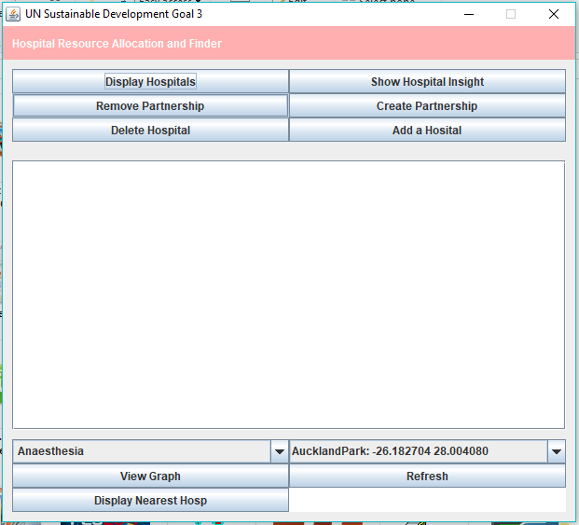
Initial Display
A set of button to perform various actions starting by clicking on Display Hopitals

Slide 8
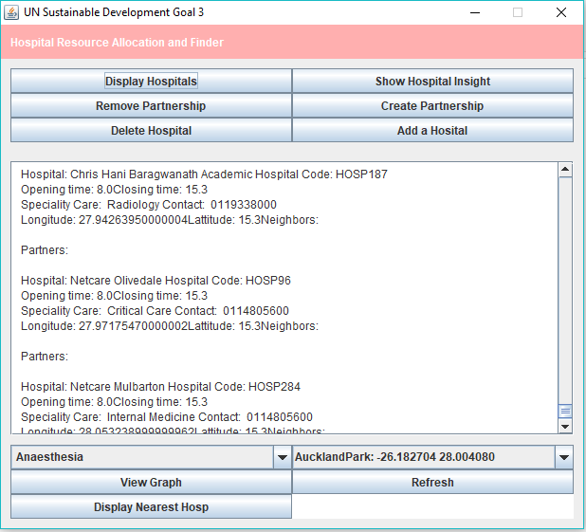
Display every hospital in Johannesburg and its details

Slide 9
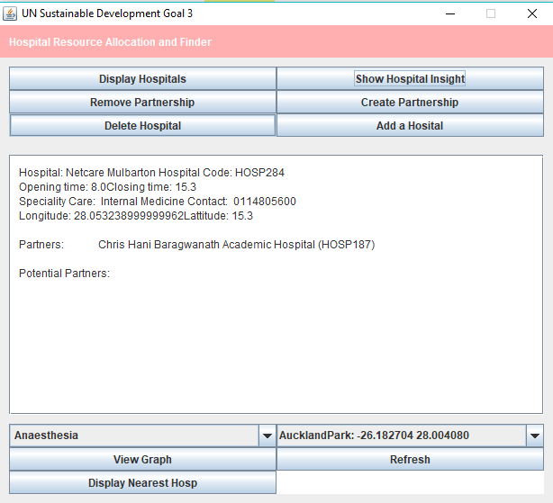
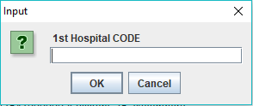
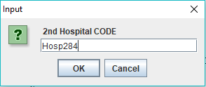
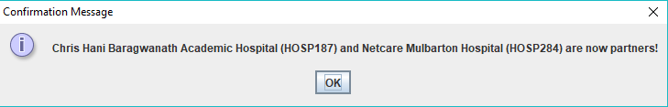
Adding an edge
Click on Create Partnership then Show Hospital insight

Slide 10
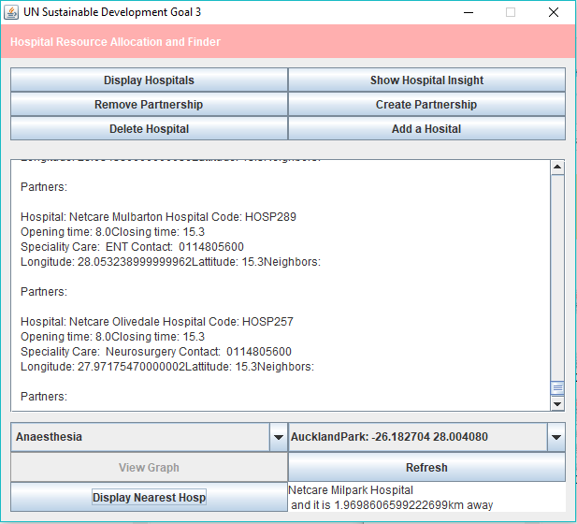
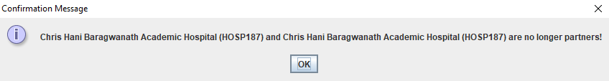
Removing an edge
Click on Remove Partnership then check for partnership to show removal of the edge

Slide 11
Adding Nodes(vertices)
Click on Add a Hospital then provide its details them check by viewing the hospital

Slide 12
Removing a Node(vertex)
Click on delete Hospital and provide hospital code then re-display the hospitals and check

Slide 13
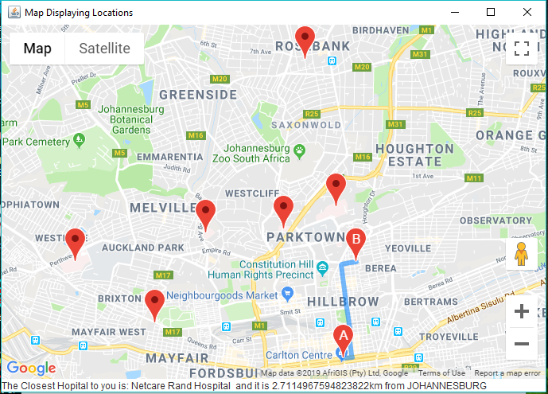
Visual Representation of Nodes
Nodes represented by hospitals on the google map shown y the red spots. The edge is the blue line showing the path

Slide 14
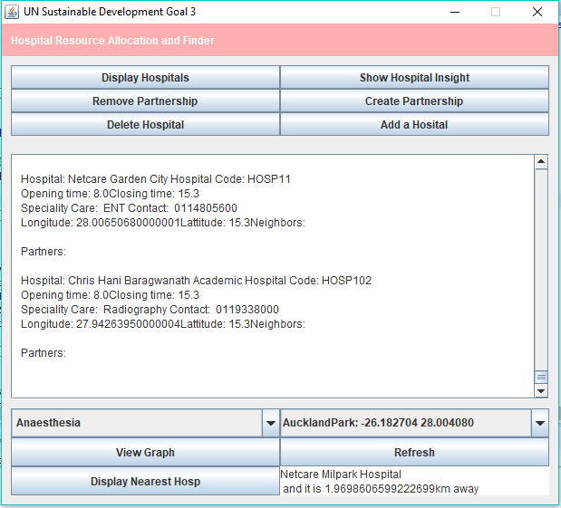
Determining the best Hospital using location and medical service provided in the combo box then view graph

Slide 15
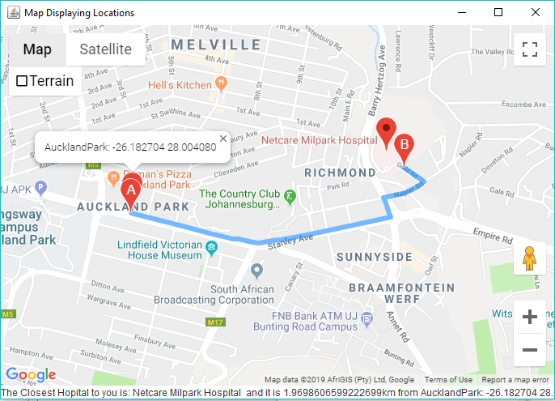
Showing directions on the google map using the shortest path

Slide 16
Value added and stuff learned
This solution helped a lot in terms of using graphs because it provides links like if hospital “a” is partner with hospital “b” and “b” with “c”, then c is a potential partner to a and help to hop and traverse every node
In addition, because I was using google maps, this solution helps adapt with real locations and it is more practical
I learnt that graph are best to represent set of linked nodes in a complex data structure

Slide 17
Conclusion
Summary of findings: How to use google map, exporting to .jar files, using libraries, research and programming skills
Potential Future Work: Build an application to restructure hospitals in a country that will help better health care.
“The sky is the limit”

