Slide 1
Online Marketing SmartAdsAgent Program
By Herve Ngomseu Fotsing - 217092052
Artificial Intelligence Project – Honours

Slide 2
Outline
Introduction of Agent
Component Diagram
Class Diagram
Agent Program Specifications

Slide 3

The agent program falls under learning agent.
The program simulates online marketing platform
Ability to track users’ preferences to have a better insights on various items to
Introduction of Agent

Slide 4
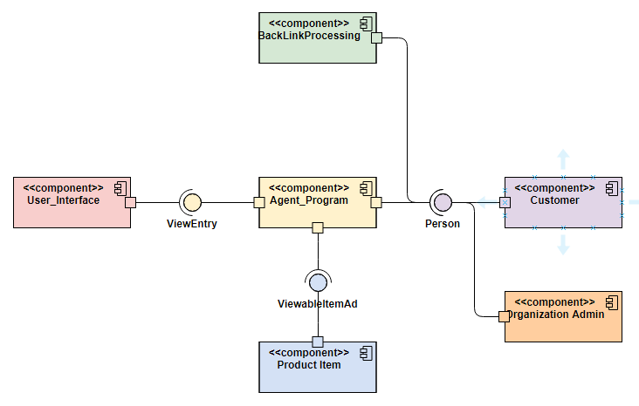
Component Diagram
Depicting System interactions

Slide 5
Class Diagram
Showing Modules and its relationships

Slide 6

Agent Program Specifications
The agent was implemented in Java programming language the eclipse workspace
Essential Data Structures like Graphs ADT-Search traversals , SinglyLinkedLists, ArrayLists were used in the methodology
The user interface is illustrated using the Java Swing JFrame Library, together with inputDialogues and JTextArea space to represent information.
The program makes effective use of object orientation, abstraction using generics.
The program all together constitutes 1442 lines of code.

Slide 7
Demo time
Thank you!!
“The sky is the limit”

