Slide 1
Fast updating feedback from piriform cortex to the olfactory bulb relays multimodal identity and reward contingency signals during rule-reversal
Hernandez et al. 2025
Nature Communications

Slide 2
Early Olfactory Circuit
Images from supplement here

Slide 3
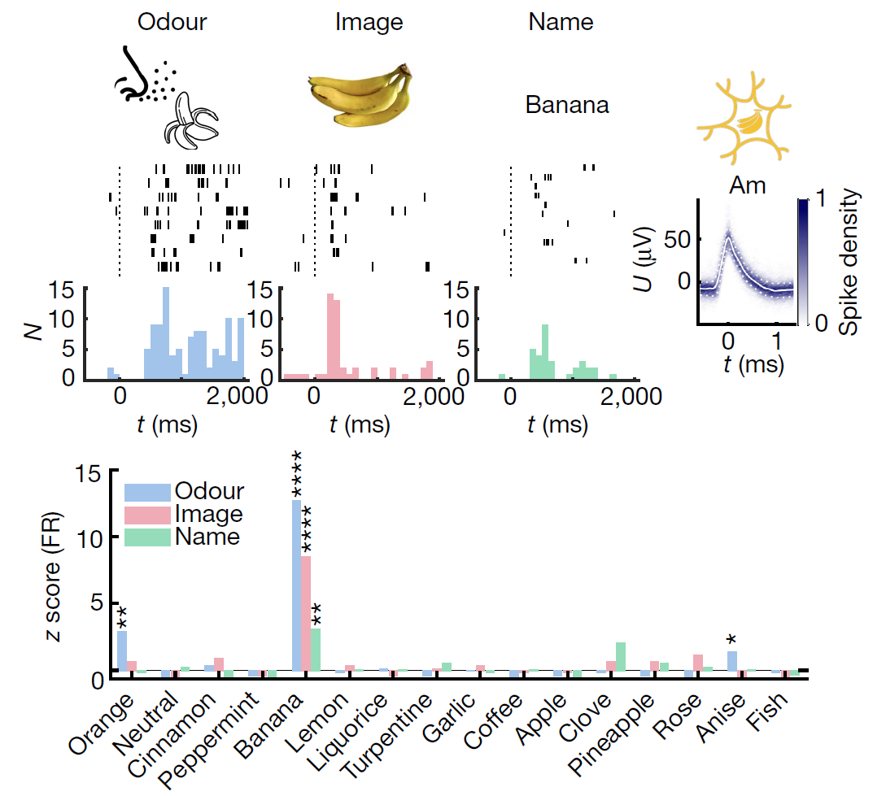
Piriform Is Association Cortex
“Olfactory cortex”
In humans, PCx represents multimodal odor information.
Kehl et al., 2024

Slide 4
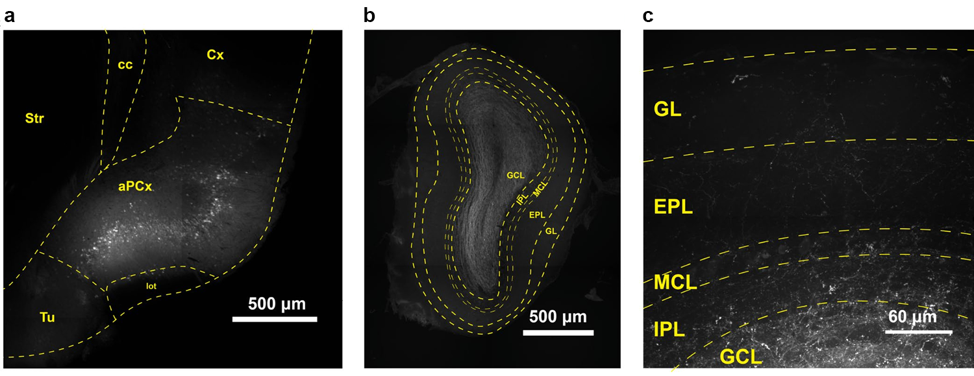
Cortico-Bulbar Feedback

Slide 5
Experiment 1
Go/no-go task
Odorant and audio stimuli
Rule-reversals in block design

Slide 6
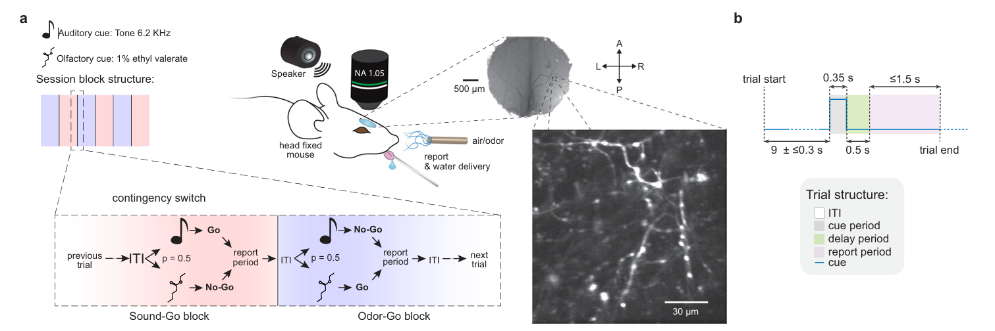
Task Design
Notes:
MicevirallyexpressingGCaMP5inthe anteriorpiriformcortex(aPCx)withachroniccranialwindowimplantedabovethe olfactorybulb
Piriform efferents labelled
Do axonal boutons in OB encode cue reversal?

Slide 7
Task Design
Notes:
MicevirallyexpressingGCaMP5inthe anteriorpiriformcortex(aPCx)withachroniccranialwindowimplantedabovethe olfactorybulb
Piriform efferents labelled
Do axonal boutons in OB encode cue reversal?

Slide 8
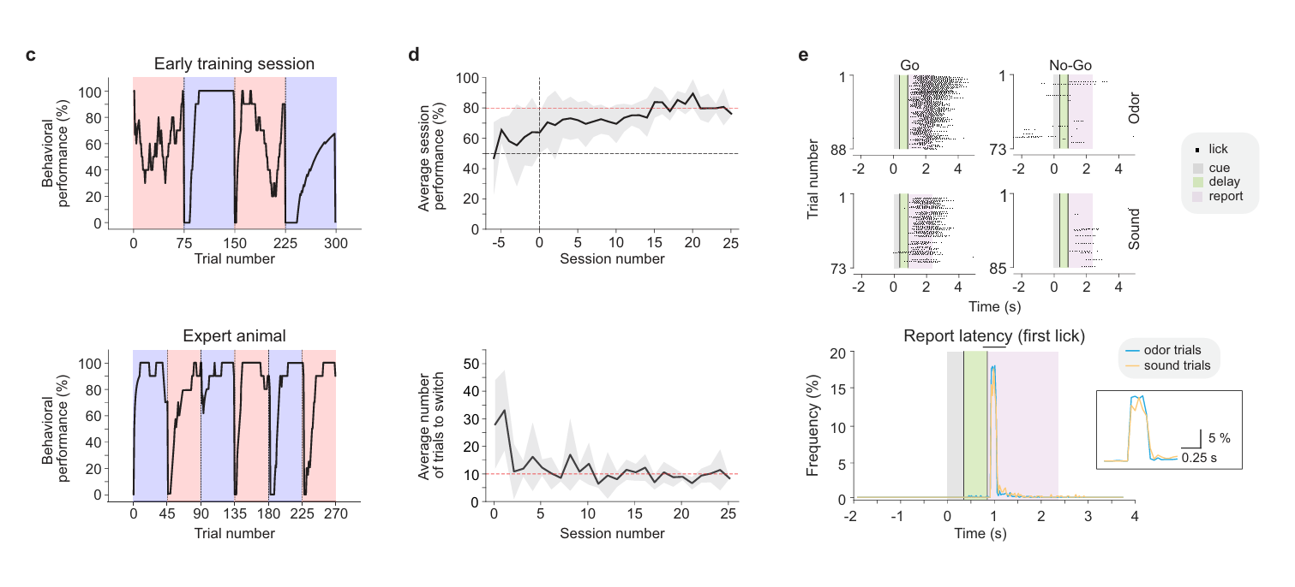
Behavior

Slide 9
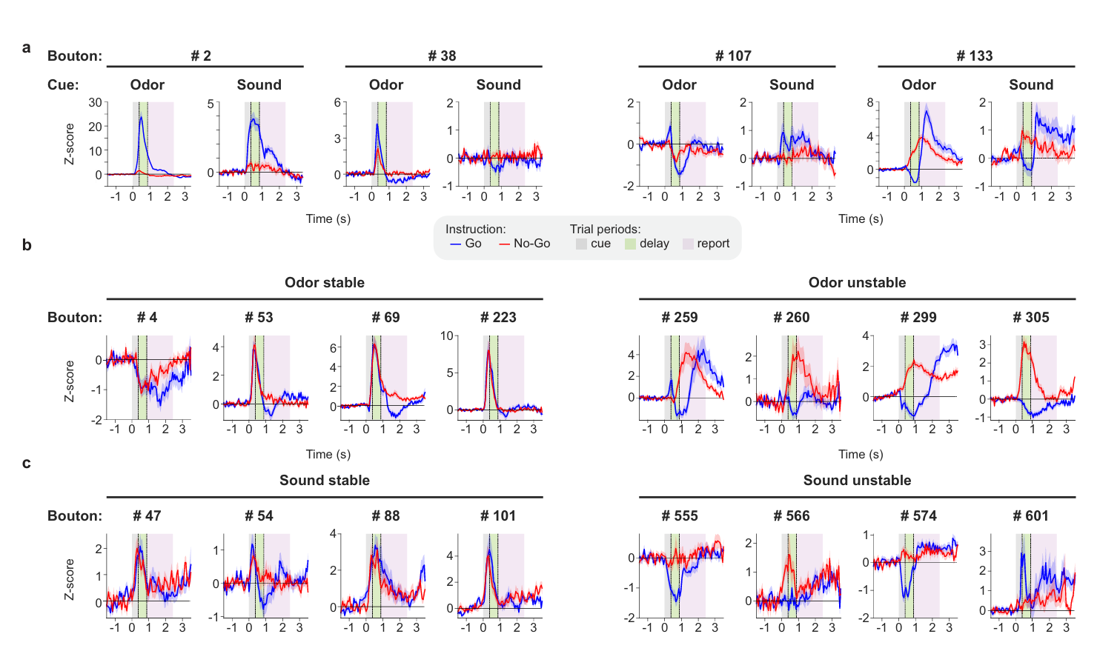
Fast Update of Cortico-Bulbar Feedback

Slide 10
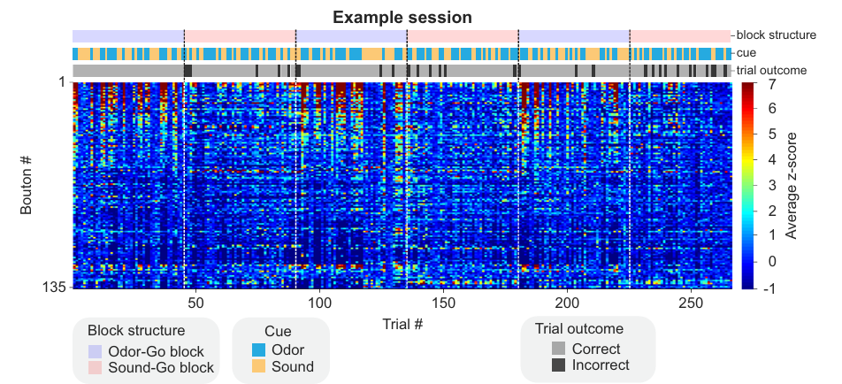
Fast Update of Cortical Bulbar Feedback

Slide 11
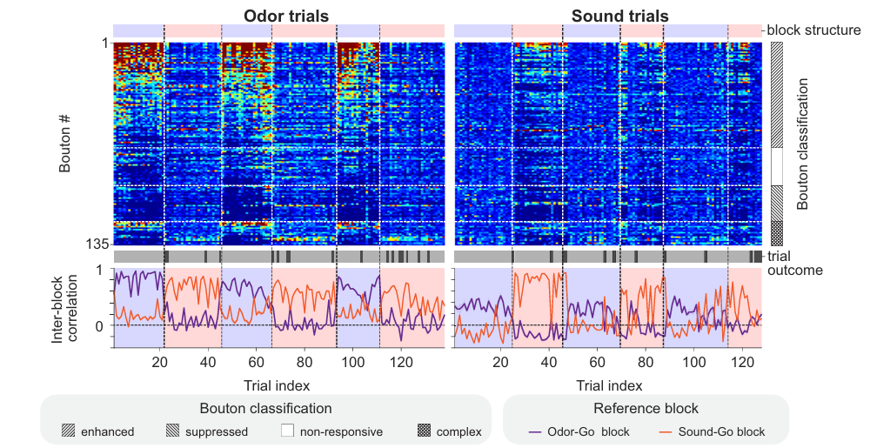
Fast Update of Cortical Bulbar Feedback

Slide 12
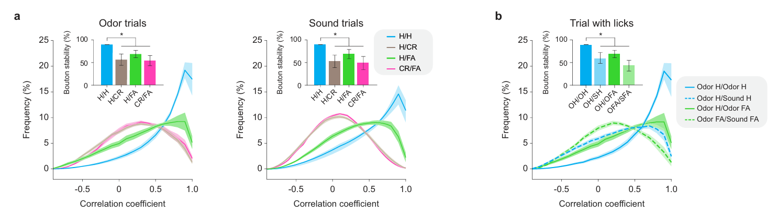
Individual Bouton Response Correlations

Slide 13
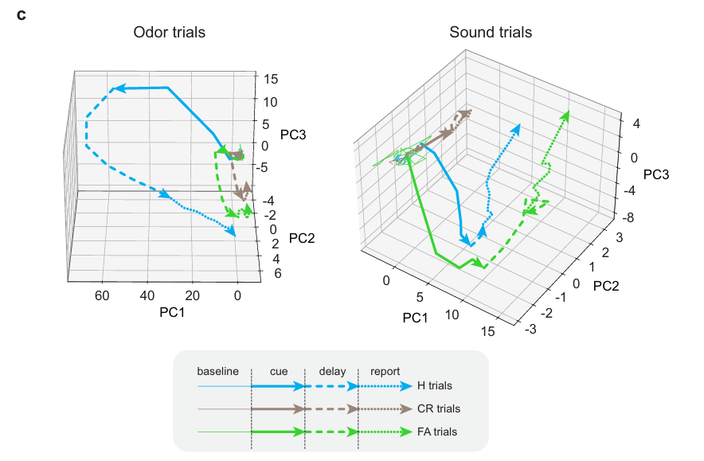
Population Response Trajectories

Slide 14
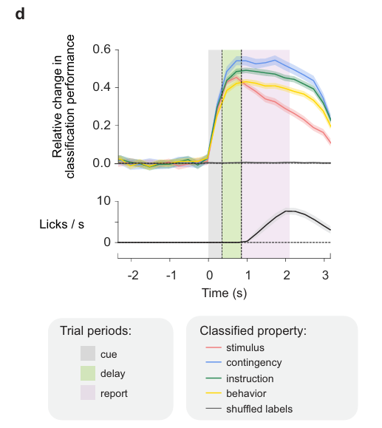
Population Response Trajectories

Slide 15
Brief Detour

Slide 16
Does Bulb Actually Care About Sound?
In the multimodal task, we might infer that sound is useful to bulb because it provides information about odor.
Would an auditory-only task elicit cortico-bulbar responses?

Slide 17
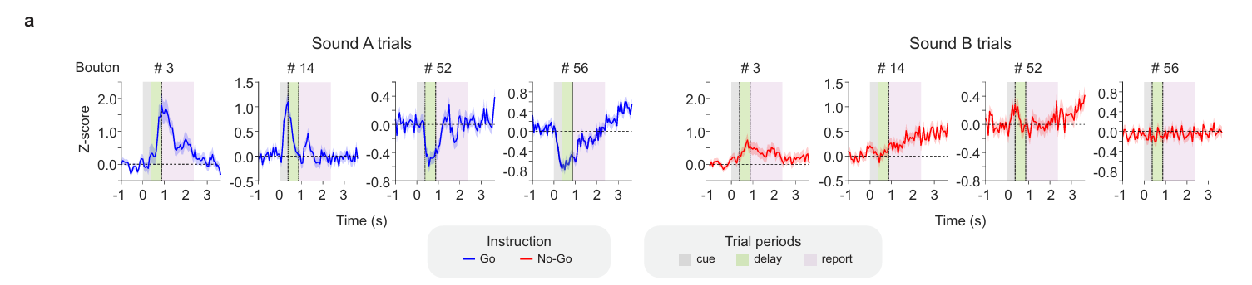
Auditory-Only Go/No-Go Task

Slide 18
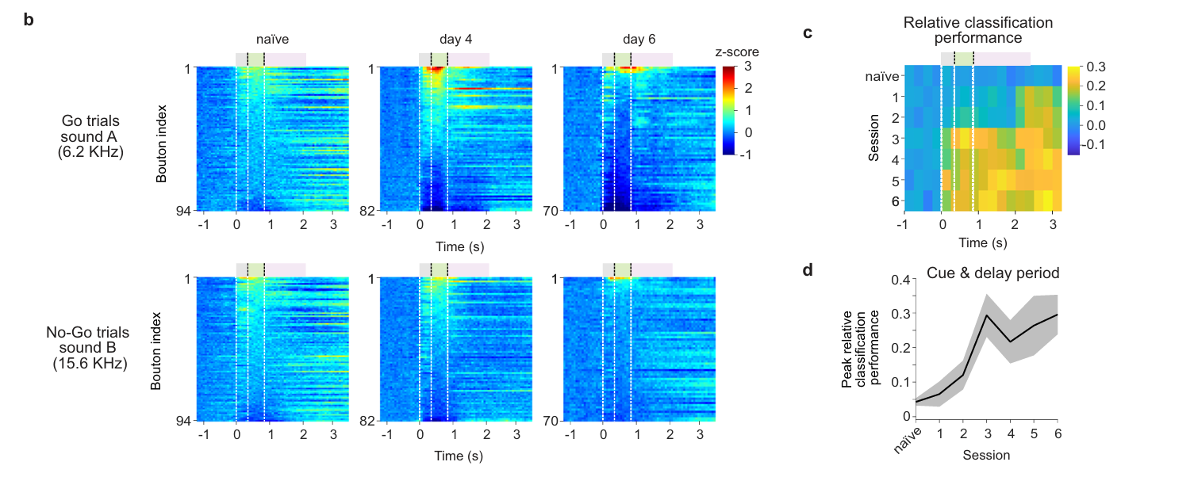
Auditory-Only Go/No-Go Task
Notes:
Which mice are these? Were they completely naïve or just naïve to this version of the task?

Slide 19
Back To Multimodal Task

Slide 20
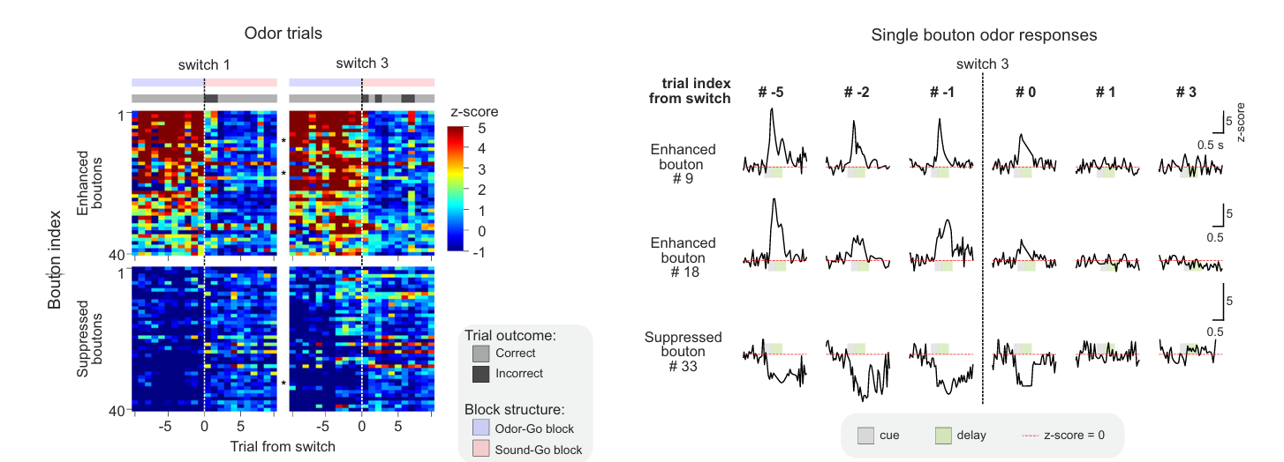
Fast Updating Feedback Activity
Notes:
a Example bouton responses during block transitions sampled throughout the ‘delay period’fromonefieldofviewinanexpertmouse.(Top)Odortrials.(Bottom) Soundtrials.Graybarsmarkthetrialoutcome(correct–lightgray;incorrect–dark gray).

Slide 21
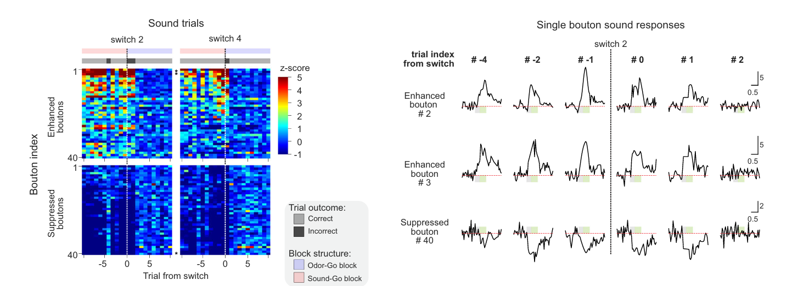
Fast Updating Feedback Activity
Notes:
a Example bouton responses during block transitions sampled throughout the ‘delay period’fromonefieldofviewinanexpertmouse.(Top)Odortrials.(Bottom) Soundtrials.Graybarsmarkthetrialoutcome(correct–lightgray;incorrect–dark gray).

