Slide 1
Experimental validation of the free-energy principle with in vitro neural networks
Isomura, Kotani, Jimbo & Friston
Nature Communications 2023

Slide 2
Free Energy Principle
Karl Friston
Statistical parametric maps in functional imaging: a general linear approach (1994)
Dynamic Causal Modeling (2003)
The free-energy principle: a unified brain theory? (2010)
Notes:
Neuroimaging pioneer. Psychiatrist neuroscientist physicist. 347k citations

Slide 3
Free Energy Principle
Karl Friston
Statistical parametric maps in functional imaging: a general linear approach (1994)
Dynamic Causal Modeling (2003)
The free-energy principle: a unified brain theory? (2010)
Notes:
Neuroimaging pioneer. Psychiatrist neuroscientist physicist. 347k citations

Slide 4
Free Energy Principle
“Surprise” = Free Energy
“Belief” = Free energy minimization
Isomura (2023) asserts that belief is encoded in synaptic strength
Attempts empirical validation of the FEP.

Slide 5
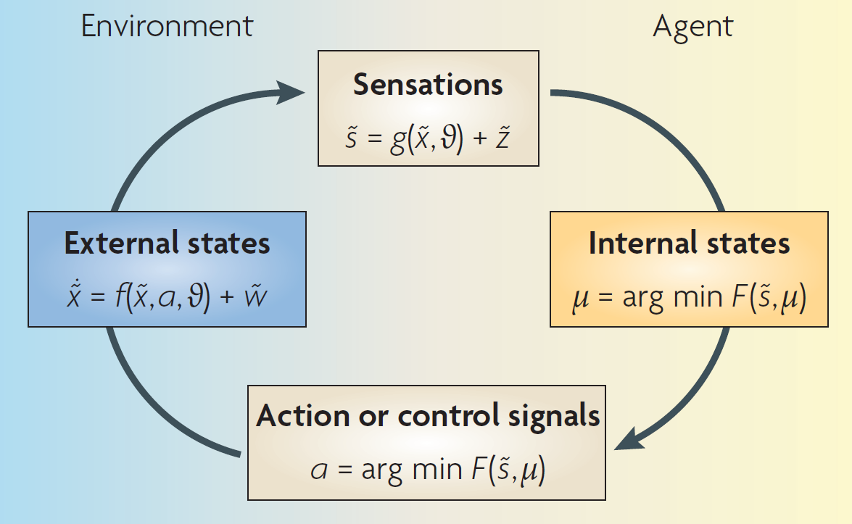
Free Energy Principle
Friston (2010)

Slide 6
Gradient descent on free energy
Friston (2010)
Notes:
The figure details a neuronal architecture that optimizes the conditional expectations of
causes in hierarchical models of sensory input. It shows the putative cells of origin of forward
driving connections that convey prediction error (grey arrows) from a lower area (for
example, the lateral geniculate nucleus) to a higher area (for example, V1), and nonlinear
backward connections (black arrows) that construct predictions41. These predictions try to
explain away prediction error in lower levels.

Slide 7
FEP: a unified brain theory? (2010)
Recognition is a probabilistic representation of what caused a particular sensation.
Predictions about the environment can be encoded as neuronal activity & connection strengths

Slide 8
FEP: a unified brain theory? (2010)
Free energy principle fits with:
Bayesian brain
Predictive coding

Slide 9
Isomura et al. (2023)
Attempts to validate the FEP in vitro
Cultured “neuronal network”
Partially Observable Markov Decision Process (POMDP)

Slide 10
Isomura et al. (2023)
Attempts to validate the FEP in vitro
Cultured “neuronal network”
Will it act like a variational Bayes model?

Slide 11
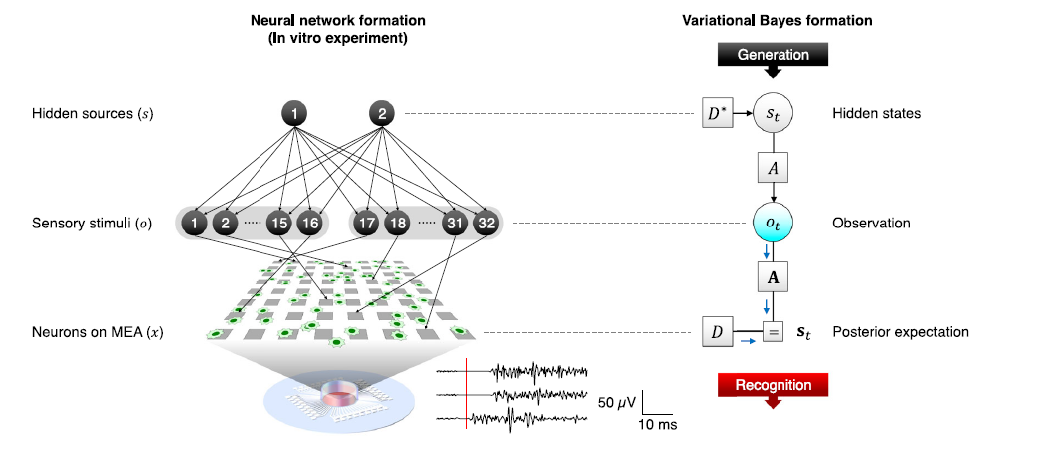

Slide 12
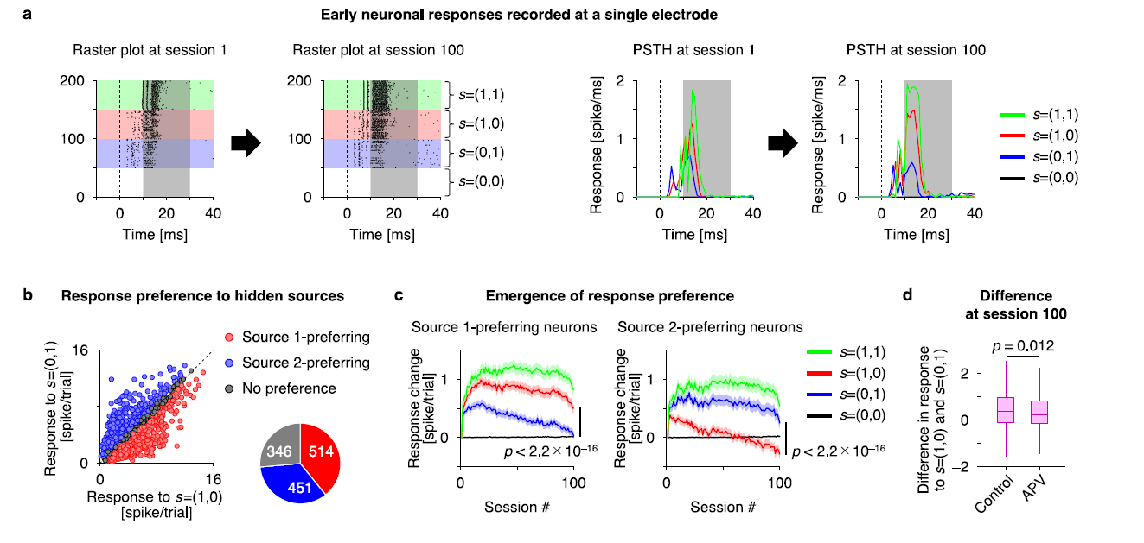

Slide 13
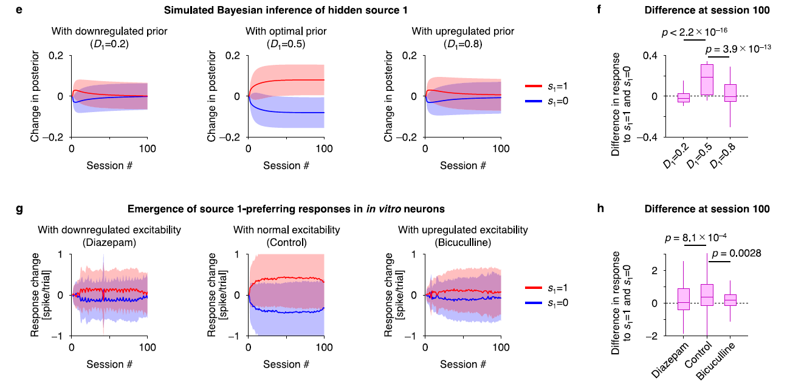

Slide 14
Reverse Engineering Approach

Slide 15
Variational Bayes

Slide 16
POMDP Generative Model

Slide 17
Discuss
What is the value in a grand unified theory of the brain?
For neuroscience?
For psychology?
FEP counterexamples?

Slide 18
Discuss
FEP counterexamples?

Slide 19
Discuss
What are the upper bounds on what a brain predicts?
Are they limited by perception?
Compute?
Action?

