Slide 2
Friston

Slide 3
Free Energy Principle
“Surprise” = Entropy
“Belief” = Free energy minimization
Isomura (2023) asserts that belief is encoded in synaptic strength

Slide 4
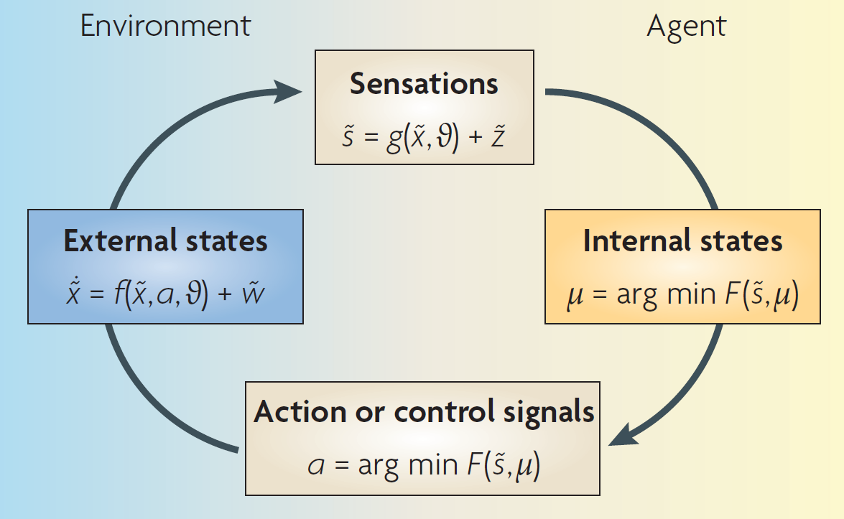
Free Energy Principle

Slide 5
The free-energy principle: a unified brain theory
Friston (2010)
Recognition density is a probabilistic representation of what caused a particular sensation.
Could be encoded as neuronal activity & connection strengths

Slide 6
Reverse Engineering Approach

Slide 7
Variational Bayes

Slide 8
POMDP Generative Model

