Slide 1
Psilocybin desynchronizes the human brain
Siegel et al. 2024
Nature
Notes:
Paper seeks to identify neural correlates of psilocybin-induced mystical experience

Slide 2
Highlights
Dense longitudinal sampling of functional connectivity.
Task demands modulate psilocybin efficacy.
Persistent DMN-Hippocampal FC reduction.
Notes:
After a decade of hype, psychedelic research has moved toward deeper study of neural mechanisms of the psychedelic experience and its potential benefits

Slide 3
Experiment
7 participants
At least one prior psilocybin experience.
No psilocybin in the 6 months prior to scanning.
~18 scans each
Notes:
After a decade of hype, psychedelic research has moved toward deeper study of neural mechanisms of the psychedelic experience and its potential benefits

Slide 4
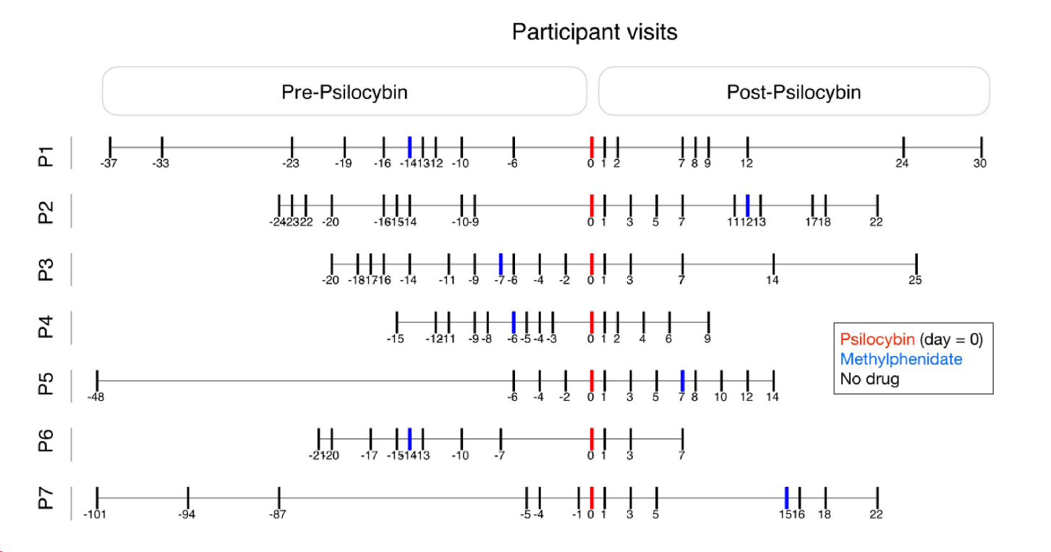
Experiment
Notes:
Are these days or weeks?

Slide 5
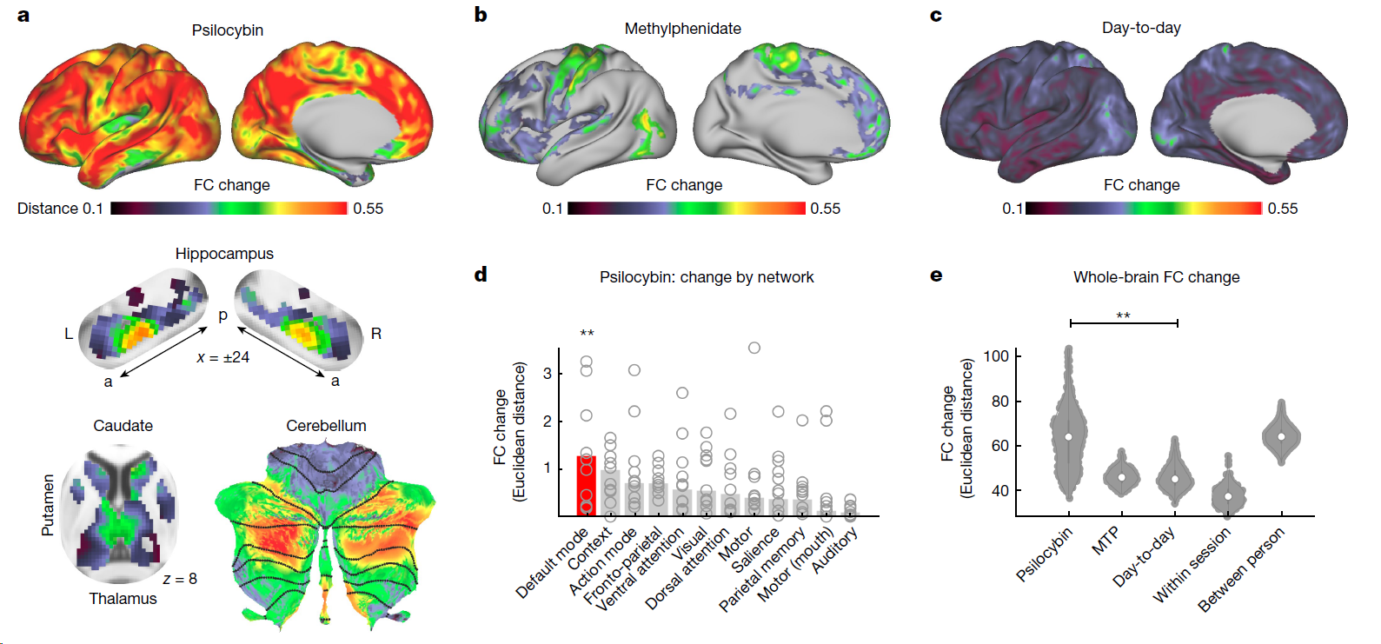
Fig. 1 - Acute psilocybin effects on functional brain organization.
Notes:
After a decade of hype, psychedelic research has moved toward deeper study of neural mechanisms of the psychedelic experience and its potential benefits

Slide 6
FC change predicts mystical experience
Participants completed the MEQ30 after each drug session.
FC Change predicted MEQ30 score.
Notes:
This was a suprathreshold auditory–visual matching task in which
participants were presented with a naturalistic visual image (duration
500 ms) and coincident spoken English phrase, and were asked to
respond with a button press to indicate whether the image and phrase
were ‘congruent’ (for example, an image of a beach and the spoken
word ‘beach’) or ‘incongruent’.
Task fMRI scans used the same sequence used
in resting fMRI, included 48 trials (24 congruent, 24 incongruent) and
lasted a total of 410 s.

Slide 7
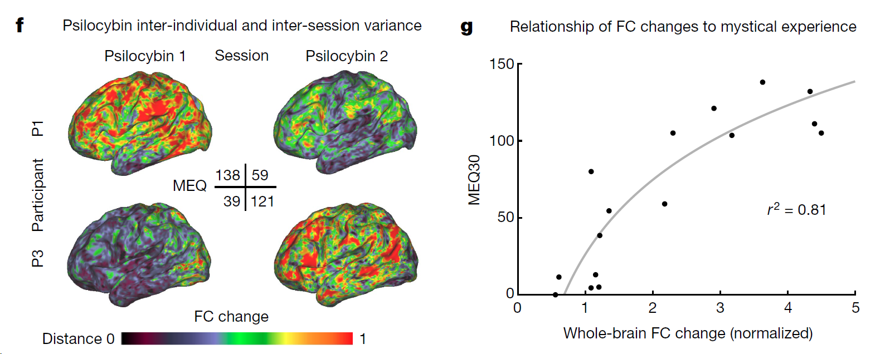
Fig. 1 continued – FC change predicts mystical experience
Notes:
After a decade of hype, psychedelic research has moved toward deeper study of neural mechanisms of the psychedelic experience and its potential benefits

Slide 8
Task-state modulated FC effects
When given an audio-visual matching task, participants showed closer-to-baseline FC.
Task took about 7 minutes.
Notes:
This was a suprathreshold auditory–visual matching task in which
participants were presented with a naturalistic visual image (duration
500 ms) and coincident spoken English phrase, and were asked to
respond with a button press to indicate whether the image and phrase
were ‘congruent’ (for example, an image of a beach and the spoken
word ‘beach’) or ‘incongruent’.
Task fMRI scans used the same sequence used
in resting fMRI, included 48 trials (24 congruent, 24 incongruent) and
lasted a total of 410 s.

Slide 9
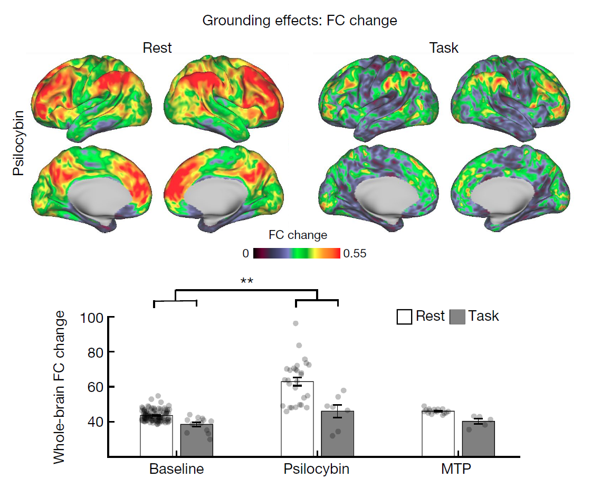
Notes:
This was a suprathreshold auditory–visual matching task in which
participants were presented with a naturalistic visual image (duration
500 ms) and coincident spoken English phrase, and were asked to
respond with a button press to indicate whether the image and phrase
were ‘congruent’ (for example, an image of a beach and the spoken
word ‘beach’) or ‘incongruent’.
Task fMRI scans used the same sequence used
in resting fMRI, included 48 trials (24 congruent, 24 incongruent) and
lasted a total of 410 s.

Slide 10
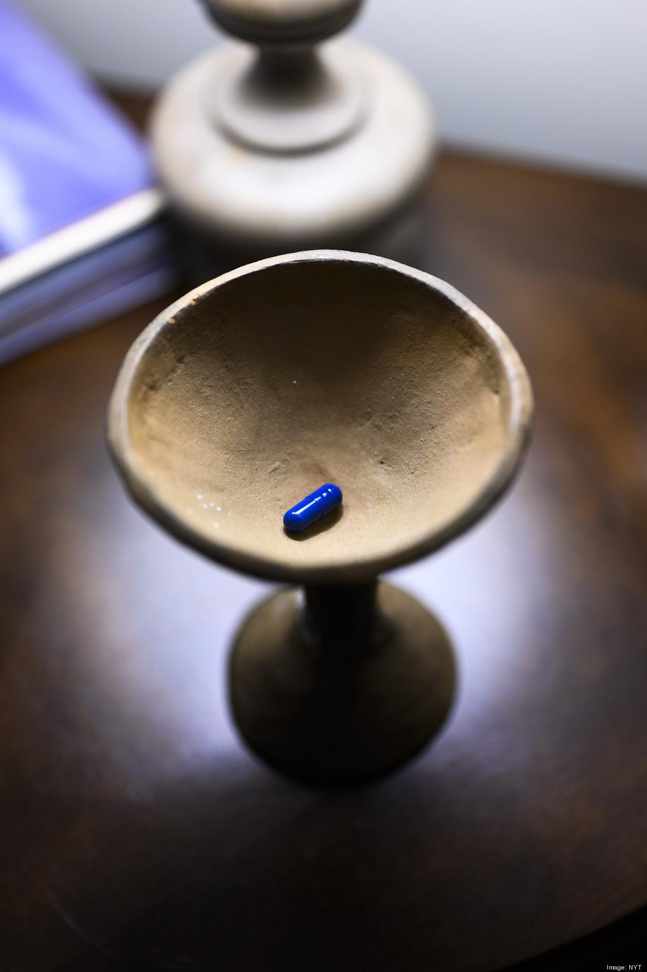
Set and Setting
Roland Griffiths’s therapeutic research has been criticized for its less-than-scientific approach.
Mystical experience correlates with decreased FC.
Notes:
https://www.nytimes.com/2024/03/21/health/psychedelics-roland-griffiths-johns-hopkins.html

Slide 11
Set and Setting
Might the content of an experience modulate the persistent physiological effects of psilocybin?

Slide 12
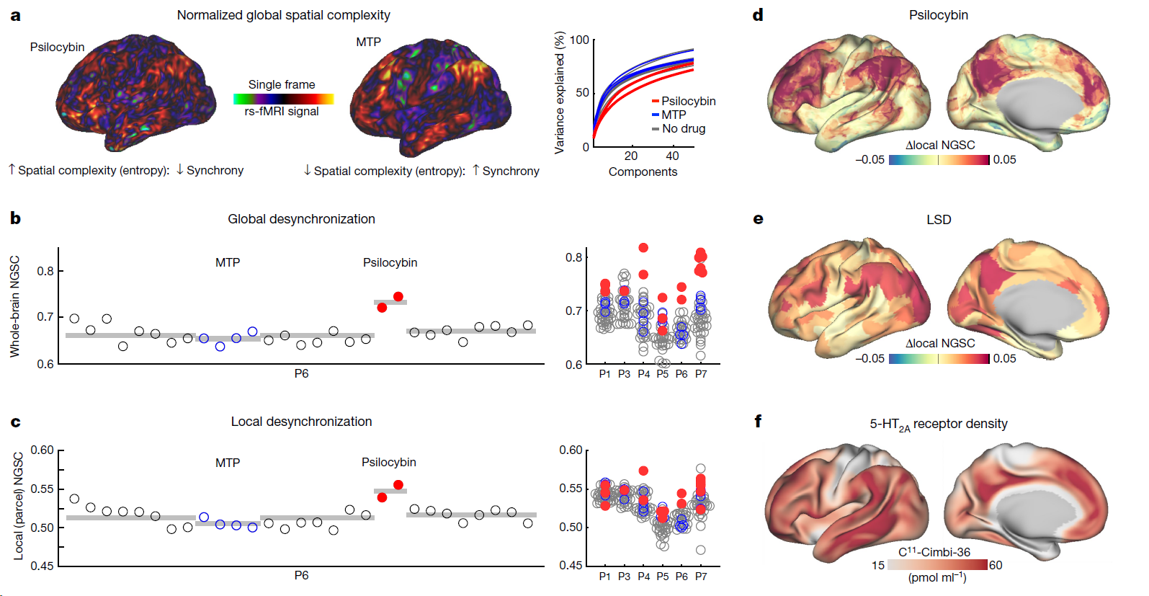
Fig. 2 - Data-driven clustering of brain network variability.
Notes:
After a decade of hype, psychedelic research has moved toward deeper study of neural mechanisms of the psychedelic experience and its potential benefits

