Slide 1
Psilocybin desynchronizes the human brain
Siegel et al.
Nature, August 2024
Notes:
Paper seeks to identify neural correlates of psilocybin-induced mystical experience

Slide 2
Highlights
Dense longitudinal sampling of functional connectivity.
Task demands modulate FC during psilocybin exposure.
Persistent DMN-Hippocampal FC reduction.
Notes:
After a decade of hype, psychedelic research has moved toward deeper study of neural mechanisms of the psychedelic experience and its potential benefits

Slide 3
Experiment
7 participants
At least one prior psilocybin experience.
No psilocybin in the 6 months prior to scanning.
~18 scans each
Notes:
After a decade of hype, psychedelic research has moved toward deeper study of neural mechanisms of the psychedelic experience and its potential benefits

Slide 4
Experiment
>= 10 baseline scans
Single 25mg psilocybin scan
Single 40mg methylphenidate (MTP) scan
Additional psilocybin scan 6-12 months later
Notes:
40mg Ritalin is dose-matched to 25mg psilocybin for arousal effects.

Slide 5
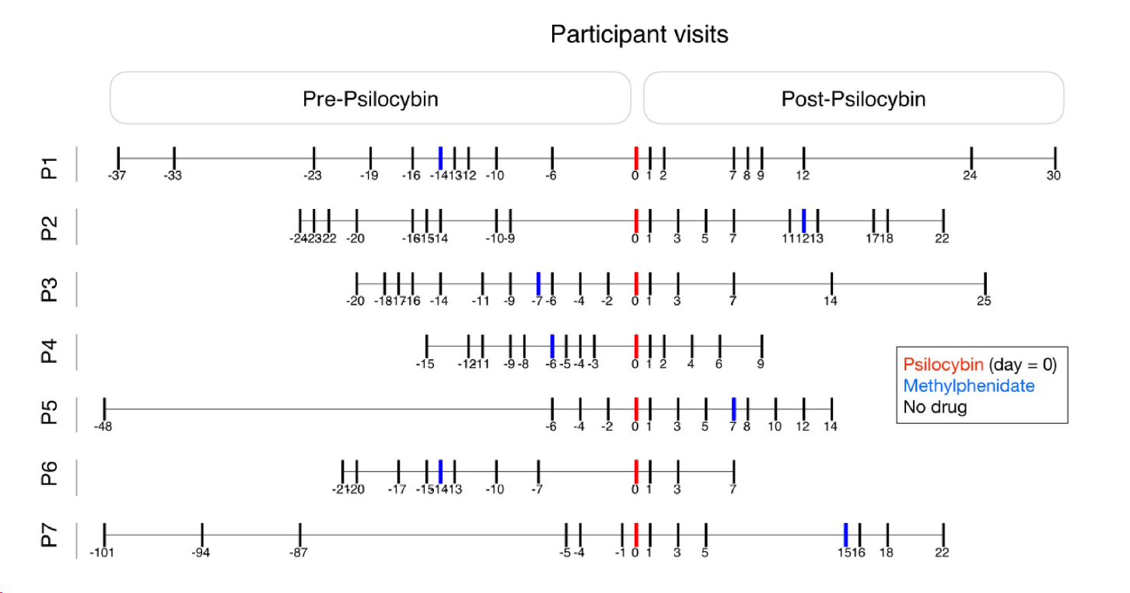
Experiment
Notes:
Are these days or weeks?

Slide 6
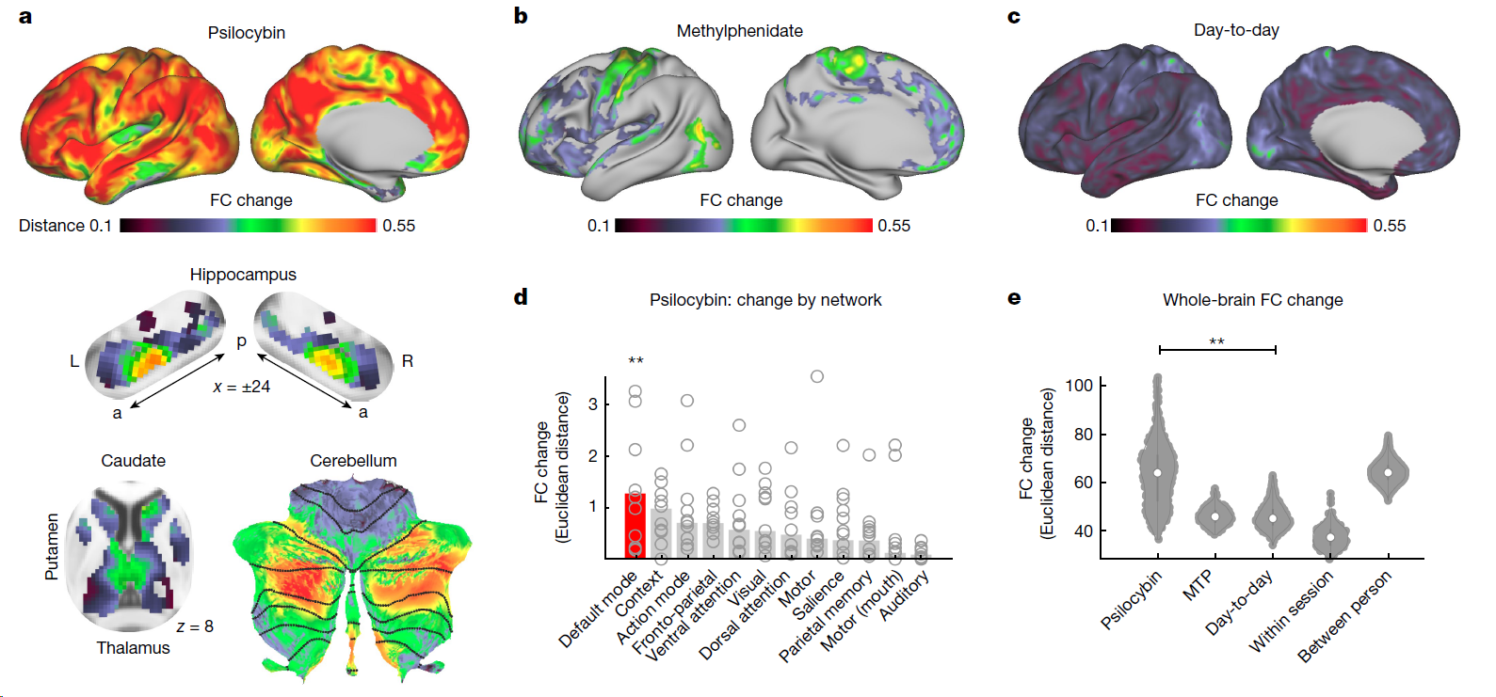
Fig. 1 - Acute psilocybin effects on functional brain organization.
Notes:
To put the effects of psilocybin into perspective, it helps to consider that the mean
changes in brain organization caused by the drug were as large as the
differences in brain organization between different people

Slide 7
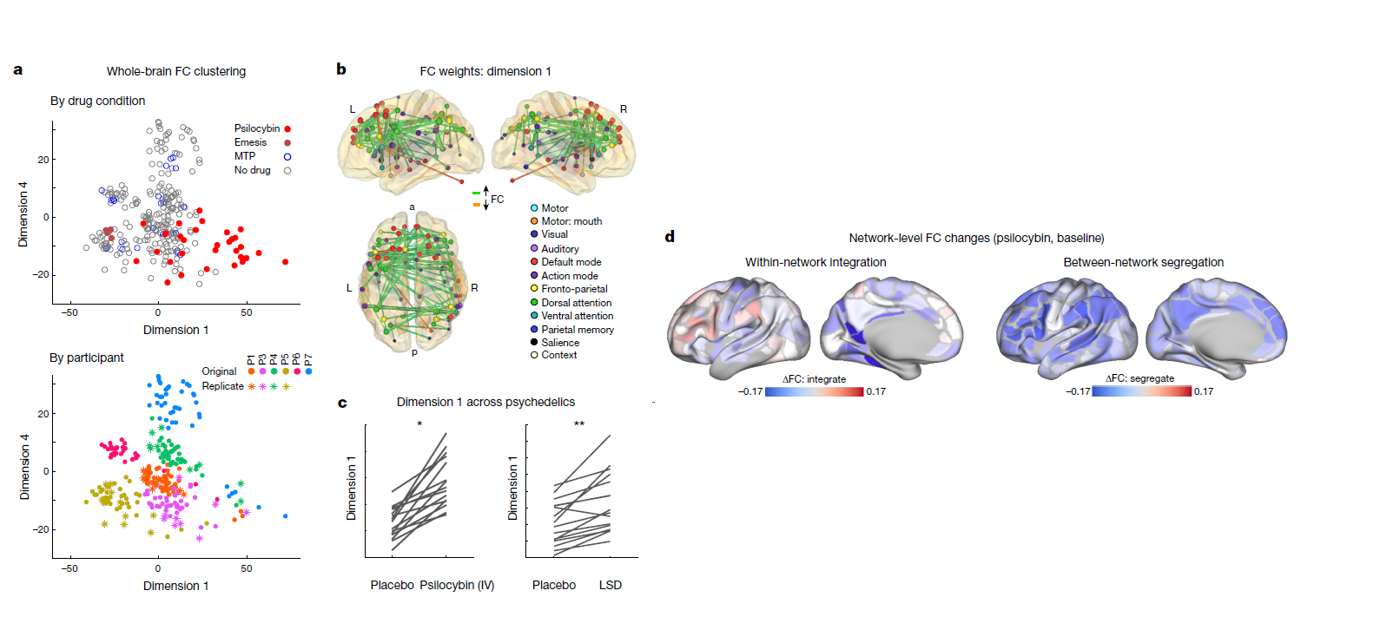
Fig. 2 – Data-driven clustering of brain network variability
Notes:
After a decade of hype, psychedelic research has moved toward deeper study of neural mechanisms of the psychedelic experience and its potential benefits

Slide 8
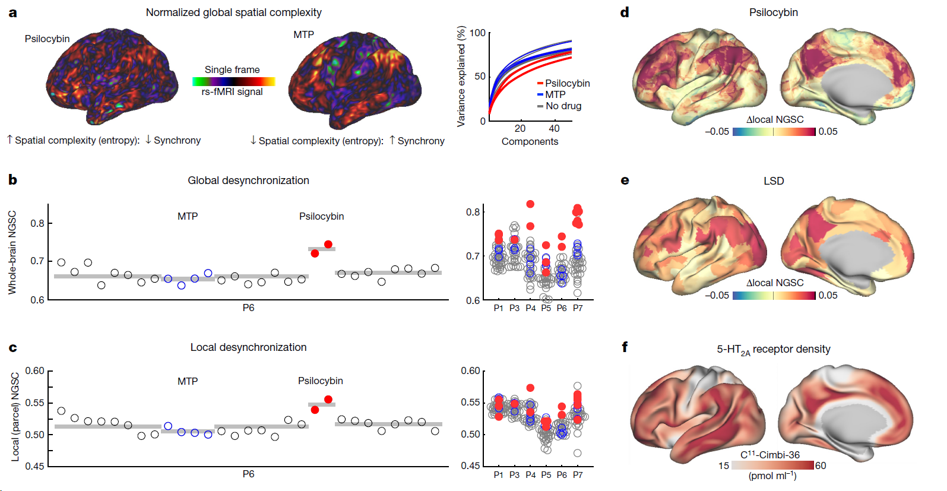
Fig. 2 - Spatial desynchronization of cortical activity during psilocybin.
Notes:
NGSC is derived from the the number of spatial principal components needed to explain the underlying structure. The plot to the right in fig 2a shows that under psilocybin, more principal components are needed to explain variance.
The authors take NGSC to represent desynchronization
Multi-unit recording studies suggest that agonism of 5-HT2A receptors
by psychedelics desynchronizes populations of neurons that typically co-activate
Psilocybinand-lsd-associated increases in entropy were largest in association cortex and reflected the density of serotonin 2a receptors

Slide 9
FC change predicts mystical experience
Participants completed the MEQ30 after each drug session.
MEQ measures four dimensions:
Mystical
Positive mood
Transcendence of time & space
Ineffability
FC Change predicted MEQ30 score.
Notes:
Transcendance correlated most closely with FC changes (I also think it’s the lowest common denominator and lowest threshold effect)

Slide 10
MEQ30 – Rated on a 5 pt. Likert Scale
Freedom from the limitations of your personal self and feeling a unity or bond with what was felt to be greater than your personal self.
Experience of pure being and pure awareness (beyond the world of sense impressions).
Experience of oneness in relation to an “inner world” within.
Experience of the fusion of your personal self into a larger whole.
Experience of unity with ultimate reality.
Feeling that you experienced eternity or infinity.
Experience of oneness or unity with objects and/or persons perceived in your surroundings.
Experience of the insight that “all is One.”
Awareness of the life or living presence in all things.
Gain of insightful knowledge experienced at an intuitive level.
Certainty of encounter with ultimate reality (in the sense of being able to “know” and “see” what is really real at some point during your experience.
You are convinced now, as you look back on your experience, that in it you encountered ultimate reality.
Sense of being at a spiritual height.
Sense of reverence.
Feeling that you experienced something profoundly sacred and holy.
Notes:
This was a suprathreshold auditory–visual matching task in which
participants were presented with a naturalistic visual image (duration
500 ms) and coincident spoken English phrase, and were asked to
respond with a button press to indicate whether the image and phrase
were ‘congruent’ (for example, an image of a beach and the spoken
word ‘beach’) or ‘incongruent’.
Task fMRI scans used the same sequence used
in resting fMRI, included 48 trials (24 congruent, 24 incongruent) and
lasted a total of 410 s.

Slide 11
MEQ30 – Rated on a 5 pt. Likert Scale
Experience of amazement.
Feelings of tenderness and gentleness.
Feelings of peace and tranquility.
Experience of ecstasy.
Sense of awe or awesomeness.
Feelings of joy.
Loss of your usual sense of time.
Loss of your usual sense of space.
Loss of usual awareness of where you were.
Sense of being “outside of” time, beyond past and future.
Being in a realm with no space boundaries.
Experience of timelessness.
Sense that the experience cannot be described adequately in words.
Feeling that you could not do justice to your experience by describing it in words.
Feeling that it would be difficult to communicate your own experience to others who have not had similar experiences.
Notes:
Question 30 is silly. This is the nature of experience.
If there was a common lexicon, many things could be effable
Ecstatic experiences are impossible to capture in words, but they can be outlined to a degree that someone who has had similar experience can then reference their own experience more fully.

Slide 12
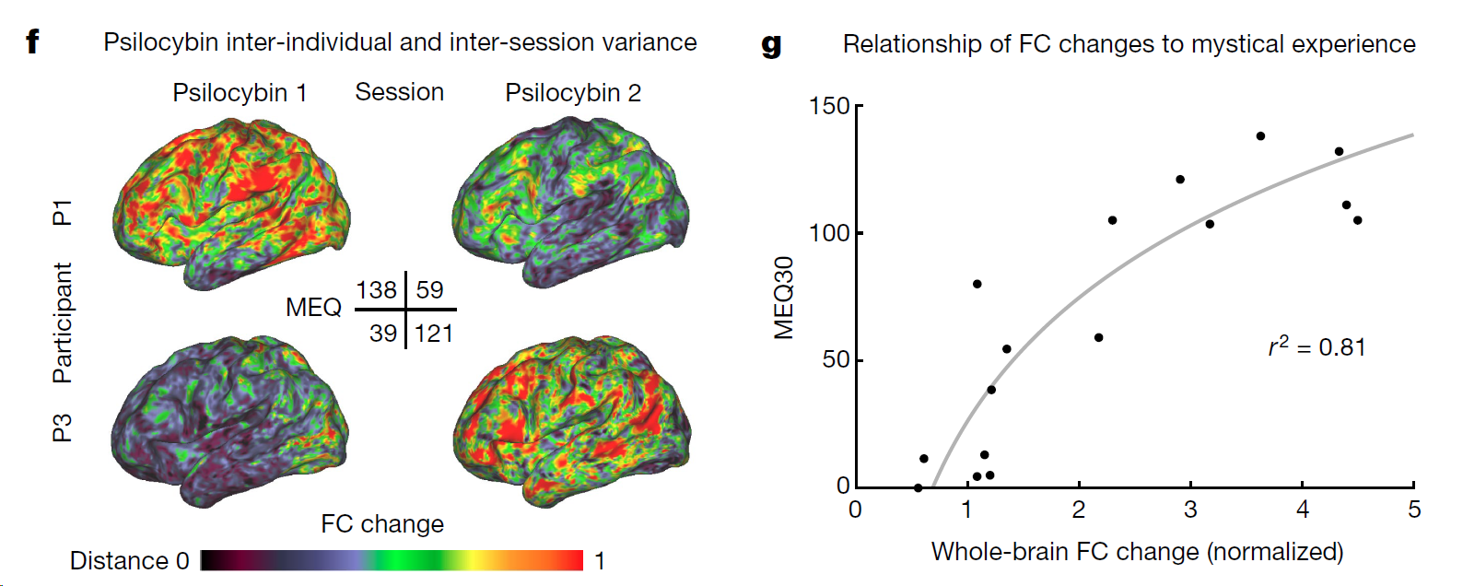
Fig. 1 continued – FC change predicts mystical experience
Notes:
of the four MEQ30 dimensions (mystical, positive mood, transcendence of time
and space, and ineffability), the one most strongly correlating with
brain change was transcendence (for example, ‘loss of your usual sense
of time or space’, r2 = 0.86, Supplementary Fig. 5), however, all dimensions
were highly correlated (r > 0.8). Repeated

Slide 13
Task-state modulated FC effects
When given an audio-visual matching task, participants showed closer-to-baseline FC.
Task took about 7 minutes.
Notes:
This was a suprathreshold auditory–visual matching task in which
participants were presented with a naturalistic visual image (duration
500 ms) and coincident spoken English phrase, and were asked to
respond with a button press to indicate whether the image and phrase
were ‘congruent’ (for example, an image of a beach and the spoken
word ‘beach’) or ‘incongruent’.
Task fMRI scans used the same sequence used
in resting fMRI, included 48 trials (24 congruent, 24 incongruent) and
lasted a total of 410 s.

Slide 14
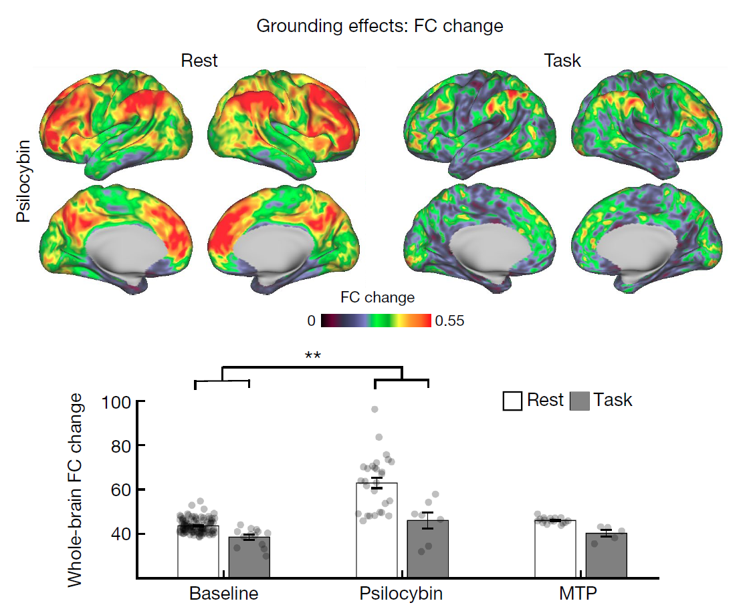
Fig. 4a
Notes:
The higher score on dimension 1 associated with psilocybin, corresponded to reduced segregation between the DMN and
other networks that are typically anticorrelated with it.

Slide 15
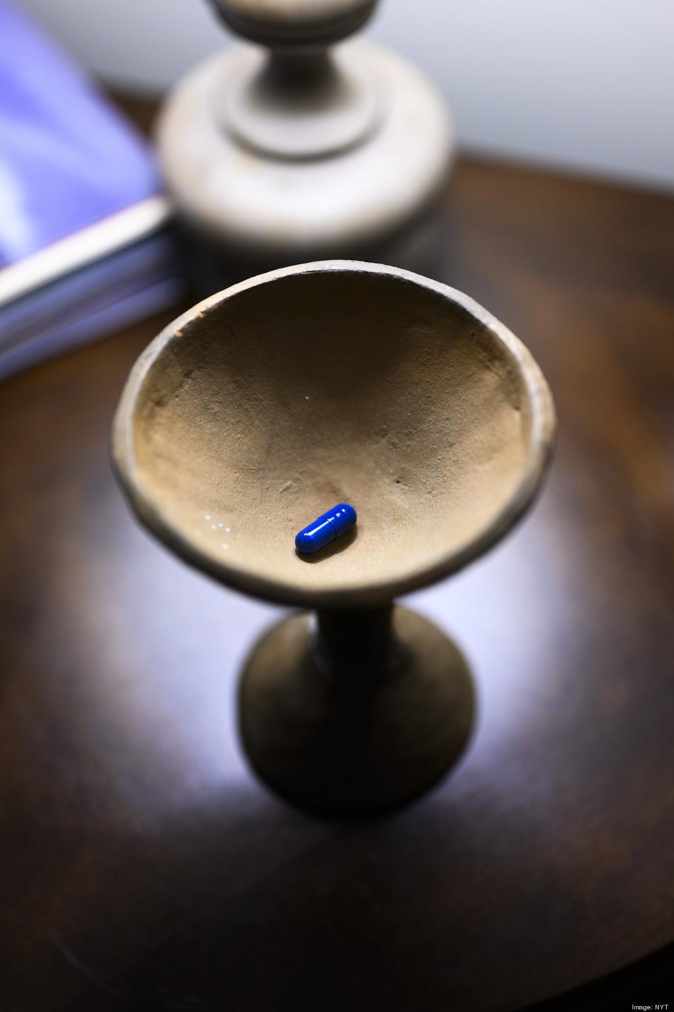
Set and Setting
Roland Griffiths’s psilocybin therapy research has been criticized for its less-than-clinical approach.
Griffiths nodded toward folk-traditions of psychedelic therapy, embracing the “task” of mystic experience.
Notes:
https://www.nytimes.com/2024/03/21/health/psychedelics-roland-griffiths-johns-hopkins.html

Slide 16
Set and Setting
MEQ sample question:
Rate your sense of having “profound humility before the majesty of what was felt to be sacred or holy.”
Notes:
https://www.nytimes.com/2024/03/21/health/psychedelics-roland-griffiths-johns-hopkins.html

Slide 17
Set and Setting
Might the content of an experience modulate the persistent physiological effects of psilocybin?
Does within-experience FC correlate to persistent effects?

Slide 18
Persistent decrease in hippocampal FC
After 3 weeks, whole-brain FC change scores were near baseline.
However, persistent FC change was observed in hippocampus.
Notes:
The authors cite a paper on MS patients who have increased depressive symptoms correlated with increased FC between hippocampus and DMN

Slide 19
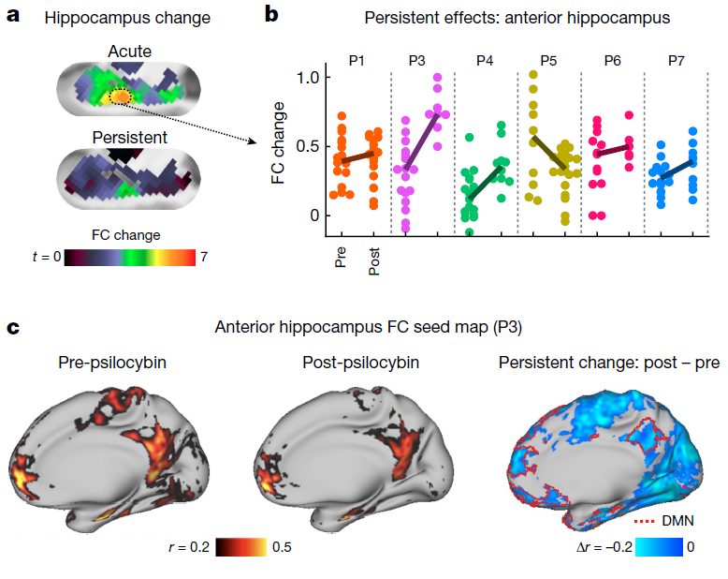
Fig. 5a-c
Notes:
The higher score on dimension 1 associated with psilocybin, corresponded to reduced segregation between the DMN and
other networks that are typically anticorrelated with it.

Slide 20
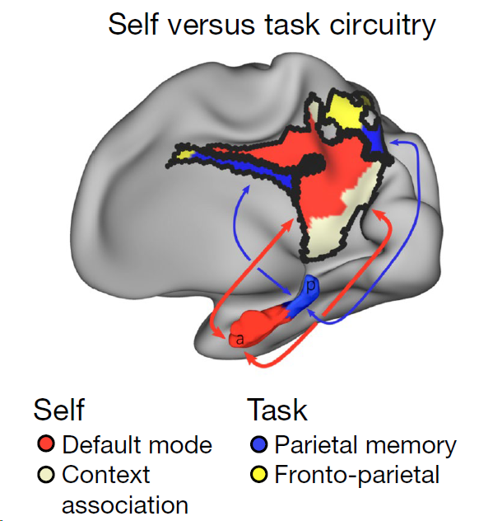
Fig. 5e - Schematic of hippocampal-cortical circuits
Notes:
The higher score on dimension 1 associated with psilocybin, corresponded to reduced segregation between the DMN and
other networks that are typically anticorrelated with it.

Slide 21
Summary
Dense sampling allowed for analysis of individual-specific brain changes.
Effects of arousal-matched dose of psilocybin on FC were more than 3x greater than MTP.
Mean changes in FC were as large as those between different people.
Persistent (at 3 weeks but not 6 months) changes in hippocampal FC.
Notes:
This was a suprathreshold auditory–visual matching task in which
participants were presented with a naturalistic visual image (duration
500 ms) and coincident spoken English phrase, and were asked to
respond with a button press to indicate whether the image and phrase
were ‘congruent’ (for example, an image of a beach and the spoken
word ‘beach’) or ‘incongruent’.
Task fMRI scans used the same sequence used
in resting fMRI, included 48 trials (24 congruent, 24 incongruent) and
lasted a total of 410 s.

Slide 22
Questions?
Where does fMRI-based psychedelic research go from here?
Should neuroscientific inquiry be prioritized over therapeutic inquiry?
Notes:
This was a suprathreshold auditory–visual matching task in which
participants were presented with a naturalistic visual image (duration
500 ms) and coincident spoken English phrase, and were asked to
respond with a button press to indicate whether the image and phrase
were ‘congruent’ (for example, an image of a beach and the spoken
word ‘beach’) or ‘incongruent’.
Task fMRI scans used the same sequence used
in resting fMRI, included 48 trials (24 congruent, 24 incongruent) and
lasted a total of 410 s.

Slide 23
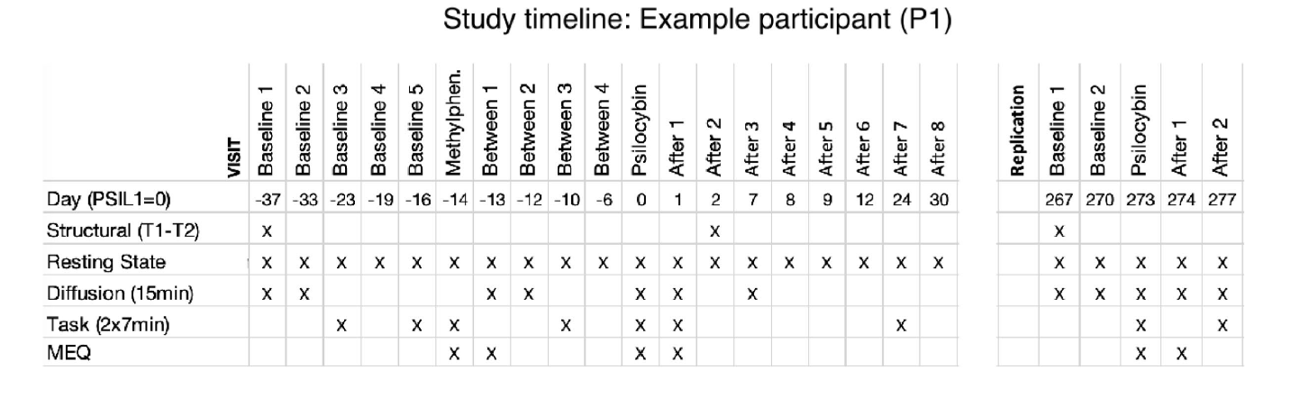
Extended Fig. 1d
Notes:
Are these days or weeks?

Slide 24
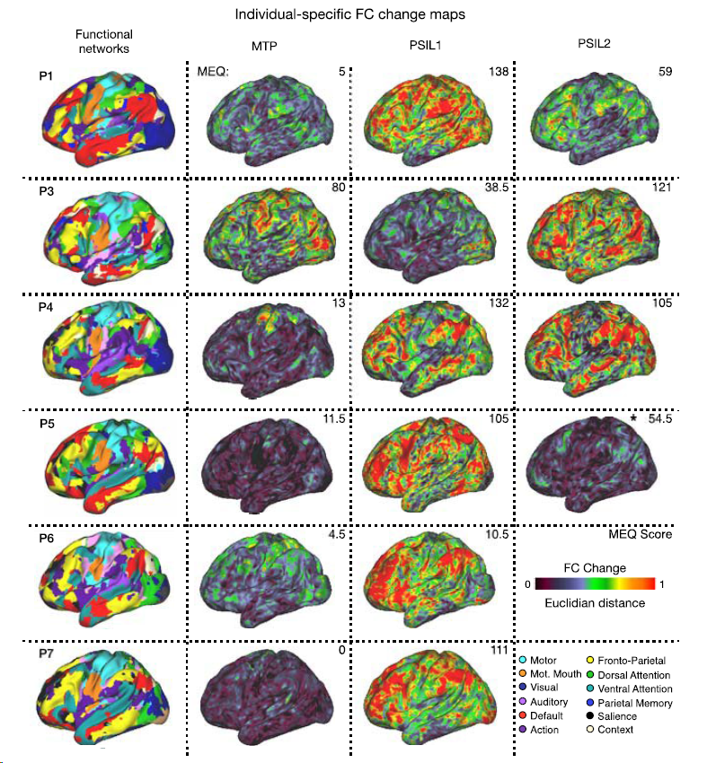
Extended Fig. 4a
Notes:
Are these days or weeks?

