Slide 1
CSHL Neural Data Science 2023 Project 1

Slide 2
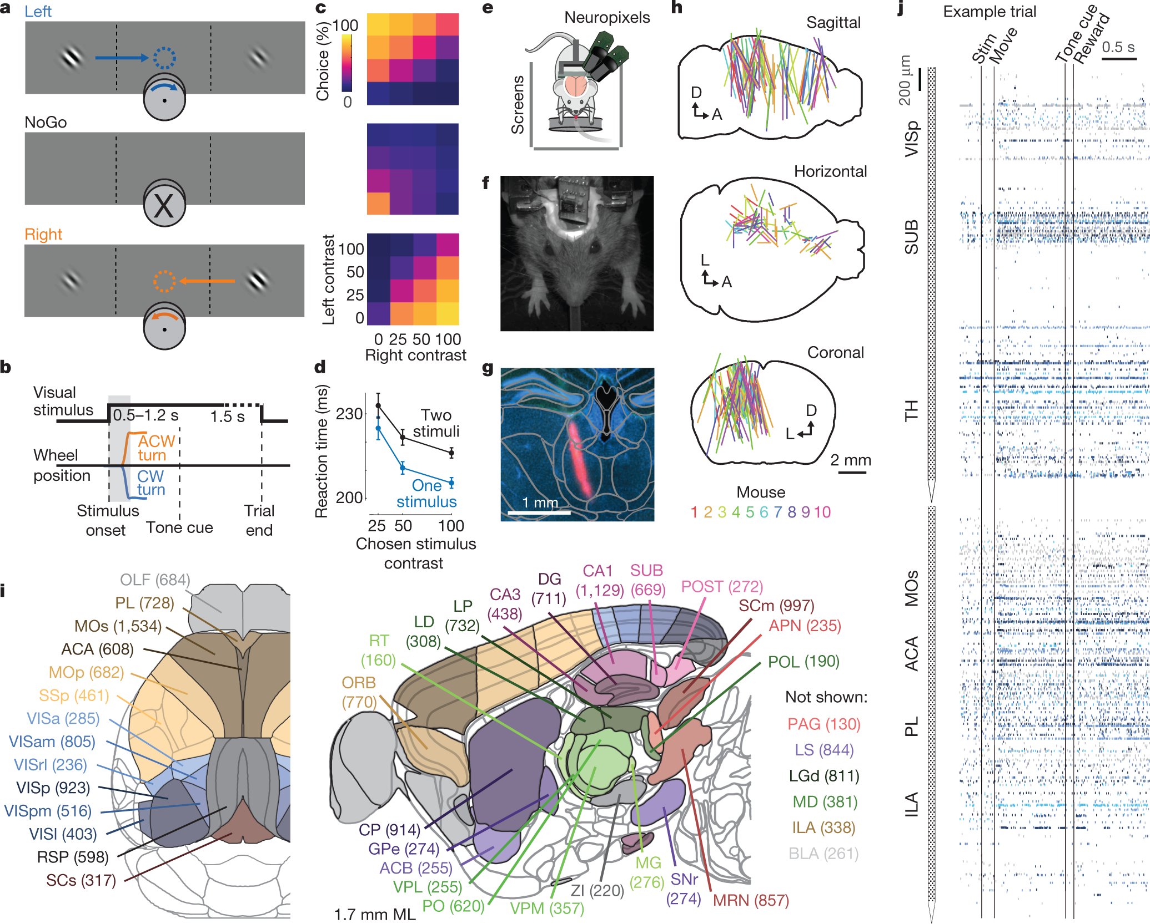
Behavioural task and brain recordings
Brain regions
"CA1"
"DG"
"LP"
"MG"
"MRN"
"NB"
"POST"
"SPF"
"VISam"
"VISp"
"root"
turn R No turn turn L
______ _______ ______
L 52 29 14
equal 16 36 6
R 1 9 51
Probe 0 Probe 1
______ _______
ACA 154 0
CA3 0 93
DG 0 63
LS 233 0
MOs 162 0
SUB 0 113
VISp 0 220

Slide 4
Selected a visual stimulus contralateral to the recorded hemisphere | Selected a visual stimulus ispilateral to the recorded area | Missed contralateral stimulus resulting in no action | Missed ipsilateral stimulus resulting in no action | Movement | Choice | Choice for contralateral stimulus | Choice for either but mostly ipsilateral stimulus | choice-selective neurons exhibited directionally opposed activity: their activity increased before one choice and decreased below baseline before the other | increased firing before both left and right choices (10 out of 48, 21% suppressed for non-preferred choice
First activated: Visual areas such as: visual cortex (VIS) superficial superior colliculus (SCs) | First activated: rest of the brain regions (frontal cortex (MOs, ACA and PL), basal ganglia (CP, GPe and SNr), and several midbrain nuclei (SCm, MRN, APN and ZI) | Activation of: classical visual areas basal ganglia Several midbrain structures | Recorded hemisphere was silent | The widely distributed activity seen following trial onset was therefore present only when mice moved, regardless of the particular stimulus and particular action. | Sparse but found in: frontal cortex (MOs, PL and MOp) basal ganglia (CP and SNr) higher-order thalamus and motor-related superior colliculus(SCm) midbrain reticular nucleus ZI (NOT VISP) | midbrain (MRN, SCm, SNr and ZI), | forebrain (MOs, PL, MOp and CP) | Midbrain choice selective neurons | Frontal choice selective neurons
Soon spread to: rest of the brain regions (frontal cortex (MOs, ACA and PL), basal ganglia (CP, GPe and SNr), and several midbrain nuclei (SCm, MRN, APN and ZI) | Last activated: visual cortex (VIS) superficial superior colliculus (SCs) | No propagation to other brain areas
The widely distributed activity seen following trial onset was therefore present only when mice moved, regardless of the particular stimulus and particular action. Whereas responses to visual stimuli are largely confined to a restricted visual pathway, neural correlates of action initiation are essentially global. |  |  |  |  | Neurons encoding choice, therefore, exhibit a distinctive bilateral encoding of both choices in the forebrain, versus a unilateral encoding of contralateral choices in the midbrain

Slide 5
Engagement: Differences were also seen in pre-stimulus firing rates; for instance, | Engagement: a net decrease in pre-stimulus activity during task context | Engagement: consistent increase
pre-stimulus activity in VISp was lower in the task (Miss trials) than during passive stimulation pre-stimulus activity in CP showed the opposite modulation | Neocortex sensory thalamus | basal ganglia other subcortical choice-encoding areas

Slide 6
Neurons encoding choice, therefore, exhibit a distinctive bilateral encoding of both choices in the forebrain, versus a unilateral encoding of contralateral choices in the midbrain (Fig. 4h).

