Slide 1
Brain-optimized deep neural network models of human visual areas learn non-hierarchical representations
Ghislain St-Yves, Emily J. Allen, Yihan Wu, Kendrick Kay & Thomas Naselaris

Slide 2
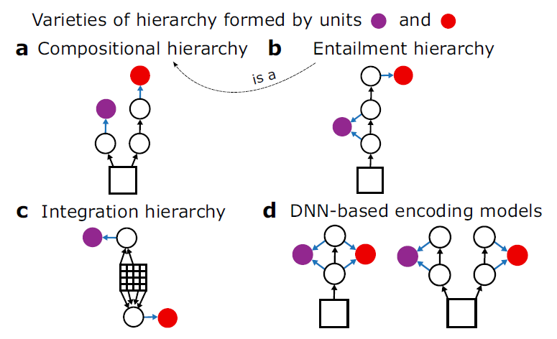
Fig. 1

Slide 3
Fig. 1

Slide 4
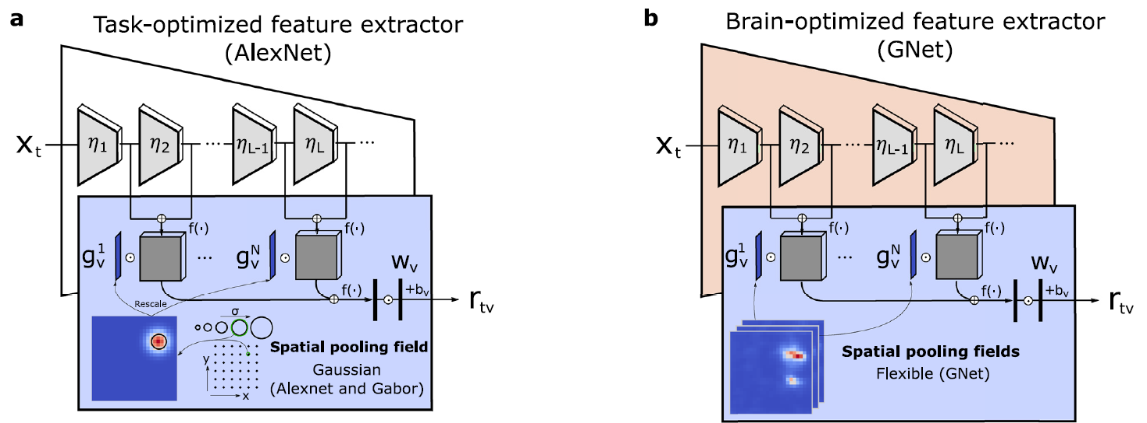
Fig. 2

Slide 5
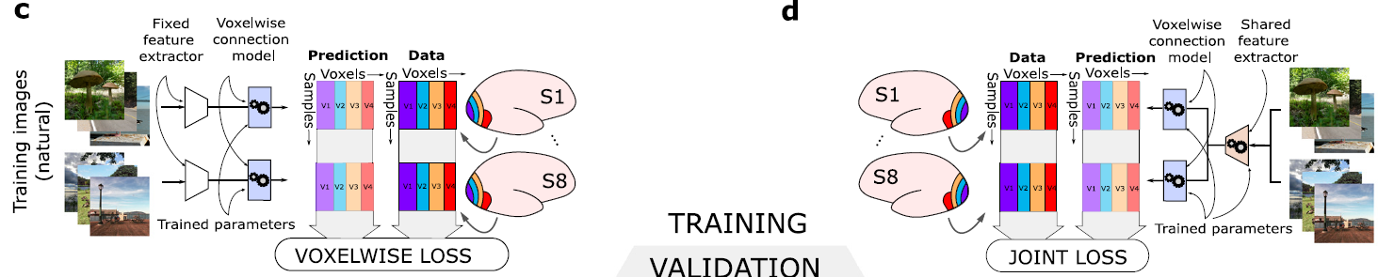
Fig. 2

Slide 6
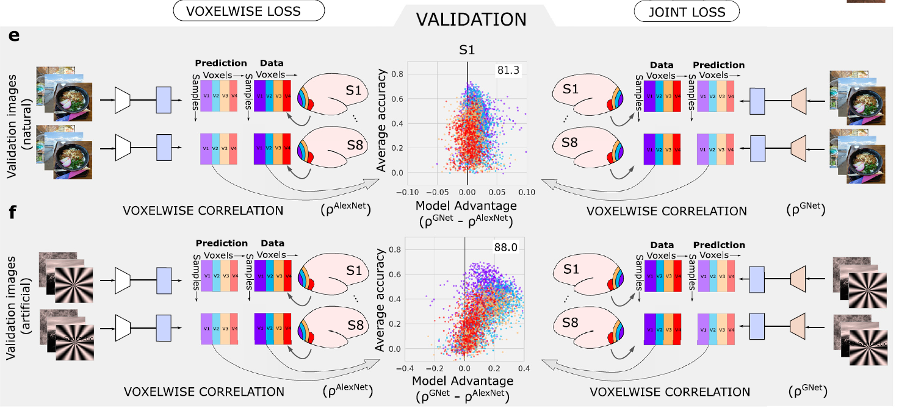
Fig. 2

Slide 7
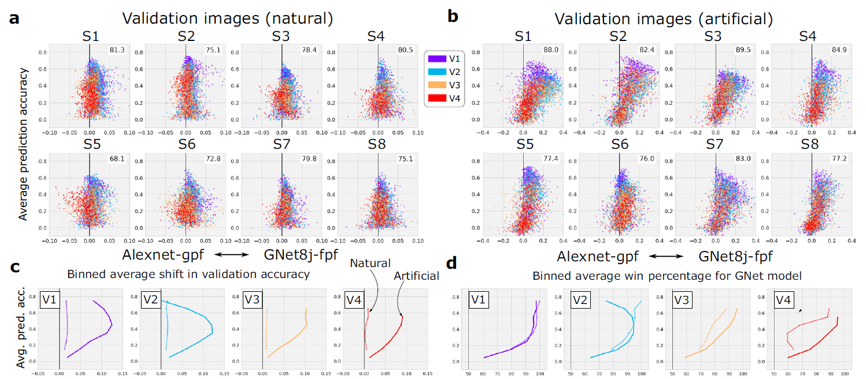
Fig. 3

Slide 8
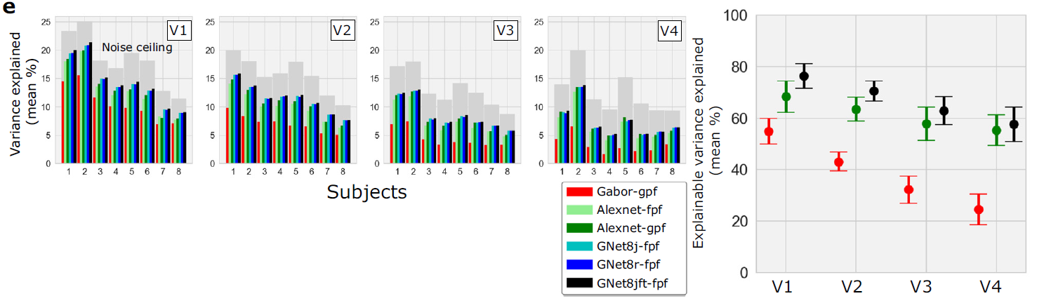
Fig. 3

Slide 9
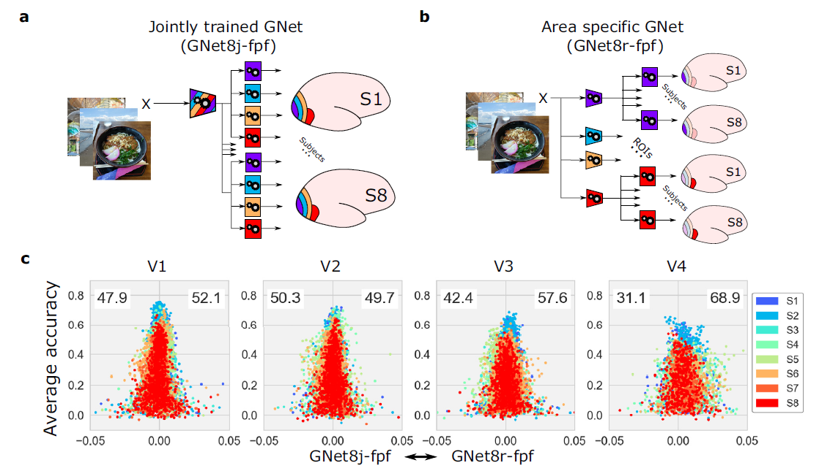
Fig. 4

Slide 10
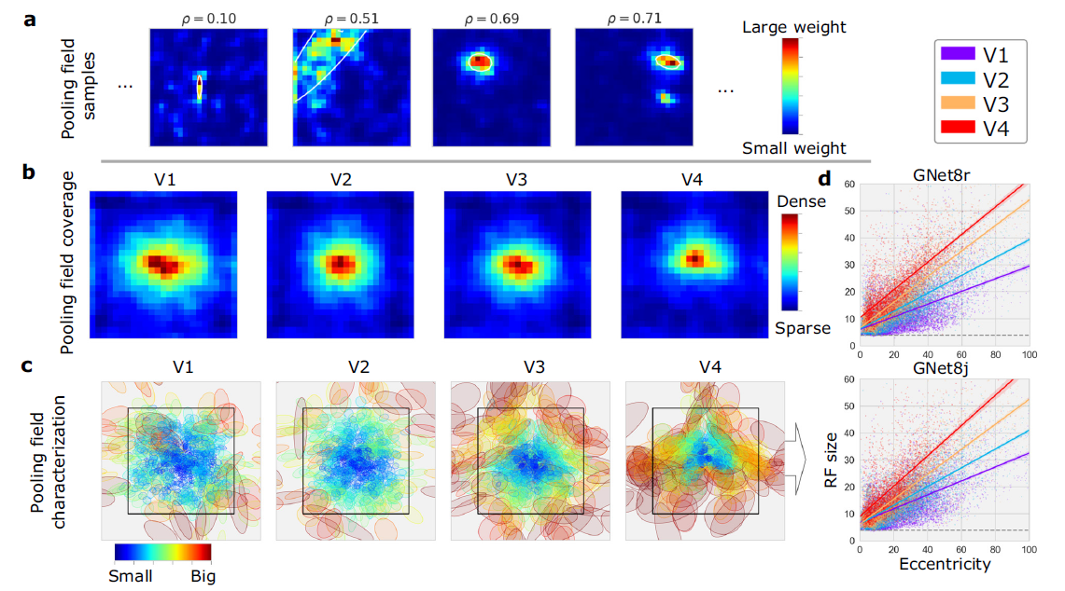
Fig. 5

Slide 11
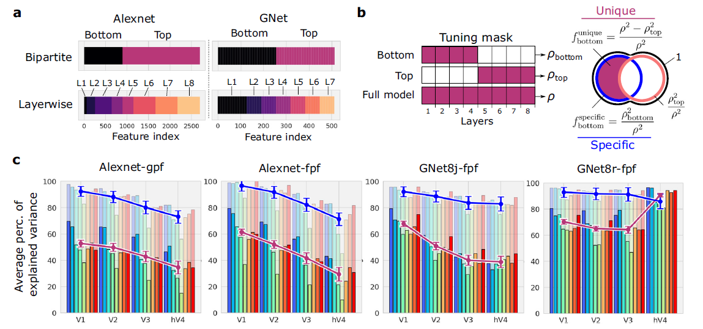
Fig. 6

Slide 12
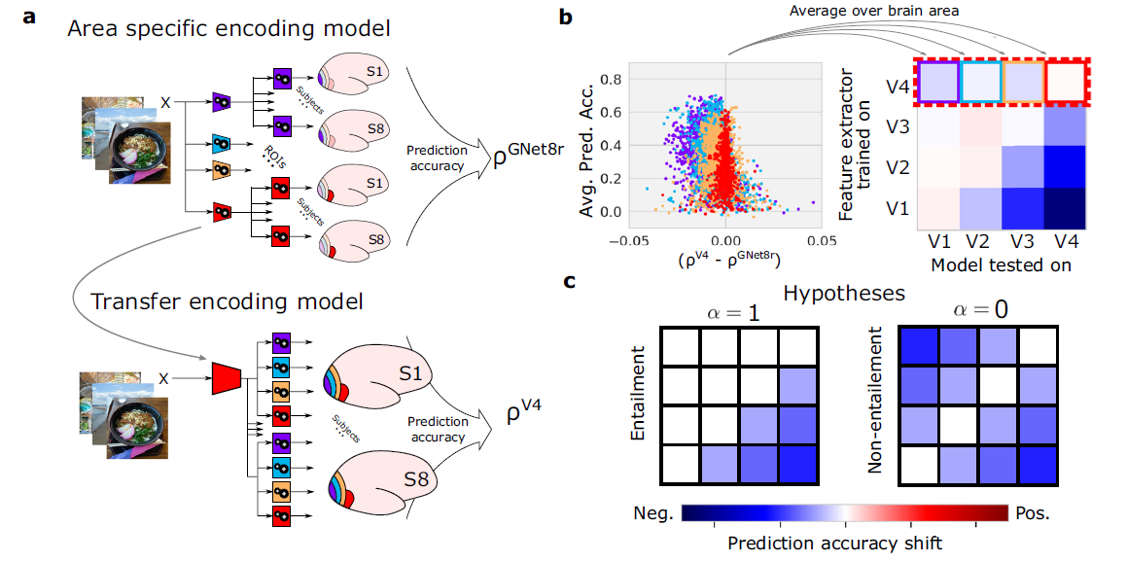
Fig. 7

Slide 13
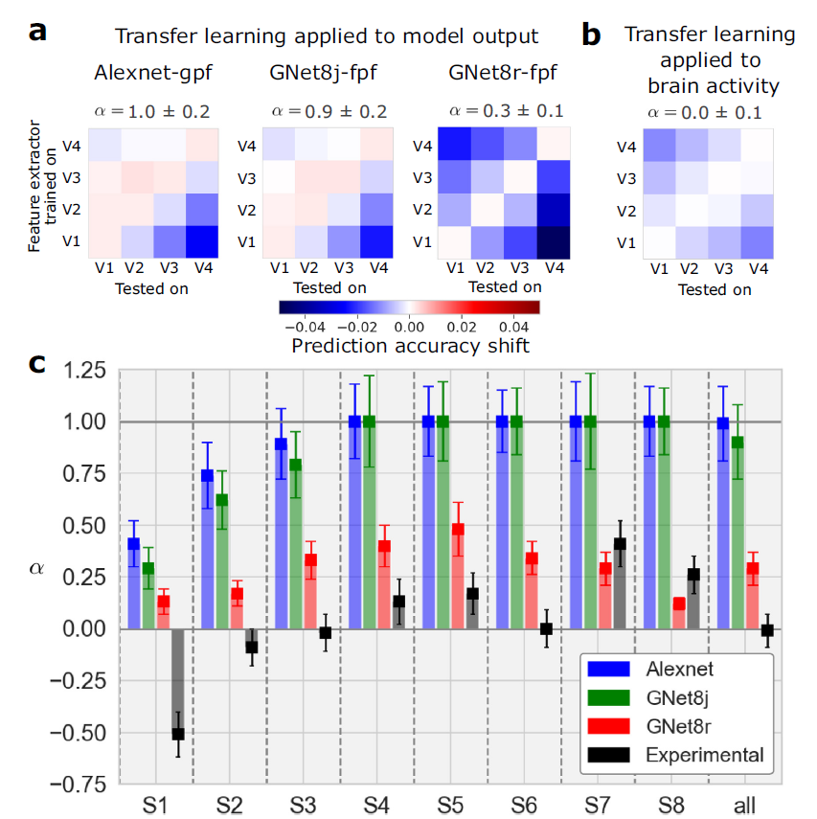
Fig. 8

Slide 14
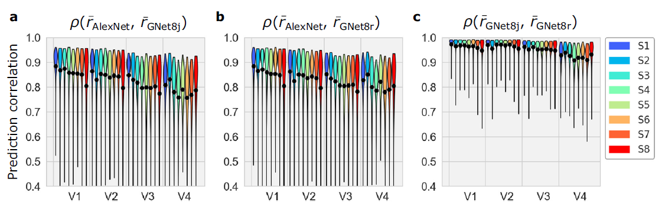
Fig. 9

