Slide 1
Brain-optimized deep neural network models of human visual areas learn non-hierarchical representations
Ghislain St-Yves, Emily J. Allen, Yihan Wu, Kendrick Kay & Thomas Naselaris

Slide 2
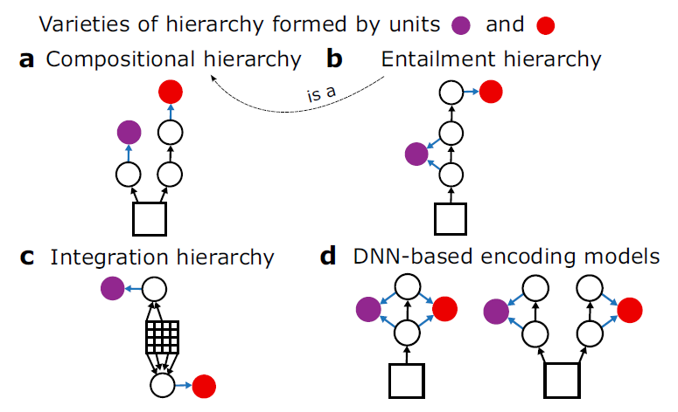
Fig. 1

Slide 3
Fig. 1
Notes:
In a compositional hierarchy higher-level representations require
more nonlinear processing steps to compute than lower-level representations
(Fig. 1a). This kind of hierarchy has been offered as an
explanation for the “gradient of complexity” of representations in the
primate visual system

Slide 4
Fig. 1
Notes:
In an entailment hierarchy low-level representations act as
necessary pre-processing stages for higher-level representations
(Fig. 1b). We refer to this as “entailment” because it implies that a
successful DNN model of a higher brain area would have to include
layers that successfully model lower brain areas
One of the main pieces of evidence that the primate visual system is an entailment hierarchy is that lesioning primary visual cortex reduces activity in higher areas.

Slide 5
Fig. 1
Notes:
In an integration hierarchy, the spatial integration windows (i.e.,
receptive field size) that underlie some representations are larger than
others (Fig. 1c). The expansion of receptive field sizes with progression
from lower to higher visual areas is arguably the most salient kind of
hierarchy in the visual system
Maybe get more on this

Slide 6
Fig. 1
Notes:
Although a purely feedforward DNN (e.g., AlexNet)most naturally
embodies all three kinds of hierarchy, each kind of hierarchy could be
formed by units in DNNs with a wide variety of different architectures,
including DNNs with recurrent connections, skip connections, or
multiple, independent branches

Slide 7
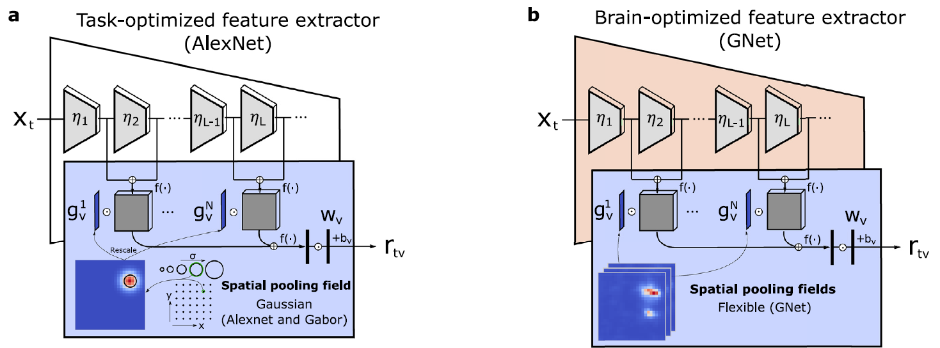
Fig. 2 (Models)
Notes:
Xt = stimulus for trial t
Eta layers
G is the pooling field for each voxel, size as position selected from a fixed grid of candidates
Grey boxes are feature maps, which are multiplied and summed to obtain a single value for each voxel
These are multiplied by weight and biases to get a prediction r_tv for brain activity on the trial

Slide 8
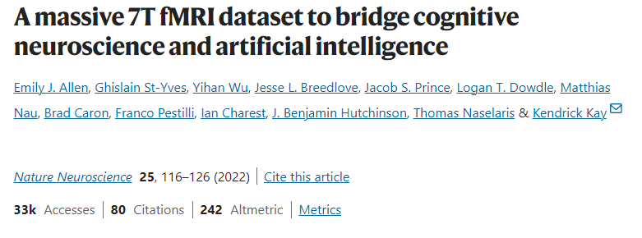
Notes:
P is prediction, right?

Slide 9
Notes:
P is prediction, right?

Slide 10
Notes:
P is prediction, right?

Slide 11
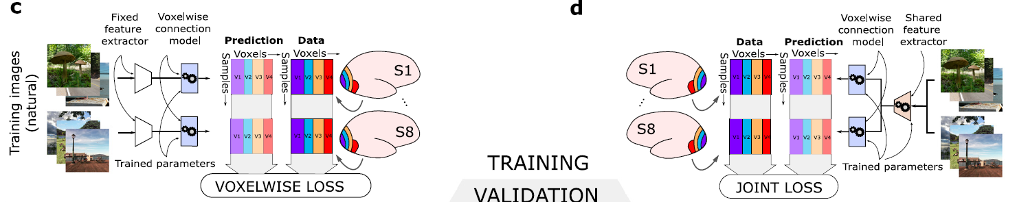
Fig. 2 (Training)
Notes:
For each voxel, read-out heads were
permitted to sample from all layers of the DNN, thus giving encoding
models the flexibility to learn representations that formed whatever
kind of hierarchy was needed to most accurately predict brain activity.

Slide 12
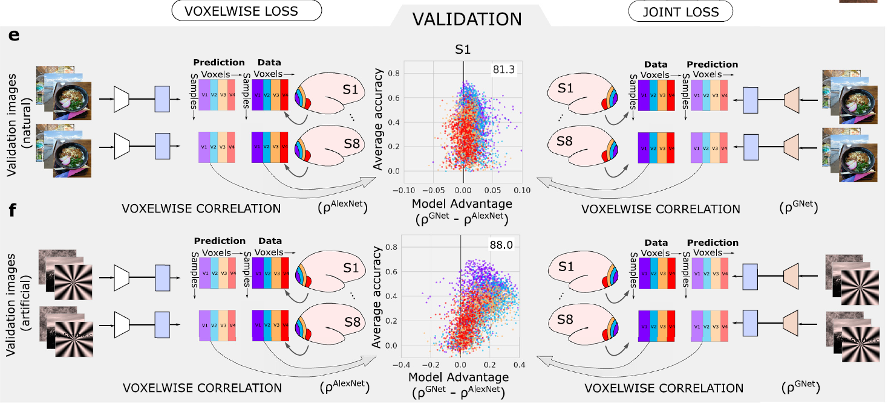
Fig. 2 (Comparison)
Notes:
P is prediction, right?

Slide 13
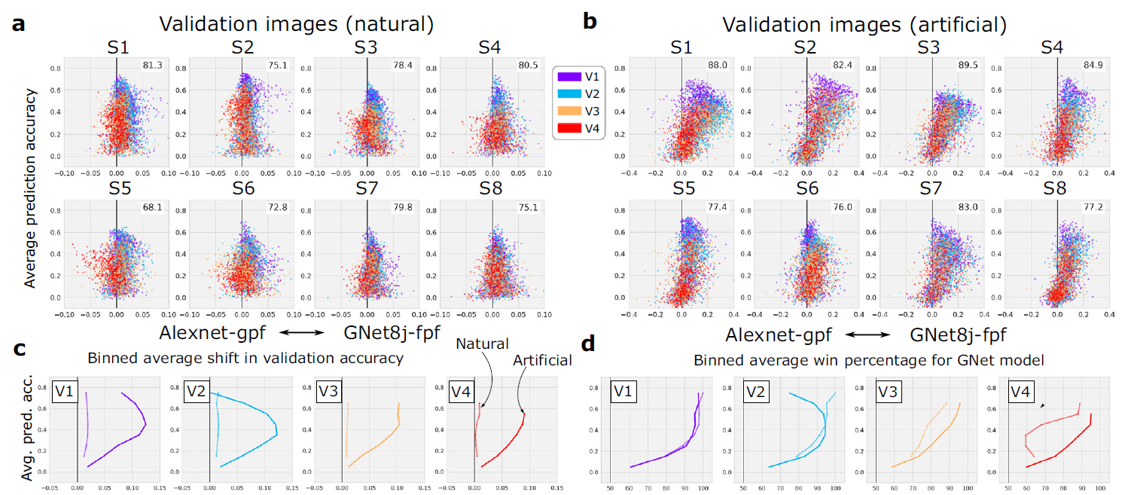
Fig. 3
Notes:
Gpf = gaussian pooling field
Fpf = flexible pooling field

Slide 14
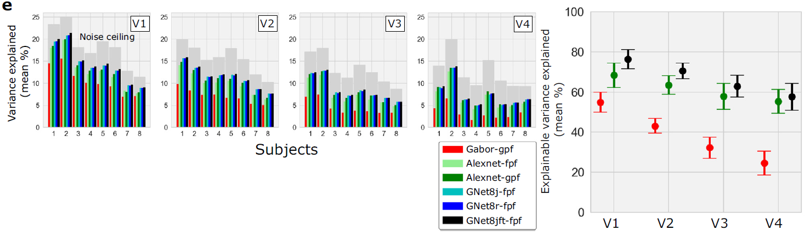
Fig. 3
Notes:
Noise ceiling: upper limit of model performance determined by the inherent noise in the data
The takeaway at this point in the paper is that the Gnet model outperforms Alexnet and is a trustworthy tool for predicting stimulus-triggered brain activity
Poportion of exaplainable variance explained = R^2_model/R^2_noiseceiling
Gabor wavelet model is a control
We conclude that our encoding models based upon brain
Optimized networks are as trustworthy a tool for testing hypotheses
about representations encoded in human brain activity as any currently
existing network-based encoding model
What is gpf and fpf?: gaussian pooling field and flexible pooling field

Slide 15
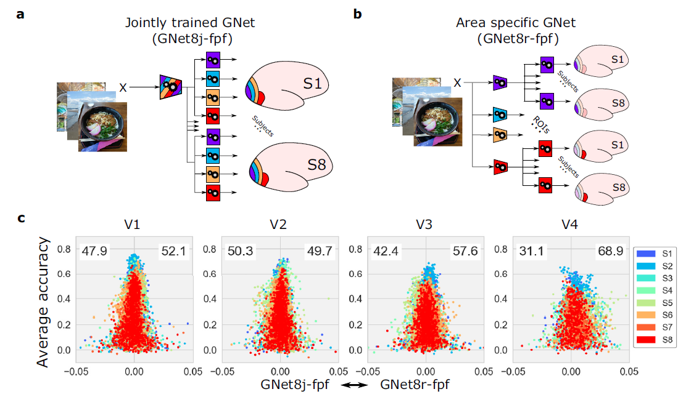
Fig. 4
Notes:
The relationship between DNN architecture and representation can be quite tenuous: Fig 4 shows that DNNs with very different architectures (jointly trained versus ROI-trained)
and objective functions yield nearly identical accuracy when read-out into predictions of brain activity. Though it’s worth nothing that win rate was 68.9% in V4
From text: “although GNet8r and GNet8j have very different architecture, they are equally plausible models of representation in V1–V4”
Fpf = flexible pooling field

Slide 16
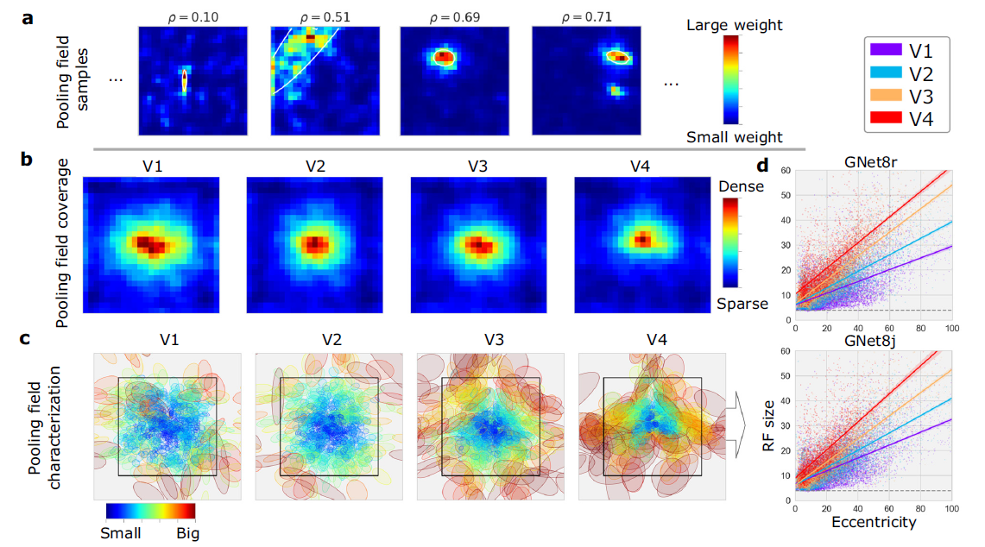
Fig. 5
Notes:
Retinotopic maps reconstructed, maybe get the grid search image

Slide 17
Fig. 5 (Integration Hierarchy)
Notes:
Retinotopic maps reconstructed, maybe get the grid search image

Slide 18
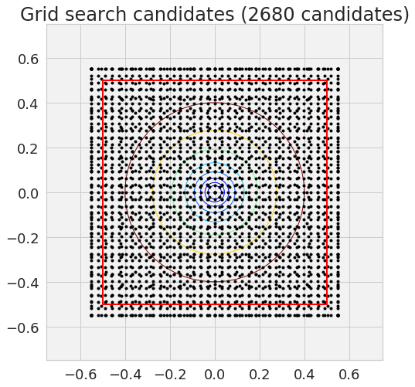
Notes:
Xt = stimulus for trial t
Eta layers
G is the pooling field for each voxel, size as position selected from a fixed grid of candidates
Grey boxes are feature maps, which are multiplied and summed to obtain a single value for each voxel
These are multiplied by weight and biases to get a prediction r_tv for brain activity on the trial

Slide 19
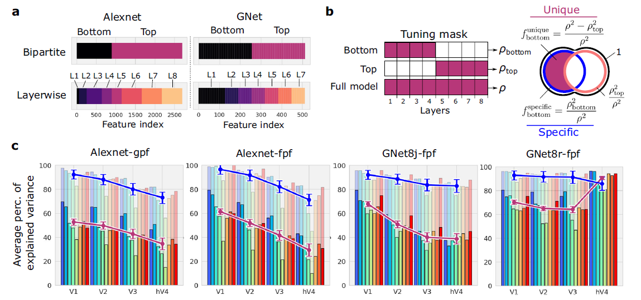
Fig. 6
Notes:
We see here that chopping off the top half of layers reduces prediction performance for higher layers for alexnets and jointly-trained GNet8. However, ROI-trained Gnet8 shows no such dropoff at hV4

Slide 20
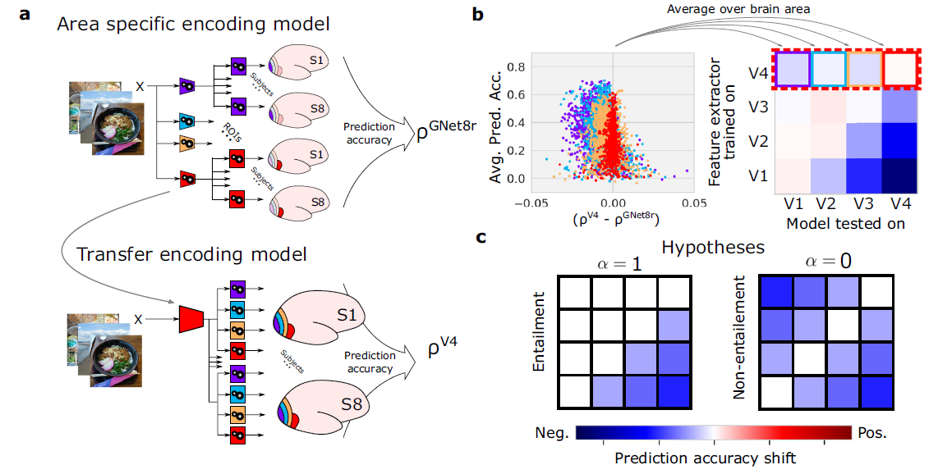
Fig. 7

Slide 21
Fig. 7 (Entailment Hierarchy)
Notes:
The idea is that a higher node in an entailment hierarchy has all the information it needs to predict activity in a lower node. So predictions are perfect above the diagonal. On the other hand, in a completely non entailment

Slide 22
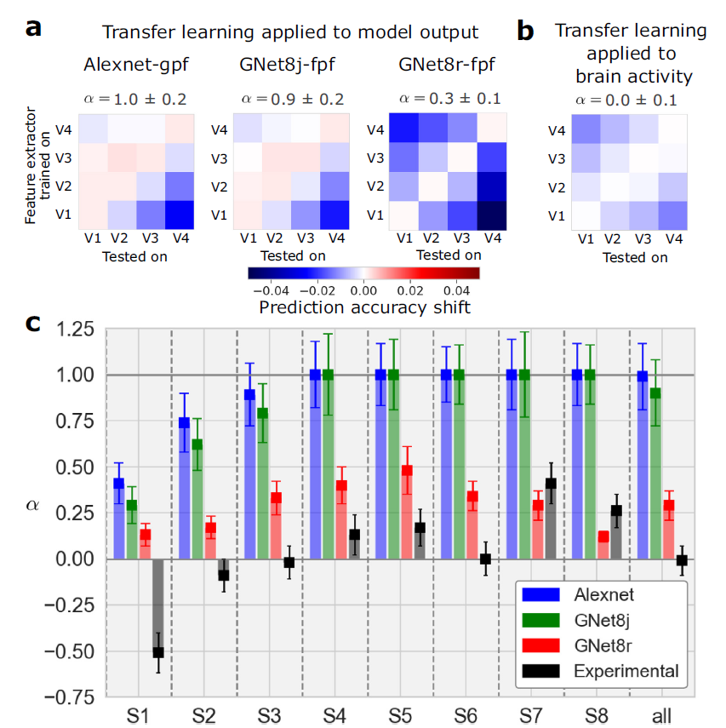
Fig. 8
Notes:
Alexnet and Gnet8-joint show show entailment hierarchies
Gnet8-ROI and Brain activity do not.

Slide 23
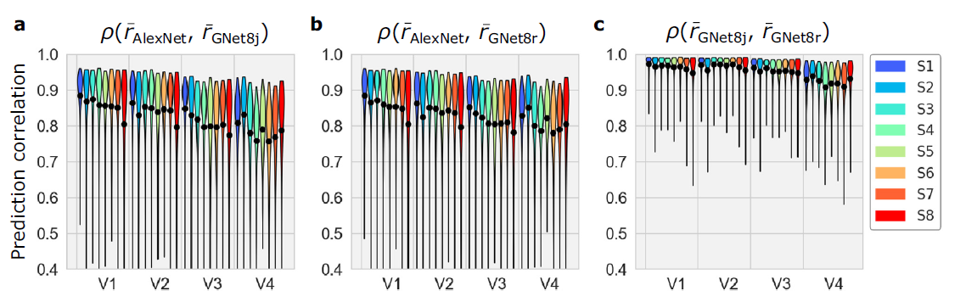
Fig. 9
Notes:
This is showing that the two Gnet8 models had very high agreement in their predictions, despite having much different architecture (And representations)
Median correlation decreases with progression toward higher layers

Slide 24
Fig. 9
Notes:
This is showing that the two Gnet8 models had very high agreement in their predictions, despite having much different architecture (And representations)
Median correlation decreases with progression toward higher layers

Slide 25
Discussion
Notes:
This is showing that the two Gnet8 models had very high agreement in their predictions, despite having much different architecture (And representations)

