Slide 1
Timer 1
OCR1BH OCR1BL
=
OCF1B
TCCR1A
TCCR1B
TCNT1H TCNT1L
TOV1
=
OCF1A
OCR1AH OCR1AL

Slide 2
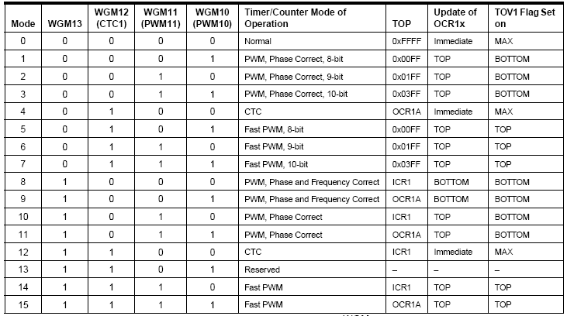
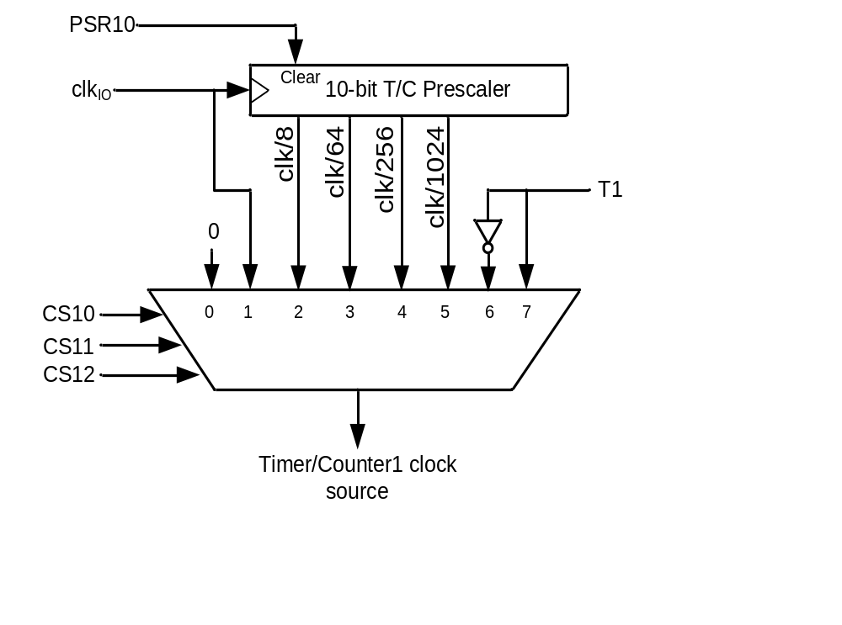
Clock Selector (CS)
CS12 CS11 CS10 Comment
0 0 0 No clock source (Timer/Counter stopped)
0 0 1 clk (No Prescaling)
0 1 0 clk / 8
0 1 1 clk / 64
1 0 0 clk / 256
1 0 1 clk / 1024
1 1 0 External clock source on T0 pin. Clock on falling edge
1 1 1 External clock source on T0 pin. Clock on rising edge

Slide 3
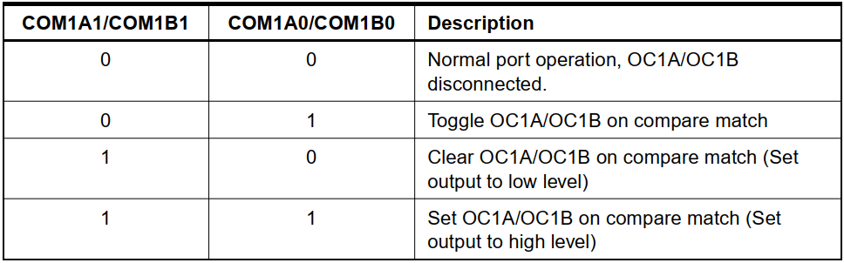

Slide 4
16 – bit Timer / Counter 1
● Two Independent Output Compare Units
● can be used as Pulse Width Modulator (PWM)
● Clear Timer on Compare Match (Auto Reload)
● One Input Capture Unit
● can be used as External Event Counter
● Four Independent Interrupt Sources
TOV1, OCF1A, OCF1B, and ICF1

Slide 5
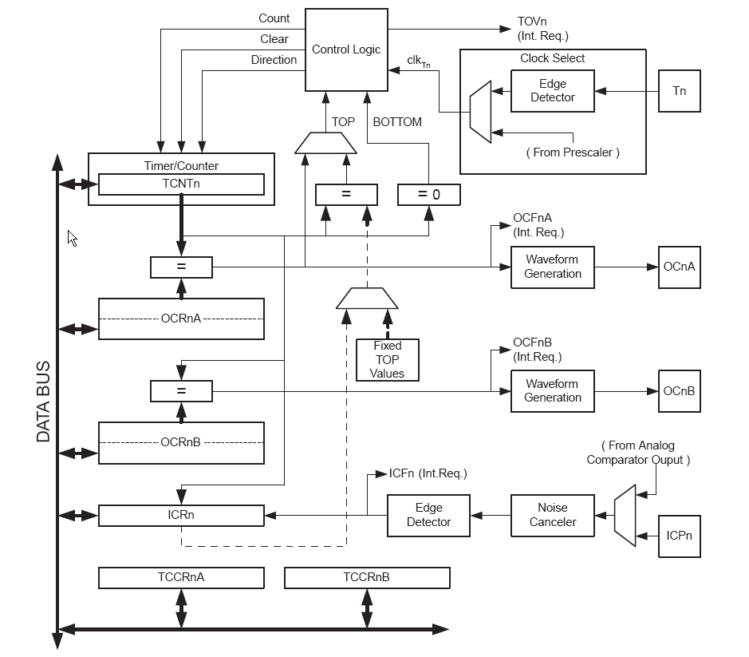
16 – bit Timer / Counter 1
● TCNT1, OCR1A,
OCR1B and ICR1
are 16-bit registers
● write high byte first
read low byte first
(automatically done in C)
● clocking via prescaler or
external clock on pin T1
● output compare register
OCR1A/B can be used
for PWM generation
(output pin: OC1A/B)
or for interrupt request

Slide 6
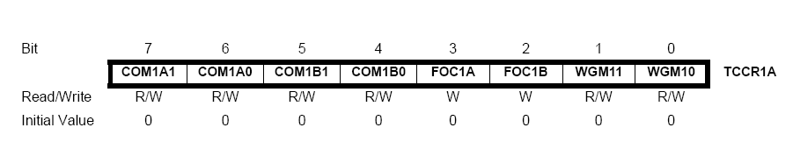
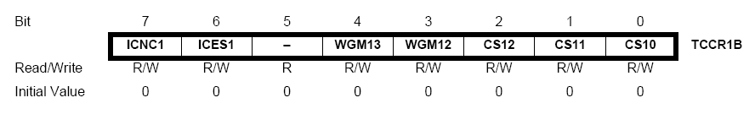
16 – bit Timer / Counter 1
● Mode configuration using TCCR1A and TCCR1B
PWM Mode, set/clear/toggle of OC1A/B, auto-reload, Noise canceller
Find Details in the ATmega8 datasheet !

Slide 7
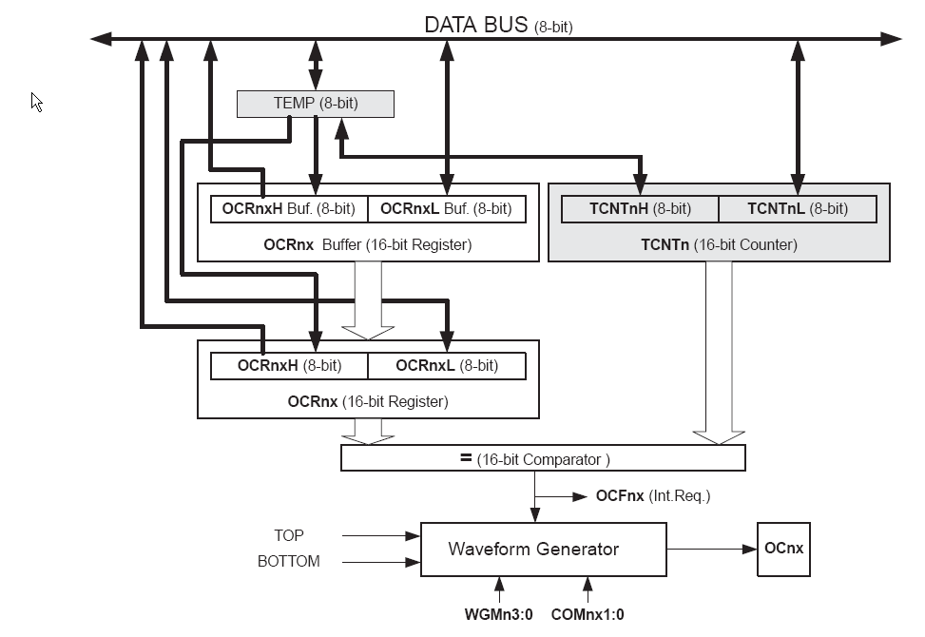
16 – bit Timer / Counter 1
● Output Compare Units: compare TCNT1 with OCR1A and OCR1B
Can generate Output Capture Interrupt
● 13 PWM / Waveform
generation modes
● Top and Bottom values
● Auto reload

Slide 8
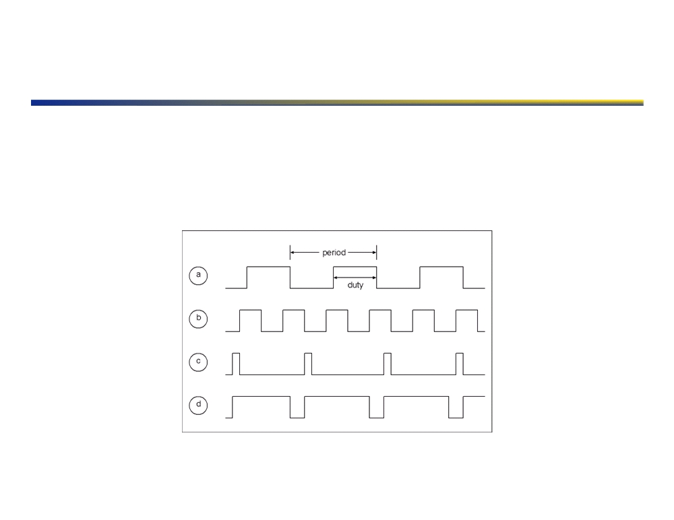
Pulse Width Modulation
▪ Vary the duty cycle of a fixed period “square” wave to vary output power!
▪ DC Motor Speed Control, LED Brightness, Servo Positioning, “Poor-manʼs DAC”!
▪ Waveform Generator / Output Compare module!
▪ Coupled with timer peripheral!
http://www.ece.utep.edu/courses/web3376/concepts/pwm.html!
16!

Slide 9
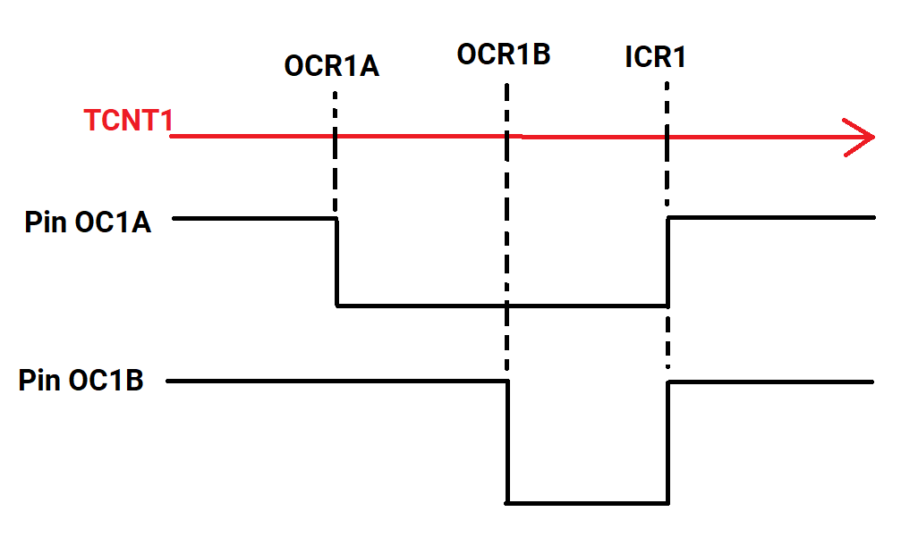

Slide 10
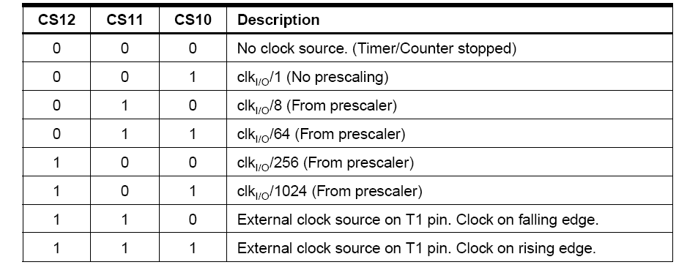
16 – bit Timer / Counter 1
● Clock source configuration using TCCR1B

