Slide 1
Timer/counter
Chapter 9

Slide 2
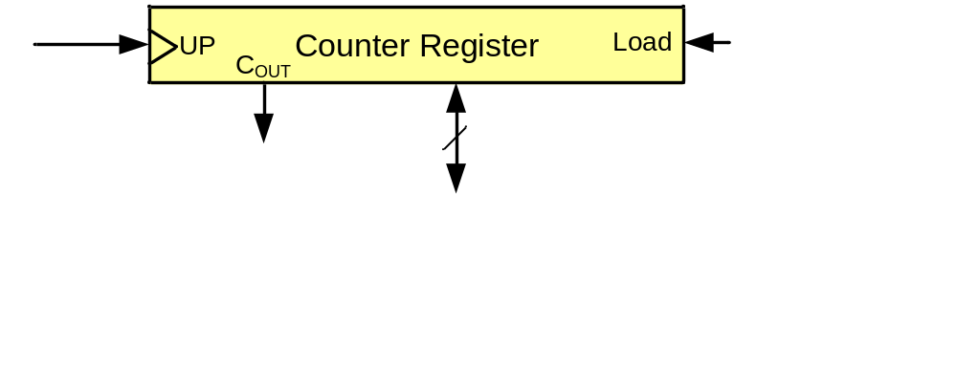
A counter register

Slide 3
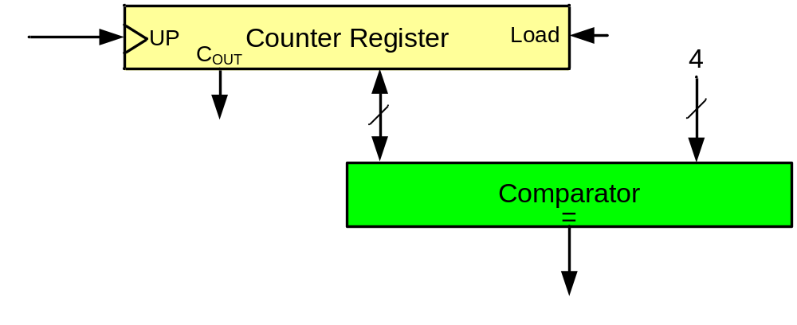
A simple design (counting people)
First design
Sensor

Slide 4
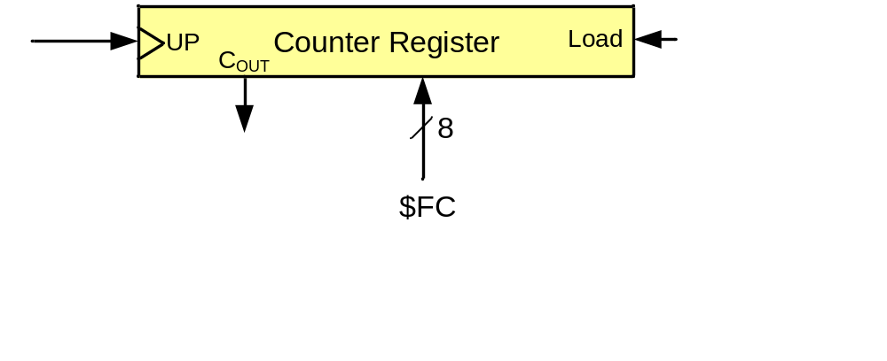
A simple design (counting people)
Second design
Sensor

Slide 5
A simple design (making delay)

Slide 6
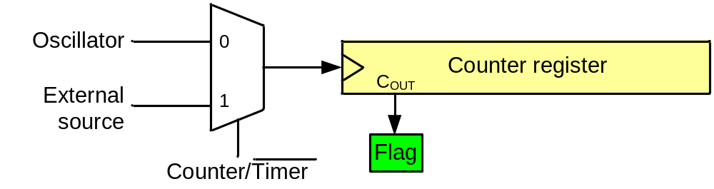
A generic timer/counter
Delay generating
Counting
Wave-form generating
Capturing

Slide 7
Timers in AVR
1 to 6 timers
  3 timers in ATmega32
8-bit and 16-bit timers
  two 8-bit timers and one 16-bit timer in ATmega32

Slide 8
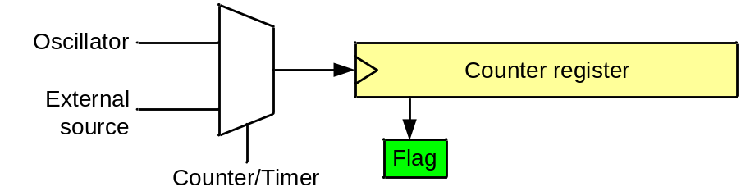
Timer in AVR
TCNTn (Timer/Counter register)
TOVn (Timer Overflow flag)
TCCRn (Timer Counter control register)
OCRn (output compare register)
OCFn (output compare match flag)
TCCRn
TCNTn
TOVn
=
OCFn
Comment:
All of the timer registers are byte-addressable I/O registers
OCRn

Slide 9
Timer 0 (an 8-bit timer)

Slide 10
Timer 0
TCCR0
TCNT0
TOV0
=
OCF0
OCR0

Slide 11
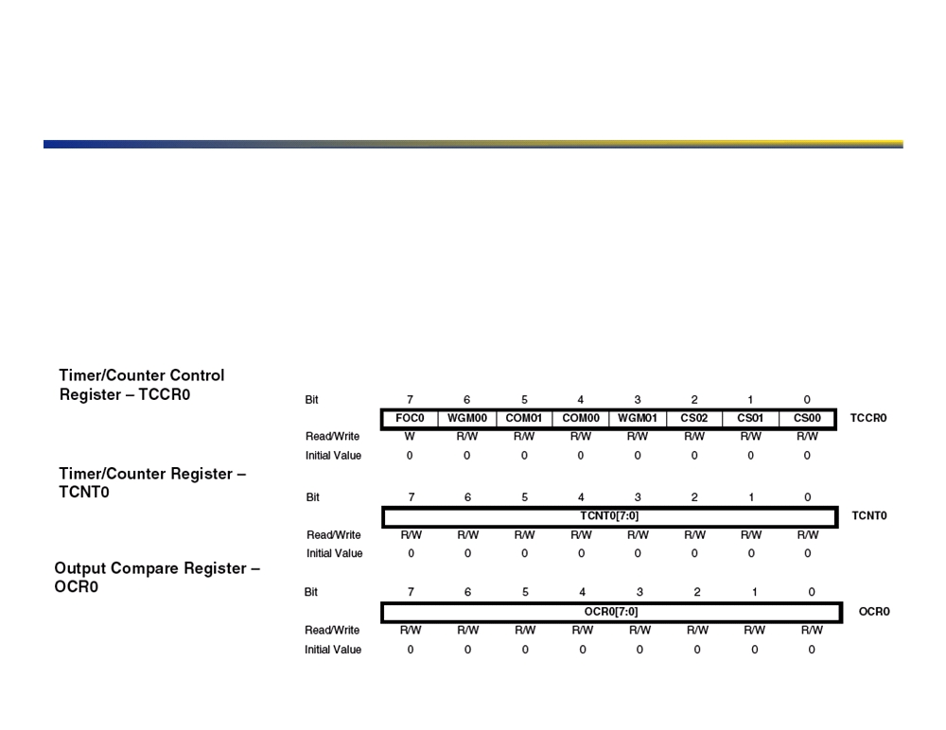
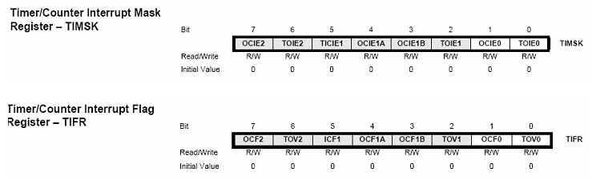
Timer Registers
▪ Three main registers in diagram, plus two more, to interact with this particular timer!
▪ TCCR controls the timer functioning, waveform generation mode (PWM, etc), and clock prescaling! ▪ TCNT contains the current clock value, which can be reset and changed at will. Remember that this is incremented by the pre-scaled clock as configured by the TCCR register!
▪ OCR contains the target clock value at which time an interrupt should be generated or a pin state should be changed!
▪ A fourth register, ASSR, which is not show on the functional diagram is used on this particular timer to select between the internal and external clocks, as well as indicate when the timer is busy! ▪ TIMSK (Timer Interrupt MaSK), also not shown, is used to enable interrupts on specific timer events!
14!

Slide 12
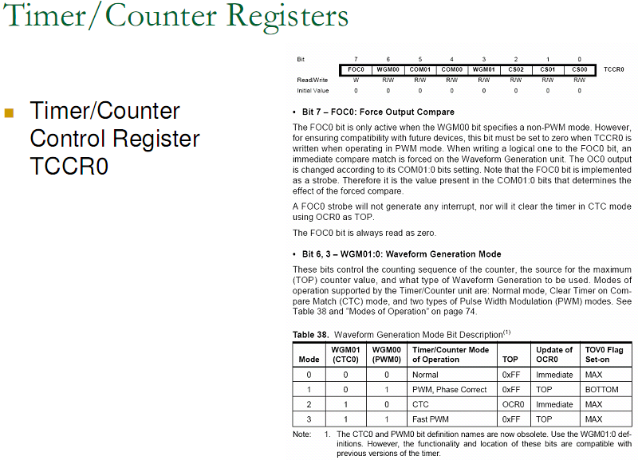

Slide 13
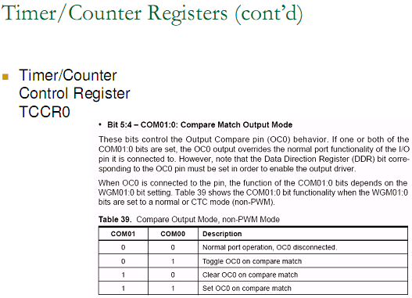

Slide 14
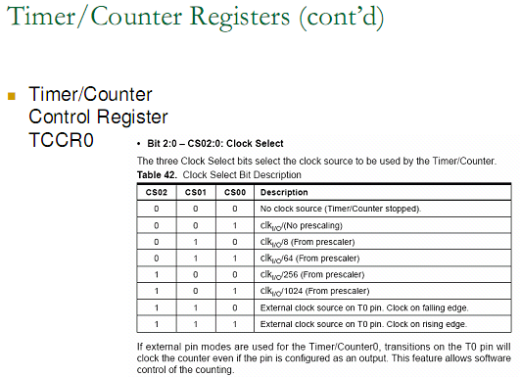

Slide 15
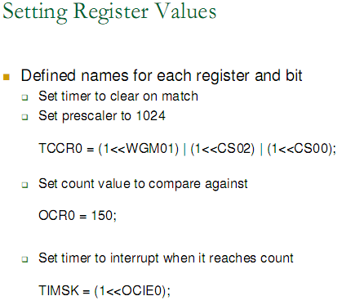

Slide 17
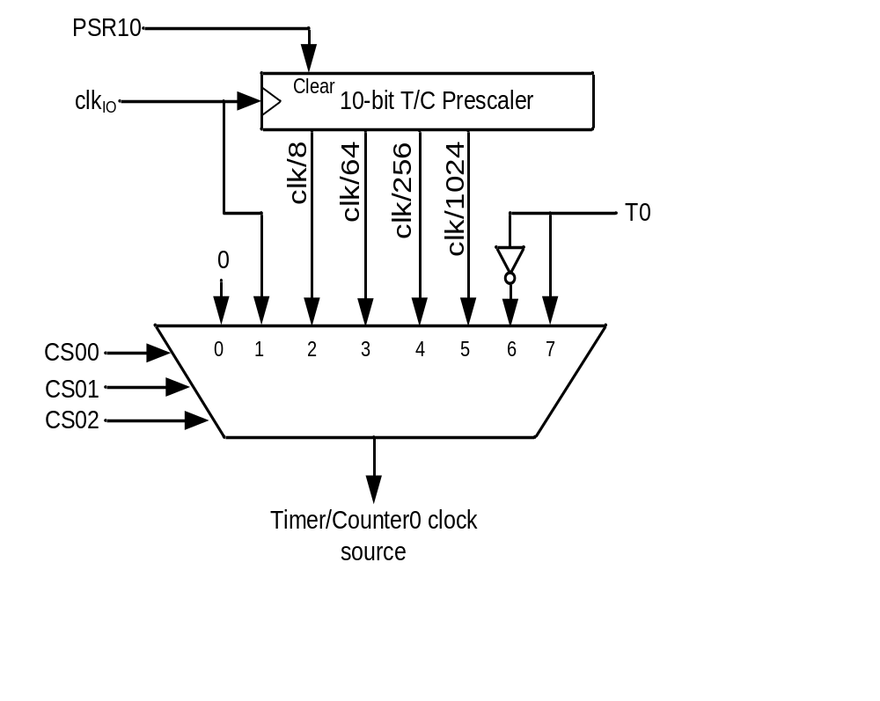
Clock Selector (CS)
Timer Mode (WGM)
CS02 CS01 CS00 Comment
0 0 0 No clock source (Timer/Counter stopped)
0 0 1 clk (No Prescaling)
0 1 0 clk / 8
0 1 1 clk / 64
1 0 0 clk / 256
1 0 1 clk / 1024
1 1 0 External clock source on T0 pin. Clock on falling edge
1 1 1 External clock source on T0 pin. Clock on rising edge
WGM00 WGM01 Comment
0 0 Normal
0 1 CTC (Clear Timer on Compare Match)
1 0 PWM, phase correct
1 1 Fast PWM

Slide 18
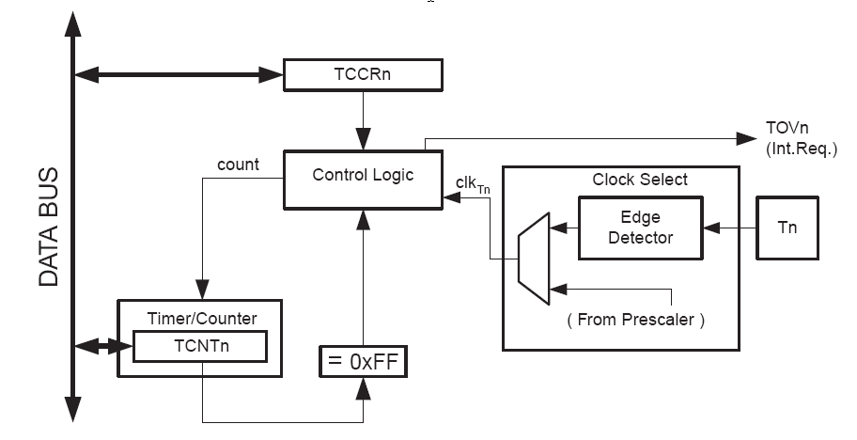
II: Atmega8 – Basic features
8-bit Timer / Counter0
• 10-bit clock Prescaler
timer-clk (t0) = clk (IO) / prescaler
• External clock source T0 connected to PD4
cannot be prescaled, clk(ext) <= clk (IO) / 2.5

Slide 19
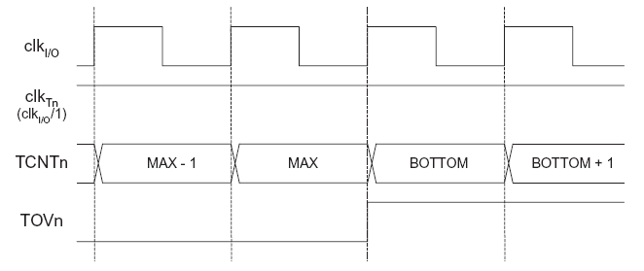
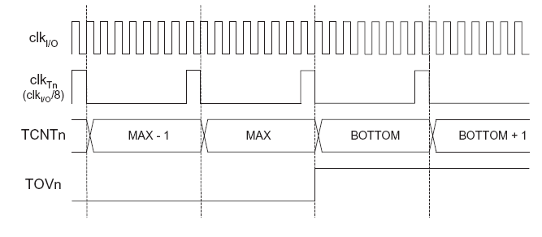
II: Atmega8 – Basic features
8-bit Timer / Counter0 - prescaler operation
No prescaler
MAX=0xff
BOTTOM=0
Prescaler = 8

Slide 20
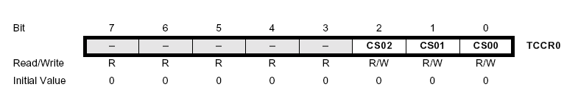
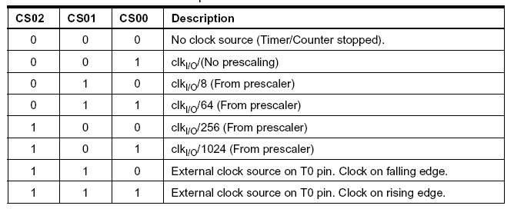
II: Atmega8 – Basic features
8-bit Timer / Counter0 usage
Timer/Counter0 Control Register (TCCR0), Bits CS02-CS00
select Clock Source and Prescaler Value :

Slide 21
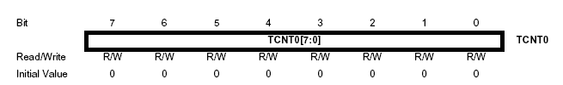
II: Atmega8 – Basic features
8-bit Timer / Counter0 usage
Timer/Counter0 Register (TCNT0) :
read/write, incremented per CLK cycle, overflow: 0xff
• A Reload-Value is used to fine-tune the interrupt interval
• write Reload-Value to TCNT0 in the ISR

Slide 22
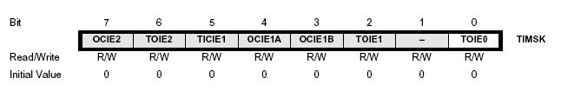
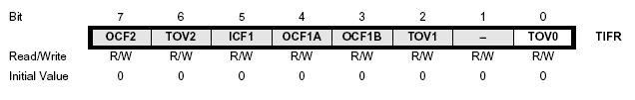
II: Atmega8 – Basic features
8-bit Timer / Counter0 usage
Timer/Counter Interrupt Mask Register (TIMSK) :
Bit 0 : Timer 0 interrupt enable
set 1 to enable timer 0 overflow interrupt ( + I-Bit in SREG)
Timer Interrupt Flag Register (TIFR) :
TOV0 indicates a Timer0 overflow, cleared by hardware when
the ISR is executed or by writing 1 to the flag

Slide 23

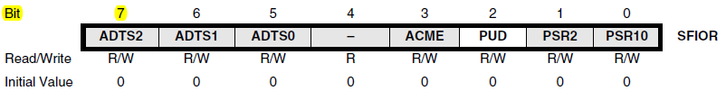
Where does PSR10 come from?

Slide 24
Normal mode
TCNT0
0xFF
TOV
TOV
TOV
0
time
FF
0
FE
TOV0:
1
2
1
0
TOV0 = 1

Slide 25
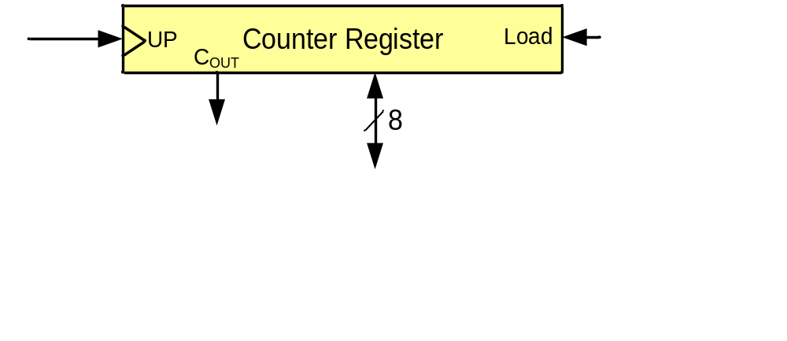
Example 1: Write a program that waits 14 machine cycles in Normal mode.
14 = $0E
$100
-$0E
$F2
$F2
0 0
0 0 1
WGM00 WGM01 Comment
0 0 Normal
0 1 CTC
1 0 PWM, phase correct
1 1 Fast PWM

Slide 26
Example 1: write a program that waits 14 machine cycles in Normal mode.
$100
-$0E
$F2
.INCLUDE "M32DEF.INC"
LDI R16,0x20
SBI DDRB,5 ;PB5 as an output
LDI R17,0
OUT PORTB,R17
BEGIN: LDI R20,0xF2
OUT TCNT0,R20 ;load timer0
LDI R20,0x01
OUT TCCR0,R20 ;Timer0,Normal mode,int clk
AGAIN: IN R20,TIFR ;read TIFR
SBRS R20,TOVO ;if TOV0 is set skip next inst.
RJMP AGAIN
LDI R20,0x0
OUT TCCR0,R20 ;stop Timer0
LDI R20,(1<<TOV0) ;R20 = 0x01
OUT TIFR,R20 ;clear TOV0 flag
EOR R17,R16 ;toggle D5 of R17
OUT PORTB,R17 ;toggle PB5
RJMP BEGIN
DDRB = 1<<5;
PORTB &= ~(1<<5); //PB5=0
while (1)
{
TCNT0 = 0xF2;
TCCR0 = 0x01;
while((TIFR&(1<<TOV0))==0);
TCCR0 = 0;
TIFR = (1<<TOV0);
PORTB = PORTB^(1<<5);
}
Question: How to calculate the delay generated
by the timer?
Answer:
1) Calculate how much a machine clock lasts.
T= 1/f
2) Calculate how many machine clocks it waits.
3) Delay = T * number of machine cycles

Slide 27
In example 1 calculate the delay. Imagine XTAL = 10 MHz.
Solution 1 (inaccurate):
1) Calculating T:
T = 1/f = 1/10M = 0.1µs
Calculating num of machine cycles:
$100
-$F2
$0E = 14
Calculating delay
14 * 0.1µs = 1.4 0µs
.INCLUDE "M32DEF.INC"
LDI R16,0x20
SBI DDRB,5 ;PB5 as an output
LDI R17,0
OUT PORTB,R17
BEGIN: LDI R20,0xF2
OUT TCNT0,R20 ;load timer0
LDI R20,0x01
OUT TCCR0,R20 ;Timer0,Normal mode,int clk
AGAIN: IN R20,TIFR ;read TIFR
SBRS R20,0 ;if TOV0 is set skip next inst.
RJMP AGAIN
LDI R20,0x0
OUT TCCR0,R20 ;stop Timer0
LDI R20,0x01
OUT TIFR,R20 ;clear TOV0 flag
EOR R17,R16 ;toggle D5 of R17
OUT PORTB,R17 ;toggle PB5
RJMP BEGIN

Slide 28
Accurate calculating
Other than timer, executing the instructions consumes time; so if we want to calculate the accurate delay a program causes we should add the delay caused by instructions to the delay caused by the timer
LDI R16,0x20
SBI DDRB,5
LDI R17,0
OUT PORTB,R17
BEGIN: LDI R20,0xF2 1
OUT TCNT0,R20 1
LDI R20,0x01 1
OUT TCCR0,R20 1
AGAIN: IN R20,TIFR 1
SBRS R20,0 1 / 2
RJMP AGAIN 2
LDI R20,0x0 1
OUT TCCR0,R20 1
LDI R20,0x01 1
OUT TIFR,R20 1
EOR R17,R16 1
OUT PORTB,R17 1
RJMP BEGIN 2
18
Delay caused by timer = 14 * 0.1µs = 1.4 µs Delay caused by instructions = 18 * 0.1µs = 1.8
Total delay = 3.2 µs ➔ wave period = 2*3.2 µs = 6.4 µs ➔ wave frequency = 156.25 KHz

Slide 29
Finding values to be loaded into the timer
Calculate the period of clock source.
  Period = 1 / Frequency
    E.g. For XTAL = 8 MHz ➔ T = 1/8MHz
Divide the desired time delay by period of clock.
Perform 256 - n, where n is the decimal value we got in Step 2.
Set TCNT0 = 256 - n

Slide 30
Example 2: Assuming that XTAL = 10 MHz, write a program to generate a square wave with a period of 10 us on pin PORTB.3.
For a square wave with T = 10 µs we must have a time delay of 5 µs. Because XTAL = 10 MHz, the counter counts up every 0.1 µs. This means that we need 5 µs / 0.1 µs = 50 clocks. 256 - 50 = 206.
.INCLUDE "M32DEF.INC"
LDI R16,0x08
SBI DDRB,3 ;PB3 as an output
LDI R17,0
OUT PORTB,R17
BEGIN: LDI R20,206
OUT TCNT0,R20 ;load timer0
LDI R20,0x01
OUT TCCR0,R20 ;Timer0,Normal mode,int clk
AGAIN: IN R20,TIFR ;read TIFR
SBRS R20,TOV0 ;if TOV0 is set skip next
RJMP AGAIN
LDI R20,0x0
OUT TCCR0,R20 ;stop Timer0
LDI R20,0x01
OUT TIFR,R20 ;clear TOV0 flag
EOR R17,R16 ;toggle D3 of R17
OUT PORTB,R17 ;toggle PB3
RJMP BEGIN
DDRB = 1<<3;
PORTB &= ~ (1<<3);
while (1)
{
TCNT0 = 206;
TCCR0 = 0x01;
while((TIFR&0x01) == 0);
TCCR0 = 0;
TIFR = 1<<TOV0;
PORTB = PORTB ^ (1<<3);
}

Slide 31
Example 3: Modify TCNT0 in Example 2 to get the largest time delay possible with no prescaler. Find the delay in µs. In your calculation, do not include the overhead due to instructions.
To get the largest delay we make TCNT0 zero. This will count up from 00 to 0xFF and then roll over to zero.
.INCLUDE "M32DEF.INC"
LDI R16,1<<3
SBI DDRB,3 ;PB3 as an output
LDI R17,0
OUT PORTB,R17
BEGIN: LDI R20,0x0
OUT TCNT0,R20 ;load Timer0
LDI R20,0x01
OUT TCCR0,R20 ;Timer0,Normal mode,int clk
AGAIN: IN R20,TIFR ;read TIFR
SBRS R20,TOV0 ;if TOV0 is set skip next
RJMP AGAIN
LDI R20,0x0
OUT TCCR0,R20 ;stop Timer0
LDI R20,0x01
OUT TIFR,R20 ;clear TOV0 flag
EOR R17,R16 ;toggle D3 of R17
OUT PORTB,R17 ;toggle PB3
RJMP BEGIN
DDRB = 1 << 3;
PORTB &= ~(1<<3);
while (1)
{
TCNT0 = 0x0;
TCCR0 = 0x01;
while((TIFR&(1<<TOV0))==0);
TCCR0 = 0;
TIFR = 0x01;
PORTB = PORTB^(1<<3);
}
Solution
1) Calculating T:
T = 1/f = 1/10MHz = 0.1µs
2) Calculating delay
256 * 0.1µs = 25.6µs

Slide 32
Generating Large Delays
Using loop
Prescaler
Bigger counters

Slide 33

Prescaler and generating a large time delay

Slide 34

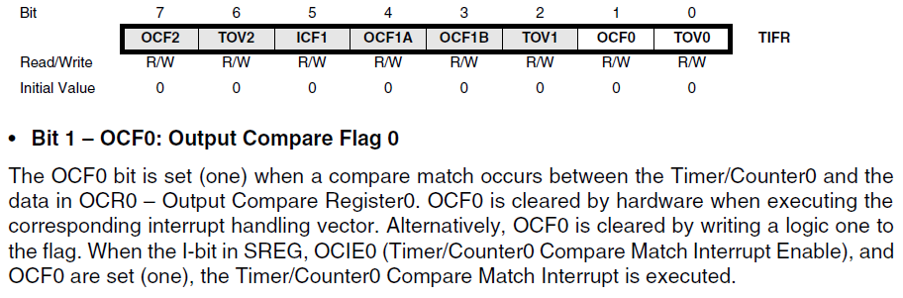
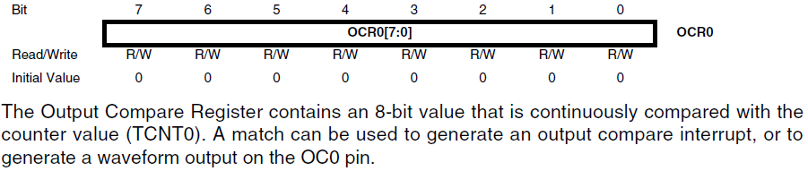

CTC (Clear Timer on Compare match) mode
TCNT0
0xFF
OCR0
OCF0
OCF0
OCF0
0
time
OCR0
xx
0
TOV0:
2
0
1
OCF0:
1
0
TOV0 = no change
OCF0 = 1

Slide 35
Rewrite example 2 using CTC
Example 4: Rewrite example 2 using CTC
For a square wave with T = 10 µs we must have a time delay of 5 µs. Because XTAL = 10 MHz, the counter counts up every 0.1 µs. This means that we need 5 µs / 0.1 µs = 50 clocks. Therefore, we have OCR0= 49.
.INCLUDE "M32DEF.INC"
LDI R16,0x08
SBI DDRB,3 ;PB3 as an output
LDI R17,0
OUT PORTB,R17
LDI R20,49
OUT OCR0,R20 ;load timer0
BEGIN: LDI R20,0x09
OUT TCCR0,R20 ;Timer0,CTC mode,int clk
AGAIN: IN R20,TIFR ;read TIFR
SBRS R20,OCF0 ;if OCF0 is set skip next
RJMP AGAIN
LDI R20,0x0
OUT TCCR0,R20 ;stop Timer0
LDI R20,0x02
OUT TIFR,R20 ;clear OCF0 flag
EOR R17,R16 ;toggle D3 of R17
OUT PORTB,R17 ;toggle PB3
RJMP BEGIN
DDRB |= 1<<3;
PORTB &= ~(1<<3);
while (1)
{
OCR0 = 49;
TCCR0 = 0x09;
while((TIFR&(1<<OCF0))==0);
TCCR0 = 0; //stop timer0
TIFR = 0x02;
PORTB.3 = ~PORTB.3;
}

Slide 36
Timer2
Timer0
Timer2
TCCR0
TCCR2
TCNT0
TCNT2
TOV0
TOV2
=
OCF0
=
OCF2
OCR0
OCR2

Slide 37
The difference between Timer0 and Timer2
Timer0
Timer2
CS02 CS01 CS00 Comment
0 0 0 Timer/Counter stopped
0 0 1 clk (No Prescaling)
0 1 0 clk / 8
0 1 1 clk / 64
1 0 0 clk / 256
1 0 1 clk / 1024
1 1 0 External clock (falling edge)
1 1 1 External clock (rising edge)
CS22 CS21 CS20 Comment
0 0 0 Timer/Counter stopped
0 0 1 clk (No Prescaling)
0 1 0 clk / 8
0 1 1 clk / 32
1 0 0 clk / 64
1 0 1 clk / 128
1 1 0 clk / 256
1 1 1 clk / 1024

Slide 38
Timer 1
OCR1BH OCR1BL
=
OCF1B
TCCR1A
TCCR1B
TCNT1H TCNT1L
TOV1
=
OCF1A
OCR1AH OCR1AL

Slide 39
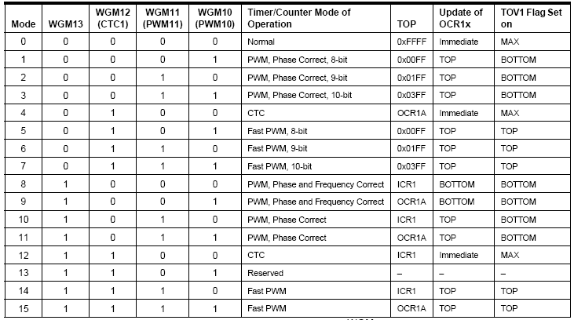

Clock Selector (CS)
CS12 CS11 CS10 Comment
0 0 0 No clock source (Timer/Counter stopped)
0 0 1 clk (No Prescaling)
0 1 0 clk / 8
0 1 1 clk / 64
1 0 0 clk / 256
1 0 1 clk / 1024
1 1 0 External clock source on T0 pin. Clock on falling edge
1 1 1 External clock source on T0 pin. Clock on rising edge

Slide 40
16 – bit Timer / Counter 1
● Two Independent Output Compare Units
● can be used as Pulse Width Modulator (PWM)
● Clear Timer on Compare Match (Auto Reload)
● One Input Capture Unit
● can be used as External Event Counter
● Four Independent Interrupt Sources
TOV1, OCF1A, OCF1B, and ICF1

Slide 41
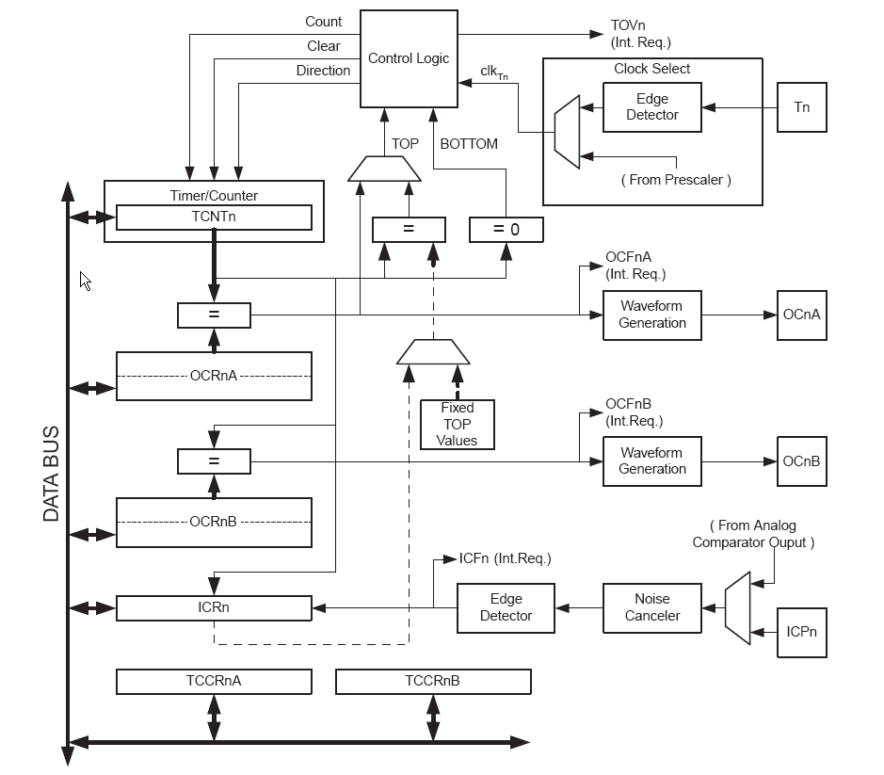
16 – bit Timer / Counter 1
● TCNT1, OCR1A,
OCR1B and ICR1
are 16-bit registers
● write high byte first
read low byte first
(automatically done in C)
● clocking via prescaler or
external clock on pin T1
● output compare register
OCR1A/B can be used
for PWM generation
(output pin: OC1A/B)
or for interrupt request

Slide 42
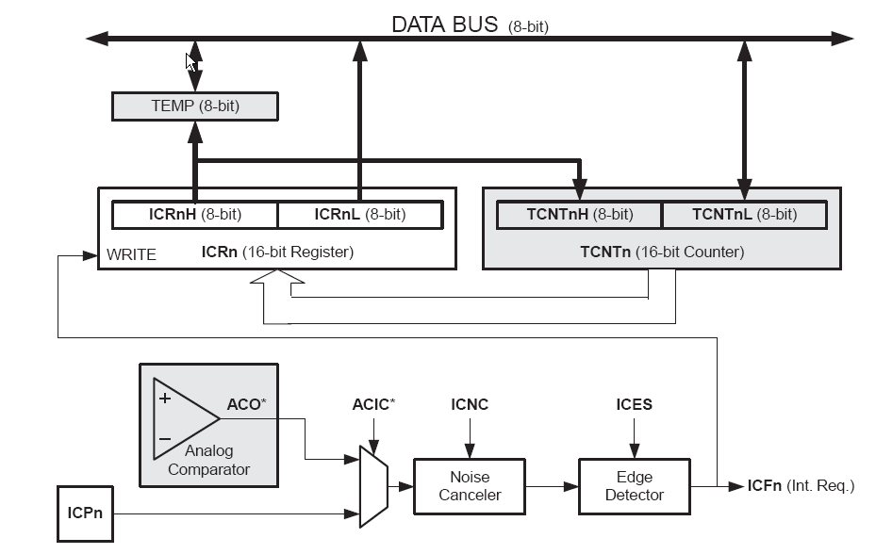
16 – bit Timer / Counter 1
● Input capture Unit: timestamp external events on ICP1 pin (or on Analog comp.)
Can generate Input Capture Interrupt

Slide 43
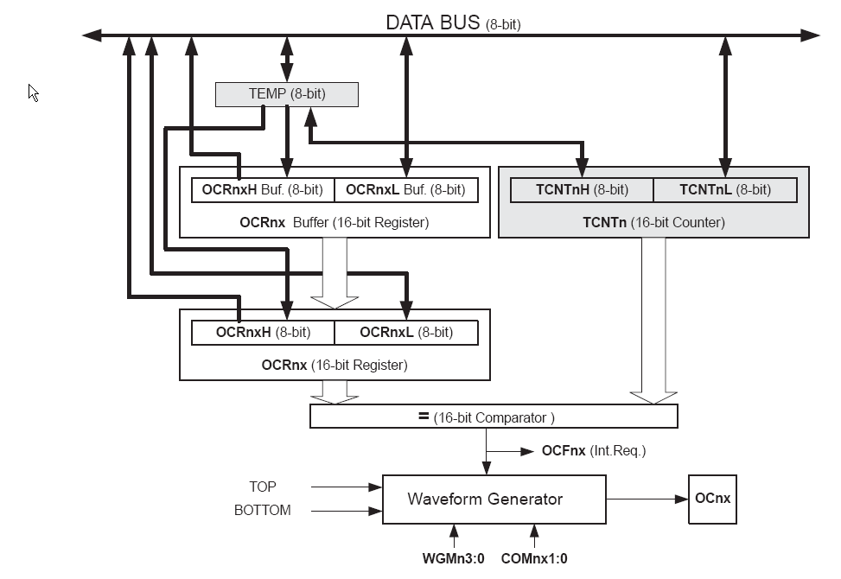
16 – bit Timer / Counter 1
● Output Compare Units: compare TCNT1 with OCR1A and OCR1B
Can generate Output Capture Interrupt
● 13 PWM / Waveform
generation modes
● Top and Bottom values
● Auto reload

Slide 44
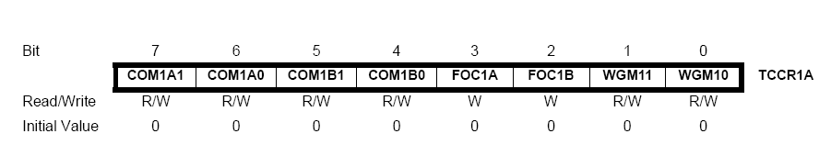
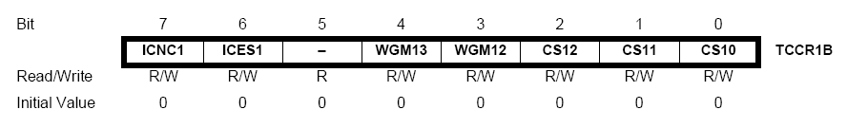
16 – bit Timer / Counter 1
● Mode configuration using TCCR1A and TCCR1B
PWM Mode, set/clear/toggle of OC1A/B, auto-reload, Noise canceller
Find Details in the ATmega8 datasheet !

Slide 45
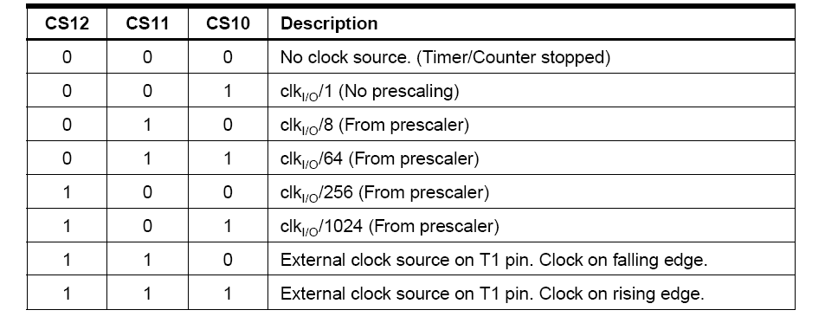
16 – bit Timer / Counter 1
● Clock source configuration using TCCR1B

Slide 46
Assuming XTAL = 10 MHz write a program that toggles PB5 once per millisecond, using Normal mode.
.INCLUDE "M32DEF.INC"
LDI R16,HIGH(RAMEND) ;init stack pointer
OUT SPH,R16
LDI R16,LOW(RAMEND)
OUT SPL,R16
SBI DDRB,5 ;PB5 as an output
BEGIN:SBI PORTB,5 ;PB5 = 1
RCALL DELAY_1ms
CBI PORTB,5 ;PB5 = 0
RCALL DELAY_1ms
RJMP BEGIN
DELAY_1ms:
LDI R20,0xD8
OUT TCNT1H,R20 ;TEMP = 0xD8
LDI R20,0xF0
OUT TCNT1L,R20 ;TCNT1L = 0xF0, TCNT1H = TEMP
LDI R20,0x0
OUT TCCR1A,R20 ;WGM11:10=00
LDI R20,0x1
OUT TCCR1B,R20 ;WGM13:12=00,CS=CLK
AGAIN:IN R20,TIFR ;read TIFR
SBRS R20,TOV1 ;if OCF1A is set skip next instruction
RJMP AGAIN
LDI R20,1<<TOV1
OUT TIFR,R20 ;clear TOV1 flag
LDI R19,0
OUT TCCR1B,R19 ;stop timer
OUT TCCR1A,R19 ;
RET
XTAL = 10 MHz ➔ 1/10 MHz = 0.1 µs
Num. of machine cycles = 1 ms / 0.1 µs = 10,000
TCNT1 = 65,536 – 10,000 = 55,536 = $D8F0
TCNT1H
TCNT1L
LDI R20,HIGH(-10000)
OUT TCNT1H,R20
LDI R20, ,LOW(-10000)
OUT TCNT1L,R20 ;Timer1 overflows after 10000 machine cycles

Slide 47
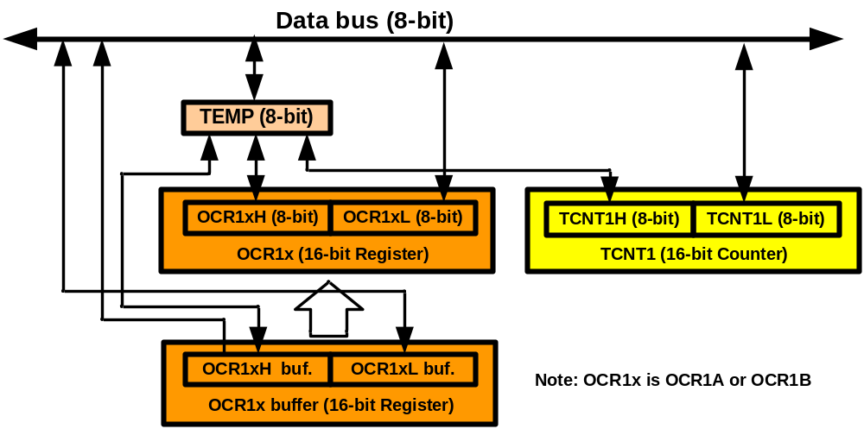
TEMP register
LDI R20,0xF3
OUT TCNT1H,R20
LDI R20,0x53
OUT TCNT1L,R20
IN R20,TCNT1L
IN R21,TCNT1H
a = TCNT1L;
b = TCNT1H;
TCNT1H = 0xF3;
TCNT1L = 0x53;

Slide 48
Assuming XTAL = 10 MHz write a program that toggles PB5 once per millisecond, using CTC mode.
.INCLUDE "M32DEF.INC"
LDI R16,HIGH(RAMEND)
OUT SPH,R16
LDI R16,LOW(RAMEND)
OUT SPL,R16
SBI DDRB,5 ;PB5 as an output
BEGIN:SBI PORTB,5 ;PB5 = 1
RCALL DELAY_1ms
CBI PORTB,5 ;PB5 = 0
RCALL DELAY_1ms
RJMP BEGIN
DELAY_1ms:
LDI R20,0x00
OUT TCNT1H,R20 ;TEMP = 0
OUT TCNT1L,R20 ;TCNT1L = 0, TCNT1H = TEMP
LDI R20,0x27
OUT OCR1AH,R20 ;TEMP = 0x27
LDI R20,0x0F
OUT OCR1AL,R20 ;OCR1AL = 0x0F, OCR1AH = TEMP
LDI R20,0x0
OUT TCCR1A,R20 ;WGM11:10=00
LDI R20,0x09
OUT TCCR1B,R20 ;WGM13:12=01,CS=CLK
AGAIN:
IN R20,TIFR ;read TIFR
SBRS R20,OCF1A ;if OCF1A is set skip next instruction
RJMP AGAIN
LDI R20,1<<OCF1A
OUT TIFR,R20 ;clear OCF1A flag
LDI R19,0
OUT TCCR1B,R19 ;stop timer
OUT TCCR1A,R19 ;
RET

Slide 49
Counting

Slide 50
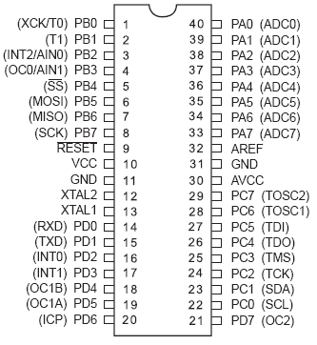
Counting
T0
6
7

Slide 51
Example Assuming that clock pulses are fed into pin T0, write a program for counter 0 in normal mode to count the pulses on falling edge and display the state of the TCNT0 count on PORTC.
.INCLUDE "M32DEF.INC"
CBI DDRB,0 ;make T0 (PB0) input
LDI R20,0xFF
OUT DDRC,R20 ;make PORTC output
LDI R20,0x06
OUT TCCR0,R20 ;counter, falling edge
AGAIN:
IN R20,TCNT0
OUT PORTC,R20 ;PORTC = TCNT0
IN R16,TIFR
SBRS R16,TOV0
RJMP AGAIN ;keep doing it
LDI R16,1<<TOV0
OUT TIFR, R16
RJMP AGAIN ;keep doing it

Slide 52
Assuming that clock pulses are fed into pin T1. Write a program for counter 1 in CTC mode to make PORTC.0 high every 100 pulses.
.INCLUDE "M32DEF.INC"
CBI DDRB,1 ;make T1 (PB1) input
SBI DDRC,0 ;PC0 as an output
LDI R16, 0X01
LDI R17, 0
LDI R20,0x0
OUT TCCR1A,R20
LDI R20,0x0E
OUT TCCR1B,R20 ;CTC, counter, falling edge
AGAIN:
LDI R20,0
OUT OCR1AH,R20 ;TEMP = 0
LDI R20,99
OUT OCR1AL,R20 ;ORC1L = R20, OCR1H = TEMP
L1: IN R20,TIFR
SBRS R20,OCF1A
RJMP L1 ;keep doing it
LDI R20,1<<OCF1A ;clear OCF1A flag
OUT TIFR, R20
EOR R17,R16 ;SBI PORTC,0 ;PC0 = 1
OUT PORTC, R17 ;CBI PORTC,0 ;PC0 = 0
RJMP AGAIN ;keep doing it

Slide 53
Interrupt
Chapter 10

Slide 54
Contents
Polling Vs. interrupt
Interrupt unit
Steps in executing an interrupt
Edge trigger Vs. Level trigger in external interrupts
Timer interrupt
Interrupt priority
Interrupt inside an interrupt
Task switching and resource conflict
C programming

Slide 55
Polling Vs. Interrupt
Interrupt
  Efficient CPU use
  Has priority
  Can be masked
main( )
{
Do your common task
}
whenever PIND.2 is 0 then
do something
Polling
  Ties down the CPU
while (true)
{
if(PIND.2 == 0)
//do something;
}

Slide 56

Real Time Systems Interrupts
3!

Slide 57
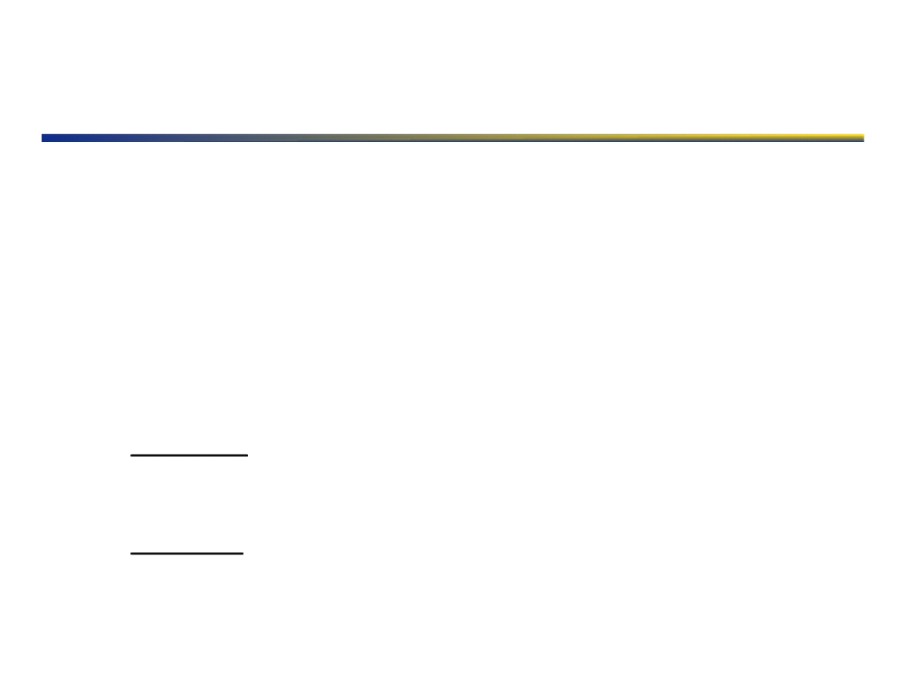
Real Time Systems
” A real-time system is one in which the correctness of the computations not only depends upon the logical correctness of the computation but also upon the time at which the result is produced. If the timing constraints of the system are not met, system failure is said to have occurred. " !
!
Donald Gillies, UBC!
▪ POSIX 1003.1 states: “Realtime in operating systems: the ability of the operating system to provide a required level of service in a bounded response time”!
▪ There are two major classifications of Real Time:!
▪ Hard Real Time is when a task not being completed at the required time causes the operation to fail!
▪ Example: A bottle arrives late to the filling nozzle in a bottling plant, causing the product to be deposited on the conveyor belt and not into the bottle!
▪ Soft Real Time is when a task not being completed at the desired time causes, for example, a decrease in system efficiency, but does not result in total failure!
▪ Example: A bottle arrives early to the filling nozzle, causing the bottle to have to wait until the nozzle can fill it!
4!

Slide 58
Interrupts
▪ How do we stop whatever else the processor is doing at the appropriate time to “focus” on the time-critical task?!
▪ Interrupts!!
▪ low-level CPU function!
▪ External stimulus to the active computations!
▪ Interrupt Request or IRQ!
▪ Causes the CPU to halt the current execution sequence and jump the program counter to a specific address!
▪ Address is called the Interrupt Vector!
▪ Interrupt Vector points to a section of your code that performs whatever actions are required upon that specific IRQ!
▪ This function is called a handler or Interrupt Service Routine (ISR)! ▪ Upon completion of the ISR, the CPU resumes normal program execution from where it left off!
5!

Slide 59
Interrupts - Context Switch
▪ How does the processor switch to the ISR?!
▪ Move the CPU working registers and Program Counter into RAM, ! ▪ Repeat above step in reverse to restore the CPU to the pre-IRQ state once the ISR completes!
▪ This entire process takes a non-trivial amount of time, sometimes on the order of 10s-100s of CPU cycles. See the datasheet for more details.! ▪ Sometimes the CPU hardware will assist with the context switch, but often the software is responsible!
▪ The AVR-GCC compiler implements the required software automatically in its libraries.!
▪ IRQ Sources!
▪ Internal Timers (compared to a specific value or upon overflow)! ▪ External IRQ (a special Input pin function)!
▪ Other Peripherals (UART, I2C, SPI, ADC, Comparator, etc)!
6!

Slide 60
Interrupt Preemption
▪ It is possible that on a particular system there would be multiple real-time tasks, with some tasks being more time critical than others!
▪ Simple Buoy example:!
▪ The ADC can interrupt when its buffer is full, requiring immediate attention to avoid data loss (hard real time)!
▪ The compact flash can also interrupt when it is ready for more data to write, however this is a soft real time task.!
▪ If the ADC signaled while the ISR was running for the compact flash, you would want:!
▪ to run the ISR for the ADC immediately! ▪ then return to the compact flash ISR! ▪ and then resume normal operation.!
9!

Slide 61
Interrupt Preemption
▪ This is called preemption, and can get extremely complex!
▪ Some processors have a hierarchy of IRQ priorities, which can specify which IRQ preempt which ISRs!
▪ Other processors do not have this feature, making preemption quite difficult.!
▪ Some processors will automatically disable all interrupts while one ISR is running (like the AVR Series). In this case, you must manually re- enable global interrupts at the beginning of the ISR for preemption to be possible at all!
▪ Preemption is often required for real time systems that have both soft and hard components, as well as those with multiple interrupt sources of non-equivalent priority!
10!

Slide 62
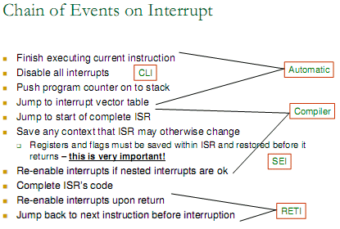
II: Atmega8 – Basic features

Slide 63
II: Atmega8 – Basic features
Interrupt Processing
● several Interrupt Sources:
External Interrupts, Timer, Bus-Peripherals,
ADC, EEPROM
● individual Interrupt-Enable bits in the SFR‘s
● global interrupt enable Bit in SREG,
set with sei() and clear with cli() instruction
● flagged (remembered) and non-flagged interrupt sources
● lowest addresses in program memory reserved
for the interrupt vector table
● higher priority interrupts have lower addresses

Slide 64
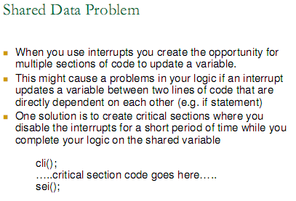
II: Atmega8 – Basic features

Slide 65
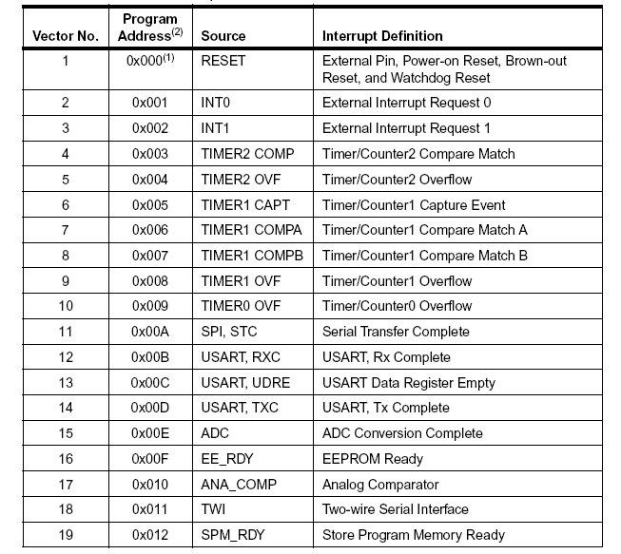
II: Atmega8 – Basic features
Reset-Vector and
Interrupt-Vectors
● Word addresses
0, 1 – 19 in Flash Ram
● When a reset or
interrupt occurs,
the CPU calls
the address
● Install an Interrupt
Handler: modify
the vector table to
jump to your user-
handler
● return from interrupt:
reti

Slide 66
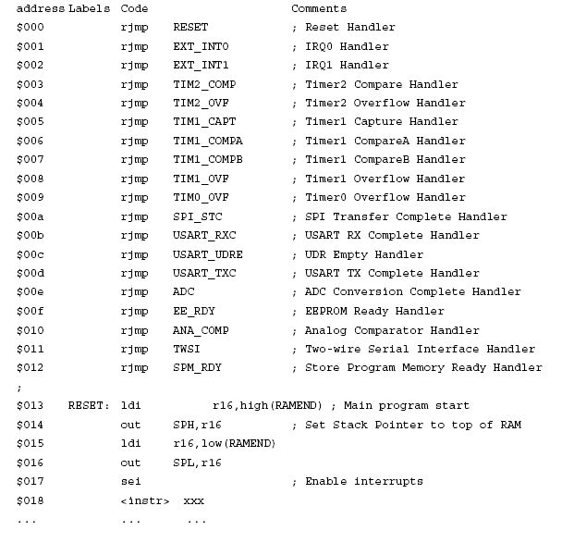
II: Atmega8 – Basic features
Reset-Vector and
Interrupt-Vectors
● example shows
full featured
vector table
● 19 handlers installed
● program execution
after reset:
jmp RESET ($013)
● Main program is
located at $013,
beyond the vectors

Slide 67
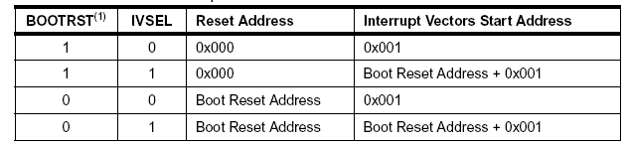
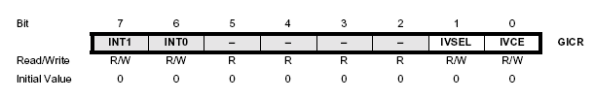
II: Atmega8 – Basic features
Reset- and Interrupt- Vectors
● Reset vector can be set to the Bootloader section using the
BOOTRST fuse bit
● Interrupt vectors can be set to the Bootloader
section using the IVSEL bit of the General Interrupt Contol Register

Slide 68
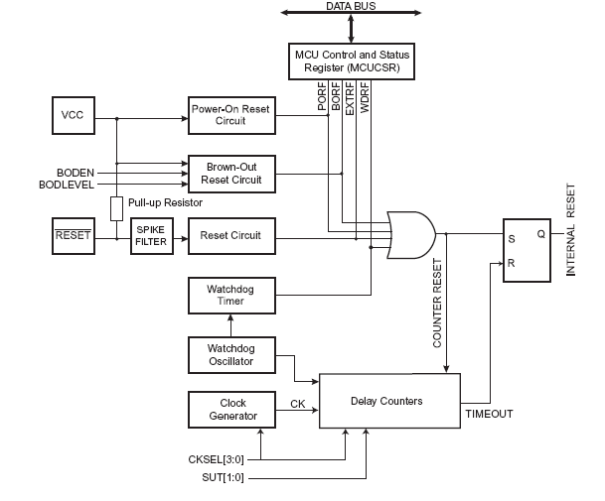
II: Atmega8 – Basic features
AVR Reset Sources:

Slide 69
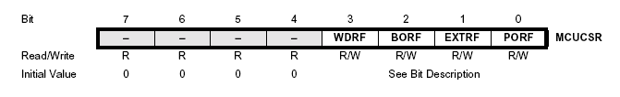
II: Atmega8 – Basic features
Reset Sources:
• Power-on Reset: supply voltage is
below the Power-on Reset threshold
• External Reset: low level is present on
/RESET – input pin
• Watchdog Reset: Watchdog Timer
enabled and period expires
• Brown-out Reset: Brown-out Detector
enabled and supply voltage below
threshold
MCUCSR provides information on which reset source caused a CPU reset

Slide 70
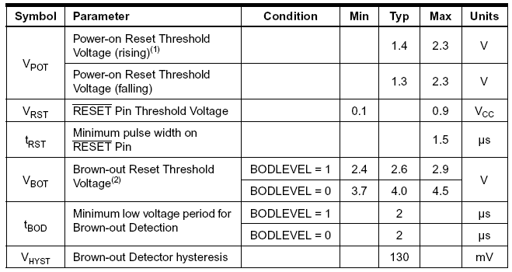
II: Atmega8 – Basic features
Reset Voltage Thresholds

Slide 71
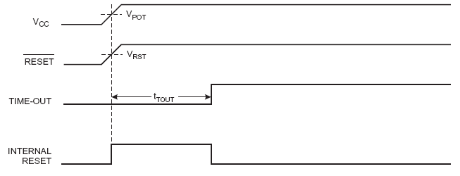
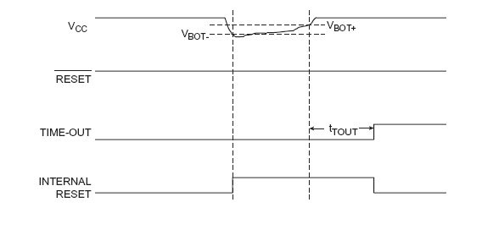
II: Atmega8 – Basic features
Reset Voltage Thresholds:
Example:
Power-on Reset
Example:
Brown Out Reset

Slide 72
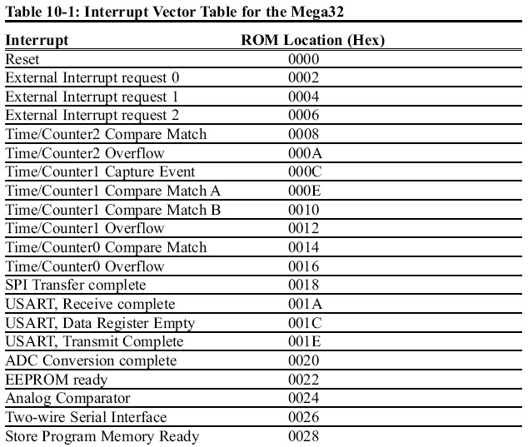
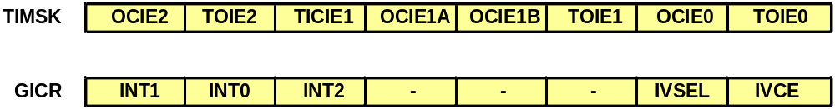
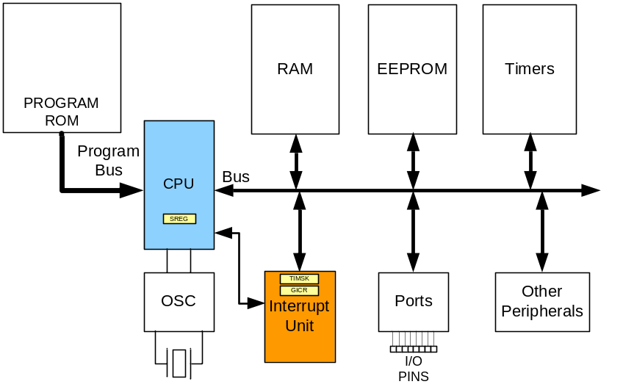
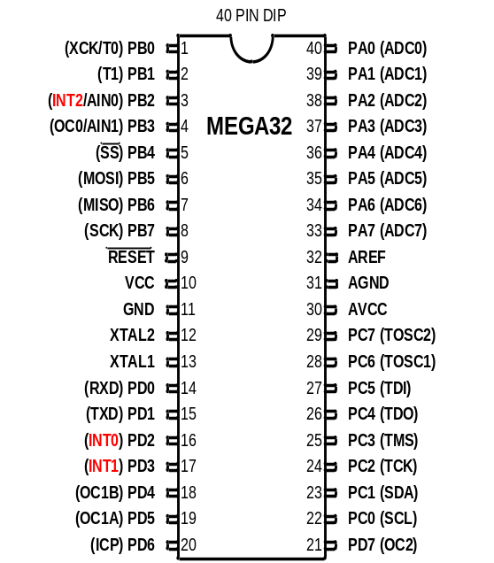
Interrupt unit

Slide 73
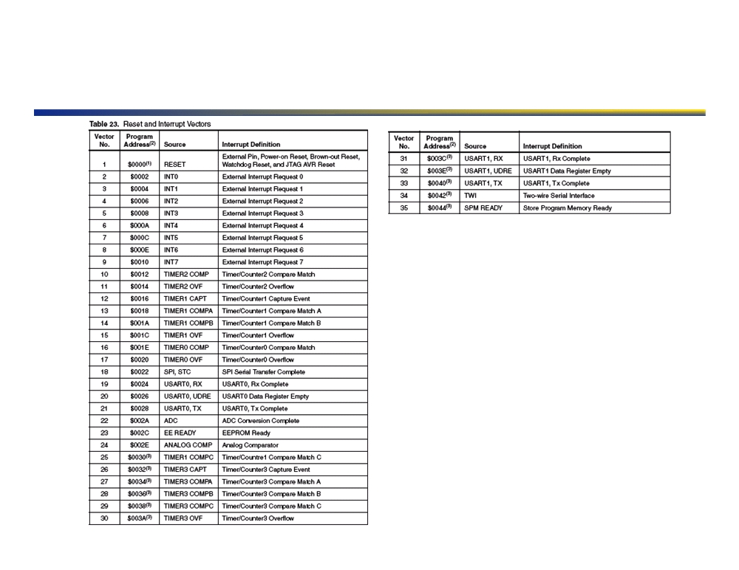
Example: AtMega128 Interrupts
7!

Slide 74


Slide 75
Steps in executing an interrupt
Address
Code
PB0
1
2
3
4
5
6
7
8
9
10
11
12
13
14
15
16
17
18
19
20
40
39
38
37
36
35
34
33
32
31
30
29
28
27
26
25
24
23
22
21
VCC
.INCLUDE "M32DEF.INC"
.ORG 0 ;location for reset
JMP MAIN
.ORG 0x02 ;location for external INT0
JMP EX0_ISR
MAIN: LDI R20,HIGH(RAMEND)
OUT SPH,R20
LDI R20,LOW(RAMEND)
OUT SPL,R20
SBI DDRC,3 ;PC.3 = output
SBI PORTD,2 ;pull-up activated
LDI R20,1<<INT0 ;Enable INT0
OUT GICR,R20
SEI ;Set I (Enable Interrupts)
LDI R30, 3
LDI R31, 4
ADD R30, R31
HERE:JMP HERE
EX0_ISR:IN R21,PORTC
LDI R22,0x08
EOR R21,R22
OUT PORTC,R21
RETI
PB1
0002
PA0 (ADC0)
0000 0002 0002 0004 0005 0006 0007 0008 0009 000A 000B 000C 000D 000E 000F 0010 0012 0013 0014 0015 0016
(INT2) PB2
PA1 (ADC1)
(OC0/AIN0) PB3
PA2 (ADC2)
(SS) PB4
ATmega32
PA3 (ADC3)
(MOSI) PB5
PA4 (ADC4)
(MISO) PB6
0012
PA5 (ADC5)
0013
0014
0015
0016
000D
000A
0009
000C
000B
0008
0006
000F
000E
0004
0007
0005
PC:
0000
(SCK) PB7
PA6 (ADC6)
RESET
PA7 (ADC7)
VCC
AGND
GND
AVCC
XTAL2
PC7 (TOSC2)
XTAL1
PC6 (TOSC1)
00
(RXD) PD0
PC5 (TDI)
0F
(TXD) PD1
SP
PC4 (TDO)
(INT0) PD2
PC3 (TMS)
(INT1) PD3
PC2 (TCK)
(OC1B) PD4
Stack
PC1 (SDA)
(OC1A) PD5
PC0 (SCL)
(ICP) PD6
PD7 (OC2)

Slide 76

Interrupt Example Code
▪ Several steps are necessary on the ATmega to enable interrupts!
▪ The control register that is responsible for the interrupt you desire must be configured to generate an IRQ upon an event!
▪ An ISR must be defined!
▪ Global Interrupts must be enabled!
Software example to interrupt on an external pin!
#include <io.h>
#include <signal.h> #include <interrupt.h>
▪ SIGNAL(SIG_INTERRUPT0)
/* signal handler for external interrupt int0 */
{
/* Do whatever you want to have happen during the interrupt here */
}
int main(void) {
DDRB = 0x00; /* use Port D for input*/
EIMSK = (1<<INT0); /* Enable external interrupt 0 */ sei(); /* enable interrupts */
for (;;) { /*Your main loop here */ }
}
8!

Slide 77


II: Atmega8 – Basic features
External Interrupts Int0 and Int1:
• Int0 connected to PD2
• Int1 connected to PD3
• asynchronous operation: can wake up CPU
• rising/falling edge or low level can trigger interrupt,
defined by Interrupt Sense control – bits of MCUCR SFU

Slide 78


II: Atmega8 – Basic features
External Interrupts Int0 and Int1:
• Int0 and Int1 have to be enabled by the GICR (+ I-bit in SREG)
• flagged interrupts: General Interrupt Flag Register (GIFR)
indicates when an interrupt request happened
• flags are cleared by executing the interrupt service routine (ISR)
or by writing 1 to the flag bit of GIFR

Slide 79

Edge trigger Vs. Level trigger in external interrupts
LDI R20,0x02 ;falling
OUT MCUCR,R20

Slide 80

Edge trigger Vs. Level trigger (Cont.)

Slide 81
Timers Interrupts
▪ Timers are counters that are incremented on a clock tick, or after a certain number of clock ticks!
▪ Clock Sources, availability dependent on peripheral!
▪ Main Oscillator (16MHz / 8MHz)!
▪ Watch Crystal (32.768KHz)! ▪ External Clock!
▪ Often Scaled internally!
▪ Factors of 1, 8, 64, 256, 1024 on AVR!
▪ Interrupts, flags, and pin state changes can be generated on timer overflow or compare!
▪ High resolution timers by comparing with a target value! ▪ Long running timers by counting overflows! ▪ Pulse-Width Modulation!
12!

Slide 82
II: Atmega8 – Basic features
8-bit Timer / Counter0 for AVR 8
• 10-bit clock Prescaler
timer-clk (t0) = clk (IO) / prescaler
• External clock source T0 connected to PD4
cannot be prescaled, clk(ext) <= clk (IO) / 2.5

Slide 83

8-bit Timer Peripheral
Sample 8-bit Timer on the ATmega128!
<- Timer control register (TCCR)!
External!
Oscillator!
Current Timer! Value (TCNT)!
Output Compare!
Waverform Generator!
(OCR)!
13!

Slide 84
II: Atmega8 – Basic features
8-bit Timer / Counter0 - prescaler operation
No prescaler
MAX=0xff
BOTTOM=0
Prescaler = 8

Slide 85
II: Atmega8 – Basic features
8-bit Timer / Counter0 usage
Timer/Counter0 Control Register (TCCR0), Bits CS02-CS00
select Clock Source and Prescaler Value :

Slide 86
II: Atmega8 – Basic features
8-bit Timer / Counter0 usage
Timer/Counter0 Register (TCNT0) :
read/write, incremented per CLK cycle, overflow: 0xff
• A Reload-Value is used to fine-tune the interrupt interval
• write Reload-Value to TCNT0 in the ISR

Slide 87
II: Atmega8 – Basic features
8-bit Timer / Counter0 usage
Timer/Counter Interrupt Mask Register (TIMSK) :
Bit 0 : Timer 0 interrupt enable
set 1 to enable timer 0 overflow interrupt ( + I-Bit in SREG)
Timer Interrupt Flag Register (TIFR) :
TOV0 indicates a Timer0 overflow, cleared by hardware when
the ISR is executed or by writing 1 to the flag

Slide 88

Using Timer0 overflow interrupt
This program uses Timer0 to generate a square wave on pin PORTB.5, while at the same time data is being transferred from PORTC to PORTD.
Timer int.
init.
1
2
3
4
5
6
7
8
9
10
11
12
13
14
15
16
17
;Program 10-1
.INCLUDE "M32DEF.INC"
.ORG 0x0 ;location for reset
JMP MAIN
.ORG 0x16 ;loc. for Timer0 over.
JMP T0_OV_ISR
;----main program for initialization
.ORG 0x100
MAIN: LDI R20,HIGH(RAMEND)
OUT SPH,R20
LDI R20,LOW(RAMEND)
OUT SPL,R20
SBI DDRB,5 ;output
LDI R20,0
OUT DDRC, R20
LDI R20,0xFF
OUT DDRD, R20
18
19
20
21
22
23
24
25
26
27
28
29
30
31
32
33
34
LDI R20,(1<<TOIE0)
OUT TIMSK,R20
SEI
LDI R20,-32 ;value for 4µs
OUT TCNT0,R20
LDI R20,0x01
OUT TCCR0,R20
HERE: IN R20,PINC
OUT PORTD,R20
JMP HERE
;--------ISR for Timer 0
T0_OV_ISR:
IN R16,PORTB
LDI R17,0x20
EOR R16,R17
OUT PORTB,R16
RETI
Timer init.

Slide 89

Timer0 compare match interrupt
using Timer0 and CTC mode generate a square wave on pin PORTB.5, while at the same time data is being transferred from PORTC to PORTD.
.INCLUDE "M32DEF.INC"
.ORG 0x0 ;location for reset
JMP MAIN
.ORG 0x14 ;location for Timer0 compare match
JMP T0_CM_ISR
;-main program for initialization and keeping CPU busy
.ORG 0x100
MAIN: LDI R20,HIGH(RAMEND)
OUT SPH,R20
LDI R20,LOW(RAMEND)
OUT SPL,R20
LDI R20,39
OUT OCR0,R20 ;OCR0 = 39
LDI R20,0x09
OUT TCCR0,R20 ;Start Timer0
SBI DDRB,5 ;PB5 as an output
LDI R20,(1<<OCIE0) ;Timer0 compare match
OUT TIMSK,R20
SEI ;Set I
LDI R20,0x00
OUT DDRC,R20 ;make PORTC input
LDI R20,0xFF
OUT DDRD,R20 ;make PORTD output
Time (µS)
HERE: IN R20,PINC
OUT PORTD,R20
JMP HERE
;--------ISR for Timer 0
T0_CM_ISR:
IN R16,PORTB
LDI R17,0x20
EOR R16,R17
OUT PORTB,R16
RETI
Timer init.
Timer int.
init.

Slide 90
Interrupt priority
Highest priority
Lowest priority

Slide 91
Interrupt inside an interrupt
The I flag is cleared when the AVR begins to execute an ISR. So, interrupts are disabled.
The I flag is set when RETI is executed.

Slide 92
Task switching and resource conflict
Does the following program work?
1
2
3
4
5
6
7
8
9
10
11
12
13
14
15
16
.INCLUDE "M32DEF.INC"
.ORG 0x0 ;location for reset
JMP MAIN
.ORG 0x14 ;Timer0 compare match
JMP T0_CM_ISR
;---------main program------------------------------
.ORG 0x100
MAIN: LDI R20,HIGH(RAMEND)
OUT SPH,R20
LDI R20,LOW(RAMEND)
OUT SPL,R20 ;set up stack
SBI DDRB,5 ;PB5 = output
LDI R20,160
OUT OCR0,R20
LDI R20,0x09
OUT TCCR0,R20
17
18
19
20
21
22
23
24
25
26
27
28
29
30
31
32
LDI R20,(1<<OCIE0)
OUT TIMSK,R20
SEI
LDI R20,0xFF
OUT DDRC,R20
OUT DDRD,R20
LDI R20, 0
HERE: OUT PORTC,R20
INC R20
JMP HERE
;--------------------------ISR for Timer0
T0_CM_ISR:
IN R20,PIND
INC R20
OUT PORTD,R20
RETI

Slide 93
Solution 1: different registers
Use different registers for different tasks.
1
2
3
4
5
6
7
8
9
10
11
12
13
14
15
16
.INCLUDE "M32DEF.INC"
.ORG 0x0 ;location for reset
JMP MAIN
.ORG 0x14 ;Timer0 compare match
JMP T0_CM_ISR
;---------main program------------------------------
.ORG 0x100
MAIN: LDI R20,HIGH(RAMEND)
OUT SPH,R20
LDI R20,LOW(RAMEND)
OUT SPL,R20 ;set up stack
SBI DDRB,5 ;PB5 = output
LDI R20,160
OUT OCR0,R20
LDI R20,0x09
OUT TCCR0,R20
17
18
19
20
21
22
23
24
25
26
27
28
29
30
31
32
LDI R20,(1<<OCIE0)
OUT TIMSK,R20
SEI
LDI R20,0xFF
OUT DDRC,R20
OUT DDRD,R20
LDI R20, 0
HERE: OUT PORTC,R20
INC R20
JMP HERE
;--------------------------ISR for Timer0
T0_CM_ISR:
IN R21,PIND
INC R21
OUT PORTD,R21
RETI

Slide 94
Solution 2: Context saving
Save the contents of registers on the stack before execution of each task, and reload the registers at the end of the task.
1
2
3
4
5
6
7
8
9
10
11
12
13
14
15
16
17
.INCLUDE "M32DEF.INC"
.ORG 0x0 ;location for reset
JMP MAIN
.ORG 0x14 ;Timer0 compare match
JMP T0_CM_ISR
;---------main program------------------------------
.ORG 0x100
MAIN: LDI R20,HIGH(RAMEND)
OUT SPH,R20
LDI R20,LOW(RAMEND)
OUT SPL,R20 ;set up stack
SBI DDRB,5 ;PB5 = output
LDI R20,160
OUT OCR0,R20
LDI R20,0x09
OUT TCCR0,R20
LDI R20,(1<<OCIE0)
18
19
20
21
22
23
24
25
26
27
28
29
30
31
32
33
34
OUT TIMSK,R20 SEI
LDI R20,0xFF
OUT DDRC,R20
OUT DDRD,R20
LDI R20, 0
HERE: OUT PORTC,R20
INC R20
JMP HERE
;--------------------------ISR for Timer0
T0_CM_ISR:
PUSH R20 ;save R20
IN R20,PIND
INC R20
OUT PORTD,R20
POP R20 ;restore R20
RETI

Slide 95
Saving SREG
We should save SREG, when we change flags in the ISR.
PUSH R20
IN R20,SREG
PUSH R20
...
POP R20
OUT SREG,R20
POP R20

Slide 96

C programming
Using Timer0 generate a square wave on pin PORTB.5, while at the same time transferring data from PORTC to PORTD.
#include "avr/io.h"
#include "avr/interrupt.h"
int main ()
{
DDRB |= 0x20; //DDRB.5 = output
TCNT0 = -32; //timer value for 4 µs
TCCR0 = 0x01; //Normal mode, int clk, no prescaler
TIMSK = (1<<TOIE0); //enable Timer0 overflow interrupt
sei (); //enable interrupts
DDRC = 0x00; //make PORTC input
DDRD = 0xFF; //make PORTD output
while (1) //wait here
PORTD = PINC;
}
ISR (TIMER0_OVF_vect) //ISR for Timer0 overflow
{
TCNT0 = -32;
PORTB ^= 0x20; //toggle PORTB.5
}
sei ( ); //set I
cli ( ); //clear I

Slide 97
C programming Example 2
Using Timer1 and CTC mode write a program that toggles pin PORTB.5 every second, while at the same time transferring data from PORTC to PORTD. Assume XTAL = 8 MHz.
#include "avr/io.h"
#include "avr/interrupt.h"
int main ()
{
DDRB |= 0x20; //make DDRB.5 output
OCR0 = 40;
TCCR0 = 0x09; //CTC mode, internal clk, no prescaler
TIMSK = (1<<OCIE0); //enable Timer0 compare match int.
sei (); //enable interrupts
DDRC = 0x00; //make PORTC input
DDRD = 0xFF; //make PORTD output
while (1) //wait here
PORTD = PINC;
}
ISR (TIMER0_COMP_vect) //ISR for Timer0 compare match
{
PORTB ^= 0x20; //toggle PORTB.5
}

Slide 98
C programming Example 3
Assume that the INT0 pin is connected to a switch that is normally high. Write a program that toggles PORTC.3, whenever INT0 pin goes low. Use the external interrupt in level-triggered mode.
#include "avr/io.h"
#include "avr/interrupt.h"
int main ()
{
DDRC = 1<<3; //PC3 as an output
PORTD = 1<<2; //pull-up activated
GICR = (1<<INT0); //enable external interrupt 0
sei (); //enable interrupts
while (1); //wait here
}
ISR (INT0_vect) //ISR for external interrupt 0
{
PORTC ^= (1<<3); //toggle PORTC.3
}

Slide 99

Timer Overflow Example Code
Sample Timer Overflow C Code!
#include <io.h>
#include <interrupt.h> #include <signal.h>
SIGNAL(SIG_OVERFLOW0)
/* ISR for TCNT0 overflow */
{
/* DO YOUR WORK HERE */
TCNT0 = 0;
/* Reset TCNT0 to get the interrupt again */
}
void main(void)
{
TCCR0 = 0x05;
/* TCNT0 is clocked with cpu/1024 clock */
TIMSK = 1<<TOIE0;
/* Timer Overflow Interrupt Enable on TCNT0 */
TCNT0 = 0;
/* Reset TCNT0 */
sei();
/* Enable interrupts */
for (;;) {
/* Main loop */
}
}
15!

Slide 100

Pulse Width Modulation
▪ Vary the duty cycle of a fixed period “square” wave to vary output power!
▪ DC Motor Speed Control, LED Brightness, Servo Positioning, “Poor-manʼs DAC”!
▪ Waveform Generator / Output Compare module!
▪ Coupled with timer peripheral!
http://www.ece.utep.edu/courses/web3376/concepts/pwm.html!
16!

Slide 101
PWM Example Code (1/2)
#include <io.h>!
#include <interrupt.h>! #include <signal.h>!
void main(void)! {!
!DDRL=0x38;!
!PORTL=PORTL | 0x38; //start off with the tri-color LED off! !for (;;) {!
!
!/* Main loop */!
!}! }!
17!

Slide 102
PWM Example Code (2/2)
void ColorCycle( void )!
{!
!//First, set up the timer/counter #5 for the color LED control! !TCCR5A = (1 << COM5A1) | (1 << COM5B1) | (1 << COM5C1) | (1 << WGM50);!
! TCCR5B = (1 << CS52) | (1 << CS50) | (1 << WGM52); // clk/1024, PWM (mode 5 in table 82 of datasheet)! !//Start with just green!
!OCR5A = 255;!
!OCR5B = 255;! !OCR5C = 0;! !sei();!
!while ( 1 )! !{!
!
!for (OCR5A = 255; OCR5A>1; OCR5A--)!
!
!
!DelayMS();!
!
!for (OCR5C = 0; OCR5C<255; OCR5C++)!
!
!
!DelayMS();!
!
!for (OCR5B = 255; OCR5B>1; OCR5B--)!
!
!
!DelayMS();!
!
!for (OCR5A = 0; OCR5A<255; OCR5A++)!
!
!
!DelayMS();!
!
!for (OCR5C = 255; OCR5C>1; OCR5C--)!
!
!
!DelayMS();!
!
!for (OCR5B = 0; OCR5B<255; OCR5B++)!
!
!
!DelayMS();!
!}! }!
18!

Slide 103

ATmega2560 Interrupt Unit
3!

Slide 104
Pulse Width Modulation
▪ Vary the duty cycle of a fixed period “square” wave to vary output power!
▪ DC Motor Speed Control, LED Brightness, Servo Positioning, “Poor-manʼs DAC”!
▪ Waveform Generator / Output Compare module!
▪ Coupled with timer peripheral!
http://www.ece.utep.edu/courses/web3376/concepts/pwm.html!
4!

Slide 105
PWM Example Code (1/2)
#include <io.h>!
#include <interrupt.h>! #include <signal.h>!
void main(void)! {!
!DDRL=0x38;!
!PORTL=PORTL | 0x38; //start off with the tri-color LED off! !for (;;) {!
!
!/* Main loop */!
!}! }!
5!

Slide 106
PWM Example Code (2/2)
void ColorCycle( void )!
{!
!//First, set up the timer/counter #5 for the color LED control! !TCCR5A = (1 << COM5A1) | (1 << COM5B1) | (1 << COM5C1) | (1 << WGM50);!
! TCCR5B = (1 << CS52) | (1 << CS50) | (1 << WGM52); // clk/1024, PWM (mode 5 in table 82 of datasheet)! !//Start with just green!
!OCR5A = 255;!
!OCR5B = 255;! !OCR5C = 0;! !sei();!
!while ( 1 )! !{!
!
!for (OCR5A = 255; OCR5A>1; OCR5A--)!
!
!
!DelayMS();!
!
!for (OCR5C = 0; OCR5C<255; OCR5C++)!
!
!
!DelayMS();!
!
!for (OCR5B = 255; OCR5B>1; OCR5B--)!
!
!
!DelayMS();!
!
!for (OCR5A = 0; OCR5A<255; OCR5A++)!
!
!
!DelayMS();!
!
!for (OCR5C = 255; OCR5C>1; OCR5C--)!
!
!
!DelayMS();!
!
!for (OCR5B = 0; OCR5B<255; OCR5B++)!
!
!
!DelayMS();!
!}! }!
6!

