Slide 1
Timer/counter
Chapter 9

Slide 2
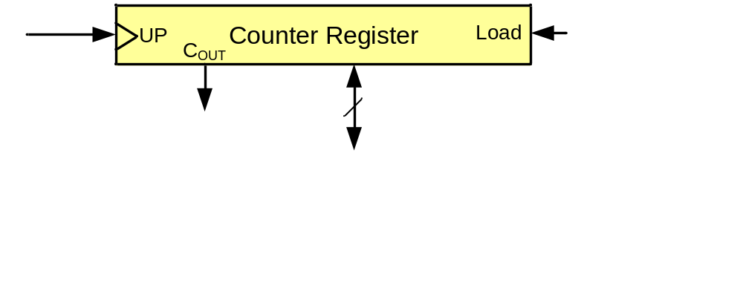
A counter register

Slide 3
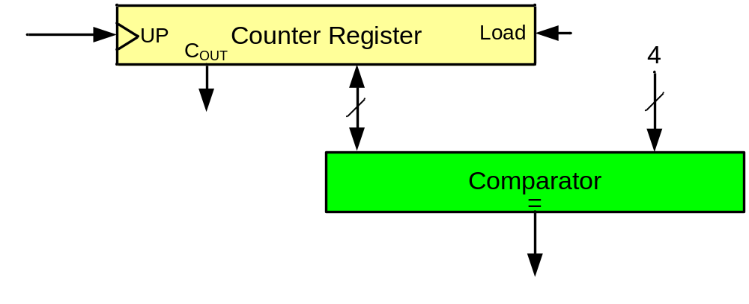
A simple design (counting people)
First design
Sensor

Slide 4
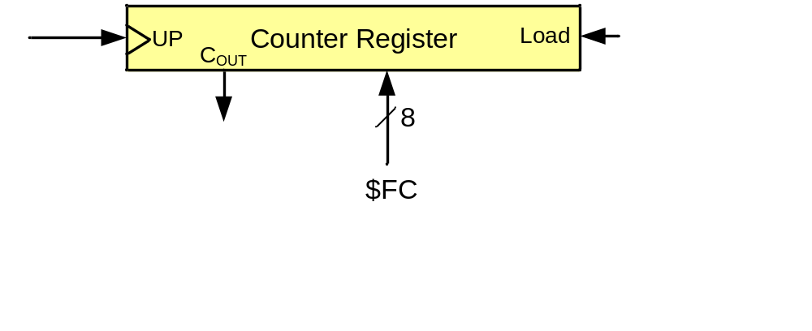
A simple design (counting people)
Second design
Sensor

Slide 5
A simple design (making delay)

Slide 6
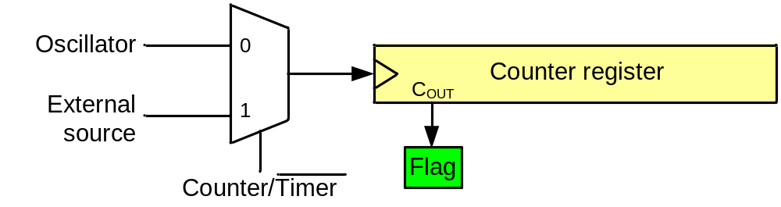
A generic timer/counter
Delay generating
Counting
Wave-form generating
Capturing

Slide 7
Timers in AVR
1 to 6 timers
  3 timers in ATmega32
8-bit and 16-bit timers
  two 8-bit timers and one 16-bit timer in ATmega32

Slide 8
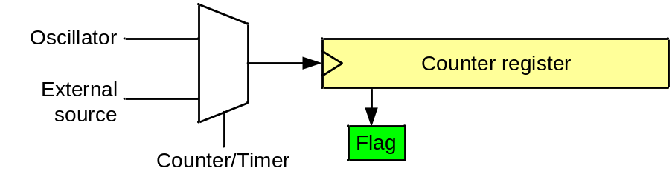
Timer in AVR
TCNTn (Timer/Counter register)
TOVn (Timer Overflow flag)
TCCRn (Timer Counter control register)
OCRn (output compare register)
OCFn (output compare match flag)
TCCRn
TCNTn
TOVn
=
OCFn
Comment:
All of the timer registers are byte-addressable I/O registers
OCRn

Slide 9
Timer 0 (an 8-bit timer)

Slide 10
Timer 0
TCCR0
TCNT0
TOV0
=
OCF0
OCR0

Slide 11
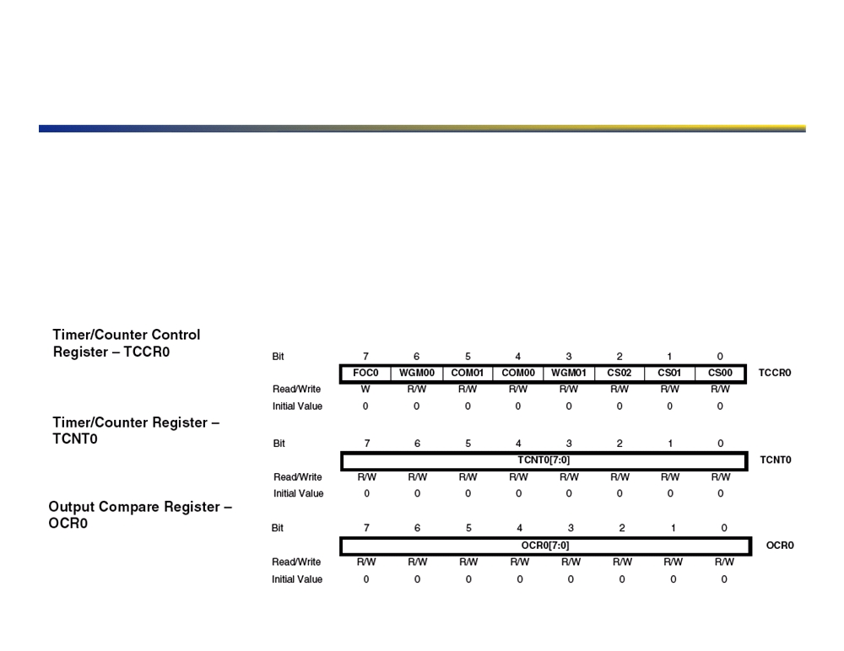
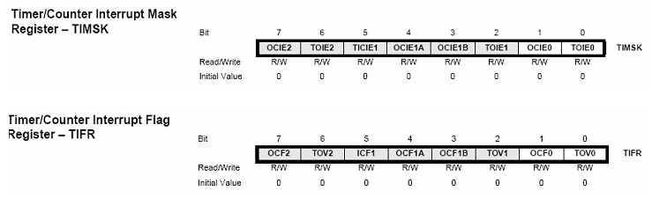
Timer Registers
▪ Three main registers in diagram, plus two more, to interact with this particular timer!
▪ TCCR controls the timer functioning, waveform generation mode (PWM, etc), and clock prescaling! ▪ TCNT contains the current clock value, which can be reset and changed at will. Remember that this is incremented by the pre-scaled clock as configured by the TCCR register!
▪ OCR contains the target clock value at which time an interrupt should be generated or a pin state should be changed!
▪ A fourth register, ASSR, which is not show on the functional diagram is used on this particular timer to select between the internal and external clocks, as well as indicate when the timer is busy! ▪ TIMSK (Timer Interrupt MaSK), also not shown, is used to enable interrupts on specific timer events!
14!

Slide 12
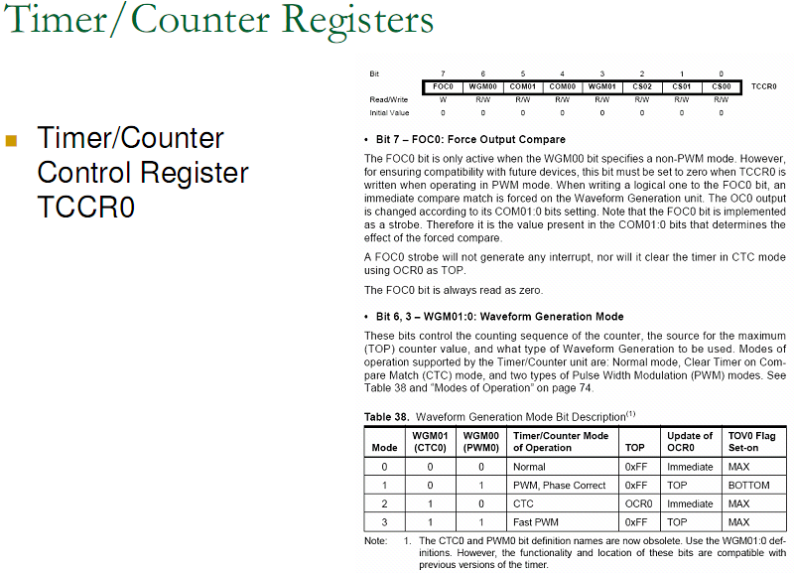

Slide 13
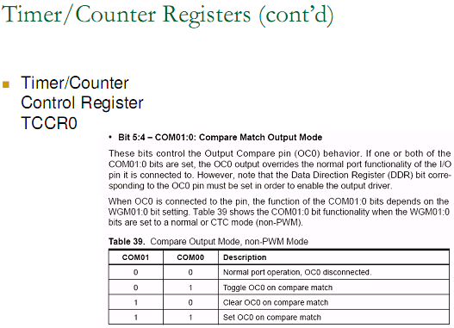

Slide 14
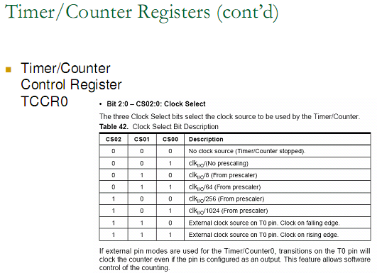

Slide 15
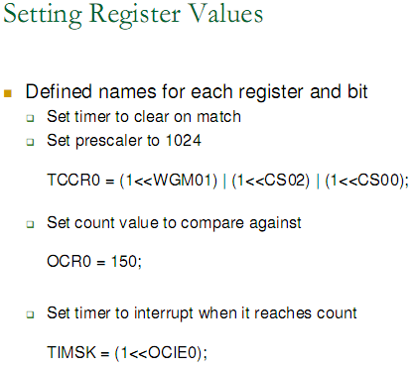

Slide 17
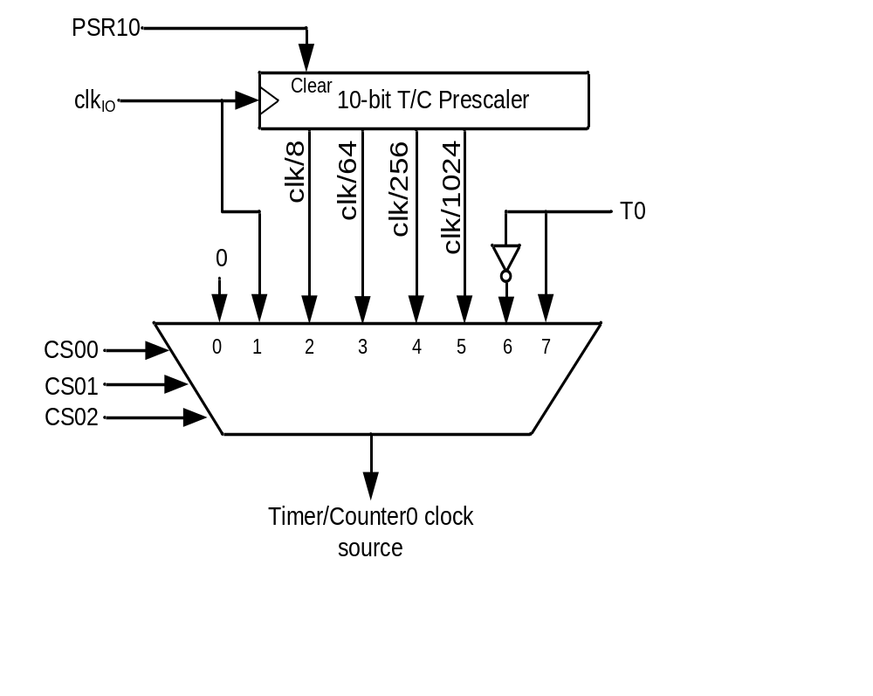
Clock Selector (CS)
Timer Mode (WGM)
CS02 CS01 CS00 Comment
0 0 0 No clock source (Timer/Counter stopped)
0 0 1 clk (No Prescaling)
0 1 0 clk / 8
0 1 1 clk / 64
1 0 0 clk / 256
1 0 1 clk / 1024
1 1 0 External clock source on T0 pin. Clock on falling edge
1 1 1 External clock source on T0 pin. Clock on rising edge
WGM00 WGM01 Comment
0 0 Normal
0 1 CTC (Clear Timer on Compare Match)
1 0 PWM, phase correct
1 1 Fast PWM

Slide 18
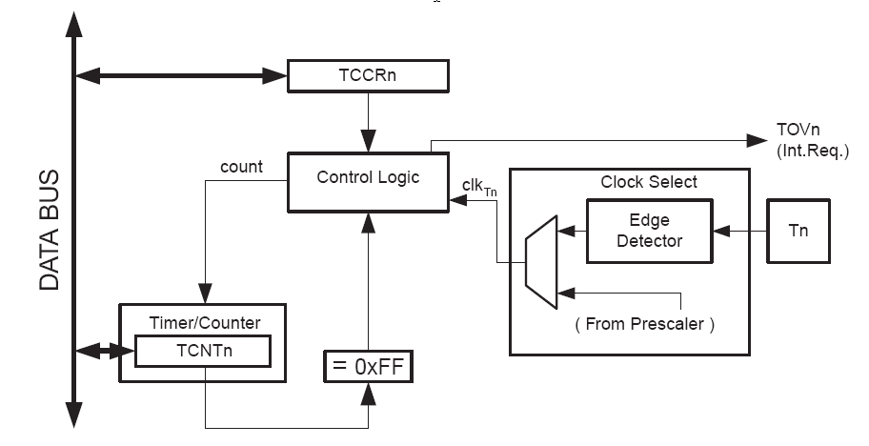
II: Atmega8 – Basic features
8-bit Timer / Counter0
• 10-bit clock Prescaler
timer-clk (t0) = clk (IO) / prescaler
• External clock source T0 connected to PD4
cannot be prescaled, clk(ext) <= clk (IO) / 2.5

Slide 19
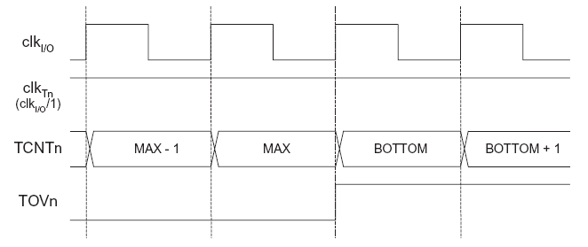
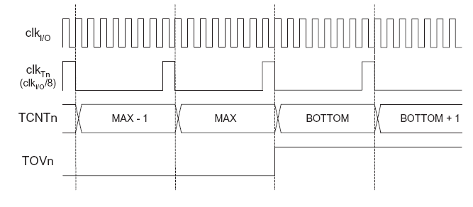
II: Atmega8 – Basic features
8-bit Timer / Counter0 - prescaler operation
No prescaler
MAX=0xff
BOTTOM=0
Prescaler = 8

Slide 20
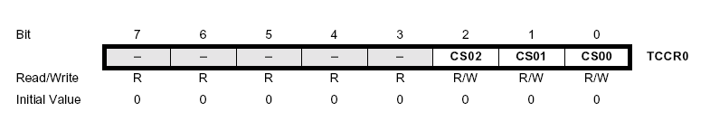
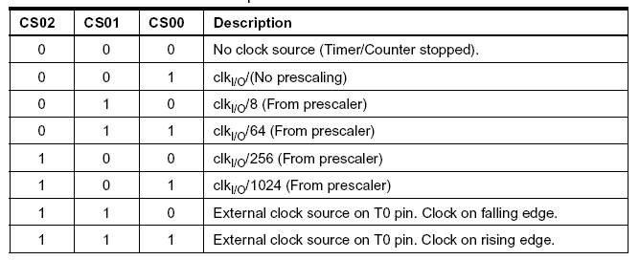
II: Atmega8 – Basic features
8-bit Timer / Counter0 usage
Timer/Counter0 Control Register (TCCR0), Bits CS02-CS00
select Clock Source and Prescaler Value :

Slide 21
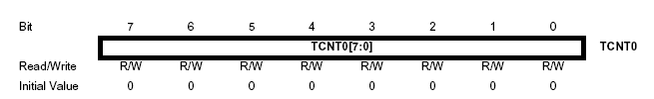
II: Atmega8 – Basic features
8-bit Timer / Counter0 usage
Timer/Counter0 Register (TCNT0) :
read/write, incremented per CLK cycle, overflow: 0xff
• A Reload-Value is used to fine-tune the interrupt interval
• write Reload-Value to TCNT0 in the ISR

Slide 22
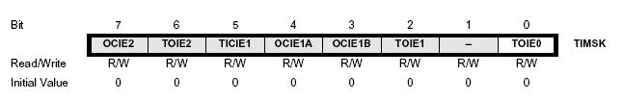
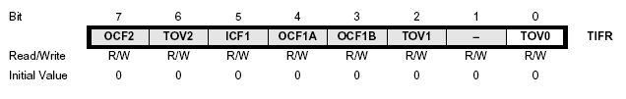
II: Atmega8 – Basic features
8-bit Timer / Counter0 usage
Timer/Counter Interrupt Mask Register (TIMSK) :
Bit 0 : Timer 0 interrupt enable
set 1 to enable timer 0 overflow interrupt ( + I-Bit in SREG)
Timer Interrupt Flag Register (TIFR) :
TOV0 indicates a Timer0 overflow, cleared by hardware when
the ISR is executed or by writing 1 to the flag

Slide 23

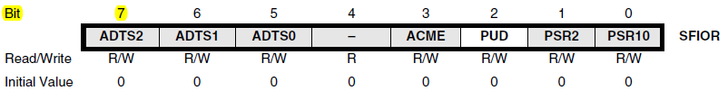
Where does PSR10 come from?

Slide 24
Normal mode
TCNT0
0xFF
TOV
TOV
TOV
0
time
FF
0
FE
TOV0:
1
2
1
0
TOV0 = 1

Slide 25
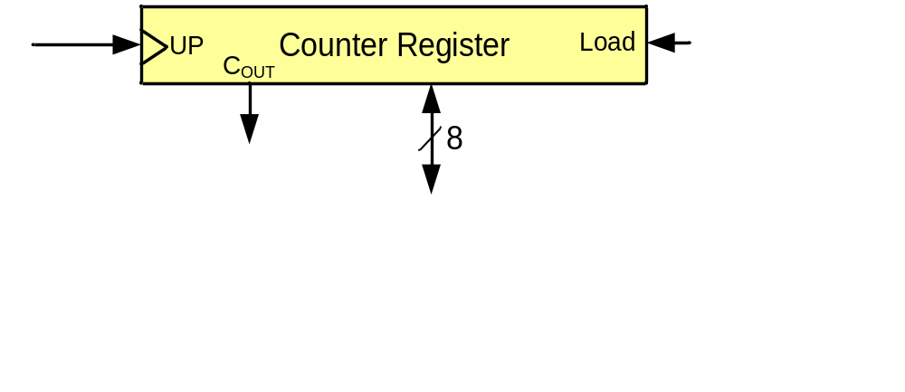
Example 1: Write a program that waits 14 machine cycles in Normal mode.
14 = $0E
$100
-$0E
$F2
$F2
0 0
0 0 1
WGM00 WGM01 Comment
0 0 Normal
0 1 CTC
1 0 PWM, phase correct
1 1 Fast PWM

Slide 26
Finding values to be loaded into the timer
Calculate the period of clock source.
  Period = 1 / Frequency
    E.g. For XTAL = 8 MHz ➔ T = 1/8MHz
Divide the desired time delay by period of clock.
Perform 256 - n, where n is the decimal value we got in Step 2.
Set TCNT0 = 256 - n

Slide 27
Timer2
Timer0
Timer2
TCCR0
TCCR2
TCNT0
TCNT2
TOV0
TOV2
=
OCF0
=
OCF2
OCR0
OCR2

Slide 28

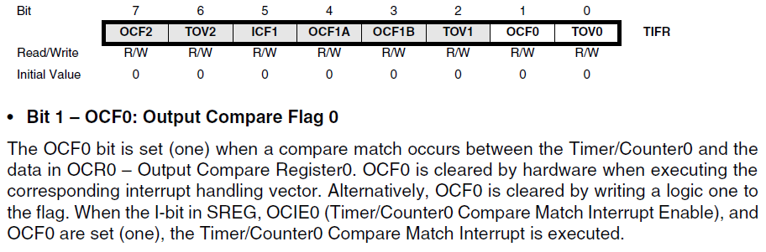
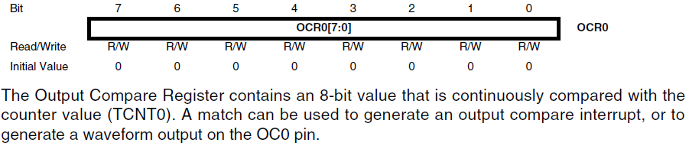

CTC (Clear Timer on Compare match) mode
TCNT0
0xFF
OCR0
OCF0
OCF0
OCF0
0
time
OCR0
xx
0
TOV0:
2
0
1
OCF0:
1
0
TOV0 = no change
OCF0 = 1

Slide 29
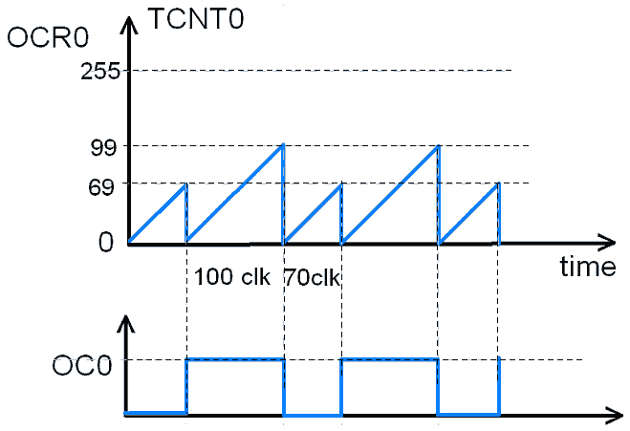
CTC Mode
You can modify OCRO to change the period and amplitude

Slide 30
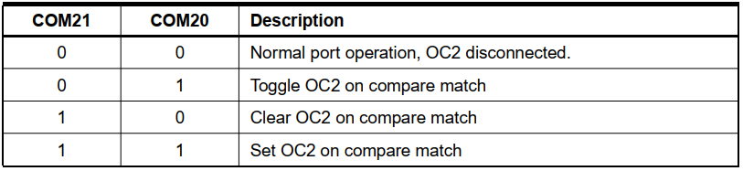
Rewrite example 2 using CTC
Example 4: Rewrite example 2 using CTC
For a square wave with T = 10 µs we must have a time delay of 5 µs. Because XTAL = 10 MHz, the counter counts up every 0.1 µs. This means that we need 5 µs / 0.1 µs = 50 clocks. Therefore, we have OCR0= 49.
.INCLUDE "M32DEF.INC"
LDI R16,0x08
SBI DDRB,3 ;PB3 as an output
LDI R17,0
OUT PORTB,R17
LDI R20,49
OUT OCR0,R20 ;load timer0
BEGIN: LDI R20,0x09
OUT TCCR0,R20 ;Timer0,CTC mode,int clk
AGAIN: IN R20,TIFR ;read TIFR
SBRS R20,OCF0 ;if OCF0 is set skip next
RJMP AGAIN
LDI R20,0x0
OUT TCCR0,R20 ;stop Timer0
LDI R20,0x02
OUT TIFR,R20 ;clear OCF0 flag
EOR R17,R16 ;toggle D3 of R17
OUT PORTB,R17 ;toggle PB3
RJMP BEGIN
DDRB |= 1<<3;
PORTB &= ~(1<<3);
while (1)
{
OCR0 = 49;
TCCR0 = 0x09;
while((TIFR&(1<<OCF0))==0);
TCCR0 = 0; //stop timer0
TIFR = 0x02;
PORTB.3 = ~PORTB.3;
}

Slide 31
The difference between Timer0 and Timer2
Timer0
Timer2
CS02 CS01 CS00 Comment
0 0 0 Timer/Counter stopped
0 0 1 clk (No Prescaling)
0 1 0 clk / 8
0 1 1 clk / 64
1 0 0 clk / 256
1 0 1 clk / 1024
1 1 0 External clock (falling edge)
1 1 1 External clock (rising edge)
CS22 CS21 CS20 Comment
0 0 0 Timer/Counter stopped
0 0 1 clk (No Prescaling)
0 1 0 clk / 8
0 1 1 clk / 32
1 0 0 clk / 64
1 0 1 clk / 128
1 1 0 clk / 256
1 1 1 clk / 1024

