Slide 1
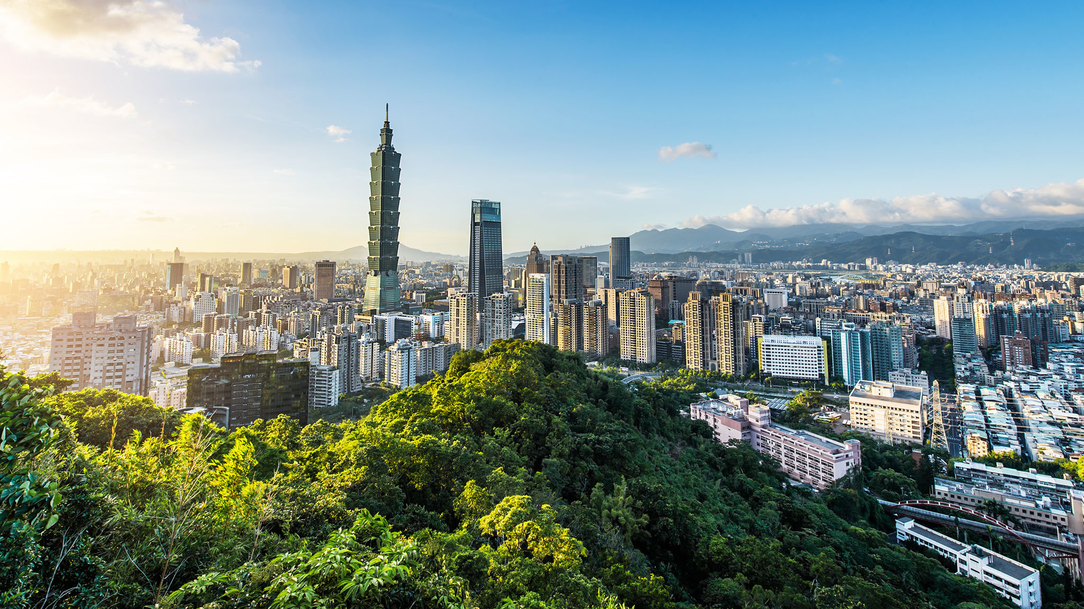
Explore the neighborhood of Taipei - Taiwan
Data Science Capstone Final Project

Slide 2
Introduction - Overview
Taipei is the capital of Taiwan ROC
Area: 271.8 km2
Population 2.674 million
Main language: Mandarin
Divided into 12 administrative districts

Slide 3

Introduction – Problem & Solutions
An attractive but not-easy for non-speaking Mandarin people
We will explore Taipei’s inner cities using web scraping, Foursquare API and plotting
Goal: explore distinguish characteristics of each areas
Include two attempts:
For all features
Restaurant-only feature

Slide 4
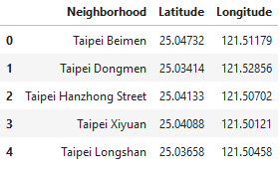
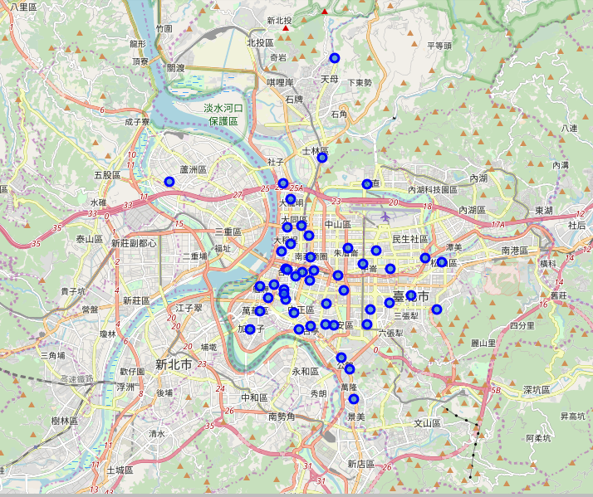
Data
48 Taipei post office locations with latitude and longitudes that reprensents the neighborhood of different areas in the city.
Foursquare explore method for each neighborhood

Slide 5
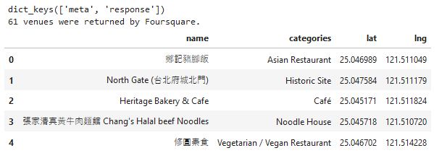
Process – Test with one sample neighborhood
We test the Foursquare API with the first neighborhood in our Data Frame.
The response seems very promising with 61 venues within a radius of 500 m from the location.

Slide 6
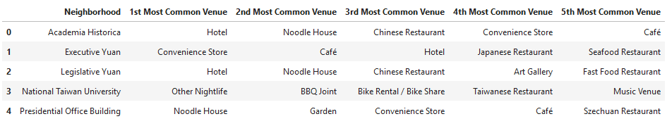
Solution – Explore all available neighborhoods
We apply the same method for all available neighborhoods and save it as a Data Frame consists of the most common venues

Slide 7
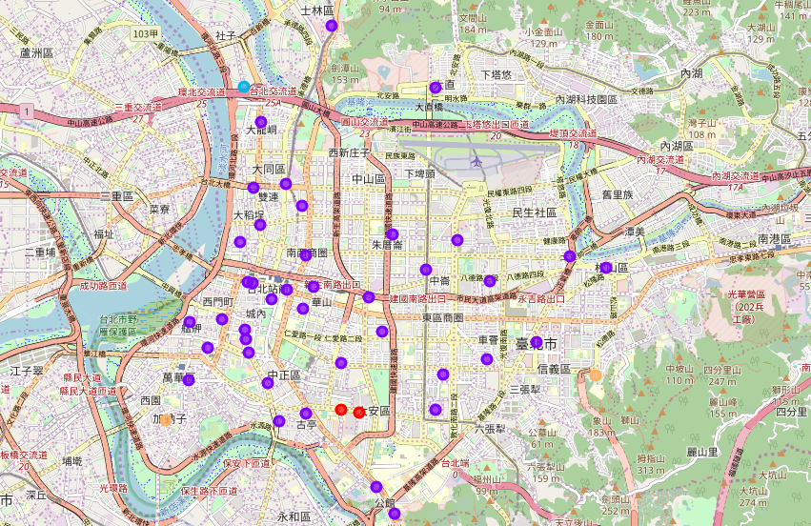
Solution – KNN clustering of the neighborhood
We use KNN clustering to classify the neighborhood based on the common venues in each areas and make a report from the results.

Slide 8
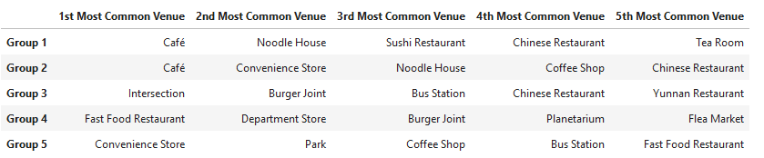
Solution – KNN clustering of the neighborhood
It seems like Taipei people love drinking and eating so much
Group 1, 2 are inner cities filled with Cafe and restaurant
Group 3,4,5 are outside areas with intersection, convenience store, parks and so on

Slide 9

It seems like the clustering is not very distinguish as Taipei is filled with Café and restaurant. How about a clustering based only on Restaurant features?

Slide 10

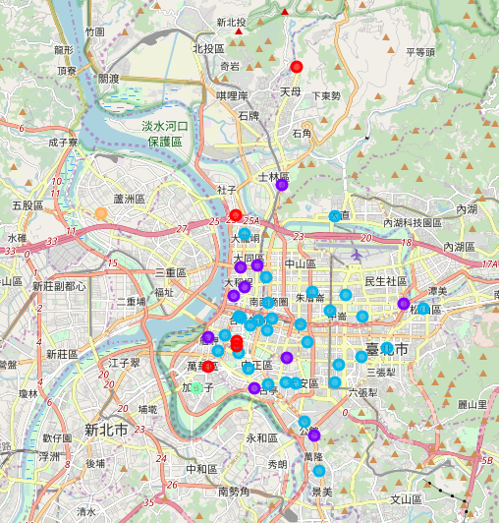
Solution – KNN clustering of the neighborhood (Restaurant)
I make a new Data Frame that only contains features including the word “Restaurant”
res = taipei_venues[taipei_venues["Venue Category"].str.contains("Restaurant")].reset_index(drop=True)
The new clustering is more interesting!

Slide 11
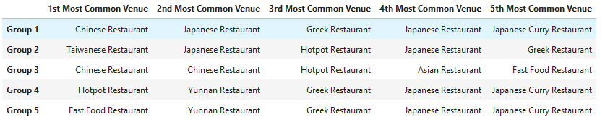
Solution – KNN clustering of the neighborhood (Restaurant)
Group 1, 2 are mostly inner cities areas filled with Chinese Restaurant or Taiwanese restaurant
Group 3,4,5 contain more exotic restaurant like Hotpot, Yunnan or Greek Restaurant

Slide 12

Thank you and have fun with Data Science!

