Slide 1
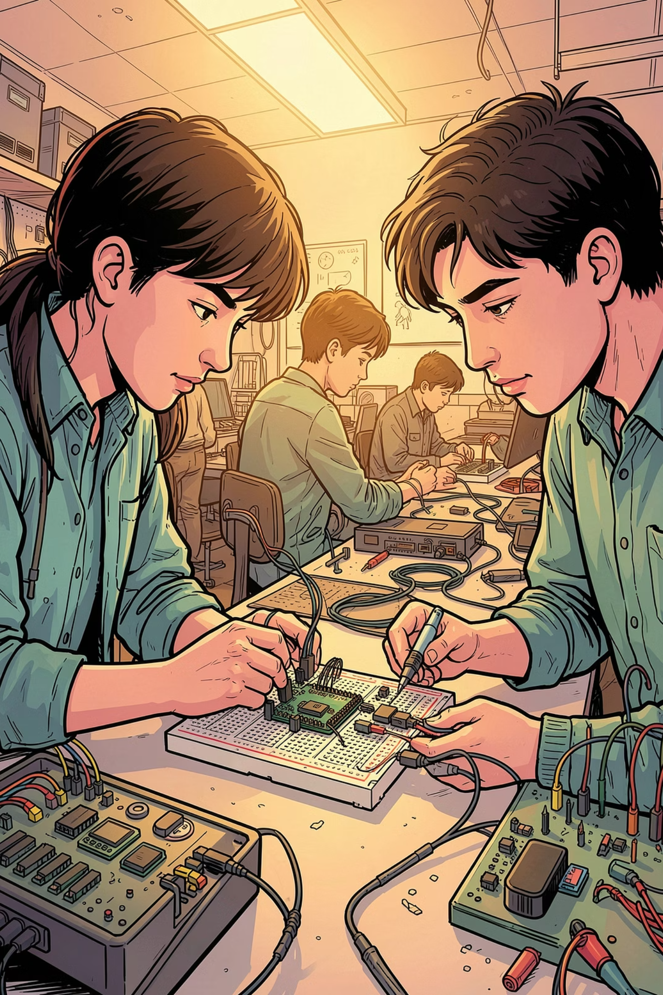
WEEK 2
Second Week of the Project
Assembly begins — sensors, microcontroller, and display come together. A critical setback teaches us the importance of voltage discipline.

Slide 2
Components & Materials
All required parts for initial assembly and testing.
ESP32 A1S
Rain Sensor
Main microcontroller for sensor integration and data processing.
Detects precipitation for environmental monitoring.
MPU 6050
LCD 1602 I2C
6-axis IMU for motion and orientation sensing.
16×2 character display via I2C (borrowed from lecturer).
Battery & Protection
Breadboard & Wires
Rechargeable battery with 5V mainboard protection circuit.
Dupont wires and breadboard for prototyping (borrowed).

Slide 3
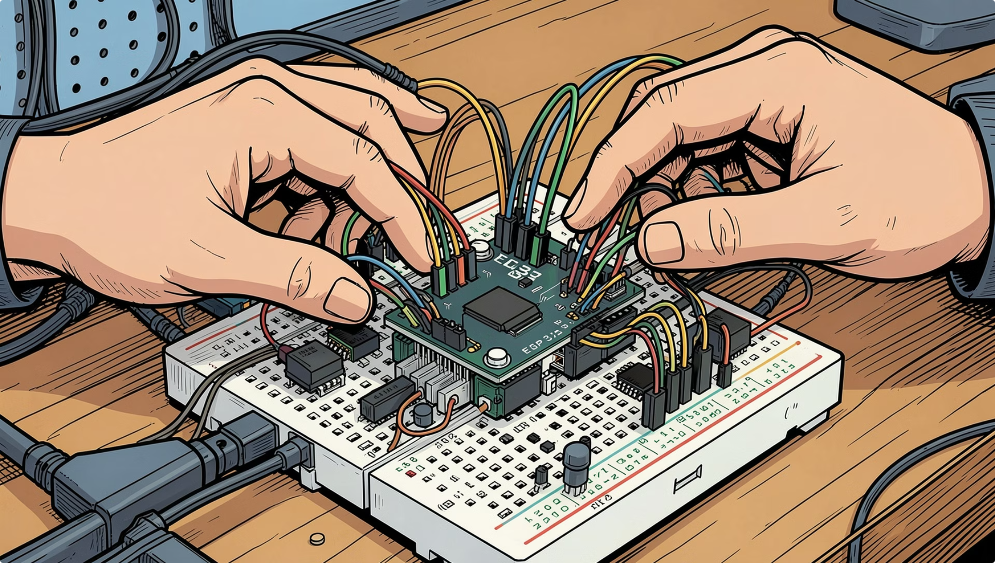
What We Set Out to Do
Assembly Goals
Connect All Sensors
Wire the Rain Sensor and MPU 6050 to the ESP32 A1S on the breadboard.
Integrate the LCD
Hook up the LCD 1602 I2C display to output sensor readings.
Power Safely
Recharge the battery and implement 5V protection on the mainboard.

Slide 4

Setback & Recovery Plan
⚠️ What Happened
✅ Moving Forward
We accidentally supplied 12V instead of 5V to the sensor circuit, burning the components. Replacement sensors have been ordered and will arrive in at least one week.
01
Wait for Replacement Sensors
Use the downtime to prepare code and documentation.
Always verify voltage levels before connecting power — a multimeter check takes seconds and saves components.
02
Prepare Mini Slide
Build a presentation summarizing the project process and lessons learned.
03
Finalize Source Code & UI
Complete the ESP32 firmware and LCD output interface for demo.

