Slide 1
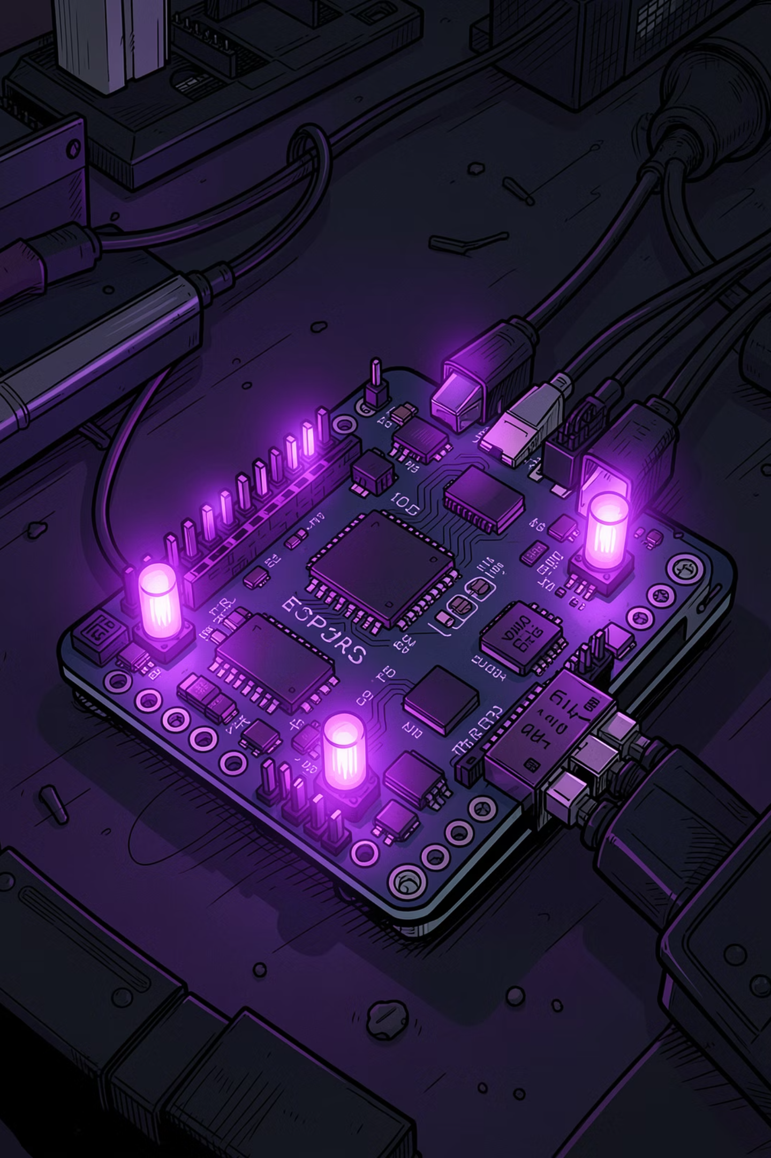
Powering the Future: Mastering IoT with ESP32-A1S
A hands-on exploration of embedded systems, smart hardware, and the Arduino ecosystem — from first power-on to cloud-connected intelligence.

Slide 2
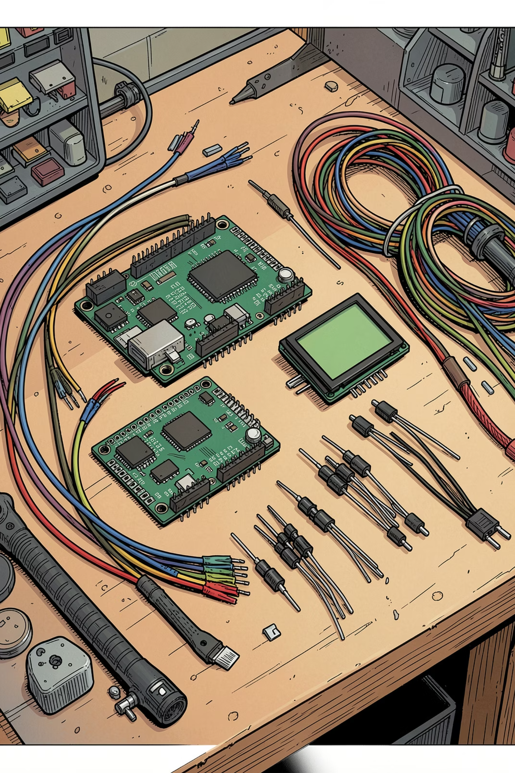
The Toolkit: Essential Hardware Components
ESP32-A1S
Dual-core Wi-Fi/BT module with integrated voice codec and PSRAM for high-performance embedded tasks.
LCD 1602 I2C
Efficient 2-line character display for real-time data visualization with minimal wiring.
Mainboard Protection
Critical 5V circuit safeguards to prevent over-voltage damage and ensure hardware longevity.
Dupont Wires
Reliable modular connectors for rapid prototyping and clean breadboard connections.

Slide 3

The Ecosystem: Bridging Hardware and Code
Development Workflow
I2C communication reduces wiring complexity to just two signal lines (SDA + SCL) between the ESP32 and the LCD display.
The Arduino IDE streamlines every step — from driver installation to final firmware upload. By integrating official ESP32-A1S technical documentation, you unlock full access to its peripheral capabilities.

Slide 4

Project Vision: Building Intelligent Hardware
🎯 Purpose
Transform raw sensor data into actionable insights through localized, low-power embedded systems.
🔌 Scalability
Leverage the ESP32's rich peripheral set — ADC, DAC, PWM, and GPIO — to expand functionality over time.
🚀 Get Started
Begin with a 5V power test, verify I2C communication on the LCD, then bridge your prototype to the cloud.

