Slide 1
Hotel Management System
By Ly Pham Gia Nghia

Slide 2
Overview
1.Introduction
-What is a Hotel management application ?
-Why we use it ?
-Use case diagram
-Database
2.Feture explanation and demo

Slide 3
What is a hotel management application and what it do ?
-A hotel management app is an application used by the Hotel
-This app is used to manage customer information and rooms
-Customers have to leave there personal information such as id, name, phone number in order to book a room and use other services

Slide 4
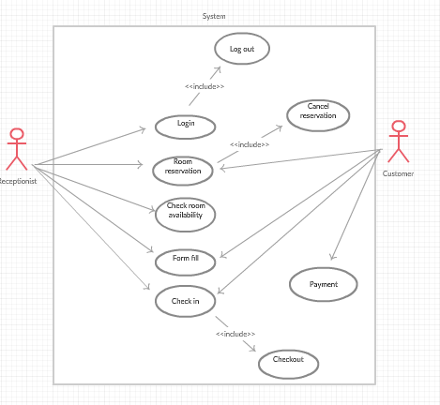

Slide 5
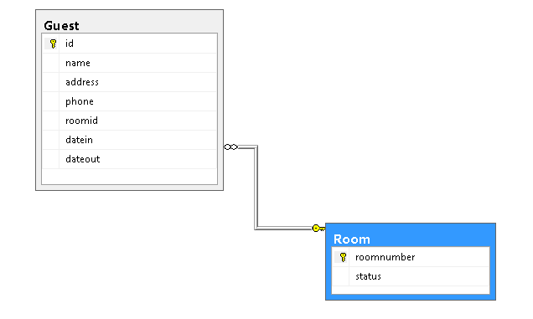

Slide 6
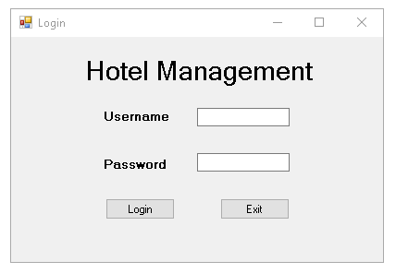

Slide 7
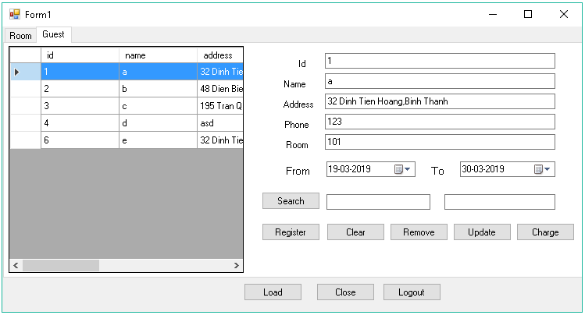

Slide 8
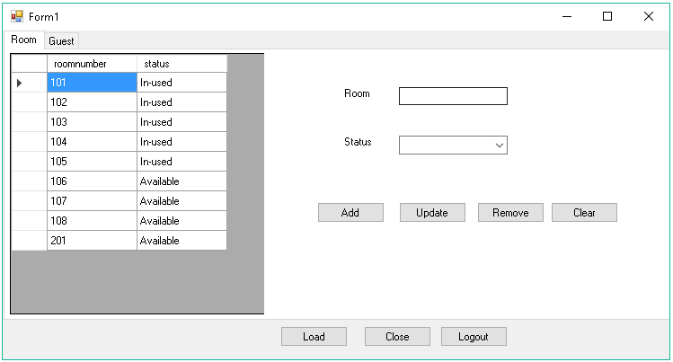

Slide 9
Demo

