Slide 1

HMS Orchastic on Kubernetes
Anh Nghia Nguyen – Oct 2019

Slide 2
Agenda
HMS project review
HMS on Kubernetes
Kubernetes API integration
Demo

Slide 3
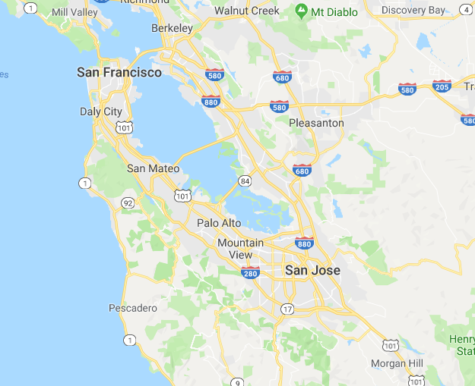
HMS project review
Hierarchical geo-based sharding to tracking and locating objects

Slide 4



HMS project review
REST API servers
Kafka
Clients
Service units

Slide 5


HMS on Kubernetes
Decide target server
Clone/scale up/down
Restore from failure
Backup, update
…..
API
By metadata
Kubernetes
Server 1
Server 2
Server 3
Server N
……

Slide 6
Demo

