Slide 1
CSD201 Data Structures and Algorithms using Java
Lecturer: Thân Văn Sử
(sutv@fpt.edu.vn)

Slide 2
Agenda
1- Course Introduction
2- Contents and Learning outcomes
3- Course Requirements
4- Read yourself: Sharing
5- Review on algorithm’s complexity
6- Evaluating complexity of a given algorithm

Slide 3
1- Course Introduction
What is a computer program?
A program is a sequence of instructions that can be executed by a computer. The term can refer to the original source code or to the executable (machine language) version(MS Computer Dictionary).
The term usually implies a self-contained entity.
Data
Instructions
-
-
-
-
Input device
Output device

Slide 4
Course Introduction
Classifying computer programs based on input
Small-scale programs: Input data size is small.
Large-scale programs: Input data size is small.
In a large-scale program, if data are well organized, program performance is improved.
Program
Data
Input device
Output device
Instructions
-
-

Slide 5
Course Introduction
How can we choose a proper way to store program data?
We need to catch knowledge in this subject, Data structures and Algorithms.
What are data structures?
A data structure is a organizational scheme, such as a record or array, that can be applied to data to facilitate interpreting the data or performing operations on it (MS Computer Dictionary).
A data structure defines a way to store and access data .
Based on a specific data structure, appropriate algorithms can be performed.

Slide 6
Course Introduction
What are introduced in this course?
Theory:
This course introduces the fundamental concepts of data structures and the algorithms that proceed from them. Topics include the basics of algorithmic analysis, fundamental data structures (including linked lists, stacks, queues, trees, graphs, hash tables). In this course, recursive algorithm, sorting and data compressing are introduced also.
Practice:
You will be helped to implement some basic structures and to use pre-defined data structure classes in Java libraries.

Slide 7

Course Introduction
Resources in this course:
Main books/resources:
1) Michael T. Goodrich, Roberto Tamassia, Michael H. Goldwasser: Data Structures and Algorithms in Java, 6th Edition, 2014 (eBook)
2) Link to the book: http://coltech.vnu.edu.vn/~sonpb/DSA/Data%20Structures%20and%20Algorithms%20in%20Java,%206th%20Edition,%202014.pdf
FU CMS at https://lms-hcmuni.fpt.edu.vn/
Page: CSD201-SuTV
Downloading slides, e-book, exercises.
Taking quizzes and assignments
Software Tools: Java programming tools using the JDK from 1.7 version

Slide 8
Course Introduction
Objectives:
Knowledge
The connection between data structures and their algorithms, including an analysis of algorithms' complexity
Skills
Using Java OOP
Defining basic data structures using
Implementing basic operations on data structures including Add/ Search/ Removal/ Traversals/ Sort
➔ From problem description, you can decide what data structure must be used to store related data and why you choose this structure.

Slide 9
2- Course Contents and Learning Outcomes
No. | Topic | Learning outcome
1 | Linked Lists | LO1: Describe the list data structure and its’ different way of implementations. Implement the singly linked list.
2 | Stacks and Queues | LO2: Define stack and queue. Describe basic operations and the use of these structures.
3 | Recursions | LO3: Describe about recursive definitions, algorithms, functions and their implementation and use.
4 | Trees | LO4: Explain about general tree, Binary Tree and Binary Search Tree (BST). Implement BST with basic operations.
5 | Graphs | LO5: Discuss about graphs and their application. Implement a graph with some basic operations.
6 | Sorting | LO6: Explain the operation and performance of some basic and advanced sorting algorithms
7 | Hashing | LO7: Explain about hashing and application.
8 | Text Processing | LO8: Describe the Text Processing problem and its’ application. Explain the Huffman, LZW and Run-length encoding Algorithms.

Slide 10
3- Course Requirements
Student’s Responsibilities:
Following lessons in classrooms
Reading textbooks at home
Completing and submitting workshops /assignments/ quizzes in time → All deadlines are set up suitable. You have enough time to complete them. Please do not issue any requirement about timelines.
Discussing actively in your teams and in classrooms
Answer questions of each chapter:
- at the end of each slide - at the end of the course’s syllabus.

Slide 11
Course Requirements
Grading Policies:
Chỉ dùng IDE tool là Netbeans
và WinZip để nén.
- Tất cả các công cụ khác ngoài các công cụ nêu trên (cho dù mở vô tình hay mở không sử dụng) sẽ coi như là vi phạm qui chế thi và sẽ bị 0 điểm PE
On-going assessment: - 2 Assignments (AS): 20% - 2 Progress tests (PT): 20%
Practical and Final Exams: - 1 Practical Exam (PE): 30% - 1 Final Exam (FE): 30%
Total score (TS) = 0.2*AS + 0.2*PT + 0.3*PE + 0.3*FE
Completion Criteria: 1) Every on-going assessment (average) component > 0 2) PE > 0 (there is no resit) 3) FE >= 4 & TS >= 5

Slide 12
Course Requirements
FPT-University Academic policy:
Cheating, plagiarism and breach of copyright are serious
offenses under this Policy.
Cheating: Cheating during a test or exam is construed as talking, peeking at another student’s paper or any other clandestine method of transmitting information.
Plagiarism: Plagiarism is using the work of others without citing it; that is, holding the work of others out as your own work.
Breach of Copyright: If you photocopy a textbook without the copyright holder's permission, you violate copyright law.

Slide 13
4- Read yourself: Sharing
Tâm tình:
Chúng ta sẽ ở đâu trong bản đồ nghề nghiệp IT sau ba/bốn năm nữa?
Liệu chúng ta có đủ sức để ra trường không?
Tất cả đều phụ thuộc vào kiến thức và kỹ năng code của chúng ta thế nào?
Những yêu cầu để ra trường và đi làm:
Năng lực thiết kế dữ liệu
Năng lực chọn và đánh giá giải thuật
Năng lực hiện thực giải thuật ← Kỹ năng code
➔ Môn học này giúp các bạn cải thiện các năng lực này

Slide 14
Read yourself
Quy định cần tuân thủ:
Các bài tập có hướng dẫn đầy đủ bảo đảm ai cũng làm được → Không cần lấy bài của khóa trước hay của bạn→ Có làm có ăn → Có cố gắng sẽ giỏi hơn và thành công.
Điều chúng ta không mong đợi: Bị phát hiện gian dối khi đánh giá.
Rất mong mọi sinh viên đều hứa sẽ tự giác, trung thực để chúng ta có thể sống với niềm tin là xã hội này còn tốt đẹp. Chúng ta cùng nhau cố gắng nhé.

Slide 15
5- Review on Algorithm’s Complexity
Problem and Algorithms:
What is a problem?
A situation in which something is hidden.
What is algorithm?
A set of operations for finding down result of a problem – Hidden data is found.
Expectations on an algorithm:
Space (memory): small,
Time consuming: short
Former computers had small size memories and low-speed CPUs → 2 factors must be considered carefully.
Nowadays computers have large size memories and ultra-speed CPUs→ Time performance is the main factor.

Slide 16
Review on Algorithm’s Complexity
Choosing algorithms.
One problem can be solved using one of some different algorithms → The most appropriate (fastest) algorithm should be chosen.
How to evaluate time cost of an algorithm?
Time cost can be estimated using complexity of an algorithm
Complexity = number of basic operations which must be performed → It is a non-decreasing function of number of input (time function).
- A basic operation is considered as an execution unit. It can be a comparison, an assignment, a basic math operations (+ - * /)
Each basic operation is evaluated as an execution unit.

Slide 17
Review on Algorithm’s Complexity
Finding Complexities in codes
Code, integer n > 0 | Basic operation | Complexity
S=0; for (i=0; i<n; i++) S+= i; | Adding: S = S + i; | T(n) = n n adding must be performed
S= 0; for (i=0; i<n; i++) for (j=1; j<=n; j*=2) S += i*j; | Adding: S += i*j; | T(n) = n* (floor(log₂(n) )+ 1) Value of i changes n times Value of j changes log₂(n) times
S= 0; for (i=0; i<n; i++) for (j=1; j<n; j+=5) S += i*j; | Adding S += i*j; | T(n) = n* (ceil(n/5 )) Value of i changes n times Value of j changes ceil(n/5) times.
S= 0; for (i=0; i<n; i++) for (j=1; j<=n; j+=5) for (k=1; k<=n; k*=2) S += i*j-k; | Adding: S += i*j-k; | Do yourself

Slide 18
Review on Algorithm’s Complexity
The worst, the best and the average cases.
In practice, time function of an algorithm depends on input properties. Consider the comparison x==a[i] in a searching algorithm on an array:
i | 0 | 1 | 2 | 3 | 4 | … | n-1
a[i] | 5 | 2 | 1 | 6 | 4 | … | 20
for ( i=0; i<n; i++)
if (x==a[i]) return i;
return -1;
x | Comparisons | Evaluation | Complexity
5 | 1 | The best case | t(n) = 0*n + 1
2 | 2 |  | t(n) = 0*n + 2
1 | 3
… | …
20 or a non-existed value | n | The worst case | t(n) = n
Sum | (n+1)*(n/2)
Avg. | (n+1)/2 | Average case | t(n) = (n+1)/2
The worst case is usually concerned.

Slide 19
Review on Algorithm’s Complexity
The average case of linear searching in a sorted array having the result of failure.
i=0;
While (a[i]<x) i++;
if (i<n && x==a[i]) return i;
return -1;
i | 0 | 1 | 2 | 3 | 4 | … | n-1
a[i] | 1 | 3 | 5 | 7 | 9 | … | ….
x | Comparisons
0 | 1
2 | 2
4 | 3
… | …
… | n
Sum | (n+1)*(n/2)
Average | ((n+1)*(n/2))/n = (n+1)/2
This algorithm will terminate as soon as
a[i] >= x
→ The average complexity of search operation is a linear function.

Slide 20
Review on Algorithm’s Complexity
Time functions: Upper and lower bounds
- Upper bound and lower bound should be chosen in the nearest functions of T(n)
Upper bound
time
Lower bound
n
Time function, T(n), in the worst case | Upper bound | Lower bound
T(n)= 2n +10 | T(n)<= 3n, n>10 | T(n) >= 2n, n>0
T(n) = 12n + 5 | T(n) <=13n, n>0 | T(n) >= 11n., n>0,
T(n)= 2nlog₂n +10 | T(n)<= 3nlog₂n, n>10 | T(n) >= 2nlog₂n, n>0
T(n) = 12n log₁₀n | T(n) <=13nlog₁₀n, n>0 | T(n) >= 11nlog₁₀n., n>0
T(n)= 2n²logn +10 | T(n)<= 3n²logn n>10 | T(n) >= 2n²logn, n>0
T(n) = 2n⁴-3n+5 | T(n) <=2n⁴, n>2 | T(n) >= n⁴., n>2

Slide 21
Review on Algorithm’s Complexity
Notations: Big O, Big Omega , Big Theta
Upper bound: T(n) is O(g₁(n)) if there are the constant C and n_{o} such that |T(n)| <= Cg(n) whenever n>= n₀
Lower bound: T(n) is Ω(g₂(n)) if there are the constant C and n_{o} such that |T(n)| >= Cg(n) whenever n>= n₀
If g₁(n) and g₂(n)s are the same function, T(n) is Ɵ(n).
T(n) | Upper bounds and O | Lower bounds and Ω | Ɵ
T(n)= 2n +10 | 3n, 4n, 15n,… → O(n) | 2n, n, 0.5n,… → Ω(n) | Ɵ(n)
T(n) = n² + n + 5 | 2n², 2.5n², 3n²,…→ O(n²) | n², 0.5n², 0.2n²,…→Ω(n²) | Ɵ(n²)
T(n)= 2nlog₂n +10 | O(nlogn) | Ω(nlogn) | Ɵ(nlogn)
T(n)= 2n²logn +10 | O(n²logn) n>10 | Ω(n²logn) | Ɵ(n²logn)
T(n) = 2n⁴-3n+5 | O(n⁴) | Ω(n⁴) | Ɵ(n⁴)
Cg(n) → O(g(n)) ⬅ Constant is omitted.

Slide 22
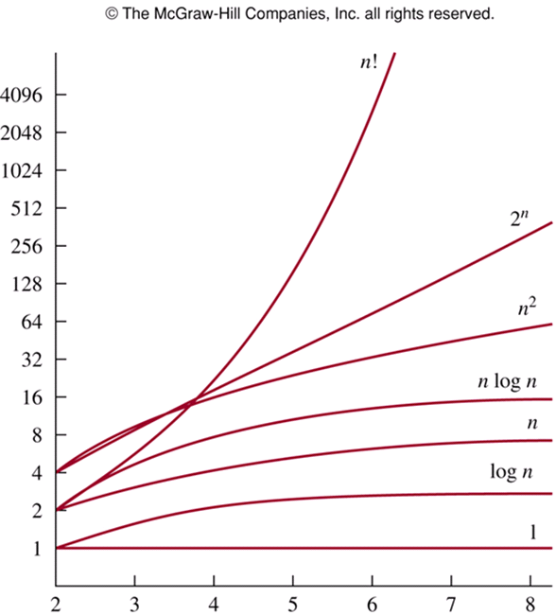
Review on Algorithm’s Complexity
Choosing one in some algorithms:
Functions which are used in O, Ω, and Ɵ, are common functions. They are already known their growth.
Situation:
Two algorithms, named as A1 and A2, can be used to solve a problem, which of them will be chosen?
A1 should be chosen if O(t1(n)) < O(t2(n))

Slide 23
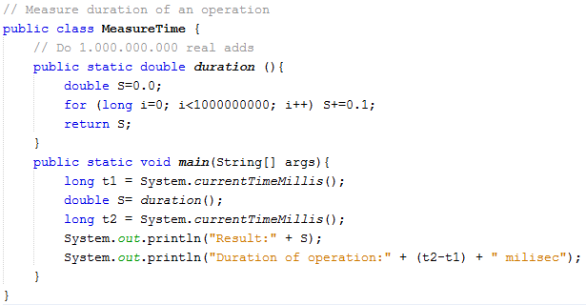
Review on Algorithm’s Complexity
How to measure time needed to run an algorithm?
Put the algorithm into a method.
Put the algorithm call between 2 calls to system for accessing system time. You can use:
System.nanoTime();

Slide 24
Exercises
Given n is a large positive integer and following time functions, what is it’s big O using the neatest function?
T(n) = n³ + 6n² +7 < n³ + 6n³ + 7n³ <= 14n³ → O(n³)
T(n) = n³/8 + 6n² +7
T(n) = n + log(n)
T(n) = log(n) + 100
T(n) = 2n + log(n) + 10000 → O(?)
You know two algorithms which can solve a problem:
A1: T1(n) = 8n² – 2n -7 <= 8n² + 2n² + 7n² <= 17n² -> O(n²)
A2: T2(n) = 8nlog(n) + 8 <= 8nlogn + 8nlogn <= 16nlogn -> O(nlogn)
Which of them should be chosen, use the neatest function?

Slide 25
6- Evaluating complexity of a given algorithm
Considering statements
Pseudo code or real code of an algorithm includes:
Basic instructions – Simple statements → O(1)
Loop statements → Many simple statements are performed → Loop/count variables are considered.
Loop statements are usually main factors which affect on algorithm’s complexity.
Code | O
S=0; for (i=0; i<n; i++) S+=i; for (i=0; i<n; i++) if (a[i]%2==0) a[i]++; for (i=1; i<n; i*=2) a[i] += a[i-1]; for (i=0; i<n; i+=3) a[i] += a[i-1]; for (i=0; i<n; i+=5) a[i] *= a[i-1]; | O(1) O(n) O(n) O(logn) O(n/3) → O(n) O(n)

Slide 26
6- Evaluating complexity of a given algorithm
Considering code blocks: Adding Principle
Nếu một giải thuật bao gồm 2 bước rời nhau tuần tự, bước 1 có O(f(n), bước 2 có O(g(n)) thì giải thuật có O(max(f(n),g(n))
Code | O
for (i=0; i<n; i++) accept a[i]; S=0; for (i=0;i<n;i++) S += a[i]; for (i=0; i<n; i++)output a[i]; Output S; | O(n) O(1) O(n) O(n) O(1)
Final complexity: O (max( n,1, n, n, 1 ) = O(n) | O(n)

Slide 27
6- Evaluating complexity of a given algorithm
Considering code blocks: Multiply Principle
Nếu một giải thuật cần lặp nhiều lần với độ phức tạp O(f(n)), mỗi bước lặp lại có độ phức tạp O(g(n)) thì giải thuật có O(f(n).g(n))
Code | O
K=0 for (i=0; i<n; i++) { for (j=1; j<=n; j*=2) K+= i+j; } Output K; for (i=0; i<n; i++) Output a[i]; | O(1) O(n) { O(logn) } O(1) O(n)
Final complexity: O (max( 1, nlogn, 1, n) | O(nlogn)

Slide 28
Questions and Answers

