Slide 1
Slot 2&3 Linked Lists
Deadline các bài tập chương này:
14, 16, 18/5/2022
XEM TRONG LMS NHÉ
ĐỪNG ĐỂ TRỄ
ĐÂY LÀ CHƯƠNG THI PRACTICAL

Slide 2
Learning Outcomes
LO1: Describe the list data structure and its’ different way of implementations. Implement the singly linked list.
LO1.1 Demonstrate the list data structure with basic operations: insert, remove, edit, search, sort,...
LO1.2 Explain two ways of implementing a list: using arrays and using linked lists.
LO1.3 Write programs to implement the singly linked list with basic operations: add (last, first, before, after, at position), search, edit, remove, reverse, sort... )
LO1.4 Understand the doubly linked-list data structure with basic operations.
LO1.5 Write code snippets which manipulate operations on doubly linked list, and use diagrams to illustrate the effect.
LO1.6 Describe the circularly linked-list data structure with some basic operations like add, remove.
LO1.7 Explain why the Java code library provides the ArrayList and LinkedList classes.

Slide 3
Contents
1- Basic operations on a group
2- Drawbacks of arrays
3- Introduction to Linked Data Structures
4- Linked Lists (LLs):
Definition
Common used LLs: Singly / Doubly/ Circular Linked Lists
Representing an item/ a LL.
Comparing
Common operations on SLLs
5- Demo 1: Singly Linked List ← Your work
6- Demo 2: Doubly Linked List ← Your work
7- When linked Lists are used?
8- Managing groups using the Java API
9- Two Advanced demo. ← Bonus, you are not required to implement

Slide 4
1- Basic operations on a group
Group is a collection of data objects which usually have the same structure. In a group, there may exist relations between elements such as ordering relations or connections between elements. Relations must be described in data.
- Physically, there are some ways to store a groups (list/ tree/…). So, a group is an abstract data type and they are declared as interfaces in languages (interface Collection, List,… in Java).
Basic operations on group include:
Adding new element
Searching an element
Removing an element
Updating an element ← Search + re-assign new value
Traversing all elements
Sorting elements using a pre-defined order.

Slide 5
2: Drawbacks of Arrays
Array is a group of elements (nodes)
which belong to the same data type
They are stored in contiguous memory cells
Each element can be accessed using its positional index.
→ Array is the simplest data structure for a group. Positional indices describe an ordering relations between elements.
0 | 1 | 2 | 3 | 4 | 5 | 6 | 7 | 8 | 9 | 10 | 11 | 12 | 13 | 14
9 | 3 | 1 | 6 | 7 | 8 | 8 | 5 | 6 | 4
a
No empty cell is allowed!!!
Empty cells
MAXN=15
n = 10

Slide 6
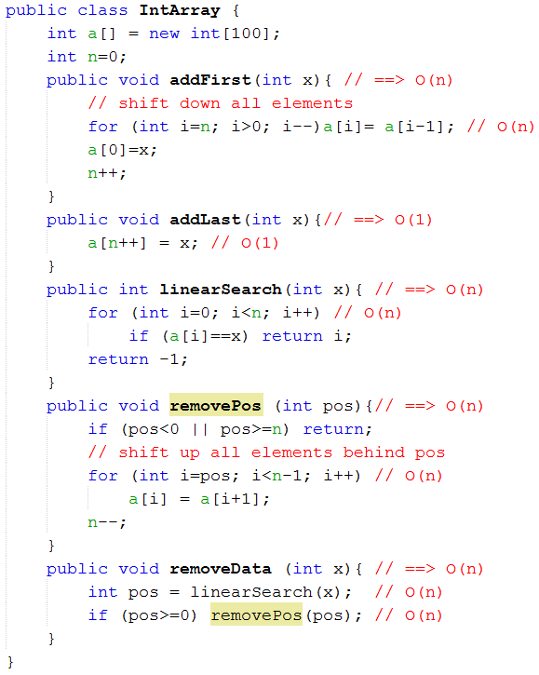
Drawbacks of Arrays…
Memory for elements must be allocated in advance.

Slide 7
Drawbacks of Arrays …
Summary of Arrays and Expectations:
Operation | Complexity | Expectation
Memory allocation | Allocated memory size can be redundant/ lack | To optimize memory use, memory for storing elements will be allocated when needed.
Add x to the end | O(1) → Good
Add x to the position pos | O(n) | < O(n)
Search x | O(n) | < O(n)
Remove element at the position pos | O(n) | < O(n)
Linked Data Structures are introduced.
Question: Why linked data structures are needed? → Answer.

Slide 8





3: Introduction to Linked Data Structures
Linked Data structure: A data organization in which each node includes itself data and links to others.
An example depict memory figure of a linked data structure:
James
Linda
Jane
Tom
Jack
Paul
42
25
10
22
22
8
Manager
Officer
student
student
Designer
Kid
1000
3000
8000
200
10000
0 (NULL)
400
1000
3000
8000
200
10000
Memory
address
Element
structure
Person
(name, age, role)
Info of an element itself
next
Reference to the next element

Slide 9
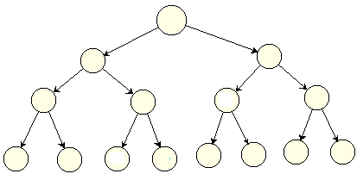
3: Intro. to Linked Data Structures
Types of Linked Data Structures:
Linear data structure/ List: Structure having only one line to access all elements ← Array, linked lists.
Linear Linked data structures/ Linked List: Links establish only one line to access elements ← linked lists
obj1
obj2
obj3
obj4
obj5
1000
800
400
600
null
Non linear linked data structure: Links establish multiple lines to access elements ← Trees

Slide 10
4: Linked Lists (LLs)
Linked list: A group of nodes, each node contains its data and links to others. Links form a linear path to access elements.
A link describes a previous-next relation between two elements.
Linked list is the simplest linked data structure.
700
1000
800
400
600
head: 700
obj1
obj2
obj3
obj4
obj5
Singly Linked list (SLL)
tail: 600
1000
800
400
600
null
700
1000
800
400
600
Circularly Singly Linked list (CSLL)
head: 700
obj1
obj2
obj3
obj4
obj5
tail: 600
1000
800
400
600
700
Object data
Item head
Item
List
Item next
Item tail

Slide 11
LLs…
Linked list: A group of nodes, each node contains its data and links to others. Links form a linear path to access elements.
A link describes a previous-next relation between two elements.
Linked list is the simplest linked data structure.
Linear accessing path may form a circle. It means that the ending element links to the beginning.
Common used linked lists:
Singly linked lists (SLL)
Circular linked lists (CSLL)
Doubly linked lists (DLL)
Circular doubly linked lists (CDLL)

Slide 12
LLs: Common used LLs
700
1000
800
400
600
head: 700
obj1
obj2
obj3
obj4
obj5
Item
tail: 600
SLL
1000
800
400
600
null
Object data
Item next
head: 700
obj1
obj2
obj3
obj4
obj5
CSLL
tail: 600
1000
800
400
600
700
700
1000
800
400
600
Item
head: 700
obj1
obj2
obj3
obj4
obj5
tail: 600
DLL
Object data
1000
800
400
600
null
null
700
1000
800
400
Item next
Item previous
head: 700
obj1
obj2
obj3
obj4
obj5
tail: 600
CDLL
1000
800
400
600
700
List
600
700
1000
800
400
Item head
Item tail

Slide 13
LLs…: Representing Item/List
Representing an item(element):
Representing a linked list:
Item in DLL
Linked List
Item in SLL
Object data
Object data
Item head
Item next
Item next
Item tail
Item previous
A list can be managed using a reference to the beginning item only but we should use both references to the head and the tail of the list. The reference to the tail helps the add-last operation a new item to the end of a list with the best performance (O(1)). If not, when we want to add a new item to the end of a list, we need to move from the beginning to the end of the list (O(n)).

Slide 14
LLs…: Comparing
SLL and DLL:
View | Evaluation
Memory | In SLL, only one reference is added to each item In DLL, two references are added to each item ➔ Memory cost of DLL is greater than SLL.
Flexibility | SLL has only one path (one accessing direction) Ex: for (t=head; t!=null; t= t.next) DLL has two paths ➔ DLL is more flexible than SLL. Ex: for (t=head; t!=null; t= t.next) Ex: for (t=tail; t!=null; t= t.previous)
Circular (CLL) and Non - circular LL (LL):
View | Evaluation
Identifying the last item | In LL, the last item of a path has the reference is NULL Ex: for (t=head; t!=null; t= t.next) In CLL, the last item of a path has the reference is the path’s beginning Ex: for (t=head; t.next!=head; t= t.next) ➔ CLL cause more complex when it is implemented.

Slide 15
LLs…: Operations
Operations on DLL and CLL:
They are similar to operations on SLL
Pay attentions:
Update the reference previous in DLL
In CLLs, the tail item links to the head item.
So, only basic operations on SLL are introduced including:
Add the data x to the beginning / the end of a SLL
Add data x to the position after the reference ref of a SLL
Searching the first existence of the data x in a SLL
Remove the first existence of the data x in a SLL
Traversing items in a list (this operation will be introduced in the assignment)
Sorting a SLL
Reversing a SLL

Slide 16
SLL Operations: Adding
Add the data x to the beginning of a SLL
Item p = new Item(x);
if (head==null) head=tail = p;
else {
p.next = head;
head = p;
}
x
null
p = 700
head: null → 700
Complexity: O(1)
tail: null → 700
x
obj1
obj2
obj3
obj4
null→1000
800
400
600
null
p = 700
1000
800
400
600
head: 1000 → 700
tail: 600

Slide 17
SLL Operations: Adding…
Add the data x to the end of a SLL
Item p = new Item(x);
if (head==null) head=tail = p;
else {
tail.next = p;
tail = p;
}
x
null
p = 700
Complexity: O(1)
head: null → 700
tail: null → 700
obj1
obj2
obj3
obj4
x
800
400
600
null → 700
null
1000
800
400
600
p = 700
head: 1000
tail: 600 → 700

Slide 18
SLL Operations: Adding…
Add the data x to the position after the reference ref of a SLL
if (ref==tail) Add x to the end of the list;
else {
Item p = new Item(x);
p.next = ref.next;
ref.next = p;
}
Complexity: O(1)
obj1
obj2
obj3
obj4
800
400
600 → 700
null
1000
800
ref= 400
600
head: 1000
x
tail: 600
null → 600
p = 700

Slide 19
SLL Operations: Searching
Search the first existence of data x in the SLL
If (head==null) return null;
for (Item t = head; t!=null; t = t.next)
if (t.data==x) return t;
return null;
Linear search → O(n)
Search x in an array:
for (i=0; i<n; i++)
if (a[i]==x) return i;
return -1;
x= 8
t= 1000 → 800 → 400 → 600
head: 1000
7
6
5
8
30
tail: 700
800
400
600
700
null
1000
800
400
600
700

Slide 20
SLL Operations: Removing
Remove the first existence of data x in the SLL
If (head==null) return null;
Item pAfter = null, pDel = head;
// Determine the reference which can be removed
While (pDel!=null && pDel.data!=x) {
pAfter=pDel;
pDel = pDel.next;
}
// If removed data existed
If (pDel != null) {
if (pDel==head) { // remove head
If (head==tail) head=tail= null; // list has only one node
else head = head.next;
}
Else if (pDel==tail) {// remove tail
pAfter.next = null; tail= pAfter;
}
else pAfter.next = pDel.next;
return pDel;
x= 8
pAfter= null → 1000 → 800 → 400
pDel= 1000 → 800 → 400 → 600
1000
800
400
600
700
Linear search
→ O(n)
7
6
5
8
30
800
400
600
700
null
→700
head: 1000
tail: 700

Slide 21
SLL Operations: Traversing
List traversal is the process of visiting each node in the list exactly one time → O(number of nodes)
Sample code:
for (t = head; t!=null; t= t.next){
Process t;
}
We can implement a list traversal in an object, called as Iterator. This technique will be introduced in the assignment.

Slide 22
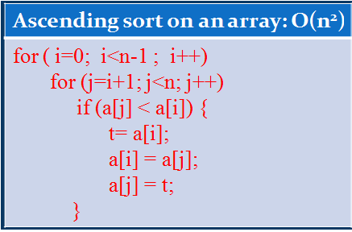
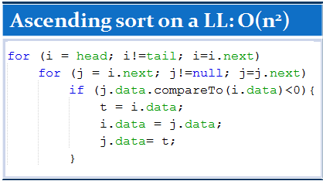
SLL Operations: Sorting
Sorting is not a main operation on a LL.
We can modify a simple sort algorithm on an array to sort a LL.
Sample code:

Slide 23
SLL Operations: Reversing
head: 1000
obj1
obj2
obj3
obj4
tail: 600
800
400
600
null
1000
800
400
600
after=null
P
before
obj1
obj2
obj3
obj4
800 → 0
400
600
null
1000
800
400
600
after
P
before
obj1
obj2
obj3
obj4
0
1000
600
null
1000
800
400
600
after
P
before
obj1
obj2
obj3
obj4
0
1000
800
null
1000
800
400
600
after
P
before
head: 600
obj1
obj2
obj3
obj4
tail: 1000
0
1000
800
400
1000
800
400
600

Slide 24
LLs…: Operations- Summary
Complexities: Linked list s and Arrays
In LLs, Add and remove operations are more efficient.
Search and sort operations are not improved because linear search is still used.
How to improve?
Sorted LL can improve search operations but add operations decrease their performance to maintain order of elements.
Given sorted list: 1 → 3 → 5 → 7 → 9 → 11 → 13 → 15
Add 10 to the list: t → t → t → t → t. Add 10 after the reference t.
Operation | Arrays | L- lists | Sorted L-lists
Add new element to the beginning | O(n) | O(1) | Add to the right position ➔ Average cost: n/2
Add new element to the end | O(1) | O(1)
Add new element to a specific position | O(n) | O(1)
Linear Searching | O(n) | O(n) | Average cost: n/2
Remove an element at a specific position | O(n) | O(1) | O(1)
Sort | O(n²) | O(n²) | The list was sorted
Break

Slide 25
Demo 1: Singly Linked List
Objectives:
(1) Implementing basic operations on a singly linked list.
(2) Reading/ writing data from/to a text file
(3) Differentiating the RandomAccessFile and BufferedReader classes.
(4) Introducing the way you can face when taking a practical exam.

Slide 26
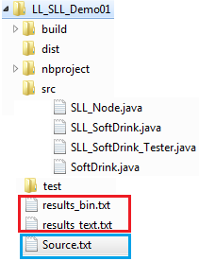
Demo 1: Singly Linked List
A list of soft drinks will be managed using a singly linked list.
SoftDrink : Class for a soft drink.
SLL_Node: Class for a node in a SLL.
Sll_SoftDrink: Class for a SLL of soft drinks.
SLL_SoftDrink_Tester: Class for testing.
Output text files
Input file
In a practical exam, methods in the class for a linked list are usually let empty. You must implement them.

Slide 27
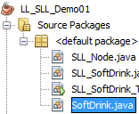
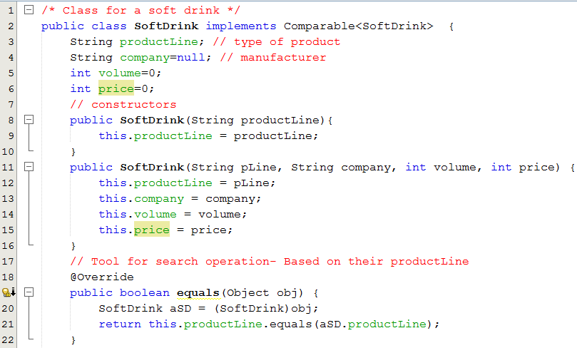
Demo 1: Singly Linked List

Slide 28
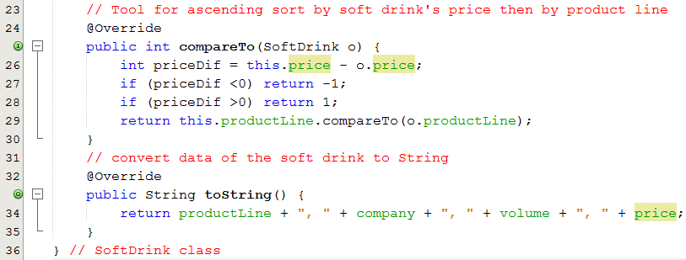
Demo 1: Singly Linked List

Slide 29
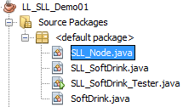
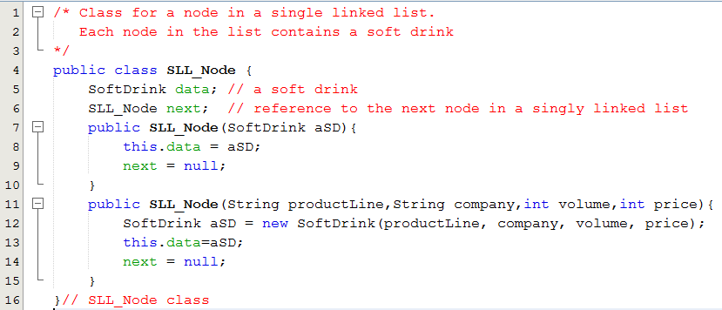
Demo 1: Singly Linked List

Slide 30
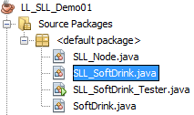
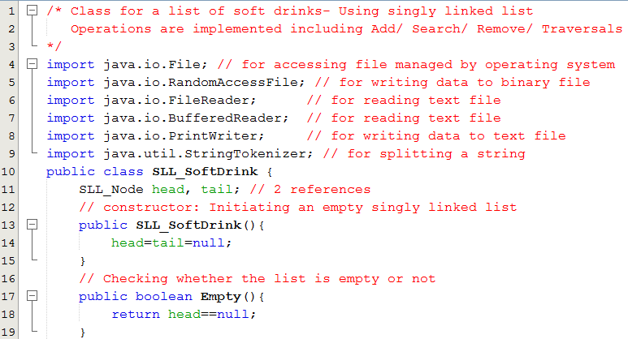
Demo 1: Singly Linked List

Slide 31
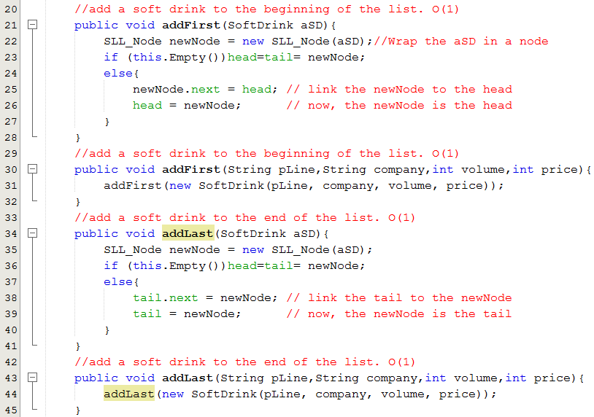
Demo 1: Singly Linked List

Slide 32
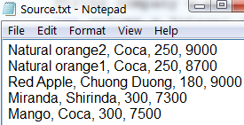
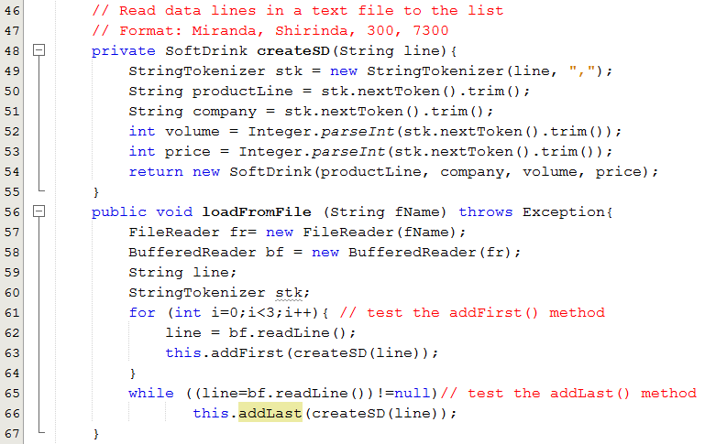
Demo 1: Singly Linked List

Slide 33
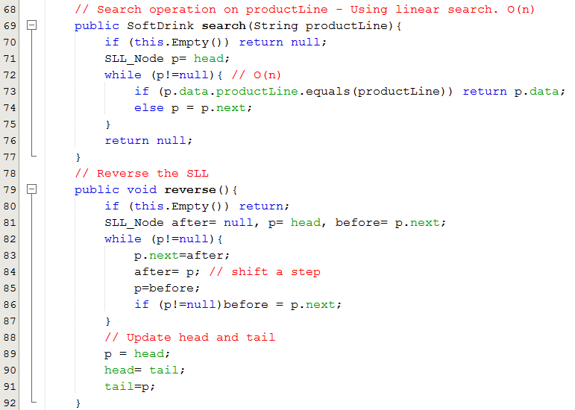
Demo 1: Singly Linked List

Slide 34
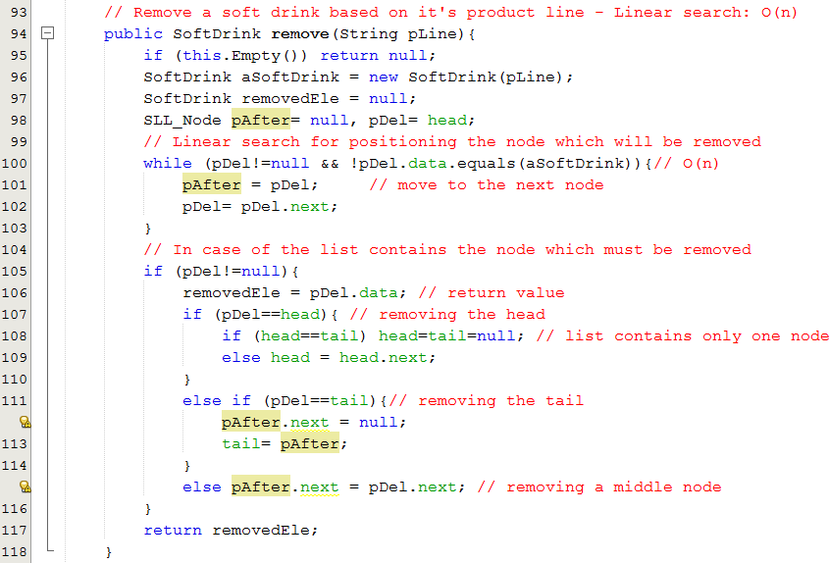
Demo 1: Singly Linked List

Slide 35
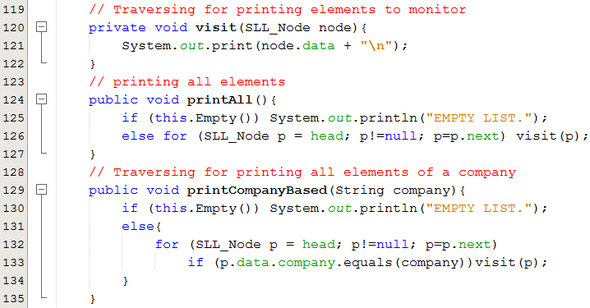
Demo 1: Singly Linked List

Slide 36
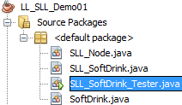
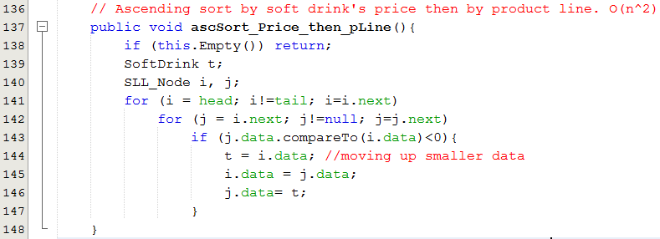
Demo 1: Singly Linked List

Slide 37
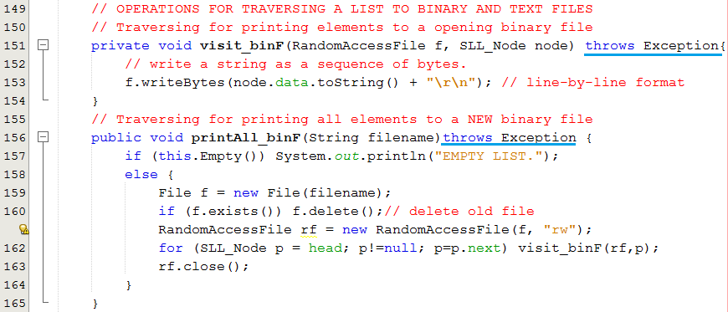
Demo 1: Singly Linked List
The method writeBytes(String) of the RandomAccessFile class DO NOT AUTOMATICALLY ADD the code of character NEW LINE.
Content of the file are character codes.

Slide 38
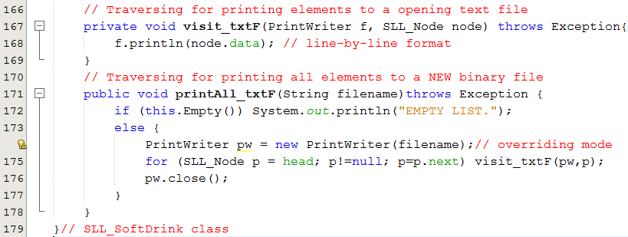
Demo 1: Singly Linked List
The method println(…) of the PrintWriter class will automatically add the code of the NEWLINE character to the end of parameter.

Slide 39
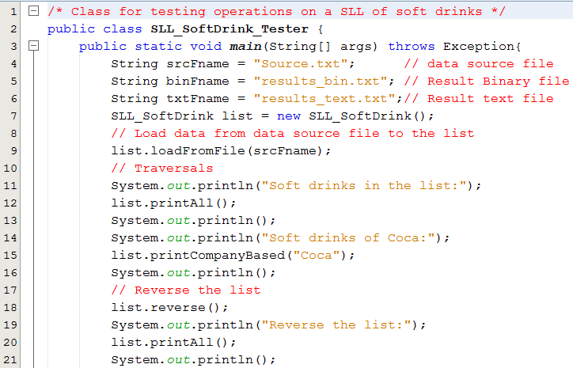
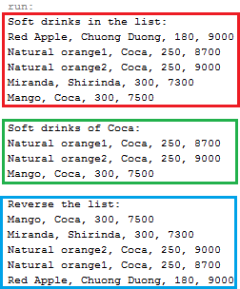
Demo 1: Singly Linked List
Testing

Slide 40
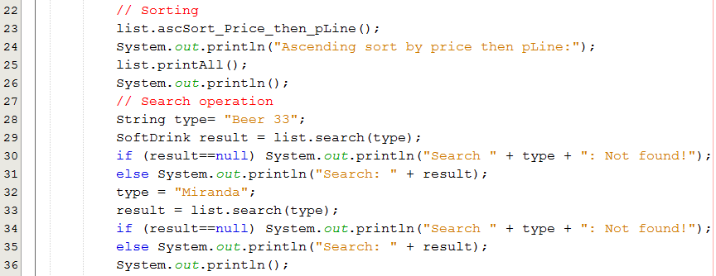
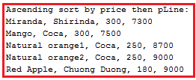

Demo 1: Singly Linked List
Testing

Slide 41
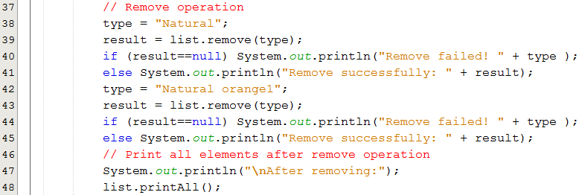
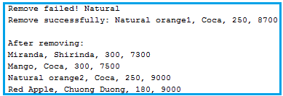
Demo 1: Singly Linked List
Testing

Slide 42
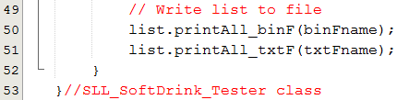
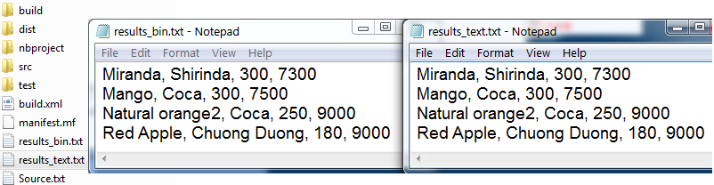
Demo 1: Singly Linked List
Testing
We can read data in the file results.txt because data in this file are codes of characters.

Slide 43
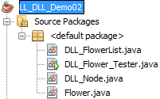
Demo 2: Doubly Linked List
A list of flowers managed using a Doubly Linked List.
Flower: Class for a flower
DLL_Node: Class for a node in a DLL.
DLL_FlowerList: Class for a DLL of flowers.
Class for testing: DLL_Flower_Tester
In a practical exam, methods in the class for a linked list are usually let empty. You must implement them.
In this demonstration, write-to-file operations are not implemented. You can do them by yourself.

Slide 44
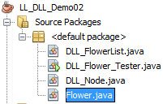
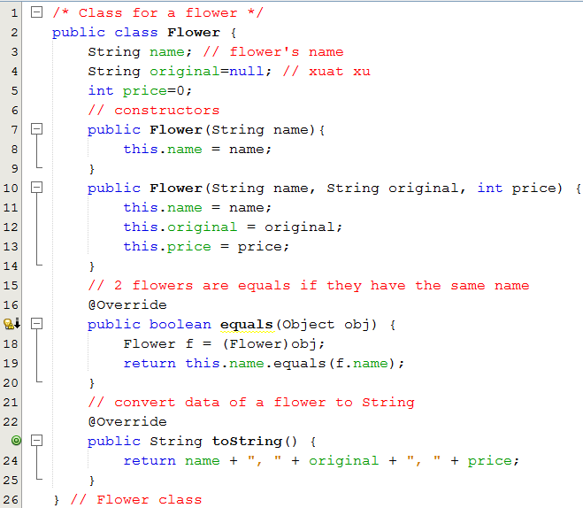
Demo 2: Doubly Linked List

Slide 45
Demo 2: Doubly Linked List

Slide 46
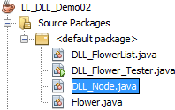
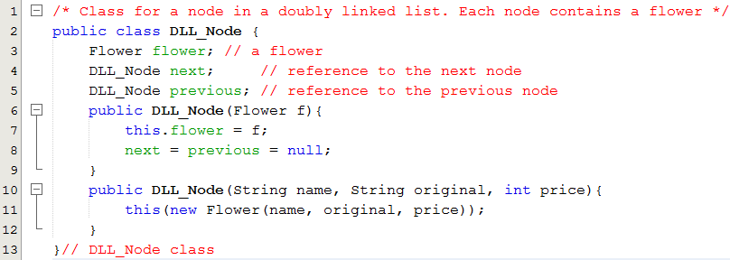
Demo 2: Doubly Linked List

Slide 47

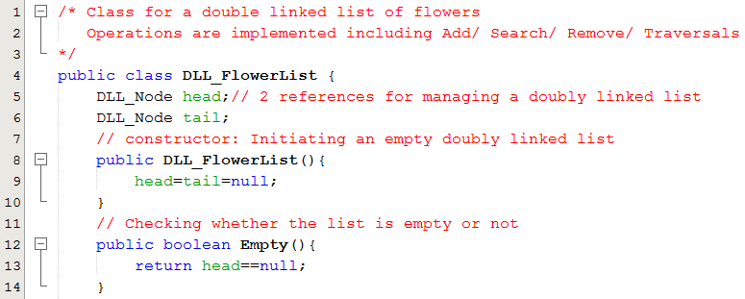
Demo 2: Doubly Linked List

Slide 48
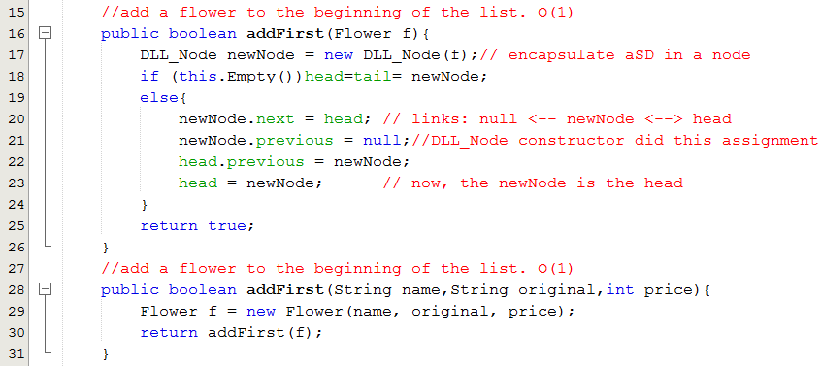
Demo 2: Doubly Linked List
newNode
head
data
data
next
next
previous
previous

Slide 49
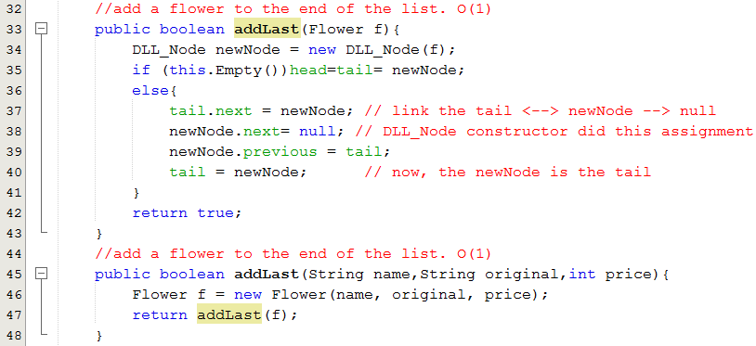
Demo 2: Doubly Linked List
tail
newNode
data
data
next
next
previous
previous

Slide 50
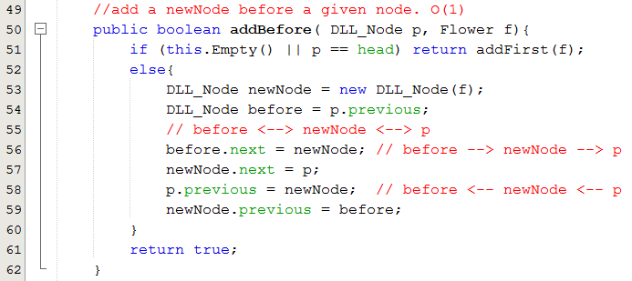
Demo 2: Doubly Linked List
before
p
newNode

Slide 51
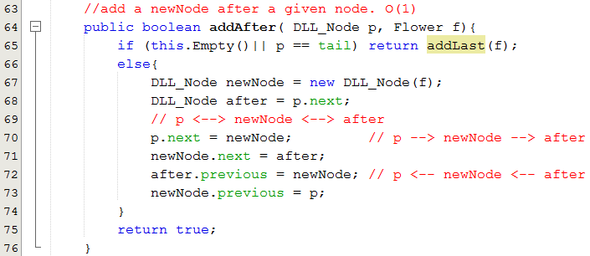
Demo 2: Doubly Linked List
p
after
newNode

Slide 52
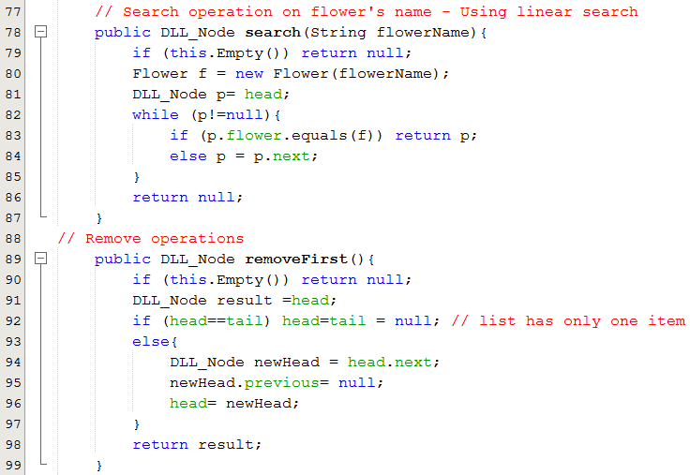
Demo 2: Doubly Linked List
head
newHead

Slide 53
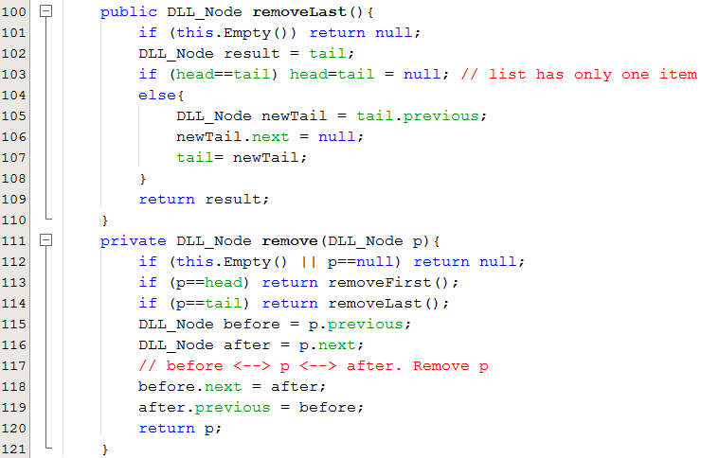
Demo 2: Doubly Linked List
newTail
tail
before
p
after

Slide 54
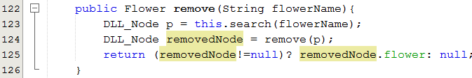
Demo 2: Doubly Linked List

Slide 55
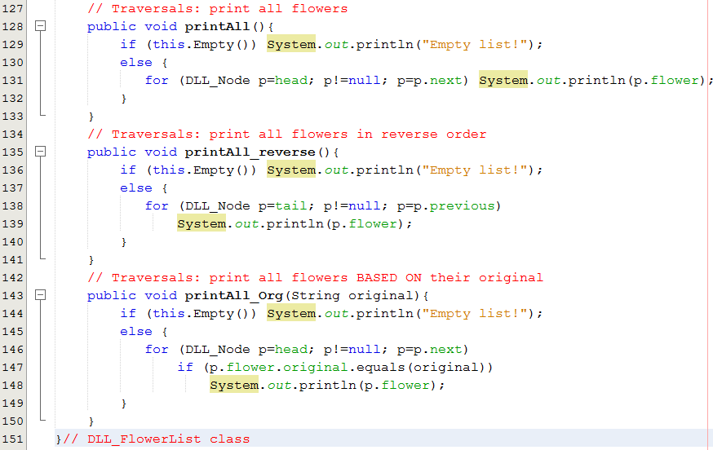
Demo 2: Doubly Linked List

Slide 56
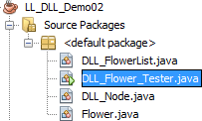
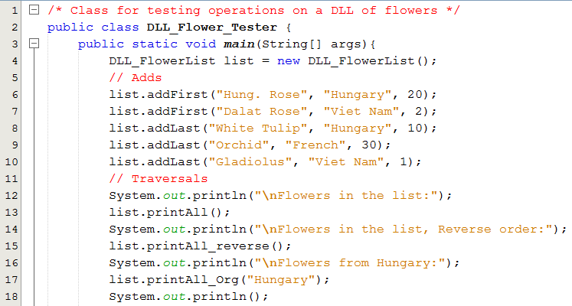
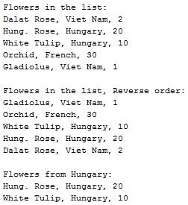
Demo 2: Doubly Linked List
Testing

Slide 57
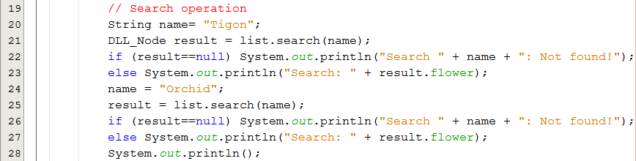

Demo 2: Doubly Linked List
Testing

Slide 58
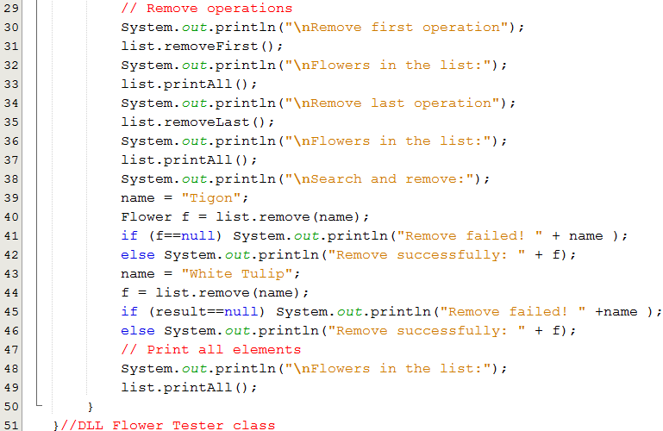
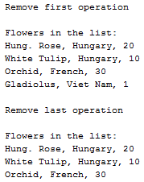


Demo 2: Doubly Linked List
Testing

Slide 59
7- Where a linked list should be used?
(1) From advantages of LLs, a LL should be used when:
Number of items is not known in advance ← Memory can not be allocated in advance.
Add and remove operations are frequently used.
(2) LL is suitable to store a sparse table/ sparse matrix
A sparse table is a large-size 2D array in which number of valuable values is very small
 | 0 | 1 | 2 | 3 | 4 | … | … | 9999
0 | 0 | 0 | 1 | 1 | 0 | 0 | 0 | 0
1 | 1 | 0 | 0 | 0 | 0 | 0 | 1 | 0
2
3
…
9999
1s are valuable but 0s.
Almost of values in the table is 0.
0s need not to be stored.
Linked list is suitable.

Slide 60
Where a linked list should be used?...
Using LLs instead of a sparse matrix:
 | 0 | 1 | 2 | 3 | 4 | … | 9999
0 | 0 | 0 | 1 | 1 | 0 | 0 | 0
1 | 1 | 0 | 0 | 0 | 0 | 0 | 0
2
3
…
9999
head0
Col, val
Col, val
Col, val
Col, val
head1
Col, val
Col, val
Col, val
head2
Val, Col
head3
Col, val
Col, val
headi
Col, val
Col, val
Col, val
headn
Col, val
Col, val
Col, val
Col, val
Sorted lists based on column
N (9999) rows → N lists

Slide 61
8: Managing groups using the java API
In the java.util package, basic classes for a collection:
Dynamic arrays: Initial, 10 elements are allocated, when arrays are full, user program will be paused and memory manager allocates double –size memory → (10 →20, 20 → 40, …). Steps: (1) Allocating new double-size memory block (2) Copy old array to new array (3) De-allocate old array.
structure | Class | Characteristics | When is it used?
Dynamic Array | Vector | Accessing an element using its index. Thread safe is supported All basic operations are implemented. | Data group for single or multi-thread applications
Dynamic Array | ArrayList | Accessing an element using its index. Thread safe (synchronized technique) is NOT supported All basic operations are implemented. | Single -thread application
Double linked list | LinkedList | Thread safe (synchronized technique) is NOT supported. All basic operations are implemented. | Single -thread application

Slide 62
Summary
A linked structure is a collection of nodes storing data and links to other nodes.
A linked list is a data structure composed of nodes, each node holding some information and a reference to another node in the list.
In a singly linked list, each node has a link only to its successor in this sequence.
A list is called as circular list when nodes form a ring.
LL Advantages: Insert, remove operations are performed efficiently.
LL Disadvantages: Search operation is not performed effectively because of sequential scanning.

Slide 63
Summary (continued)
A sparse table refers to a table that is populated sparsely by data and most of its cells are empty.
Linked lists allow easy insertion and deletion of information because such operations have a local impact on the list.
The advantage of arrays over linked lists is that they allow random accessing.
Random access: given address, data at that address will be accessed → very fast.

Slide 64
Summary

LO1.1 Demonstrate the list data structure with basic operations: insert, remove, edit, search, sort,...
LO1.2 Explain two ways of implementing a list: using arrays and using linked lists.
LO1.3 Write programs to implement the singly linked list with basic operations: add (last, first, before, after, at position), search, edit, remove, reverse, sort... )
LO1.4 Understand the doubly linked-list data structure with basic operations.
LO1.5 Write code snippets which manipulate operations on doubly linked list, and use diagrams to illustrate the effect.
LO1.6 Describe the circularly linked-list data structure with some basic operations like add, remove.
LO1.7 Explain why the Java code library provides the ArrayList and LinkedList classes







Slide 65
Ôn tập
Viết vào vở theo mẫu sau:
1- Cấu trúc dữ liệu liên kết là gì?
Là một nhóm phần tử trong đó mỗi phân tử có liên kết với các phần tử khác. Slide tham khảo: 8
2-Tại sao lại cần cấu trúc liên kết?
3- Cấu trúc liên kết tuyến tính là gì?
4- Cấu trúc liên kết phi tuyến là gì?
5- Danh sách liên kết là gì?
6- Danh sách liên kết vòng là gì?
7- Làm sao mô tả một nút trong danh sách liên kết. Cho một thí dụ.
8- Tại sao một DSLK nên được quản lý bằng 2 tham chiếu head và tail?
9- Hãy so sánh độ phức tạp thời gian giữa DSLK và mảng trên các tác vụ thêm/ tìm/ xoá phần tử.
10- Để cải tiến hiệu quả của tác vụ tìm kiếm trên DSLK, DSLK nên được tổ chức như thế nào và hiệu quả ra sao?
11- Khi nào DSLK được khuyên dùng?

Slide 66
Ôn tập
12- Bảng thưa là gì? Mô tả bảng thưa như thế nào để tiết kiệm bộ nhớ.
13- Lớp java.util.LinkedList thuộc loại DSLK nào? Có hỗ trợ kỹ thuật an toàn về luồng hay không?
Given a linked list of positive integers and it is managed using head and tail references: 5 __ 7 __ 1 __ 6 __ 9 __ 2 __ 4 __ 10 __ 8 __ 3
14- If following codes perform, the value in S is ___
S=10;
for (t=head; t.nexr!=null; t=t.next)
if (t.data%2!=0) S += t.data;
15- If following codes perform, the value in S is ___
S=0;
t = tail;
while (t!=null) {
if ((t.data & (t.data-1))==0) S += t.data;
t = t.previous;
}

